Slide 1

Sleep and anaesthesia (1)
Dr Anna Zecharia
Biophysics Section
Imperial College London
anna.zecharia@imperial.ac.uk

Slide 2
Overview
Lecture 1 – An introduction to sleep
    Sleep neurobiology
Lecture 2 – What is the evidence that general anaesthetics can interact with natural sleep pathways?
    Focus on hypothalamic pathways

Slide 3


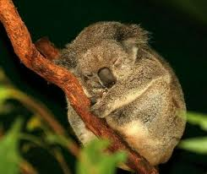
What is sleep?
Natural, reversible state of ‘behavioural quiescence’
Species-specific stereotypic posture
Reduced responsiveness to sensory stimuli
Rebound after deprivation

Slide 4
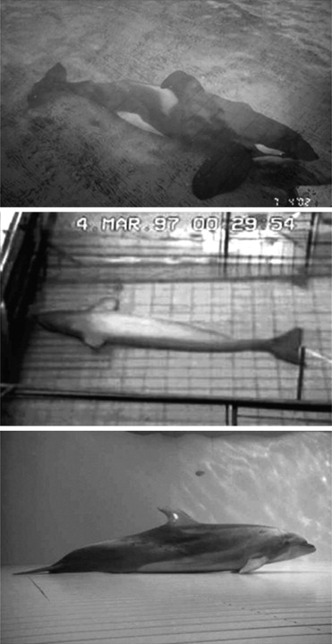
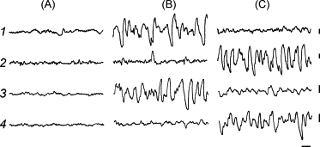
What is sleep?
Cetacean sleep:
Unihemispheric slow waves
Contralateral eye open
Lyamin et al 2008 “Cetacean sleep: an unusual form of mammalian sleep

Slide 5
Function?
Plasticity?
  Learning
  Development
  Synaptic ‘downscaling’ after wake-induced increase
Neuronal protection?
  Unfolded protein response?
May have species-specific functions e.g. maintenance of breathing in cetaceans.
Vassali & Dijk 2009, Eur J Neurosci.29(9):1830-41

Slide 6
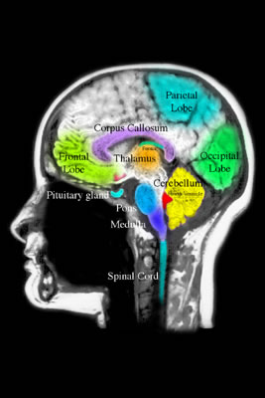
The electroencephalogram (EEG)
What changes in the brain during sleep?
The EEG represents cortical activity

Slide 7
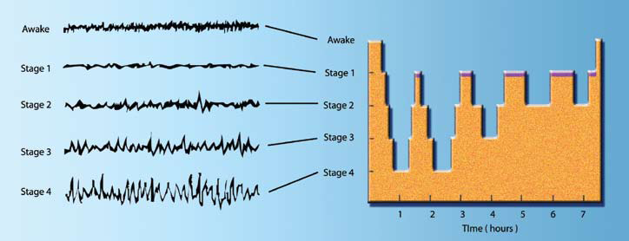
What changes in the brain during sleep?
4 stages of non-rapid eye movement (NREM) sleep
Followed by a period of rapid eye-movement (REM) sleep
Architecture alters throughout the night

Slide 8
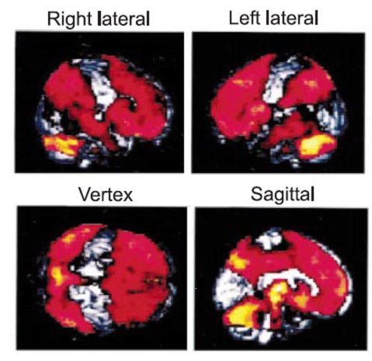
1. Cerebral blood flow is reduced in NREM sleep
PET H₂¹⁵O
Global reduction in deep sleep CBF ~10%
Primary cortices spared
(deep SWS v wake, Kajimura et al 1999)
Absolute rCBF
Notes:
Kajimura et al, 1999 J Neurosci 19(22):10065-10073

Slide 9
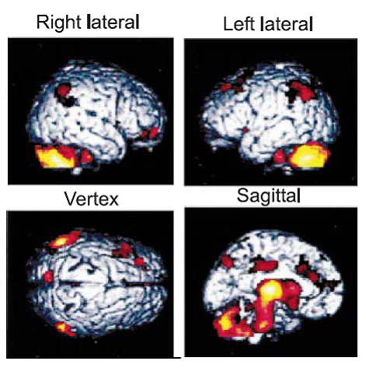
2. Some areas are affected more than others
Relative decreases in CBF:
  Pons
  Midbrain
  Cerebellum
  Thalamus
  Cortical association areas
(deep SWS v wake, Kajimura et al 1999)
Relative rCBF – normalised for global flow

Slide 10
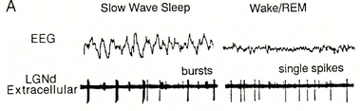
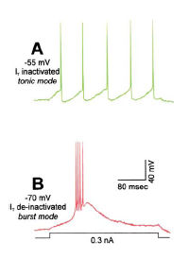
3. Thalamocortical relay neurons change their firing mode
(McCormick & Bal, 1997)
NREM (SWS) – burst firing
Wake/REM – tonic firing
(Sherman & Guillery, 2002)

Slide 11
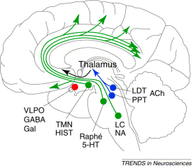
4. The brain contains ‘wake-active’ neurons
The sleep switch: hypothalamic control of sleep and wakefulness
(Saper et al, 2001)

Slide 12
What is sleep?
Natural, reversible state of ‘behavioural quiescence’
Species-specific stereotypic posture
Reduced responsiveness to sensory stimuli
Rebound after deprivation

Slide 13
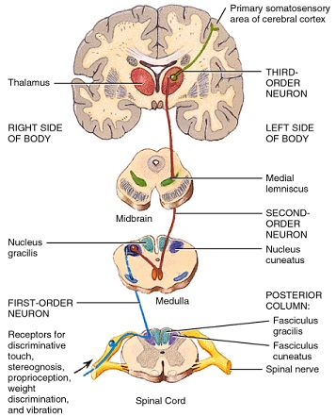
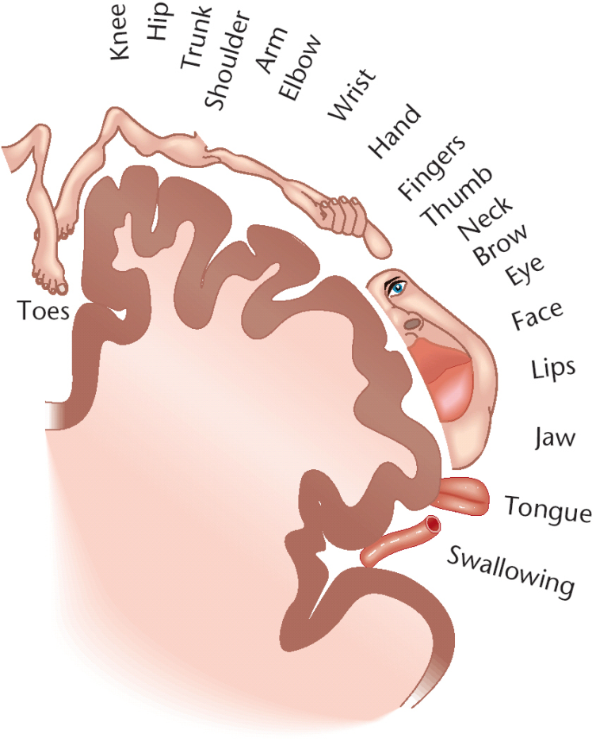
Sensory processing

Slide 14
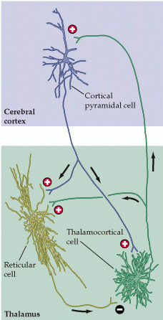
The thalamocortical system
During wakefulness:
  ‘the gateway to the cortex’
During NREM sleep:
  Sensory information becomes distorted

Slide 15
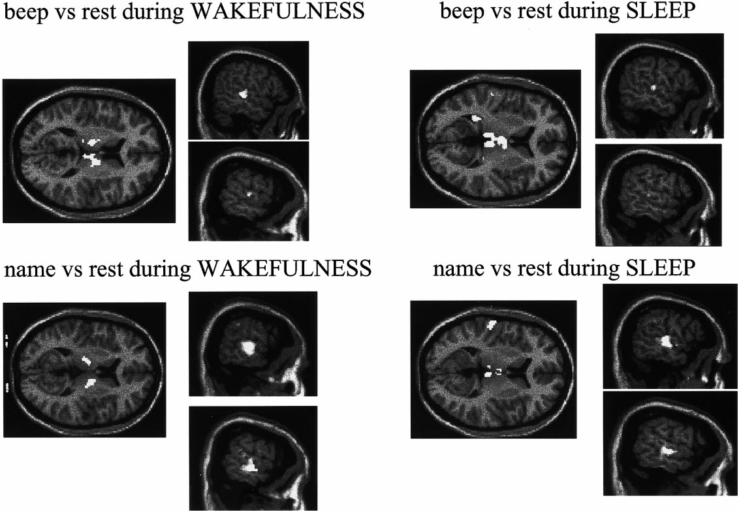
Sensory processing during sleep
Portas et al 2000, Neuron, Vol. 28, 991–999

Slide 16
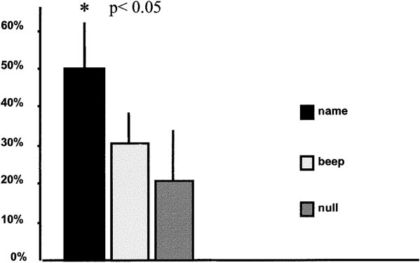
Sensory processing during sleep
% awakenings related to stimulus (beep/name)
Portas et al 2000, Neuron, Vol. 28, 991–999

Slide 17
The thalamocortical system
During wakefulness:
  ‘the gateway to the cortex’
During NREM sleep:
  Sensory information becomes distorted
Due to the firing properties of thalamocortical neurons

Slide 18
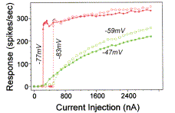
Bursting closes the gateway
Tonic
  Linear spike response to increasing current injections
  Faithful representation of sensory information
Bursting
  Non-linear response
  Distorted information flow
(Sherman & Guillery, 2002)

Slide 19
The brain contains ‘wake-active’ neurons
The sleep switch: hypothalamic control of sleep and wakefulness
(Saper et al, 2001)

Slide 20
Acetylcholine, noradrenaline, histamine and glutamate:
  Can switch TC firing mode from burst to tonic
  Due to a direct depolarising effect on TC cells:
(McCormick, 1992)
These neurotransmitters are released in a state-dependent fashion
i.e. during wakefulness

Slide 21
Neurobiology of sleep – what controls the thalamocortical switch?
The sleep switch: hypothalamic control of sleep and wakefulness
(Saper et al, 2001)

Slide 22
Sleep is an active state
Morruzi & Magoun (1949)
Focal lesions - ‘ascending reticular activating system’ (ARAS)
Morruzi & Magoun (1959)
  Focal barbiturate application to the caudal brainstem induced wakefulness
  The nucleus of the tractus solitarus (NTS) was identified as a brainstem ‘hypnogenic centre’
Sterman & Clemente (1962)
  Electrical stimulation of the anterior hypothalamus (preoptic) induced sleep
Frederic Bremer (1937)

Slide 23
The preoptic hypothalamus
Constantin von Economo (1923)
  Persistent insomnia:
  Their brains showed cell loss in the preoptic anterior hypothalamus/basal forebrain
  He concluded this was a hypnogenic region
  Encephalitis lethargica: excessive sleep
  Massive cell loss in the posterior hypothalamus and ARAS

Slide 24
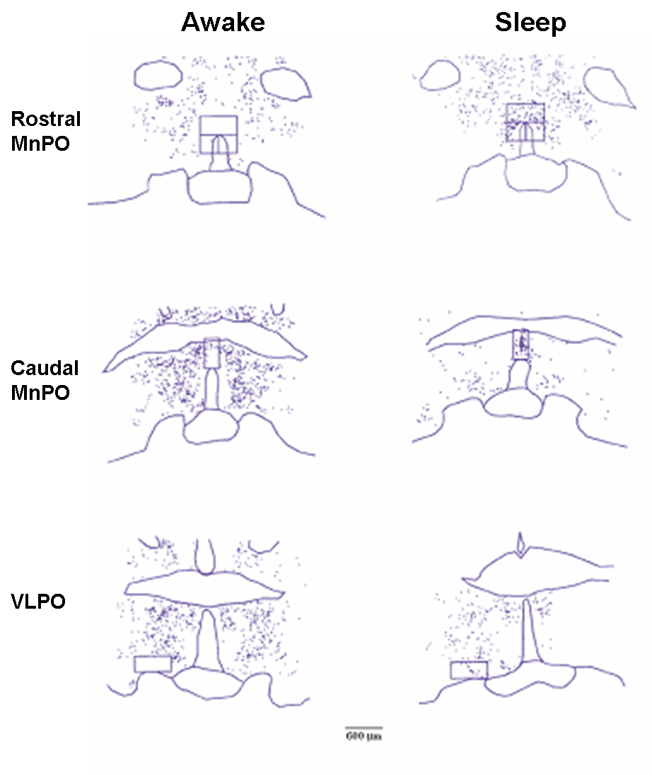
The preoptic hypothalamus – sleep active region
c-fos – immediate early gene that is induced within a few minutes of neuronal activation
The protein c-Fos can be measured for up to half an hour later
(Sherin et al, 1996; McGinty & Szymusiak, 2001)

Slide 25
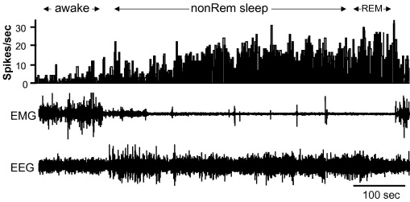
This c-Fos expression correlates with neuronal firing
Extracellular VLPO neuron recording
Shows sleep-related activity
Firing progressively increases from light to deep NREM sleep
(Szymusiak et al, 2007 Review)

Slide 26
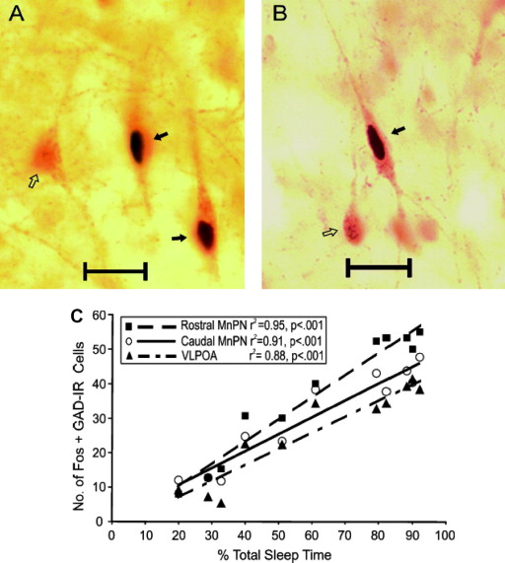
VLPO/MnPN neurons are GABAergic
GABA – major inhibitory neurotransmitter
GABA_{A} (ion channel)
GABA_{B} (G protein)
(Szymusiak et al, 2007 Review)

Slide 27
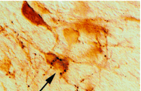
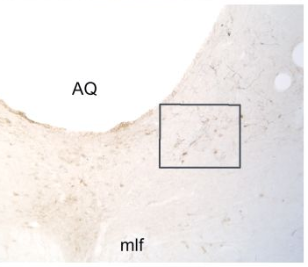
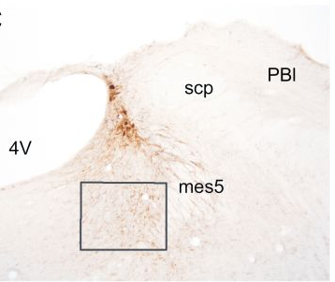
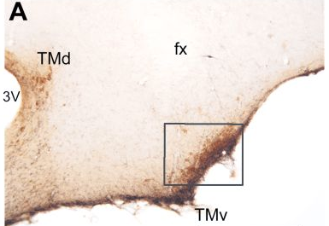
GABAergic sleep-active neurons project to arousal centres
Wake-active:
  A –TMN (histamine)
  B – LC (noradrenaline)
  C – DRN (5-HT)
(TMN; Sherin et al, 1996)
B
C
(Steininger et al, 2001)

Slide 28
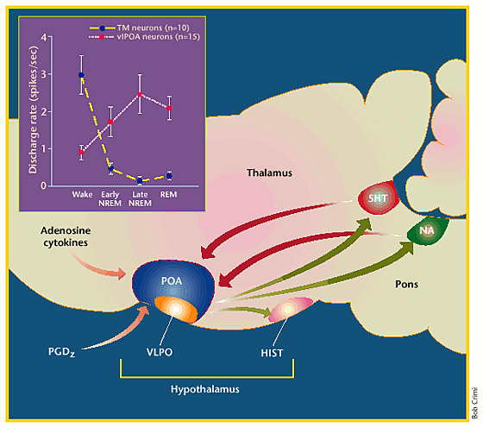
VLPO & arousal centres: reciprocal activity
VLPO begins firing just prior to sleep onset
GABAergic inhibition of the TMN by VLPO
Quietens the wake-related firing activity of TMN
VLPO firing increases as sleep deepens
(McGinty & Szymusiak, 2001 Review)

Slide 29
Sleep-wake model
Hypothesis: Sleep is CAUSED by the GABAergic inhibition of the brain’s arousal centres
Lecture 2: Is there any evidence that anaesthetics act on sleep pathways?

Slide 30
Sleep disorders
Narcolepsy
1 person in 2000 has narcolepsy with cataplexy
    Excessive daytime sleepiness
    Brief and sudden loss of muscle tone, triggered by emotion
    Sleep paralysis, hypnagogic hallucinations, insomnia
    Do not sleep more than normal – sleep is disordered & fragmented
    Tightly associated with hypocretin (orexin) deficiency
        - but not at a genetic level (in humans)
        - linked to HLA-DQB1, TNF-α, COMT
        autoimmune disease?

Slide 31
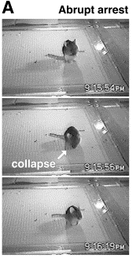
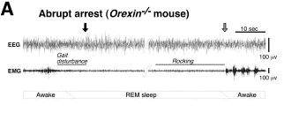
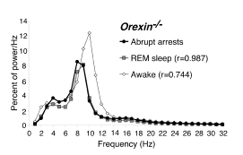
Orexin^{-/-} mouse: model of narcolepsy
B
(Willie et al, 2003)

Slide 32
Therapy for narcolepsy
Good sleep hygiene
Modafinil (sleepiness)
Antidepressants (cataplexy)
Sodium oxybate (GHB, GABA_{B})
New approaches – H₃ antagonists, orexin gene therapy

Slide 33
Sleep disorders......
Sleep apnea
Restless legs syndrome
Confusional arousals
Sleep terrors
Sleepwalking
REM Sleep Behaviour Disorder
Nocturnal Seizures
Sleep-related expiratory groaning

Slide 34
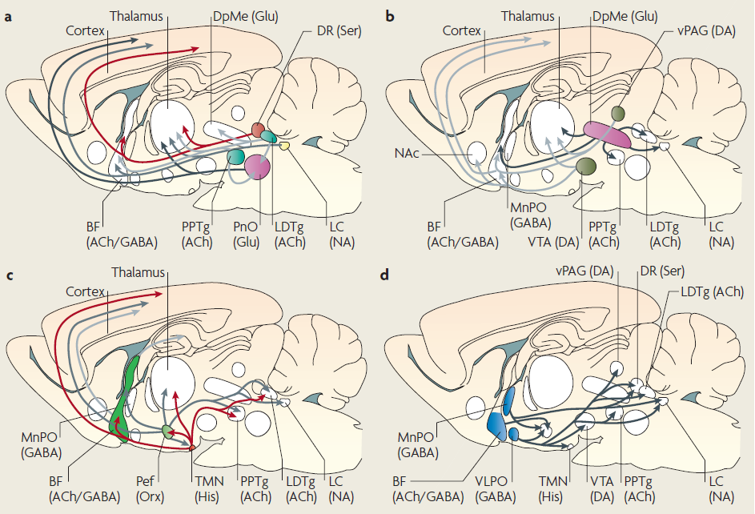
Neural pathways of sleep and arousal
(Franks, 2008)

Slide 35
Sleep-wake model
Where could general anaesthetics act?

