Slide 1
Sepsis: Cellular and humoral mechanisms
Kieran O’Dea PhD
Critical Care Research Group
Anaesthetics, Pain Medicine and Intensive Care

Slide 2
Areas covered
Microbial recognition and propagation of the inflammatory response
Inflammatory response targeted approaches in sepsis
New concepts and targets
Notes:
In which I will focus on the best understood pathway, known as the lipopolysaccahride-toll recptot 4 pathway
I will describe the clinical outcome of barious trails, and the current successes and failure and the reasons
And finally I will decribe new concepts of sepsis pathogenesis and how these may help identify new targets for therapy

Slide 3
Inflammatory homeostasis during sepsis
Early
multi-organ dysfuntion
shock
Cytokine
storm
Late
multi-organ dysfuntion
shock
Pro-inflammatory
SIRS
Systemic inflammation
Local
Infection
(Lungs
Abdomen
Urinary)
Systemic
spill-over
Anti-inflammatory
Compensatory Anti-inflammatory Response Syndrome
(CARS)
Sub-clinical
Clinical
Notes:
Sytemic inflammatory reponse is central to the pathophyiolofy of sepsis
Based on Bone RC. Crit Care Med. 1996 Jan;24(1):163-72.
1.This schematic shows the a time course of the intensity of the inflammatory reponse during sepsis
2. Bacterial sepsis is usually preceded by a local infection or injury in which there is there is a release of proinflammatory mediators in the local microenvironment. If the initial insult is severe there will be spill over of inflammatory mediators into the systemic circulation. Normal response: recruits cells to site of infection and primes to the host to potential. Anti-inflammatory mediators may then bring both the local and systemic response under control
3. If the local infection is not controlled then a bacteraemia may develop. The intensity of this may or may not be appropriate to the level of infection. Eirher way, if the compensatory anti-inflammatory response is inadequate then perstitnant or overwhelming inflammation leads to shock and MODS and death.

Slide 4
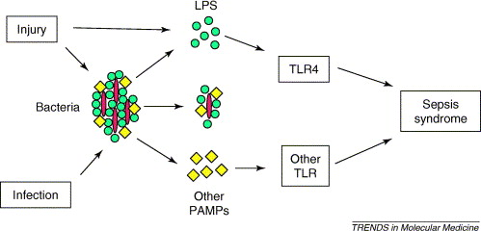
Sepsis and SIRS: the classic viewpoint based on the Toll receptor pathway (2005)
Infection
Recognition
Response
Brunn GJ and Platt JL. 2005. Trends in Molecular Medicine. 12 (1): 10-16
Notes:
Figure 1. The canonical model of sepsis. This model emerged following research spanningO150 years. Injury or infection of tissues leads to entry of microorganisms such as
bacteria. Microorganisms subsequently introduce poisons consisting of LPS or other PAMPs, which act on TLR. In some cases, injury introduces bacterial poisons without
infection, causing sepsis syndrome or SIRS. TLR deliver cellular signals that ultimately lead to fever, tachycardia, shock and death, which characterize the sepsis syndrome.

Slide 5
The path to discovering Toll receptors in sepsis
1823: Sepsis (=‘putrefaction’) syndrome produced by injection of extracts of purulent material
1863: Microbes were responsible putrefaction
1892: The term ‘endotoxin’ described activity associated with pathogen
1947: Lipopolysaccharide (LPS ) chemical structure
1974: A single gene (Lps) responsible for endotoxin resistance in mutant C3H/HeJ mice
1976: Mediation of LPS effects by macrophages
1985: Tumour necrosis factor (TNF-α) can reproduce the sepsis syndrome
1990: LPS binding protein (plasma) and CD14 (cell membrane)
1998: Lps gene = Toll-like receptor 4
2011: The Nobel Prize for Medicine/Physiology
Bruce A. Beutler and Jules A. Hoffmann ”for their discoveries concerning the activation of innate immunity”

Slide 6
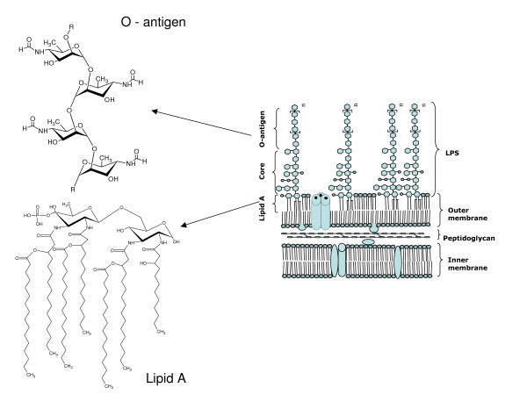
Lipopolysaccharide (LPS) structure-activity
Essential structural glycolipid present on surface of Gram-ve bacteria.
O-antigen polysaccharide: structurally and antigenically diverse region which
determines the bacterial serotype.
Lipid A: Highly conserved anchoring region responsible for the biological activity of LPS.
Bacterial wall
Notes:
The crucialr ole of Gram-negative bacterial lipopolysaccharides
(LPS) in the pathogenesis of infectious disease
has been suggested by numerous studies. In particular,
injection of LPS into laboratory animals has been shown
to produce a myriad of pathophysiologic effects which
closely resemble the clinical symptoms characteristic of
Gram-negative bacteremia and sepsis. These have included
fever, hypotension, blood-clotting disorders, complement
activation, and lethatlo xicity (1).a nd collectively
define the endotoxic properties of LPS.
LPS has been demonstrated to interact with a variety
of serum components, particularly the serum complement
system (7). The lipid A region of LPS has been
shown to interact directly with C1, thus providing an
antibody-independent mechanism for LPS-mediated activation
of the classical pathway of complement (8). In
addition, however, the polysaccharide portion of the LPS
macromolecule has been shown to mediate the activation
of the alternative pathway of complement (9). These interactions
can lead to the production of the spectrum of
potent inflammatory mediators of the complement system
(10 ).

Slide 7
LPS-binding protein (LBP) and CD14 are required for
efficient transfer and binding of LPS to cells.
Monocyte
[LPS]_{n} + LBP
LPS:CD14
Toll-like receptor 4
signalling
+_{s}CD14
LPS:LBP
LPS:sCD14
Endothelial cell
HDL
LPS-HDL

Slide 8
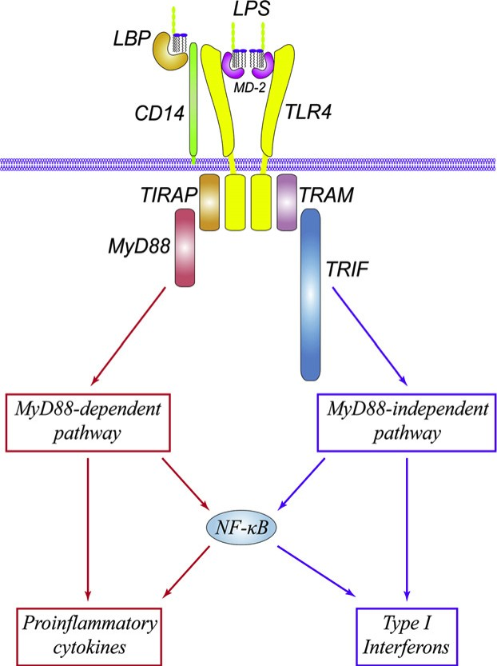
LPS mediated activation of gene transcription by TLR4 signalling
CD14 facilitates transfer of LPS to the TLR4/MD-2
MD-2: myeloid differentiation protein complex
TLR4 recruits adaptor proteins to Toll-interleukin 1 receptor (TIR) domain
MyD88: myeloid differentiation primary response gene
TIRAP: TIR adaptor protein
TRIF: TIR domain-containing adaptor inducing IFN-β
TRAM: TRIF-related adaptor molecule
The MyD88 signalling pathway activates NFkB and pro-inflammatory gene expression
The MyD88-independent pathway mediates induction of Type I interferon (α, β) genes
TIR
(Lu et al. Cytokine 2008;42;145)
Notes:
The TLR4 signaling pathway is highly regulated. (A) Following LPS binding, TLR4 signals through two main adaptor molecules, MyD88 and TRIF. In the MyD88 dependent pathway, IRAK1 and IRAK4 are phosphorylated, then dissociate from the complex and activate TRAF6. TRAF6 activates the MAP kinases ERK, JNK, and p38, as well as the IKK complex. IKK phosphorylates IκBα, leading to its degradation, releasing NFκB to enter the nucleus and activate gene transcription. In the TRIF dependent pathway, TBK-1 phosphorylates IRF3, which then dimerizes and enters the nucleus to transcribe Type 1 IFN-inducible genes. TRIF signaling also leads to a delayed NFκB response. AP-1 activator protein 1

Slide 9
The Toll-Like Receptor family
The Toll-Like-Receptor family has principle role in innate recognition
13 TLR indentified in mammals.
Single TLR types recognise different molecules
All pathogens: Bacteria, viruses, fungi, protozoan and helminth parasites.
TLR
dimer
Ligand
Recognition domain:
Leucine-rich repeats
+
Toll/IL-1R homology
(TIR) domain
Activation signal
Conformational
changes

Slide 10
Innate immune system recognises conserved molecules
Pathogen-Associated Molecular Patterns (PAMP)
Membrane:
Lipopolysaccharide
Peptidoglycan
Lipoteichoic acid
Lipopeptides
Nucleus
Bacterial/viral
DNA/dsRNA
Pattern-Recognition Receptors (PRR)
TLR Toll-Like Receptors (TLR)
NLR Nucleotide oligomerisation domain (NOD)-Like Receptors
RLR Retinoic acid inducible gene 1 (RIG-1)-Like Receptor
Notes:
Pathogen-Associated
Molecular Patterns (PAMP):
Conserved cellular and molecular structures performing essential function
Pattern recognition receptors (PRR):
Germ-line encoded soluble and cellular receptors responsible for innate sensing
and killing of invading microorganisms

Slide 11
Recognition of microbes takes place in different
cellular compartments
Soluble/complexed
PAMPS
Opsonisation
(complement/antibody)
Microbial/viral invasion
Cell membrane
Receptors
TLR
Endosomal
Receptors
TLR
Cytosolic receptors
NLR
RLR
Activation of signalling cascades by common or different pathways
Notes:
NOD-LRR:

Slide 12
Multiple, cooperative recognition systems
Lipoteichoic acid
Lipopeptides
LPS
Microbial membrane
sensors
TLR 2/1
TLR 2/6
Membrane
TLR4
Cytosol
Endosome
Flagellin
Flagellin
sensors
TLR
3,7,8,9
IκB
TLR5
NLR
p50
p65
NF-κB
AP1
Pro-IL-1,
IL-18
Nucleic acid
sensors
Caspase 1
(ICE)
Cytokine etc
IL-1
IL-18

Slide 13
NF-κB activation triggers a coordinated inflammatory response
Response amplification/transmission:
Tumour necrosis factor
Interleukin-1β
IL-6, IL-12
Activation of endothelium, permeability,
vascular tone:
Inducible nitric oxide synthase
Inducible cyclooxygenase-2
5-Lipoxygenase
Cytosolic phospholipase A2
Increased leukocyte production
GM-CSF
M-CSF
G-CSF
Coagulation:
Tissue factor
Leukocyte mobilisation and activation
IL-8
MIP-α,
MCP-1, MCP-3
Anti-inflammatory mediators:
IL-10, IL-11, IL-4, TGF-b
Soluble cytokine antagonists: soluble TNF receptors, IL-1 receptor antagonist
Leukocyte recruitment and activation:
ICAM-1
VCAM-1
E-selectin
Notes:
Phospholipase A2 activation results in release from from PC and PE
COX-1 constitutive: normal homeostatic processes in kidneys and gut
COX-2 inducible: LPS, Il-1, growth factors
Both inhibited by aspirin, indomethacin and other NSAID
Products of arachidonic meatablosim: eicosanoids i.e. prpstaglandins, TXs;
And leukotrienes
TXB2, 6-keo PGF1a, PGE2, PGF2a increased in sepsis
Products of the genes that are regulated by NF- B also cause the activation of NF- B. The proinflammatory cytokines interleukin-1 and TNF- both activate and are activated by NF- B. This type of positive regulatory loop may amplify and perpetuate local inflammatory responses
Coordinated release of factors require
Amplification of the intial stimulus
Co
CAM reponse: can this be explian, no, but suffice to say things happen at different times which presumably has puropes

Slide 14
A sequential model of sepsis pathogenesis provides many targets
Infection
Live micro-organism
Antibiotics
PAMPS
Antibodies, antagonists
Host sensing apparatus
(PRR)
Antagonists
Signal transduction
Pharmacological inhibitors
Antibodies,
Soluble receptors
Pro-inflammatory mediators
Anti-coagulants
leukocyte adhesion blocking
Pro-inflammatory processes
Pathology

Slide 15
Edwin Deitch: Multiple Organ Failure: Pathophysiology and Potential Future Therapy. 1992. Ann. Surg. 216 (2) 117-134
‘.. the 1990s will see the transition of molecular biology from the laboratory to the clinic…
…it is almost certain that molecular biologic therapies will become part of the therapeutic armamentarium of most practising surgeons’

Slide 16
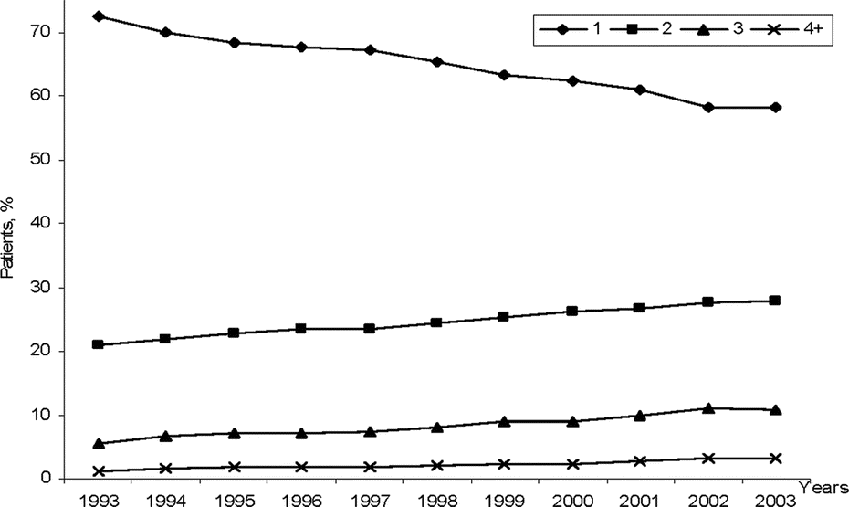
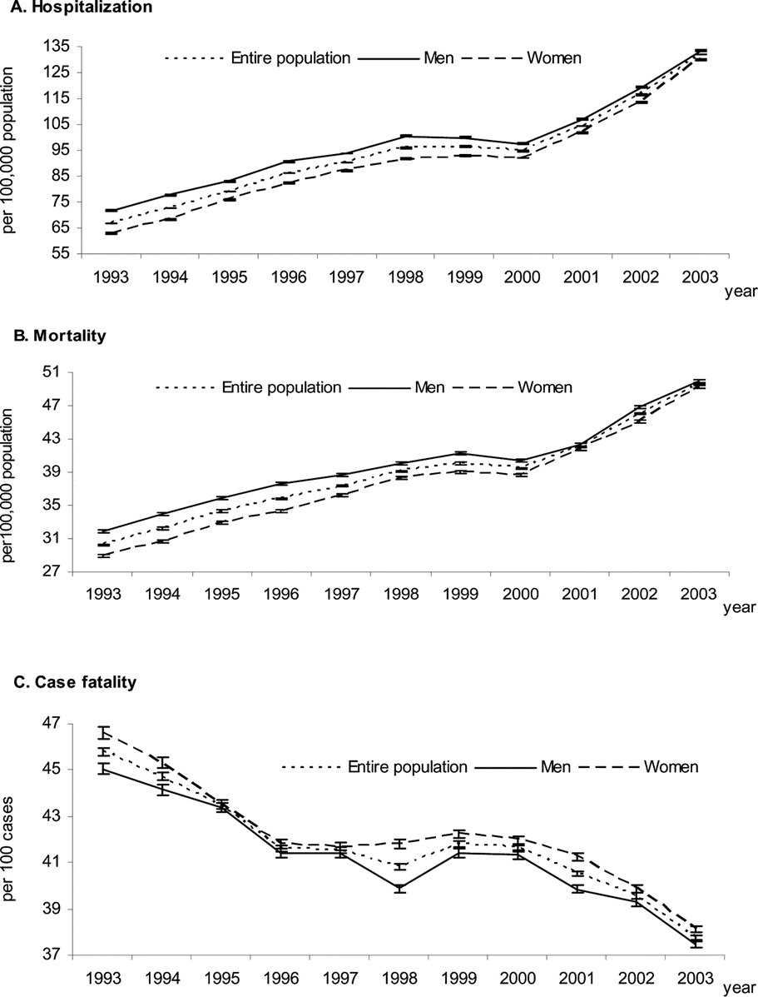
Rapid increase in hospitalization and mortality rates for
severe sepsis in the United States
Hospitalization
1 organ
Patients
2 organs
Mortality
3 organs
4 organs
Dombrovskiy et al. Critical Care Medicine 2007, 35; 1244-1250

Slide 17
Clinical trials: anti-inflammatory therapies “Graveyard” for pharmaceutical companies
Anti-endotoxin therapy
Anti-endotoxin monoclonal Ab | No significant effect on mortality
rBPI (bactericidal/permeability increasing protein) TLR4 | No significant effect on mortality Eritoran: no significant effect on mortality (2011)
Anti-cytokine therapy
Anti-TNF monoclonal Ab | No significant effect on mortality
TNF receptor p75 fusion protein | No effect, possible increase in mortality at high dose
TNF receptor p55 fusion protein | No significant effect on mortality
IL-1 receptor antagonist | No significant effect on mortality
Other anti-inflammatory agents
PAF antagonist | No significant effect on mortality
NOS inhibition (L-NAME) | Increased mortality, study discontinued

Slide 18
Anti-coagulation therapy
Anti-thrombin III | No significant effect on mortality Increased risk of haemorrhage when administered with heparin
TFPI (tissue factor pathway inhibitor) | No significant effect on mortality
Activated Protein C | Significant effect on mortality (19% decrease)
Activated protein C inactivates clotting factors Va and VIIA
+ potent anti-inflammatory activity (↓monocyte TNF,IL-6,IL-8)
2001: First trial showed better effect in high-risk patients
2005: No benefit in low-risk adults. Trial stopped. Enhanced bleeding
2007: No benefit in children. Trial stopped. Enhanced CNS bleeding
2011: Mortality rate of 26.4% (223/846) in treated patients
compared to 24.2% (202/834) in placebo-treated patients.
Withdrawn completely in USA 25th October 2011

Slide 19
Why has translation from the lab to the clinics failed?
Animal models:
Too simple (LPS/bacterial injection). Caecal Ligation and Puncture induced peritonitis is now the preferred model
Inflammation vs immunity:
Blocking components of innate response exacerbates infection by reducing immunity
Targeting the wrong pathogen:
Gram-positive>Gram-negative>fungal infections
Timing:
Too late to target pro-inflammatory cascade (e.g. TNF) when clinical symptoms develop
Complexity:
No single mediator, overlap in pathways…no magic bullet!

Slide 20
Is severe sepsis triggered by PAMPs?
Trauma- and sepsis-associated SIRS are clinically indistinct
Plasma endotoxin levels are usually low and do not predict severity or outcome
Anti-endotoxin treatment of patients unsuccessful
Gram-positive bacterial products (peptidoglycan, lipoteichoic acid) induce experimental sepsis only at very high concentrations

Slide 21
Emerging paradigm: Toll-like receptor 4: sentinel for detection of tissue damage. Mollen et al. 2006. Shock: 26 (5); 430-437
Endogenous agonist of TLR | Receptor | Location
Heparan sulfate | TLR4 | Extracellular matrix, cell surfaces
Hyaluronic acid | TLR4 | Extracellular matrix, synovium
Fibronectin extra-domain A | TLR4 | Extracellular matrix, serum
HMGB-1 | TLR4 | Cell nucleus
Heat-shock protein 60 | TLR4 | Mitochondria
Heat-shock protein 70 | TLR2 and TLR4 | Cytoplasm
Gp96 | TLR2 and TLR4 | Endoplasmic reticulum
β-Defensin 2 | TLR4 | Epithelial surfaces
Fibrinogen | TLR4 | Serum
Surfactant protein-A | TLR4 | Lung epithelium
Chromatin–IgG complexes | TLR9 | Nucleus and serum
Lauric acid | TLR4 | Serum
Biglycan | TLR2 and TLR4 | Extracellular matrix, macrophages
TLR4 recognition has been implicated
in various sterile acute inflammatory
responses:
Hemorrhagic shock
Ischemia reperfusion
Traumatic tissue injury
Burn
Toxin exposure
Notes:
TLRs and endogenous ligands In Drosophila, fungal infection triggers protease cascades leading to the generation of the Spatzle protein, the endogenous ligand for Toll, from inactive precursors. The biologically active Spatzle then induces ligand-dependent Toll receptor dimerization55. In contrast, mammalian TLRs may recognize microbial components directly. Several studies have shown species-specificity in the response of mammalian cells to different LPS structures and this specificity is determined by the TLR. When the TLR4 from one species is expressed in cells from a different species, the response to lipid A is determined by the introduced TLR, not that of the host cells56, 57. These data suggest that TLR4 functions as the species-specific lipid A receptor. Cross-linking experiments further suggested that LPS is present in close proximity to CD14, TLR4 and MD-258. However, conclusive evidence showing that LPS is directly recognized by TLR4 remains to be published. There is no evidence yet to show that, in vertebrates, endogenous TLR ligands are generated in response to infection by pathogens, in a manner that is analogous to Drosophila Spatzle processing. However, increasing evidence suggests that endogenous ligands can stimulate TLRs and trigger an immune response. Signals from damaged or stressed cells may initiate an immune response even in the absence of infection, the so-called "danger model" of the immune response59. Such signals may be generated when cells undergo pathological cell death (necrosis), which initiates inflammation and immune responses, in contrast to physiological apoptotic cell death, which does not trigger inflammation. Such "stressed" or "damaged" cells could generate signals as a result of changes in the lipid and/or carbohydrate moieties expressed on their surfaces or by the expression of proteins not normally found in the outer cell membrane. Whether TLRs mediate immune responses triggered by tissue damage or tissue stress remains to be determined. One potential stress signal is the increased expression of heat shock proteins (hsps). hsps are highly conserved molecules that participate in protein folding and assembly, as well as in the translocation of proteins between different cellular compartments. hsp synthesis is dramatically increased under stress conditions. Microbial and mammalian hsp60 have potent immunostimulatory properties. Necrotic, but not apoptotic, cells can release hsps. The LPS-hyporesponsive C3H/HeJ strain is resistant to hsp60-induced macrophage activation, which suggests that human hsp60 activates TLR460. During an inflammatory response, production and degradation of various extracellular matrix (ECM) components is increased. The activation of extracellular proteases or the release of intracellular proteases generates lower molecular mass ECM components that are proinflammatory. Oligosaccharides of hyaluronan and heparan sulfate can induce maturation of DCs61, 62 and cellular fibronectin fragments can activate TLR463. The inflammatory responses by other ECM components may also be mediated by TLR family members and thereby play a role in the immune response. In ischemic heart diseases and heart failure, myocardial expression of inflammatory cytokines is increased, seemingly without any evidence of infection. Reactive oxygen species are proposed to be a major pathogenic factor for hypoxic and ischemic damage in the heart. Hydrogen peroxide can trigger NF- B and AP-1 activation through a mechanism that involves TLR264. However, it seems unlikely that hydrogen peroxide directly interacts with TLR2 to form a classical ligand-receptor complex. One possibility may be that cell death or injury could cause the release of one or more factors that interact with and activate TLR2.

Slide 22
Innate response to ‘danger’ signals produced by a infection.
DAMP
Cell
destruction
DAMP
Innate
response
Tissue
damage
Pathogen
Inflammation
PAMP
DAMP= Danger Associated Molecular Pattern

Slide 23
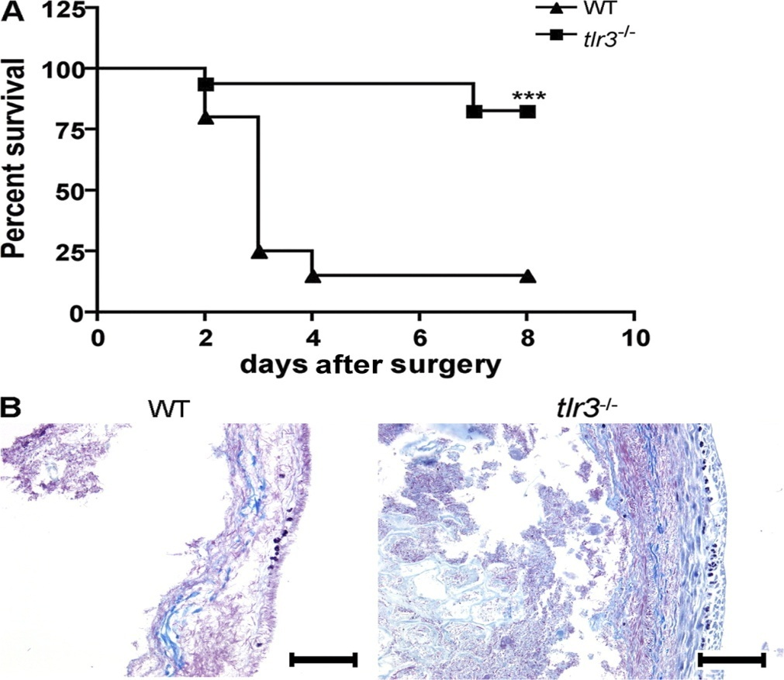
TLR3 exacerbates polymicrobial sepsis pathology by responding to necrotic host cells
The inflammatory response after caecal ligation and puncture was shortened in TLR3 deficient mice
TLR3 recognises viral double stranded RNA but also eukaryotic mRNA
The macrophage pro-inflammatory response to necrotic neutrophils was TLR3-dependent
Cavassani et al. Journal of Experimental Medicine 2008:205:2609-2621
© 2008 Cavassani et.al.

Slide 24
‘A new strategy: blocking late-acting, pleiotropic mediators to reverse established sepsis’ See: Rittirsch D et al. Nat Rev Immunol. 2008 Oct;8(10):776-87.
Targeting late-acting mediators:
High-mobility group box 1 (HMGB1), endogenous mediator and DAMP
HMGB-1 induced by bacterial products and pro-inflammatory cytokines
Released passively from necrotic cells (DAMP)
Signals through different receptors including TLR2, TLR4 and RAGE
Levels peak in late sepsis and neutralisation protective in later stage

Slide 25
The DAMP theory under scrutiny
Highly purified HMGB-1 and Heat Shock Proteins (HSP) do not induce cytokines
‘PAMP-binding molecules’?
HMGB-1 binds: LPS, ssDNA, Pam3Cys (TLR2), IL-1
HSPs bind : LPS, Pam3Cys
Of 23 endogenous ligands of TLR
8 have no cytokine effects in highly purified form
9 bind LPS and 14 bind other lipids or PAMPS
Heat shock proteins and high mobility group box 1 protein lack cytokine function.
J leukocyte Biol. 2011 Tsan et al.

Slide 26
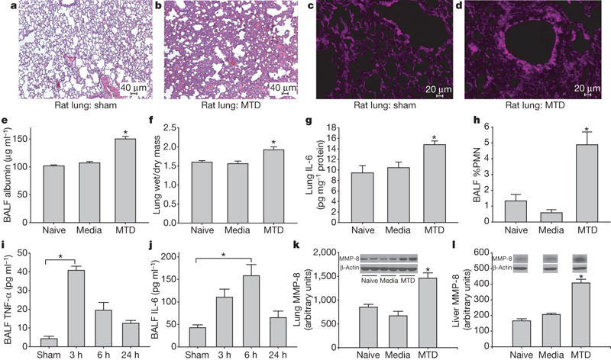
Circulating mitochondrial PAMPS/DAMPS cause inflammatory responses to injury. Nature 2010. Zhang et al. 464, 104-108
Lung: eosin/haematoxylin
Oxidant stain
Mitochondria contain bacterial-like DNA (CpG repeats) and formylated peptides
Mitochondrial DNA levels elevated in trauma patient plasma, 1000x normal levels
Mitochondrial DAMPS activate signaling (p38 MAPK, Ca²⁺) and IL-8/MMP8 expression in neutrophils.
Mitochondrial DAMPS induce systemic inflammation and acute lung injury (↑TNF, IL6, PMN influx, oedema)
Notes:
Injury causes a systemic inflammatory response syndrome (SIRS)
that is clinically much like sepsis1. Microbial pathogen-associated
molecular patterns (PAMPs) activate innate immunocytes
through pattern recognition receptors2. Similarly, cellular injury
can release endogenous ‘damage’-associated molecular patterns
(DAMPs) that activate innate immunity3. Mitochondria are evolutionary
endosymbionts that were derived from bacteria4 and so
might bear bacterial molecular motifs. Here we show that injury
releases mitochondrial DAMPs (MTDs) into the circulation with
functionally important immune consequences. MTDs include
formyl peptides and mitochondrial DNA. These activate human
polymorphonuclear neutrophils (PMNs) through formyl peptide
receptor-1 and Toll-like receptor (TLR) 9, respectively. MTDs
promote PMN Ca21 flux and phosphorylation of mitogenactivated
protein (MAP) kinases, thus leading to PMN migration
and degranulation in vitro and in vivo. Circulating MTDs can elicit
neutrophil-mediated organ injury. Cellular disruption by trauma
releases mitochondrial DAMPs with evolutionarily conserved
similarities to bacterial PAMPs into the circulation. These signal
through innate immune pathways identical to those activated in
sepsis to create a sepsis-like state. The release of such mitochondrial
‘enemies within’ by cellular injury is a key link between
trauma, inflammation and SIRS.

Slide 27
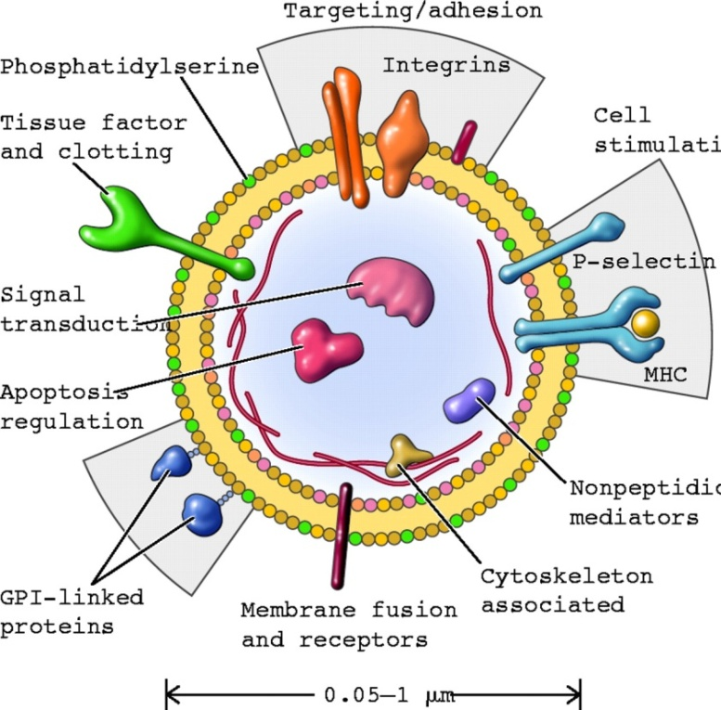
Microvesicles: a new regulator of inflammation in sepsis
Sub-cellular particles released from activated (LPS and ATP stimulation) or dying cells
Surface molecules enable binding and uptake by cells
Functions:
Coagulation
Cell activation
Release of IL-1b from parent cell
Can transmit signal over long distances i.e. systemically. Potential transporters of DAMPS undiluted
Induce TLR4-dependent TNF expression in monocytes
Microvesicles from septic patients induce organ inflammation when administered to mice, but may reduce hypotensive state
In severe sepsis, levels raised in plasma but correlated inversely with mortality
Hugel B et al. Physiology 2005;20:22-27

Slide 28
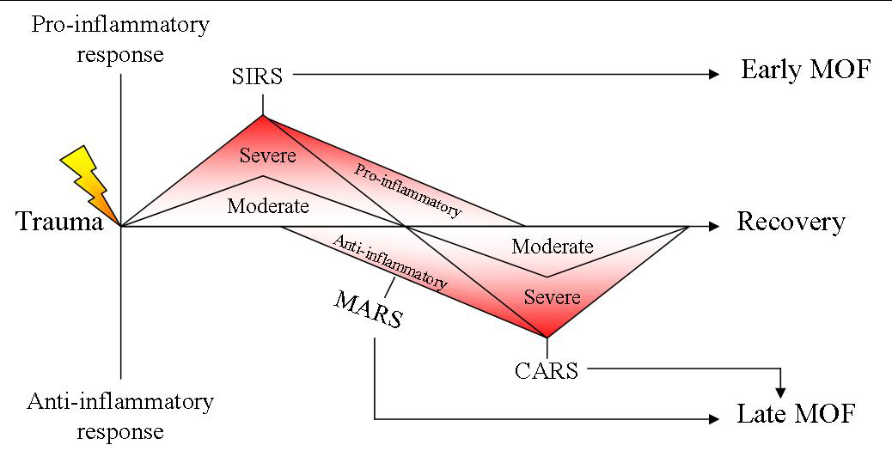
Restoring systemic homeostasis: tailoring treatments to different phases of the disease.
CARS: compensatory anti-inflammatory response syndrome
MARS: mixed antagonist response syndrome
Notes:
Aim of targetted therapies is to reestablish homeostasis
Apoptosis in immune cells (B cells, CD4 T cells, follicular dendritic cells)
The hypothesis is, there are changes in immune response over time.
This figure illustrates 3 hypothetical patients with sepsis. All 3 patients have an initial hyperinflammatory phase, followed by hypoinflammatory phase.
The response of each individual may be determined by many factors (organism, patient conditions, age, gene polymorphism in cytokines/immune-effector molecules).
In case of healthy person with a serious MS, there is a big hyperinflammatory response with high levels of TNF/cytokines. Death may occur during this initial phase, and anti-inflammatory therapy may improve survival. If the infection resolves rapidly, there is only a minimal hypoimmune state.
In case of elderly patients with malnutrition, the initial hyperinflammatory phase is limited, followed by a prolonged hypoinflammatory phase. Either death or recovery occurs during this prolonged hypoimmune period.
In case of patients with substantial underlying disease, a prolonged immunosuppression dominates. For these patients, anti-inflammatory therapies could be deleterious, and immuno-enhancing therapy, such as INF gamma treatment, may be beneficial.
The important notion from this hypothesis is, immunomodulation strategies must to be tailored to the status of immune response in the individual patients.
One question is how does a hyporesposive state translate in to exacerbation of injury to organs. It generally quoted that individual becomes more susceptible to further infection.
An explanation is that the systemic picture obtained by analysis of soluble mediators in plasma of the inflammatory phenotype of circulating cells does not necessarily reflect the local response in organs

Slide 29
Reduction in case fatality rates
Improvements cited: Low-dose corticosteroids; intensive glucose control;
‘early goal directed resuscitation’
Dombrovskiy et al. Critical Care Medicine 2007, 35; 1244-1250
Notes:
Recent advances in treatment
Low-dose corticosteroids
Intensive glucose control
‘early goal directed resuscitation’
Dotrecogin alpha

Slide 30
Questions?

Slide 32
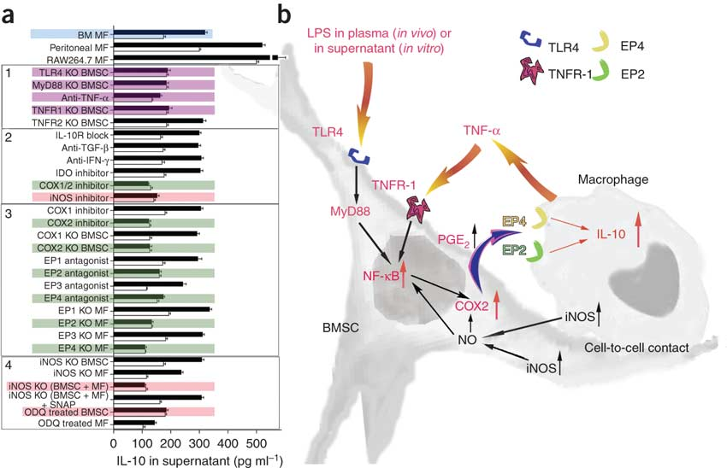
‘Bone marrow stromal cells attenuate sepsis via prostaglandin E2–dependent reprogramming of host macrophages to increase their interleukin-10 production’
Nemeth K et al. Nature Medicine 2008. 15, 42 – 49.
Sepsis inflammation is a complex non-linear process that may not be effectively controlled by single mediator targeting.
Restoration of inflammatory homeostasis might be
feasible by reprogramming cellular responses
Notes:
Administering bone marrow stromal cells (BMSCs—also known as mesenchymal stem cells) to mice before or shortly after inducing sepsis by cecal ligation and puncture reduced mortality and improved organ function. The beneficial effect of BMSCs was eliminated by macrophage depletion or pretreatment with antibodies specific for interleukin-10 (IL-10) or IL-10 receptor. Monocytes and/or macrophages from septic lungs made more IL-10 when prepared from mice treated with BMSCs versus untreated mice. Lipopolysaccharide (LPS)-stimulated macrophages produced more IL-10 when cultured with BMSCs, but this effect was eliminated if the BMSCs lacked the genes encoding Toll-like receptor 4, myeloid differentiation primary response gene-88, tumor necrosis factor (TNF) receptor-1a or cyclooxygenase-2. Our results suggest that BMSCs (activated by LPS or TNF- ) reprogram macrophages by releasing prostaglandin E2 that acts on the macrophages through the prostaglandin EP2 and EP4 receptors. Because BMSCs have been successfully given to humans and can easily be cultured and might be used without human leukocyte antigen matching, we suggest that cultured, banked human BMSCs may be effective in treating sepsis in high-risk patient groups.

Slide 33
Sepsis produces a pro-coagulant state
Tissue factor expression induced in monocytes, enhancing activation of the coagulation cascade.
Activated protein C (anticoagulant) levels decreased due reduced hepatic synthesis and systemic consumption.
Thrombomodulin expression decreased (TNF, IL-1) and inactivated by neutrophil elastase.
Tissue factor pathway inhibitor administration reduces intravascular coagulation and severity in experimental models of sepsis

Slide 34
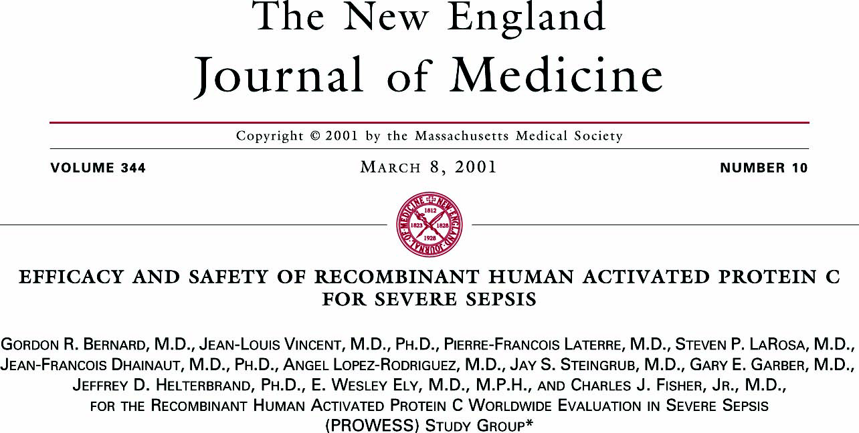
Drotrecogin alfa (activated) for adults with severe sepsis and a low risk of death.
N Engl J Med. 2005 Sep 29;353(13):1332-41
The absence of a beneficial treatment effect, coupled with an increased incidence of
serious bleeding complications, indicates that DrotAA should not be used in patients with
severe sepsis who are at low risk for death, such as those with single-organ failure or
an APACHE II score less than 25.

Slide 35
Dual recognition system to sense
infection and injury
Revamp, too much info on ligands, but the 3 classes are correct
Receptor | Endogenous ligands
CD14 | Apoptotic cells, various lipids, heat shock proteins, fibrinogen
Toll-like receptors | Heat shock proteins, heparan sulphate, hyaluronan
Mannose receptor | L-selectin, mannosyl/ fucosyl glycoconjugates
Scavenger receptors | Apoptotic cells, various lipids, modified LDL
Fc receptor | Immunoglobulin bound (natural antibodies) to necrotic cells/debris
Complement receptor 3 (CD11b/CD18) | iCb3, ICAM-1, heparan sulphate, fibrinogen
Notes:
From Gordon S. Pattern Recognition Receptors: Doubling Up for the Innate Immune Response.
2002. Cell: Vol 111, 927-930

