Slide 1
Acute lung injury: Pathophysiology
Mark Griffiths
AICU Royal Brompton Hospital
Imperial College London
Notes:
Thanks honour

Slide 2
Acute Lung Injury: Pathophysiology
Learning Objectives
What is ALI/ARDS?
Acute inflammation
  what’s special about the lung
Alveolar-capillary membrane
  how it works
And that’s it ………..
Notes:
Evidence

Slide 3
American / European Consensus Conference definition of Acute Lung Injury (ALI) & Acute Respiratory Distress Syndrome (ARDS)
Cause/ Timing
Oxygenation
Chest Radiograph
Exclude heart
failure
ALI
Acute
PaO₂ / FiO₂ < 40kPa 300mmHg
Bilateral opacities consistent with pulmonary oedema
PAOP <18mmHg if measured or no clinical evidence of left atrial hypertension
ARDS
PaO₂ / FiO₂ < 27kPa
200mmHg
PaO₂ / FiO₂ – arterial partial pressure of oxygen / inspired oxygen fraction
PAOP – pulmonary artery occlusion pressure

Slide 4
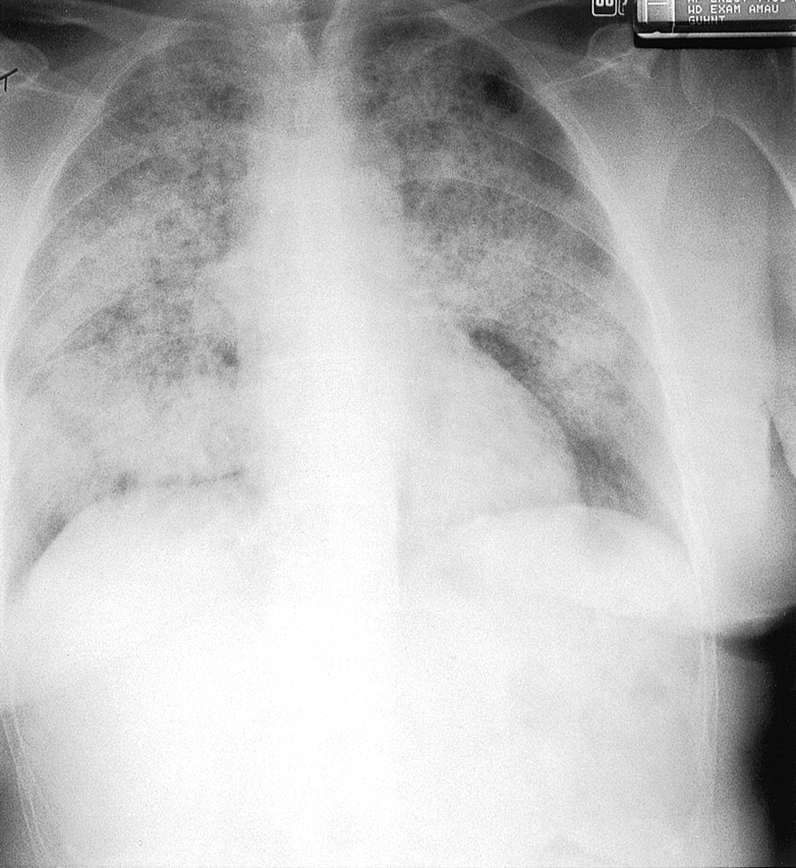
Spectrum of Lung Injury
ARDS ALI Subclinical LI

Slide 5
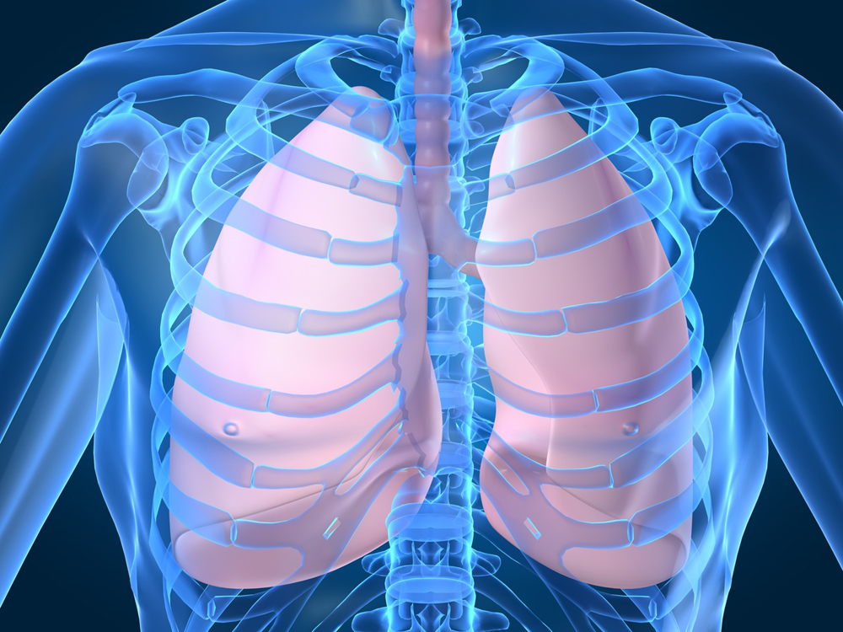
Pneumonia
Aspiration of vomit
Noxious inhalation
Sepsis
Embolisation
TRALI

Slide 6
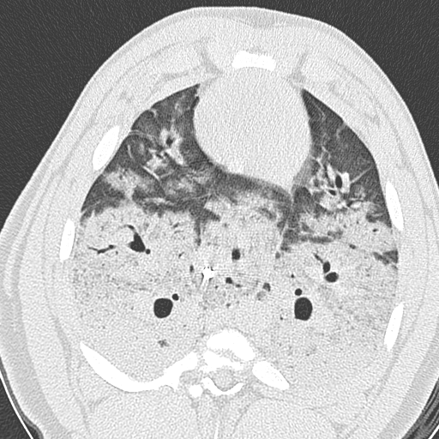
Sepsis/SIRS causes ARDS - Indirect
Sepsis/ SIRS
ARDS MODS

Slide 7
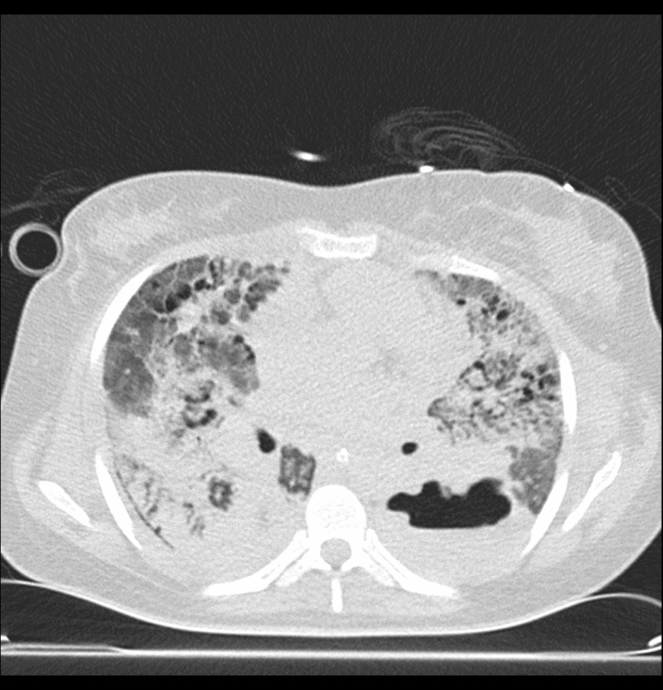
Direct ARDS (leads to Sepsis/SIRS)
Direct Lung Injury
ARDS
Sepsis/ SIRS

Slide 8
Potency of single risk factors for ARDS
Burns
Cardiopulmonary bypass
Bacteraemia
Transfusion 10u/day
Head injury
Multiple fractures
Drug OD in ICU
Pneumonia in ICU
Pulmonary contusion
Gastric aspiration
Transfusion 15u/day
Sepsis syndrome
Patients developing ARDS %

Slide 9
Primary insult
Gastric aspiration
CAP / bacterial
pH1N1 influenza A
Thoracic trauma
Old age
Alcoholism
Pregnancy
“Genes”
#NOF
Secondary insults
Surgery
UTI
Transfusion
Respiratory failure
ALI
ICU
ICU
Fluid ++
Transfusion
ARDS
Mechanical
ventilation
VAP
VALI
Mechanical
ventilation
ARDS

Slide 10
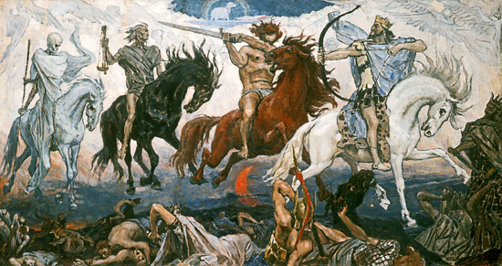
  Fluid overload
  Transfusion related acute lung injury
  Ventilator associated pneumonia
  Ventilator associated lung injury

Slide 11
VALI - Mechanical Ventilation
Almost all patients with ARDS require MV
Experimentally, MV → ARDS / VILI
  Webb & Tierney 1964
Mortality of ARDS affected MV strategy
  ARMA study; ARDS Network 2000

Slide 12
Study | Patients | Mean Tidal Volume Vt ml/kg |  | Mean Plateau Pressure cmH₂O |  | PEEP cmH₂O |  | Mortality %
 |  | P | C | P | C | P | C | P | C | p
Stewart | 120 | 6.8 | 10.1 | 20 | 28.6 | 9.6 | 8.0 | 50 | 47 | NS
Brower | 52 | 7.3 | 10.2 | 24.9 | 30.6 | Not given |  | 50 | 46 | NS
Brochard | 116 | 7.4 | 10.7 | 24.5 | 30.5 | 9.6 | 8.5 | 47 | 38 | NS
ARMA ARDS Network | 861 | 6.5 | 11.4 | 26 | 37 | 8.1 | 9.1 | 31 | 40 | 0.007

Slide 13
National Center for Health Statistics
10 lives / day saved in USA!
Asthma
AIDS
Emphysema
ARDS
In terms of QALYs gained, if an average ICU spent $10,000 per ALI patient in order to achieve >90% adherence to low tidal volume ventilation the intervention would still be cost effective
Cooke et al. Chest 2009; 136:79-88
Thousand deaths / year

Slide 14
“Baby Lung” in ARDS
On consolidated & collapsed dependent lung
  Tidal Volumes of 6-10 ml/kg based on weight
  Tidal Volumes of 20-50 ml/kg based on open lung units

Slide 15
Ventilator associated Lung Injury
Dreyfuss ARRD 1988;137:1159
Rodents ventilated in three modes:
  High Pressure
  (45 cmH₂O), High Volume
  Low Pressure (negative pressure ventilator), High Volume
  High Pressure
  (45 cmH₂O), Low Volume (strapped chest and abdomen)

Slide 16
Biotrauma hypothesis
Skeleton of the lung parenchyma
Epithelium
Matrix
Endothelium
Stress failure
Mechanotransduction
?
Mechanical ventilation
Mechanical strain
ARDS, SIRS
Death
Inflammatory Mediators

Slide 17
Fluid management strategies
N Engl J Med 2006;354:2564-75
7d protocolised fluid Mx in 1000 ALI pts within 48hrs of Dx
30% of pts in FACT had a PAOP > 18 mmHg
cumulative 7d fluid balance in liberal grp (6992±502 ml) vs in conservative grp (-136±491 ml)
Outcome | Conservative | Liberal | P value
Death @ d60 | 25.5 | 28.4 | 0.30
Ventilator-free days from d1-28 | 14.6+0.5 | 12.1+0.5 | <0.001
ICU-free days
Days 1-7 | 0.9+0.1 | 0.6+0.1 | <0.001
Days 1-28 | 13.4+0.4 | 11.2+0.4 | <0.001
Organ failures |  |  | nd

Slide 18
Acute neutrophilic inflammation

Slide 19
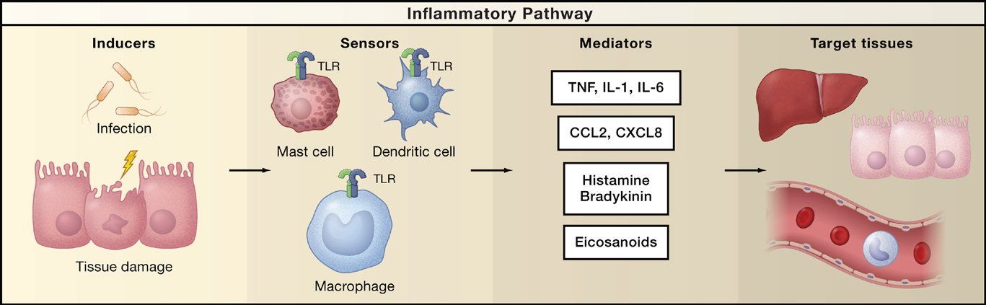
Inflammation
ACM

Slide 20
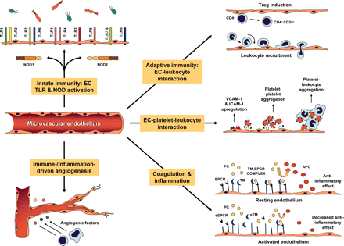
Notes:
Schematic overview of the various functions and cellular interactions mediated by microvascular ECs that impact on innate and adaptive immunity, coagulation, and inflammation. PC, Protein C; APC, activated protein C; sEPCR, soluble EPCR; sTM, soluble TM.P

Slide 21
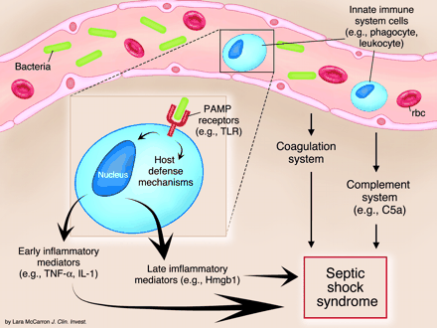
Role of the innate immune system
PAMP – pathogen associated molecular patterns
TLR – Toll-like receptors
HMGB - high-mobility group box 1 protein

Slide 22
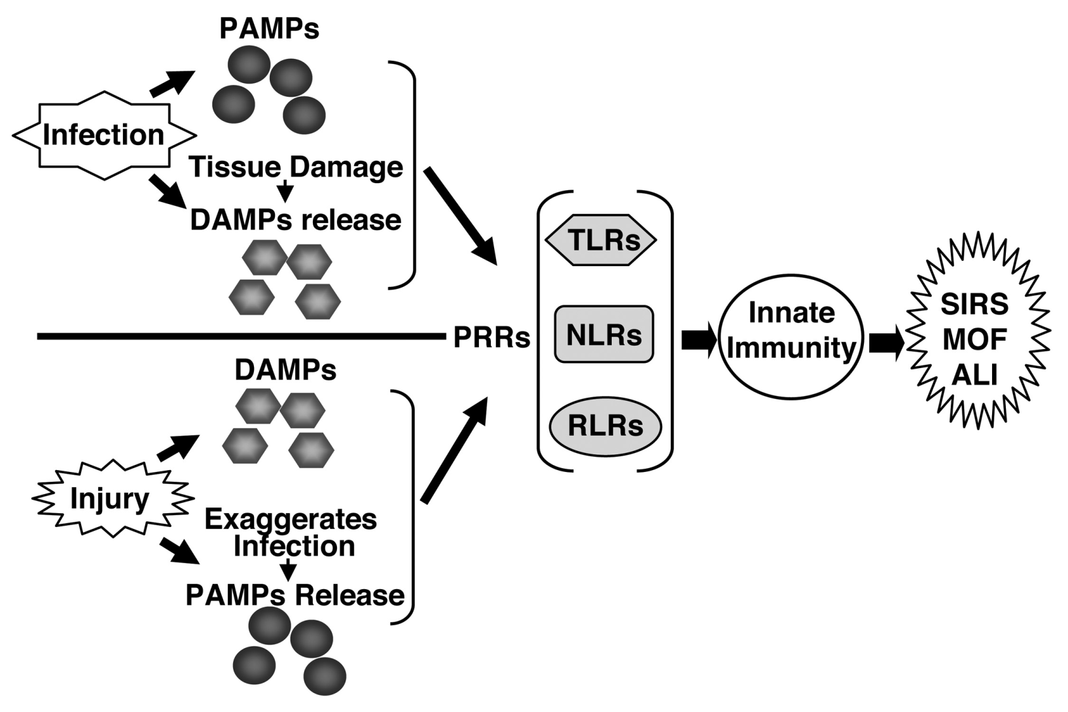
Pattern recognition receptors in ALI

Slide 23
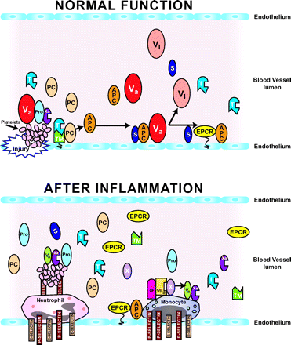
Thrombomodulin
T - thrombin
PC - protein C
Va - activated factorV
TF – tissue factor
Notes:
Control of coagulation in normal and inflamed vasculature. Top panel: Normal function. Vascular injury, indicated on the lower portion of the blood vessel wall, initiates prothrombin (Pro) activation, which subsequently induces thrombin (T) formation. Prothrombin activation involves the formation of complexes between factor Va and factor Xa. Thrombin then binds to thrombomodulin (TM) on the luminal side of the endothelial cell wall, and the thrombin-TM complex converts protein C to APC. APC then binds to protein S (S) on endothelial cell surfaces. The complex composed of protein S and APC then converts factor Va into an inactive complex (VI). Protein S and APC also interact with the endothelial cell protein C receptor (EPCR). Bottom panel: After inflammation. During inflammation, specific mediators cause the disappearance of thrombomodulin from the endothelial cell surface. The endothelial cell leukocyte adhesion molecules P-selectin and E-selectin are synthesized and expressed on the surfaces of endothelial cells or platelets. Tissue factor (TF) is expressed on monocytes where it binds to factor VIIa. The TF-VIIa complex converts factor X to factor Xa, which then complexes with factor Va to generate thrombin from prothrombin. Very little APC is formed, and that which is formed does not function well because of low levels of protein S. Consequently, factor Va is not activated, and the prothrombin activation complexes are stabilized.

Slide 24
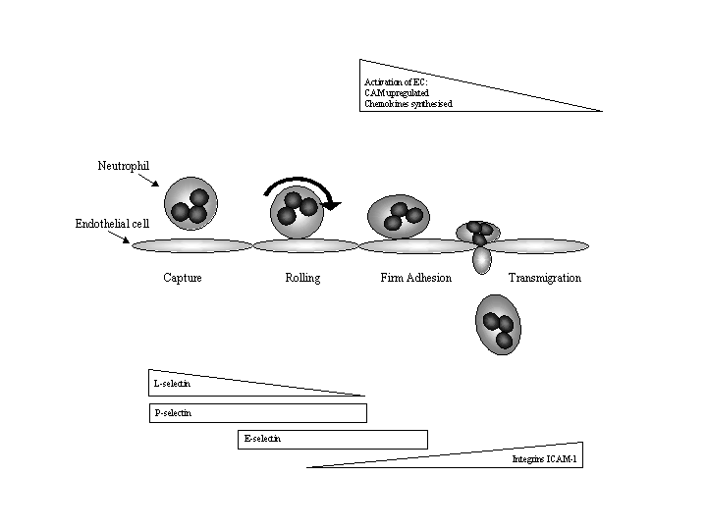
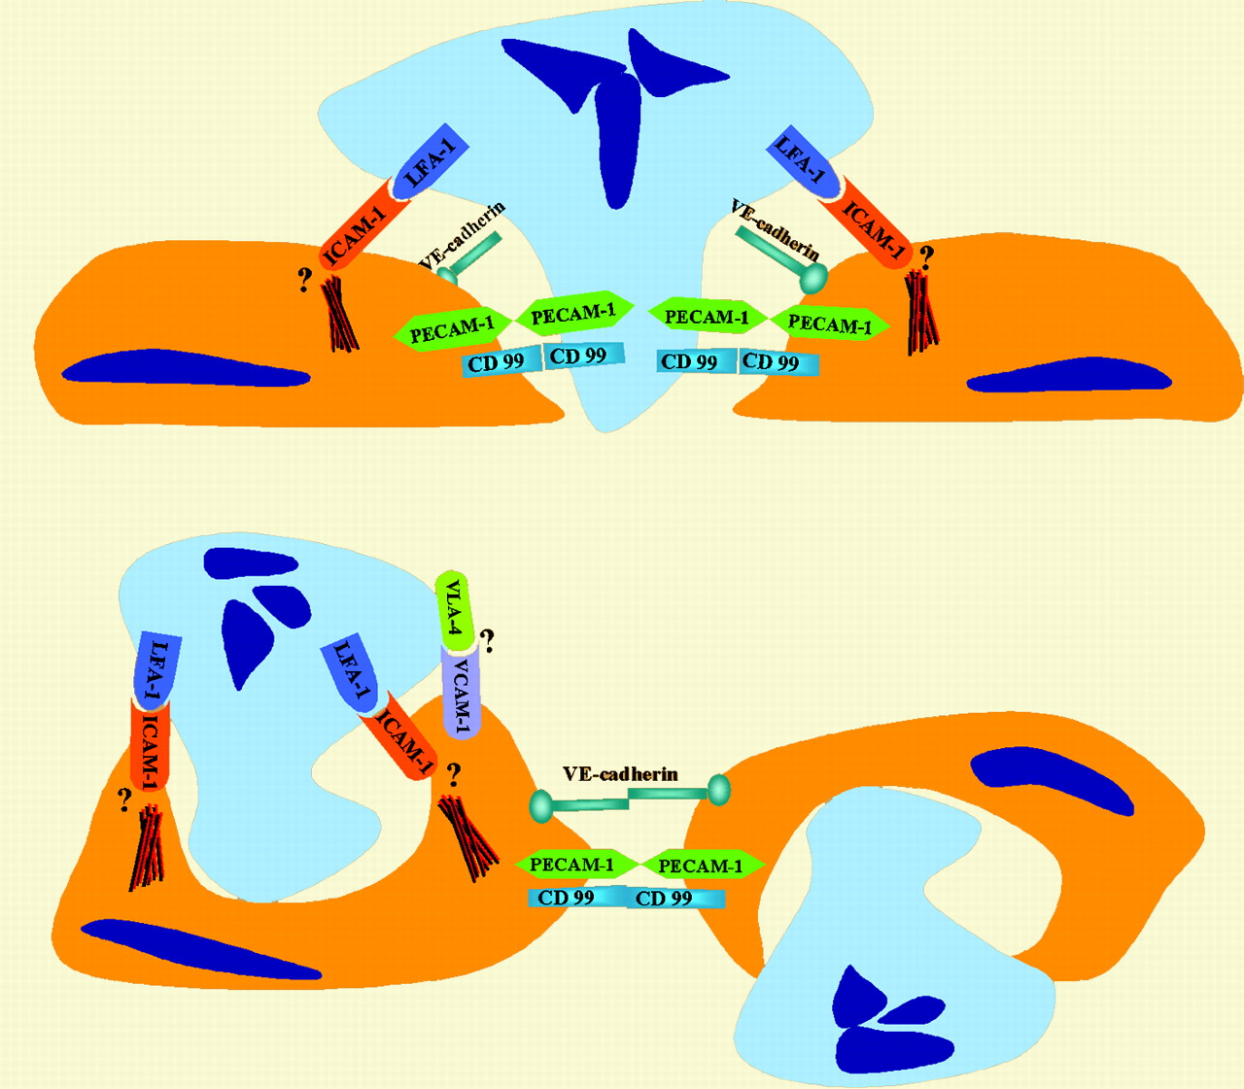
ICAM-1 regulates para- & trans-cellular pathways of neutrophil trans-endothelial migration
Zen, K. et al. Blood 2005;106:394-395

Slide 25
Systemic circulation
Post-capillary venule
Pulmonary circulation
Capillary
Endothelial cell
Neutrophil
CAPTURE/
ROLLING
FIRM
ADHESION
TRANSMIGRATION
RETENTION
FIRM
ADHESION
TRANSMIGRATION
Selectins
Integrins/ Ig-like CAM
Stiffening
+ β2 intergrins/ ICAM-1
- β2 intergrins/ ICAM-1
Notes:
In the lung parenchyma, neutrophils exit the pulmonary circulation at the capillary level, rather than via postcapillary venules, as in the systemic circulation.¹³ This unique site for neutrophil migration may be amenable to selective interventions. Rheologic considerations including the size, shape, and deformability of neutrophils (a function of cytoskeletal changes) are important determinants of neutrophil transit across the pulmonary capillary network.¹⁴ Recruitment of neutrophils from the bronchial circulation may follow the "rolling-tethering" paradigm, reviewed extensively elsewhere¹⁵; in this process, the interaction of neutrophil P-selectin glycoprotein ligand-1, E-selectin ligand-1, and L-selectin, and subsequently the β₂-integrins (lymphocyte function-associated antigen-1 and Mac-1) with their cognate endothelial partners, leads to rolling and subsequently firm cell adhesion/arrest. The involvement of different adhesion molecules also varies according the precise stimulus.¹⁶ Once arrested in the circulation, migrating neutrophils must cross the endothelial cell layer and traverse the pericyte sheath and the basement membrane. A recent study¹⁷ has demonstrated that, remarkably, up to 70% of transmigrating neutrophils cross the endothelial barrier by an active process of engulfment by endothelial cells that is dependent on the small guanosine triphosphatase RhoG. Less is known about the mechanisms of migration through the pericyte sheath and basement membrane, but the existence of regions of reduced matrix protein density within the endothelial cell basement membrane has been reported. These low-density regions were shown to align with the gaps between pericytes and offered preferential sites for neutrophil transmigration.¹⁸
Summers Chest 2008

Slide 26
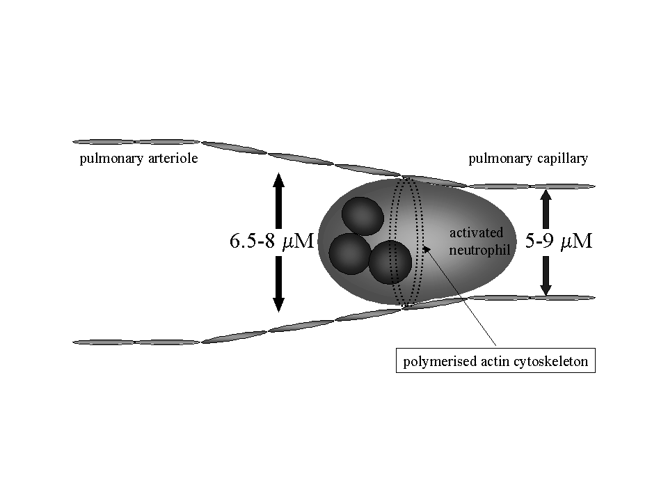
Pulmonary capillaries are smaller

Slide 27
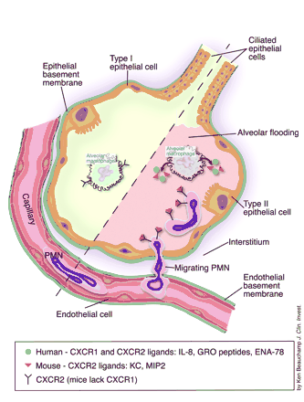
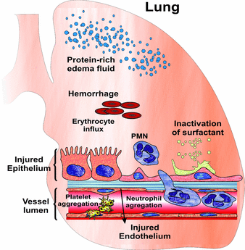
Role of chemokines &
their receptors in the lung

Slide 28
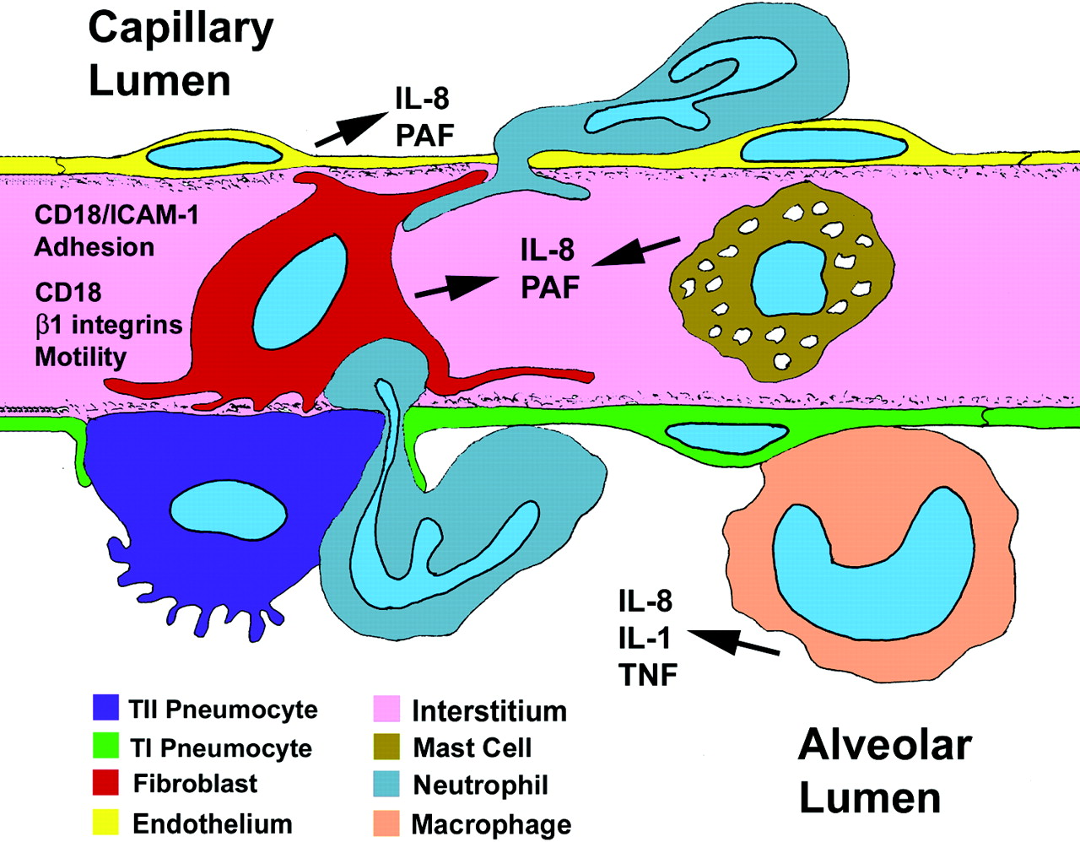

Slide 29
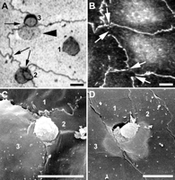
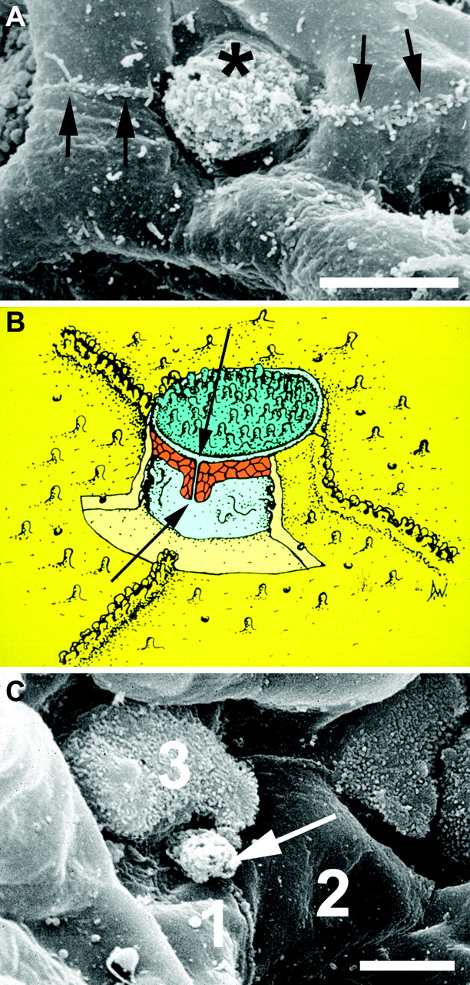
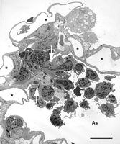
Burns AR et al. 1994 J Immunol 153: 3189
Notes:
In A, human neutr can be seen adhering to and migrating across a HUVEC monolayer that has been treated with IL-1; 10 U/ml for 4 h. When viewed in the light microscope, endothelial borders appear black after silver staining (tricellular corners are indicated with arrows). One neutrophil is sitting on the body of the endothelial cell (1), another on top of a tricellular corner (2), and a third is transmigrating at a tricellular corner (3); a portion of the neutrophil is beneath the monolayer (arrowhead). In B, immunofluorescence staining for ZO-1 (a tight junction protein) reveals discontinuous staining at tricellular corners (arrows). C is a scanning electron micrograph showing a human neutrophil fixed in the act of migrating across an IL-1-treated HUVEC monolayer. D is a scanning electron micrograph of a rabbit neutrophil fixed in the act of migrating across the pulmonary microvascular endothelium after instillation of St pn(10⁸ organisms, 2 h).
pores in the alveolar wall neutrophil emigration.4hr tracheal instillation of Str pn, Capillary lumens (*) appear empty because the tissue was fixed by vascular perfusion. Bar is 10 µm.
In A rabbit lung microvillar projections on the surface of a at2 (*). On at1, microvilli are largely confined to the cell borders (arrows). B. The cut-away shows the arrangement of epithelial tight junctions (orange) at a tricellular corner where 2 at1 (yellow) converge on a at2 (turquoise). A discontinuity (arrows) in the junctional complex exists because it is not possible to make a three-sided junction. C neutr transepithelial migration in rabbit lung 4 h Str pn. Bar is 5 µm.

Slide 30
Resolution of acute inflammation
Remove / resolve inflammatory stimulus
Apoptosis predominates over necrosis
Macrophage clean-up
Muco-ciliary escalator

Slide 31
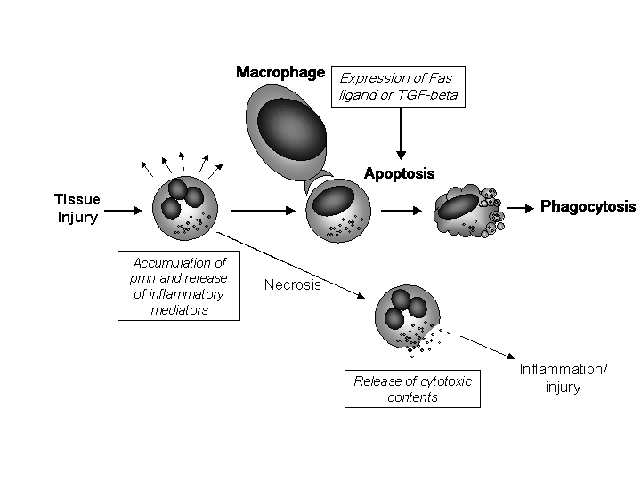
Apoptosis vs necrosis

Slide 32
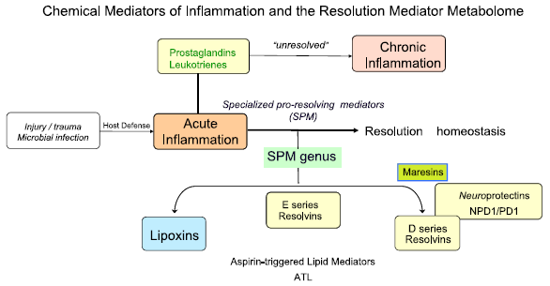

Slide 33
Alveolar-capillary membrane

Slide 34
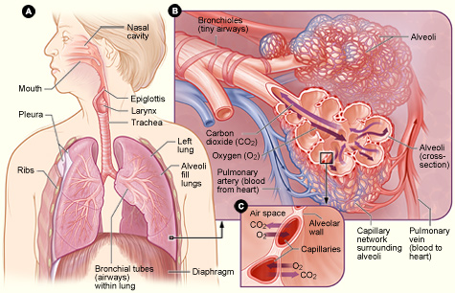
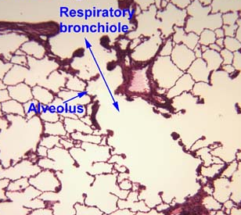
The lung is for gas exchange!

Slide 35
Vasculopathy of Sepsis/ ALI
Disordered vascular tone
Increased vascular permeability
Microvascular thrombosis
Altered cellular metabolism

Slide 36
Systemic
Vascular dystonia
Intra-vascular coagulation
Microvascular leak
Lung
Loss of HPV
P Hypertension & incr dead space
Pulmonary oedema

Slide 37
AIR
V
Q
BLOOD

Slide 38
Hypoxic Pulmonary Vasoconstriction
V
P_{alv}O₂
Q

Slide 39
Inhaled Vasodilators + HPV
P_{alv}O₂
NO
Q
Q

Slide 40
Vasodilators (iv) vs HPV
P_{alv}O₂
PGI₂
V/Q

Slide 41
Endothelial gaps form actively
LPS
Vessel
lumen
Coagulation
Proteases
Cell activation
and injury
Gap
Endothelium
Epithelium
Alveoli
Toxins
Scanning EM

Slide 42
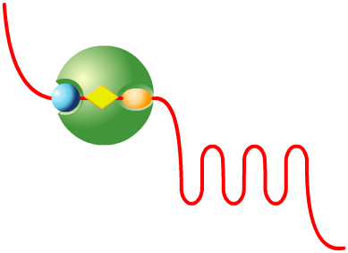
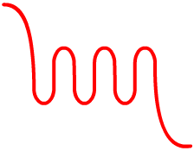

Regulation of lung EC barrier function
Thrombin
Occludin
Rho
ZO-1
Rac
Cortactin
Actin stress fibers
Ca²⁺
MLCK
P60src
α−catenin
MLCK
MLCK
catenin
β/γ
Adherens junction
MLC
phosphatase
Cadherin
Myosin
X
Focal adhesion assembly/ disassembly
Rho
PAX
Talin
Vinculin
GIT1
FAK
Integrin
Integrin
β
α
α
β
Actin/Myosin contraction
Cellular adhesion
Barrier dysfunction
Barrier integrity
Adapted from Jacobson et al. AJRCMB 2004;30:662

Slide 43
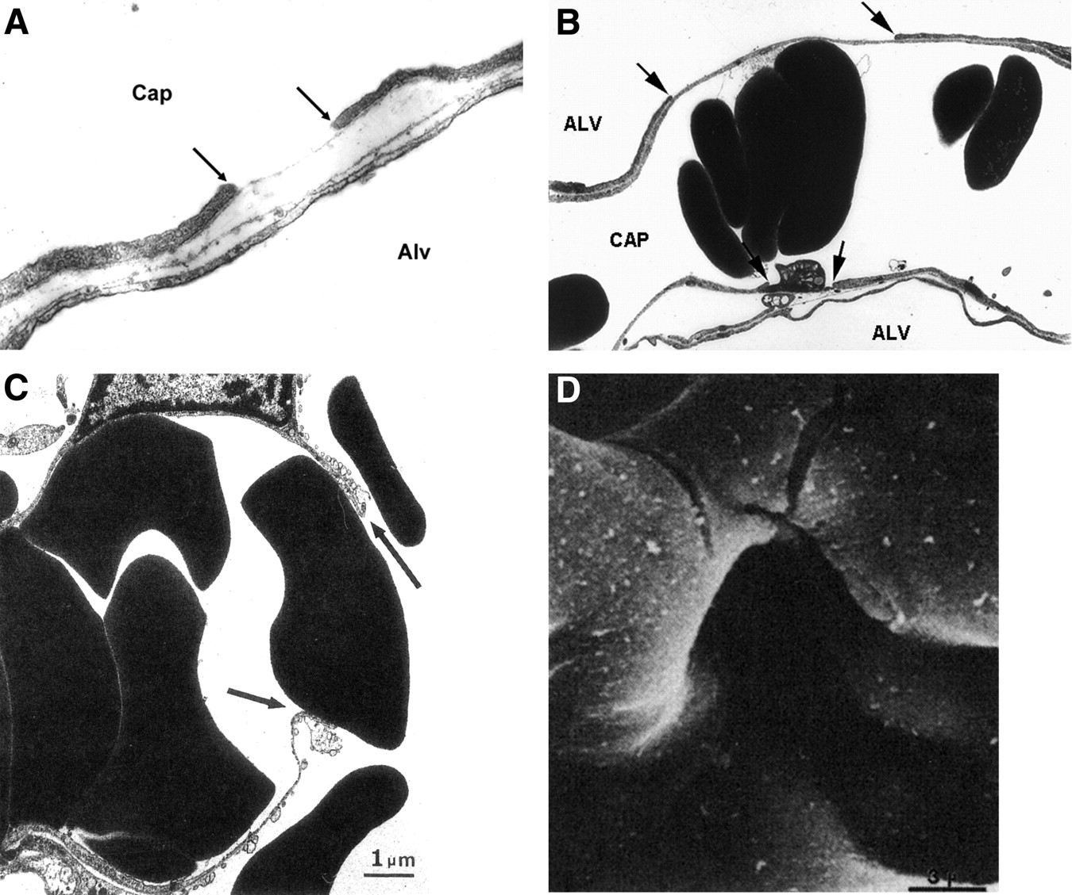
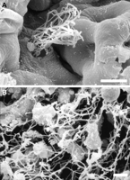
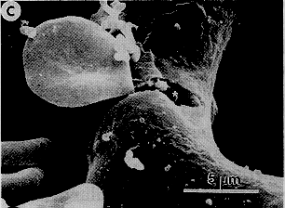
Stress failure in pulmonary capillaries
Maina JN and West JB. 2005. Physiol Rev 85:811-844
Copyright ©2005 American Physiological Society

Slide 44
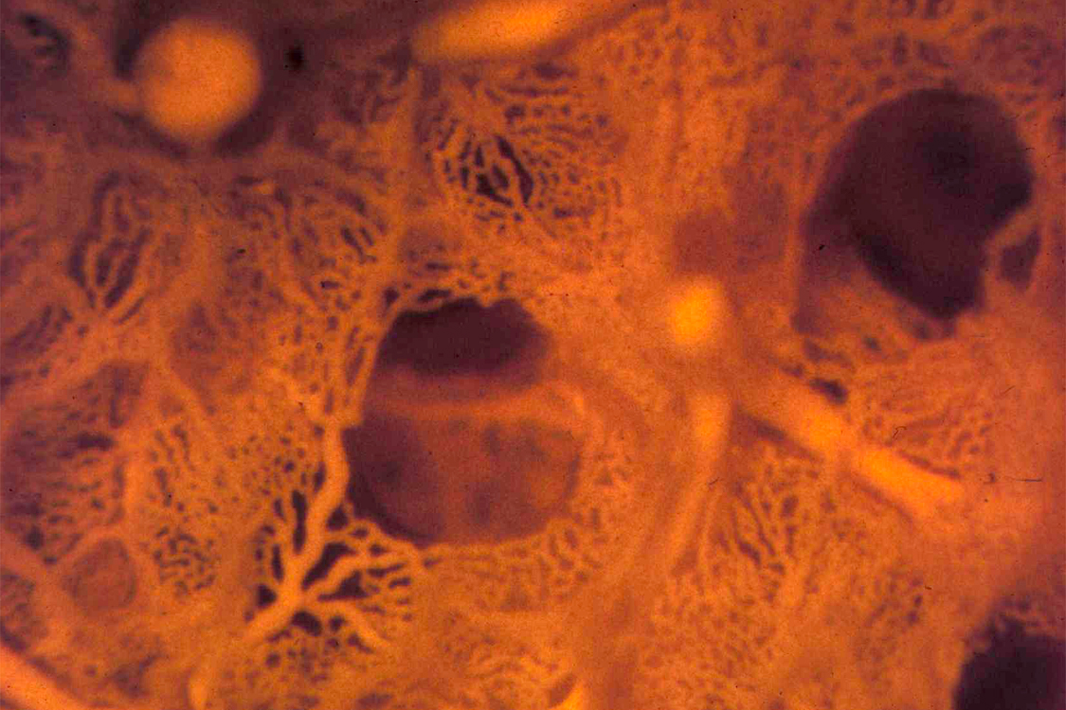
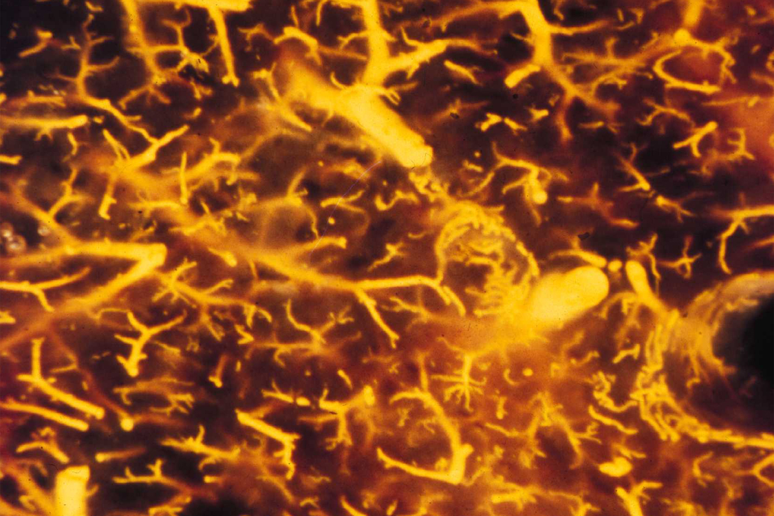
Microvascular obstruction & remodelling in ARDS
Normal human lung capillaries
Lung capillaries p 14 d ARDS
Zapol et al Chest, 1977; Snow et al ARRD 1982

Slide 45
Alveolar epithelium
Contribution to acute inflammation
Repair of the alveolar-capillary membrane
Fibrosis and death

Slide 46
Trachea
Bronchi
Bronchioles
Terminal
Bronchioles
Respiratory
Bronchioles
Alveolar
ducts
Alveolar
sacs
Air space
Type 1 cell
Type 2 cell
Matrix

Slide 47
Acute lung injury
Type 1 cell death
Acute inflammation
Provisional matrix
Surfactant dysfunction

Slide 48
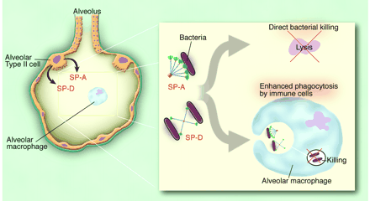
Surfactant dysfunction / deficiency
Decreased surfactant production
Inactivation by inflammatory exudate
Loss of host
defence function

Slide 49
Pulmonary repair
Wound Healing
dedifferentiation
proliferation
migration
matrix modulation
Inflammation
cytokine & growth
factor secretion
cell-cell contacts

Slide 50
Sodium transport across alveolar epithelial cells drives alveolar fluid clearance
Apical (air side)
H₂O
Cl⁻
CFTR
Tight
Junction
ENaC
Na⁺
Na⁺
Na⁺
Cl⁻
Epithelial Cells
Basal Conditions
Maximal Conditions
2K⁺
2K⁺
ATPase
ATPase
Basolateral
3Na⁺
Cl⁻
3Na⁺
Cl⁻
Na⁺
H₂O
Notes:
Therefore the ideal paracellular pathway would allow little overall ion conductance and have a strong preference for CHLORIDE (i.e. sodium barrier)

Slide 51
Impaired alveolar fluid clearance associated with increased mortality in ARDS
Ware L, Am J Respir Crit Care Med 2001;163:1376
70
60
* p<0.02
50
Hospital
mortality (%)
40
30
*
20
10
0
Impaired
(n = 69)
Maximal
(n = 10)
Alveolar fluid clearance
Notes:
Impaired in majority of patients with ALI/ARDS about 90%

Slide 52
Pulmonary remodelling
Differentiation Hyperplasia
Apoptsis Recruitment
Phagocytosis Fibrosis

Slide 53
ALI = acute inflammation + alveolar capillary membrane
ACM dysfunction
Pulmonary Oedema
Surfactant dysfunction
Collapse, incompliance
+
Loss of hypoxic PV’constrictn
+
Intravasc thrombosis
=
Respiratory failure

Slide 54
Summary
ARDS is a syndrome of acute respiratory failure, it is a diagnosis not the diagnosis
Understand acute inflammation
Superimpose that on the function of the ACM
That’s it
“The art of medicine consists in amusing the patient while nature cures the disease”
Voltaire (1694 - 1778)

Slide 55
Pathophysiology of gas exchange abnormalities in lung injury
Loss of hypoxic pulmonary vasoconstriction
Atelectasis
Intra-vascular coagulation
Extra-vascular compression
Decreased compliance
HYPERCARBIA
HYPOXIA

Slide 56
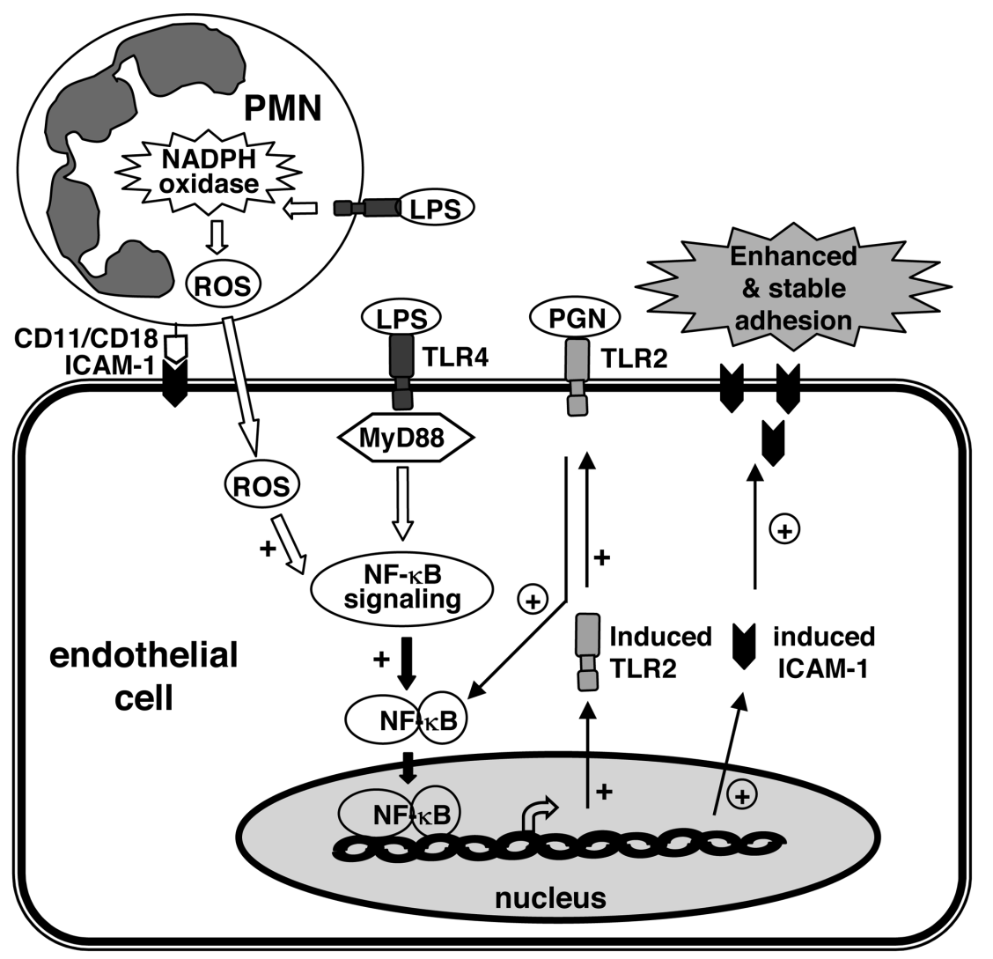
LPS stimulated neutrophil mediates endothelial cell activation

