Slide 1
Molecular basis of anaesthesia and analgesia
Novel targets for pain relief
BSc Surgery and Anaesthesia module
Kenji OKUSE
Div. Cell & Molecular Biology
Faculty of Natural Sciences
Imperial College London
13th December 2011
1
Notes:
Today, I’m going to talk about identification of a novel regulatory factor that facilitates the expression of Na_{V}1.8

Slide 2
Types of Pain
Overview of sensory nervous system and pain pathway
Introduction of key molecules in pain pathway
Pain killers
2

Slide 3
Types of Pain
Overview of sensory nervous system and pain pathway
Introduction of key molecules in pain pathway
Pain killers
3

Slide 4
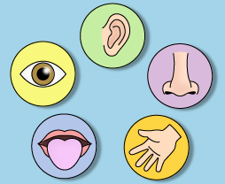
Five senses
Audition
(hearing)
Vision
Olfaction
(smell)
Gustation
(taste)
Tactile sense
(touch, pain)
4

Slide 5
Types of Pain
Nociceptive Pain - mechanical, thermal, electrical…
Inflammatory Pain - ischaemia, infection…
Neuropathic Pain - nerve injury, maladaptive plasticity
5

Slide 6
Pain can be caused by wide range of stimuli
Temperature - heat, cold
Mechanical - pressure, friction edema
Chemical - gastric enzymes, histamines, caustic substances
6

Slide 7
Acute Pain vs. Chronic Pain
Acute Pain Chronic Pain
May be sudden or gradual with periods of remission & exacerbation
> 6 months
Usually sudden, self-limiting
< 6 months
Precipitating event
May not be associated with injury
Resolves with treatment
Difficult to treat
Restless, anxious, crying
Depressed, withdrawn
7

Slide 8
Pain mechanisms
Same mechanism – different pain
Same pain – different mechanisms
8

Slide 9
Types of Pain
Overview of sensory nervous system and pain pathway
Introduction of key molecules in pain pathway
Pain killers
9

Slide 10
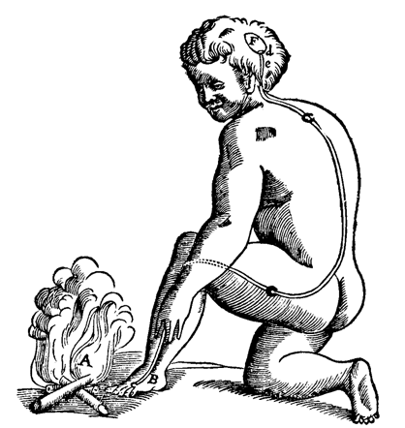
Descartes first described the human body
in terms of a machine
PAIN
“fast moving particles of fire that disturb the filaments in the nerve”
René Descartes
Le Traité de l'Homme (1664)
NOCICEPTION
10

Slide 11
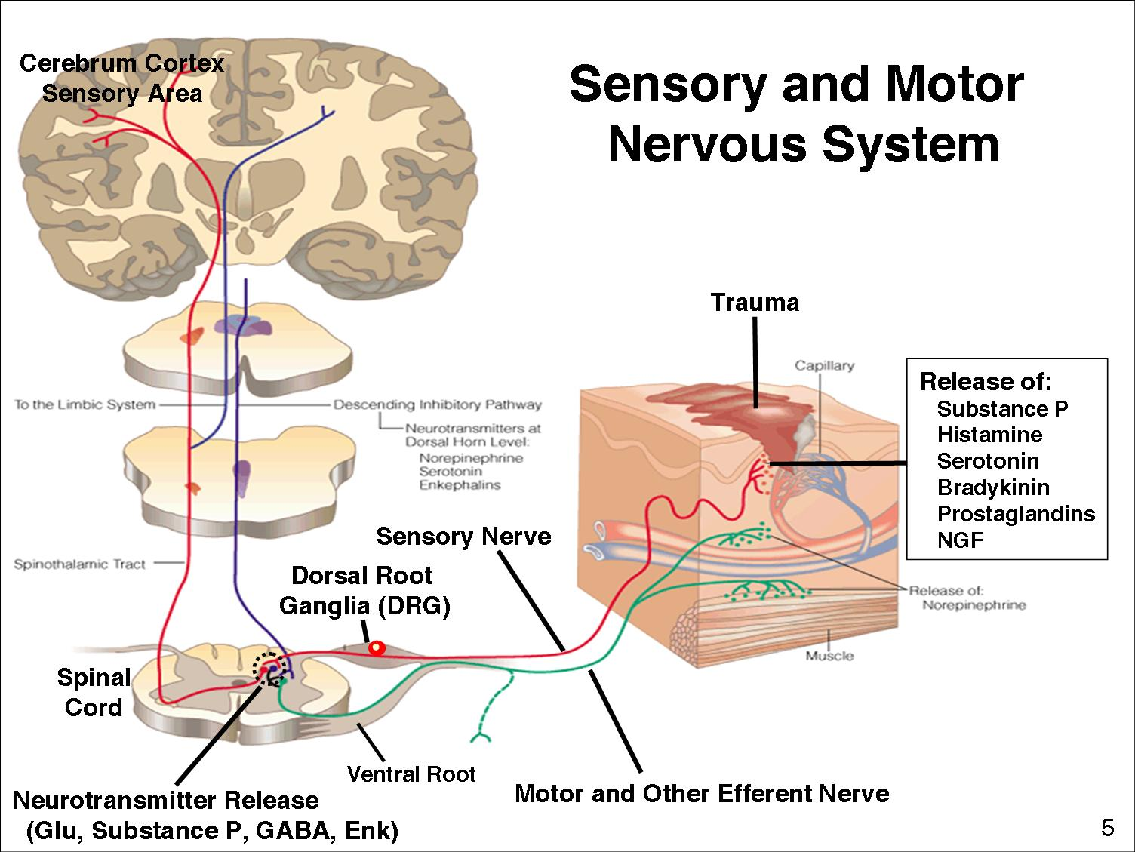
11

Slide 12
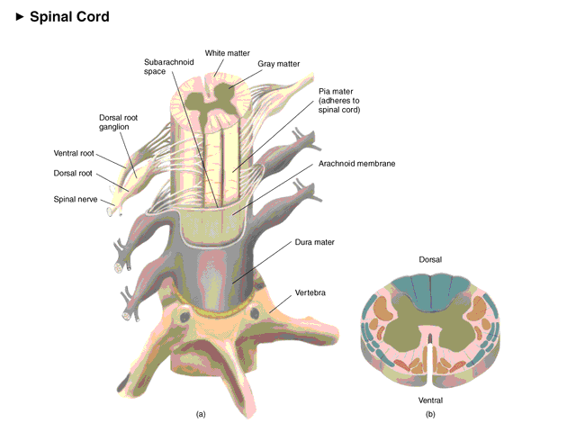
Spinal Cord and Dorsal Root Ganglion
12
6

Slide 13
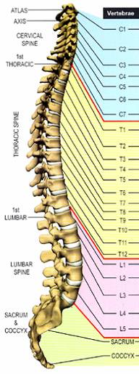
Vertebral subluxation and innervation chart
Cervical
Median nerve (arms, hands)
Thoracic
Gastric nerve (stomach)
Lumbar
Sciatic nerve (legs, foots)
Sacral
13

Slide 14
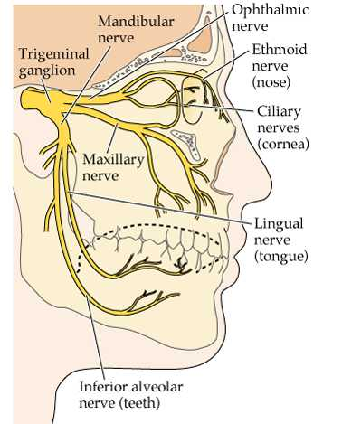
Trigeminal ganglion neurons innervate
facial nerves
14

Slide 15
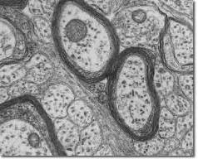
Small diameter sensory neurons
are responsible for nociception
DRG
Spinal Cord
Peripheral
Small diameter, unmyelinated C fibre neuron (chronic pain)
Medium diameter, thinly myelinated A-δ fibre neuron (acute pain)
Large diameter, myelinated A-β fibre neuron (touch)
15

Slide 16
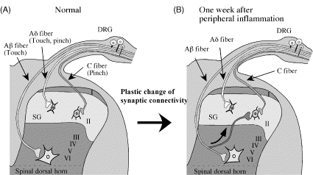
Dorsal horn
The cells of the spinal cord are arranged in layers or laminae, six in the dorsal horn (I-VI), three in the ventral horn (VII-IX) and an additional column of cells clustered around the central canal as Lamina X
C nociceptive afferents terminate mainly in Laminae I and II
A-δ afferents terminate mainly in Laminae I. II and V
A-β afferents terminate mainly in Laminae V, VI
16

Slide 17
Types of Pain
Overview of sensory nervous system and pain pathway
Introduction of key molecules in pain pathway
Pain killers
17

Slide 18
Mediators
Receptors
18
12

Slide 19
Pain inducers / Inflammation mediators
Bradykinin
Bradykinin
- polypeptide (Arg-Pro-Gly-Phe-Ser-Pro-Phe-Arg)
- made from Kininogen by proteolysis in blood in response to
tissue damage/blood coagulation
Bradykinin receptors
- B1, B2
- 7-TM G-protein coupled receptors
- linked to Gq and Gi
- Activate phospholipase Cβ (PLCβ) and phospholipase A2 (PLA2) - Activation of PLCβ leads to protein kinaseC (PKC) activation
- Activation of PLA2 causes production of arachidonic acid (AA)
from the cellular phospholipid bilayer
- AA is converted into prostanoids
19

Slide 20
Pain inducers / Inflammation mediators
Prostanoids
Prostaglandins (PGE₂)
- Synthesized/released from Glanulocyte, Macrophage, and Nociceptive Neurons in response to tissue damage
- Binds to EP2 receptor expressed at free nerve endings
Cyclooxygenase: COX is the rate-limiting enzyme of PGE₂ synthesis
COX-2 can be induced by proinflammatory cytokines such as TNFα and IL-Iβ at the site of local inflammation
20

Slide 21
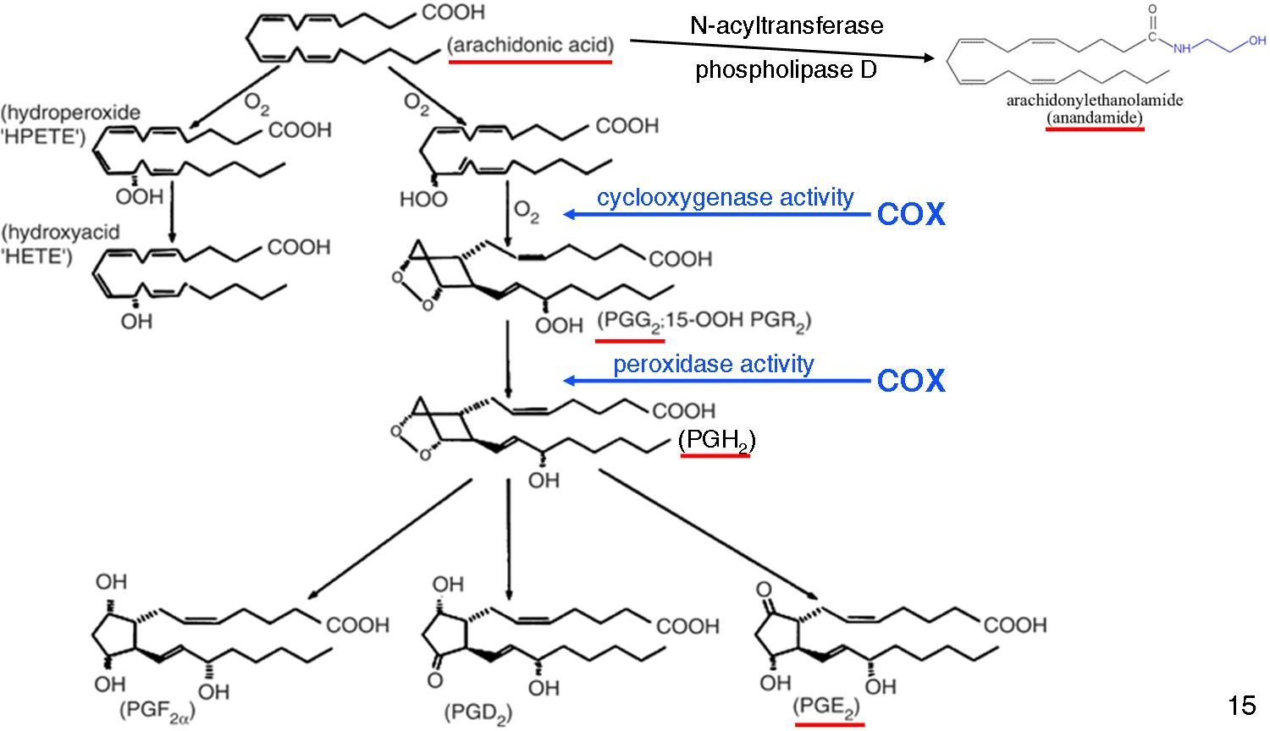
Prostaglandin synthesis pathways
21

Slide 22
Pain inducers / Inflammation mediators
Prostaglandin receptors
- DP1, DP2
- EP1, EP2, EP3, EP4
- FP
- IP
- 7-TM G-protein coupled receptors
- PGE2 binds to EP2 receptor expressed at free nerve endings
- Activates adenylate cyclase via Gs
- Increases intracellular cAMP
- cAMP leads to protein kinase A (PKA) activation
- Phosphorylates channels, Lower the thresholds of nociceptive neurons
22

Slide 23
Pain inducers / Inflammation mediators
NGF (Nerve Growth Factor)
NGF - Regulate the peripheral sensitivity of nociceptive neurons
- Increased NGF levels lead to mechanical and thermal hyperalgesia
- Increases functional sodium channel expression
TrkA - Single-TM tyrosine kinase receptor for NGF
- Selectively expressed in unmyelinated nociceptive sensory neurons
BDNF (brain-derived neurorophic factor)
NT-4/5
NT-3
TrkB
TrkC
23

Slide 24
Channels
24
21

Slide 25
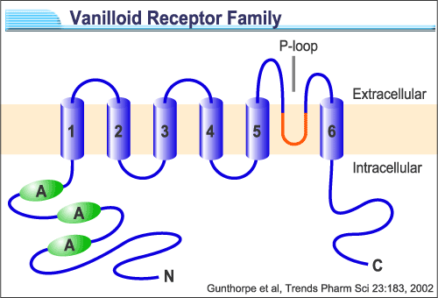
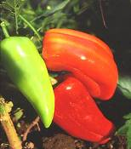

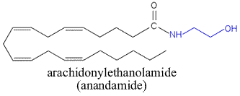
TRP Channels
TRPV1 (VR1): Non-selective cation channel activated by capsaicin,
noxious heat and low pH
Expressed in nociceptive primary sensory neurons
TRPV1 knockout mice are impaired in the detection of painful heat stimuli
25

Slide 26
Prostaglandin synthesis pathways
26
23

Slide 27
TRPV1 could be involved in the development of inflammatory heat hyperalgesia
TRPV1 (VR1): Non-selective cation channel activated by capsaicin,
noxious heat and low pH
Expressed in nociceptive primary sensory neurons
TRPV1 knockout mice are impaired in the detection of painful heat stimuli
Induces depolarisation/excitation/transmitter release
Acute TRPV1 activation induces burning pain sensation
    The level of endogenous ligands (anandamide and
    lipoxygenase products) are increased during inflammation
    Inflammatory mediators activate/sensitise it
27

Slide 28
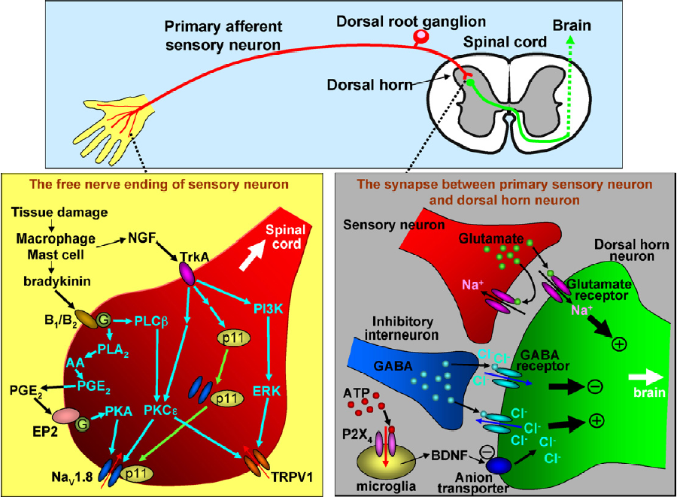
Key molecules in pain pathways at peripheral nerves
28

Slide 29
TRPV1 is activated during inflammatory conditions
Inflammatory mediators (bradykinin, PGE2, NGF)
Post-translational modification (phosphorylation, PKA, PKC, PI3K, PIP2 removal)
Endogenous ligands (anandamide, lipoxygenase products)
Transcriptional changes
(splice variant - modified tetramer composition)
Reduced temperature threshold
29

Slide 30
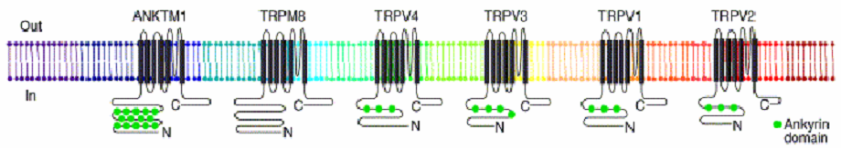
Thermosensitive TRP channels respond to
a wide range of ambient temperatures
Temperature (°C)
0
10
20
30
40
50
60
ANKTM1
TRPM8
TRPV4
TRPV3
TRPV1
TRPV2
Temperature
range
<17°
8-28°
>27°
>31or39°
>43°
>52°
Agonists
Menthol
Capsaicin
30

Slide 31
ATP-gated channel
P2X₃: Non-selective cation channel activated by ATP.
Responsible for ATP-evoked nociceptor activation.
P2X3 knockout mice show deficiency in detection of
some painful stimuli.
P2X₄: ATP activates microglial P2X₄ upon nerve injury.
Microglia releases Brain-Derived Neurotrophic Factor (BDNF).
BDNF acts on neurons to reduce the expression of KCC2 (anion transporter).
Increases of the intracellular Cl⁻.
GABA works as excitatory transmitter
rather than an inhibitory one.
31

Slide 32
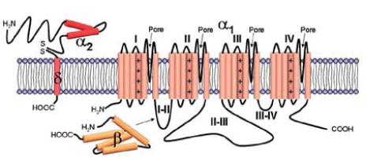
Voltage-gated Ca²⁺ channels
N-type: Blockers for N-type calcium channels prevent
neurotransmitter release, and act as pain killer.
Ca_{V}2.2 knockout mice show reduced response to
inflammatory and neuropathic pain.
Gabapentin: Originally developed for epilepsy
Binds and blocks the α2δ subunit of voltage-gated Ca²⁺ channel
Has analgesic effects in neuropathic pain
32

Slide 33
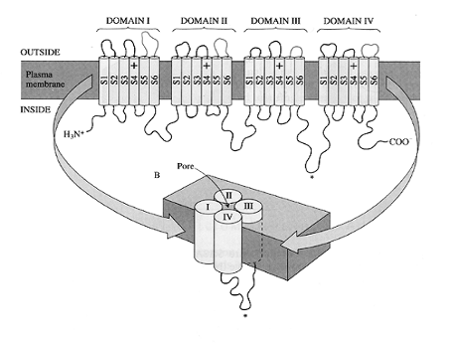
Voltage-gated Na⁺ channels
~250 kDa
6 transmembrane segments X 4 domains (24 transmembrane regions)
Voltage sensors in segment 4 in each domains
9 genes have been identified so far
Expressed mainly in neurons and muscle cells
33
Notes:
Voltage-gated sodium channels initiate and propagate action potentials in excitable cells.
These sodium channels comprise a large membrane spanning pore-forming alpha-subunits and small accessory beta-subunits.
So far 3 beta-subunits have been discovered, and all of them share common structure which is one transmembrane domain and extracellular Ig loops.

Slide 34
Mammalian voltage-gated sodium channel α subunits
Gene
Primary
Present
TTX
Type
Symbol
Name
Tissue
in DRG
sensitivity
+
+
Na_{V}1.1
SCN1a
type I
CNS, heart
+
+
Na_{V}1.2
SCN2a
type II
CNS
+
+
Na_{V}1.3
SCN3a
type III
fetal brain
-
+
Na_{V}1.4
SCN4a
SkM1 (μ1)
skeletal muscle
-
-
Na_{V}1.5
SCN5a
SkM2 (Η1)
heart
+
+
Na_{V}1.6
SCN8a
NaCh6
CNS, glial cells
+
+
Na_{V}1.7
SCN9a
PN1
SCG, CNS
+
-
Na_{V}1.8
SCN10a
SNS (PN3)
DRG
Na_{V}1.9
SCN11a
DRG
+
-
NaN (SNS2)
Na_{X}
SCN7a
sciatic nerve, lung
+
+
(?)
NaG
34
Notes:
So far, 10 distinct alpha-subunits have been identified.
Among them, the expression of the tetrodotoxin-resistant sodium channel Na_{V}1.8 (also known as SNS or PN3) is restricted to damage sencing small diameter C-fiber associated sensory neurons.
Behavioral studies on Na_{V}1.8 knock-out mice have demonstrated a role for Na_{V}1.8 in the detection of noxious thermal, mechanical and inframmatory stimuli.

Slide 35
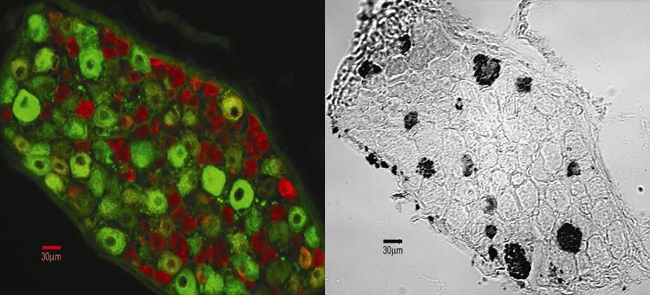
Na_{V}1.8-like immunoreactivity specifically localised in small diameter C fibre sensory neurons
Rat Dorsal Root Ganglion
Na_{V}1.8
NF200 (a marker for large
diameter A-β fibre neurons)
35

Slide 36
PGE₂ increases TTX-resistant Na⁺ current and causes
a hyperpolarizing shift of its activation curve in DRG neurons
2
Command potential (mV)
0
-80
-60
-40
-20
0
20
40
-2
control
1 μM PGE₂
-4
-6
-8
Peak sodium
current (nA)
-10
S. England et al. (1996) J. Physiol.
36

Slide 37
Na_{V}1.7 Knock-Out mice show reduced responses to mechanical stimuli
WT
KO
Nassar et al. PNAS (2004) 101(34): 12706-12711
37

Slide 38
The locations of the identified human mutations in Na_{V}1.7 which cause paroxysmal extreme pain disorder
(gain of function mutation)
Paroxysmal extreme pain disorder, previously known as familial rectal pain, is an autosomal dominant paroxysmal disorder of pain and autonomic dysfunction. The distinctive features of this disorder are paroxysmal episodes of burning pain in the rectal, ocular, and mandibular areas accompanied by autonomic manifestations such as skin flushing.
38

Slide 39
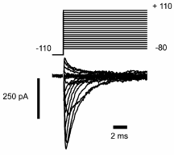
The locations of the identified human mutations in Na_{V}1.7 which cause paroxysmal extreme pain disorder
(gain of function mutation)
WT Na_{V}1.7
mutant Na_{V}1.7
39

Slide 40
The locations of the identified human mutations in Na_{V}1.7 which cause the complete inability to sense pain
(loss of function mutation)
2298 T deletion
GCT ATA GGA GC ATA GGA
2691 G A
Ala Ile Gly Ala STOP
TGG TGA
Trp STOP
1376 C G
TCA TGA
Ser STOP
40

Slide 41
Key molecules in pain pathways at peripheral nerves
41

Slide 42
Neurotransmitters
42

Slide 43
Neurotransmitters
Glutamate
Excitatory neurotransmitter
Released from postsynaptic terminals of sensory neurons at dorsal horn
- Variety of receptors
AMPA
GluR1-4 (GluRα1-α4)
GluR5-7 (GluRβ1-β3)
KA1/2 (GluRγ1/γ2)
GluRδ1/δ2
Kinate
Ionotropic
NA2A-D (GluRε1-ε4)
NR1 (GluRζ)
NR3A/3B (GluRκ1),
NMDA
mGluR group I
mGluR1/5
Gq/G₁₁ – PLCβ (IP3/DAG)
metabotropic
mGluR group II
mGluR2/3
Gi – AC (cAMP↓)
mGluR group III
mGluR6-8
Gi – AC (cAMP↓)
43

Slide 44
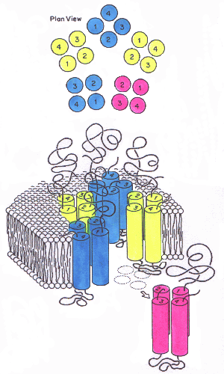
Neurotransmitters
GABA (γ-amino butyric acid)
Interneurones in laminae I, II and III are GABA-rich, and mediate gate control in the dorsal horn by synapsing on neurons that contain Glutamate and substance P
GABA-A receptor: ligand-gated Cl⁻ channel
GABA-B receptor: 7-TM G-protein coupled receptor
44

Slide 45
Neurotransmitters
Peptidergic neurotransmitters
Substance P
CGRP (calcitonin gene-related peptide)
VIP (vasoactive intestinal polypeptide)
Somatostatin
Bombesin
Galanin
Neuropeptide Y
Cholecystokin
PACAP (Pituitary adenyl cyclase activating peptide)
45

Slide 46
Key molecules in pain pathways at peripheral nerves
46
Okuse K (2007) Int J Biochem Cell Biol. 39(3): 490-496

Slide 47
Types of Pain
Overview of sensory nervous system and pain pathway
Introduction of key molecules in pain pathway
Pain killers
47

Slide 48
Current analgesics
NSAIDs (Non-Steroid Anti Inflamatory Drugs)
Prevent prostaglandin biosynthesis by inhibiting cyclo-oxygenase (COX),
the crucial enzyme in the initial synthesis of prostaglandins
irreversible inactivation of COX
- Aspirin (irreversibly acetylates COX)
reversible competitive inhibition
- Ibuprofen and Mefenamic acid
reversible non-competitive inhibition
- Paracetamol (no anti-inflammatory effect)
COX-1: makes prostaglandins vital for protecting the stomach through mucus production, and maintenance of renal blood flow
COX-2: the inducible form that mediates the pain of inflammation by sensitising peripheral nociceptors
COX-3: splice variant of COX-1 (retaining intron 1), target for Paracetamol
48

Slide 49
Current analgesics
Opiates
Opioids/morphine act by stimulating μ, δ, and κ receptors
Orphan receptor called ORL-1 (for "opiate-like receptor 1")
- 60% sequence homology with the other opiate receptors
- An endogenous ligand (nociceptin/orphanin F2)
Morphine as pain killer
μ and δ receptor activation causes decrease of cyclic AMP production, and hyperpolarisation of membranes by stimulating an inward rectifying potassium channel. This hyperpolarisation decreases the release of neurotransmitters from the nerve cell, as such release depends on opening of voltage-sensitive calcium channels
Opiate receptors are expressed in brain, spinal cord, and peripheral nerves
49

Slide 50
Current analgesics
Opiates
Opium (morphine): an extract of the poppy plant
Why should the brain have receptors for an extract of the opium poppy?
- the brain must have receptors for compounds produced by the body (endogenous
compounds) which happen to share a chemical similarity with morphine
Enkephalins (from the Greek meaning "in the head“)
Tyr-Gly-Gly-Phe-Met
Tyr-Gly-Gly-Phe-Leu
Endorphins (endogenous morphine-like molecule)
α-Endorphin
Tyr-Gly-Gly-Phe-Met-Thr-Ser-Glu-Lys-Ser-Gln-Thr-Pro-Leu-Val-Thr
γ-Endorphin
Tyr-Gly-Gly-Phe-Met-Thr-Ser-Glu-Lys-Ser-Gln-Thr-Pro-Leu-Val-Thr-Leu
β-Endorphin
Tyr-Gly-Gly-Phe-Met-Thr-Ser-Glu-Lys-Ser-Gln-Thr-Pro-Leu-Val-Thr-Leu-Phe-Lys-Asn-Ala-Ile- Ile-Lys-Asn-Ala-Tyr-Lys-Lys-Gly-Glu
HO
HO
O
CH₃
H
N
N
NH₂
HO
O
R
O
morphine
enkephalins/
endorphins
50

Slide 51
Up-and-coming medications
COX-2 (Cyclo-Oxygenase 2) Inhibitors: Celebrex (released in 1999, Pfizer)
Vioxx (withdrawn in 2004, Merck)
Unlike the other COX inhibitors such as Aspirin, COX-2 specific inhibitors do not block the COX-1 enzyme that protects the stomach lining, thus do not produce the potential stomach problems
darbufelone (Pfizer)
CS-502 (Sankyo)
LAS 34475 (Almirall Profesfarma)
LAS 34555 (Almirall Profesfarma)
S-33516 (Servier)
SD 8381 (Pharmacia)
BMS-347070 (Bristol-Myers Squibb)
MK-966 (Merck)
L-783003 (Merck)
T-614 (Toyama)
D-1367 (Chiroscience)
L-748731 (Merck)
CT3 (Atlantic Pharmaceutical)
CGP-28238 (Novartis)
BF-389 (Biofor/Scherer)
GR-253035 (Glaxo Wellcome)
6-dioxo-9H-purin-8-yl-cinnamic acid (Glaxo Wellcome)
S-2474 (Shionogi)
51

Slide 52
Up-and-coming medications
Sodium Channel Blockers
Co102862 (CoCensys): currently undergoing pre-clinical development for neuropathic pain and epilepsy
4030W922, 4991W93, GW-286103(GSK): Phase II
Na_{V}1.8 regulator : IX-4000 (Ionix-Varnalis) Lead Discovery & Optimization
Through rational design methods the company has identified drug-like compounds which disrupt the interaction of Na_{V}1.8 with one of these regulatory proteins – p11
IX-4000 compounds have been demonstrated to specifically down-regulate functional expression of Na_{V}1.8 in neuronal cells
52

Slide 53
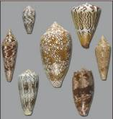
Up-and-coming medications
Calcium Channel Blockers
Ziconotide (Elan): under regulatory review at the FDA
Developed from cone snail w-conotoxin
Targets N-type calcium channels
Gabapentin (Neurontin): originally developed for epilepsy
Binds α2δ subunit of voltage-gated calcium channel, and blocks the channel
Has analgesic effects in neuropathic pain
53

Slide 54
Up-and-coming medications
P2X receptor antagonist: AZD9056 (AstraZeneca)
P2X₇ antagonist
into phase II clinical trials for rheumatoid arthritis
54

Slide 55
Up-and-coming medications
Nicotinic ACh receptor agonists: ABT-594 (Abbott Laboratories)
Epibatidine, an skin extract from the skin of South American tree frogs, can block pain 200 times more effectively than morphine but can not be used for human due to its toxicity
Epibatidine’s structure resembled nicotine
ABT-594, an experimental compound for Alzheimer's Disease, is very similar in structure to Epibatidine, and also has pain-killing properties
Finished Phase I-II development
54

