Slide 1


Assessment of neuropathic pain
Dr B Kuehler
for Professor Andrew Rice
b.kuehler@imperial.ac.uk
www.lpc.ac.uk

Slide 2
Define Neuropathic Pain

Slide 3
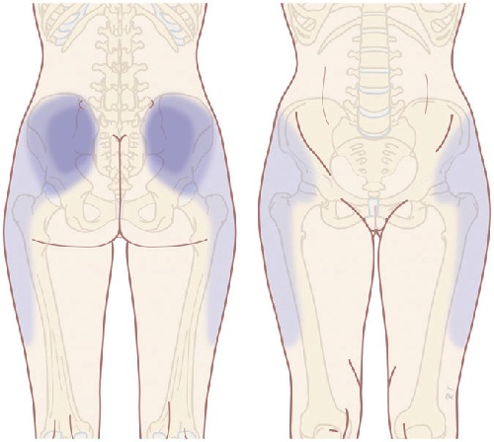

Slide 4
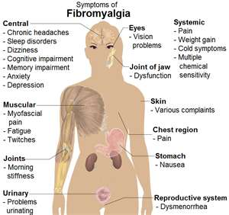

Slide 5
Persistent Pain
Nociceptive Pain
Pain-signalling
“pathway” intact
Neuropathic Pain
Pain arising as a direct
consequence of a lesion or disease
affecting the somatosensory
system
Treede RD et al Neurology 2008; 70(18):1630-1635.

Slide 6
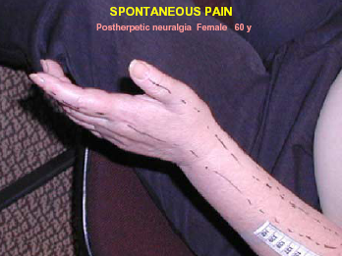
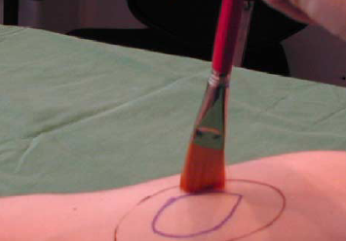
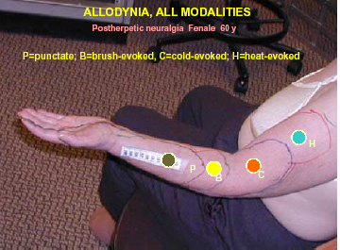
Key Features of Neuropathic Pain
Spontaneous pain in absence of a noxious stimulus
Pain in areas of sensory loss (numbness)- Anaesthesia Dolorosa
Allodynia – pain in response to an innocous stimulus
Nurmikko www.liv.ac.uk/pri

Slide 7
Neuropathic Pain
Pain occasionally generated in response to damage to central or peripheral nervous system
  ~ 40% of HIV patients (Smyth et al 2007)
  ~ 9% of patients after Acute Herpes Zoster (Scott 2003)
Usually severe and chronic:
  92 % POPNO pts in 2⁰ care (Backonja & Stacey 2004)
  * Pain of Predominantly Neuropathic Origin
  Mean age 46 yr (21-79)
  60% ♀
  Mean duration 78 months
  Average pain 5.7/10 (worst pain 7.7)
  Increased pain to touch in 64%
  Increased pain to heat in 38%
Best available therapies have modest efficacy:
  NNT>50% pain relief ~ 2-6
    Hempenstall 2005; Finnerup 2005
  Narrow therapeutic index
Elements to pain
Spontaneous pain
  Continuous (ongoing)
  Paroxysmal (lancinating)
Evoked (stimulus dependant) pain
  Sensory Phenomena Associated with Pain
Sensory loss (Hyposensory) phenomena:
    Anaesthesia dolorosa
    Sensory loss
      Mechanical
      Thermal
Sensory gain (Hypersensory) phenomena:
    Mechanical allodynia
      Static – C fibres
      Dynamic – Aß fibres
    Cold allodynia /hyperalgesia
    Heat allodynia /hyperalgesia – C fibres
    Hyperpathia
    Wind-up
    After-sensations
    Paraesthesiae
    Dysaesthesiae
Notes:
The Journal of Pain, Vol 5, No 9 (November), 2004: pp 491-497Neuropathic Pain Symptoms Relative to Overall Pain Rating
Misha-Miroslav Backonja* and Brett Stacey†
92 POPno patiens with mixed Neup Abstract: The influence of sensory symptoms on overall simple pain ratings in neuropathic pain is
not well understood. The goal of this study was to determine this relationship by using the Neuropathic
Pain Questionnaire (NPQ) and Neuropathic Pain Scale (NPS) in patients who had neuropathic
pain. Overall pain intensity ratings were assessed by means of Average and Worst Pain ratings from
the Brief Pain Inventory. Ongoing average pain was rated as 5.7 and worst pain as 7.7 on 0 to 10 scale,
and it was present in 96% of patients, whereas symptoms that are commonly studied in the
laboratory, such as increased pain due to touch and due to heat, were much less frequent (64% and
38%, respectively). Worst pain was most highly correlated with shooting, stabbing, and distress
symptom complex, which was in contrast to Average pain, which was most highly correlated with
symptom complex consisting of a large number of items. Analysis of conceptually related thermal
heat sensation types of pain, spontaneous “burning” pain and the evoked pain “increased due to
heat,” showed that spontaneous burning pain was reported at much higher frequency and intensity
than the evoked increased pain due to heat. There was no statistically significant difference between
descriptors from NPS and NPQ among subgroups of neuropathic pain, such as polyneuropathy,
radiculopathy, or posttraumatic neuralgia, but this could be in part due to relatively small number of
patients in these subgroups of neuropathic pain. Quantitative analysis, as performed in this study, is
one of the steps in developing an approach for elucidating the relationship between neuropathic pain
symptoms and underlying mechanisms.
Perspective: Assessment of neuropathic pain symptoms by means of specifically designed questionnaires
provides significant insight into patients’ pain experience, including pain overall, which is under
many influences. Further research of this type can contribute to advances in mechanism-based diagnosis
and treatment.
© 2004 by the American Pain Society
Key words: Neuropathic pain; symptoms; mechanisms; measurementHyperpathai (Textbook of CPM)
Archetypayl feature of axonal loss
Explosivce pain which occurs in area of partial sensory loss whenever the thresholsd is rached

Slide 8


Neuropathic Pain Prevalence
S-LANSS questionnaire sent to 6000 randomly selected adults registered with 6 general practices in Aberdeen, Leeds & London
POPNO* (>12 LANSS score) prevalence 8%
Response rate 52%
Chronic pain prevalence 48%
POPNO had major impact on daily activities, quality of life and general health.
Torrance et al J. Pain 2006;7:281
Smith et al Clin J Pain 2007;23:143
DN4 questionnaire sent to 30,155 randomly selected adults in “Access Sante” database
POPNO* (>3 DN4 score) prevalence 6.9%
Response rate 81%
Chronic pain prevalence 31%
22% of chronic pain is POPNO
Moderate to severe pain intensity (>4/10) in 74% of POPNO patients (5.1% prevalence)
Bouhassira et al Pain 2008;136:380
* Pain of Predominantly Neuropathic Origin

Slide 9
Assessment
Haanpaa, ML et al NeuPSIG guidelines on neuropathic pain assessment, Pain, In Press, Corrected Proof, 2010.
Haanpaa ML et al Assessment of neuropathic pain in primary care. Am J Med 2009;122:S13-S21.

Slide 10
Pain is a complex experience that depends strongly on cognitive, emotional, cultural and educational influences.
We need tools that can measure pain objectively.
by G. Cruccu and A. Truini

Slide 11
Diagnosis & Assessment of Neuropathic Pain
Investigation of underlying disease.
Is there a lesion or disease of the somatosensory system?
Is the pain neuropathic?
How severe is the pain?
What is the impact of the pain?

Slide 12
Diagnosis & Assessment of Neuropathic Pain
Investigation of underlying disease.
Is there a lesion or disease of the somatosensory system?
Is the pain neuropathic?
How severe is the pain?
What is the impact of the pain?

Slide 13
Bedside Examination
Motor, sensory and autonomic phenomena
Body maps
Tactile sense: cotton wool
Pinprick: wooden cocktail stick or neurotester
Thermal sense: warm and cold objects
Vibration: tuning fork

Slide 14
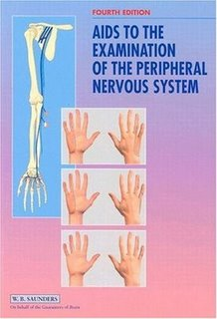
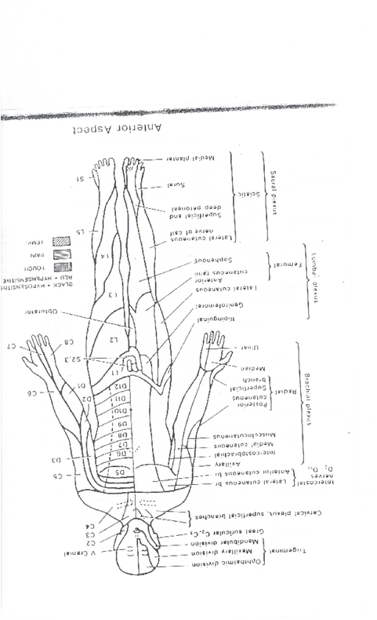
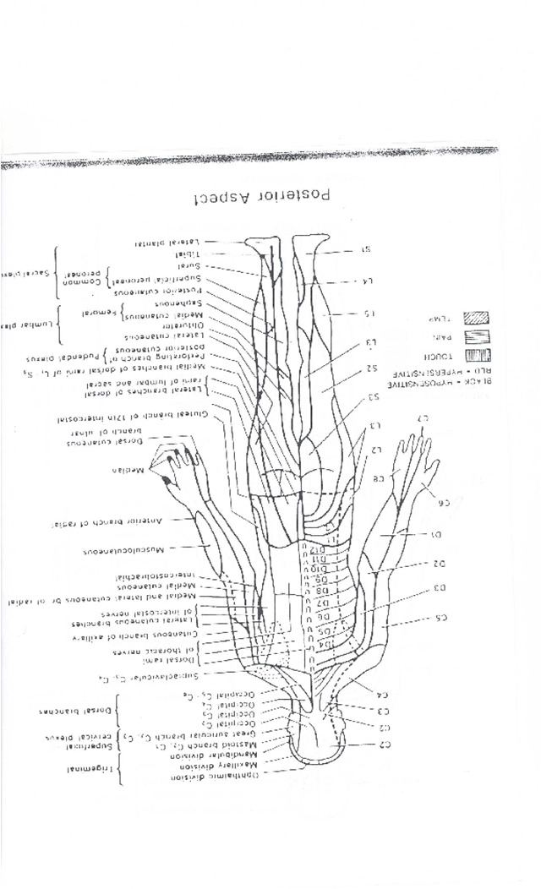
Is there a lesion or disease of the somatosensory system?
  Clinical history and examination:
    Neurological deficits
    Signs of sensory loss
    Signs of sensory gain
    Map deficits

Slide 15
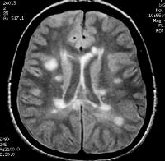
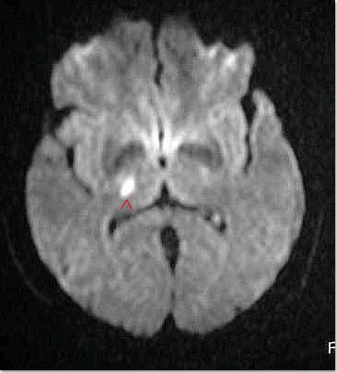
Is there a lesion or disease of the somatosensory system?
  Clinical history and examination
  Imaging

Slide 16
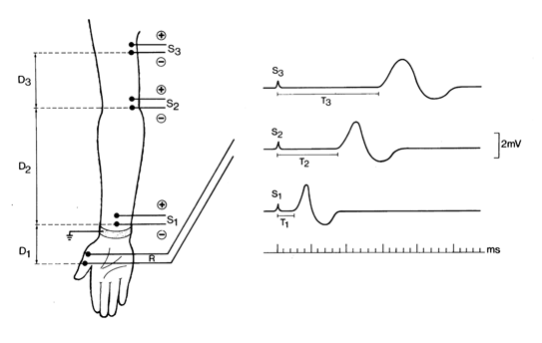
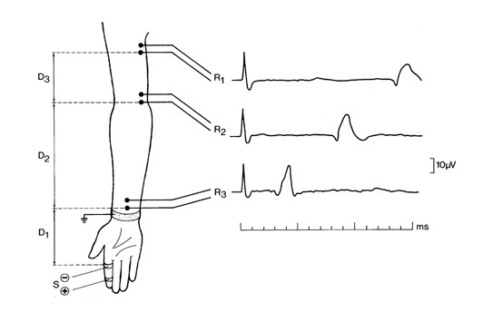
Is there a lesion or disease of the somatosensory system?
  Clinical history and examination
  Imaging
  Electrophysiological studies
    EMG/Motor NCS/Sensory NCS
      Require Clinical Neurophysiologist
      Can determine site of focal lesion
      Can differentiate between:
        Axonal loss - ↓ CAP amplitude
        Demyelination - ↓ CV
      Sensitive to functional changes in large fibres(20%), but not small fibres(80%)

Slide 17
Lab tests for Diagnosing Neuropathic Pain (SEP and NCS)
large size, non nociceptive afferents have lower electrical threshold than small-size nociceptive afferents.
NCS and SEP’s (somatosensory evoked potentials) assess damage, but cannot assess nocicetive function
Late evoked potentials using laser exciting free nerve endings (A delta and C) in superfiscial skin layers

Slide 18
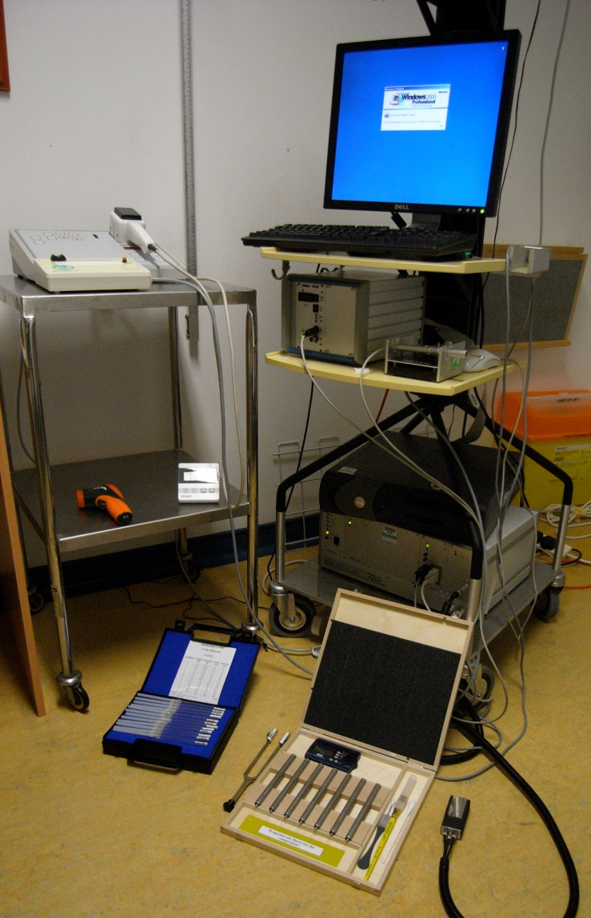
Is there a lesion or disease of the somatosensory system?
  Clinical history and examination
  Imaging
  Electrophysiological studies
  Quantitative sensory testing:
    Determines sensory phenotype
    Can be used in sites where electrophysiological studies not feasible
    Thermal thresholds for diagnosis of small fibre neuropathies
    But:
      Requires training and skill
      Time consuming ~ 2 hrs/patient
      Expensive equipment
Notes:
Editors: Warrell, David A.; Cox, Timothy M.; Firth, John D.; Benz, Edward J.
Title: Oxford Textbook of Medicine, 4th Edition
Copyright ©2003 Oxford University Press
> Table of Contents > Volume 3 > 24 - Neurology > 24.2 - Electrophysiology of the central and peripheral nervous systems > Studies of the peripheral neuromuscular system > Nerve conduction studies
Nerve conduction studies
Motor and sensory nerve conduction studies of peripheral nerves are performed by recording the propagated responses evoked by supramaximal electrical nerve stimulation. The responses reflect the summation of action potentials from individual sensory nerve fibres (the compound sensory action potential, CSAP) or motor units (the compound motor action potential, CMAP), and their amplitudes represent a semiquantitative measure of the number of activated myelinated fibres. The CSAP amplitude is an
P.3.919
expression of activity in large fibres with diameters greater than 7 µm, whereas small fibres in the nerve contribute only slightly to the response. The CMAP amplitude is a reflection of the number of α-motor neurones. A reduction of the CSAP or the CMAP amplitudes is an indicator of fibre loss. However, the CMAP amplitude is also influenced by the size of the motor-unit response. During chronic axonal loss, collateral spouting causes an increase of the MUP, which partially or completely may compensate for the fibre loss. Since reinnervation does not have the same effect on sensory nerves, the CMAP is a less sensitive measure for determining the degree of fibre loss in chronic axonal lesions than the amplitude of the CSAP. Conduction studies are supplemented with EMG to ascertain whether motor fibres are affected by the pathological process.
Method
Investigations of motor and sensory fibres are carried out separately.
Motor conduction studies
The nerve is stimulated by an electrical pulse of 0.1- to 0.2-ms duration applied to the nerve at well-defined sites, with the cathode (depolarizing electrode) being placed over the nerve distal to the anode if a longitudinal electrode placement is used. It is essential that the stimulation pulse is supramaximal, defined as being 10 to 20 per cent above the stimulus strength that elicits a maximal CMAP. This stimulation strength requires that the output of the stimulator provides a stimulus at least four times higher than threshold when surface electrodes are used, and ensures that all fibres in the nerve remain activated even though the stimulation electrode may move slightly. The CMAP is recorded from the muscle, preferably using surface electrodes or a subcutaneous needle electrode to ensure that activity from all the muscle fibres in the muscle can be ‘seen’ by the recording electrode. Usually a belly-tendon montage is used, with the reference electrode being placed over a remote site. Recording of the CMAP with a concentric electrode is usually discouraged since the amplitude is highly dependent on how close the electrode is in relation to the active muscle fibres. However, a concentric needle electrode is useful in very atrophic muscles, as it allows a sharp deflection from the baseline to be measured. The response is amplified at a frequency band between 10 (or 20) Hz and 10 kHz.
Measurements
The parameters include latencies, conduction velocities, amplitudes, areas, durations, and shapes of the CMAPs (Fig. 12). The latency is measured to the first deflection from the baseline, which is negative when the CMAP is recorded from the endplate zone. Motor nerve conduction velocities (MNCV) between two sites of stimulation are calculated by dividing the distance between stimulation sites by the difference in latencies (Fig. 12).
Fig. 12 Motor and sensory conduction studies of a normal ulnar nerve from a patient with diffuse complaints from the arm. Above: compound sensory action potentials, evoked by electrical stimulation at digit V (DV), were recorded via needle electrodes at the wrist (WR), below the elbow (DE), and above the elbow (PE). The latencies were measured to the first positive peak (arrows) and the sensory nerve conduction velocities (SNCV), indicated above the traces, were calculated as indicated in the Method section. Below: compound muscle action potentials, evoked by stimulation at the wrist (WR), below the elbow (DE), and above the elbow (PE) were recorded via a surface electrode over the abductor digiti minimi muscle (ADM). The latencies were measured to the first deflection from the baseline (arrows). DML (distal motor latency) and MNCV (motor nerve conduction velocities), indicated above the traces were obtained as described in the Method section.
P.3.920
Distance between stimulation sites (mm)Difference between distal and proximal latencies (ms) = MNCV (m/s)
An MNCV is not calculated for the most distal site of stimulation since the latency includes conduction along terminal motor-axon branches and the neuromuscular transmission delay. In this instance, the delay is designated the distal motor latency (DML) (Fig. 12).
The CMAP amplitude (in mV) is measured either at the negative phase or peak-to-peak. The negative phase is usually preferred since it is less subject to influence by the positioning of the reference electrode. The area and duration of the negative phase are useful in evaluating temporal dispersion or conduction block.
Sensory conduction studies
In contrast to the CMAP, the compound sensory action potential (in µV) is recorded directly from active nerve fibres, and it is therefore only about 1/500th to 1/1000th of the CMAP amplitude. The response may be recorded through surface electrodes placed on the skin above the nerve or through needle electrodes placed close to the nerve. Surface electrodes are easy to apply but have a lower sensitivity than needle electrodes. In some normal, elderly people a CSAP from the lower limbs may, therefore, not be recorded through surface electrodes that have a resolution of about 1 µV, whereas near-nerve needle electrodes allow the recording of responses with an amplitude as low as 0.1 µV. In addition, the use of needle electrodes allow simultaneous recording from several sites along the nerve, which are usually not possible using surface electrodes (Fig. 12).
Sensory responses may be recorded antidromically (proximal stimulation, distal recording) or orthodromically (distal stimulation, proximal recording). The recording and reference electrodes may be placed longitudinally in relation to the nerve (bipolar recording), or the reference electrode may be placed transversely at a remote site (unipolar recording). The recording arrangements have advantages and disadvantages: the main advantage of bipolar recording being a smaller stimulus artefact; and the main disadvantage that the potential recorded by the reference electrode influences the CSAP shape and amplitude. Due to the low amplitude of the CSAP, electronic averaging is usually required to obtain a clear response that is suitably free of noise.
Measurements
The parameters include latencies, conduction velocities, amplitudes, and shapes of the CSAPs. The latency is measured to the first positive phase of the CSAP. This indicates conduction along the largest fibres in the nerve. Since the conduction path between the sites of stimulation and recording does not include synaptic transmission, a distal sensory nerve conduction velocity (SNCV) may be calculated (Fig. 12):
Distance between stimulation and recording sites (mm)Latency (ms) = Distal SNCV (m/s)
When the orthodromically conducted CSAPs are recorded at several sites along the nerve, the SNCV is calculated using a similar procedure as that used to calculate the MNCV:
Distance between proximal and distal recording sites (mm)Differernce between proximal and distal latencies (ms) = SNCV (m/s)
In some laboratories, the latency of the CSAP is measured to the first negative phase. This is to be discouraged, since this part of the response is a summation of both large and small fibres. A change in summation due to temporal dispersion therefore precludes measurements to the same group of fibres.
The amplitude of the CSAP (in µV) is measured peak-to-peak. The shape is usually bi- or triphasic. In both axonal and demyelinating neuropathies the shape may become dispersed, and when recorded with a needle electrode, the shape may become polyphasic. Due to temporal dispersion, the conduction distance has a marked influence on the shape of the CSAP. At long conduction distances a polyphasic shape may be normal.
Clinical correlations
The motor and sensory nerve conduction velocities (MNCV, SNCV) are measures of conduction of the largest motor and sensory fibres in the nerve. These limitations should be considered when the results of the studies are interpreted as, for example, a small-fibre neuropathy may escape detection. Similarly, if just a single large motor fibre is preserved, the motor conduction velocity may remain normal, indicating that the conduction velocity cannot be used in isolation to establish the presence of a neuropathy.
Focal nerve lesions
The number of patients referred to the clinical neurophysiology laboratory with possible focal nerve lesions due to compression or entrapment at root level, or along the course of the nerve, far outweighs that for other neuromuscular disorders. In entrapment and focal compression neuropathy, the main pathological abnormalities comprise demyelination at the site of the lesion, which is complicated by axonal loss in advanced lesions. Accordingly, the electrophysiological findings display a disproportionate slowing of conduction at the site of the compression, and also, in some cases, a loss of fibres as demonstrated by reduced amplitudes of the CMAP and the CSAP. This is illustrated in Fig. 13 from a patient with ulnar nerve entrapment at the elbow; the MNCV and SNCV across the elbow were markedly reduced compared to the conduction velocities distal to the elbow, consistent with a focal demyelinating lesion. The CSAP amplitudes were, in addition, markedly diminished, thus indicating axonal loss (Fig. 13(b)), and the slight reduction in SNCV distal to the elbow is commensurate with a loss of large fast-conducting fibres. The apparent sparing of the CMAP
P.3.921
amplitude is due to collateral reinnervation masking the motor fibre loss revealed by EMG examination (see above). The slight MNCV reduction distal to the elbow is due to the fibre loss (Fig. 13(a)). Similar methods are used to study focal nerve lesions in patients with compression of the peroneal nerve at the fibular head and in patients with Saturday night palsy (compression of the radial nerve in the spiral groove).
Fig. 13 Conduction studies in a patient with clinical signs of an ulnar nerve lesion. Both (a) motor and (b) sensory conduction showed a marked reduction of conduction velocities across the elbow (57 per cent and 41 per cent reduced between distal to the ulnar sulcus (DS) and proximal to the sulcus (PS), respectively). In addition, there was motor and sensory axonal loss, as indicated by the reduction in amplitudes of the CMAP and the CSAPs. The mild–moderate slowing of conduction distal to the elbow was probably due to a loss of large fibres.
In patients with carpal tunnel syndrome, the distal motor latency of the CMAP to the abductor pollicis brevis muscle, evoked by stimulation at the wrist, is prolonged, indicating a slowing of conduction beneath the flexor retinaculum. However, because it is difficult to stimulate motor fibres distal to the entrapment, differential attenuation of the MNCV is therefore not assessed. To ensure that the median nerve is selectively affected, the latency to the non-affected ulnar nerve should be normal. The SNCV, by contrast, may be tested both distal to and across the carpal tunnel, and is disproportionately reduced along this segment of the nerve compared with that distal to it. Variations on the study paradigm have been devised to increase the sensitivity of the electrophysiological studies.
On the other hand, it is usually not possible to directly study conduction across the compressed nerve segment in patients with very proximal lesions located at spinal roots or the brachial plexus across a cervical rib or band. In these situations, the anatomical distribution of EMG signs of chronic partial denervation is important in the differential diagnosis. For example, EMG findings in patients with apparent involvement of the ulnar nerve due to a C8 lesion or a thoracic outlet syndrome include abnormalities in non-ulnar nerve innervated muscles (for instance, the abductor pollicis brevis and the extensor digitorum communis muscles). This distribution of motor axon loss, and the absence of focal MNCV changes at the elbow (Fig. 14(a)), show that a single nerve lesion is not the cause of the clinical deficit, but it does not distinguish between a radicular and a brachial plexus lesion. By contrast, sensory conduction studies in root lesions usually remain normal, provided that the lesion is located proximal to the dorsal root ganglion, whereas the CSAP from digit V in the thoracic outlet syndrome is diminished due to sensory fibre loss at the level of the brachial plexus (Fig. 14(b)).
Fig. 14 Conduction studies in a patient with clinical signs of an ulnar nerve lesion that was clinically localized at the brachial plexus or the spinal roots, as indicated by the extent of sensory complaints along the medial forearm and upper arm. Both (a) motor and (b) sensory conduction showed normal conduction velocities distal to and across the elbow. However, the amplitudes of the CMAPs and the CSAPs were markedly decreased, indicating diffuse axonal loss. The loss of sensory fibres is inconsistent with a root lesion and indicates entrapment at the brachial plexus.
Generalized nerve lesions (peripheral neuropathy)
The electrophysiological study in patients with suspected polyneuropathy should document that pathological abnormalities are widely distributed. It is therefore a prerequisite that several motor and sensory nerves in the upper and lower limbs are investigated. However, the study should be individually tailored to delineate the distribution of changes, and the strategy should reflect the symptoms and clinical findings and hence address the question of the differential diagnosis. For example, it may be necessary to investigate certain nerves bilaterally if the symptoms are asymmetrical. This would allow the investigation to show whether the patient may have a mononeuropathy, a multiple mononeuropathy, or a polyneuropathy with asymmetrical features.
Axonal polyneuropathy
The underlying pathology in most patients with peripheral neuropathy is axonal loss in a symmetrical distribution, primarily located at distal nerve segments and more pronounced in the legs than in the arms. The electrophysiological characteristics in these patients are due to a loss of nerve fibres, that is associated with EMG signs of chronic partial denervation and conduction studies that show diminished amplitudes of evoked CMAPs and CSAPs. The remaining fibres in the nerve may conduct normally, and the MNCV and the SNCV in these patients may therefore be normal or show a reduction consistent with a large-fibre loss (Fig. 15). In some patients, the pathological changes may primarily be present at the distal nerve segments, thus studies of these segments will also be required (Fig. 15).
Fig. 15 Motor and sensory conduction studies of the peroneal nerve in a patient with diabetic neuropathy. The findings in this patient were consistent with axonal loss, primarily present in the very distal segment of the nerve. Top panel: orthodromic compound sensory action potentials (CSAPs), evoked at the deep peroneal nerve in the first dorsal interstice (ToeI), were recorded at the ankle (ankle) and the fibular head (CF). The amplitudes were more than 95 per cent diminished. The SNCVs were moderately diminished due to large-fibre loss. Middle panel: CSAP of the superficial peroneal nerve evoked at the superior retinaculum (RetSup) at the ankle and recorded at the CF. The amplitude was slightly diminished, and the SNCV was normal. Lower panel: compound muscle action potentials (CMAPs) of the deep peroneal nerve, evoked at the ankle and the fibular head, were recorded at the extensor digitorum brevis muscle (EDB). The distal motor latency (DML) was prolonged and the MNCV was reduced due to fibre loss.
Only motor or sensory fibres are involved in the rarer types of neuropathy, and demonstration of such a distribution may have important implications in the differential diagnosis. A sensory neuronopathy in a 47-year-old woman with profound sensory ataxia is illustrated in Fig. 16. The motor nerve conduction studies and the EMG were normal, but the sensory conduction studies were profoundly abnormal, and the sural nerve biopsy showed a 95 per cent loss of myelinated fibres (Fig. 16(a) and Fig. 16(b)). The SNCV was at the lower normal range, consistent with the slightly diminished diameter of the largest remaining fibres being around 10 µm (Fig. 16(b) and Fig. 16(c)). These findings were consistent with an autoimmune sensory neuronopathy.
Fig. 16 Morphometric and electrophysiological studies of the sural nerve in a 47-year-old woman with sensory neuronopathy. (a) Transverse semithin sections of the sural nerve showed a generalized severe fibre loss without evidence of degeneration or regeneration. (b) A total of 328 myelinated fibres were counted in the whole nerve. The fibre-diameter distribution showed a loss of both small and large fibres with a maximal diameter of 10 to 11 µm. (c) Conduction studies in the sural nerve showed a pronounced reduction of the CSAP amplitude and a dispersed shape. The SNCV was at the lower normal limit, consistent with the diameters of the largest fibres at morphometry. (Histological studies by courtesy of H. Schmalbruch, University of Copenhagen.)
Demyelinating neuropathy
Primary demyelination usually has a hereditary, inflammatory, or autoimmune basis. Although demyelinating neuropathy is rare compared to axonal neuropathy, it has become increasingly important to be able to diagnose acquired demyelinating neuropathy with a high degree of certainty since acute or chronic inflammatory demyelinating neuropathy may respond to immunomodulatory therapy. The primary electrophysiological sign of demyelination is a markedly reduced conduction velocity that is beyond the diminution caused by large-fibre loss. In hereditary motor and sensory neuropathy, type I and III, the MNCV and the SNCV are markedly diminished to less than 50 per cent of the lower limit of normal throughout the nerves, consistent with primary demyelination. In these conditions the amplitudes of the CMAPs and the CSAPs are, however, also markedly reduced and nerve biopsy confirms a marked loss of myelinated nerve fibres. Pure demyelination without axonal loss does not occur in these hereditary conditions and is extremely rare in acquired demyelinating neuropathy. The distinguishing features in acquired demyelinating neuropathy include widespread demyelination, often in a multifocal pattern, as indicated by focal temporal dispersion or conduction block or both of CMAPs
P.3.922
and CSAPs. Criteria have been established to assist in the diagnosis of these demyelinating neuropathies (Table 3).
Table 3 Criteria for the classification of acquired demyelinating polyneuropathies
Nerve conduction parameter
Albers and Kelly, 1989
Ho et al., 1997
Copenhagen values
Upper limbs
Lower limbs
Distal motor latency
>115% of UNL (amp. nl.)
>110% of UNL (amp. nl.)
4.5 ms
6.4 ms
>125% of UNL (amp. <nl.)
>120% of UNL (amp. <nl.)
5.4 ms
7.7 ms
Motor conduction
<90% of LNL (amp. nl.)
<95% of LNL (amp. >50% of LNL)
45 m/s
35 m/s
velocity
<80% of LNL (amp. <nl.)
<85% of LNL (amp. <50% of LNL)
38 m/s
30 m/s
Focal conduction
Temporal dispersion (>10–15%
Temporal dispersion
changes
increased duration). Proximal/
distal amplitude ratio, <0.7
F-wave latency
>125% of UNL
>120% of UNL
LNL, lower normal 95 per cent confidence limit; UNL, upper normal 96 per cent confidence limit; amp., amplitude of CMAP; nl., normal.
A weakness or sensory loss does not result solely from a diminished conduction velocity, but also as a consequence of nerve fibre loss or a block of conduction between the CNS and the target muscle. Conduction block is a partial or complete inability of fibres to propagate action potentials along a segment of the nerve, and is demonstrated by recording a larger motor or sensory response more distal to than proximal to the site of the block (Fig. 17(a)). This reduction in amplitude should be greater than that associated with a temporal dispersion of the conducting fibres. Therefore to demonstrate a block of motor fibres, the CMAP should show a reduction of at least 50 per cent (Fig. 17(a)). Conduction block may occur in acquired acute or chronic inflammatory demyelinating neuropathy and in some cases of monoclonal gammopathy. It does not occur in hereditary demyelinating neuropathy and probably not in gammopathy with IgM anti-MAG antibodies. However, demyelination due to compression may also cause a conduction block, and in demyelinating neuropathy a conduction block must therefore be demonstrated outside the usual sites of entrapment or compression. The pathophysiological changes in inflammatory demyelinating diseases usually show a multifocal pattern, with some nerves showing pronounced changes while other nerves or nerve segments have normal conduction.
Fig. 17 Motor conduction studies of the median and ulnar nerves of a 29-year-old woman with electrophysiological signs of demyelinating neuropathy and clinical signs of relapsing chronic inflammatory demyelinating neuropathy. Clinical examination showed marked weakness of the thenar and forearm median innervated muscles. The force in ulnar innervated muscles was normal. Left panel: CMAP recorded from the abductor pollicis brevis muscle (APB). Stimulation at the wrist (WR) and elbow (EL) elicited normal CMAPs and the DML and MNCV along the forearm were normal. Stimulation at the axilla (AX) resulted in a markedly reduced CMAP amplitude and a reduced MNCV between the elbow and axilla, consistent with a partial conduction block. Right panel: stimulation of the ulnar nerve at the wrist and axilla evoked CMAPs at the abductor digiti minimi (ADM) of normal amplitudes, DML and MNCV, indicating that motor fibres were not affected.
Apparent conduction block may be found in acute neuropathies due to vasculitis. However, conduction along the nerve segment distal to a focal lesion may continue for several days before Wallerian degeneration takes place, and repeated studies should therefore be carried out to exclude this possibility.
Motor disorders (motor neurone disease and motor neuropathy)
Conduction studies in motor neurone disease are normal at early stages of the disease, but at late stages the CMAP amplitudes are reduced. The distal motor latencies of weak and wasted muscles are often prolonged, and the MNCV slightly to moderately reduced due to a loss of large α-motor axons. In ALS, sensory conduction studies are usually normal, though the CSAP amplitudes may be slightly diminished. Therefore, conduction studies are mainly of use in the diagnosis of ALS in that they are normal in the face of widespread neurogenic changes at EMG. However, patients with X-linked bulbospinal muscular atrophy (Kennedy's syndrome) are characterized by a marked reduction of CSAP amplitudes, while the EMG examination shows abnormalities characteristic of motor neurone disease (fasciculations, widespread denervation, markedly enlarged and prolonged MUPs, and discrete high-amplitude recruitment at maximal effort).
Asymmetrical or focal weakness, atrophy, fasciculations (see Fig. 7), without or with only slight sensory symptoms, due to multifocal motor neuropathy may be mistaken for the early stages of spinal forms of motor neurone disease. The course is, however, prolonged over several years, and there is no involvement of bulbar muscles and no signs of corticospinal involvement. The electrophysiological features in these patients are distinct, with conduction block of motor fibres indicating focal demyelination. Usually there is also EMG evidence of chronic partial denervation, indicating fibre loss. The sensory conduction studies through affected nerve segments are normal. These patients frequently have high titres of anti-GM1 antibodies, and often respond clinically and electrophysiologically to intravenous infusions of immunoglobulin. Patients with chronic inflammatory demyelinating neuropathy may have mainly motor symptoms, with only minimal sensory deficits. Motor conduction studies in chronic inflammatory demyelinating neuropathy show signs of mixed demyelination, including conduction block, and fibre loss; sensory conduction studies are abnormal, with small CSAP amplitudes and often reduced SNCV. This is an important distinction, since patients with chronic inflammatory demyelinating neuropathy may respond to treatment with corticosteroids and other immune-modulating strategies that have no effect on multifocal motor neuropathy.
Andrew S.C. Rice MB BS MD FRCA FFPMRCA
Professor of Pain Research
Department of Anaesthetics, Pain Medicine and Intensive Care
Imperial College London
Chelsea & Westminster Hospital Campus
369 Fulham Road,
London SW10 9NH,
United Kingdom
Tel: +44 (0) 20 8746 8816
Fax: +44 (0)20 8237 5109
email a.rice@imperial.ac.uk
Sensory conduction in the median, ulnar, and radial nerves can be measured by applying stimuli through ring electrodes upon a finger (Fig. 2.19) and then recording the sensory nerve action potential through cutaneous electrodes applied over the trunk of the nerve (orthodromic conduction). For other nerves, such as the sural, the nerve trunk is stimulated and sensory nerve action potentials recorded from surface electrodes (antidromic or orthodromic conduction). The sensory nerve action potential (SNAP) is so small that averaging techniques are required following multiple stimuli, and occasionally needle recording electrodes inserted close to the nerve are required (Kimura 1983; Liveson and Ma 1992; Binnie et al. 1995).
View Figure
Fig. 2.19. Diagrammatic representation of the technique of measuring the sensory nerve action potential (SNAP) in the median nerve (at points R₁, R₂, R₃) after orthodromic stimulation of the finger(s) (reproduced from Bradley 1974).
Sensory nerve action potential amplitudes generally range from 5 to 50 µV, depending upon the particular nerve being studied, and drop in amplitude, or absence of the potential, occurs in axonal degenerative, demyelinating, or compressive neuropathies. Thus a diminished SNAP cannot in itself distinguish between these types of neuropathy. Sensory nerve action potentials reflect the integrity of the distal axonal branch of the dorsal root ganglion sensory neurons. They remain normal in disease such as spondylitic radiculopathy affecting the spinal nerve roots containing the proximal axonal branches because the dorsal root ganglia cell bodies lie outside the intervertebral foramina (Aminoff et al. 1985). The only exception to this can occur in the lower lumbar and sacral nerve roots, in which the dorsal root ganglia can lie within the intervertebral foramina, and loss of sensory nerve action potentials may occur with spinal disease as well as with peripheral nerve disease. Radiculopathy may be confirmed by the finding of denervation within limb and paraspinal muscles innervated by the same segment. Sensory nerve conduction latencies and velocities can be measured but generally find little usefulness in diagnostic clinical practice. Routine techniques for measuring possible conduction block in sensory nerves have not been established.
Andrew S.C. Rice MB BS MD FRCA FFPMRCA
Professor of Pain Research
Department of Anaesthetics, Pain Medicine and Intensive Care
Imperial College London
Chelsea & Westminster Hospital Campus
369 Fulham Road,
London SW10 9NH,
United Kingdom
Tel: +44 (0) 20 8746 8816
Fax: +44 (0)20 8237 5109
email a.rice@imperial.ac.uk

Slide 19
Advantage of QST
Sensitivity to sensory plus signs and hyperalgesia and allodynia
Presence of heat hyperalgesia might be sign for peripheral sensitization
Static mechanichal hyperalgesia or dynamic mechanichal allodynia (DMA) indicates central sensitization

Slide 20
Disadvantage of QST
Abnormalities cannot provide conclusive evidence of neuropathic pain because it also shows changes in non-neuropahtic pain states (rheumatoid arthritis and inflammatory arthromyalgias)
Time consuming

Slide 21
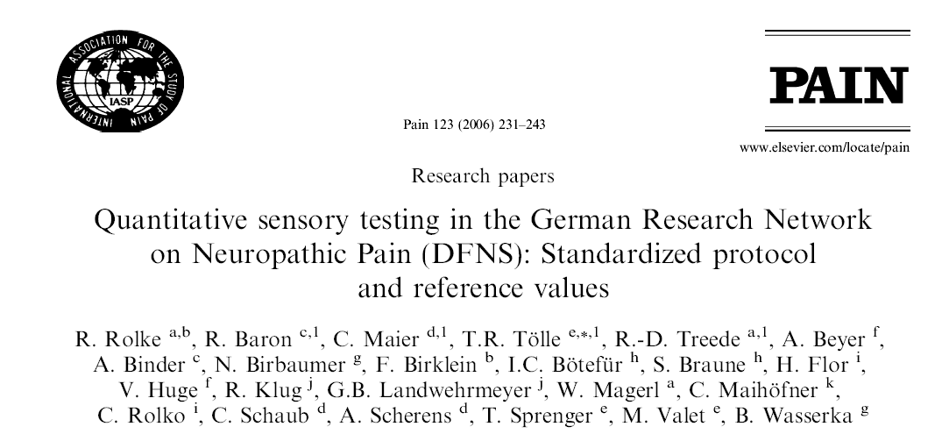
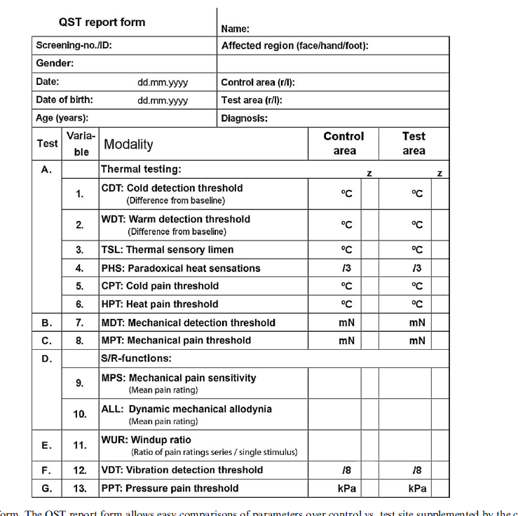
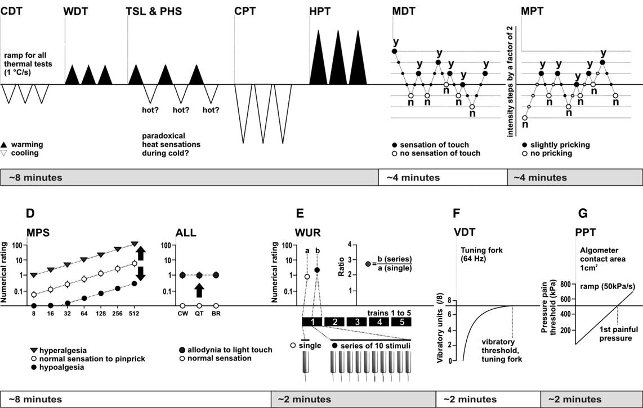
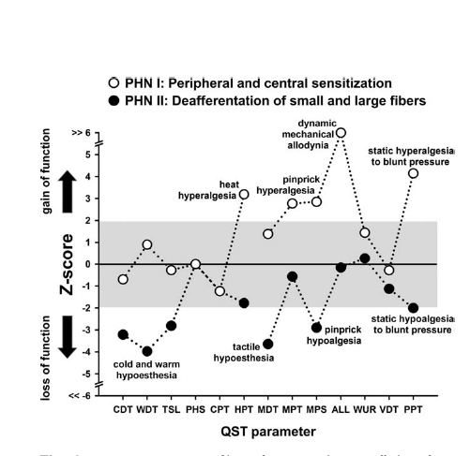
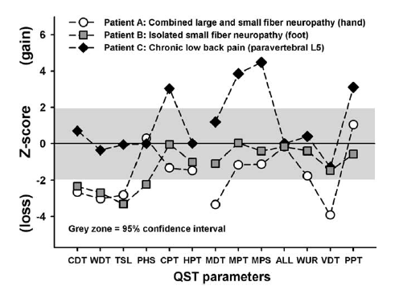
Rolke et al Eur. J. Pain 2006;10:77–88
Notes:
QST tests the somatosensory system in its entirety, from receptor to neural network. With peripheral nerves, spinal cord, brainstem and Thalamus in between

Slide 22
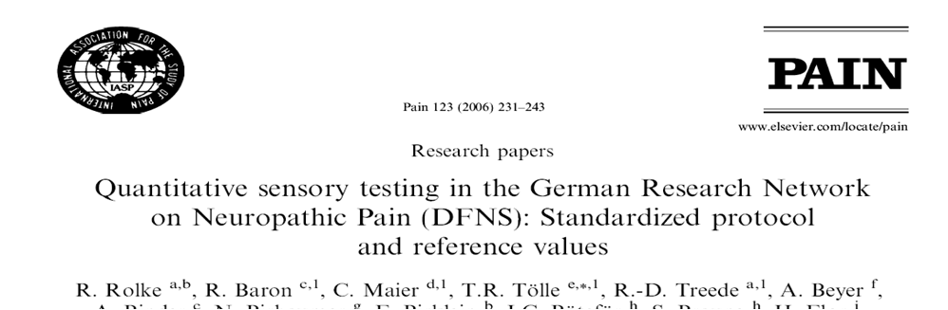
Clinical Heterogeneity of Neuropathic Pain – Clinical Signs

Slide 23
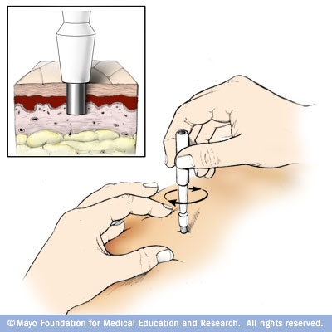
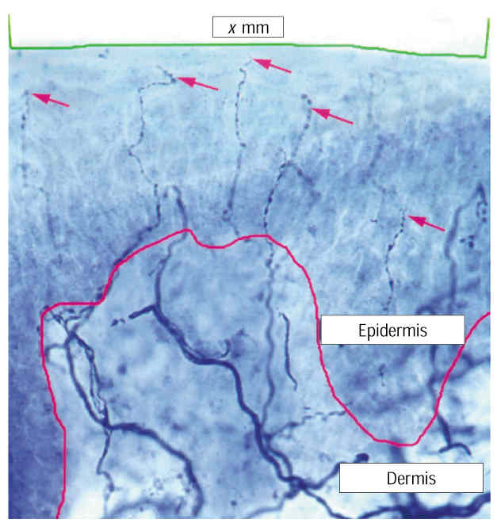
Is there a lesion or disease of the somatosensory system?
  Clinical history and examination
  Imaging
  Electrophysiological studies
  Quantitative sensory testing
  Skin biopsy (3-4mm punch)
    Minor outpatient procedure
    Intraepidemal nerve fibre density measurement
    Requires skilled immunohistochemistry and image analysis
McArthur JC et al Arch. Neurol. 1998;55:1513-20
Notes:
Editors: Warrell, David A.; Cox, Timothy M.; Firth, John D.; Benz, Edward J.
Title: Oxford Textbook of Medicine, 4th Edition
Copyright ©2003 Oxford University Press
> Table of Contents > Volume 3 > 24 - Neurology > 24.2 - Electrophysiology of the central and peripheral nervous systems > Studies of the peripheral neuromuscular system > Nerve conduction studies
Nerve conduction studies
Motor and sensory nerve conduction studies of peripheral nerves are performed by recording the propagated responses evoked by supramaximal electrical nerve stimulation. The responses reflect the summation of action potentials from individual sensory nerve fibres (the compound sensory action potential, CSAP) or motor units (the compound motor action potential, CMAP), and their amplitudes represent a semiquantitative measure of the number of activated myelinated fibres. The CSAP amplitude is an
P.3.919
expression of activity in large fibres with diameters greater than 7 µm, whereas small fibres in the nerve contribute only slightly to the response. The CMAP amplitude is a reflection of the number of α-motor neurones. A reduction of the CSAP or the CMAP amplitudes is an indicator of fibre loss. However, the CMAP amplitude is also influenced by the size of the motor-unit response. During chronic axonal loss, collateral spouting causes an increase of the MUP, which partially or completely may compensate for the fibre loss. Since reinnervation does not have the same effect on sensory nerves, the CMAP is a less sensitive measure for determining the degree of fibre loss in chronic axonal lesions than the amplitude of the CSAP. Conduction studies are supplemented with EMG to ascertain whether motor fibres are affected by the pathological process.
Method
Investigations of motor and sensory fibres are carried out separately.
Motor conduction studies
The nerve is stimulated by an electrical pulse of 0.1- to 0.2-ms duration applied to the nerve at well-defined sites, with the cathode (depolarizing electrode) being placed over the nerve distal to the anode if a longitudinal electrode placement is used. It is essential that the stimulation pulse is supramaximal, defined as being 10 to 20 per cent above the stimulus strength that elicits a maximal CMAP. This stimulation strength requires that the output of the stimulator provides a stimulus at least four times higher than threshold when surface electrodes are used, and ensures that all fibres in the nerve remain activated even though the stimulation electrode may move slightly. The CMAP is recorded from the muscle, preferably using surface electrodes or a subcutaneous needle electrode to ensure that activity from all the muscle fibres in the muscle can be ‘seen’ by the recording electrode. Usually a belly-tendon montage is used, with the reference electrode being placed over a remote site. Recording of the CMAP with a concentric electrode is usually discouraged since the amplitude is highly dependent on how close the electrode is in relation to the active muscle fibres. However, a concentric needle electrode is useful in very atrophic muscles, as it allows a sharp deflection from the baseline to be measured. The response is amplified at a frequency band between 10 (or 20) Hz and 10 kHz.
Measurements
The parameters include latencies, conduction velocities, amplitudes, areas, durations, and shapes of the CMAPs (Fig. 12). The latency is measured to the first deflection from the baseline, which is negative when the CMAP is recorded from the endplate zone. Motor nerve conduction velocities (MNCV) between two sites of stimulation are calculated by dividing the distance between stimulation sites by the difference in latencies (Fig. 12).
Fig. 12 Motor and sensory conduction studies of a normal ulnar nerve from a patient with diffuse complaints from the arm. Above: compound sensory action potentials, evoked by electrical stimulation at digit V (DV), were recorded via needle electrodes at the wrist (WR), below the elbow (DE), and above the elbow (PE). The latencies were measured to the first positive peak (arrows) and the sensory nerve conduction velocities (SNCV), indicated above the traces, were calculated as indicated in the Method section. Below: compound muscle action potentials, evoked by stimulation at the wrist (WR), below the elbow (DE), and above the elbow (PE) were recorded via a surface electrode over the abductor digiti minimi muscle (ADM). The latencies were measured to the first deflection from the baseline (arrows). DML (distal motor latency) and MNCV (motor nerve conduction velocities), indicated above the traces were obtained as described in the Method section.
P.3.920
Distance between stimulation sites (mm)Difference between distal and proximal latencies (ms) = MNCV (m/s)
An MNCV is not calculated for the most distal site of stimulation since the latency includes conduction along terminal motor-axon branches and the neuromuscular transmission delay. In this instance, the delay is designated the distal motor latency (DML) (Fig. 12).
The CMAP amplitude (in mV) is measured either at the negative phase or peak-to-peak. The negative phase is usually preferred since it is less subject to influence by the positioning of the reference electrode. The area and duration of the negative phase are useful in evaluating temporal dispersion or conduction block.
Sensory conduction studies
In contrast to the CMAP, the compound sensory action potential (in µV) is recorded directly from active nerve fibres, and it is therefore only about 1/500th to 1/1000th of the CMAP amplitude. The response may be recorded through surface electrodes placed on the skin above the nerve or through needle electrodes placed close to the nerve. Surface electrodes are easy to apply but have a lower sensitivity than needle electrodes. In some normal, elderly people a CSAP from the lower limbs may, therefore, not be recorded through surface electrodes that have a resolution of about 1 µV, whereas near-nerve needle electrodes allow the recording of responses with an amplitude as low as 0.1 µV. In addition, the use of needle electrodes allow simultaneous recording from several sites along the nerve, which are usually not possible using surface electrodes (Fig. 12).
Sensory responses may be recorded antidromically (proximal stimulation, distal recording) or orthodromically (distal stimulation, proximal recording). The recording and reference electrodes may be placed longitudinally in relation to the nerve (bipolar recording), or the reference electrode may be placed transversely at a remote site (unipolar recording). The recording arrangements have advantages and disadvantages: the main advantage of bipolar recording being a smaller stimulus artefact; and the main disadvantage that the potential recorded by the reference electrode influences the CSAP shape and amplitude. Due to the low amplitude of the CSAP, electronic averaging is usually required to obtain a clear response that is suitably free of noise.
Measurements
The parameters include latencies, conduction velocities, amplitudes, and shapes of the CSAPs. The latency is measured to the first positive phase of the CSAP. This indicates conduction along the largest fibres in the nerve. Since the conduction path between the sites of stimulation and recording does not include synaptic transmission, a distal sensory nerve conduction velocity (SNCV) may be calculated (Fig. 12):
Distance between stimulation and recording sites (mm)Latency (ms) = Distal SNCV (m/s)
When the orthodromically conducted CSAPs are recorded at several sites along the nerve, the SNCV is calculated using a similar procedure as that used to calculate the MNCV:
Distance between proximal and distal recording sites (mm)Differernce between proximal and distal latencies (ms) = SNCV (m/s)
In some laboratories, the latency of the CSAP is measured to the first negative phase. This is to be discouraged, since this part of the response is a summation of both large and small fibres. A change in summation due to temporal dispersion therefore precludes measurements to the same group of fibres.
The amplitude of the CSAP (in µV) is measured peak-to-peak. The shape is usually bi- or triphasic. In both axonal and demyelinating neuropathies the shape may become dispersed, and when recorded with a needle electrode, the shape may become polyphasic. Due to temporal dispersion, the conduction distance has a marked influence on the shape of the CSAP. At long conduction distances a polyphasic shape may be normal.
Clinical correlations
The motor and sensory nerve conduction velocities (MNCV, SNCV) are measures of conduction of the largest motor and sensory fibres in the nerve. These limitations should be considered when the results of the studies are interpreted as, for example, a small-fibre neuropathy may escape detection. Similarly, if just a single large motor fibre is preserved, the motor conduction velocity may remain normal, indicating that the conduction velocity cannot be used in isolation to establish the presence of a neuropathy.
Focal nerve lesions
The number of patients referred to the clinical neurophysiology laboratory with possible focal nerve lesions due to compression or entrapment at root level, or along the course of the nerve, far outweighs that for other neuromuscular disorders. In entrapment and focal compression neuropathy, the main pathological abnormalities comprise demyelination at the site of the lesion, which is complicated by axonal loss in advanced lesions. Accordingly, the electrophysiological findings display a disproportionate slowing of conduction at the site of the compression, and also, in some cases, a loss of fibres as demonstrated by reduced amplitudes of the CMAP and the CSAP. This is illustrated in Fig. 13 from a patient with ulnar nerve entrapment at the elbow; the MNCV and SNCV across the elbow were markedly reduced compared to the conduction velocities distal to the elbow, consistent with a focal demyelinating lesion. The CSAP amplitudes were, in addition, markedly diminished, thus indicating axonal loss (Fig. 13(b)), and the slight reduction in SNCV distal to the elbow is commensurate with a loss of large fast-conducting fibres. The apparent sparing of the CMAP
P.3.921
amplitude is due to collateral reinnervation masking the motor fibre loss revealed by EMG examination (see above). The slight MNCV reduction distal to the elbow is due to the fibre loss (Fig. 13(a)). Similar methods are used to study focal nerve lesions in patients with compression of the peroneal nerve at the fibular head and in patients with Saturday night palsy (compression of the radial nerve in the spiral groove).
Fig. 13 Conduction studies in a patient with clinical signs of an ulnar nerve lesion. Both (a) motor and (b) sensory conduction showed a marked reduction of conduction velocities across the elbow (57 per cent and 41 per cent reduced between distal to the ulnar sulcus (DS) and proximal to the sulcus (PS), respectively). In addition, there was motor and sensory axonal loss, as indicated by the reduction in amplitudes of the CMAP and the CSAPs. The mild–moderate slowing of conduction distal to the elbow was probably due to a loss of large fibres.
In patients with carpal tunnel syndrome, the distal motor latency of the CMAP to the abductor pollicis brevis muscle, evoked by stimulation at the wrist, is prolonged, indicating a slowing of conduction beneath the flexor retinaculum. However, because it is difficult to stimulate motor fibres distal to the entrapment, differential attenuation of the MNCV is therefore not assessed. To ensure that the median nerve is selectively affected, the latency to the non-affected ulnar nerve should be normal. The SNCV, by contrast, may be tested both distal to and across the carpal tunnel, and is disproportionately reduced along this segment of the nerve compared with that distal to it. Variations on the study paradigm have been devised to increase the sensitivity of the electrophysiological studies.
On the other hand, it is usually not possible to directly study conduction across the compressed nerve segment in patients with very proximal lesions located at spinal roots or the brachial plexus across a cervical rib or band. In these situations, the anatomical distribution of EMG signs of chronic partial denervation is important in the differential diagnosis. For example, EMG findings in patients with apparent involvement of the ulnar nerve due to a C8 lesion or a thoracic outlet syndrome include abnormalities in non-ulnar nerve innervated muscles (for instance, the abductor pollicis brevis and the extensor digitorum communis muscles). This distribution of motor axon loss, and the absence of focal MNCV changes at the elbow (Fig. 14(a)), show that a single nerve lesion is not the cause of the clinical deficit, but it does not distinguish between a radicular and a brachial plexus lesion. By contrast, sensory conduction studies in root lesions usually remain normal, provided that the lesion is located proximal to the dorsal root ganglion, whereas the CSAP from digit V in the thoracic outlet syndrome is diminished due to sensory fibre loss at the level of the brachial plexus (Fig. 14(b)).
Fig. 14 Conduction studies in a patient with clinical signs of an ulnar nerve lesion that was clinically localized at the brachial plexus or the spinal roots, as indicated by the extent of sensory complaints along the medial forearm and upper arm. Both (a) motor and (b) sensory conduction showed normal conduction velocities distal to and across the elbow. However, the amplitudes of the CMAPs and the CSAPs were markedly decreased, indicating diffuse axonal loss. The loss of sensory fibres is inconsistent with a root lesion and indicates entrapment at the brachial plexus.
Generalized nerve lesions (peripheral neuropathy)
The electrophysiological study in patients with suspected polyneuropathy should document that pathological abnormalities are widely distributed. It is therefore a prerequisite that several motor and sensory nerves in the upper and lower limbs are investigated. However, the study should be individually tailored to delineate the distribution of changes, and the strategy should reflect the symptoms and clinical findings and hence address the question of the differential diagnosis. For example, it may be necessary to investigate certain nerves bilaterally if the symptoms are asymmetrical. This would allow the investigation to show whether the patient may have a mononeuropathy, a multiple mononeuropathy, or a polyneuropathy with asymmetrical features.
Axonal polyneuropathy
The underlying pathology in most patients with peripheral neuropathy is axonal loss in a symmetrical distribution, primarily located at distal nerve segments and more pronounced in the legs than in the arms. The electrophysiological characteristics in these patients are due to a loss of nerve fibres, that is associated with EMG signs of chronic partial denervation and conduction studies that show diminished amplitudes of evoked CMAPs and CSAPs. The remaining fibres in the nerve may conduct normally, and the MNCV and the SNCV in these patients may therefore be normal or show a reduction consistent with a large-fibre loss (Fig. 15). In some patients, the pathological changes may primarily be present at the distal nerve segments, thus studies of these segments will also be required (Fig. 15).
Fig. 15 Motor and sensory conduction studies of the peroneal nerve in a patient with diabetic neuropathy. The findings in this patient were consistent with axonal loss, primarily present in the very distal segment of the nerve. Top panel: orthodromic compound sensory action potentials (CSAPs), evoked at the deep peroneal nerve in the first dorsal interstice (ToeI), were recorded at the ankle (ankle) and the fibular head (CF). The amplitudes were more than 95 per cent diminished. The SNCVs were moderately diminished due to large-fibre loss. Middle panel: CSAP of the superficial peroneal nerve evoked at the superior retinaculum (RetSup) at the ankle and recorded at the CF. The amplitude was slightly diminished, and the SNCV was normal. Lower panel: compound muscle action potentials (CMAPs) of the deep peroneal nerve, evoked at the ankle and the fibular head, were recorded at the extensor digitorum brevis muscle (EDB). The distal motor latency (DML) was prolonged and the MNCV was reduced due to fibre loss.
Only motor or sensory fibres are involved in the rarer types of neuropathy, and demonstration of such a distribution may have important implications in the differential diagnosis. A sensory neuronopathy in a 47-year-old woman with profound sensory ataxia is illustrated in Fig. 16. The motor nerve conduction studies and the EMG were normal, but the sensory conduction studies were profoundly abnormal, and the sural nerve biopsy showed a 95 per cent loss of myelinated fibres (Fig. 16(a) and Fig. 16(b)). The SNCV was at the lower normal range, consistent with the slightly diminished diameter of the largest remaining fibres being around 10 µm (Fig. 16(b) and Fig. 16(c)). These findings were consistent with an autoimmune sensory neuronopathy.
Fig. 16 Morphometric and electrophysiological studies of the sural nerve in a 47-year-old woman with sensory neuronopathy. (a) Transverse semithin sections of the sural nerve showed a generalized severe fibre loss without evidence of degeneration or regeneration. (b) A total of 328 myelinated fibres were counted in the whole nerve. The fibre-diameter distribution showed a loss of both small and large fibres with a maximal diameter of 10 to 11 µm. (c) Conduction studies in the sural nerve showed a pronounced reduction of the CSAP amplitude and a dispersed shape. The SNCV was at the lower normal limit, consistent with the diameters of the largest fibres at morphometry. (Histological studies by courtesy of H. Schmalbruch, University of Copenhagen.)
Demyelinating neuropathy
Primary demyelination usually has a hereditary, inflammatory, or autoimmune basis. Although demyelinating neuropathy is rare compared to axonal neuropathy, it has become increasingly important to be able to diagnose acquired demyelinating neuropathy with a high degree of certainty since acute or chronic inflammatory demyelinating neuropathy may respond to immunomodulatory therapy. The primary electrophysiological sign of demyelination is a markedly reduced conduction velocity that is beyond the diminution caused by large-fibre loss. In hereditary motor and sensory neuropathy, type I and III, the MNCV and the SNCV are markedly diminished to less than 50 per cent of the lower limit of normal throughout the nerves, consistent with primary demyelination. In these conditions the amplitudes of the CMAPs and the CSAPs are, however, also markedly reduced and nerve biopsy confirms a marked loss of myelinated nerve fibres. Pure demyelination without axonal loss does not occur in these hereditary conditions and is extremely rare in acquired demyelinating neuropathy. The distinguishing features in acquired demyelinating neuropathy include widespread demyelination, often in a multifocal pattern, as indicated by focal temporal dispersion or conduction block or both of CMAPs
P.3.922
and CSAPs. Criteria have been established to assist in the diagnosis of these demyelinating neuropathies (Table 3).
Table 3 Criteria for the classification of acquired demyelinating polyneuropathies
Nerve conduction parameter
Albers and Kelly, 1989
Ho et al., 1997
Copenhagen values
Upper limbs
Lower limbs
Distal motor latency
>115% of UNL (amp. nl.)
>110% of UNL (amp. nl.)
4.5 ms
6.4 ms
>125% of UNL (amp. <nl.)
>120% of UNL (amp. <nl.)
5.4 ms
7.7 ms
Motor conduction
<90% of LNL (amp. nl.)
<95% of LNL (amp. >50% of LNL)
45 m/s
35 m/s
velocity
<80% of LNL (amp. <nl.)
<85% of LNL (amp. <50% of LNL)
38 m/s
30 m/s
Focal conduction
Temporal dispersion (>10–15%
Temporal dispersion
changes
increased duration). Proximal/
distal amplitude ratio, <0.7
F-wave latency
>125% of UNL
>120% of UNL
LNL, lower normal 95 per cent confidence limit; UNL, upper normal 96 per cent confidence limit; amp., amplitude of CMAP; nl., normal.
A weakness or sensory loss does not result solely from a diminished conduction velocity, but also as a consequence of nerve fibre loss or a block of conduction between the CNS and the target muscle. Conduction block is a partial or complete inability of fibres to propagate action potentials along a segment of the nerve, and is demonstrated by recording a larger motor or sensory response more distal to than proximal to the site of the block (Fig. 17(a)). This reduction in amplitude should be greater than that associated with a temporal dispersion of the conducting fibres. Therefore to demonstrate a block of motor fibres, the CMAP should show a reduction of at least 50 per cent (Fig. 17(a)). Conduction block may occur in acquired acute or chronic inflammatory demyelinating neuropathy and in some cases of monoclonal gammopathy. It does not occur in hereditary demyelinating neuropathy and probably not in gammopathy with IgM anti-MAG antibodies. However, demyelination due to compression may also cause a conduction block, and in demyelinating neuropathy a conduction block must therefore be demonstrated outside the usual sites of entrapment or compression. The pathophysiological changes in inflammatory demyelinating diseases usually show a multifocal pattern, with some nerves showing pronounced changes while other nerves or nerve segments have normal conduction.
Fig. 17 Motor conduction studies of the median and ulnar nerves of a 29-year-old woman with electrophysiological signs of demyelinating neuropathy and clinical signs of relapsing chronic inflammatory demyelinating neuropathy. Clinical examination showed marked weakness of the thenar and forearm median innervated muscles. The force in ulnar innervated muscles was normal. Left panel: CMAP recorded from the abductor pollicis brevis muscle (APB). Stimulation at the wrist (WR) and elbow (EL) elicited normal CMAPs and the DML and MNCV along the forearm were normal. Stimulation at the axilla (AX) resulted in a markedly reduced CMAP amplitude and a reduced MNCV between the elbow and axilla, consistent with a partial conduction block. Right panel: stimulation of the ulnar nerve at the wrist and axilla evoked CMAPs at the abductor digiti minimi (ADM) of normal amplitudes, DML and MNCV, indicating that motor fibres were not affected.
Apparent conduction block may be found in acute neuropathies due to vasculitis. However, conduction along the nerve segment distal to a focal lesion may continue for several days before Wallerian degeneration takes place, and repeated studies should therefore be carried out to exclude this possibility.
Motor disorders (motor neurone disease and motor neuropathy)
Conduction studies in motor neurone disease are normal at early stages of the disease, but at late stages the CMAP amplitudes are reduced. The distal motor latencies of weak and wasted muscles are often prolonged, and the MNCV slightly to moderately reduced due to a loss of large α-motor axons. In ALS, sensory conduction studies are usually normal, though the CSAP amplitudes may be slightly diminished. Therefore, conduction studies are mainly of use in the diagnosis of ALS in that they are normal in the face of widespread neurogenic changes at EMG. However, patients with X-linked bulbospinal muscular atrophy (Kennedy's syndrome) are characterized by a marked reduction of CSAP amplitudes, while the EMG examination shows abnormalities characteristic of motor neurone disease (fasciculations, widespread denervation, markedly enlarged and prolonged MUPs, and discrete high-amplitude recruitment at maximal effort).
Asymmetrical or focal weakness, atrophy, fasciculations (see Fig. 7), without or with only slight sensory symptoms, due to multifocal motor neuropathy may be mistaken for the early stages of spinal forms of motor neurone disease. The course is, however, prolonged over several years, and there is no involvement of bulbar muscles and no signs of corticospinal involvement. The electrophysiological features in these patients are distinct, with conduction block of motor fibres indicating focal demyelination. Usually there is also EMG evidence of chronic partial denervation, indicating fibre loss. The sensory conduction studies through affected nerve segments are normal. These patients frequently have high titres of anti-GM1 antibodies, and often respond clinically and electrophysiologically to intravenous infusions of immunoglobulin. Patients with chronic inflammatory demyelinating neuropathy may have mainly motor symptoms, with only minimal sensory deficits. Motor conduction studies in chronic inflammatory demyelinating neuropathy show signs of mixed demyelination, including conduction block, and fibre loss; sensory conduction studies are abnormal, with small CSAP amplitudes and often reduced SNCV. This is an important distinction, since patients with chronic inflammatory demyelinating neuropathy may respond to treatment with corticosteroids and other immune-modulating strategies that have no effect on multifocal motor neuropathy.
Andrew S.C. Rice MB BS MD FRCA FFPMRCA
Professor of Pain Research
Department of Anaesthetics, Pain Medicine and Intensive Care
Imperial College London
Chelsea & Westminster Hospital Campus
369 Fulham Road,
London SW10 9NH,
United Kingdom
Tel: +44 (0) 20 8746 8816
Fax: +44 (0)20 8237 5109
email a.rice@imperial.ac.uk
Sensory conduction in the median, ulnar, and radial nerves can be measured by applying stimuli through ring electrodes upon a finger (Fig. 2.19) and then recording the sensory nerve action potential through cutaneous electrodes applied over the trunk of the nerve (orthodromic conduction). For other nerves, such as the sural, the nerve trunk is stimulated and sensory nerve action potentials recorded from surface electrodes (antidromic or orthodromic conduction). The sensory nerve action potential (SNAP) is so small that averaging techniques are required following multiple stimuli, and occasionally needle recording electrodes inserted close to the nerve are required (Kimura 1983; Liveson and Ma 1992; Binnie et al. 1995).
View Figure
Fig. 2.19. Diagrammatic representation of the technique of measuring the sensory nerve action potential (SNAP) in the median nerve (at points R₁, R₂, R₃) after orthodromic stimulation of the finger(s) (reproduced from Bradley 1974).
Sensory nerve action potential amplitudes generally range from 5 to 50 µV, depending upon the particular nerve being studied, and drop in amplitude, or absence of the potential, occurs in axonal degenerative, demyelinating, or compressive neuropathies. Thus a diminished SNAP cannot in itself distinguish between these types of neuropathy. Sensory nerve action potentials reflect the integrity of the distal axonal branch of the dorsal root ganglion sensory neurons. They remain normal in disease such as spondylitic radiculopathy affecting the spinal nerve roots containing the proximal axonal branches because the dorsal root ganglia cell bodies lie outside the intervertebral foramina (Aminoff et al. 1985). The only exception to this can occur in the lower lumbar and sacral nerve roots, in which the dorsal root ganglia can lie within the intervertebral foramina, and loss of sensory nerve action potentials may occur with spinal disease as well as with peripheral nerve disease. Radiculopathy may be confirmed by the finding of denervation within limb and paraspinal muscles innervated by the same segment. Sensory nerve conduction latencies and velocities can be measured but generally find little usefulness in diagnostic clinical practice. Routine techniques for measuring possible conduction block in sensory nerves have not been established.
Andrew S.C. Rice MB BS MD FRCA FFPMRCA
Professor of Pain Research
Department of Anaesthetics, Pain Medicine and Intensive Care
Imperial College London
Chelsea & Westminster Hospital Campus
369 Fulham Road,
London SW10 9NH,
United Kingdom
Tel: +44 (0) 20 8746 8816
Fax: +44 (0)20 8237 5109
email a.rice@imperial.ac.uk

Slide 24
Skin biospsies
Punch biopsies can quantify A delta and C fibres by measuring the density of intra-epidermal nerve fibres ( IENF)
Minimally invasive
Useless in central pain and demyelating neuropathy
Only available in few centres

Slide 25
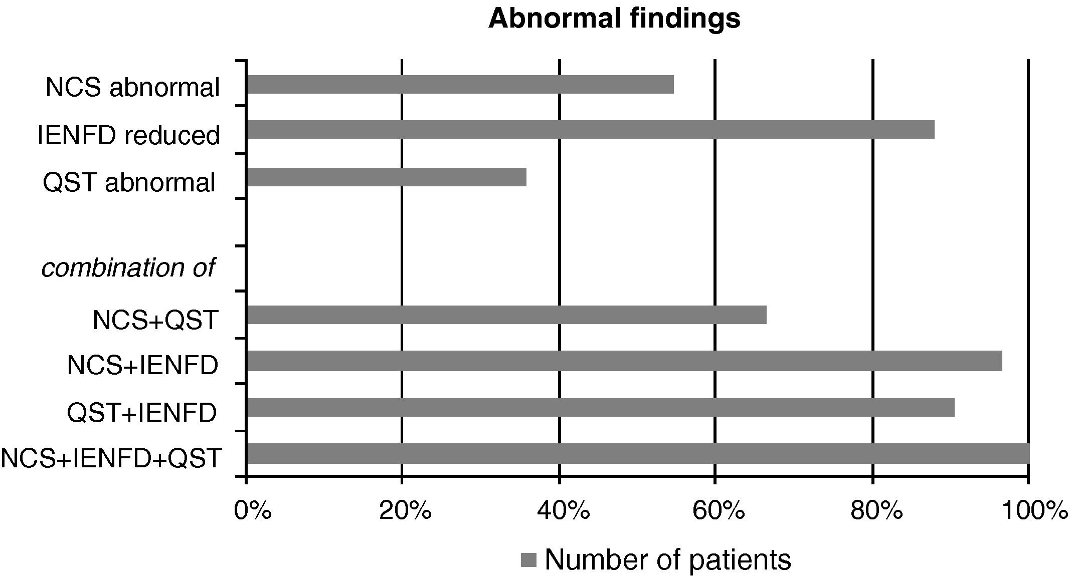
Scherens et al. European Journal of Pain 13 (2009)
Notes:
Pat with dysesthesias

Slide 26
Diagnosis & Assessment of Neuropathic Pain
Investigation of underlying disease.
Is there a lesion or disease of the somatosensory system?
Is the pain neuropathic?
How severe is the pain?
What is the impact of the pain?

Slide 27
Is The Pain Neuropathic?
Body chart
Questionnaires for pain characteristics

Slide 28
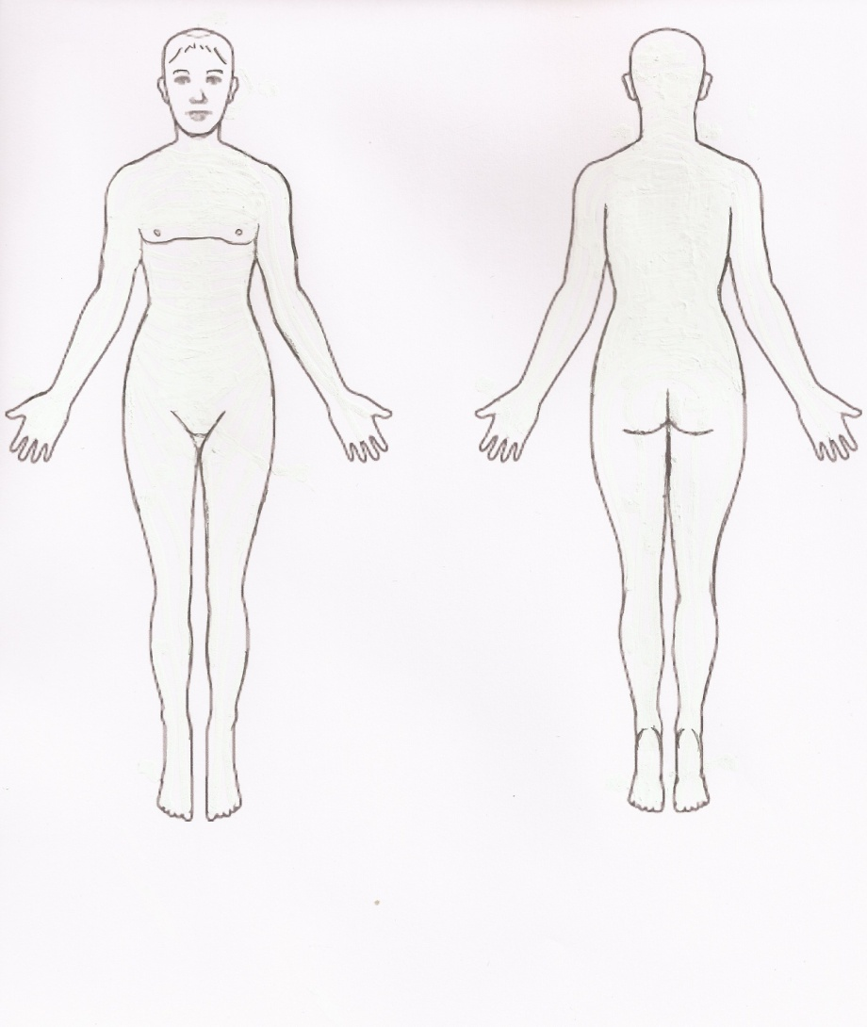
Is The Pain Neuropathic?
Body chart to determine whether pain:
  Lies within dermatome distribution
  Lies within peripheral nerve distribution
  Has “glove and stocking” distribution

Slide 29
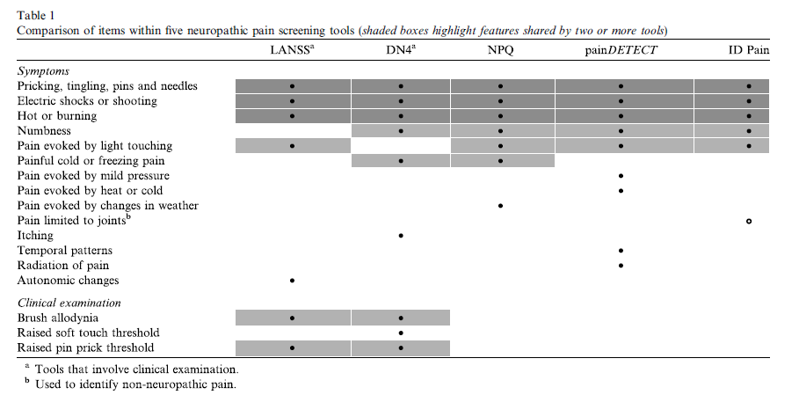
Notes:
Screening tools fail to identify 10-20% of patients. Cannot replace clinical judgement

Slide 30
Douleur Neuropathique 4 Questions (DN4)
Bouhassira et al Pain 2005;114:29–36
7 symptom questions
3 clinical examination questions
Specificity 83%
Sensitivity 90%
Score > 4/10 = POPNO*
7 symptom questions can be used alone as self administration form
Multiple validations in several languages
* Pain of Predominantly Neuropathic Origin
Notes:
Sesnitivity – abilty to detect true +
Specfcfity abilty to dtect treu -ve

Slide 31
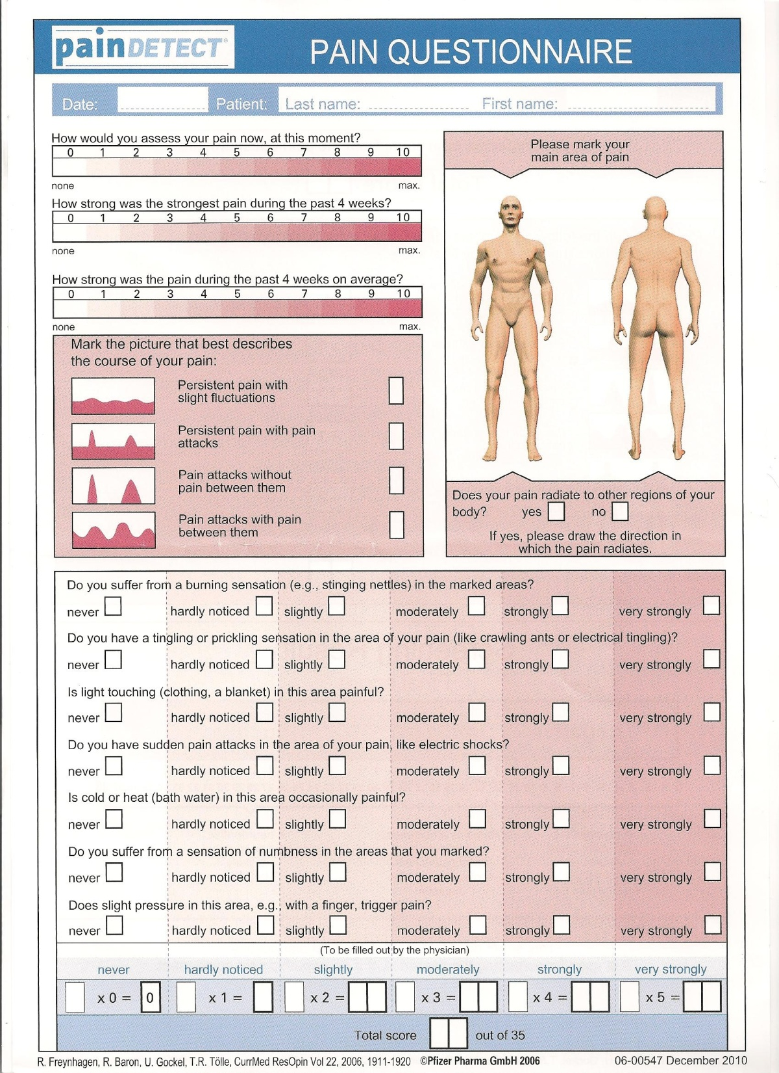

Slide 32
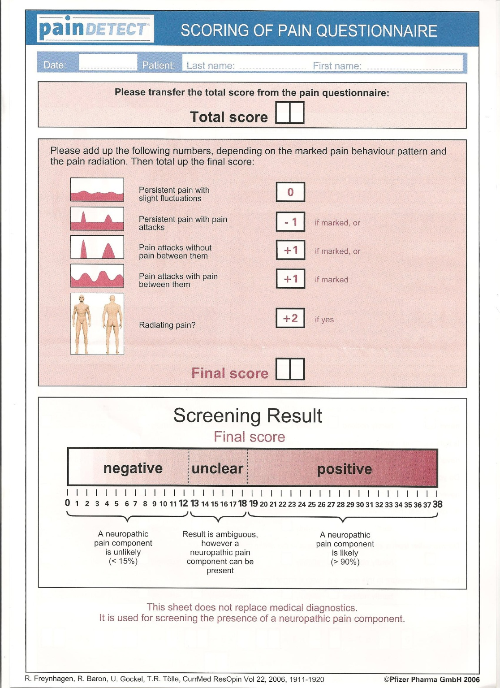

Slide 33
Diagnosis & Assessment of Neuropathic Pain
Investigation of underlying disease.
Is there a lesion or disease of the somatosensory system?
Is the pain neuropathic?
How severe is the pain?
What is the impact of the pain?

Slide 34
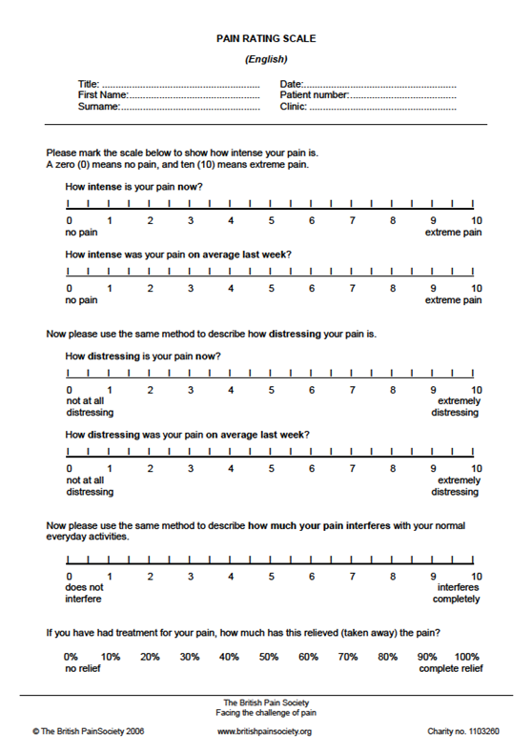
How severe is the pain?
Conventional analogue, Likert or categorical scales are adequate for routine clinical use
Separate measurement for:
  Spontaneous pain - continuous
  Spontaneous pain – paroxysmal (also event diary)
  Evoked pain - various modalities
Can also be used for:
  Pain relief
  Other symptoms e.g. paraesthiesae

Slide 35
Diagnosis & Assessment of Neuropathic Pain
Investigation of underlying disease.
Is there a lesion or disease of the somatosensory system?
Is the pain neuropathic?
How severe is the pain?
What is the impact of the pain?

Slide 36
Co-morbidity associated with peripheral neuropathic pain
Difficulty sleeping
60
Lack of energy
55
Drowsiness
39
Concentration difficulties
36
Depression
33
Anxiety
27
Poor appetite
18
0
10
20
30
40
50
60
70
% patients with moderate to very severe discomfort due to symptoms (n=126)
1. Meyer-Rosberg K et al. Eur J Pain 2001; 5: 379–389.
Notes:
Key message
Patients with peripheral neuropathic pain experience significant co-morbid symptoms
Other information
This study investigated pain intensity, employment status and quality of life in a survey of 126 patients with neuropathic pain from 2 Swedish Multidisciplinary Pain Centres¹
Patients were asked to what extent they were bothered by 25 pain-related symptoms and/or side-effects of treatment during the past week (rated as 1 = no discomfort to 7 = very severe discomfort)¹
The slide shows the proportions of patients who scored 4 (moderate) to 7 (very severe) discomfort. Data on 7 of the 10 most frequently reported symptoms are shown on the slide¹
Difficulty sleeping was most bothersome and was moderate to very severe in 60% of patients¹
Moderate to very severe discomfort due to anxiety was reported by 27% (1 in 4 patients) and depression by 33% (1 in 3 patients)¹
Reference:
Meyer-Rosberg K, Kvarnström A, Kinnman E et al. Peripheral neuropathic pain – a multidimensional burden for patients. Eur J Pain 2001; 5(4): 379–389.

Slide 37
What is the impact of the pain?
Domains:
  Sleep interference
  Anxiety
  Depression
  Quality of life and health impact
  Impact on daily living/function

Slide 38
Pain is a complex experience that depends strongly on cognitive, emotional, cultural and educational influences.
We need tools that can measure pain objectively.
by G. Cruccu and A. Truini

Slide 39
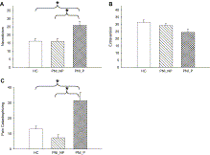
Pain-catastrophizing and personality scores (K.S.Taylor et al. Pain 2010)
Patients following complete upper limb peripheral nerve trans-section with neuropathic pain and without
With pain had changes in QST
Worse motor recovery
Difference in pain-catastrophizing, personality, belief
Fig. 5. Pain-catastrophizing and personality scores are displayed for healthy controls (HCs), patients without pain (PNI-NP), and patients with pain (PNI-P). Mean (±SE) group data are shown for (A) neuroticism scores, (B) extraversion scores, and (C) pain-catastrophizing scores. Asterisks denote statistically significant differences of p < 0.05.

Slide 40
Levels of objectivity
Laboratory tests that measure objective responses (NCS, LEP, fMRI)
QST (quantitative sensory testing)
Bedside examination
Pain questionnaires

Slide 41
No correlation between distinct neuropathic pain subtypes, these are not defined by the condition causing pain
Pain subtypes might represent active
biological mechanism. Examples:
spontanous burning pain- ectopic discharges in heat sensitive nociceptor neurons
Brush stroke evoked pain likely due to increase in excitability of dorsal horn neurons

Slide 42
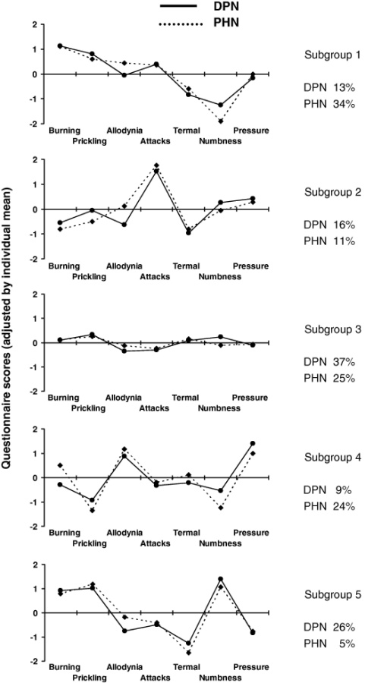
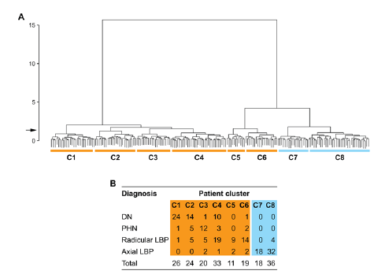
Clinical Heterogeneity of Neuropathic Pain - Symptoms
Scholz et al PLoS Medicine 2009;6:e1000047
Baron et al Pain 2009;146:34
Notes:
Also Backonja & stacey 64 % mechaical 38% thermal hypersesnitivuty

Slide 43
Standardized evaluation of pain (StEP)Developed by Scholz and colleagues
Low back pain (nociceptive axial pain and neuropathic radicular pain
Six interview questions
Ten physical tests
90% sensitivity and specificity in distinguishing neuropathic from nociceptive pain

Slide 44
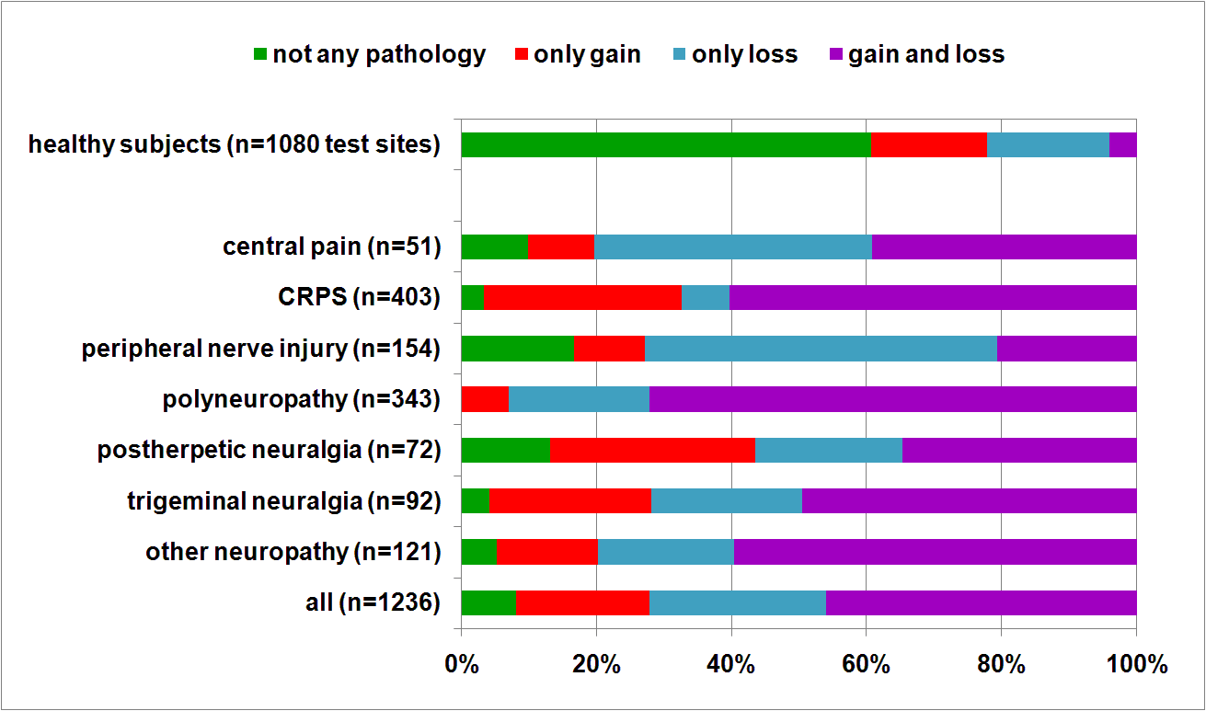
Clinical Heterogenity of Neuropathic Pain – Clinical Signs
Maier C et al Pain 2010; 150:439-450
Notes:
92% of patients at least one QST abnormality. Mechanical tests revealed more abnormality than thermal tests. Highest rate of abnormalities in PHN

Slide 45
Conclusion
Often cause of neuroapthic pain remains unknown
New laboratory tests can help to diagnose and quantifiy damage, but do not measure pain intensity or response to treatment
fMRI the answer? Currently not widely available and not standardized

Slide 46
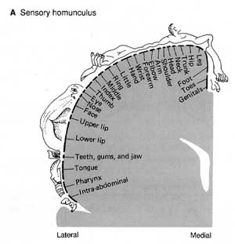
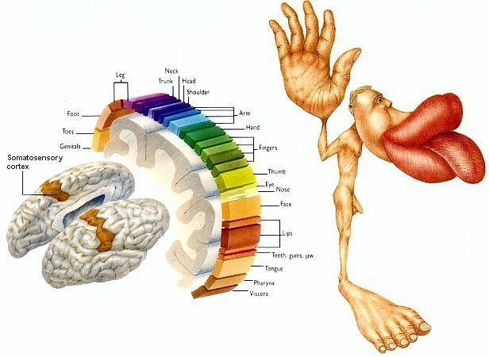
Homunculus

Slide 47
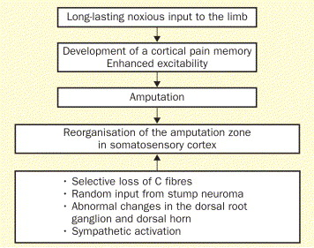
Phantom-limb pain: characteristics, causes, and treatment
Herta Flor Department of Clinical and Cognitive Neuroscience, University of Heidelberg, Central Institute of Mental Health, Mannheim, Germany
Lancet, Neurology July 2002, Pages 182-189

Slide 48
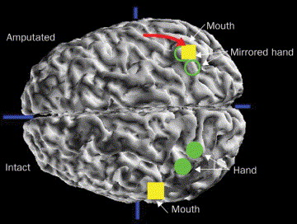
Phantom-limb pain: characteristics, causes, and treatment
Herta Flor Department of Clinical and Cognitive Neuroscience, University of Heidelberg, Central Institute of Mental Health, Mannheim, Germany
Lancet, Neurology July 2002, Pages 182-189
Notes:
Assessment of reorganisation of the primary somatosensory cortex in an individual with amputation of the arm and phantom-limb pain. Neuromagnetic source imaging was used to define the localisation of the hand and mouth regions on the cortical hemisphere contralateral to the intact side and of the mouth region on the hemisphere contralateral to the amputation side. Magnetic fields evoked by pneumatic stimulation of the fingers of the intact side and the comer of the mouth on both sides were integrated with structural magnetic resonance images. The localisation of the intact hand was then transposed to the side contralateral to the amputation (with the assumption of a symmetrical localisation of the somatosensory homunculus) to assess where the former hand region was localised. The mouth representation on the amputated side has completely invaded the hand region. The amount of shift can be identified by calculating the Euclidean distance between the mouth and the hand region. The larger this distance (red arrow) the greater the cortical reorganisation.

Slide 49
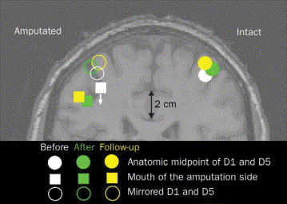
Phantom-limb pain: characteristics, causes, and treatment
Herta Flor Department of Clinical and Cognitive Neuroscience, University of Heidelberg, Central Institute of Mental Health, Mannheim, Germany
Lancet, Neurology July 2002, Pages 182-189
Notes:
Change in cortical reorganisation after training in sensory discrimination in a group of patients with arm or hand amputations. On the right, the representation of the hand of the intact side is shown for the measurement points before and after training and at 3-month follow-up. On the left, the mirror image of the hand representation is shown in the upper part of the figure. The lower part shows the change of the mouth representation of the amputation side. After training the reorganisation was reversed-ie, the mouth has shifted toward its original more inferior and lateral position. At 3-month follow-up (no training in between) the original reorganisation is again approached.

Slide 50
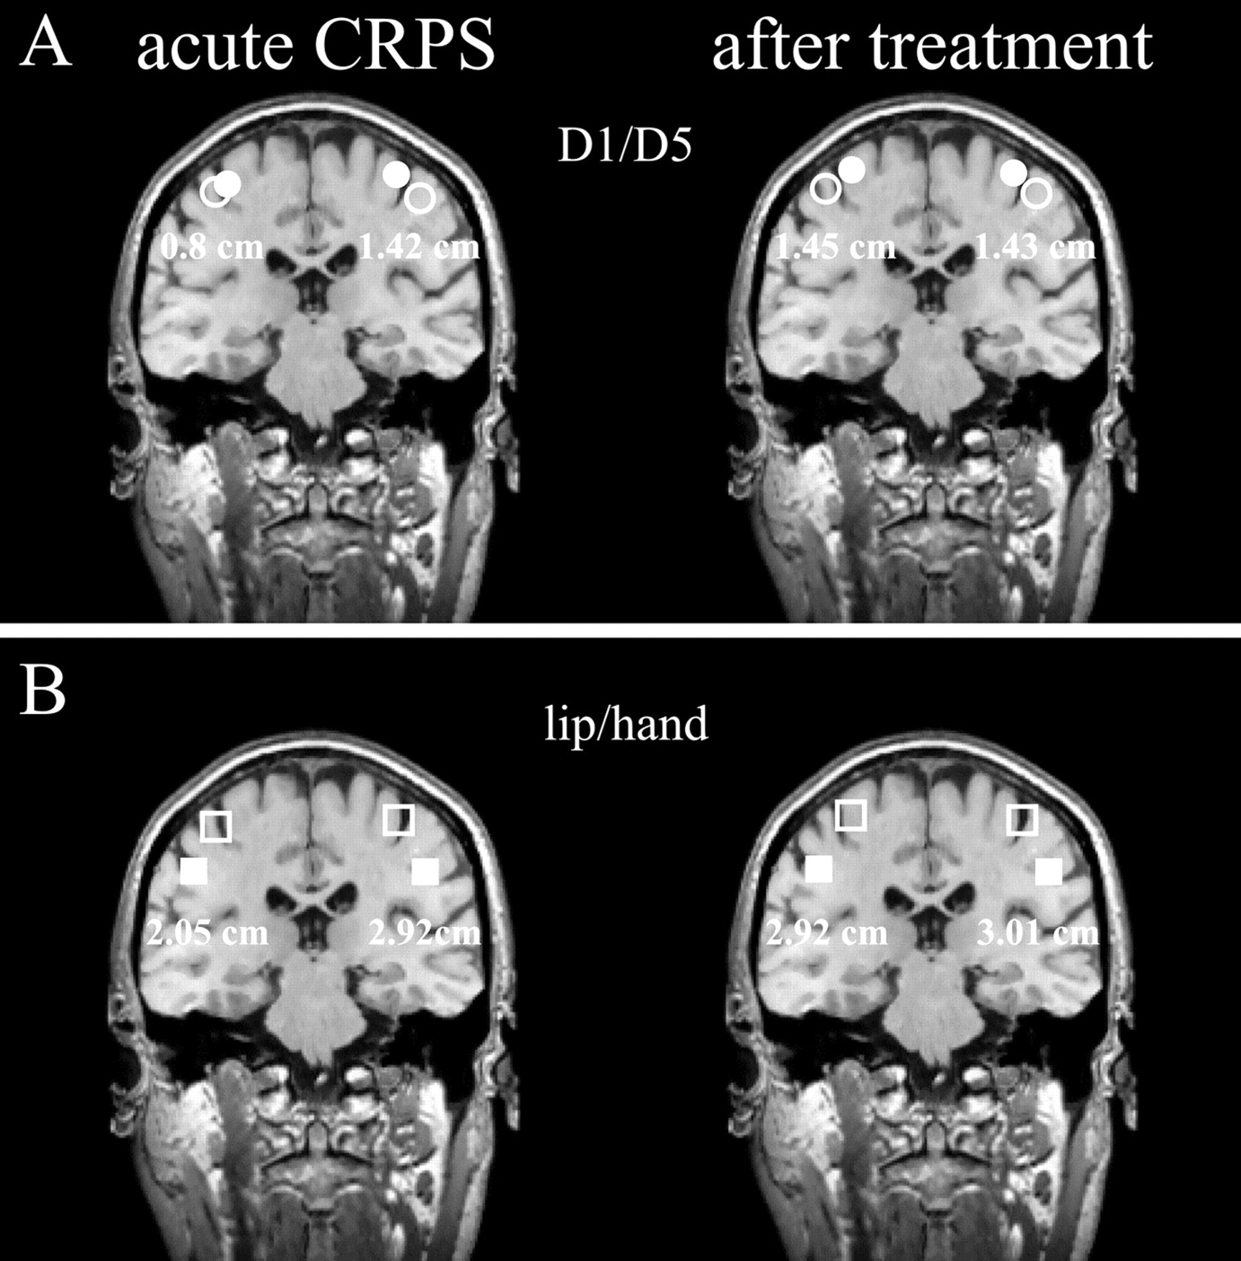

Figure 2. (A) Projection of the equivalent current dipole (ECD) localizations for D1 (filed circle) and D5 (open circle) onto individual MRI slices for one representative patient (#3).
http://www.roussillon.co.uk/
Maihöfner C et al. Neurology 2004;63:693-701
©2004 by Lippincott Williams & Wilkins
Notes:
Figure 2. (A) Projection of the equivalent current dipole (ECD) localizations for D1 (filed circle) and D5 (open circle) onto individual MRI slices for one representative patient (#3). There was a reduction of the hand extension from 1.42 cm (unaffected side) to 0.8 cm (complex regional pain syndrome [CRPS]-affected side) during acute CRPS. After the follow-up time of 62 months, the distance between D1 and D5 increased to 1.45 cm on the affected side, whereas the corresponding distance on the unaffected side remained unchanged (1.43 cm). (B) Projection of the ECDs for the center of the hand (open squares) and the lower lip (filled squares) onto individual MRI slices. The distance between the center of the hand and the lower lip increased from 2.05 cm to 2.92 cm following therapy on the CRPS-affected side, whereas the respective ECD localizations for the unaffected side remained unchanged (distance hand–lip 2.92 vs 3.01 cm, before and after treatment).

Slide 51
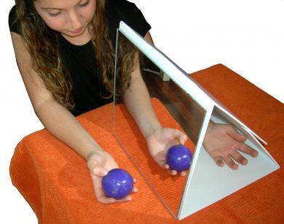

Slide 52
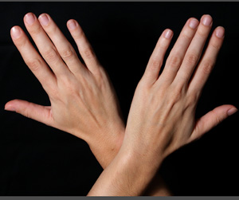
Crossing your arms relieves pain
20 May 2011 - Crossing your arms reduces the intensity of pain you feel when receiving a painful stimulus on the hand
Published in the current issue of the journal PAIN, the research shows that crossing your arms over the midline (an imaginary line running vertically down the centre of the body)
confuses the brain and reduces the intensity of the pain sensation.
Scientists believe that the reason for this phenomenon is due to conflicting information between two of the brain’s maps – the one for you body and the one for external space.
As your left hand usually performs actions on the left side of space (and vice-versa for the right side), these two maps are used to working together to produce strong impulses in response to stimuli.
When our arms are crossed, the two maps are mismatched and processing of noxious information is weakened – resulting in less pain.

Slide 53
Many thanks to Prof Rice

