Slide 1


Neuropathic pain 1
Dr Wenlong Huang
on behalf of
Professor Andrew SC Rice
a.rice@imperial.ac.uk
www.lpc.ac.uk

Slide 2
Definition of neuropathic pain
Diseases/disorders in which neuropathic pain appears
Mechanisms of neuropathic pain

Slide 3
Define Neuropathic Pain
Neuropathic pain is caused by a lesion or disease affecting the somatosensory nervous system
Treede,R.D. et al. Neuropathic pain: redefinition and a grading system for clinical and research purposes. Neurology 70, 1630-1635 (2008).

Slide 4
Biological Function of Pain
Pain
Cutaneous Nociceptive Pain
Warns of External Threat
Visceral Nociceptive Pain
Warns of Internal Disease
Neuropathic Pain
No Useful Biological Role
Disorder of Maladaptive
Nerve Repair & Regeneration?

Slide 5
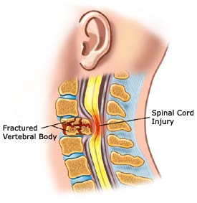

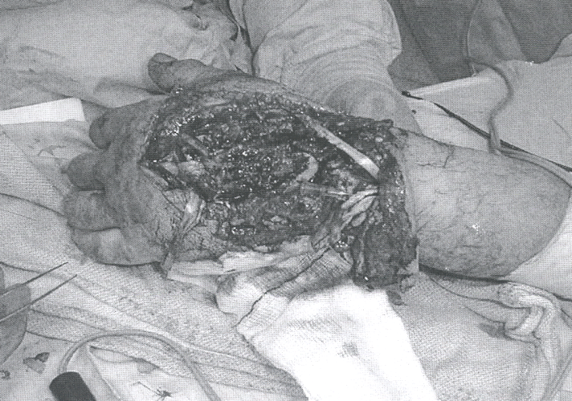
Some Diseases Associated with Neuropathic Pain
Trauma to PNS/CNS
Perkins & Kehlet. Anesthesiology 2000 93: 1123-1133
www.medicine.ox.ac.uk/bandolier

Slide 6

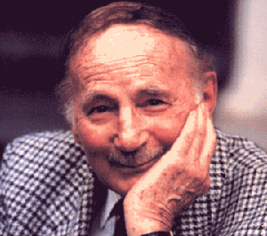
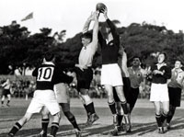
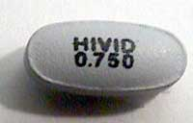
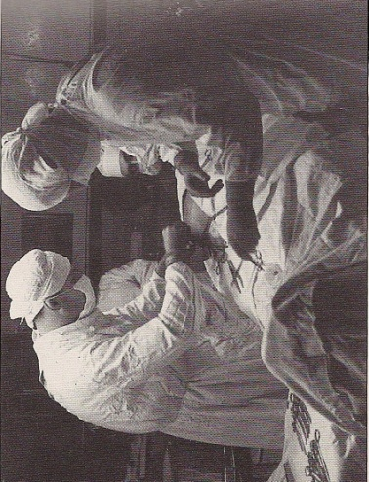

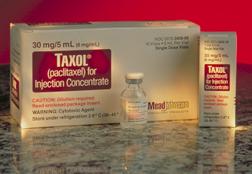
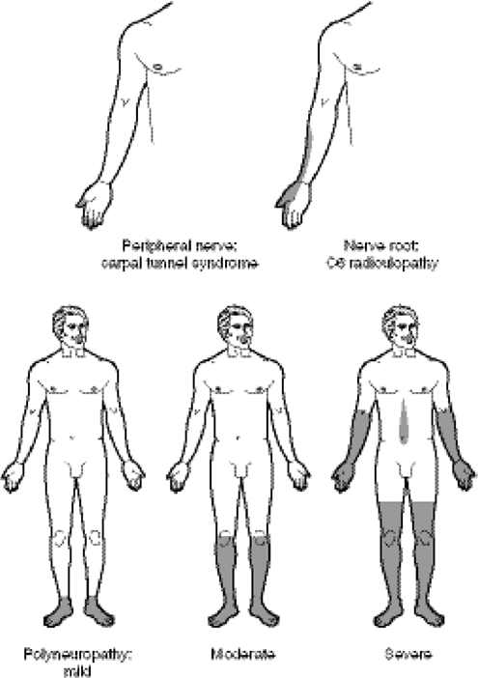
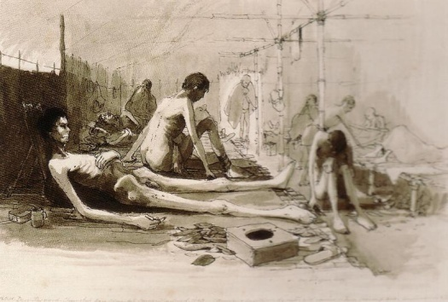

Some Diseases Associated with Neuropathic Pain
Sir Edward “Weary” Dunlop
1907 - 93
Trauma to P/CNS
Peripheral neuropathy e.g.:
  Diabetes
  Drug-induced
  Nutritional
Dry Beriberi
Thiamine (vitamin B₁) deficiency
”...intense burning of the feet
and an exquisite sensitiveness
which scarcely enables them to walk
and they cannot sleep or get any rest...”
_{War Diaries of Weary Dunlop}
Dunlop EE BMJ;1946;4474:481-6
Notes:
Sir albert coatesBeriberi is caused by a lack of thiamin (vitamin B₁). Thiamin occurs naturally in unrefined cereals and fresh foods, particularly whole grain bread, fresh meat, legumes, green vegetables, fruit, and milk. Beriberi is therefore common in people whose diet excludes these particular types of nutrition e.g. as a result of famine.
Beriberi may be found in people whose diet consists mainly of polished white rice, which is very low in thiamin because the thiamin-bearing husk has been removed. It can also be seen in chronic alcoholics with an inadequate diet (Wernicke-Korsakoff syndrome), as well as being a rare side effect of gastric bypass surgery. If a baby is mainly fed on the milk of a mother who suffers from thiamin deficiency then that child may develop beriberi as well.
Beri Beri Its symptoms include weight loss, emotional disturbances, impaired sensory perception (Wernicke's encephalopathy), weakness and pain in the limbs, and periods of irregular heart rate. Edema (swelling of bodily tissues) is common. It may increase the amount of lactic acid and pyruvic acid within the blood. In advanced cases, the disease may cause heart failure and death.
Wet beriberi affects the heart; it is sometimes fatal, as it causes a combination of heart failure and weakening of the capillary walls, which causes the peripheral tissues to become edematous.
Dry beriberi causes wasting and partial paralysis resulting from damaged peripheral nerves. It is also referred to as endemic neuritis
Its symptoms include weight loss, emotional disturbances, impaired sensory perception (Wernicke's encephalopathy), weakness and pain in the limbs, and periods of irregular heart rate. Edema (swelling of bodily tissues) is common. It may increase the amount of lactic acid and pyruvic acid within the blood. In advanced cases, the disease may cause heart failure and death.
Wet beriberi affects the heart; it is sometimes fatal, as it causes a combination of heart failure and weakening of the capillary walls, which causes the peripheral tissues to become edematous.
Dry beriberi causes wasting and partial paralysis resulting from damaged peripheral nerves. It is also referred to as endemic neuritisBeriberi is caused by a lack of thiamin (vitamin B₁). Thiamin occurs naturally in unrefined cereals and fresh foods, particularly whole grain bread, fresh meat, legumes, green vegetables, fruit, and milk. Beriberi is therefore common in people whose diet excludes these particular types of nutrition e.g. as a result of famine.
Beriberi may be found in people whose diet consists mainly of polished white rice, which is very low in thiamin because the thiamin-bearing husk has been removed. It can also be seen in chronic alcoholics with an inadequate diet (Wernicke-Korsakoff syndrome), as well as being a rare side effect of gastric bypass surgery. If a baby is mainly fed on the milk of a mother who suffers from thiamin deficiency then that child may develop beriberi as well.

Slide 7
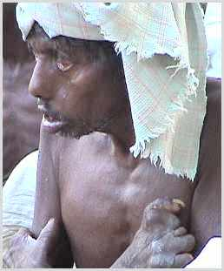
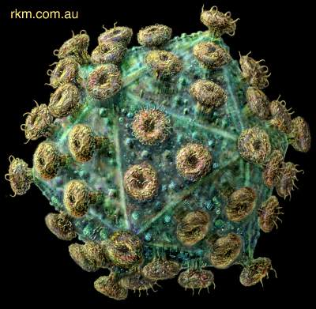
Some Diseases Associated with Neuropathic Pain
Trauma to P/CNS
Peripheral neuropathy
Infection e.g.:
  Herpes zoster
  HIV
  Syphilis
  Leprosy
Image from:
Dworkin et al CID 2007;44:S1-26

Slide 8
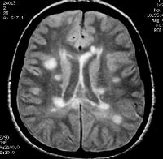
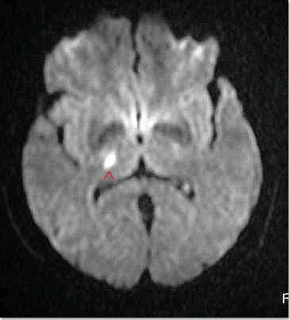
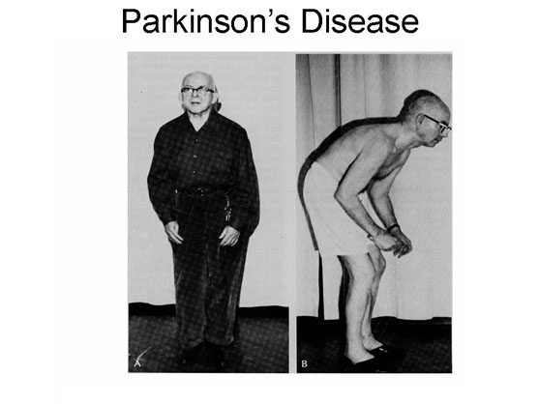
Some Diseases Associated with Neuropathic Pain
Trauma to P/CNS
Peripheral neuropathy
Infection
CNS disease: brain infarction, multiple sclerosis

Slide 9
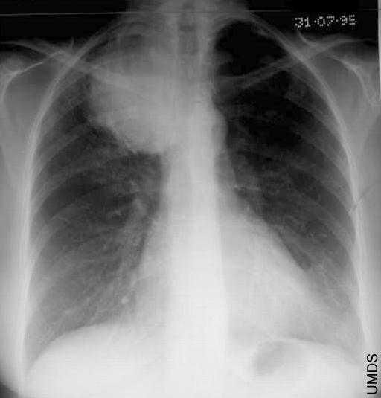
Some Diseases Associated with Neuropathic Pain
Trauma to P/CNS
Peripheral neuropathy
Infection
CNS disease
Tumours

Slide 10
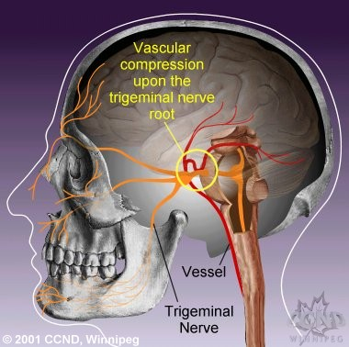
Some Diseases Associated with Neuropathic Pain
Trauma to P/CNS
Peripheral neuropathy
Infection
CNS disease
Tumours
Nerve compression

Slide 11
Mechanisms of Neuropathic Pain

Slide 12
Consequences of Peripheral Nerve Injury
Relevant to Mechanisms of Neuropathic Pain
Peripheral
Abnormal nociceptor sensitivity
Spontaneous neuronal activity
Abnormal ion-channel expression
  TRPs
  Na⁺
  Ca⁺⁺
Altered neuronal biochemistry
Loss of trophic support
Sensory neurone apoptosis

Slide 13
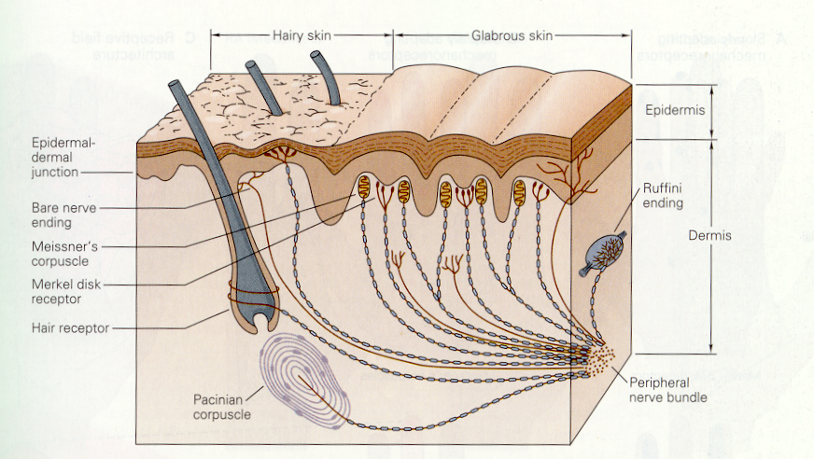
Specificity of Cutaneous Sensory Receptors
Notes:
Meissner's corpuscles (or tactile corpuscles) are a type of mechanoreceptor.^{[1]} They are a type of nerve ending in the skin that is responsible for sensitivity to light touch. In particular, they have highest sensitivity (lowest threshold) when sensing vibrations lower than 50 Hertz. They are rapidly adaptive receptors. Meissner's corpuscles are encapsulated unmyelinated nerve endings.
Merkel nerve receptors are mechanoreceptors that provide touch information to the brain. The information they provide are those regarding pressure and texture. Each ending consists of a Merkel cell in close apposition with an enlarged nerve terminal.
Pacinian corpuscles are one of the four major types of mechanoreceptor. They are nerve endings in the skin, responsible for sensitivity to vibration and pressure.
Ruffini ending is a class of slowly adapting mechanoreceptor, sensitive to skin stretch.

Slide 14
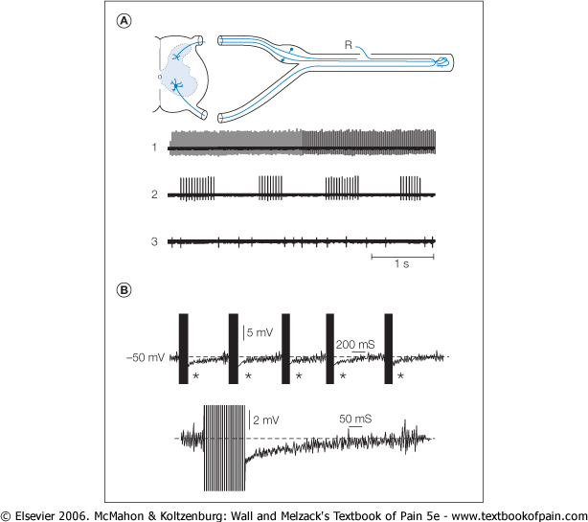
Patterns of Spontaneous Discharges in Sensory Neurones Innervating a Neuroma
Amir & Devor J. Physiol 1997;501:183-196
Notes:
From Melzack & Wall
Recording Microdissected bundles innervating a neuroma
Examples of tinoc burst and irregualr activity
Spontaneously active fibres fire tonically (1), in bursts (2), or irregularly (3)

Slide 15
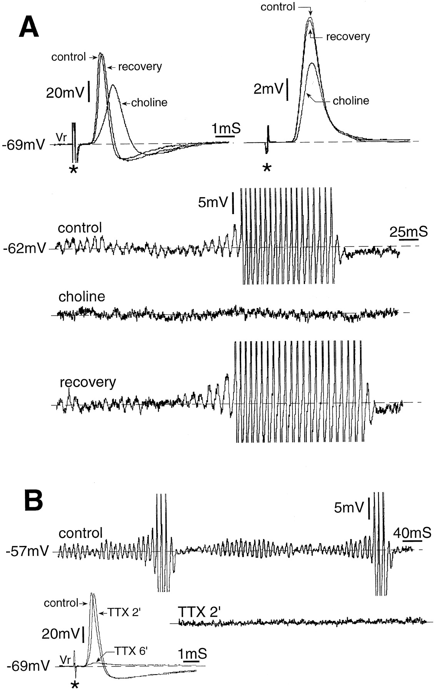
Membrane Oscillations in Injured A-Fibres are Na⁺⁻Dependent
Amir et al J. Neurosci. 1999;19:589-859
A
Notes:
Injury was axotomy and 2-15 days later made neuromea recordings Here we consider A-neurones exclusively. These were further characterized as Ainf neurones if analogue differentiation indicated an inflection on the falling limb of the spike, or A0 neurones if there was no such inflection. A0 neurones are predominantly low threshold Aß mechanoreceptors (including proprioceptors), while Ainf neurones include A delta afferents, many of which are myelinated nociceptors (Gorke and Pierau, 1980 ; Koerber and Mendell, 1992 ; Villiere and McLachlan, 1996 ).
Subthreshold membrane potential oscillations, and resulting spike bursting, depend on voltage-sensitive Na+ conductance. A illustrates a period of subthreshold oscillations that lead up to a spike burst in an A0-neuron from an adult rat whose ipsilateral sciatic nerve had been cut 7 d previously (control). Replacing NaCl in the bath solution with choline-Cl, thus reducing the bath Na+ concentration from 151 to 27 mM, abolished the oscillations and the resulting spikes within 2 min. They could not be restored by further depolarization. Washout of choline and return to the control bath solution restored both the oscillations and bursting within 17 min (recovery). All three traces were recorded at 62 mV. Top traces show (left) the intracellularly recorded spike before, during, and after choline application [at resting potential (Vr) = 69 mV], and (right) the simultaneously recorded DR compound action potential. Both spike and compound action potential persisted, if with a reduced amplitude, when oscillations and ectopic spiking were eliminated. Propagation distance from the sciatic nerve stimulation site was 37 mm to the cell soma and 50 mm to the compound action potential recording electrode. B, In this A0-neuron from an adult rat DRG, depolarization from rest (Vr = 69 mV) to 57 mV yielded subthreshold oscillations that triggered spike bursting (control trace; spikes truncated). Bath application of 1 µM TTX abolished the oscillations and spikes within 2 min (TTX 2'). Spike propagation in response to nerve stimulation at a distance of 7 mm persisted at this time, although it failed 4 min later (TTX 6'). Further depolarization failed to restore oscillations or spiking, but TTX washout frequently did (data not shown).

Slide 16
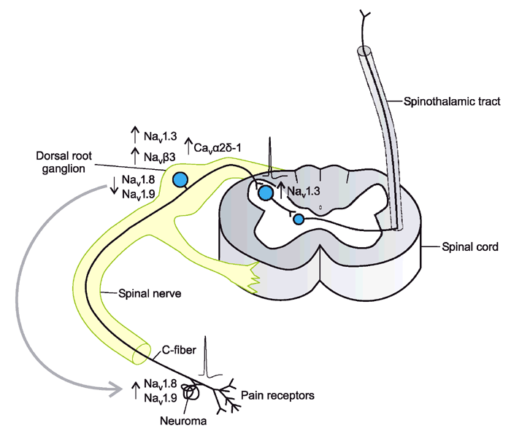
Neuronal Ion Channels after Peripheral Nerve Injury
Rogawski & Loscher Nature Medicine 2004;10, 685

Slide 17
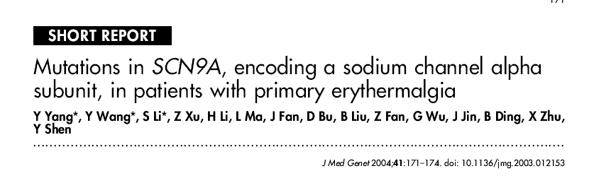
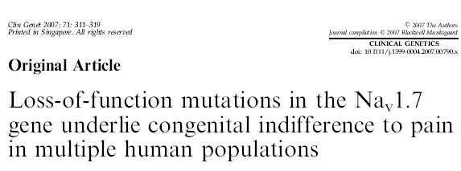
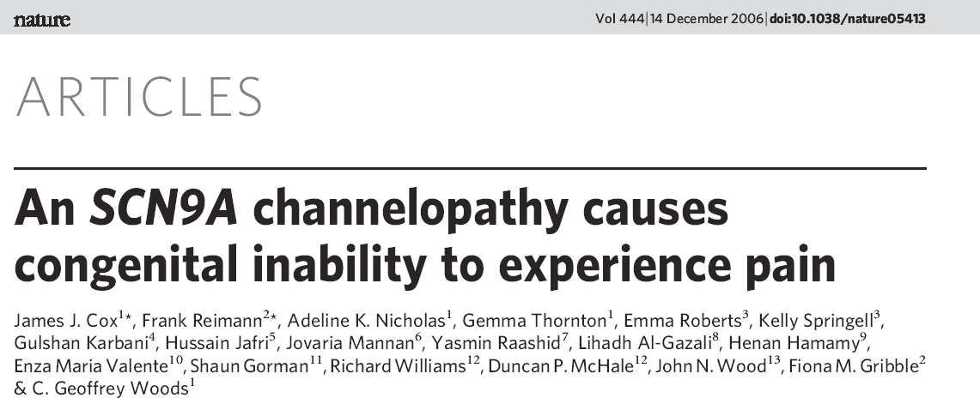
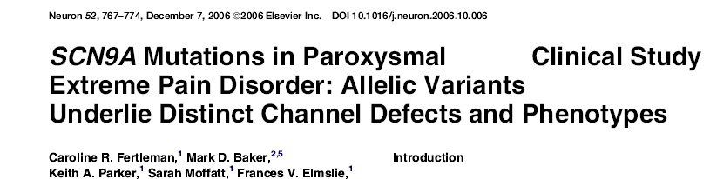
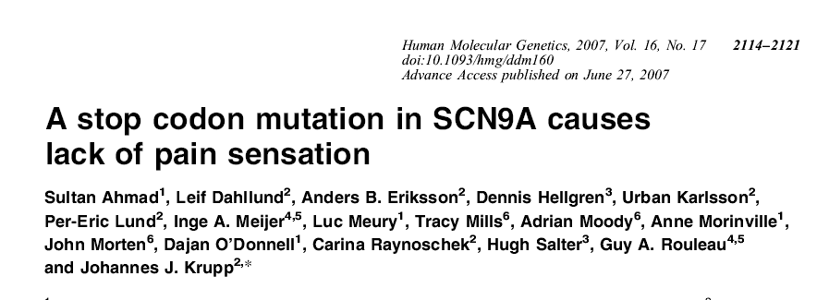
Sodium Channel Mutations and Human Pain
Gain in Function
Loss of Function

Slide 18
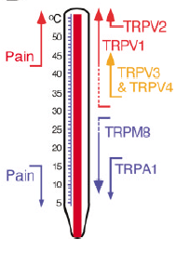
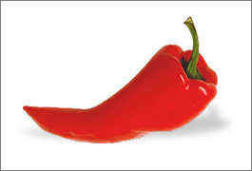
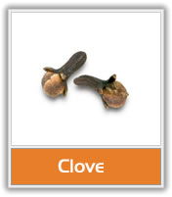
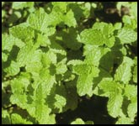
Transduction of Thermal Stimuli
Transient Receptor Potential (TRP) Ion Channels
From Tominaga and Caterina J Neurobiol. 2004 ;61:3-12.

Slide 19
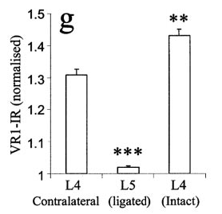
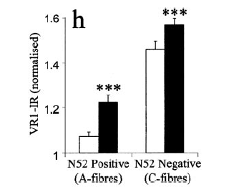
Spontaneous Burning Pain After Nerve Damage:
Cell Phenotype of TRPV-1 Heat Sensing Ion Channels is altered by nerve injury
Non
Nociceptors
Nociceptors
Hudson et al Eur. J. Neurosci. 2001;13:2105-14
Notes:
Overall VR-1 goes down significantly in DRG after axotomy, chung or seltzer.
However, after seltzer or Chung then in UNDAMAGED DRG cells there was an INCREASE in VR-1 expression. This was especially so following Chung where large cells (N52) stated to express VR-1 in the undamaged L4
this slide is from Chung 2 weeks after ligation much easier to see undmaged (L4) than damaged (L5) with this mofdel, sor seltzer they used backlabelling
florusence picture shows acculation of VR-1 at neuromati, despite overall loss in DRG. ? Just a time pehomenen
(g) Mean VR1-IR of ipsilateral L4 and L5 DRG and contralateral L4 DRG neurons. VR1-IR was dramatically reduced in L5 after ligation of its spinal nerve, but, in the ipsilateral L4 DRG (undamaged), VR1-IR was significantly greater than in the contralateral DRG. Changes in undamaged ipsilateral L4 DRG neuronal profiles after L5 spinal ligation were assessed in more detail using anti-neurofilament to distinguish between A- and C-fibre populations. (h)shows the VR1-IR in A- and C-fibres, (open bars contralateral, solid bars ipsilateral), with the biggest increases seen in A-fibres.

Slide 20
Consequences of Peripheral Nerve Injury
Relevant to Mechanisms of Neuropathic Pain
Peripheral
Abnormal nociceptor sensitivity
Spontaneous neuronal activity
Abnormal ion-channel expression
  TRPs
  Na⁺
  Ca⁺⁺
Altered neuronal biochemistry
Loss of trophic support
Sensory neuronal apoptosis
Central
Spinal reorganisation
Glutamate (NMDA)- induced central sensitisation
Glial cell activation
Loss of local spinal inhibitory mechanisms
Decreased descending inhibition
Increased descending facilitation
Cortical reorganization

Slide 21
Sensory Input to Dorsal Horn of Spinal Cord
PNS
CNS
S
P
&
C
G
R
P
NS
I
I
I
o
I
I
i
W
I
I
I
A
β
I
V
h
e
a
v
i
l
y
V
m
y
e
l
i
n
a
t
e
d
W
D
R
f
a
s
t
c
o
n
d
u
c
t
i
n
g
Aδ 
V
I
t
h
i
n
l
y
m
y
e
l
i
n
a
t
e
d
i
n
t
e
r
m
e
d
i
a
t
e
h
i
g
h
i
n
t
e
n
s
i
t
y
c
o
n
d
u
c
t
i
n
g
n
o
x
i
o
u
s
u
n
m
y
e
l
i
n
a
t
e
d
C
X
s
t
i
m
u
l
i
s
l
o
w
c
o
n
d
u
c
t
i
n
g
V
I
I
V
I
I
I
I
X
Notes:
The arrival of activity from peripheral nerves into the spinal cord is the first stage in the processing of pain. It is here that changes caused by the balance between excitatory and inhibitory effects will alter both the motor reflex responses and the messages sent through ascending tracts to the higher centres of the brain. The gate theory of pain predicted the importance of interactions at the spinal level

Slide 22
NMDA receptors are “activated” by removal of Mg⁺⁺ channel block and phosphorylation.
NK₁
Substance P
AMPA
Glutamate
NMDA
Ca⁺⁺
Mg⁺⁺
NOS
COX
BDNF
mGluR
Phosphorylation
trkB

Slide 23
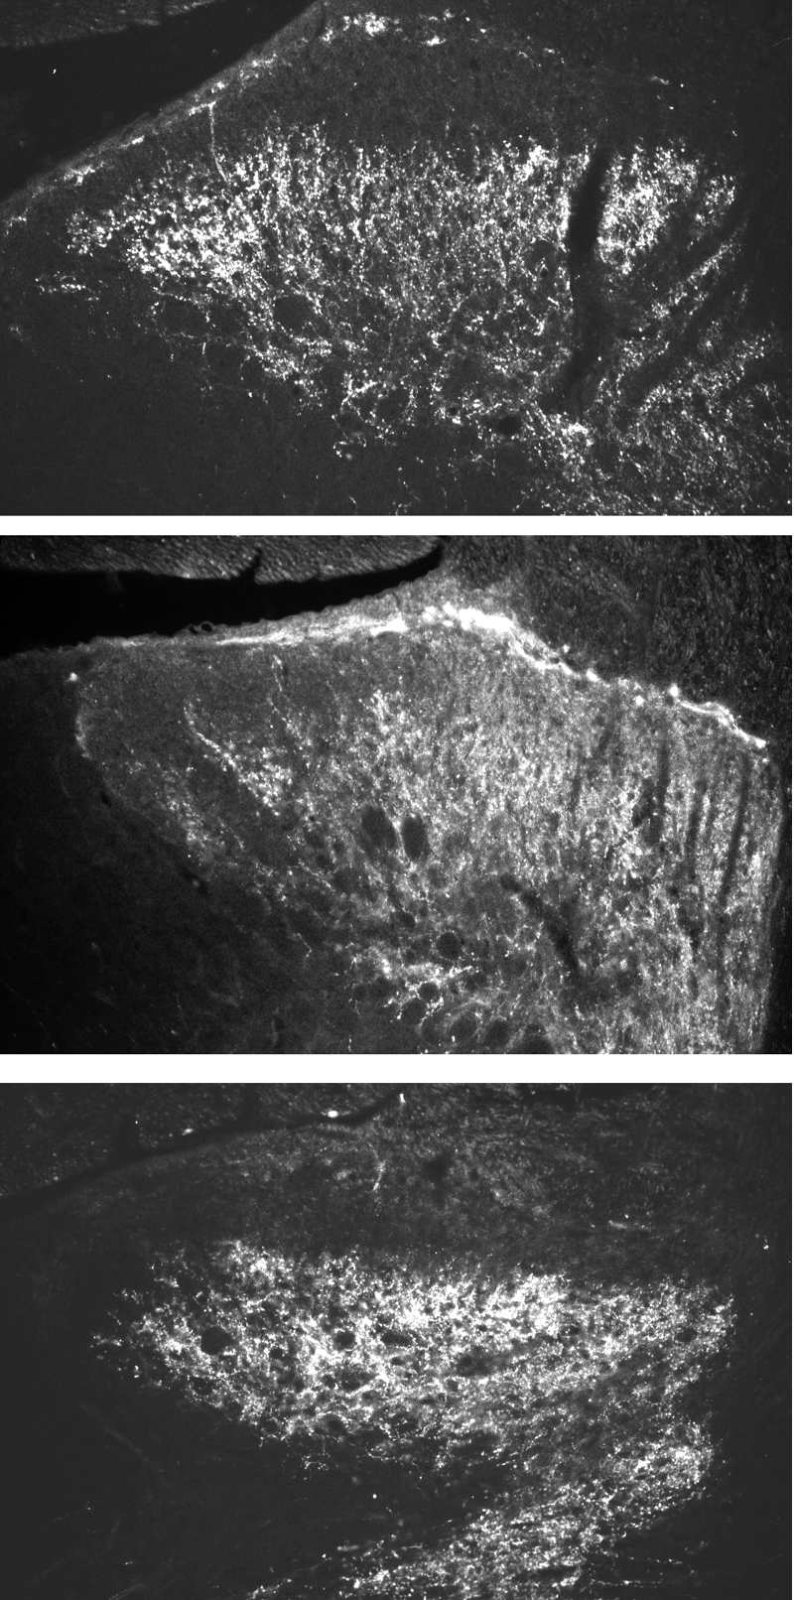
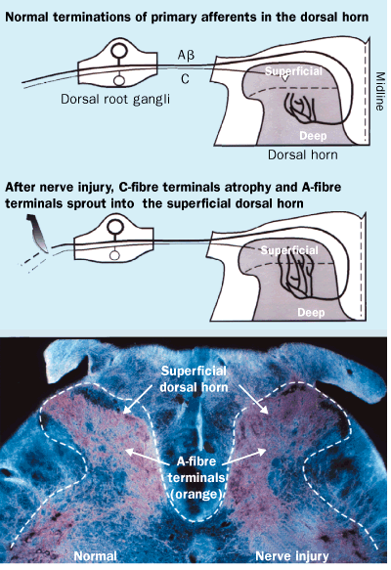
Nerve Injury Leads to Reorganization of the Laminar Structure of the Spinal Dorsal Horn
Control
Axotomized
Bennett et al. 1996; Woolf & Mannion 1999.

Slide 24
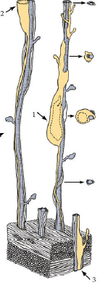
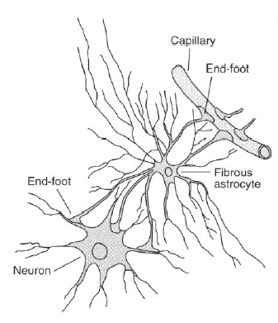
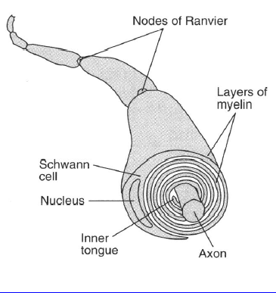
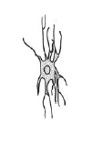
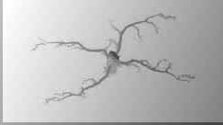
Glial Cells
Astrocytes - regulate extracellular environment
Oligodendrocytes – produce myelin in CNS
Schwann Cells - produce myelin in PNS
Radial Glia – guide development
Ependyma – CSF regulation
Microglia - Phagocytes in CNS

Slide 25
MICROGLIA

Slide 26
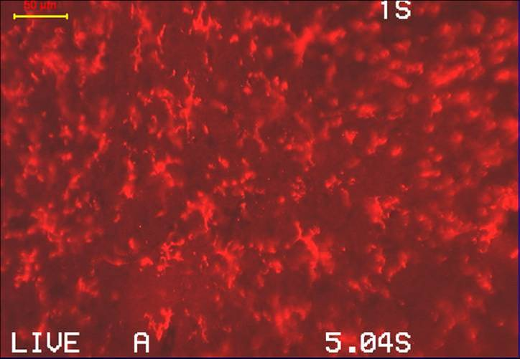
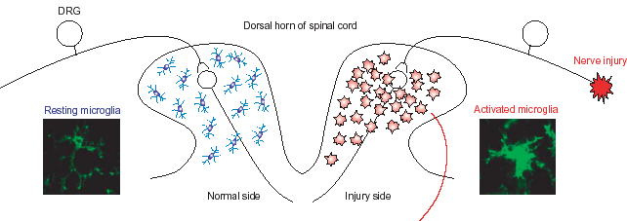
Spinal Microgliosis in Rat Neuropathy Models
Blackbeard et al unpublished data
Niave
Sham
L5 SNT
Tsuda et al TRENDS in Neurosciences Vol.28 No.2 2005

Slide 27
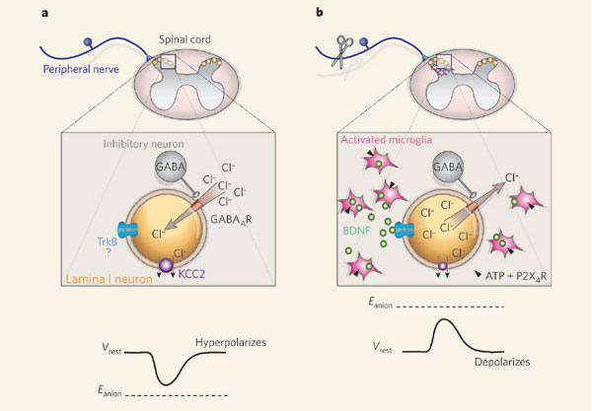
Microglial Activity Reverses Inhibitory Signalling in Spinal Cord
Coull et al Nature 2005;438:1017-1021
Notes:
Coull and colleagues3 reveal that microglial–neuronal signalling mediated by BDNF disrupts inhibition of rat lamina I spinal-cord neurons and maintains neuropathic pain. a, Activation of GABAA receptors (GABAAR) normally leads to an influx of anions (principally chloride, Cl-), causing hyperpolarization (inhibition), because the potential at which the anion flux switches from inward to outward (Eanion) is negative with respect to the resting membrane potential of the neuron (Vrest). b, Following peripheral nerve injury, activated microglia (with ATP-stimulated P2X4 receptors) release BDNF, which acts on the TrkB receptor to modify Eanion, probably by reducing levels of the potassium-chloride co-transporter KCC2. As Eanion is now positive with respect to Vrest, GABAA-receptor activation leads to an efflux of anions, depolarizing the lamina I neurons. Blockade of this microglial–neuronal signalling pathway alleviates chronic neuropathic pain in the rat model.

Slide 28
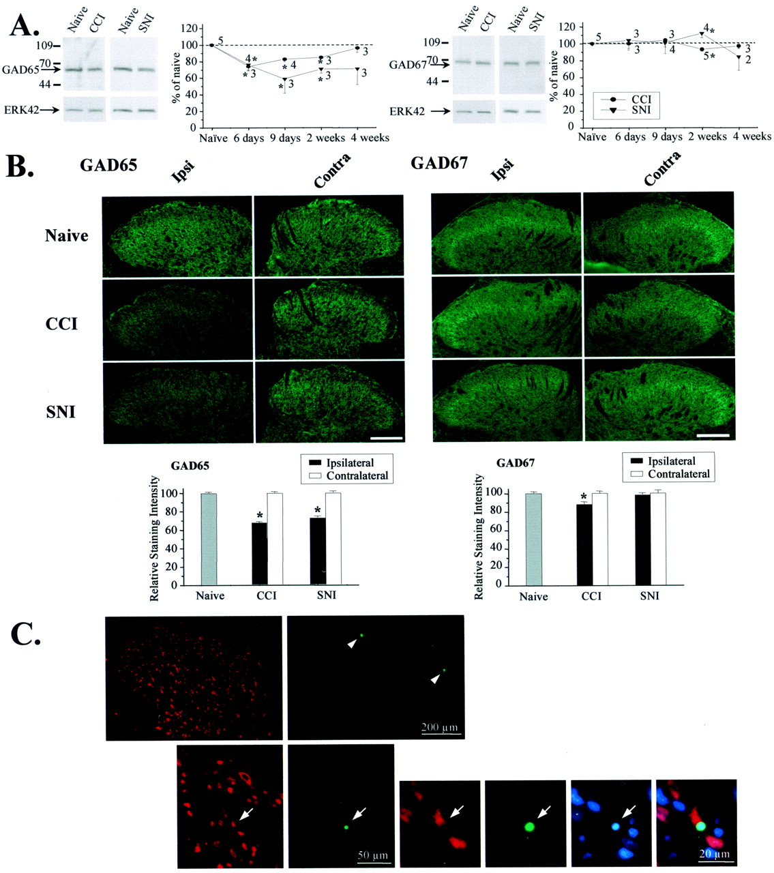
Loss of Spinal Inhibitory Mechanisms after Peripheral Nerve Injury
Loss of GABA Synthesis
Moore, K. A. et al. J. Neurosci. 2002;22:6724-6731
Notes:
A fibre eveoked IPSC reduced
2. Reduced GABA comepenet in IUPSPs shown by loss of effect of Buicculine
3. Loss of gaba synthsising enzyme GAD 65
4. not shown no reduction in GABA a receptors
Partial nerve injury reduces GAD65 levels and induces neuronal apoptosis. A, The 65 kDa, but not the 67 kDa, isoform of GAD was reduced in the lumbar (L4) dorsal horn ipsilateral to CCI or SNI when measured by Western blotting. The graph shows the time course of regulation. Data are normalized to ERK42 and expressed as a percentage of naive. *p < 0.05 compared with naive. B, Immunohistochemical analysis revealed diminished GAD65 levels in the ipsilateral dorsal horn (laminas I-IV) 2 weeks after CCI (n = 46 sections from 4 rats; p < 0.0001) and SNI (n = 31 sections from 6 rats; p < 0.0001). A small decrease in the levels of GAD67 was detectable after CCI (n = 52 sections from 4 rats; p = 0.002). Scale bar, 100 µm. *p < 0.05 compared with naive. C, TUNEL (green) and chromatin staining with bisbenzimide (blue), combined with immunostaining for the neuronal marker NeuN (red), revealed apoptotic cell death in the superficial dorsal horn of spinal cord segment L4 1 week after SNI. The top row shows a section through the ipsilateral dorsal horn with TUNEL-positive cells in laminas I and II (arrowheads). An example of neuronal apoptosis in lamina II is given below. Arrows point to a TUNEL-positive neuron with condensed chromatin structure, indicating nuclear pyknosis.
GAD synthsies GABA
Selective loss of GABAA IPSCs in CCI and SNI models. A, In naive neurons, the GABAA receptor antagonist bicuculline (5-10 µM) blocked a large fraction of the primary afferent-evoked IPSC (n = 14). However, after CCI (n = 13) or SNI (n = 7), bicuculline had little effect. Coapplication of bicuculline and strychnine (0.5 µM) reduced IPSCs to 4.3 ± 1.1 pA (n = 19). B, The amplitude of the GABAA component, but not the glycine component, of evoked IPSCs was significantly reduced after CCI (p = 0.014) or SNI (p = 0.002), but not SNT (p = 0.745). Numbers of neurons are indicated in parentheses. p < 0.05 compared with naive.
Figure 1. Partial peripheral nerve injury (CCI or SNI) reduces primary afferent-evoked IPSCs in lamina II neurons. A, Representative neuron from a CCI animal with a monosynaptic A -fiber-evoked EPSC but no evoked IPSC. After CCI or SNI, excitatory transmission remains intact, but the proportion of neurons with no evoked IPSC increases (Naive = 1/65; SNT = 3/32, p = 0.20; CCI = 7/41, p = 0.006; SNI = 9/32, p < 0.0001). *p < 0.05 compared with naive. B, Representative A-fiber-evoked IPSCs recorded in spinal cord slices from naive, CCI, and SNI rats. Note the reduction in amplitude and duration in CCI and SNI traces. C, Amplitude distributions for IPSCs recorded from naive rats and rats subjected to SNT, CCI, or SNI. In both partial nerve injury models, IPSC amplitudes were significantly decreased compared with the naive. Arrows indicate means. D, Frequency distributions of IPSC decay time constants ( ) from naive and nerve-injured rats, as well as pharmacologically isolated glycine (insensitive to 5-10 µM bicuculline; n = 18) and GABAA (bicuculline sensitive; n = 16) IPSCs

Slide 29
Consequences of Peripheral Nerve Injury
Relevant to Mechanisms of Neuropathic Pain
Peripheral
Abnormal nociceptor sensitivity
Spontaneous neuronal activity
Abnormal ion-channel expression
  TRPs
  Na⁺
  Ca⁺⁺
Altered neuronal biochemistry
Loss of trophic support
Sensory neurone apoptosis
Central
Spinal reorganisation
Glutamate (NMDA)- induced central sensitisation
Glial cell activation
Loss of local spinal inhibitory mechanisms
Decreased descending inhibition
Increased descending facilitation
Cortical reorganization

Slide 30
Further Reading
General:
  Textbook of Clinical Pain Management. 2nd ed. Chronic Pain volume 2008.
  Melzack & Wall’s Textbook of Pain
  The Science of Pain. eds: Allan I. Basbaum et al 2008 Elsevier ISBN: 978-0-12-370880-9
  Treede RD et al. Neuropathic pain: redefinition and a grading system for clinical and research purposes. Neurology 2008 29;70:1630
Mechanisms
  Wallace, V. C. J. & Rice, A. S. C. Applied physiology: neuropathic pain. Textbook of Clinical Pain Management. 2nd ed. Chronic Pain volume 2008.
  Costigan et al Neuropathic pain: a maladaptive response of the nervous system to damage Ann. Rev. Neurosci 2009;32:1-32
  Bridges D, Thompson SWN, Rice ASC. Mechanisms of neuropathic pain. British Journal of Anaesthesia 87(1), 12-26. 2001.
  Scholz J, Woolf CJ. The neuropathic pain triad: neurons, immune cells and glia. Nat Neurosci 2007;10:1361-1368.

