Slide 1
Assessment and treatment of neuropathic pain
Dr Tudor Phillips MA FRCA FFPMRCA
Consultant in Pain Medicine and Anaesthesia
Oxford University Hospitals

Slide 2
Over-view
Definition
Different causes of Neuropathic Pain
Mechanisms
Diagnosis and Assessment
Treatments
Pharmacological
Antidepressants
Anti-epileptic
Capsaicin and Lidocaine
Future targets
Non-Pharmacological
Steroid injections/ TENS/ SCS/ DBS
Summary

Slide 3
Defining Neuropathic Pain
Classical definition of two types of pain:
Nociceptive pain
Pain that arises from actual or threatened damage to non-neural tissue and is due to the activation of nociceptors.
Occurs within the context of a normally functioning somatosenory system.
Neuropathic pain
Pain arising as a direct consequence of a lesion or disease affecting the somatosensory system.
Often despite nervous system repair- sometimes pain persists
If >3 months termed chronic pain

Slide 4
Prevalence of Neuropathic Pain
Common problem
7-8% of European population suffer from pain of predominantly neuropathic origin (POPNPO).
5% pain considered severe (>5/10 NRS -moderate to severe pain)
Neuropathic pain associated with affective co-morbidities.
Significant socio-economic impact on society.

Slide 5
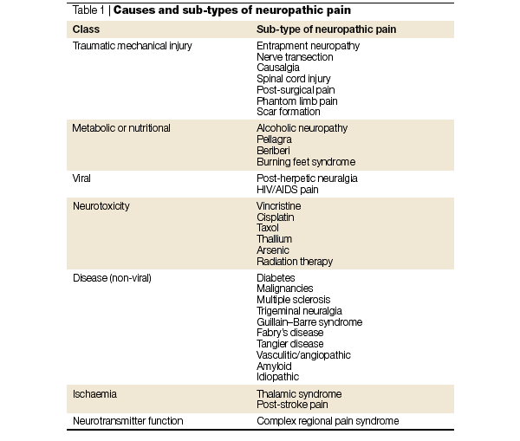
Causes of Neuropathic Pain
Multiple causes of nerve injury and dysfunction

Slide 6
Causes of Neuropathic Pain
Multiple causes of nerve injury and dysfunction

Slide 7
Causes of Neuropathic Pain
Multiple causes of nerve injury and dysfunction

Slide 8
Causes of Neuropathic Pain
Multiple causes of nerve injury and dysfunction

Slide 9
Causes of Neuropathic Pain
Multiple causes of nerve injury and dysfunction

Slide 10
Causes of Neuropathic Pain
Multiple causes of nerve injury and dysfunction

Slide 11
Causes of Neuropathic Pain
Multiple causes of nerve injury and dysfunction

Slide 12
Causes of Neuropathic Pain
Multiple causes of nerve injury and dysfunction

Slide 13
Classification by site
Central Neuropathic Pain
CVA
Spinal cord injury
Peripheral Neuropathic pain
Mechanical
Trauma - accident, surgery etc
Compression - carpal tunnel syndrome
Neuropathy
Alcoholic, HIV, DM etc
Mixed Central and Peripheral
Complex Regional Pain Syndrome (CRPS)

Slide 14
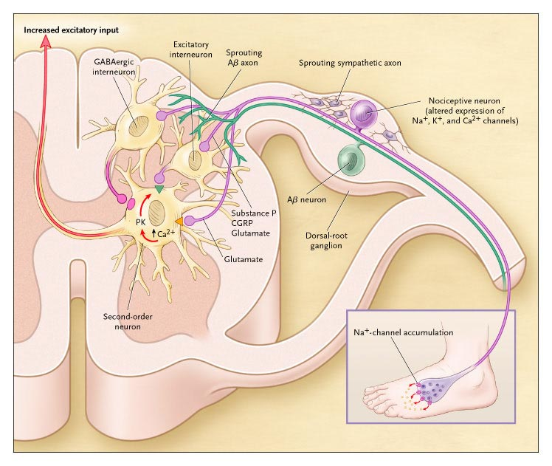
Putative Mechanisms
Peripheral changes
Sensitisation of peripheral nociceptors
Reduced thresholds for activation. (Aδ and C-fibres)
Increased expression of voltage gated Na⁺ channels and Ca²⁺ (ectopic firing)
Abnormal neuronal ‘sprouting’ of nociceptive neurons within dorsal horn
Widening of receptive fields
“Cross-talk” of modalities

Slide 15
Putative Mechanisms
Central changes
“Central sensitisation” of spinal cord neurons following peripheral changes - enhanced response to input.
Loss of central inhibitory mechanisms
Enhanced nociceptive transmission
Key is the up regulation and activation of NMDA receptors important

Slide 16
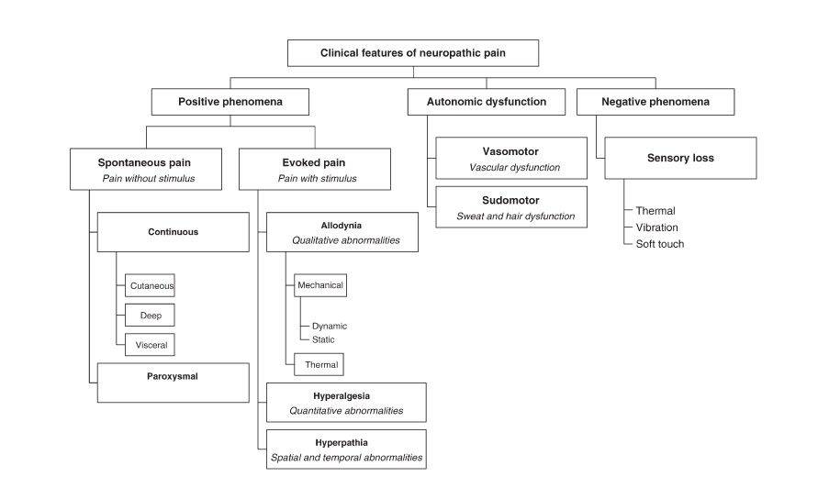
Features of Neuropathic pain
Signs and symptoms often described as positive and negative phenomena
Positive Phenomena
Negative Phenomena

Slide 17
Features of Neuropathic pain
Signs and symptoms often described as positive and negative phenomena
Positive Phenomena
Negative Phenomena

Slide 18
Features of Neuropathic pain
Signs and symptoms often described as positive and negative phenomena
Positive Phenomena
Negative Phenomena

Slide 19
Features of Neuropathic pain
Signs and symptoms often described as positive and negative phenomena
Positive Phenomena
Negative Phenomena

Slide 20
Patient verbal descriptors
Continuous
paroxysmal
Burning
Freezing
Tingling
Itching
Pins & Needles
Aching
Gnawing
Cramping
Crushing
Gripping
Shooting
Stabbing
Electric
Lightning
Running water

Slide 21
Affective co-morbidities
Difficulty sleeping
Lack of energy
Drowsiness
Concentration difficulties
Depression
Anxiety
Poor appetite
% patients with moderate to very severe discomfort due to symptoms (n=126)
Difficulty sleeping
60
Lack of energy
55
Drowsiness
39
Concentration difficulties
36
1/3 patients
Depression
33
Needs to be addressed
Anxiety
27
Poor appetite
18
0
10
20
30
40
50
60
70
% patients with moderate to very severe discomfort due to symptoms (n=126)
Meyer-Rosberg et al. Eur J Pain . 2001;5:379-389

Slide 22
Diagnosis
Difficult - No gold standard exists
Many types of pain are mixed nociceptive and neuropathic(e.g. lower back pain with peripheral nerve compression)
Various instruments designed to determine (e.g. DN4 and LANNS)
Probability of having neuropathic pain:
Definite
Probable
Possible

Slide 23
Diagnosis
DN4
Useful screening tool for differentiating between nociceptive pain and neuropathic pain
4 Questions (10 items): all “y/n”
If score ≥4/10 then positive
Sensitivity = 82.9%
Specificity = 89.9%

Slide 24
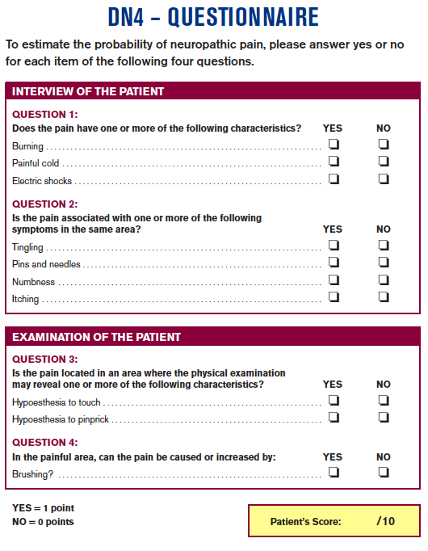
Diagnosis
DN4
Useful screening tool for differentiating between nociceptive pain and neuropathic pain
4 Questions (10 items): all “y/n”
If score ≥4/10 then positive
Sensitivity = 82.9%
Specificity = 89.9%

Slide 25
Examination/ Documentation
Full neurological examination
Standard Neurological examination - no quantification
Specific defining of sensory loss and gain of function
Pin prick, light touch, vibration
Use of fine haired brushes
Von Frey Hairs
Temperature rollers
Brush allodynia
Pin-prick hyperalgesia
Spontaneous pain
Numb area
e.g. Mapping of cutaneous involvement

Slide 26
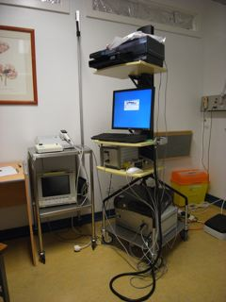
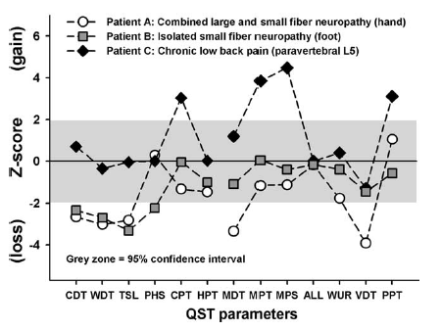
Specialist Investigations
Quantitative Sensory Testing (QST)
Measures sensory thresholds for various modalities in skin -
Warm/Cold detection & pain, pinprick, light touch, vibration
More sensitive to small fibre dysfunction
Increasingly used in clinical as well as research settings
Sensory function “ECG”

Slide 27
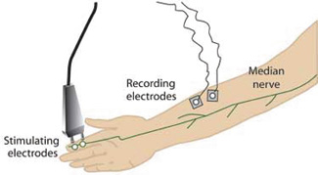
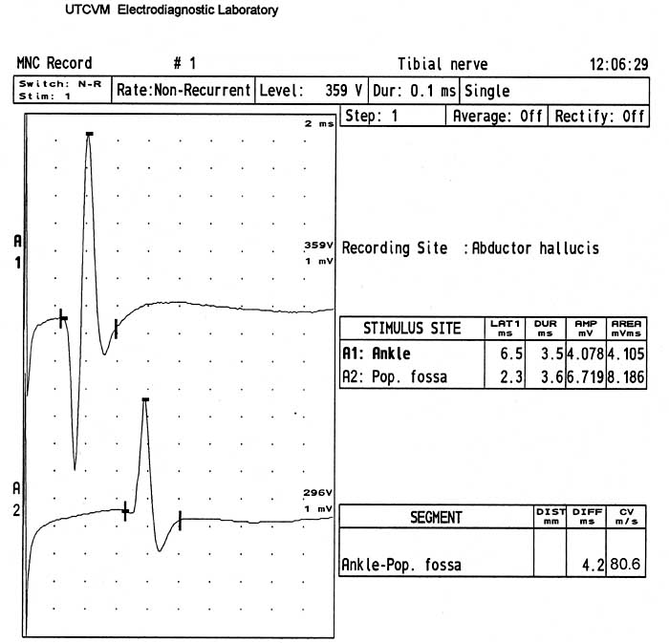
Specialist Investigation
Nerve Conduction Studies (NCS)
Able to characterise large and medium (myelinated) sensory nerve fibre dysfunction
Characteristic waveforms for conditions
Useful in peripheral nerve compressions, injuries or demyleination.
Not as useful with small fibre neuropathies

Slide 28
Treatment Overview
Anti-depressants
Under-lying cause
e.g. surgery, BM control, anti-virals
Neuropathic Pain adjuvant drugs:
e.g. TCAs, Anti-epileptic drugs
Neuropathic pain
Treatment of Anxiety and Depression
Conventional analgesics:
e.g. Opioids, NSAIDs
Non-drug:
e.g.Epidural steriod
Spinal cord stimulators
Psychology:
e.g. CBT/ Group work
Anti-depressants

Slide 29
Pharmacological Treatments
Anti-depressants
Opioids
Capsaicin
Anti-convulsants
Neuropathic pain
Local Anaesthetics
Cannabinoids
NSAIDs

Slide 30
Evidence base drug treatment
Majority of RCT for drug assessment:
Painful Diabetic Neuropathy (PDN)
Post Herpetic Neuralgia (PHN)
Few studies investigating multi-drug or sequential drug use
E.g. TCAs /gabapentinoids/ opioids
Placebo response often very large in pain RCTs.
NICE, EFNS, Cochrane etc

Slide 31
Tricyclic Antidepressants
Prototype Amitriptyline
TCAs used since 1960s for depression, now superseded in Tx of depression and anxiety by newer agents.
Found that in small doses effective in Tx of NP.
Acts primarily as a SNRI however is a ‘dirty’ drug -
Acts to facilitate central descending inhibition of pain transmission at the spinal cord level.
Acts as voltage gated Na⁺ and Ca²⁺ channel inhibitors in the periphery.
Reduces anxiety/ depression - effects very small.
mACh antagonist
EFNS recommended as 1st line treatment - NNT ~ 3

Slide 32
Newer Antidepressants
Duloxetine
Newer agent
SNRI with less SE than TCAs
Effective in the treatment of pain diabetic neuropathy pain and other small fibre neuropathies.
Not as effective in general neuropathic pain
Useful in patients with significant co-morbidity of anxiety and/or depression
Recommended 1st line therapy in painful DM neuropathy.

Slide 33
Anticonvulsants -1
Classical anticonvulsants
Sodium Valproate
Voltage gated Na⁺ channel antagonist
Rarely used as not as effective as newer agents and significant SE.
Carbamazipine
Previously widely used in all types of NP
Significant and often debilitating SE associated.
TCAs and newer anti-consultants increasingly used instead.
Useful in classical Trigeminal neuralgia (NNT 2.6) - no better drug
Phenytoin
Limited use - emergency i.v. treatment

Slide 34
Anticonvulsants - 2
Gabapentin
Developed for epilepsy - partial seizure treatment
Binds α₂δ subunit of voltage gated Ca²⁺ channels.
Putatively reduces Ca²⁺ by disrupting the trafficking of v gated Ca²⁺ channels to the periphery.
Less SE than TCA, possibly less effective.
Used as 2nd line treatment or with TCAs
Pregabalin
Similar mechanisms of action
Better pharmacokinetics - less frequent dosing required
Sometimes less SE noted in individuals

Slide 35
Other agents
Lidocaine 5% patches
Blockade of voltage gated Na⁺ channels
Patch useful over allodynic areas
12 hrs on/ 12hrs off
Useful in Post-herpetic neuralgia (PHN) and some painful peripheral neuropathies.

Slide 36
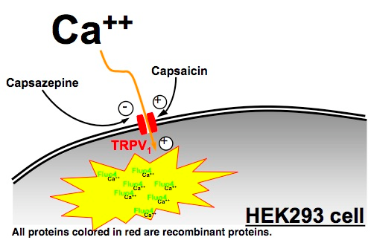
Other agents
Capsaicin - cream 0.025/0.075%/ and 8% patch
Active component of chili peppers.
Acts to open TRPV1 Ca²⁺ on unmyelinated C-fibres
Depletes fibres of neurotransmitter Sub-P
8% licensed for PDN PHN and HIV PN
Activation TRPV1➔ Ca²⁺ entry➔ exocytosis and depletion of sub-P secreting C-fibres
Cell death
Reduced nociceptive input

Slide 37
Future drug targets
Differential expression of neurotrophic receptors

Slide 38
Future drug targets
NGF antagonism:
Disappointing early clinical results
Differential expression of neurotrophic receptors on nociceptor fibres

Slide 39
Future drug targets
Differential expression of neurotrophic receptors on nociceptor fibres

Slide 40
Conventional analgesics
Opioids
Widely used in the treatment of neuropathic pain
Significant SE and addiction - longterm use
No specific opioid better than others (previously methadone)
Use of other adjuvant agents aimed at reducing the dose of opioid required.
NSAIDs
Often used in patients with mixed neuropathic-nociceptive pain (lower back pain)
Increasing evidence that NSAIDs may themselves may be effective in treating NP.

Slide 41
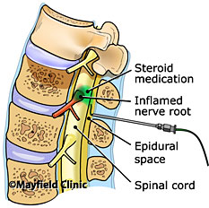
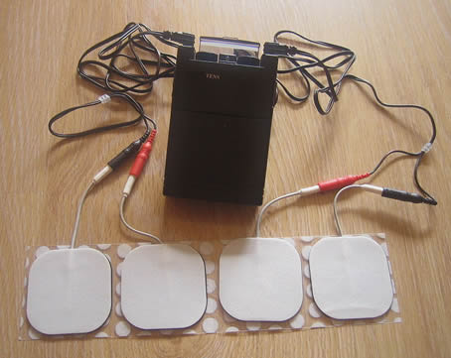
Non-Drug Treatments
Peripheral and neuraxial steroids
Epidural/ Caudal
Nerve root blocks
Poor evidence of long term benefit
Trans-cutaneous Electrical Stimulation (TENS)
Pads placeed over painful area
Low current electrical stimulus
Aβ fibre stimulation (LT mechano)
Pleasant paraesthesia (pins & needles)

Slide 42
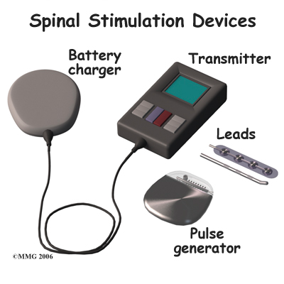
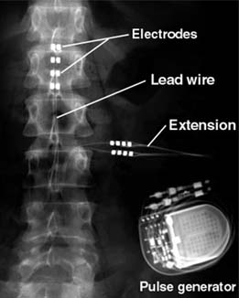
Non-drug Treatments
Spinal Cord Stimulators (SCS)
Electrodes placed on dorsal aspect of epidural space - dorsal column
Implantable Pulse Generator
Different electrical patterns and electrodes used
Stimulates dorsal columns to “close Melzack and Wall gate” via Aβ stimulation (~ rubbing area)
Patients experience pleasant paraesthesia
Comprehensive psychological assessment
Trial electrodes inserted → Full implantation
NICE support: Neuropathic pain conditions such as:
Failed back surgery syndrome (FBSS) & neuropathic pain (CRPS )

Slide 43
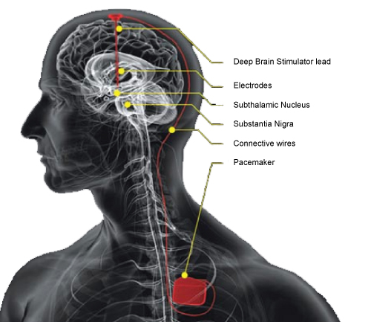
Deep Brain Stimulation
Deep Brain Stimulator (DBS)
Originally investigated 1950s
Revisited in 1980s to date
RF generator
Electrodes placed to stimulate
Somatosensory Thalamus (ST) Peri-Aquaductal Grey (PAG)
Increasing downward inhibition
Reserved for resistant NP
Poor results with central neuropathic pain - spinal cord/ stroke pain
~ £30,000 per unit
Not supported by NICE currently - case by case assessment by PCTs

Slide 44
Management Summary
Careful diagnosis - no gold standard available
Detailed assessment
Symptoms - documentation
Past medical history -underlying causes or exacerbating factors
Investigations - bloods, NCS, QST etc
Treatment of underlying causes
Better BM control, B12 replacement, thyroid, Viral load HIV etc
Drug therapy
NP adjuvant: TCAs/ gabapentinoids
Analgesics: opioids/ NSAIDS
Non-drug treatment
Steroid injections/ TENS/ SCS/ DBS

Slide 45
Management Summary
Careful diagnosis - no gold standard available
Detailed assessment
Symptoms - documentation
Past medical history -underlying causes or exacerbating factors
Investigations - bloods, NCS, QST etc
Treatment of underlying causes
Better BM control, B12 replacement, thyroid, Viral load HIV etc
Drug therapy
NP adjuvant: TCAs/ gabapentinoids
Analgesics: opioids/ NSAIDS
Non-drug treatment
Steroid injections/ TENS/ SCS/ DBS
Parallel Psychological support
Treatment of Anxiety and Depression

Slide 46
Summary
Neuropathic pain is a common problem affecting ~ 8% of the general European population.
Represents a significant socio-economic burden for society.
Diagnosis is difficult - but is aided by specialist questionnaires and quantitative investigations
Treatment is not standardised and frequently unsatisfactory.
Better understanding of the underlying mechanism required.

Slide 47
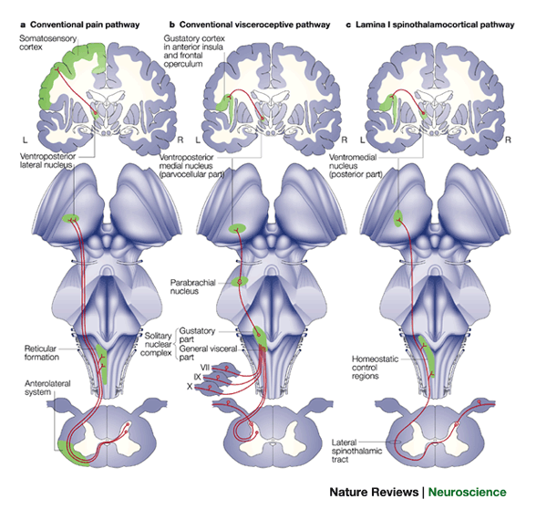
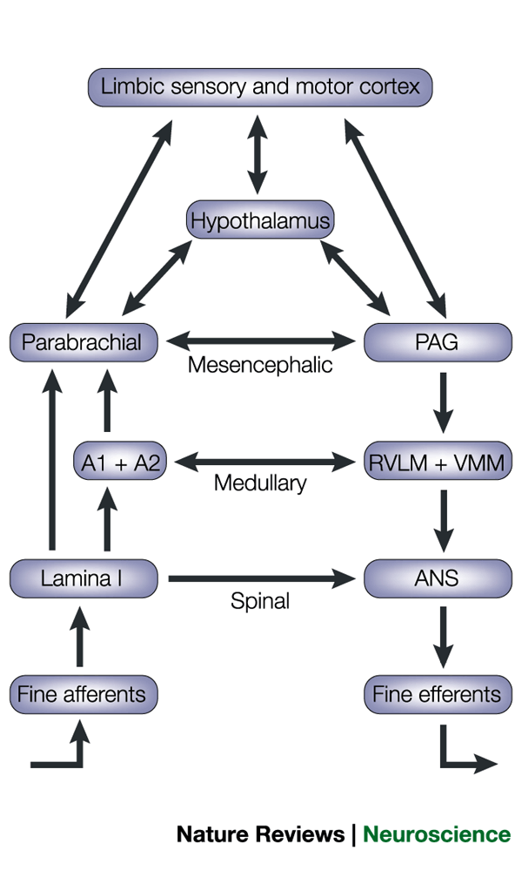
Pain Pathways
Descending inhibitory

