Slide 1
Muscle relaxation and muscle relaxants
Dr Chris Edge

Slide 2
Lecture Contents
History of neuromuscular blockade
Brief review of neuromuscular junction
Types and structures of neuromuscular blocking drugs
Monitoring of neuromuscular blockade
Problems with neuromuscular blockade
Suxamethonium apnoea
Ways to avoid neuromuscular blockade

Slide 3
History - I
Curare used for centuries by indigenous people of Amazon to hunt game
Peter Martyr d’Anghera wrote of poisoned arrows in De Orbe Novo (1516)
Sir Benjamin Brodie (1812) demonstrated that small animals could be kept alive after being injected with curare by inflating their lungs with bellows
Claude Bernard (1846) proved that curare acted solely on the neuromuscular junction
Harold King (1935) isolated d-tubocurarine from curare and established it was a rigid molecule with two quaternary ammonium groups at either end

Slide 4
History - II
Griffith & Johnson (1942) first used curare to paralyze a patient for appendicectomy:
“Every anaesthetist has wished at times that he might be able to produce rapid and complete muscular relaxation in resistant patients under general anaesthesia”
Halton & Gray (1946) used Introcostrin on patients with good results. Gave rise to Liverpool technique – a triad of narcosis, analgesia and muscle relaxation

Slide 5
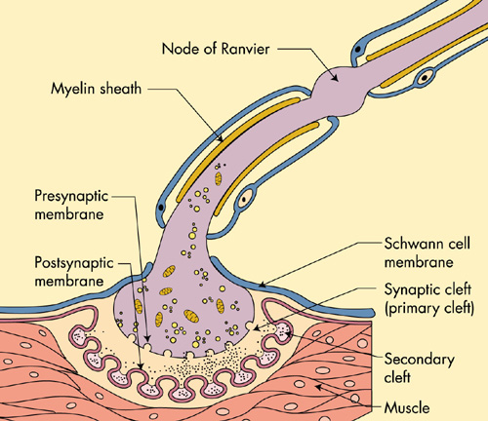
Neuromuscular Junction - I

Slide 6
Neuromuscular Junction - II
Acetylcholine (ACh) is the transmitter which interacts with the post-synaptic nicotinic receptors
Structure is:
Stored in the vesicles. About 1% form the immediately releasable store
Each vesicle holds about 12,000 molecules of ACh
ACh not binding to the receptors or released after binding are destroyed almost instantly by acetylcholinesterase ( < 1 ms) in the secondary clefts, where it is attached to the basement membrane

Slide 7
Structure of d-Tubocurarine
Compare with the structure of acetylcholine:

Slide 8
Other Muscle Relaxants - I
Succinylcholine (Suxamethonium)
Suxamethonium is the only clinical example of a DEPOLARIZING muscle relaxant. It has a rapid onset of action and, in most people, it wears off quickly (~ 5-10 min)
Has many side-effects
Acetylcholine

Slide 9
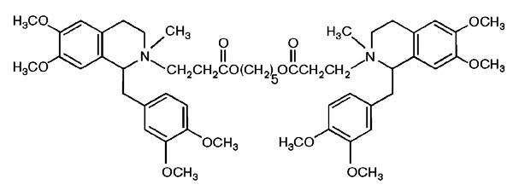
Other Muscle Relaxants - II
Atracurium
It is a bisbenzyltetrahydroisoquinolinium salt
Consists of 10 stereoisomers when synthesized
Rationally designed in 1974
Only common example of a non-steroidal NON-DEPOLARIZING muscle relaxant
Breakdown not affected by hepatic or renal disease

Slide 10
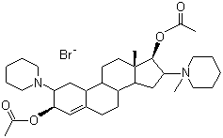
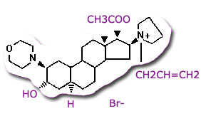
Other Muscle Relaxants - III
Vecuronium
Rocuronium
These are examples of steroidal-based muscle relaxants
They act in a NON-DEPOLARIZING manner

Slide 11
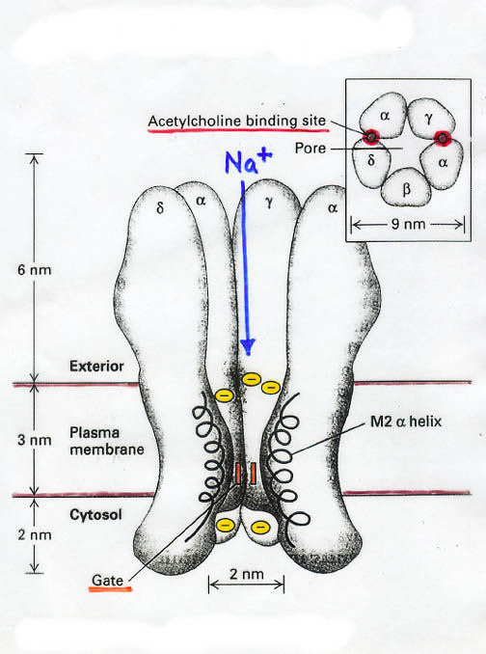
Action of Muscle Relaxants - I
In previous slides, have had DEPOLARIZING and NON-DEPOLARIZING muscle relaxants
To understand the difference, must recall the structure of the acetylcholine receptor:

Slide 12
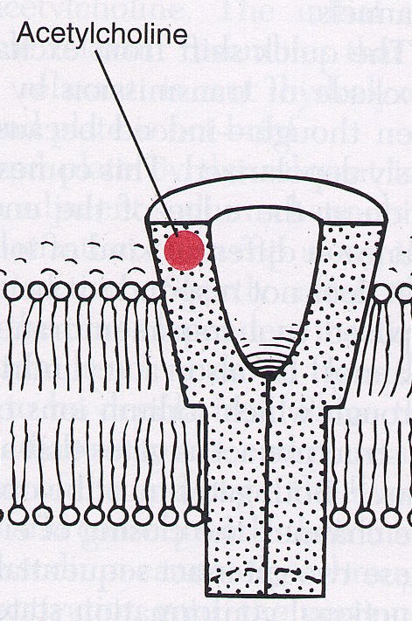
Action of Muscle Relaxants - II
Binding of one ACh molecule to one of two binding sites does not open the channel
If ACh binds to both α-subunits simultaneously, the channel will open. Ions flow across the membrane

Slide 13
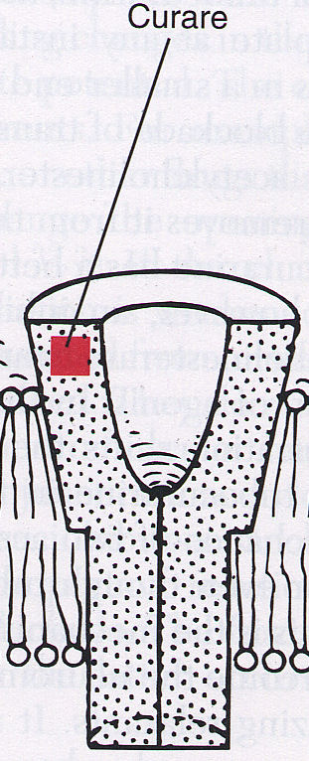
Action of NON-DEPOLARIZING Muscle Relaxants
NON_DEPOLARIZING muscle relaxants bind to one of the α-subunits competitively.
The receptor will not open, even if the other α-subunit is occupied by ACh

Slide 14
Action of DEPOLARIZING Muscle Relaxants
Suxamethonium binds simultaneously to both α-subunits, thereby activating the receptor
Voltage-sensitive Na⁺ channels open, then close and are inactivated
Cannot open again until membrane potential is reset. No electrical impulses can be conducted
Suxamethonium is not destroyed by acetylcholinesterase, but by pseudocholinesterase, in a relatively much slower reaction

Slide 15
Reversal of Blockade by Muscle Relaxants
NON-DEPOLARIZING muscle relaxants are competitive at the α-subunit
Blocking the action of acetylcholinesterase (using an acetylcholinesterase inhibitor e.g. neostigmine) will extend the lifetime and concentration of ACh
ACh will thus compete more effectively at the α-subunits and will reverse the block
The DEPOLARIZING agent suxamethonium is very similar to ACh. It stays in the cleft and reacts repeatedly with the receptors. Extending the life of ACh will not reverse the block in this case

Slide 16
Clinical Monitoring of Neuromuscular Blockade
If neuromuscular blockade is not reversed adequately in recovery, it may affect patient outcome
Can use crude clinical assessment, such as sustaining head lift for > 5 sec
Slightly more scientific way uses a nerve stimulator with a Train of Four (ToF) pattern of pulse stimulation. This is a more sensitive clinical test of reversal than just a set of pulses

Slide 17
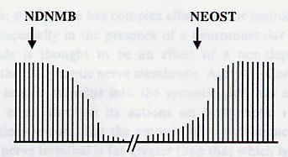
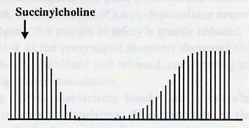
NM Stimulation Patterns
Pattern for a NDNMB with neostigmine reversal
Pattern for a DNMB:

Slide 18
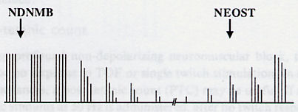
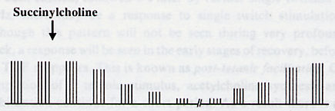
ToF Patterns
NDNMB with neostigmine reversal:
DNMB:
Fade

Slide 19
Fade
Why is fade seen with NDNMBs but not with DNMBs?
The NDNMBs bind to a pre-synaptic receptor which has a different combination of subunits to the post-synaptic receptor
Causes less acetylcholine to be released each time the nerve is stimulated
DNMBs do not bind to the pre-synaptic receptors

Slide 20
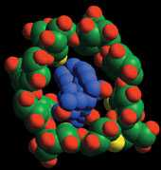
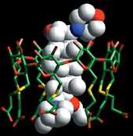
Reversal of Neuromuscular Blockade
Common clinical method is to use a competitive inhibitor of acetylcholinesterase (usually neostigmine)
Newer method uses a cyclodextrin (sugammadex) to effectively bind strongly to the NDNMB rocuronium:

Slide 21
Problems with Neuromuscular Blockade - I
Problem of most concern to anaesthetists and surgeons is awareness
Incidence is probably about 1:1000 anaesthetics if one looks hard enough but for certain procedures may be higher
If patient has NMB on board, then cannot move to let anyone know

Slide 22
Problems with Neuromuscular Blockade - II
Suxamethonium is commonly used to allow intubation
Very “dirty” drug:
Hyperkalaemia
Increased intra-ocular and intra-cranial pressure
Muscle pains
Masseter spasm
Malignant hyperthermia
“Sux apnoea”

Slide 23
Suxamethonium Apnoea
Causes prolonged neuromuscular blockade – from 30 mins to 6 hours!
Results from different forms of pseudocholinesterase, which breaks down suxamethonium
Rarely, patients may have no pseudocholinesterase; these patients have very prolonged apnoea
Autosomal recessive for the silent pseudocholinesterase gene

Slide 24
Ways to Avoid Problems with NMB
Use rocuronium with sugammadex – expensive
Avoid using NMBs altogether; some opioids are powerful enough to allow intubation without NMB
However, there can be problems with such opioids; may give rise to difficulties ventilating patients
If it is just required that the patient has regular breathing, then may be able to hyperventilate the patient, thus rendering them hypocarbic

Slide 25
SUMMARY
Looked at difference between DEPOLARIZING and NON-DEPOLARIZING neuromuscular blockers
Whilst structures are similar, mechanisms of action are quite different
Reversal of the action of NON-DEPOLARIZING neuromuscular blockers can be performed with neostigmine
Can often undertake surgery without the use of such agents

