Slide 1
Monocytes in inflammation
Kieran O’Dea PhD
Critical Care Research Group
Anaesthetics, Pain Medicine and Intensive Care
Notes:
Macrophages
Macrophages are long-lived sentinel cells who’s job it is to take up (or phagocytose) any foreign invader for destruction. They differentiate from blood-derived monocytes and reside in especially large numbers within connective tissue at the body’s main surfaces and in the liver and spleen (which act to filter the blood for microbes).
Macrophages recognise microbes by the deployment of a number of different PRR’s [See Fig2 opposite]. The major ones are called Toll-like receptors (TLR’s) and human macrophages express at least 10 different TLR’s that recognise different microbial components. For example TLR4 recognises lipopolysaccharide a common constituent of the cell wall of Gram –ve bacteria and TLR2 recognises peptidogylcan a common constituent of Gram+ve cell walls. Deployment of these 10 receptors allows the macrophage to recognise most microbes that it may encounter as dangerous invaders and to respond to them in an appropriate manner. Macrophages also express other PRR’s including: CD14 which also recognises LPS; the leukocyte integrin CD11a/CD18 which binds carbohydrate structures found on many microbes, mannose receptors which bind mannose residues which are accessible on many bacteria but are covered by other sugar groups in the carbohydrates of vertebrate cells (Fig 2). Engagement of these receptors causes the macrophage to release various SOS messages (cytokines and chemokines) that act to promote an inflammatory response and recruit cell reinforcements from the blood.

Slide 2
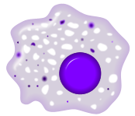






Monocytes are an intermediate stage of the mononuclear phagocyte system (MPS)
Bone marrow
Blood
Macrophages
Tissue
Monocyte
precursor
Monocyte
Myeloblast
Lymphoid
organs
Neutrophil
Precursor
(Band cell)
Neutrophil
Dendritic cells

Slide 3
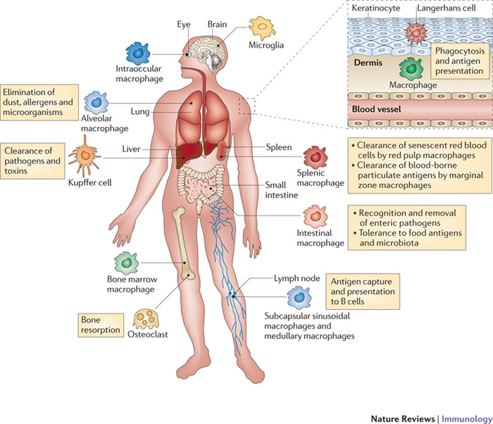
Classification of the mononuclear phagocyte system (MPS)
Monocytes/macrophages represent a continuum with overlapping phenotypes and functions.
Macrophages are classified according to their anatomical location and phenotype.
Specialised phenoytpes:
  Liver: Kupffer cells
  Lung: Alveolar macrophages
  Bone: Osteoclasts
  Brain: Microglia
  Epidermis: Langerhans cells
Multiple phenotypes
  Spleen
  Intestine

Slide 4
The MPS has multiple functions
Phagocytosis: clearance of microbes, dead cells, particles (alveolar macrophages)
Sentinal: respond to infection and tissue damage recruiting other immune cells
Antigen presentation: T cell activation.
Homeostasis: maintain non-inflammed state (where possible)
Tissue repair and remodelling: growth factors and regulation of extracellular matrix degradation.

Slide 5
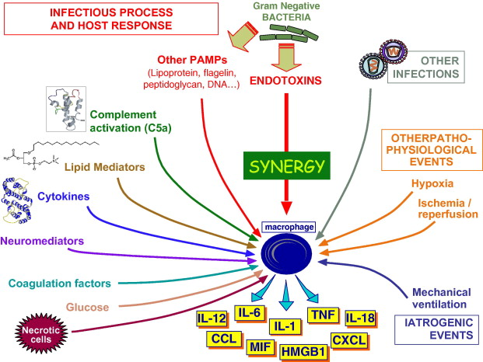
MPS cells sense all inflammatory insults
Infectious
Endogenous
Trauma
From: Adib-Conquy and Cavaillon. 2007. FEBS letters. 581: 3723-3733

Slide 6
The MPS orchestrates inflammation
500-2000 genes are upregulated (mRNA expression) in response to bacterial LPS
Macrophages release key mediators of defence and inflammation:
  NO, Reactive nitrogen intermediates (RNI) and reactive oxygen species (ROS)
  Lipid mediators: eicosanoids, platelet activating factor
  Proteases
  Cytokines
    Pro-inflammatory (TNF-α, IL-1, IL-6)
    Anti-inflammatory (Il-10, TGF-b)
  Chemokines
  Adhesion molecules
  Tissue factor

Slide 7
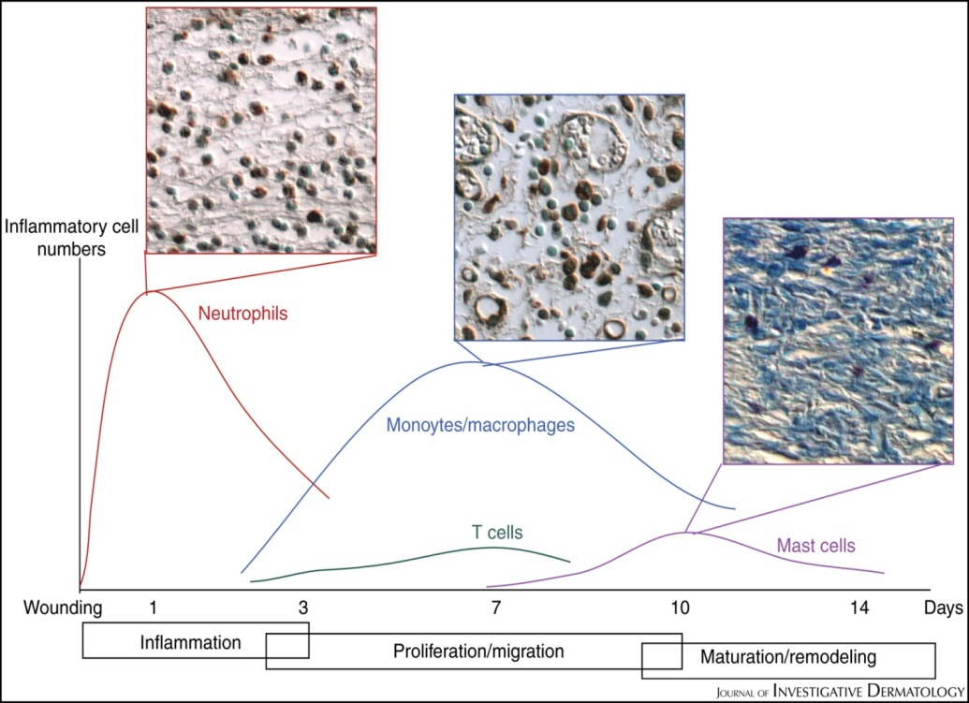
What do monocytes do?
Evolution of local inflammatory response
1: Tissue macrophages sense danger and elicit neutrophil recruitment.
2: Monocytes enter tissue
3: Neutrophil influx stops
4: Monocytes/macrophages restore homeostasis
Notes:
Relative time course of inflammatory cell recruitment to sites of tissue damage. Graphs indicate the approximate time course of influx and dispersal of neutrophils, macrophages, T lymphocytes, and mast cells in a typical murine wound response, superimposed on the three classically considered and overlapping phases of tissue repair (inflammation, proliferation/migration, and maturation/remodeling). The insets show neutrophil and macrophage immunohistochemistry at the wound site at times of peak numbers of these two cell types and mast cells revealed by toluidine blue histochemistry.
Journal of Investigative Dermatology (2007) 127, 1009–1017. doi:10.1038/sj.jid.5700811
The Inflammation–Fibrosis Link? A Jekyll and Hyde Role for Blood Cells during Wound Repair
Brian M Stramer1, Ryoichi Mori1 and Paul Martin1

Slide 8
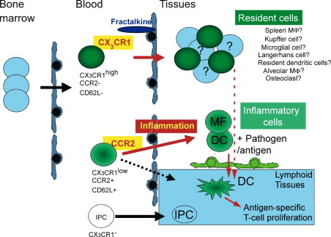
Blood Monocytes Consist of Two Principal Subsets with Distinct Migratory Properties. Immunity. 2003 Jul;19(1):71-82
In humans, phenotypically distinct monocyte subsets identified in the late 1980’s. In vivo function unknown.
2003: 2 monocyte subset defined in mice: Gr-1^{high} and Gr-1^{low}
Gr-1^{high} monocytes express CCR2 and L-selectin and migrate to local sites of inflammation
Gr-1^{low} monocytes express CX3CR1 and migrate into tissue under resting conditions.

Slide 9
‘Inflammatory’ Gr-1^{high} monocyte functions
Mediator expression higher: TNF, iNOS, ROS, IL-1b, IL-6, COX-2
Essential role in immunity to pathogenic infections:
  Bacteria: Listeria monocytogenesis, Mycobacterium tuberculosis
  Fungal: Cryptococcus neoformans, Aspergillus fumigatus
  Protozoan: Leishmania major, Toxoplasma gondi
  Viral: Murine cytomegalovirus, Vaccinia virus
Pathological role in infection:
  Trypanosoma brucei
  Influenza
In sterile inflammation:
  Atherosclerosis
  Myocardial infarct

Slide 10
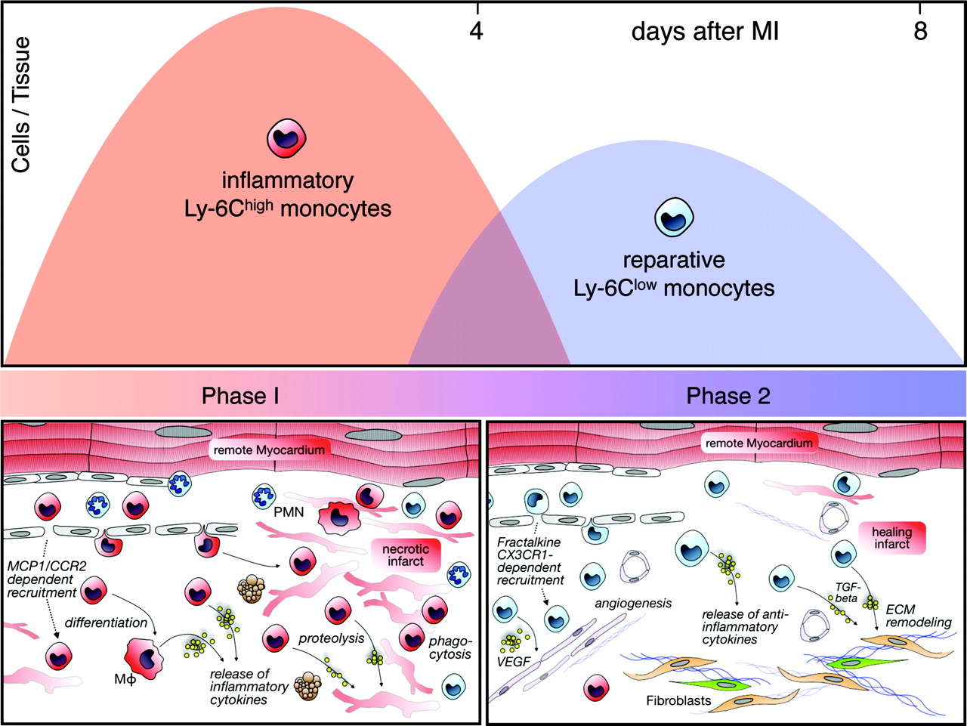
Coordination of tissue inflammation and repair by monocyte subsets
Days after myocardial infarct
CCR2 dependent recruitment
Pro-inflammatory cytokines (TNF…)
Proteolysis (matrix metalloproteases, cathepsins)
Phagocytosis
CX3CR1-dependent recruitment
Anti-inflammatory cytokines
Angiogenesis (VEGF)
Extra-cellular matrix remodelling (via TGF-beta)
The healing myocardium sequentially mobilizes two monocyte subsets with divergent and complimentary functions.
Nahrendorf M. et al. 2007. J. Exp. Med. Vol. 204, No. 12, 3037-3047

Slide 11
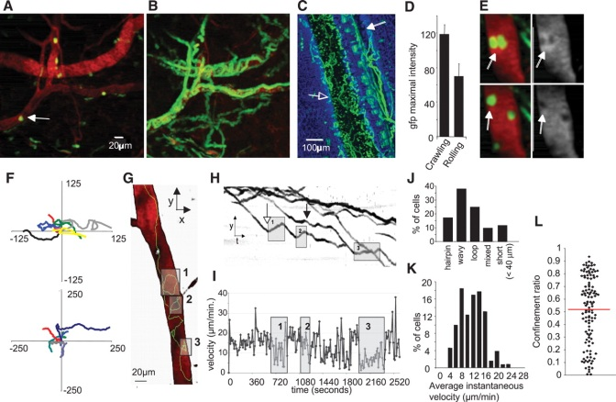
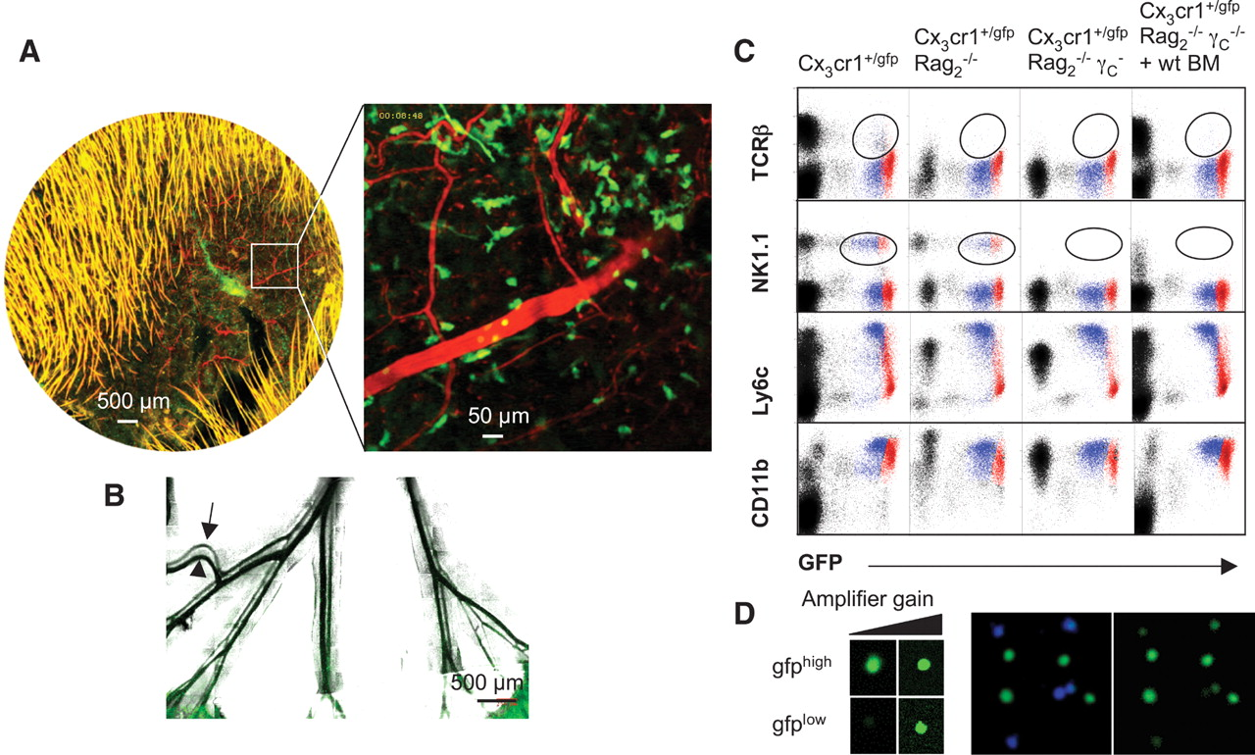
Monitoring of Blood Vessels and Tissues by a Population of Monocytes with Patrolling Behaviour
Cedric Auffray et al. Science 2007: Vol. 317. no. 5838, pp. 666 - 670
Summary
Gr-1^{low} monocytes ‘patrol’ post-capillary venules
Extravasate rapidly in response to local irritant or infection
Express chemokines for neutrophil recruitment
Express key molecules involved in tissue repair
Movement
1142883s1.avi
Videos\mov\1142883s1.mov
Sampling
1142883s2.avi
Videos\mov\1142883s2.mov
CD11a/CD18 (LFA-1)
1142883s6.avi
Videos\mov\1142883s6.mov

Slide 12
Is this relevant to human monocyte subset behaviour?
  Human CD14^{high} subset = mouse Gr1^{high}
    Migratory phenotype: CCR2, L-selectin expression
    Pro-inflammatory cytokines: ↑ TNF, IL-1β, IL-6
    ↑ ROS (↑ MPO)
    Considerable overlap in differential gene expression (130) and surface markers
Human CD14^{low} monocytes patrol like Gr-1^{low} monocytes mmc2.avi Videos\mov\mmc2.mov

Slide 13
What monocytes do in local inflammation
1: Tissue macrophages and patrolling Gr-1^{low} monocytes sense danger
2: Gr1^{low} monocytes enter tissue immediately
3: Neutrophils enter tissue, then Gr1^{high} monocytes
4: Gr-1^{high} monocytes and neutrophils remove dead cells and kill pathogens. Gr-1^{high} monocytes remove dead neutrophils.
5: Gr-1^{low} monocytes remodel tissue and restore homeostasis

Slide 14
Monocytes in acute lung injury
Part 2
Notes:
.

Slide 15
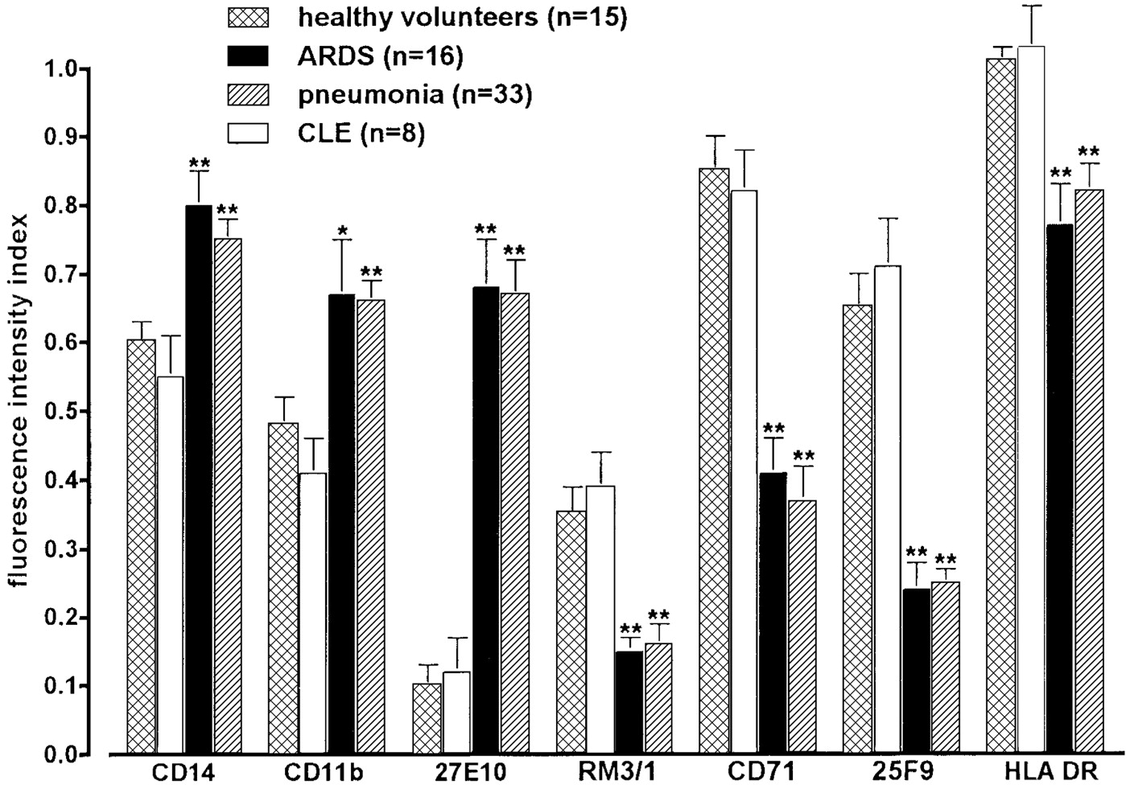
Phenotypic characterization of alveolar monocyte recruitment in acute respiratory distress syndrome.
Rosseau et al. 2000. 279: L25-L35. Am J Physiol Lung Cell Mol Physiol.
Table 2. Cell counts in first BAL
n
BAL Fluid Cells, ×10⁴/ml
Neutrophils, ×10⁴/ml
AMs, ×10⁴/ml
Lymphocytes, ×10⁴/ml
Eosinophils, ×10⁴/ml
Control
15
7.5 ± 1.8
0.01 ± 0.002
6.6 ± 1.4
0.8 ± 0.1
0.01 ± 0.003
CLE
8
9.1 ± 3.4
0.2 ± 0.04*
8.2 ± 3.3
0.6 ± 0.05
0.01 ± 0.05
ARDS
16
24.9 ± 4.6*
9.7 ± 2.6*
14.3 ± 3.1*
0.9 ± 0.1
0.03 ± 0.006
ARDS/PNEUMONIA
33
34.3 ± 3.2*
14.3 ± 2.4*
17.2 ± 1.7*
2.5 ± 0.2*
0.3 ± 0.12*
Values are means ± SE; n, no. of subjects. BAL, bronchoalveolar lavage; AM, alveolar macrophage. * P < 0.01 compared with control group.
‘A highly significant correlation between BAL fluid MCP-1 concentration, the predominance of monocyte-like AMs, and the severity of respiratory failure was noted’
Notes:
Am J Physiol Lung Cell Mol Physiol. 2000 Jul;279(1):L25-35.
Phenotypic characterization of alveolar monocyte recruitment in acute respiratory distress syndrome.
Rosseau S, Hammerl P, Maus U, Walmrath HD, Schütte H, Grimminger F, Seeger W, Lohmeyer J.
Department of Internal Medicine, Justus-Liebig-University, 35385 Giessen, Germany. simone.rosseau@charite.de
In 49 acute respiratory distress syndrome (ARDS) patients, the phenotype of alveolar macrophages (AMs) was analyzed by flow cytometry. Bronchoalveolar lavage (BAL) was performed within 24 h after intubation and on days 3-5, 9-12, and 18-21 of mechanical ventilation. The 27E10(high)/CD11b(high)/CD71(low)/ 25F9(low)/HLA DR(low)/RM3/1(low) AM population in the first BAL indicated extensive monocyte influx into the alveolar compartment. There was no evidence of increased local AM proliferation as assessed by nuclear Ki67 staining. Sequential BAL revealed two distinct patient groups. In one, a decrease in 27E10 and CD11b and an increase in CD71, 25F9, HLA DR, and RM3/1 suggested a reduction in monocyte influx and maturation of recruited cells into AMs, whereas the second group displayed sustained monocyte recruitment. In the first BAL from all patients, monocyte chemoattractant protein (MCP)-1 was increased, and AMs displayed elevated MCP-1 gene expression. In sequential BALs, a decrease in MCP-1 coincided with the disappearance of monocyte-like AMs, whereas persistent upregulation of MCP-1 paralleled ongoing monocyte influx. A highly significant correlation between BAL fluid MCP-1 concentration, the predominance of monocyte-like AMs, and the severity of respiratory failure was noted.
cardiogenic lung edema (CLE)

Slide 16
Could intravascular monocytes play a significant role in ALI?

Slide 17
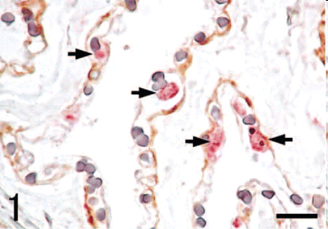
Livestock animals have pulmonary intravascular macrophages
Clearance of systemic microbes
and particles
Extremely sensitive to intravenous
endotoxin and used as a model of
extra-pulmonary ALI
The comparative biology of pulmonary intravascular macrophages.
Longworth KE. Front Biosci. 1997 Jun 1;2:d232-41
Morphologic characteristics of pulmonary macrophages in cetaceans:
Kawashima et al. Vet Pathol. 2004 Nov;41(6):682-6.

Slide 18
Role of monocytes in acute lung injury: experimental criteria
Presence in alveolar and/or pulmonary vascular space
Activation in situ and induction of injury
Attenuation of injury by depletion
Restoration of injury by repletion

Slide 19
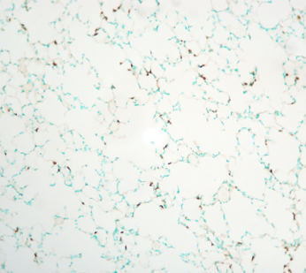
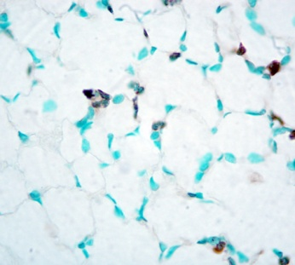
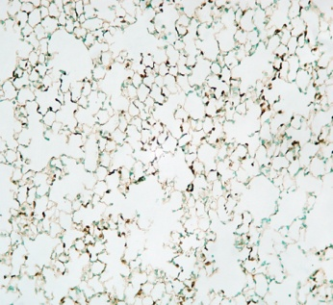
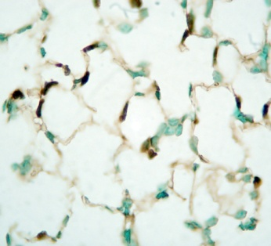
Pulmonary capillary margination of Gr-1^{high} cells in mice during sub-clinical endotoxaemia
Immunohistochemistry
Flow cytometry
x200
x1000
1
2
untreated
Gr-1
Untreated
3
Neutrophils
Gr1^{high} Mo
Gr1^{low} Mo
1
Endotoxemia
(sub-clinical)
2
Endotoxemia
(sub-clinical)
Gr-1
3

Slide 20
Monocytes marginate to the lungs for prolonged periods during sub-clinical endotoxaemia
2.5
Gr-1^{high} monocytes
Gr-1^{low} monocytes
2.0
Neutrophils
1.5
Cells×10⁶/lungs
1.0
0.5
0
0
2
4
6
8
18
Time (h) post-LPS (20ng i.v.)

Slide 21
Pre-marginated Gr1^{high} monocytes express high levels of TNF in situ after secondary LPS challenge
B
C
***
***
Neutrophils
Gr-1l^{ow}
Gr-1^{high}
**
***
***
120
Secondary
challenge:
70
***
100
60
80
None
50
TNF (MFI)
LPS
40
60
Phospho-p38 (MFI)
LPS + SB203580
30
*
40
*
20
20
10
0
0
−
+
Gr-1^{low}
Gr-1^{high}
Neutrophils
Secondary LPS
challenge

Slide 22
Depletion of lung-marginated Gr1^{high} monocytes
Gr-1^{high} monocytes
Neutrophils
3.0
3.0
2.5
2.5
2.0
2.0
Cells × 10⁶/lungs
1.5
1.5
1.0
1.0
0.5
0.5
0
0
LPS
+
+
+
+
+
+
Clod-liposome
Pre-treatment
18h
48h
18h
48h

Slide 23
Gr1^{high} monocytes induce pulmonary vascular leak
after secondary challenge with zymosan
†
0.03
†
0.025
0.02
Permeability index
(extra-vascular albumin)
0.015
0.01
0.005
Zymosan=yeast extract
Induces complement activation
(C5a) and binds TLR2 on
monocyte/macrophages
0
Clod-liposome
18h
48h
Pre-treatment
n=4-6
† p<0.01
(2-hit model of acute lung injury: 1. low dose LPS 2. Zymosan (yeast))

Slide 24
Experimental criteria satisfied
Presence in alveolar and/or pulmonary vascular space ✓
Activation in situ ✓
Injury attenuated by depletion ✓
Injury restored of by repletion ✓
Mobilization and margination of bone marrow Gr-1^{high} monocytes during subclinical endotoxemia
predisposes the lungs toward acute injury. O’Dea et al. J. Immunol. 2009. 182(2):1155-66
Role of lung-marginated monocytes in an in vivo mouse model of ventilator-induced lung injury.
Wilson et al. Am J Respir Crit Care Med. 2009 179(10):914-22.

Slide 25
Despite its lack of specificity, cell depletion by the Gr1 antibody has been used in over 60 studies to prove a neutrophil role in vivo.
Since 2009, monocytes have been implicated in several models of acute lung injury and infection
  Ventilator induced lung injury
  LPS-induced ALI
  Transfusion related acute lung injury
  Pneumococcal and influenza infection

Slide 26
Monocyte-neutrophil interactions in acute lung injury?
‘Monocytes are potent facilitators of alveolar neutrophil emigration during lung inflammation’ J Immunol. 2003; 170(6):3273-8.
Neutrophil migration with LPS/MCP-1 treatment was dependent of monocytes
‘Neutrophil secretion products pave the way for inflammatory monocytes’
Blood 2008; 112, 1461-1471.
Gr-1^{high} monocyte recruitment to local site of inflammation was neutrophil dependent (heparin binding protein (HBP) and LL-37 dependent)

Slide 27
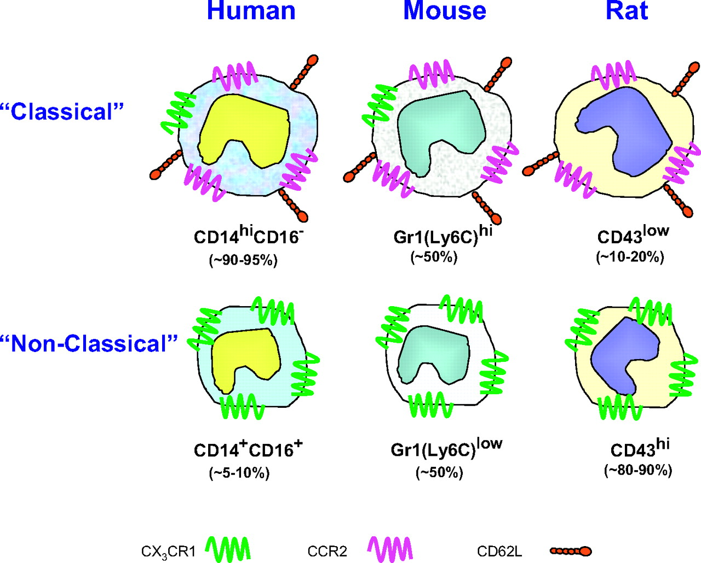
Monocytes exist as at least 2 phenotypically heterogeneous subpopulations

Slide 28
Mouse monocyte subset trafficking and division of function in vivo
Bone marrow
Blood
Inflammed
tissue
Pertinoneum (2003)
Retina (2005)
Skin (2006)
Muscle (2007)
Atherosclerotic
plaques (2007)
Brain (2007)
Salmonella
Toxplasmosis
etc..
Gr-1^{high}
Gr-1^{high}
Pathogen clearance
and
wound healing
Normal tissue
Gr-1^{low}
Resident
macrophages
and dendritic
cells
Keep but preceed with the more complicated figure?

Slide 29
Delineating the monocyte-neutrophil interaction is crucial for understanding ALI
Infection/
Sterile insult
Alveolar MΦ
MIP-2
MCP-1
Alveolar epithelia
HBP
MCP-1
Capillary endothelium

Slide 30
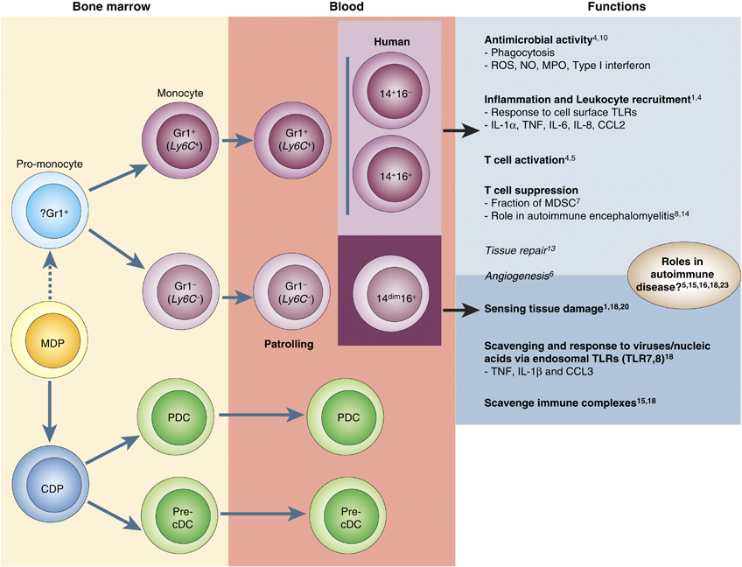

Slide 31
Can intravascular monocytes play the same role as pulmonary intravascular macrophages?
Notes:
Strategy: induce margination of monocytes with sub-clinical endotoxaemia and re-challenge with a clinical insult (2-hit model)

