Slide 1
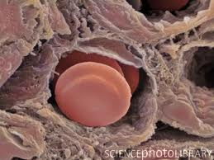
The endothelium and inflammation
Kieran O’Dea PhD
Critical Care Research Group
APMIC Section

Slide 2
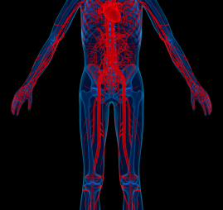
Endothelium as a structure
Lining of all blood vessels composed of a single layer of cells.
In humans, comprises 1x10¹³ cells and weighs ~1kg.
Semi-permeable barrier that separates blood from surrounding tissues.

Slide 3
The endothelium as an organ
Multi- functional: regulating homeostasis of blood and underlying tissue.
Biosynthetic repertoire
  Matrix products, growth factors, procoagulant and antithrombotic factors, vasomotor factors, lipid metabolism, inflammatory mediators
Heterogeneous: functionally adapted to its location.
Adaptable: senses and responds rapidly to changes in its microenvironment.

Slide 4
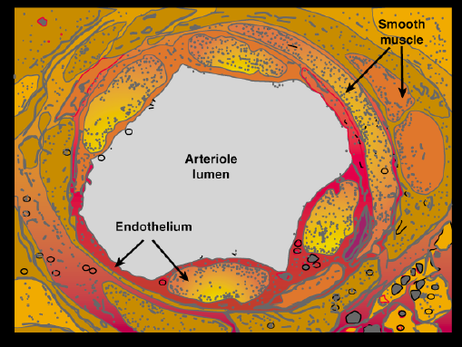
Core functions of the endothelium adapted to inflammation
Vasodilation: increase blood supply to local site
Haemostasis: coagulation and containment of the injured tissue
Permeability: increase diffusion of plasma factors
Cell adherence: increase leukocyte recruitment and migration

Slide 5
Area covered
The endothelium under resting conditions
Mechanisms of endothelial activation during inflammation
Cross-talk between the endothelium and inflammatory leukocytes
Dysregulation of endothelial function
Restoration of endothelial homeostasis

Slide 6
The endothelium under resting conditions

Slide 7
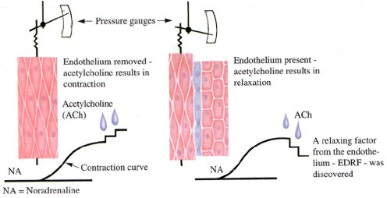
The obligatory role of endothelial cells in the relaxation of arterial smooth muscle by acetylcholine.
Furchgott RF and Zawadzki JV. Nature 288, 373 – 376. 1980
EDRF: endothelium-derived relaxing factor = nitric oxide
Notes:
The obligatory role of endothelial cells in the relaxation of arterial smooth muscle by acetylcholine
Robert F. Furchgott & John V. Zawadzki
Department of Pharmacology, State University of New York Downstate Medical Center, Brooklyn, New York 11203
Despite its very potent vasodilating action in vivo, acetylcholine (ACh) does not always produce relaxation of isolated preparations of blood vessels in vitro. For example, in the helical strip of the rabbit descending thoracic aorta, the only reported response to ACh has been graded contractions, occurring at concentrations above 0.1 µM and mediated by muscarinic receptors1,2. Recently, we observed that in a ring preparation from the rabbit thoracic aorta, ACh produced marked relaxation at concentrations lower than those required to produce contraction3,4 (confirming an earlier report by Jelliffe5). In investigating this apparent discrepancy, we discovered that the loss of retaxation by ACh in the case of the strip was the result of unintentional rubbing of its intimai surface against foreign surfaces during its preparation. If care was taken to avoid rubbing of the intimai surface during preparation, the tissue, whether ring, transverse strip or helical strip, always exhibited relaxation to ACh, and the possibility was considered that rubbing of the intimai surface had removed endothelial cells4. We demonstrate here that relaxation of isolated preparations of rabbit thoracic aorta and other blood vessels by ACh requires the presence of endothelial cells, and that ACh, acting on muscarinic receptors of these cells, stimulates release of a substance(s) that causes relaxation of the vascular smooth muscle. We propose that this may be one of the principal mechanisms for ACh-induced vasodilation in vitio. Preliminary reports on some aspects of the work have been reported elsewhere

Slide 8
Endothelial nitric oxide mediated vasolidation
Agonists/shear stress
Endothelial nitric oxide synthase (eNOS) activated by e.g.
  Shear stress, acetylcholine, ADP, bradykinin.
NO mediates guanylate cyclase activation leading to myosin light chain phosphatase activation and cytosolic calcium decrease
→ relaxation of myosin contractile apparatus
PI3K
+
eNOS
Ca²+
Calmodulin
NO
Endothelial cell
sGC
MLCP
PKG
GTP
Vaso-
relaxation
↓Ca²+
cGMP
Other vasodilators:
Prostacyclin (PGI₂),
Endothelium-Derived Hyperpolarizing Factor (EDHF)
Smooth muscle cell
Vasoconstrictors:
Endothelin, PAF, TXA₂
Notes:
Nitric oxide: primary regulator of vasodilation under normal conditions

Slide 9
The endothelium is an anti-coagulant surface
Tissue
factor
Tissue factor pathway inhibitors (TFPIs) block the actions of the factor VIIa-tissue factor (TF) complex.
Thrombomodulin (TM) binds thrombin (Factor IIa) which then converts protein C (PC) to activated-PC (APC). APC inhibits coagulation cofactors Va and VIIIa.
Endothelial protein C receptor (EPRC) facilitates the thrombin-PC interaction.
Heparan sulphate proteoglycans enable bound anti-thrombin III to inhibit thrombin.
Tissue plasminogen activators (T-PA) convert plasminogen to plasmin to promote fibrinolysis
ATPases and ADPases convert platelet ATP to AMP, blocking physical interaction with collagen.
NO and prostacyclin inhibit platelet binding.
X VII
TFPI
Tissue factor-
VIIa/Xa
PC
TM
V
EPCR
Va
APC
II
Heparan
Thrombin
fibrinogen
t-PA
fibrin
ATPase
ADPase
Platelets
eNOS

Slide 10
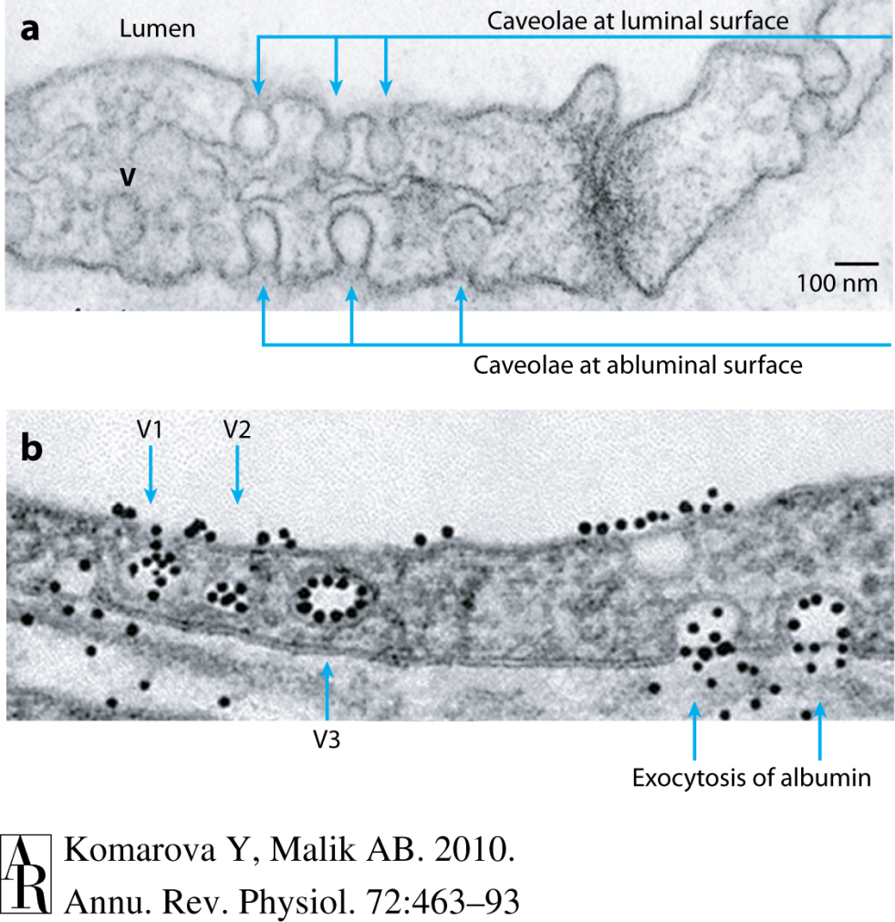
Transport of fluid and solutes in the capillaries
Intercellular clefts: small solutes and water (paracellular)
  Tight junction (apical)
  Adherens junctions (basal)
Caveolae: endocytotic uptake and transport of macromolecules across endothelial cells (transcytosis)
Vesiculo-vacuolar organelles: fused caveolae, abundant in post capillary venules

Slide 11
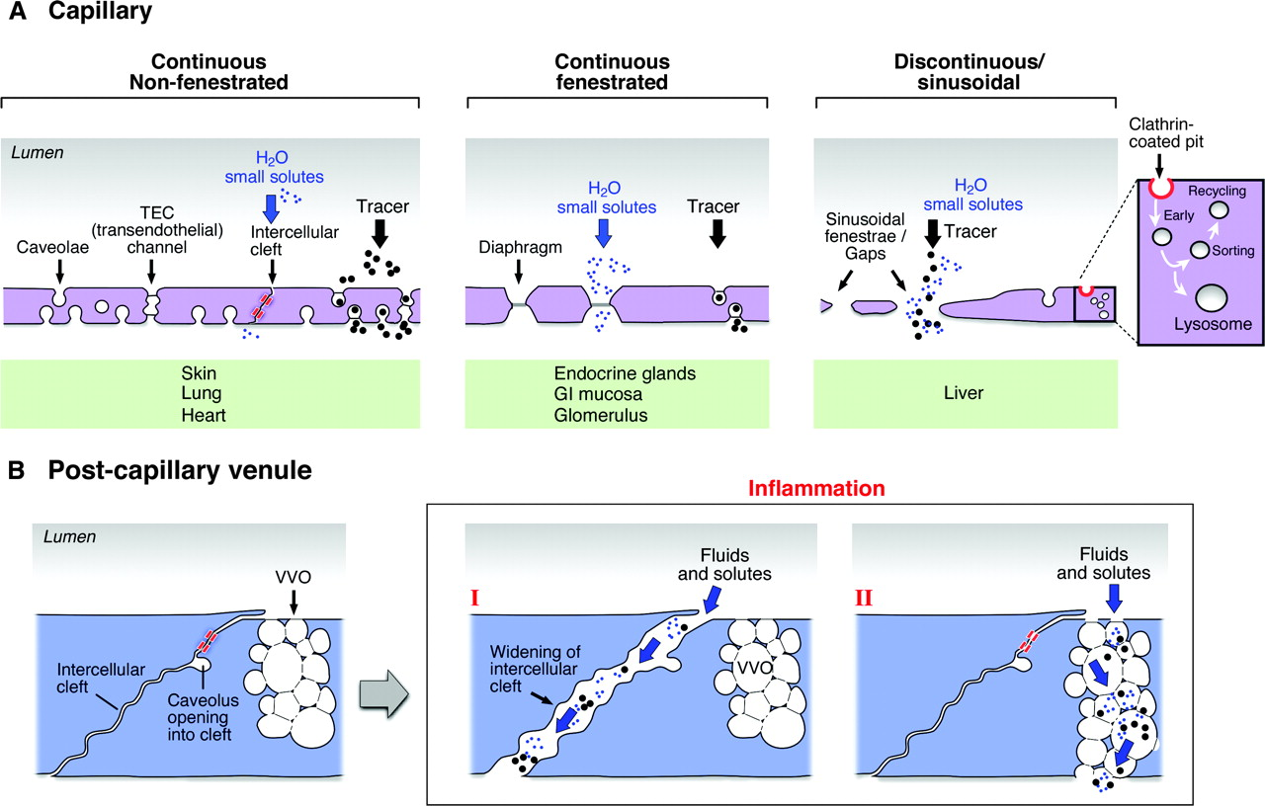
Heterogeneity of the capillary endothelial barrier
Lung, Heart, Skin
Skeletal muscle
CNS/brain: abundant tight junctions,
few caveolae
Endocrine glands,
Gastro-intestinal
Mucosa, Glomerulus
Liver
Spleen
Fenestrae: Large transcellular pores (70nm) with non-membranous diaphragm
Sinusoidal gaps: Large gaps/circular pores (110-200nm), no diaphragm

Slide 12
Activation of the endothelium

Slide 13
Endothelial activation
Type I activation: rapid response to G-protein coupled receptor (GPCR) signalling.
Type II activation: delayed response to cytokine receptor and Toll-like receptor signalling.
Gene transcription independent.
Agonists: histamine, chemokines (e.g. IL-8, MCP-1), platelet activation factor, soluble complement fragments (C3a, C5a)
Short-lived (20-30min), self limiting
Gene transcription-dependent
Microbial products (e.g. lipopolysaccharide), pro-inflammatory cytokines (IL-1b, TNF)
Long term response (hours to days)

Slide 14
Type I activation
Ligand
DAG
PtdIns(4,5)P₂
RHO
α
β
γ
RHO-GEF
α
RHO
PLCβ
RHO-dependent
kinase
InsP₃
Opening of
tight and
adherens
junctions
Nucleus
P
MLC
phosphatase
MLC
phosphatase
Ca²⁺
Ca²⁺
P
_{C}PLA₂
ER
MLC
MLC
MLCK
PC
Arachadonic acid
COX1
Arginine
PAF
acetylase
Prostacyclin
synthase
eNOS
Ca²⁺
Fusion
PAF
Calmodulin
Lysoposphatidylcholine
PGI₂
(prostacyclin)
Nitric
oxide
Vasodilation
P-selectin

Slide 15
Type I activation summary
Vasodilation: COX-1 mediated prostacyclin release and eNOS mediated NO production (synergistic interaction).
Permeability: opening of tight junctions especially in post-capillary venules.
Adhesion: exocytosis of Weibel Palade bodies with exposure of P-selectin on cell membrane. Release of von Willebrand factor increase platelet adhesiveness.
Activating surface: synthesis of PAF and presentation on membrane.

Slide 16
Type II activation
IL-1
TNF
TIRAP
MyD88
IRAK4
TRADD
IRAK1
RIP1
TRAF2
TRAF6
IκB
AP1
p50
p65
AP1
NF-κB
E-selectin
ICAM-1
VCAM-1
Chemokines
COX-2
Arachadonic acid
COX2
Heparan
sulphate
proteoglycan
E-selectin
VCAM1
PGI₂
(prostacyclin)
C
Chemokine
ICAM1

Slide 17
Type II activation summary
Activation of transcription factor NF-kB and activating protein 1 (AP1).
Adhesion: E-selectin, VCAM1, ICAM1.
Activating surface: Chemokine expression and presentation on membrane glycocalyx.
Vasolidation: COX-2 expression leading to increased prostacylin (requires type I activation to provide arachadonic acid).
Permeability: Actin filament reorganisation and opening of intercellular junctions

Slide 18
Cross-talk between the endothelium and inflammatory leukocytes

Slide 19
Leukocyte adherence to the activated endothelium
Leukocyte
Capture
Rolling + Activation
Arrest
Crawling
Migration
Selectin ligand
Selectin
Endothelium
Active Integrin
L-selectin +
PSGL-1, VLA-4
β1 and β2 integrins
Integrin
Integrin ligand
c
Chemokine receptor
Chemokine
CD11a/CD18
VLA-4 (α4β7)
CD11b/CD18
c
c
E & P selectins
PAF
Chemokines
(IL8, MCP1)
ICAM-1
VCAM-1
ICAM-1
ICAM-2
PECAM-1
JAMs
PSGL-1
Notes:
A

Slide 20
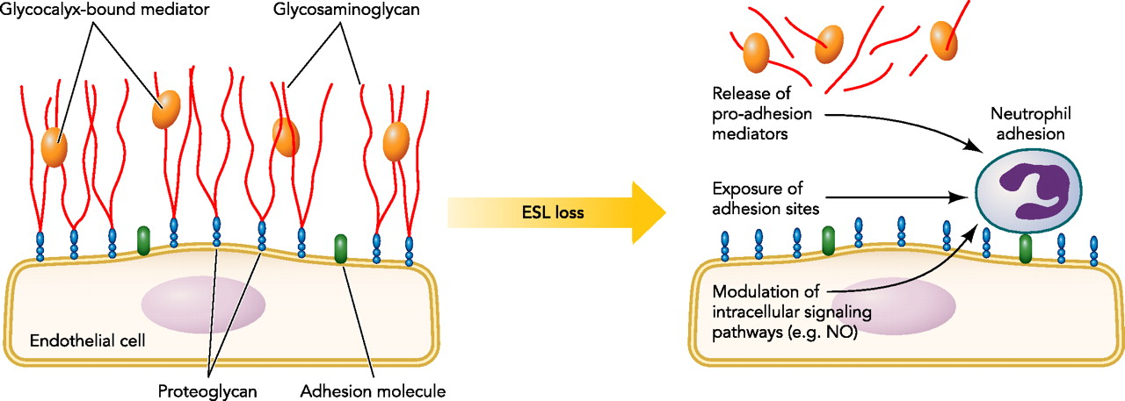
The endothelial glycocalyx
Endothelium is coated by a thick (>1μm) glycocalyx layer
Regulates permeability and leukocyte adhesion to the endothelium
Captures and presents soluble factors (e.g. chemokines)
TNF induces shedding of the glycocalyx
©2011 by American Physiological Society
Schmidt E P et al. Physiology 2011;26:334-347

Slide 21
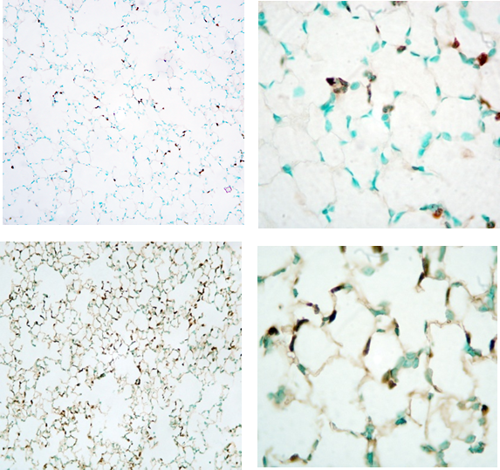
Leukocyte recruitment to the pulmonary microvasculature- ‘margination’
4
3
Circulating monocytes
(×10⁵/ml)
Loss of cell deformability results in trapping and margination in the pulmonary capillaries
Monocytopenia and neutropenia
Retention of cells is prolonged through CD11b/CD18-ICAM-1 interaction
Concentration of inflammatory responses within the microvasculature
2
1
0
0
30
60
90
120
Time post-LPS injection (min)
Normal
LPS

Slide 22
Leukocyte adhesion augments endothelial activation
Leukocytes pro-inflammatory mediators
  Type I (e.g. PAF)
  Type II activation (e.g. TNF, IL-1b).
Enhancement of coagulation by monocyte tissue factor (TF).
Local release of NO (iNOS) and reactive oxygen species

Slide 23
Endothelial adhesion augments leukocyte activation
Adherence of monocytes and neutrophil to endothelium increases their pro-inflammatory mediator expression upon stimulation with e.g. LPS, FMLP
  Monocytes: TNF, IL-8, MCP-1, COX-2, Tissue factor
  Neutrophils: Reactive oxygen species, elastase
The activated endothelium further potentiates monocyte and neutrophil responses

Slide 24
Dysfunction of the endothelium

Slide 25
Endothelial ‘activation’ vs. ‘dysfunction’
Endothelial activation under inflammatory conditions represents an adaptive phenotypic response to the local and systemic environment.
Endothelial dysfunction arises from activation, which is excessive or inappropriate in space and time.
The aims of endothelial therapies should not be to shutdown but to restore the adaptive phenotype.

Slide 26
Pathophysiology
Vasotone dysregulation
Loss of barrier function
Excessive leukocyte adherence
Coagulopathy
Oedema, microvascular occlusion
↓
Hypoxia
↓
Organ dysfunction

Slide 27
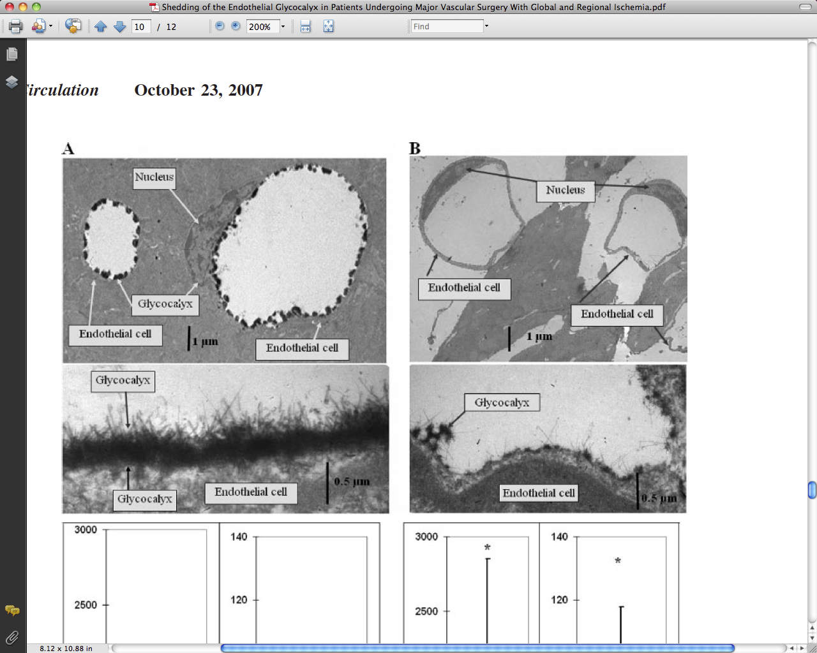
Abrupt glycocalyx shedding as an example of dysfunction
Electron microscopic views of microvessels of guinea pig hearts stained to reveal the glycocalyx
  A: after 15 minutes of blood-free perfusion
  B: after an additional 20 minutes of warm (37°C), global, stopped-flow ischemia
↑ Neutrophil adhesion ↓ NO production ↑ Vascular leak
Notes:
GAGs syndecan and heparan sulphate release into coronary venous effluent

Slide 28
Restoring endothelial homeostasis

Slide 29
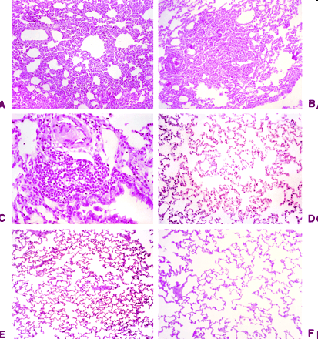
Blocking neutrophil/monocyte adherence could restore normal endothelial function
Model of prolonged sterile peritonitis in rabbits
Anti-CD18 i.v. treatment reduced leukopaenia
Neutrophil infiltration in the lungs and oxygen radical production reduced
Reduced mortality (40%) and improved lung function (↑pO₂)
Inhibition of CD11-CD18 Complex Prevents Acute Lung Injury and Reduces Mortality after Peritonitis in Rabbits
Gardinali et al. Am. J. Respir. Crit. Care Med., Volume 161, 2000, 1022-1029

Slide 30
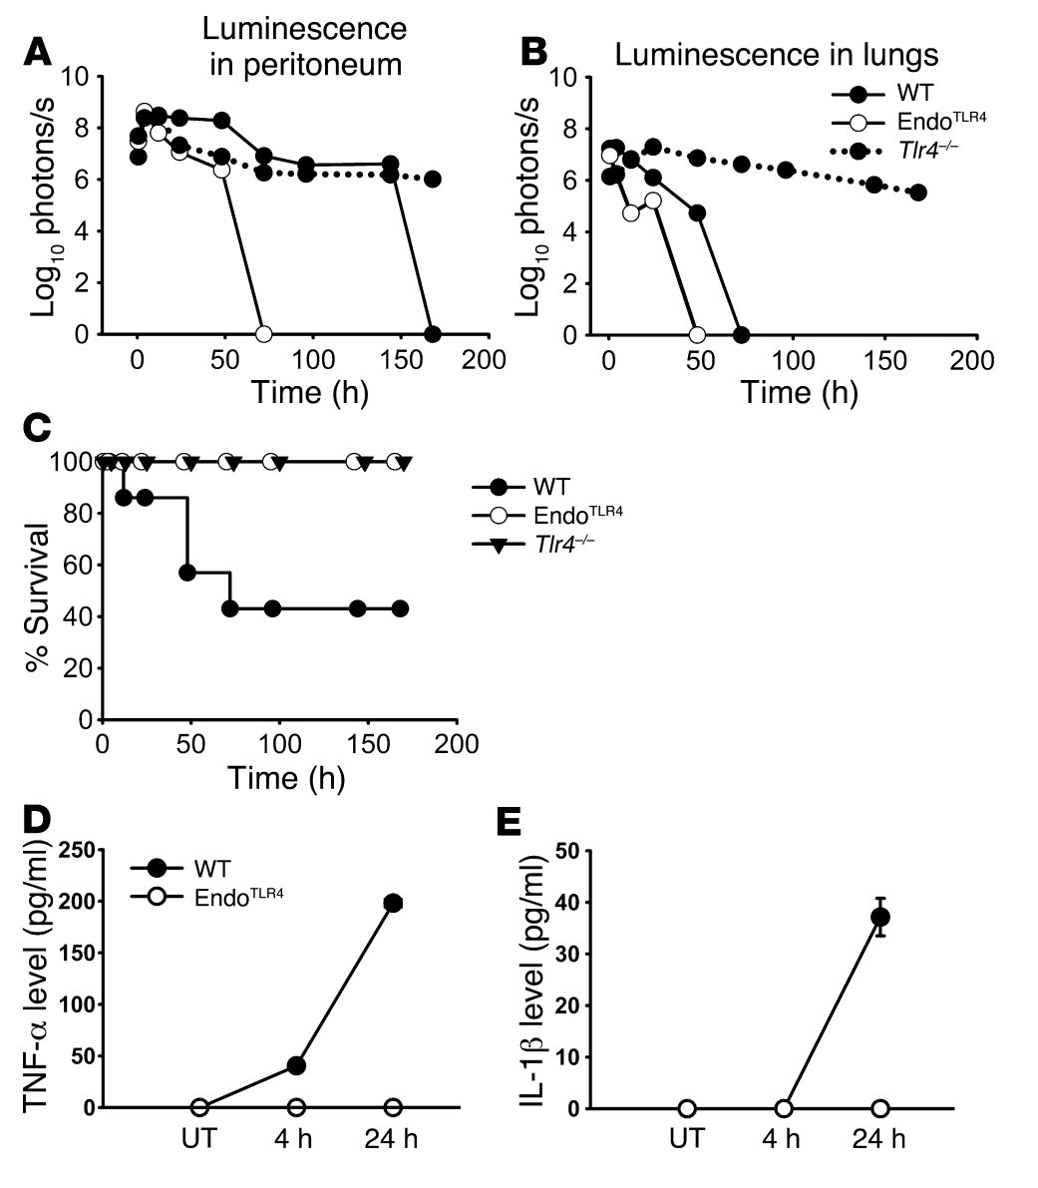
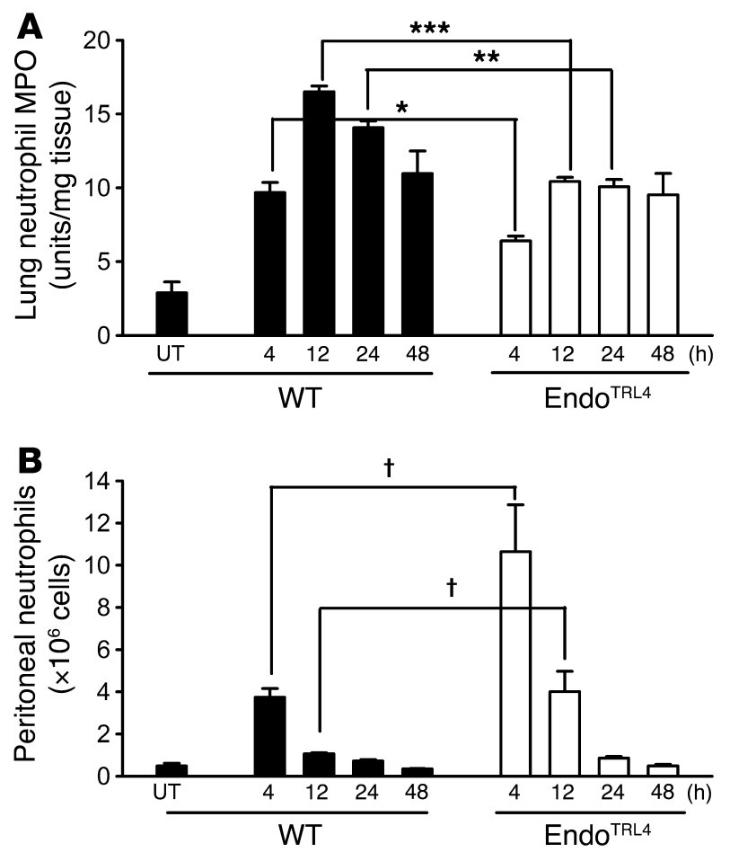
Mice that exclusively express TLR4 on endothelial cells can efficiently clear a lethal systemic Gram-negative bacterial infection.
J Clin Invest. 2009;119(7):1921–1930
Mice expressing TLR4 (LPS receptor) only on the endothelium showed an accelerated clearance of intra-peritoneal bacteria infection
Mortality was eliminated (60% in wild type)
Neutrophil margination to lungs was reduced in endothelial TLR4+/+ mice
Peritoneal recruitment of neutrophils was enhanced

Slide 31
Same mediator, opposite effects
Permeability
Oedema in
lung
Oedema in
muscle and mesenteric venules
10⁻¹²
10⁻¹¹
10⁻¹⁰
10⁻⁹
10⁻⁸
10⁻⁷
Endothelial NO concentration [log M]
Kuebler WM et al. Cell Physiol Biochem. 2010;26(1):29-40.

Slide 32
Summary
The endothelium is a highly adaptive and heterogeneous organ, coordinating key physiological processes.
It is central to the inflammatory response with a significant role in pathophysiology
It is an attractive therapeutic target, but regional regional heterogeneity represent a major challenge.

Slide 34
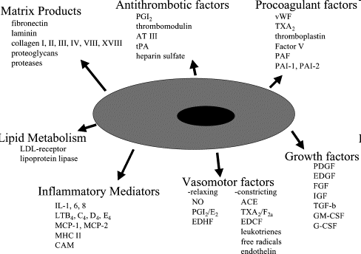
The endothelium has multiple physiological and immune functions
Sumpio BE et al. Int J Biochem Cell Biol. 2002 Dec;34(12):1508-12

Slide 35
The endothelium expresses multiple factors physiological and immune functions
Matrix products
Growth factors
Procoagulant and antithrombotic factor
Vasomotor factors
Lipid metabolism
Inflammatory mediators
Sumpio BE et al. Int J Biochem Cell Biol. 2002 Dec;34(12):1508-12
Notes:
What is the purpose of this slide: biosynthetic capacity of the endothelium indicates multiple role in maintenance of homeostasis, its own and that of the immune system

Slide 36
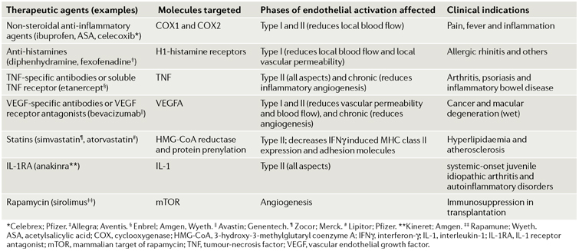
Endothelial-targeted actions of selected agents that reduce inflammation
Pober SJ and Sessa WC. Nature Reviews Immunology 7, 803-815 (October 2007)
Notes:
Went a bit flat
Make text and a message e.g. there are instances where targetting a single pathway may reset the system if other measures are in place to maintain this new steady state.
Make point that a lot of these treatments aim to targer local endothelial acitvation , whereas not global treatments availbale for SIRS and reversal of organ injury

Slide 37
Transmission of inflammation by the activated endothelium
Passive Increased permeability access to plasma factors
  Antibody
  Cytokines
  Complement
Release of locally produced mediators
  Chemokines
  Cytokines
Selective (active transport) permeability necessary to maintain organ function e.g. the pulmonary endothelium
  Smalll molecule <
  Chemokines
  Cytokines
Notes:
To translate permeability changes into the local ans sytemic inflammatory contexts>
Local inflammation: swelling….cardinal signs of inflammation
For understanding organ function the role of heterogeneity is essential
Lung brain
How is this translated with such barriers
Lung=protected from sytemic cytokines: but there is a selective permeability
Brain=transmission of signal across, with the barrier in tact.

Slide 38
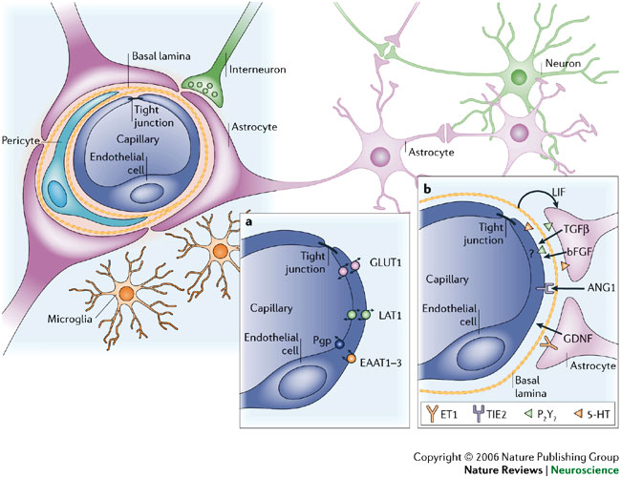
Endothelial transmission of inflammation between closed compartments
Notes:
To translate permeability changes into the local ans sytemic inflammatory contexts>
Local inflammation: swelling….cardinal signs of inflammation
For understanding organ function the role of heterogeneity is essential
Lung brain
How is this translated with such barriers
Lung=protected from sytemic cytokines: but there is a selective permeability
Brain=transmission of signal across, with the barrier in tact.

Slide 39
*Leukocyte trafficking
Recirculation of lymphocyte through high endothelial venules (HEV) of lymph nodes
Circulating leukocytes exist in equilibrium with a marginal pool.
Marginated pool
Circulating pool
Lungs: narrow capillaries
Liver: sinusoids
Notes:
Drop HEV
Focus on margination
Em pic of marginated monocyte or neutrophil

