Slide 1
Anaesthesia and the cardiovascular system
Dr Dafydd Lloyd. MRCP, FRCA.
Academic Anaesthetics. G3.21.
dafydd@imperial.ac.uk

Slide 2
Cardiovascular System:
“Relating to the heart and blood vessels”
OED.
Systemic circulation: Cerebral.
Pulmonary.
Right and left heart.

Slide 3
Miller’s Anesthesia 6th edition.
Chapter page count:
Temperature monitoring: 28 pages.
Depth of Anaesthesia: 38 pages.
Respiratory monitoring: 44 pages.
Cardiovascular monitoring: 150 pages.

Slide 4
Types of Anaesthesia:
General: Inhalational.
Intravenous: - Opioid.
- Non – opioid.
Regional: Local nerve blocks.
Central Neuroaxial.

Slide 5
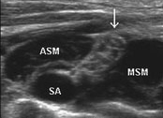
Supraclavicular Brachial Plexus:
ASM: Anterior Scalene.
MSM: Median Scalene.
SA: Subclavian Artery.
: Brachal Plexus.
NYSORA.

Slide 6
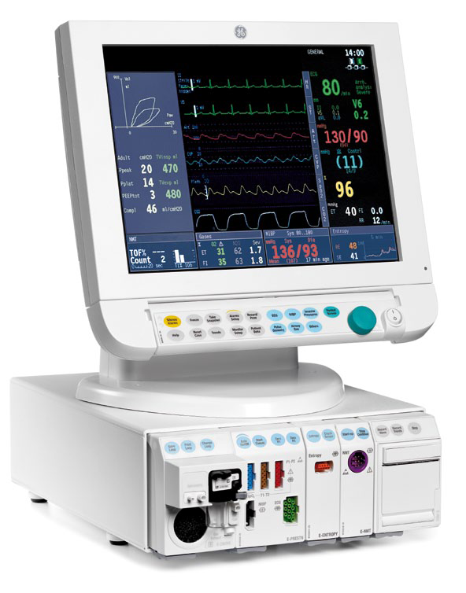
Datex Anaesthetic monitor:

Slide 8
Classical terminology:
Inotropy.
Chronotropy.
Lusitropy.
Dromotropy.

Slide 9
Classical terminology:
Inotropy : Force of contraction.
Chronotropy: Rate of contraction.
Lusitropy: Rate of relaxation.
Dromotropy: Rate of conduction.

Slide 10
Why is this machine not in the UK?:

Slide 11
Improving anaesthetic safety:

Slide 12
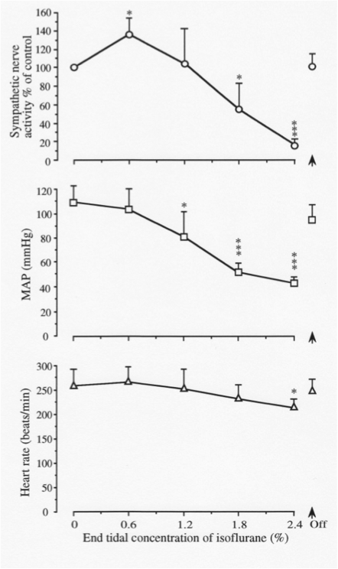
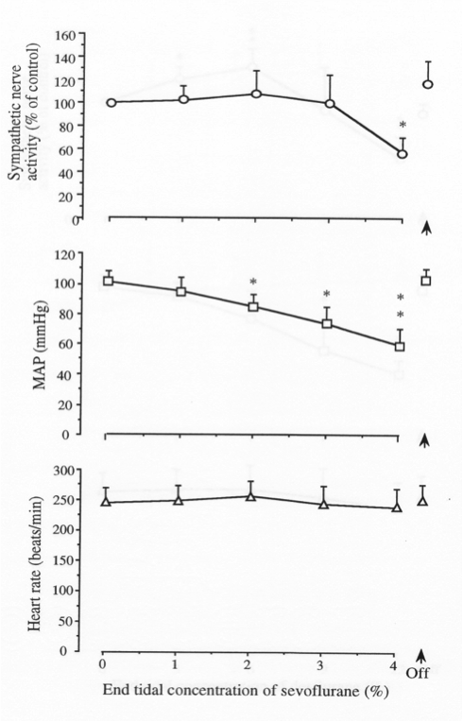
Volatiles and CVS: The overall trend
Isoflurane
Sevoflurane
Desflurane

Slide 13
Volatile induced cardiac depression:
Depress contractile function in vitro and in vivo.
Negative inotropic effect:
Reduce max velocity of shortening. Reduce peak developed force.
Reduce maximal rate of force development.
Difficult to isolate pure Cardiac effect in vivo.

Slide 14
All reduce HR and BP:
Isoflurane
Sevoflurane
Desflurane

Slide 15
Reduced Cardiac Output:
Initial increased sympathetic activity.
Reduce SVR (= MAP – CVP / CO)
MAP= P_{dias} – 1/3 (P_{sys}-P_{dias}) CO=SV x HR
Negative Chronotropy.
Abnormal, blunted responses to change.

Slide 16
Abnormal, blunted response:
Isoflurane
Sevoflurane
Desflurane

Slide 17
Altered Chronotropy:
Slow rate of SA node discharge by altering SA nodal automaticity.
Prolong AV conduction time and refractoriness.

Slide 18
Left Atrial effects:
Role of left atrium?
50% reduced LA contractility at 1.2 MAC.
Calcium mediated mechanism.
Also impair LA relaxation.

Slide 19
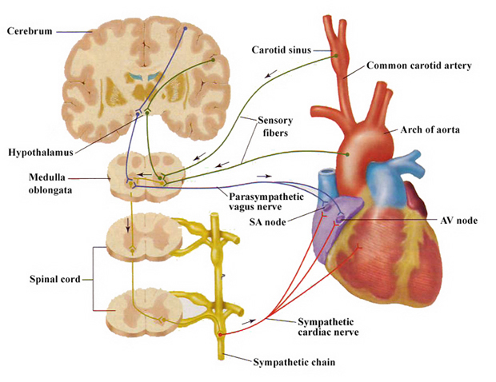
Baroreceptor reflex:
Circumferential and
Longitudinal
Extracardiac Stretch R.
Nucleus solitarius.
9th and 10th Cranial
nerves.
Volatiles inhibit HR
Component.
Reset in chronic HT:
Labile bp periop.
Corposcindosis

Slide 20
Inter-drug variation:
To varying degrees: H > I > D > S.
Propofol > Fentanyl.
Ischaemic > non-ischaemic.
Failing heart > non-failing heart.

Slide 21
Volatiles alter calcium handling:
Myocyte Action Potential:
Ca²⁺ in.

Slide 22
Several targets:
Alter L and T-type Ca²⁺ channel function to
transsarcolemmal Ca²⁺ currents.
Reduced Calcium transits:
Reduced Ca²⁺ for contractile activation
Impaired Calcium induced Calcium release.
Reduced Calcium SR stores.
Render SR leaky.

Slide 23
Altered Diastolic function:
Dose related prolongation of IVR.
Reduced atrial ejection.
May compensate for reduced contractility.
Varies in health and disease.

Slide 24
Side effects can be clinically beneficial:
Preserve metabolic and structural integrity in regional ischaemia / reperfusion.
Reduce infarct size.
Ischaemic preconditioning.

Slide 25
Improved loading conditions:
Improved pre and after loading.
May offset negative inotropy.
University of Virginia

Slide 26
Opioids and Benzodiazepines:
Haemodynamically well tolerated.
Preserve homeostatic reflex mechanisms.
Effective dose is patient dependent.
Generally very stable: “Cardiac anaesthetic”.

Slide 27
Propofol:
Used for induction and maintenance.
Hypotension: BP reduced - 40%.
Myocardial depression.
Vasodilation.
HR stable: Resets baroreceptor reflex.
No reflex tachycardia.

Slide 28
Ketamine:
Stimulates the CVS.
Increases BP, HR and Cardiac Output.
Increases Myocardial work and O₂ demand.
Direct myocardial and sympathetic stimulation.

Slide 29
Neuroaxial anaesthesia:
Sympathetic blockade:
- Vasodilation below block.
- Hypotension: Preload.
Cardiac output.
Severe in hypovolaemia.

Slide 30
Neuroaxial blockade:
Bradycardia (T1-4).
Reduced myocardial work and O₂ demand.
Reduced bleeding and DVT.
Any relative contraindications?

Slide 31
Cerebral perfusion:
Autoregulation: impaired by drugs.
Affected by: Blood pressure.
pCO₂.
pO₂.
Laryngoscopy.
Coughing.

Slide 32
Consider the anaesthetic options…..
35 yr female.
Fit and well.
Elective laparoscopic Cholecystectomy.

Slide 33
What could you use?
75 year old male.
Severe ischaemic heart disease.
Elective Coronary Bypass Graft x 4, + AVR.

Slide 34
What are the options?
50 year male.
Severe bilateral pneumonia.
Exhausted.
Sats 85% on 100% O₂.
HR 120 bpm.BP 80/50.

Slide 35
What are your options?
8 year old child.
Elective tonsillectomy.
“Doesn’t want a needle, very precious”.

Slide 36
What would work?
Road Traffic Accident.
Trapped in the vehicle.
Major lower limb bone + soft tissue injury.
In agony.

Slide 37
Last one…...
65 year male.
Hypertensive.
PONV, “Terrible, you will help me Dr….”
Previous DVT, not on warfarin.
Elective total knee replacement.

Slide 38
Recap:
Complex, varied cardiovascular effects.
Agents affect - Inotropy.
- Chronotropy.
- Lusitropy.
- Dromotropy.
Tailor choice of anaesthesia accordingly.

Slide 39
Immunofluorescent Troponin I in a Cardiac Myocyte:

Slide 40
Anaesthesia and the cardiovascular system.
Dafydd Lloyd. MRCP, FRCA.
Dafydd@imperial.ac.uk

