Slide 1
Acute pain
Carsten Bantel MD; PhD; FRCA; FFPMRCA
Clinical Senior Lecturer
Honorary Consultant Anaesthesia & Pain Medicine

Slide 2
Definitions
Pain
is an unpleasant sensory and emotional experience associated with actual or potential tissue damage, or described in terms of such damage. (International Association for the Study of Pain – IASP)
Nociception
is the neural process of encoding and processing noxious stimuli.

Slide 4
Classification of Pain
Temporal
acute: < 30days
Subacute: 30 days to 6 months
Chronic: > 6 months or "pain that extends beyond the expected period of healing.“
Location/ System involvement
headache, lower back pain, pelvic pain,
myo-fascial pain (muscles + fibrous tissue), rheumatic pain (joints), vascular pain, neuropathic (nerves)

Slide 5
Classification of Pain
Cause
Nociceptive (stimulation of ‘nociceptors’)
visceral: deep, difficult to localize
somatic: superficial, easy to localize
Neuropathic (damage to central or peripheral nervous tissue)
Inflammatory (pain caused by inflammatory process)

Slide 6
Classification of Pain
Physiological Pain
Pain with a purpose:
warning, protection, healing
transient
Pathological Pain
Pain with no purpose, “pain disease”, mechanisms can become independent/ less dependent on initiating trigger
ongoing

Slide 8
Pathways
Primary afferent (periphery)
Projection neuron (spinal cord, e.g. spino-thalamic tract)
3rd order neurons (supra-spinal): project to subcortical or cortical areas
Cortical Areas

Slide 9
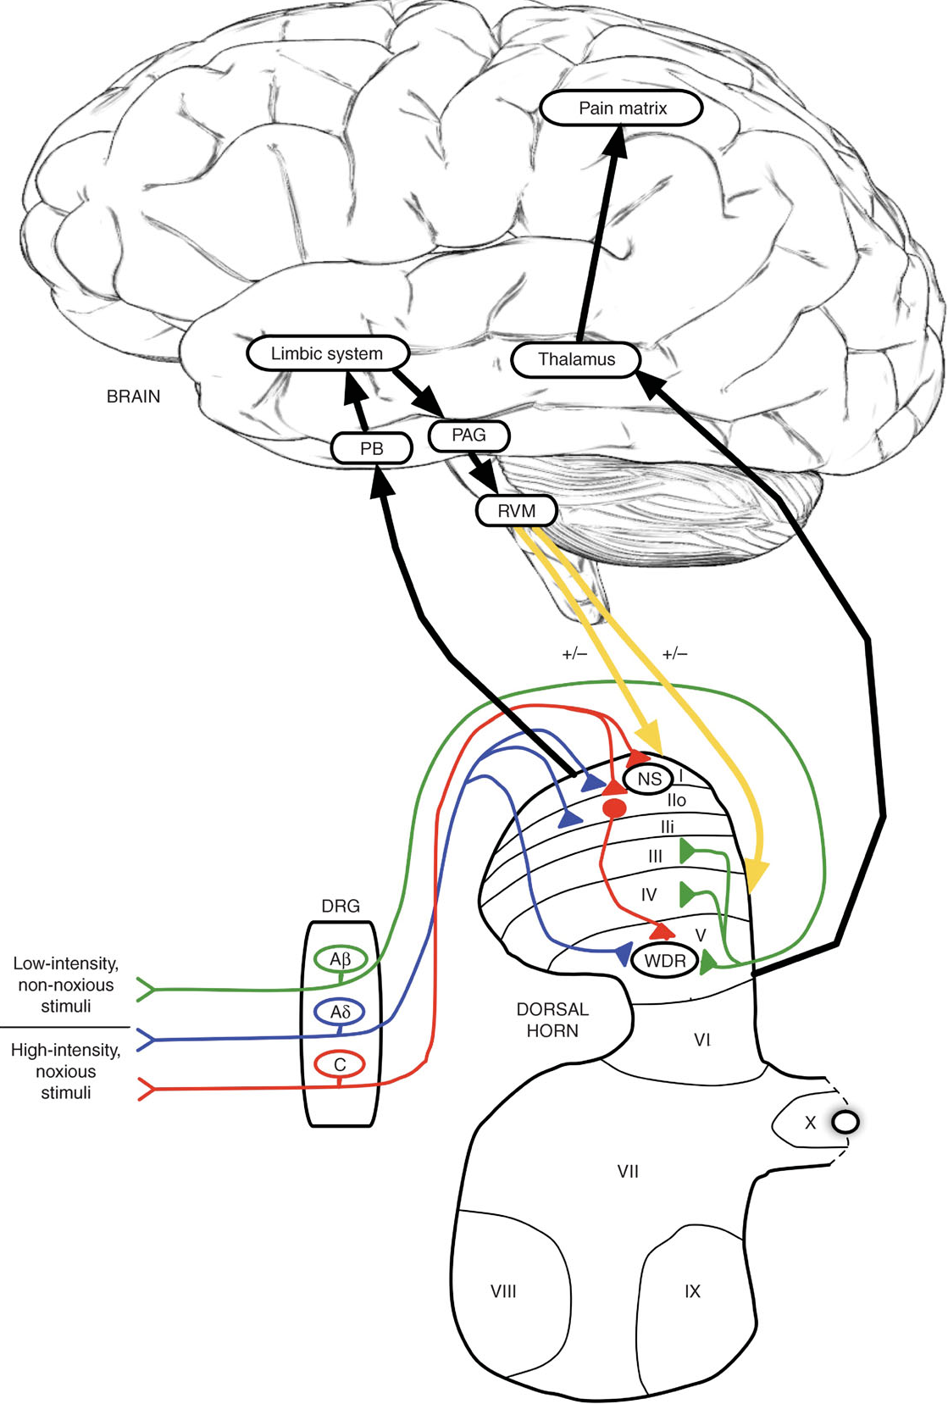

Slide 10
Pathways
Nociceptors
Free nerve endings of primary afferent neurons (A-delta and C- fibers)
Sensory specificity achieved by high threshold response only to particular features of incoming stimulus. Nociceptor only fires after this high threshold has been reached.
Triggers: thermal (TRPV1), mechanical, chemical
Types: polymodal (respond to more triggers) silent (need activation)

Slide 11
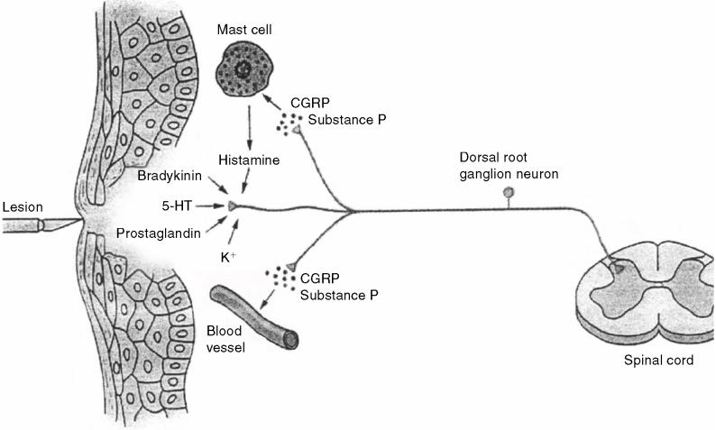
Lemke Can Vet J 2004, 45: 405

Slide 12
Pathways
Spinal Cord
lamina I,II, V concerned with nociception
‘nociceptive specific’ (NC) neurons: in lamina I; input from A-delta + C-fibers
‘wide dynamic range’ (WDR) neurons: nociceptive (A-delta and C-fiber) and non-nociceptive (A-beta) input
excitatory AAs: glutamate, Aspartate
neuropeptides: substance P, calcitonin gene-related peptide (CGRP)

Slide 14
Pathways
Ascdending
NC and WDR cross midline and ascend to supra-spinal centers
Main ascending pathways: spinothalamic, spino-reticular, spinomesencephalic

Slide 15
Pathways
Descending inhibitory
modulate incoming nociceptive signal at spinal and supra-spinal level
main transmitters: endogenous opioids, serotonin, noradrenaline
Descending facilitatory
Increase nociceptive signal

Slide 17
Symptoms
Nociceptive Pain
stimulation of superficial or deep nociceptors
superficial: achy, sharp, stinging easy to localize
deep: difficult to localize
Neuropathic Pain
paraesthesia = abnormal skin sensation
Dysaethesia = unpleasant abnormal sensation
burning, pins & needles, electric shock, wetness, numbness
Inflammatory Pain
throbbing, similar to nociceptive pain, associated symptoms (redness, swelling, increased temperature)

Slide 19
Pain Assessment
History
Location (where?)
Causes (e.g. trauma, accident, disease)
Temporal pattern of onset (sudden vs slow)
Triggers (movements, positions, heat, cold, exercise etc)
Temporal pattern of appearance (continuous vs intermittent)
Character (e.g. sharp, dull, burning, stabbing, colicky)
Severity
Relieving factors (e.g. rest, heat, cold, pain killers)
Contributing factors: beliefs, social factors, expectations, personality, co-existing diseases
Associated symptoms (e.g. nausea, vomiting, sweating, faint, changes in bowel or bladder habits)

Slide 20
Pain Assessment
Formal Assessment
Pain intensity at rest; on movements
Visual analogue scale (VAS)
Numeric rating scale (NRS)
Questionnaires
Special tests
Determination of thresholds
Nerve conduction studies
Imaging

Slide 21
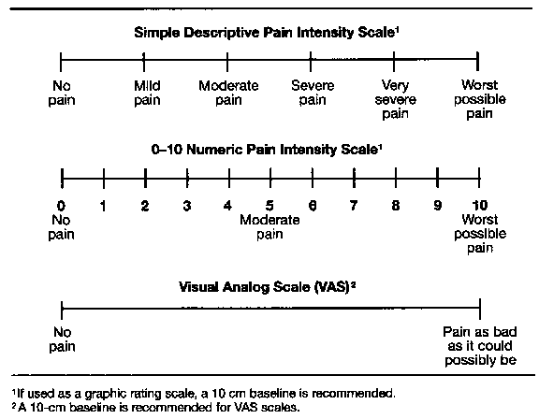
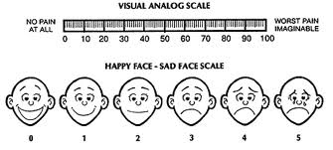

Slide 22
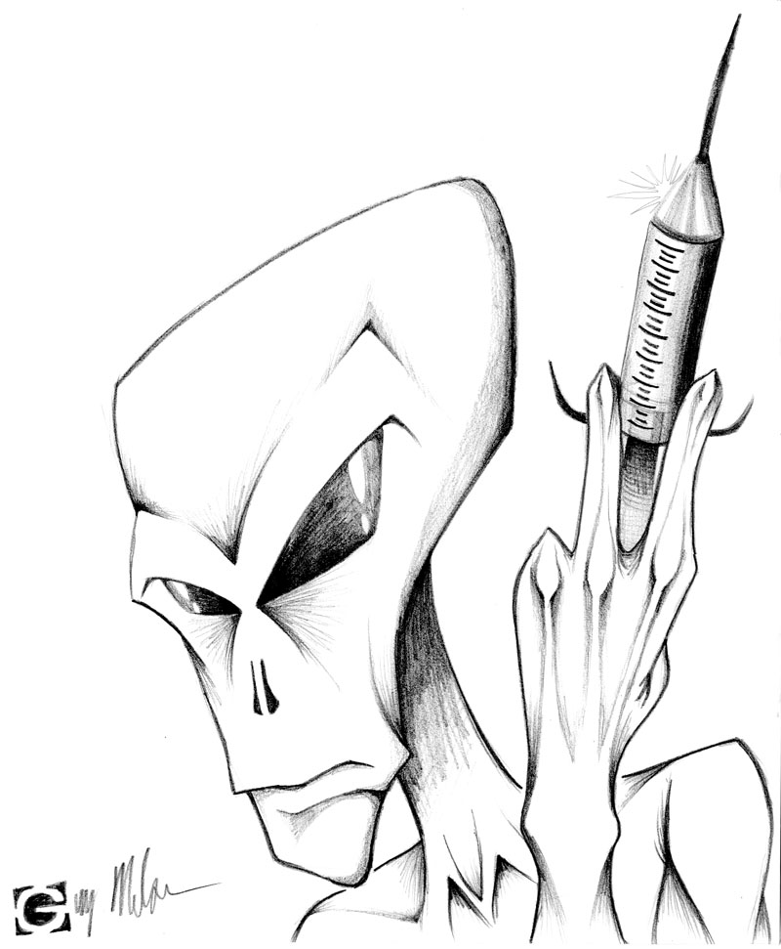

Slide 23
Principles of Drug Action
Ion-Channels
Local anaesthetics, Gabapentin, Capsaicin
Receptors
Opioids, Ketamine, Clonidine
Enzymes
COX inhibitors (NSAIDs, Paracetamol?)
Uptake inhibitors
Antidepressants (Amitriptyline, Nortriptyline)

Slide 24
Principles of Drug Action
Administration
local vs systemic
single shot vs continuous
oral, sublingual, rectal, IM, S/C, IV
Concepts
multimodal analgesia to improve efficacy and reduce adverse effects
Tissue targets
All levels possible

Slide 26
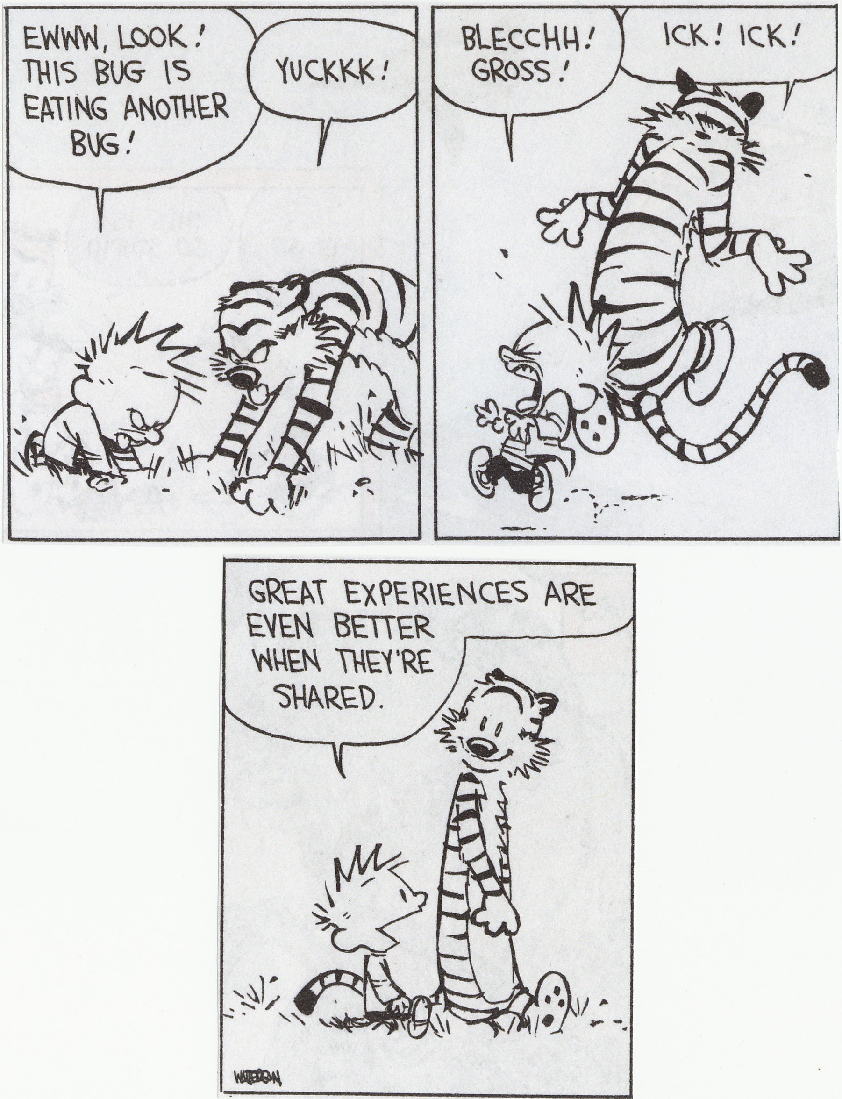
Calvin & Hobbes by Bill Watterson

