Slide 1
The autonomic nervous system in anaesthesia and pain management
Carsten Bantel MD; PhD; FRCA; FFPMRCA
Clinical Senior Lecturer

Slide 2
Anatomy
Nervous System
Central Nervous System (CNS)
Peripheral Nervous System (PNS)
Somatic Nervous System
Autonomic Nervous System (ANS)
Sympathetic Part
Parasympathetic Part

Slide 3
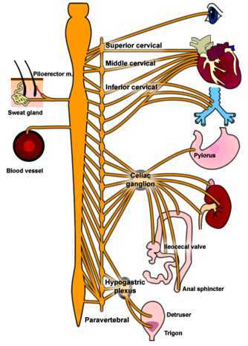
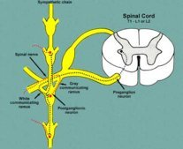
Anatomy: Sympathetic Part
Nerves arise from spinal cord T1-L2 lateral horns (white ramus communicans)
3 fates possible:
a) relay in corresponding ganglion and travel with corresponding spinal nerve;
b) ascend or descend;
c) pass through and synapse in periphery
Long postganglionic neurons travel to peripheral organs

Slide 4
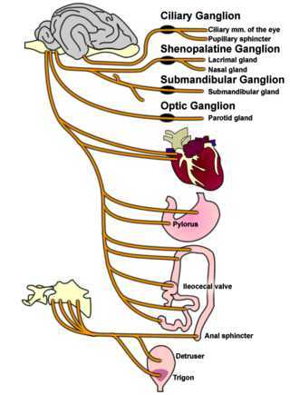
Anatomy: Parasympathetic Part
Two Components:
Sacral Outflow ( S2-S4): pelvic splanchnic nerves
Cranial Outflow:
N. III (oculomotor)
N. VII (facial)
N. IX (glossopharyngeal)
N. X (vagus)
Long pre-ganglionic fibers synapse close to or in end-organ with postganglionic fibers

Slide 5
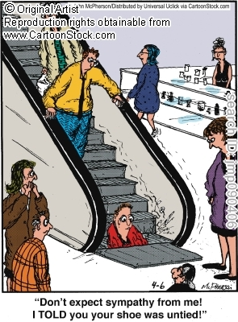

Slide 6
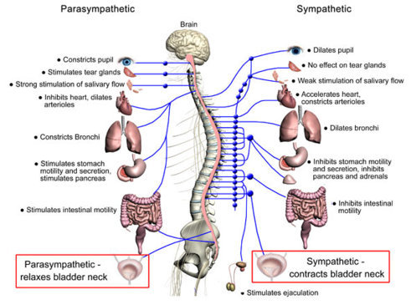
Physiology: Sympathetic Part
“Fight and Flight”
Organ Heart Lung GI-Tract Eye Blood Vessels | Action Increased rate, conduction, contractility, automaticity Bonchiodilation Decreased motility Mydriasis Receptor dependent constriction/ relaxation

Slide 7
Physiology: Parasympathetic Part
“Rest and Digest”
N. III (oculomotor):
sphincter pupillae + ciliary muscle > constriction of pupil + accommodation
N. VII (facial):
supply of lacrimal, submandibula & sublingual salivary glands
N. IX (glossopharyngeal):
Secretomotor to parotid gland
Splanchnic Nerves:
rectum + anal sphincter
bladder wall + vesical sphincter
vasodilation of cavernous sinuses in penis & clitoris

Slide 8
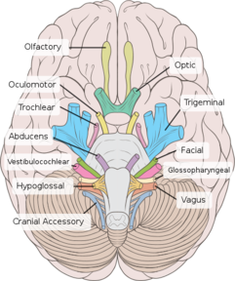
Physiology: Parasympathetic Part
N. X - Vagus Nerve - most important branches
Meningeal branch - dura
Recurrent laryngeal - motor supply to intrinsic muscles of larynx > vocal cord palsy
Cardiac - inhibition of conduction, contraction, excitability
Pulmonary branches - bronchioconstrictor
Oesophageal, gastric, hepatic, coeliac branches - digestion

Slide 9
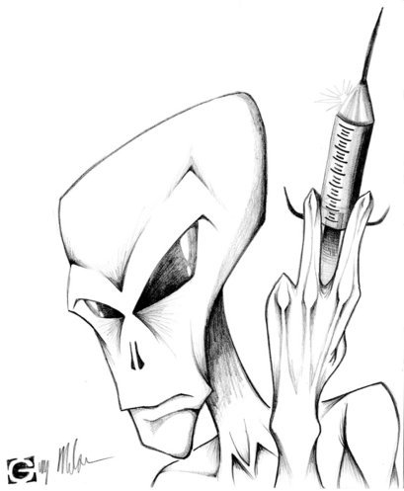

Slide 10
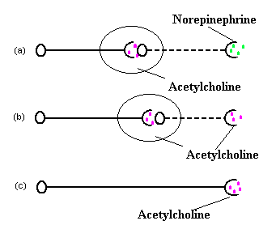
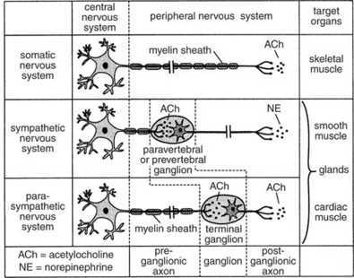
Pharmacology: General Aspects
a) Sympathetic nerve
b) Parasympathetic nerve
c) Somatic nerve

Slide 11
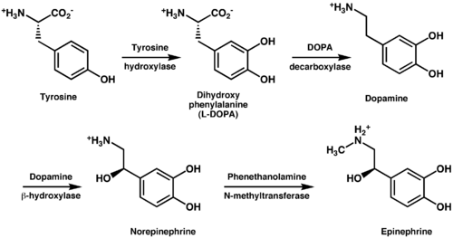
Pharmacology: Sympathetic Part

Slide 12
Pharmacology: Sympathetic Part

Slide 13
Pharmacology: Parasympathetic Part

Slide 14
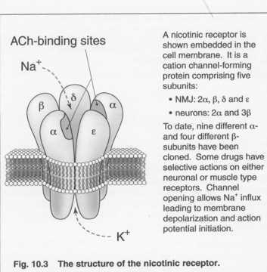
Pharmacology: Parasympathetic Part

Slide 15
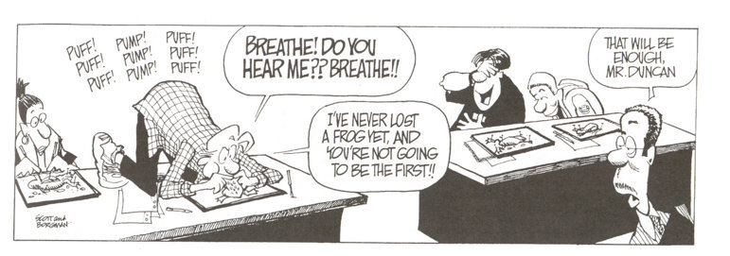

Slide 16
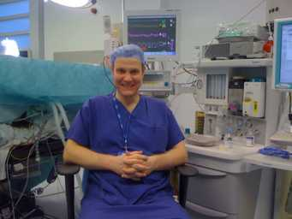
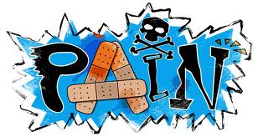
Clinical Relevance
Anaesthesia/ Intensive Care
Pain

Slide 17
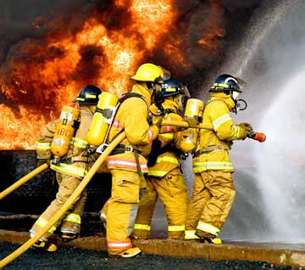
Clinical Relevance
General Principle:
Process
Pathomechanistical Changes
Activation/ Inhibition of ANS
Hence changes in ANS activity are mostly symptoms of ongoing disease processes

Slide 18
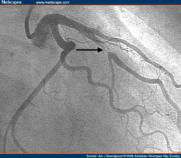
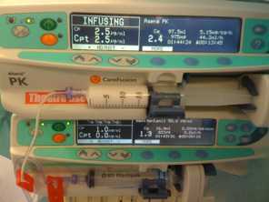
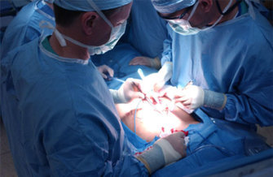
Relevance: Anaesthesia & ICU
Influences on Autonomic Nervous System:
1. Disease Processes
2. Drugs
3. Response to External Stimuli

Slide 19
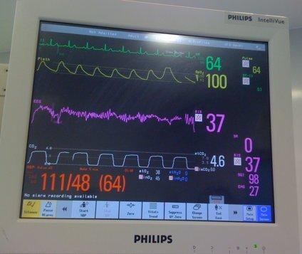
Relevance: Anaesthesia
External Stimuli:
Anxiety/ Pain/ Depth of Anaesthesia
Fluid, Gas Exchange & Acid-Base shifts
Purpose: Monitor to Treat
Heart Rate, Blood Pressure, Respiration,
Depth of Anaesthesia
Blood Gases, CVP, Cardiac Output, Fluid Balance

Slide 20
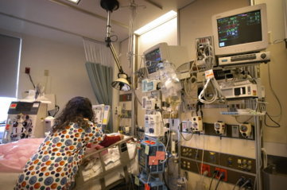
Relevance: ICU
Common Diseases/ Disturbances on ICU:
Fluid depletion
Sepsis – vasculoplegia, fluid shifts
Neurological – e.g. raised ICP
Cardio-vascular: e.g. failure
Multi-organ failure
Again: ANS important in diagnostics

Slide 21
Relevance: Drugs
Unspecific Actions:
General Anaesthetics (vasodilation, reduction of CO)
Pain killers e.g. remifentanil (bradycardia), ketamine (sympatomimetic)
Local Anaesthetics (vasodilation)
Specific Actions:
Parasympatholytics (Atropine)
Parasympathomimetics - mimic effect of parasympathicus
Sympatomimetics - mimic effect of sympathetic nervous system (alpha-, beta-adrenergics, dopaminergics)
Sympatholytics - inhibit postganglionic function of sympathicus (Clonidine)

Slide 22
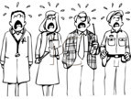
Relevance: Pain
Assessment of ANS as surrogate for patients’ comfort:
Heart Rate, Blood Pressure,
Respiration,
EMG
Movements,
(Lacrimation),
Sweating
Afferents conduct painful stimuli: classical in visceral pain,
Somatic pain afferents synapse with autonomic nervous system (parasympathetic)
Parasympathetic nuclei = important relay stations for central pain processing

Slide 23
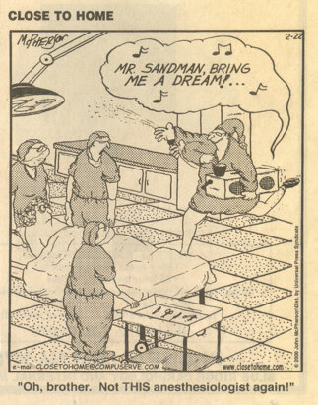

Slide 24
Summary
Autonomic Nervous System:
The ANS is involved in many processes relevant to anaesthesia and pain management. A thorough understanding is mandatory for diagnosis and treatment of those processes and also makes medicine more enjoyable for students & doctors.

