Slide 1
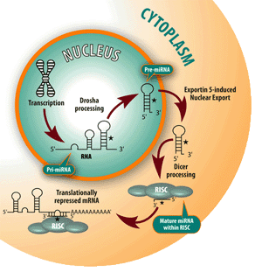
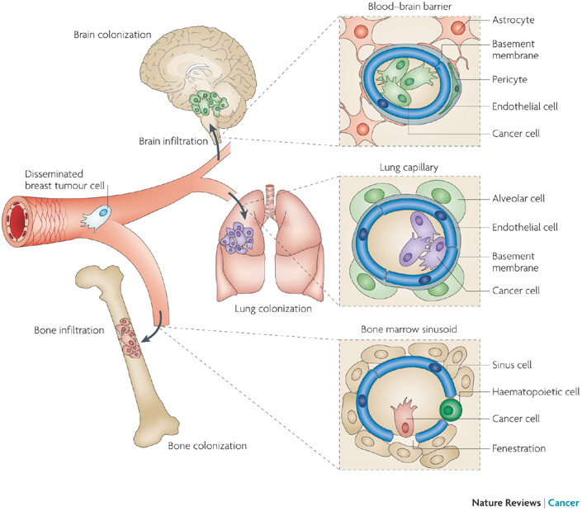
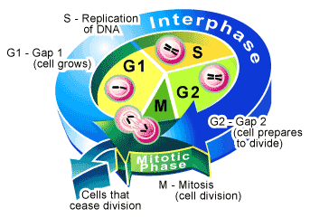
microRNAs: a new frontier in oncology
Leandro Castellano

Slide 2
microRNAs (miRNAs)
Small non-coding RNAs of 20–22 nucleotides able to regulate post-transcriptional gene expression
The latest release of the miRBase database (release 18) has catalogued more than1500 human miRNAs
Regulate the protein translation or the stability of hundreds of transcripts through sequence-specific binding to mRNA
Are involved in crucial biological processes, including development, differentiation, apoptosis and proliferation

Slide 3
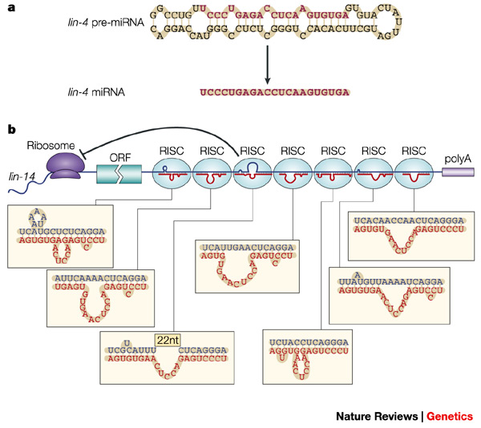
Origines
mRNA
microRNAs
5’UTR
ORF
3’UTR
1993
The founding member of the miRNA family, lin-4 was identified in C. elegans through a genetic screen for defects in the temporal control of post-embryonic development
Lin-4
dme-miR-1 - - - hsa-miR-5708
2001
2011

Slide 4
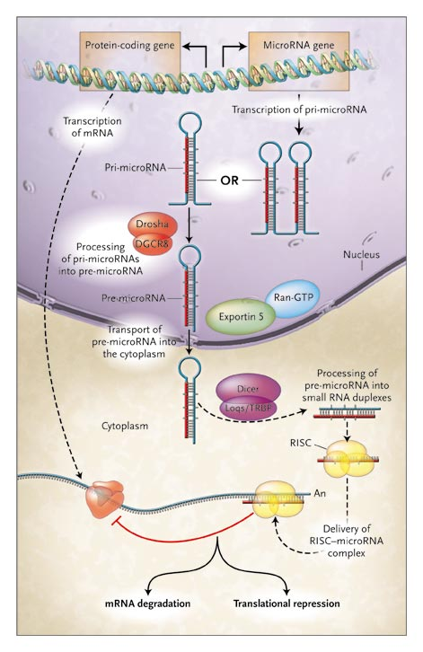
Biogenesis
Chang-Zheng Chen New Eng. J. Med., (2005)

Slide 5
Genomic organization
TSS
Intergenic
miR-n
TSS
Intergenic-clustered
miR-n1
miR-n2
miR-n3
TSS
Intronic
Exon 1
miR-n3
Exon 2
TSS
Mirtron
Exon 1
miR-n4
Exon 2
TSS
Intronic-clustered
miR-n5
miR-n6
miR-n7
Exon 1
Exon 2
Exonic
TSS
Exon 1
miR-n8
Exon 2

Slide 6
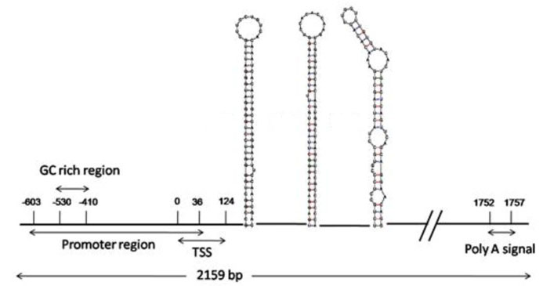
Transcriptional unit
23b
27b
24

Slide 7
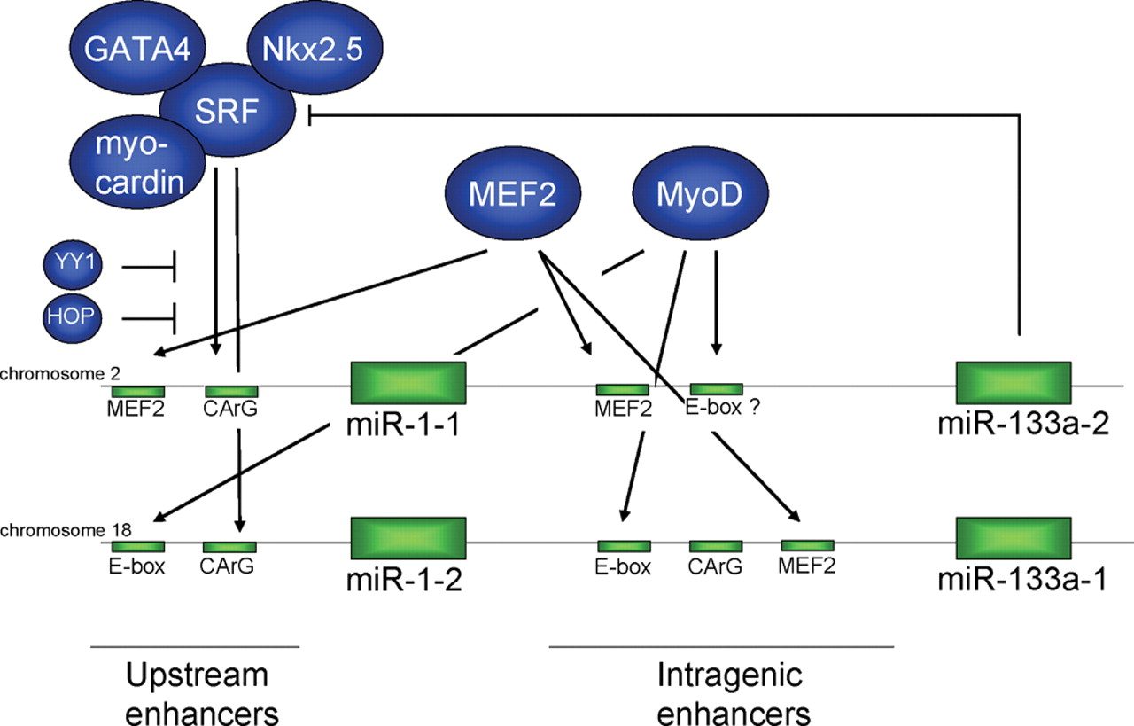
miRNAs Regulation- - - -
- - - - - - - Transcriptional
Thum T. et al., Cardiovasc Res (2008)

Slide 8
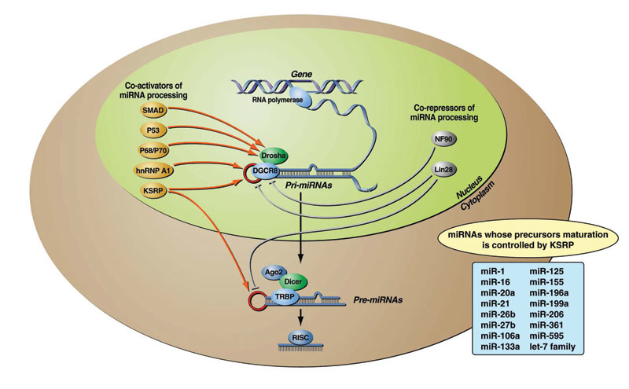
miRNAs Regulation- - - -
- - - - - - - Post - transcriptional
From the book “Regulation of microRNAs”

Slide 9
Estrogen
miRNAs
Dicer processing
Translation block
Ligand-receptor interaction
miRNA maturation
delay
Pre-miRNAs
ERα
ERα
Drosha processing
transcription
17
18a
19a
20a
19b-1
92a-1
pri-mir-17-92
Cytoplasm
Nucleus
Castellano L. et al., PNAS (2009)

Slide 10
miRNAs and Cancer - - - -
- - - - - - - first evidence
- Tumours are initiated, for the most part, by somatic genetic alterations
- Example: methylation of CpG islands in tumor suppressor gene promoters lead loss of function
- Croce and coworkers attempting to clone a tumour suppressor gene at 13q14, a chromosomal region that is frequently lost in chronic lymphocytic leukaemia (CLL),
found that all of the protein-coding genes that were present in the region of interest were not specifically altered in CLL, which suggested that they were not involved in the disease.
- However, they found two miRNA genes, miR-15a and miR-16-1, in the deletion. The traslocation breakpoint cut the presursor of these two miRNA genes, which reside in the same polycistronic RNA
- This indicated that the loss of miR-15a and miR-16-1 was the target of 13q14 deletion in CLL pathogenesis
- Following this discovery, they observed the loss of miR-15a and miR-16-1 in 70% of CLLs
- Initially identified in CLL, changes in the expression level of miRNAs have subsequently been detected by different groups in many types of human tumours

Slide 11
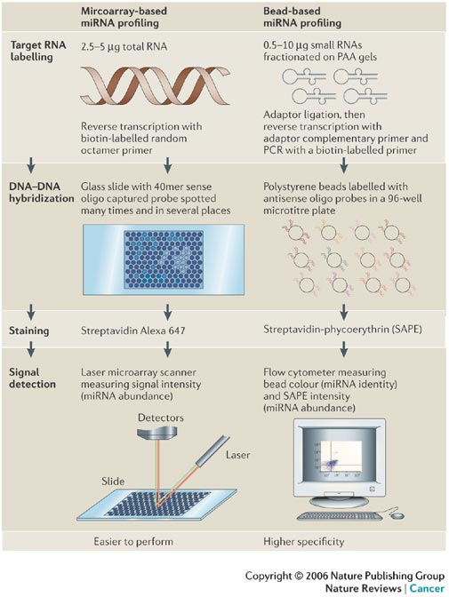
miRNAs and Cancer - - - -
- - - - - - - miRNAs signatures in human cancers

Slide 12
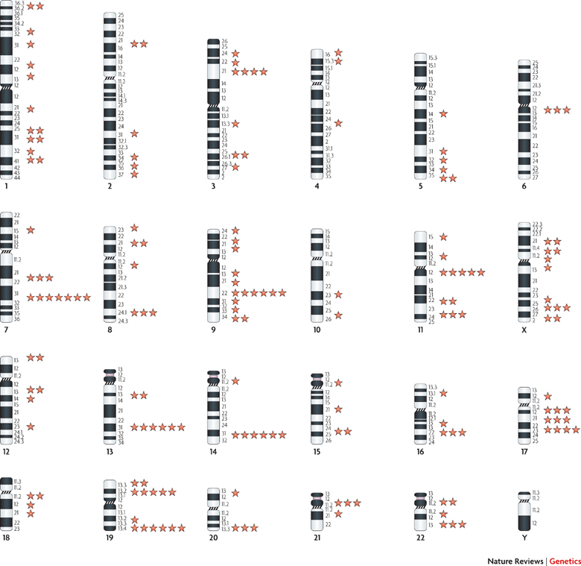
miRNAs and Cancer - - - -
- - - - - - - fragile chromosome sites

Slide 13
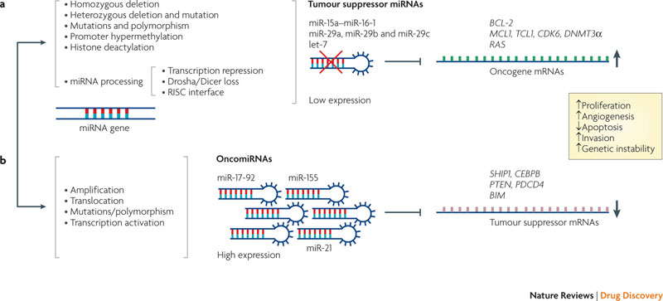
miRNAs and Cancer - - - -
- - - - - - - miRNAs as oncogenes and tumour suppressors

Slide 14
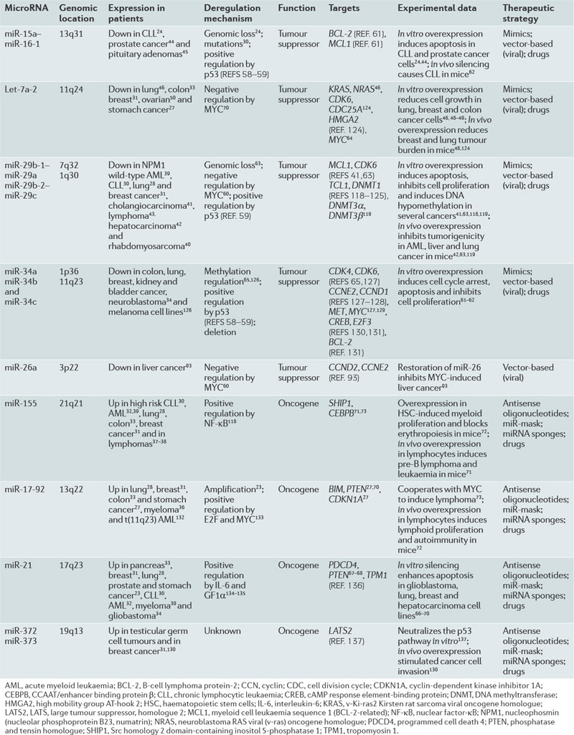

Slide 15
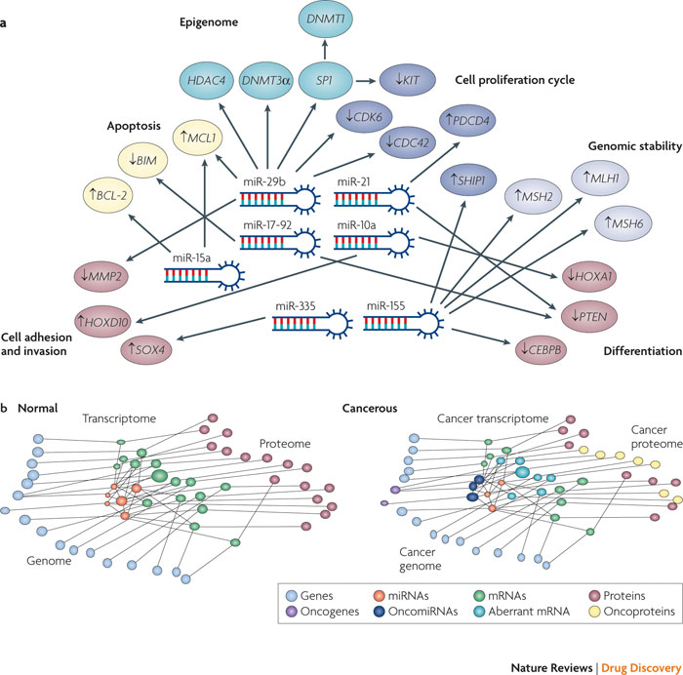
Notes:
In this figure we graphically represent the relationship between vital oncogenic transcriptome networks and the miRNAome. Target mRNAs for each major pathway are represented by circles with a unique colour. MicroRNAs (miRNAs) are represented as hairpin structures in the centre. The arrows connecting miRNAs and mRNAs indicate validated mRNA–miRNA interactions. The small arrow in the circles indicates the biological effects on the pathway by the miRNA acting on its target. For example, miR-15a induces apoptosis by targeting B-cell lymphoma protein-2 (BCL-2) or miR-29b suppresses cell proliferation by blocking CDK6(Refs 61, 63). Some miRNAs, for example miR-29b, coordinately regulate multiple targets in different pathways⁶³. As shown in the figure, miR-29b modulates target mRNAs involved in apoptosis, cell proliferation, DNA methylation, histone acetylation and cell adhesion
In this figure we graphically represent a gene–protein network in normal tissues and in cancer. miRNAs are transcribed from miRNA non-coding genes, which have their own transcriptional unit, or from introns of protein-coding genes. In general, one gene is transcribed to one mRNA and translated to one protein. By contrast, miRNAs are transcribed from one or in certain cases from two genes

Slide 16
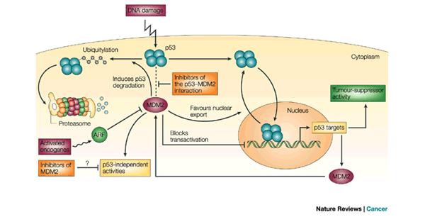
p53 tumour suppressor

Slide 17
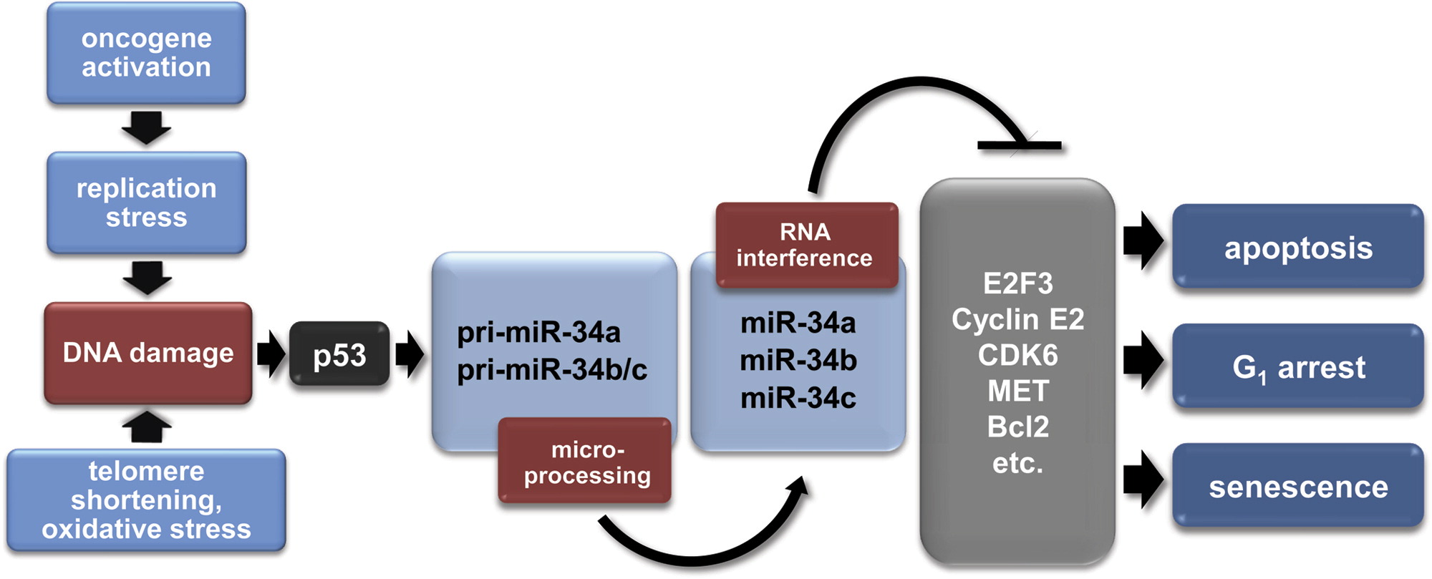
p53 Enters the MicroRNA World

Slide 18
Post-transcriptional modulation of gene expression
ORF
3’UTR
Big impact in metastasis progression
Tumour invasion and metastasis initiated by microRNA-10b in breast cancer
Nature 449, 682-8, 11 October 2007
Endogenous human microRNAs that suppress breast cancer metastasis
Nature 451, 147-152, 10 January 2008
The miR-200 family and miR-205 regulate epithelial to mesenchymal transition by targeting ZEB1 and SIP1
Nature Cell Biology 10, 593 – 601, 30 March 2008
A Pleiotropically Acting MicroRNA, miR-31, Inhibits Breast Cancer Metastasis
Cell 137, 1032–1046, 12 June 2009

Slide 19
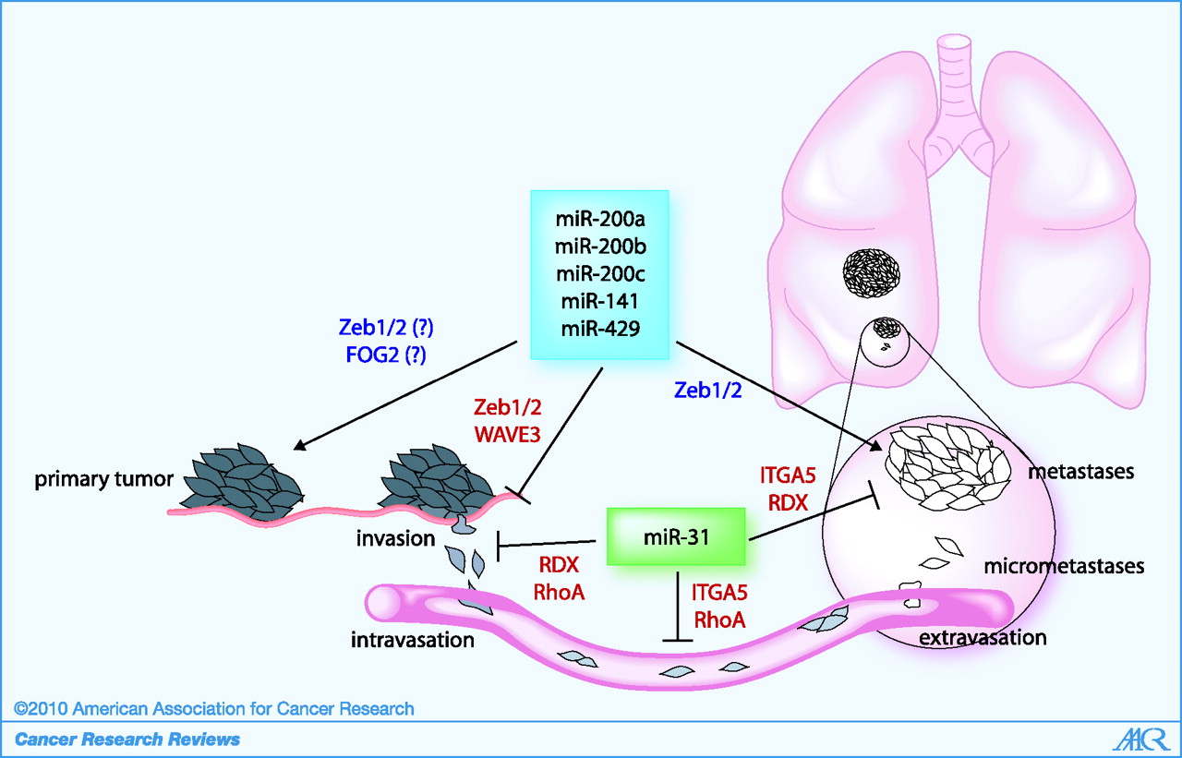
Metastatic process and miRNAs

Slide 20
miR-23b reduces cell migration
miR-23b
control

Slide 21
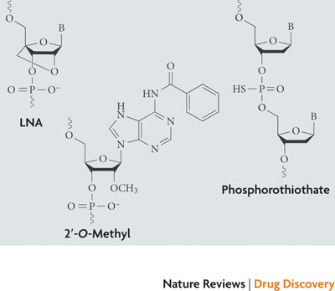
Strategies for miRNA-based therapies - - - -
- - - - - - - Blocking oncogenic miRNAs using antisense oligos
Common oligos modification structures
-The demonstration that oncogenic miRNAs are upregulated in cancer provided a rationale to investigate the use of antisense oligonucleotides to block their expression
-Antisense oligonucleotides work as competitive inhibitors of miRNAs, presumably by annealing to the mature miRNA guide strand and inducing degradation or stoichiometric duplex formation
-Modifications to the chemical structure of the oligonucleotides to increase stability, binding affinity and specificity
Introduction of 2’-O-methyl groups contributes to nuclease resistance and improve binding affinity to RNA
Locked nucleic acid (LNA) constructs (the ribose ring is 'locked' by a methylene bridge connecting the 2’-O atom and the 4’-C atom). LNA oligonucleotides display unprecedented hybridization affinity towards complementary
Both have proved to be effective inhibitors of miRNA expression in several cancer cell lines

Slide 22
Silencing miRNA in vivo - - - -
- - - - - - - 2’-O-methyl-modified cholesterol-conjugated single- stranded RNA analogues “antagomir”
miRNA
-These antagomirs were injected into the tail vein of mice and specific targeting of miR-122 (which is abundant in the liver) was observed after 24 hours
-The silencing of endogenous miRNAs by this novel method was specific, efficient and long lasting and the effects were still observed 23 days after injection
Krutzfeldt, J. et al., Nature (2005)

Slide 23
Silencing miRNA in vivo - - - -
- - - - - - - LNA anti miR
miRNA
-Elmen and colleagues examined whether LNA anti-miR with phosphorothioate modifications could improve delivery of the compounds and silence miR-122 in mice
Elmén, J.et al., Nucleic Acid Research (2008)
-intravenous injections of such LNA anti-miR showed markedly improved efficiency in antagonizing miR-122 compared with cholesterol-conjugated antagomir that targets miR-122
Elmén, J.et al., Nature (2008)
-The simple systemic delivery of an unconjugated LNA anti-miR-122 (SPC3649, developed by Santaris Pharma) has also been shown to effectively antagonize liver-expressed miR-122 in non-human primates
The authors observed an effective depletion of miR-122 in the liver without any evidence of LNA-associated toxicities or histopathological changes in the animals
Elmén, J. et al., Nature (2008)

Slide 24
miRNA in vivo over-expression - - - -
- - - - - - - Restoring tumour suppressor miRNA expression
-The loss or downregulation of a tumour-suppressor miRNA could be overcome by introducing synthetic oligonucleotides that are identical to the selected miRNA, known as miRNA mimics
-Introduction of synthetic miRNA mimics with tumour-suppressor function in cancer cells have been shown to induce cell death and block proliferation in several studies
-However, there is no in vivo data using miRNA mimics delivered by intravenous injection
-Another strategy to increase the expression of a tumour-suppressor miRNA in cancer uses adenovirus-associated vectors (AAV)
These vectors do not integrate into the genome and are eliminated efficiently with minimal toxicity, as shown in Phase I and Phase II clinical trials of about 200 patients
Michelfelder, S. & Trepel
-Intravenous injection of miR-26a (which expression was lost in human liver cancers) cloned into an AAV vector resulted in the suppression of tumorigenicity by inducing tumour apoptosis and by repressing cell growth, without signs of toxicity
Kota, J. et al.

Slide 25
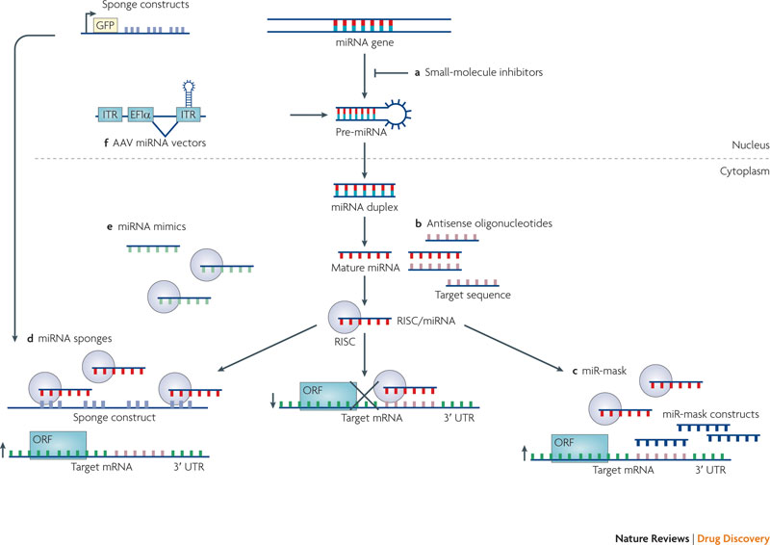
miRNAs and Cancer - - - -
- - - - - - - Strategies for microRNA-based therapies

Slide 26
Challenges of miRNA-based therapies-
-The challenges for developing miRNA-based therapeutics include issues of delivery, potential off-target effects and safety
-One of the major problems for the use of miRNA therapeutics in vivo relates to tissue-specific delivery and to cellular uptake of sufficient amounts of synthetic oligonucleotides to achieve sustained target inhibition
-Early clinical trials using DNA antisense technologies showed that severe side-effects, such as cytokine-release syndrome, haematological toxicity (thrombocytopaenia) and liver damage may occur
-It has been shown that sustained high expression of short hairpin RNAs by AAV vectors induced severe dose-dependent liver damage, owing to interference with endogenous miRNA processing in the liver and resulting in liver-specific miRNA down-regulation and injury
-Synthetic mature oligonucleotides may also saturate RISC and compete and displace other endogenous miRNAs
-Finally, because miRNAs regulate many genes, the potential off-target effects of miRNA therapeutics are a major concern, as they may cause toxic phenotypes

