Slide 1
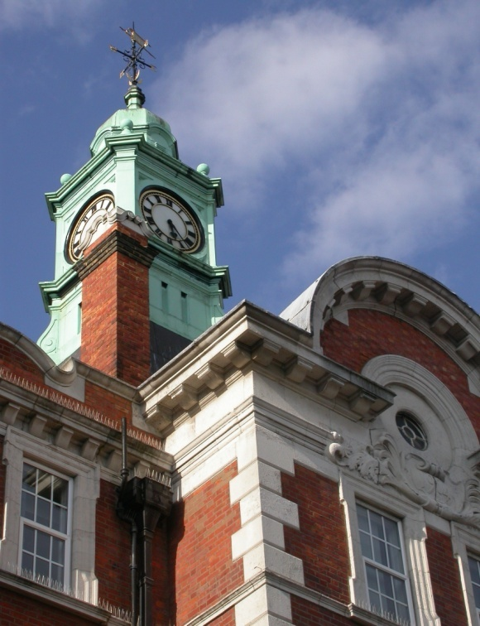

Chemoembolization of the liver
Dr NP Tait
Dept of Imaging
Hammersmith Hospital

Slide 2
Gastrointestinal Cancers:
Number of New Patients seen / Year
(actual at Hammersmith Hospitals NHS Trust)
Colorectal = 640
Pancreatic = 90
Hepatobiliary = 80+
Gastric = 70
Oesophagus = 30
Others (NETS) ≠ 90 (50-60)

Slide 3
HEPATOCELLULAR CARCINOMA
Usually fatal - <5% patients survive 5 yrs.
Median survival 4-6 months for patients with unresectable tumours.
Systemic chemotherapy relatively ineffective (response rate <20%; mortality rate up to 25%).

Slide 4
Hepatocellular Carcinoma
70 – 90% of patients with HCC have underlying cirrhosis.
HCC’s may consist of multiple angiomatous lesions.
Limitations to size and number of lesions that can be treated by other means.

Slide 5
Hepatocellular Carcinoma
Patients with cirrhosis and chronic viral hepatitis have 15.2% risk of developing HCC over 4 year period
Positive results for hepatitis C in USA increased by 285% between 1991 & 1994
Estimated that in decade 2010-2019 the number of patients presenting with HCC in USA could increase > 34,000 per annum

Slide 6
Treatment Options
Surgery - resection/transplantation (Milan criteria)
Ethanol injection.
Radiofrequency ablation.
Systemic chemotherapy.
Chemoembolization.
Radioembolisation

Slide 7
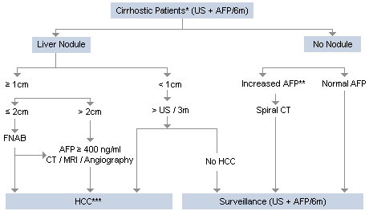

Slide 8
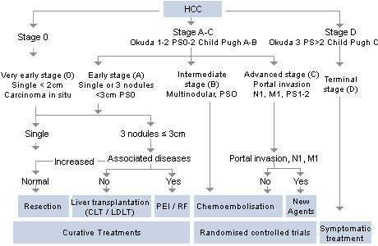

Slide 9
Sorafenib

Slide 10
Chemoembolization
Has been utilized in Japan for 20yrs.
Has produced results superior to surgery in some series.
Benefits of chemoembolization have been disputed
Does appear to improve the prognosis in those with unresectable HCC.
Choice of chemotherapeutic agent.

Slide 11
Potential Complications
Toxic hepatitis/Liver failure.
Abcess or infarction (5%) (bilary/enteric anastamosis, sphincterotomy)
Biloma. Biliary stricture
Cholecystitis or gallbladder infarction (<1%)
Cardiac toxicity (Doxorubicin)
Renal failure
Potential extrahepatic chemoembolization.
30 day mortality 1-3% with some of deaths being disease related.

Slide 12
Patient Selection
Suitable liver tumour (HCC, metastases-neuroendocrine/melanoma/sarcoma).
Not surgical candidates (both lobes of liver involved, underlying liver disease, vascular encroachment/involvement)
Portal vein patency needs to be assessed.
No extrahepatic disease.
Residual liver must be adequate.
Liver function must be adequate.

Slide 13
Contra-indications
Liver rupture.
Little liver reserve (< 25-50% normal liver).Patients not suitable for radical therapies.
Poor liver function (bilirubin > 50 micromoles/L).
Portal vein occlusion.
Cardiac or renal insufficiency. Contraindications for Doxorubicin therapy
Contraindications to hepatic embolisation treatment

Slide 14
Assessment
Triple phase CT:
- Unenhanced.
- Arterial phase.
- Portal venous phase.

Slide 15
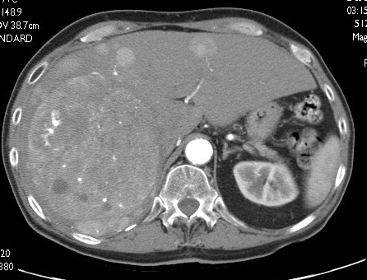
CT: Arterial phase.

Slide 16
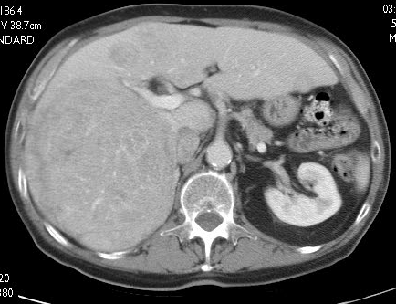
CT: Portal venous phase.

Slide 17
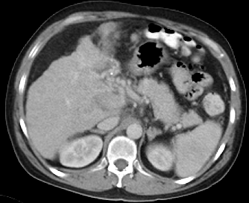
CT: anatomical aspects
Venous involvement

Slide 18
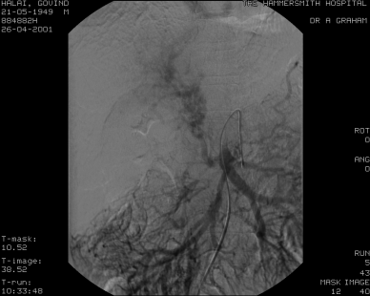
CT: anatomical aspects
Venous involvement

Slide 19
Technique (1)
Patient well hydrated.
Prophylactic antibiotics.
Pain relief and conscious sedation.
Chemoebolization mixture:
- cytotoxic agent (Doxorubicin,
Cisplatin, Mitomycin)
- lipiodol
-water soluble contrast agent
Arterial occlusion with gelfoam or PVA.

Slide 20
Technique (2)
Injection usually into right or left hepatic artery.
Other vessels may require treatment (phrenic, IMA, intercostal, adrenal)
Avoid injection into cystic or gastroduodenal artery
Microcatheters may be required.

Slide 21
Technique (3)
LFT’s checked post procedure.
Other lobe chemoembolized.
Complete treatment of liver may require 2-3 chemoembolization sessions.

Slide 22
Theory (1)
Normal Liver receives 75% of blood supply from portal vein.
Hepatic malignancies receive 75% from hepatic artery.
Embolization of hepatic artery selectively induces tumour necrosis.

Slide 23
Theory (2)
Response rates of most malignancies proportional to area under drug concentration-time curve (AUC).
Arterial delivery increases drug concentration in liver tumours 10-100 fold cf. systemic infusion.
Embolization prolongs the dwell time from hours to weeks - AUC by order of magnitude.

Slide 24
Theory (3)
Hypervascular liver lesions accumulate lipiodol.
Lesion does not contain Kupfer cells cf. normal liver.
Lipiodol/cytotoxic agent emulsion persists in lesion. Lipiodol blocks arterioles at 30µm level
Arterial occlusion increases ischaemic insult. Cellular pump that removes Doxorubicin from the cell is reduced in an ischaemic environment.

Slide 25
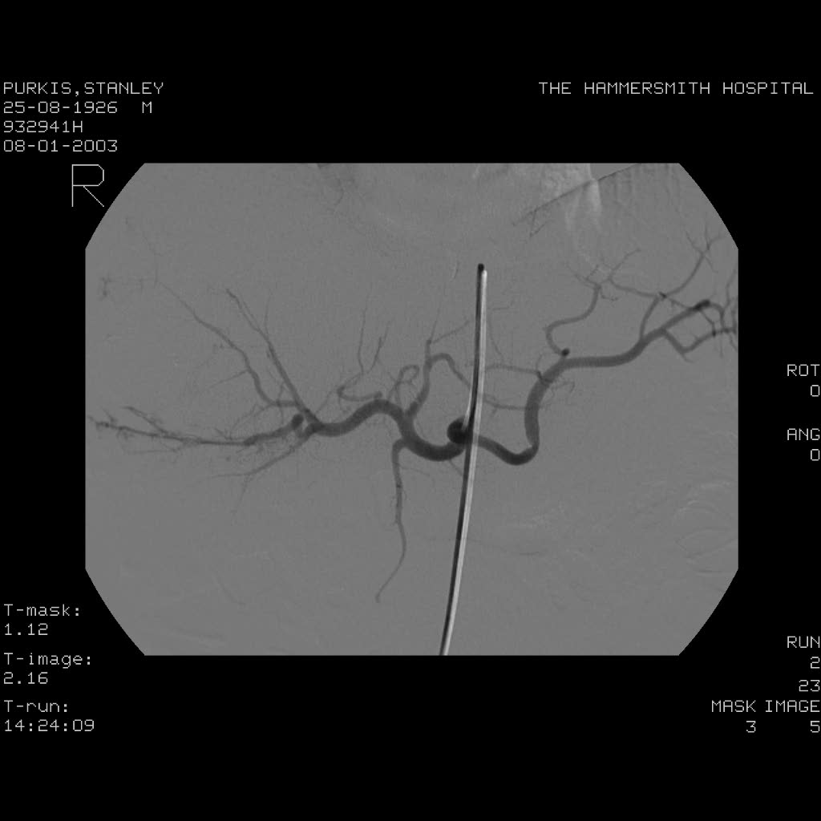
Angiography

Slide 26
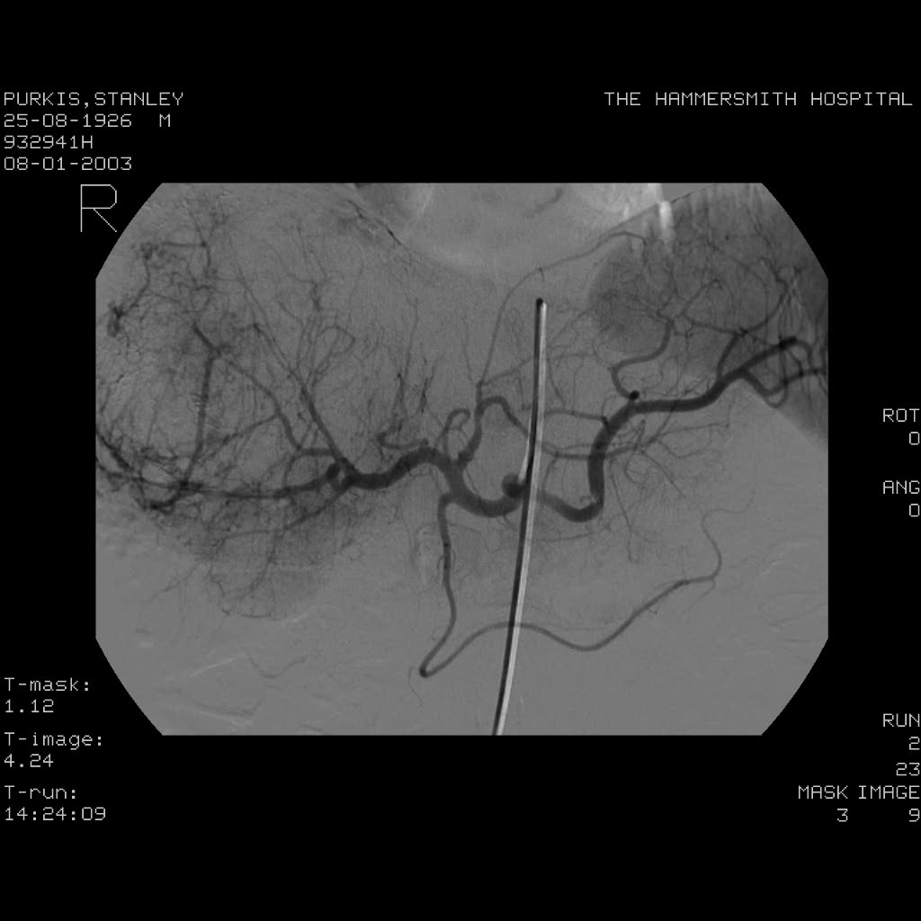
Angiography

Slide 27
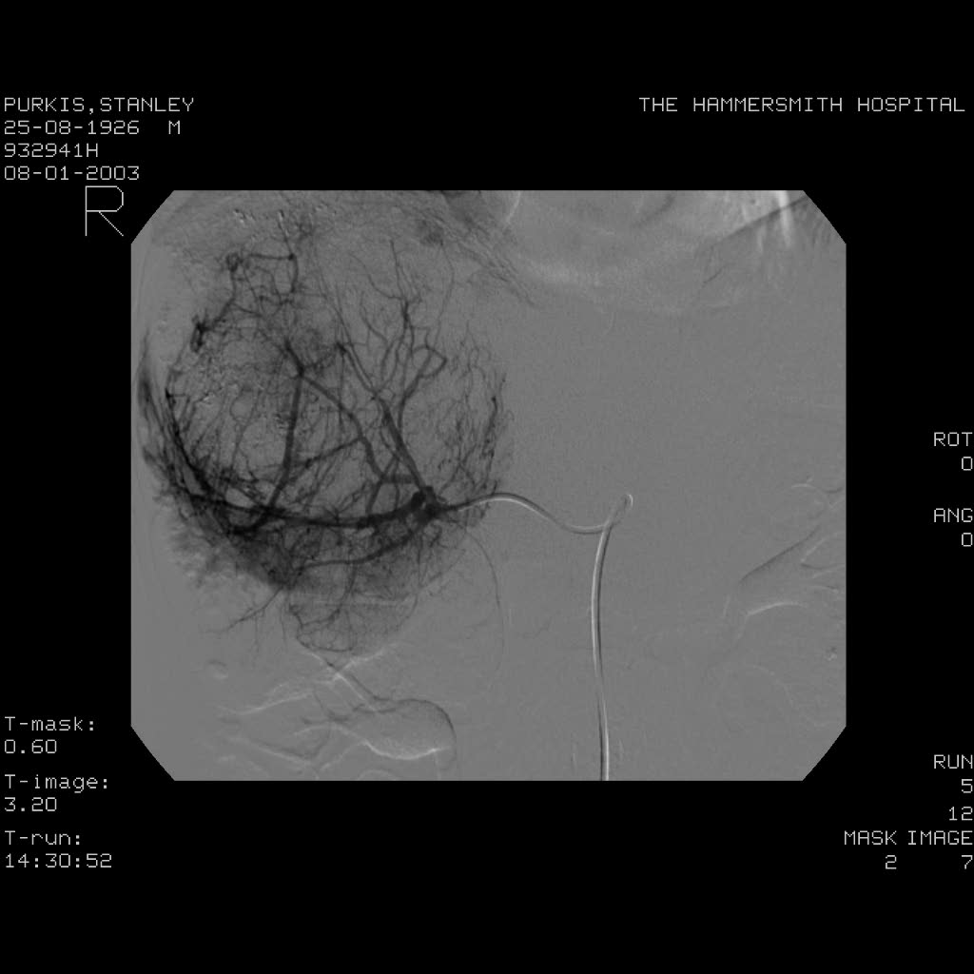
Angiography

Slide 28
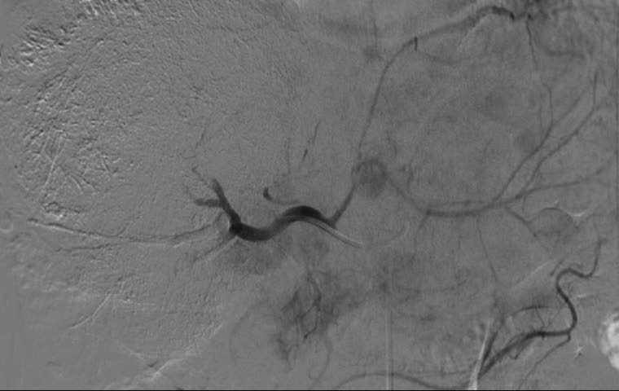
Angiography

Slide 29
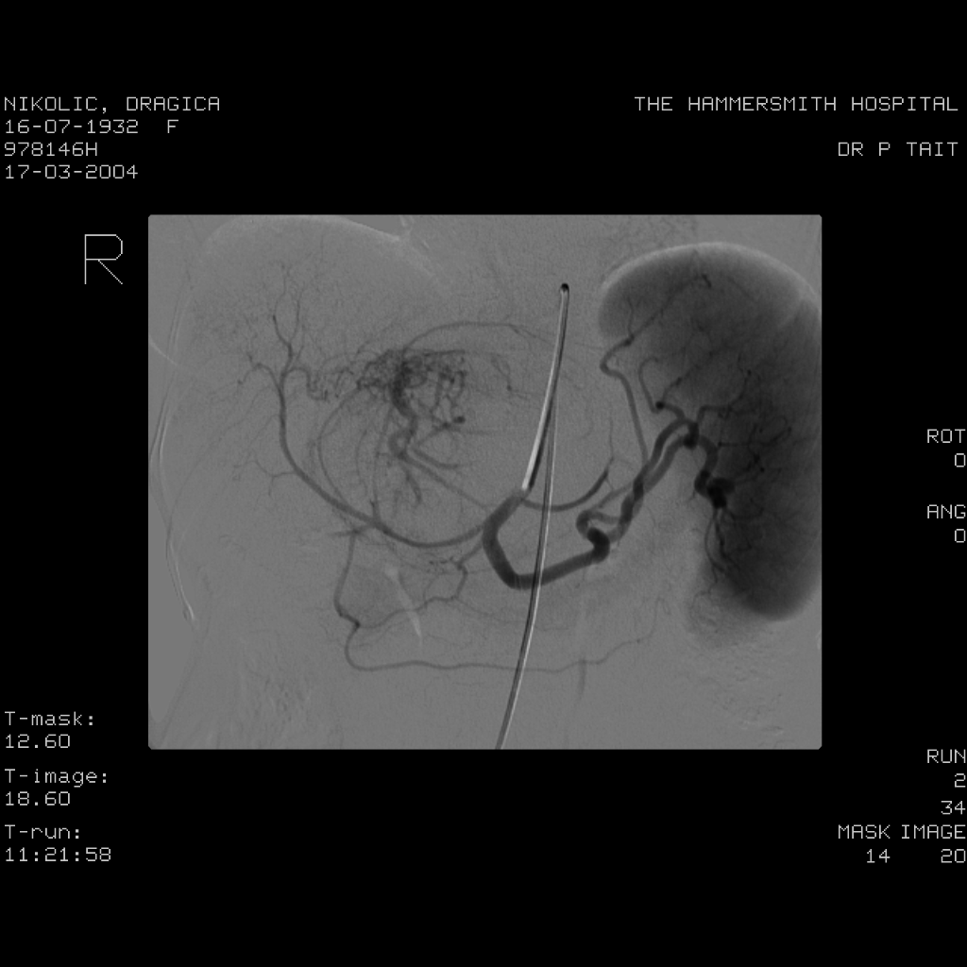
Angiography: collaterals

Slide 30
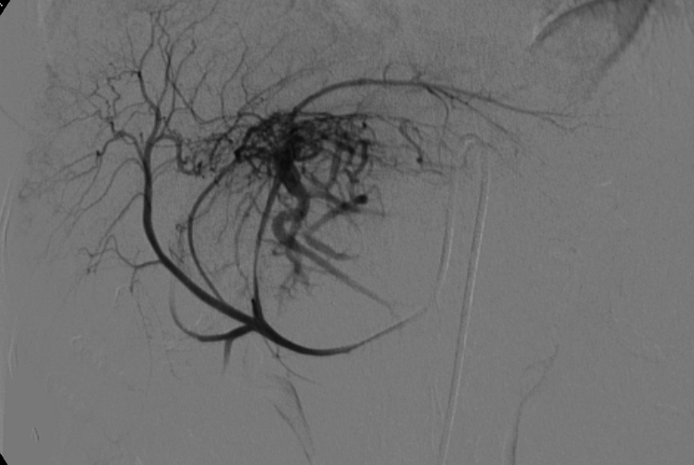
Angiography: collaterals

Slide 31
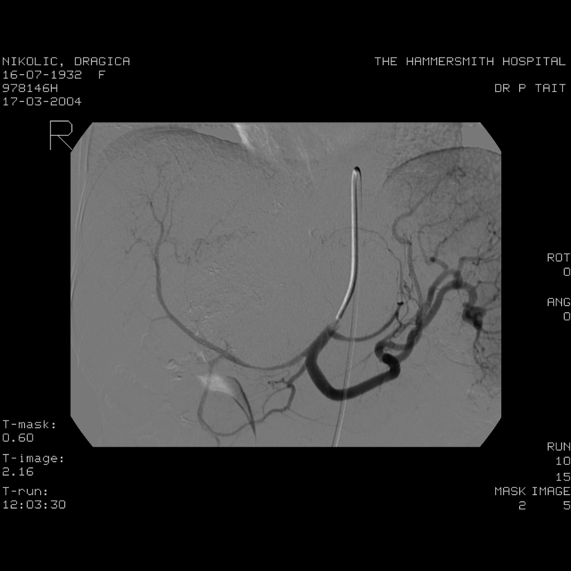
Angiography: collaterals

Slide 32
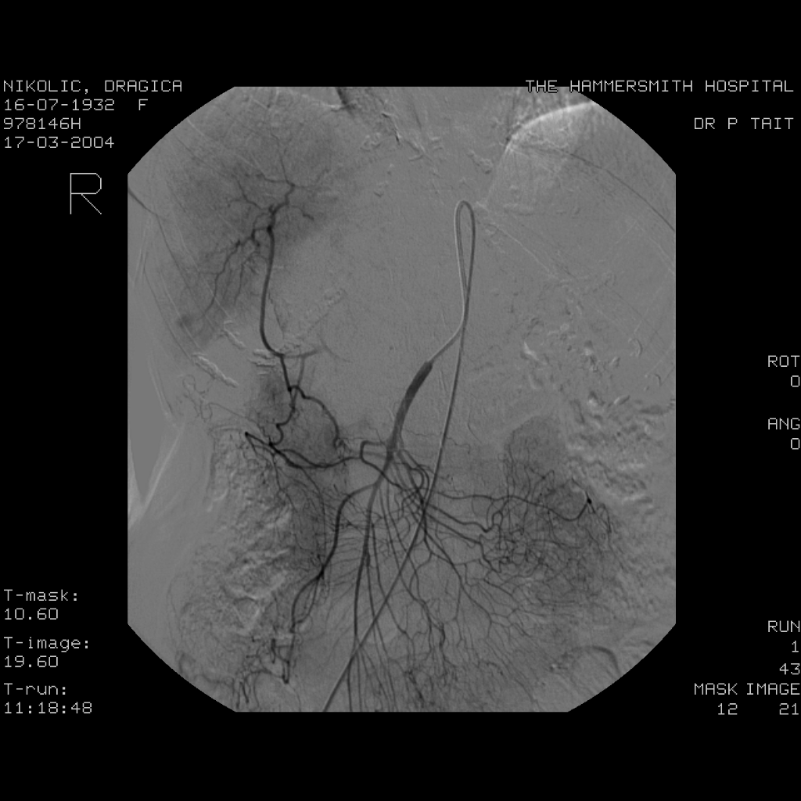
Angiography: multiple lesions

Slide 33
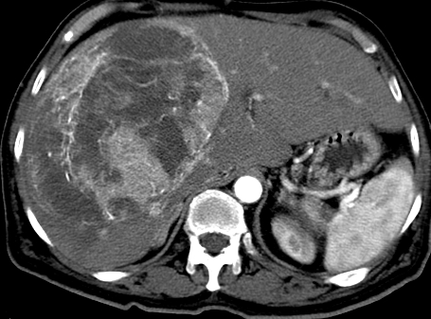
Angiography: collaterals

Slide 34
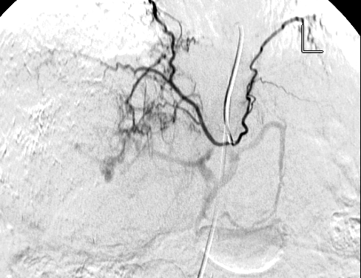
Angiography: collaterals

Slide 35
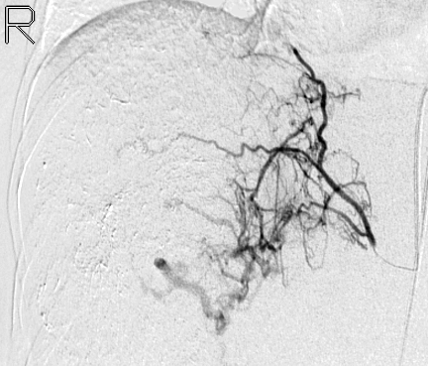
Angiography: collaterals

Slide 36
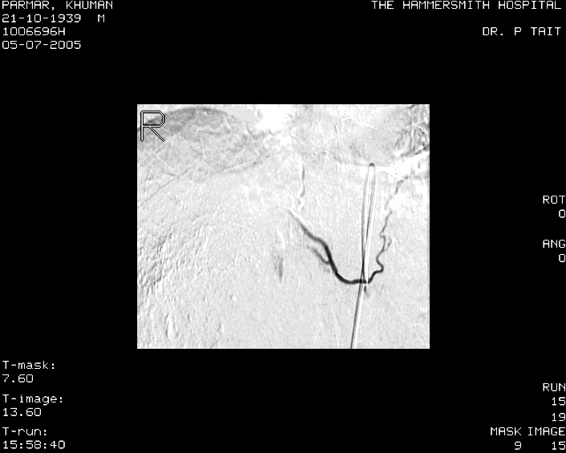
Angiography: collaterals

Slide 37
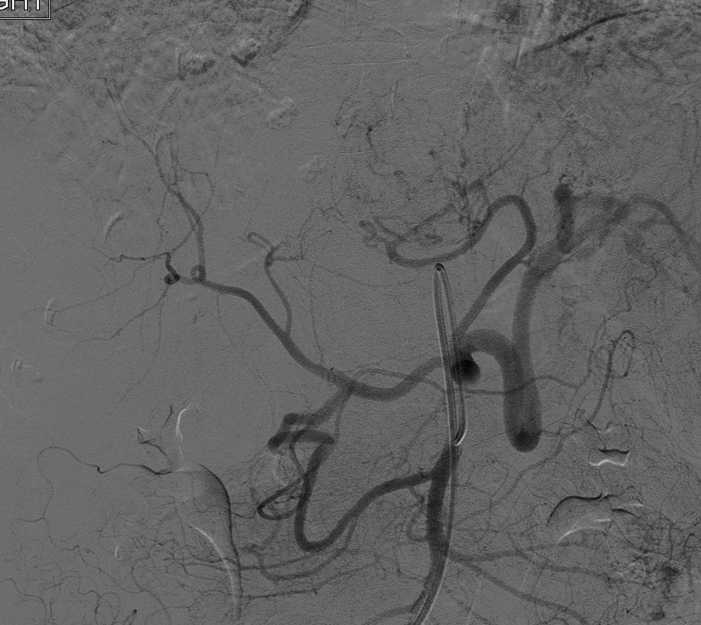
Angiography: collaterals

Slide 38
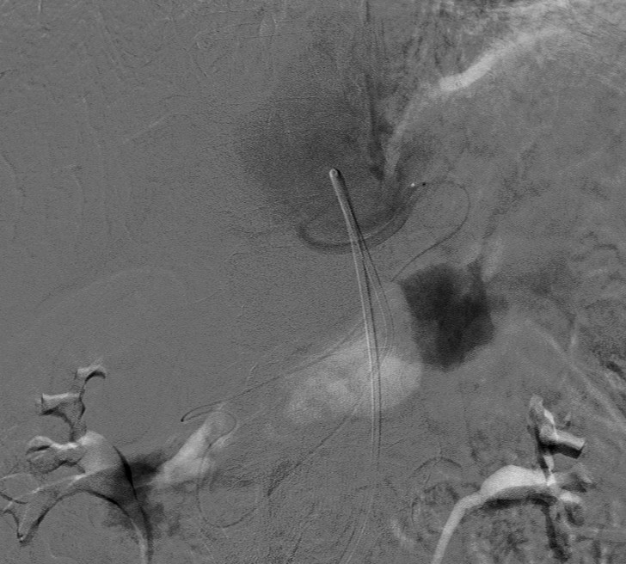
Angiography: collaterals

Slide 39
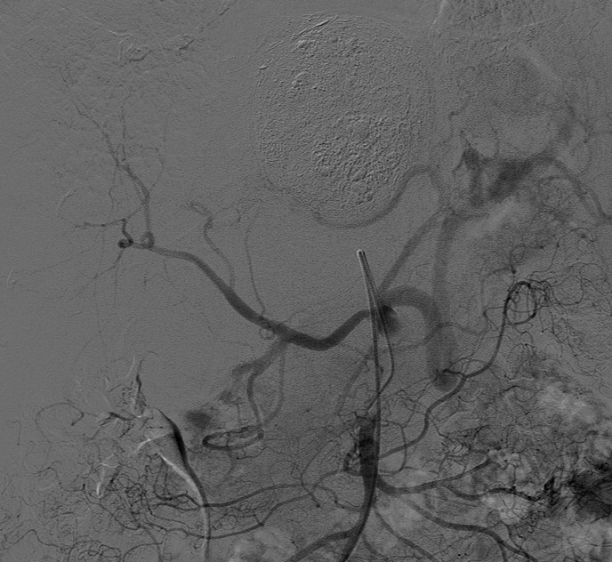
Angiography: collaterals

Slide 40
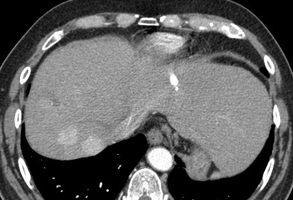
Angiography: collaterals

Slide 41
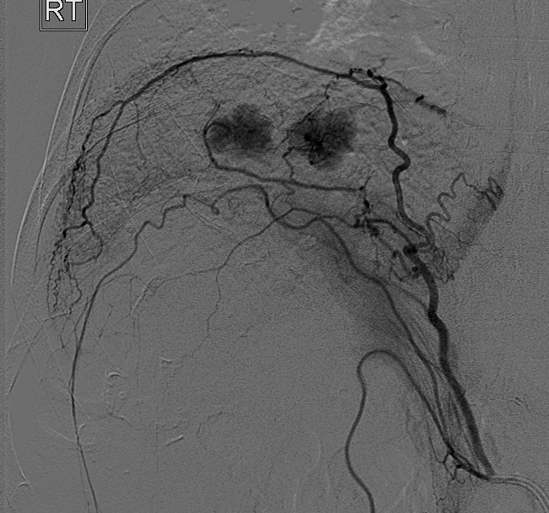
Angiography: collaterals

Slide 42
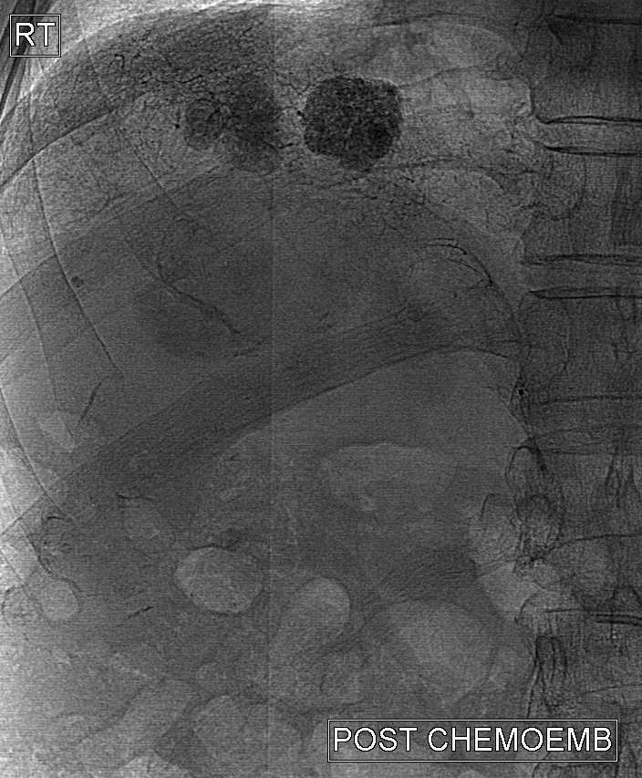
Angiography: collaterals

Slide 43
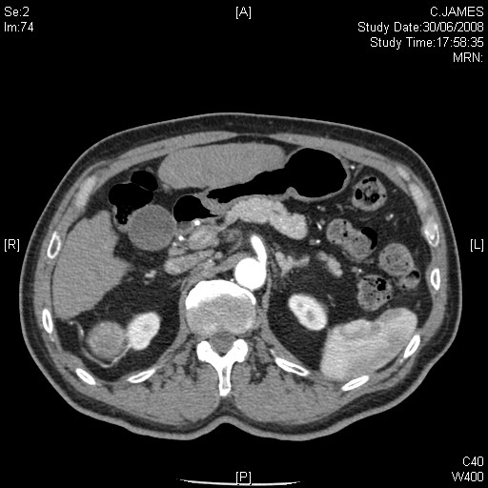
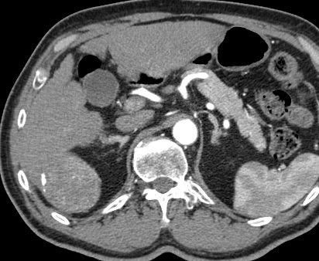
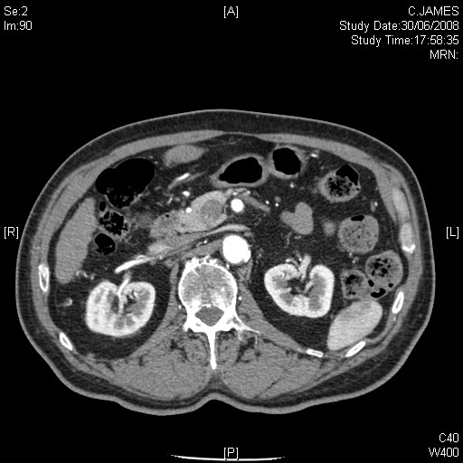
Angiography: collaterals

Slide 44
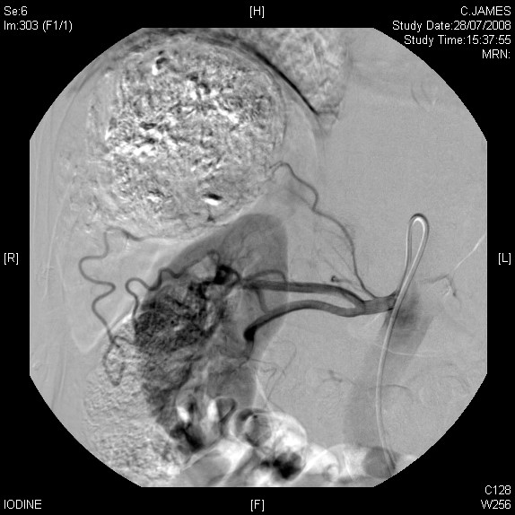
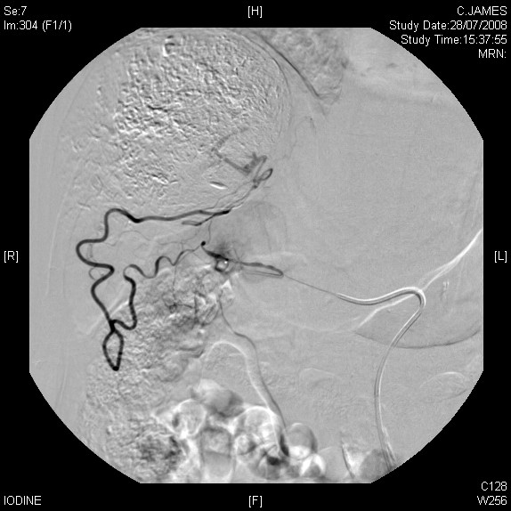
Angiography: collaterals

Slide 45
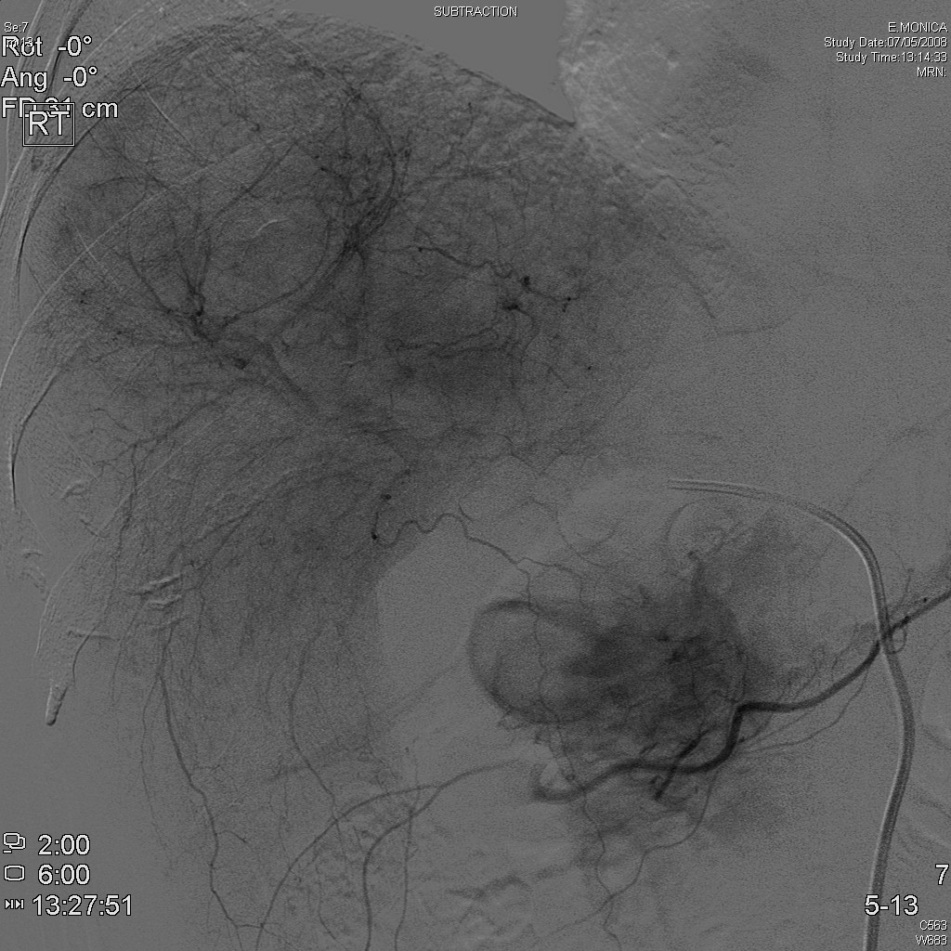
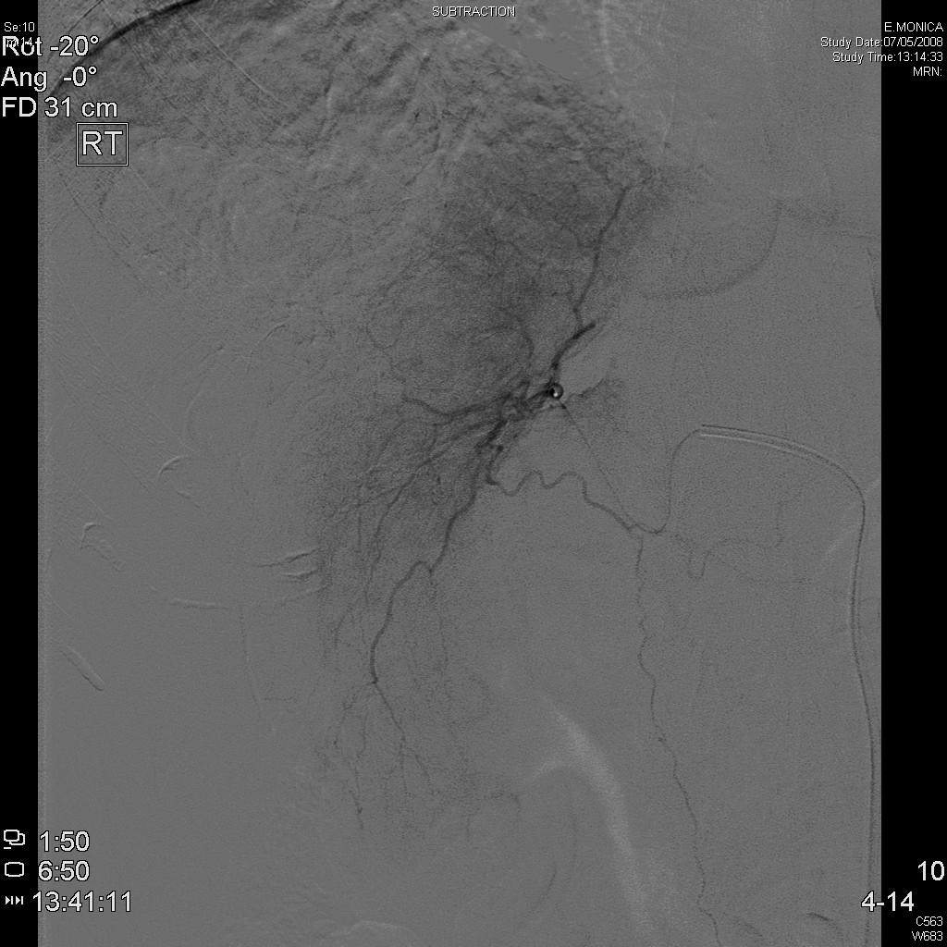
Vessels at Risk
Falciform Artery

Slide 46
Follow up
Pt. Discharged when post-embolization syndrome(pain/fever) subsided (av. 1.5days).
Unenhanced CT scan.
- 1 week, 1/3/6 months.
- tumour morphology
- lipiodol distribution.
- liver/lesion size & distribution.
Tumour markers.
- alpha-fetoprotein.

Slide 47
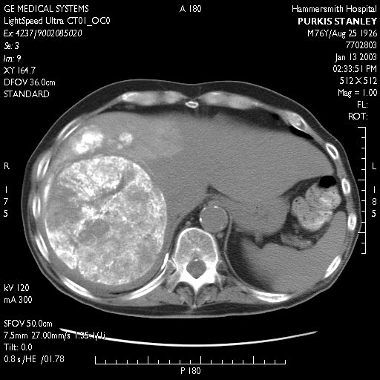
Follow up: CT

Slide 48
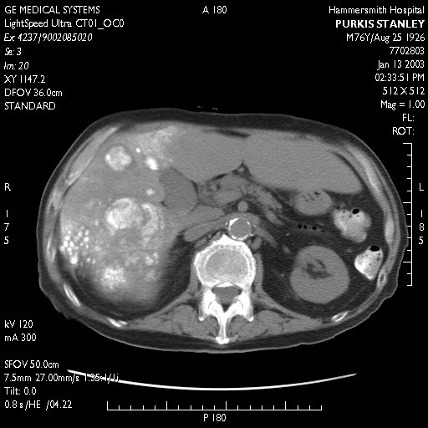
Follow up: CT

Slide 49
Outcome
Response rate 60-80% with average duration 1year.
Meta-analysis of survival:
- 70% at 1 year
- 40% at 3 years
- 10% at 5 years.
Wide range at each interval – wide discrepancy in patient status (tumour burden; stage; cirrhosis; uptake & retention of chemoembolic material).

Slide 50
“Arterial embolization or chemoembolization versus symptomatic treatment in patients with unresectable hepatocellular carcinoma: a randomised control trial.”
Llovet JM, Real MI, Montana X,Planas et al.
Lancet 2002

Slide 51
Chemo-Embolisation (CEM) Trials Summary in HCC
Trial 1st author
No. pts
Cytotoxic
Median survival
Survival at 1 year
Pelletier
42
Doxorubin
-
24% vs 31%
nsd
Madden
50
Epirubicin
48 vs 51 days nsd
-
Groupe d’Etude
96
Cisplatin
-
62% vs 43.5%
nsd
Lo
80
Cisplatin
-
57% vs 32%
p=0.002
Llovet
112
Doxorubicin
82% vs 63%
p=0.009

Slide 52
2 Significant Chemo-embolisation (CEM) Trials in HCC
1) (Lo et al, 2002) 80 Asian patients
Survival CEM V CONTROL / BSC
1 year 57% 32% (p=0.002)
2 years 31% 11%
3 years 26% 3%
hazard ratio of death 0.49 to CEM (95% CI 0.29-0.81, p=0.06)

Slide 53
2 Significant Chemo-embolisation (CEM) Trials in HCC
2) (Llovett et al et al, 2002) Barcelona. 112 pts.
Survival CEM V Embolization v CONTROL / BSC
1 year 82% 75% 63%
(p=0.009)
2 years 63% 50% 27%
hazard ratio of death 0.47 to CEM (95% CI 0.25-0.91, p=0.025)

Slide 54
“Systematic review of randomised trials for unresectable hepatocellular carcinoma: chemoembolization improves survival”
Llovet JM, Bruix J.
Hepatology 2003.

Slide 55
“Review of randomised trials for unresectable hepatocellular carcinoma.”
Primary end point survival, secondary end point response.
61 randomised trials – 14 met criteria for a meta analysis.
Arterial embolization (7 trials; 545pts) vs. tamoxifen (7 trials; 898pts).
Arterial embolization improved 2yr survival compared with control.
Benefit with chemoembolization, not embolization alone.
Objective response in 35% of patients.
Tamoxifen no benefit.

Slide 56
Definitions of best response according to WHO and RECIST (independently verified)
Response Category
WHO criteria
Change in sum of products
RECIST
Change in size of longest diameters
Complete Response (CR)
Disappearance of all target lesions without ant residual lesion
Disappearance of all target lesions
Partial Response (PR)
50% or more decrease in target lesions, without a 25% increase in any one lesion
At least 30% reduction in the sum of the longest diameter of target lesions taking as reference the baseline study
Stable Disease (SD)
Neither PR nor PD
Neither PR nor PD criteria are met, taking as reference the smallest sum of the longest diameter recorded since treatment started
Progressive Disease (PD)
25% or more increase in the size of measurable lesion or appearance of new lesions
At least 20% increase in the sum of the longest diameter of target lesions, taking as reference the smallest sum longest diameter recorded since treatment started or appearance of new lesions

Slide 57
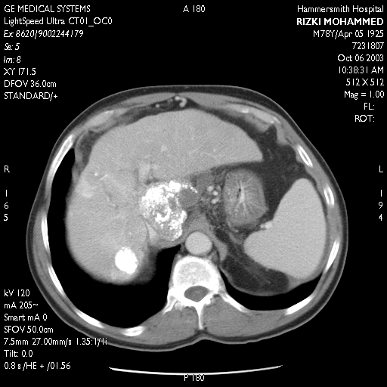
Response:
OCT 2003

Slide 58
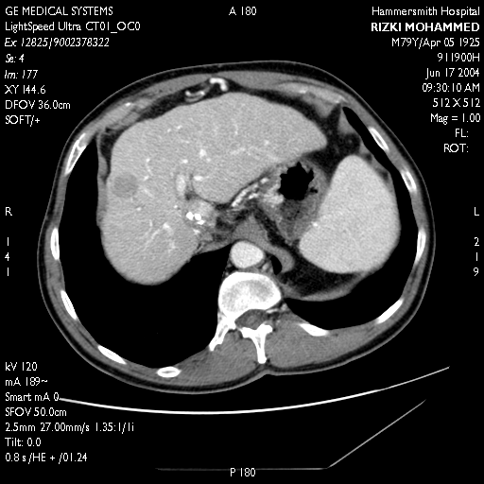
Response:
OCT 2003
JUNE 2004
RECIST vs EASL

Slide 59
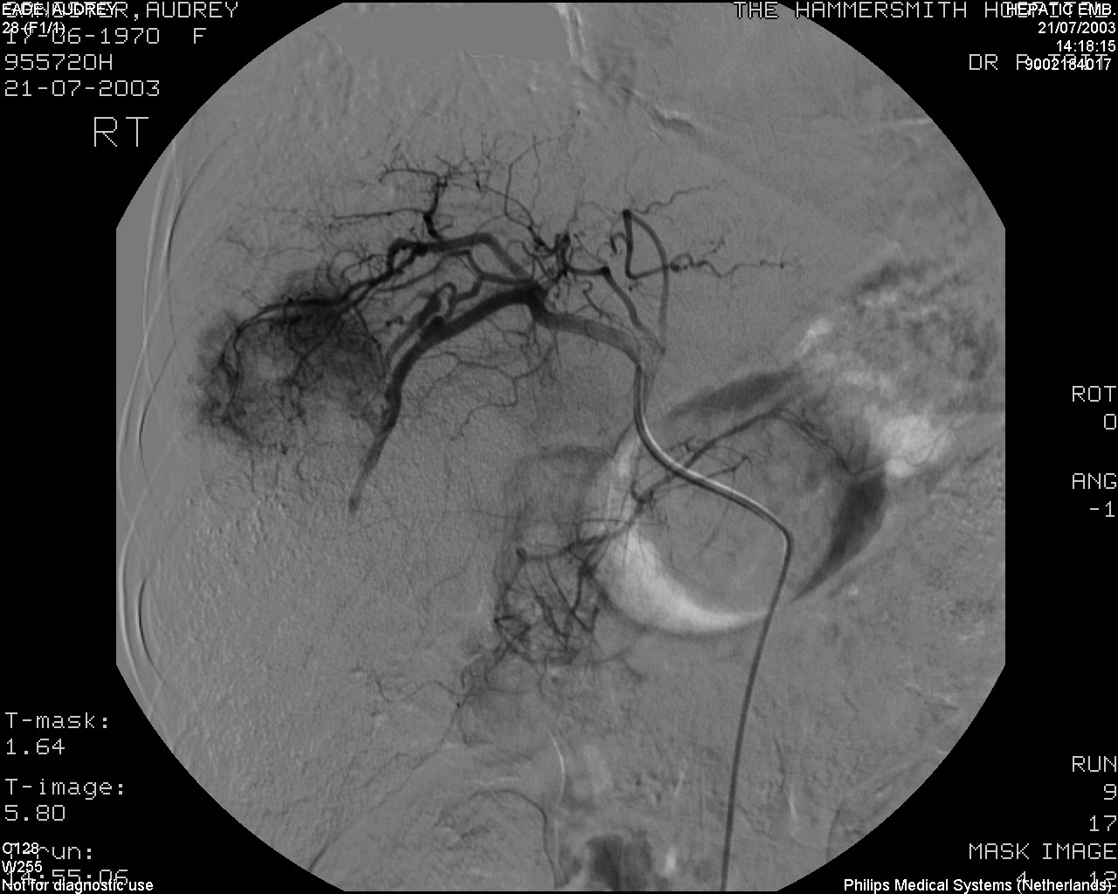
Response

Slide 60
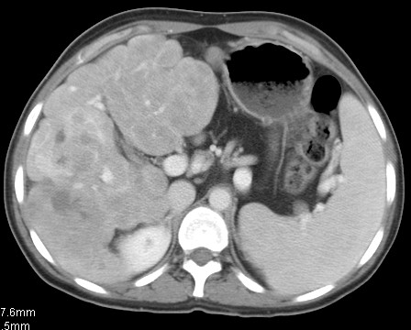
Response

Slide 61
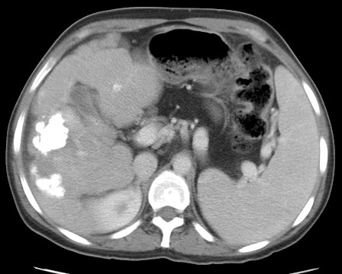
Response

Slide 62
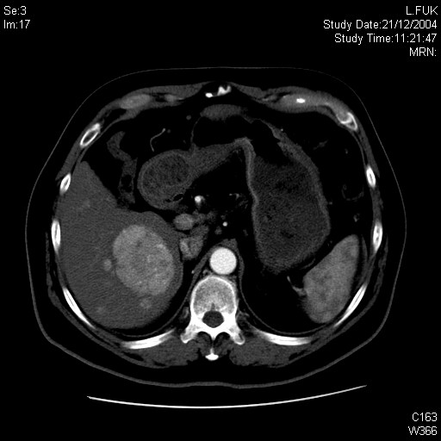
Dec 2004
Chemoembolisation X2

Slide 63
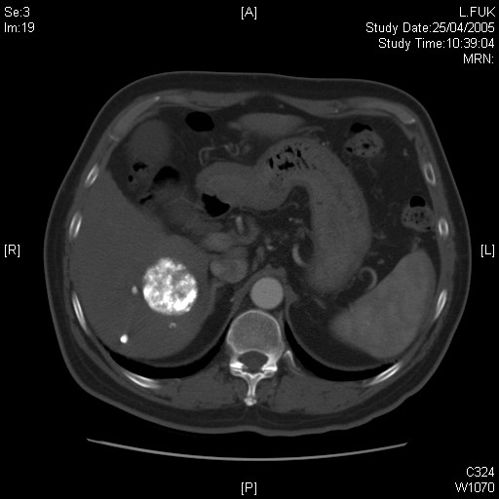
Dec 2004
Chemoembolisation X2
Aug 2005

Slide 64
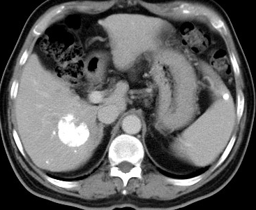
Dec 2004
Chemoembolisation X2
Aug 2005
Chemoembolisation X1
Nov 2006
RFA

Slide 65
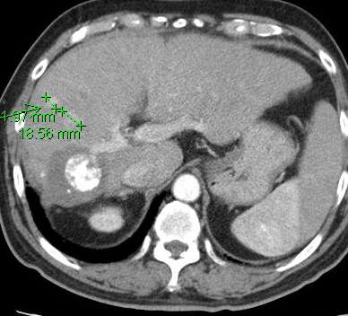
Dec 2004
Chemoembolisation X2
Aug 2005
Chemoembolisation X1
April 2008
Chemoembolisation X1
Nov 2006
RFA

Slide 66
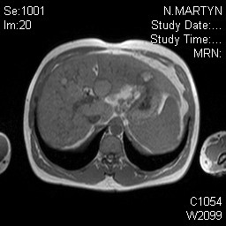

Slide 67
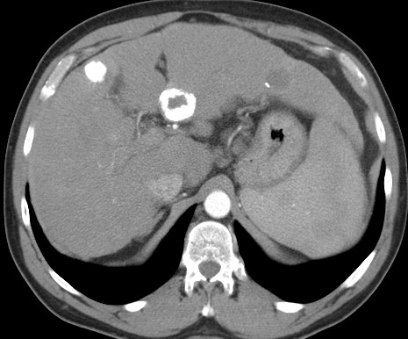

Slide 68
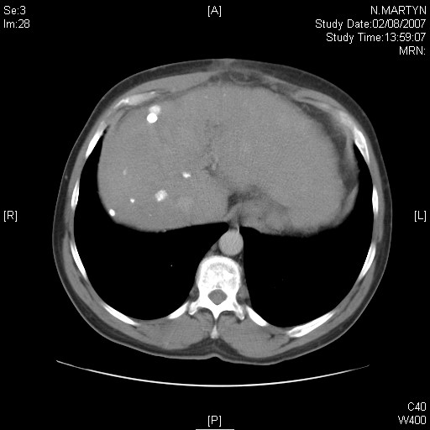
Presented 2003
4 treatment sessions

Slide 69
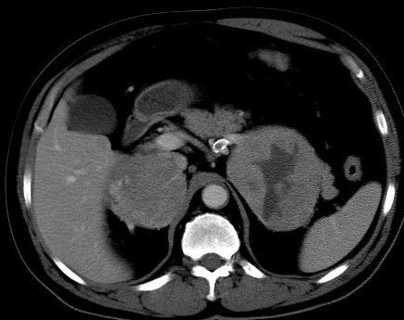
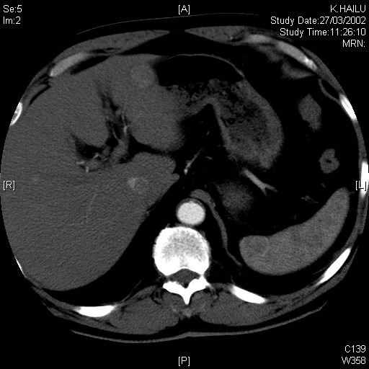
2002

Slide 70
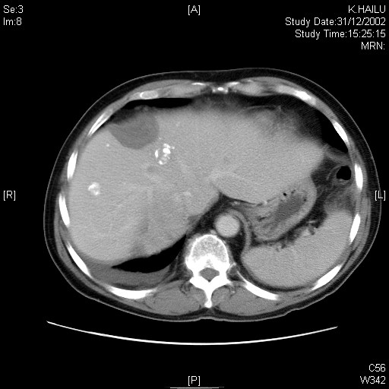
2002
Surgery and RFA

Slide 71
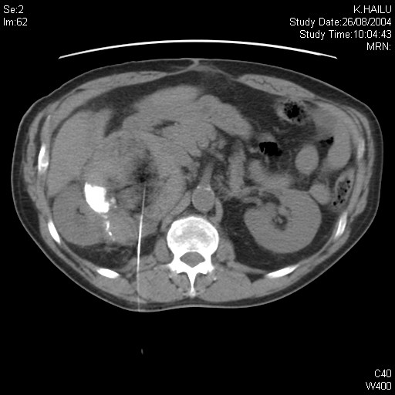
2002
Surgery and RFA
PEI

Slide 72

2002
Surgery and RFA
PEI
Chemoembolisation X5

Slide 73

2002
Surgery and RFA
PEI
Chemoembolisation X5
2002 - 2005

Slide 74



Slide 75


RAO

Slide 76

RAO

Slide 77

Response:

Slide 78

Response:

Slide 79

Response:

Slide 80
Future
New chemotherapeutic agents/regimes/timing
- no evidence that multiple combinations
convey an advantage
Combined therapies
New methods
- gene therapy
- injection of attenuated
adenoviruses.
- radiolabelled microspheres
- drug eluting spheres
- other immunological methods.
- intra-arterial drug delivery combined with
Sorafenib

Slide 81
Drug eluting beads
Chemoembolisation of hepatocellular carcinoma with drug eluting beads: efficacy and doxorubicin pharmakinetics. Varela M, Isabel real M et al. J. Hepatol. 2007
Trans-arterial chemoembolisation of unresectable HCC with drug eluting beads: results of an open-label study of 62 patients Malagari K, Chatzimichael K, Alexopoulou E et al. CVIR 2008
Phase 1/11 trial of chemoembolisation for hepatocellular carcinoma using a novell intra-arterial drug-eluting bead. Poun RT, Tso wk, Pang RW et al. Clin. Gastroenterol. Hepatol. 2007

Slide 82

Combined therapies
Portal Vein Embolization

Slide 83

Combined therapies
Portal Vein Embolization

Slide 84

Combined therapies
Portal Vein Embolization

Slide 85

Combined therapies
Portal vein Embolization & Surgery

Slide 86

Combined therapies
Portal vein Embolization & Surgery

Slide 87

Combined therapies
Portal vein Embolization & Surgery & ………….

Slide 88

Combined therapies
Portal vein Embolization & Surgery & ………….

