Slide 1



New developments in PET imaging
Dr L Kenny

Slide 2
Biomarkers
Novel agents may not cause decrease in tumour volume as per RECIST criteria
Survival benefit can occur without objective response
Clinical trials – optimal biological dose
may not relate to MTD
Early prediction of pharmacological resistance

Slide 3
Contents
Background
Proliferation
Angiogenesis
Apoptosis
Other novel tracers
PERCIST Criteria

Slide 4
PET
Positron Emission Tomography
Intravenous injection of a radiolabelled substance (microdose) – radiotracer
Reconstructed into a quantitative image
Provides a method to measure biological processes in vivo

Slide 5
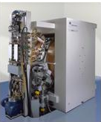
The modern cyclotron
Positron Emitter | Half-life (t_{½} of product) in min
¹¹C | 20.4
¹⁸F | 109.8
¹⁵O | 2.03

Slide 7
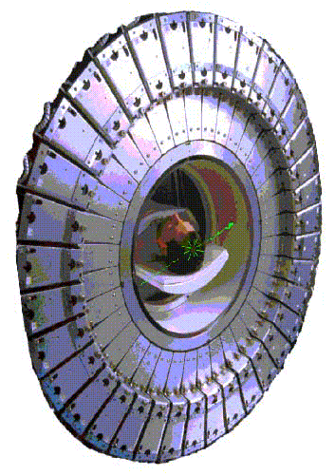
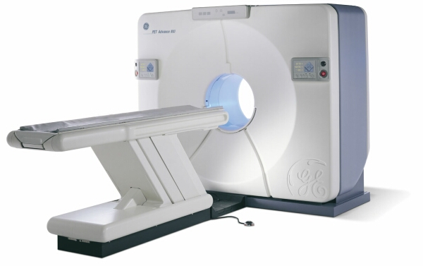
PET

Slide 8
Why do we use it?
Commonest use outside research is in oncology
TO PROVIDE INFORMATION ABOUT TUMOUR BIOLOGY
Standard imaging measures tumour size
Staging
Assessing indeterminate lesions
Measuring response to treatment

Slide 9
[18F]FDG-PET

Slide 10
2-[18F]fluoro-2-deoxyglucose: FDG
Originally developed as a chemotherapeutic agent
Most commonly used PET radiotracer – 25yr hx
Uptake based on Warburg’s principle (1921) that tumours rely more on glycolysis for energy production rather than oxidative phosphorylation
Increased glucose uptake is mediated by GLUT-1, which is a transmembrane transporter – upregulated in many cancers.
Tumour cells may also have increased hexokinase (HK1 and 2)
Glycolysis is increased by oncogenes such as src, ras, c-myc, growth factors, and hypoxia
Akt is thought to be a key mediator in tumour cell glycolysis

Slide 11
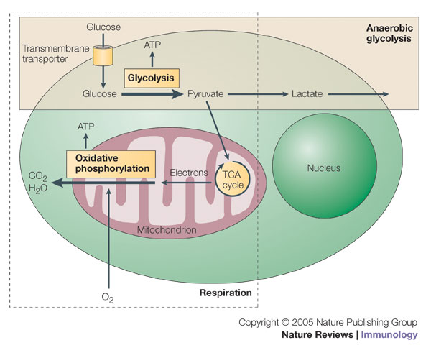

Slide 12
FDG-PET
FDG = glucose analogue
Following phosphorylation FDG-6-phosphate is effectively trapped within the cell
t_{½} = 110 mins – can be synthesized off-site
Use a nanomolar dose so that the underlying biological process is unaffected

Slide 13
FDG transport into the cell- the Sokoloff model

Slide 14
Why do we use FDG?
Provide information about the metabolic activity of tumours
Readily available
Can be shipped off-site
Complimentary to standard anatomical imaging
May detect metastases at distant sites
Reliable technology
May be used to quantify response to treatment
Improve treatment outcomes + Drug development

Slide 15
Data Interpretation
Visual
Quantitative to calculate the SUV – uptake at a particular timepoint corrected for dose injected and body weight or surface area
SUV(bw)= tissue concentration(MBq/g)
injected dose (MBq)/body weight (g)
Above methods assume that dephosphorylation is negligible

Slide 16
Data Interpretation
For more detailed analysis: need an input function generated from a large vessel on the images/ or from arterial sampling
Used to calculate the metabolic rate of glucose, MRFDG

Slide 17
Current Indications for FDG-PET
Overall sensitivity = 84%, specificity= 88%
Tumour staging: melanoma, lymphoma, oesophageal, colorectal ca, NSCLC – characterisation of solitary pulmonary nodules, breast cancer, cervical cancer
Response to treatment

Slide 18
Advantages
Can image tumours in vivo – no fixatives required!
Study tumour and its microenvironment
Can study tumours in their entirety
Repeat studies
Non-invasive

Slide 19
Challenges with PET
Spatial resolution: 4-10mm
Negative scan cannot exclude a small tumour
Precise anatomical localisation can be difficult in certain locations such as the head and neck
PET/CT – improves resolution
Cannot differentiate histological subtypes
Some tumor types e.g. mucinous, and prostate ca have low FDG uptake
Non-specific signals – e.g. inflammation, fat, dense muscle activity

Slide 20
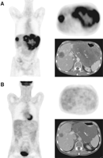
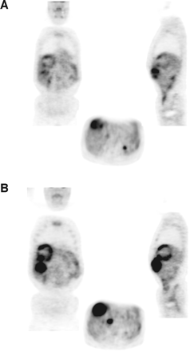
GIST and FDG
Response
And
Resistance
A Van den Abbeele, Oncologist 2008.

Slide 21
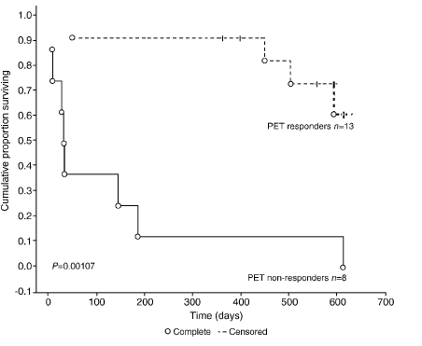
Soft-tissue Sarcoma and Imatinib
Stroobants S, EJC, 2003

Slide 22
Indications
Oesophageal cancer: characterise distal mets, less good for local nodal disease
Head and Neck: patients with cervical nodes and unknown primary site
Colorectal: low regional sensitivity due to normal metabolic activity, useful for detection of metastases
Melanoma: surveillance of stage III/IV pts
Lymphoma: staging – not so good for T cell and MALT lymphomas
Breast: staging, response to treatment
Thyroid – pts with negative ¹³¹I + high thyroglobulin
Sarcoma – staging
GTD - staging

Slide 23
Examples of Molecular Imaging Probes in Development

Slide 24
Proliferation
Thymidine analogues
[11C]thymidine
3’-deoxy-3’-[18F]fluorothymidine (FLT)
2’-deoxy-2’-[18F]fluoro-D-arabinofuranosyl-thymine (FMAU)

Slide 25
Pyrimidine Nucleoside Analogues Used in PET
O
O
Me
Me
NH
NH
11
N
O
N
O
HO
O
HO
O
OH
18
F
2[
11
C]Thymidine
[
18
F]FLT
O
O
O
11
Me
76
124
NH
Br
I
NH
NH
N
O
N
O
N
HO
O
O
HO
O
HO
O
OH
F
OH
OH
[
11
C]
FMAU
[
76
Br]
BrdU
[
124
I]
IUdR

Slide 26
[18F]FLT-PET (Kenny et al, Cancer Research 2005)
Proposed marker of proliferation, related to thymidine kinase 1 (TK1) activity
Scanned 15 patients with stage II-IV breast cancer for 95 min
29 tumor regions
Arterial sampling for PK and metabolite analysis
Kinetic analysis to quantify retention (FRT and Ki), delivery, and uptake
[18F]FLT correlated with Ki67 (r=0.92 for Ki and FRT, 0.79 for SUV)

Slide 28
[18F]FLT and proliferation in breast cancer - Results
Metabolised into a single metabolite by glucuronidation
71.5 ± 1.5% as parent compound at 90mins
Uptake, retention, delivery higher in tumor than normal tissue (p<0.0001 for all parameters)
Kinetic analysis showed irreversible trapping in tumor but not normal tissue
Wide intratumor and interpatient variation in uptake of [18F]FLT
Correlates with Ki-67:r=0.92 (p<0.0001) for Ki, FRT, 0.79 for SUV, ns = 0.28 for K1

Slide 29
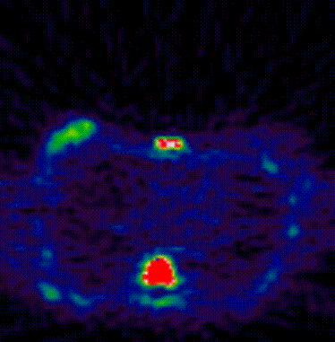
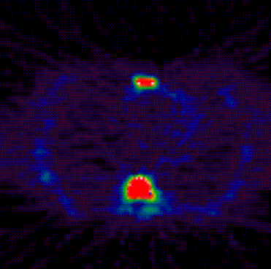

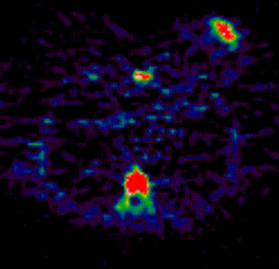
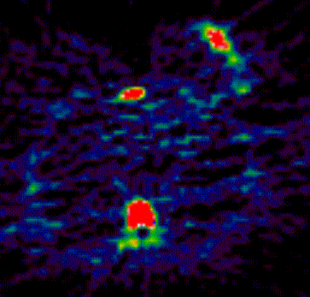
Comparison of [18]FLT-PET response and non-response
[¹⁸F]FLT uptake
A. Patient 1 Baseline
B. Patient 1 Day 8 Post FEC
100%
tumour
vertebra
0%
C. Patient 8 Baseline
D. Patient 8 Day 8 Post FEC
tumour
tumour

Slide 30
[18F]FLT-PET
Able to detect significant changes in 11/17 lesions by Ki and 12/17 by SUV
All patients who had a clinical response had an FLT-PET response
Heterogeneity of response between different lesions in the same patient
Now being assessed in other tumors – e.g. NSCLC and gefitinib – d7 FLT predicts for clinical response: positive and negative values of 0.92 (Sohn et al, Clin Canc Res Nov 2008)

Slide 31
FLT-Pharmacodynamic studies
The enzyme thymidylate synthase is an important therapeutic target
Proposed mechanism of the active metabolite FdUMP of capecitabine is inhibition of TS
Hypothesized that early inhibition of TS would increase extracellular thymidine and hence [18F]FLT uptake
Could be used to determine early resistance

Slide 32
thymidine
FLT
Cell membrane
ENT1
[¹⁸F]FLT
TMP
TK1
DNA
thymidine
TMP
TTP
Salvage pathway
dUMP TMP TTP DNA
De novo pathway
TS
Capecitabine and 5-FU

Slide 33
[18F]FLT as a PD marker (Kenny et al Clinical Cancer Res Nov 1, 2009.)
6 patients
[18F]FLT and H2[15O] (for blood flow) scans at baseline, then repeat scans at the maximum bioavailability timepoint for capecitabine
Significant increases in [18F]FLT uptake which were independent of blood flow
Non-responders failed to show a significant change
No significant change in normal tissue

Slide 34
Capecitabine

Slide 35
Results
Possible to see significant changes in FLT uptake (p=0.004 IRF60, p=0.002 Ki and SUV)
No significant change in patients with PD
Heterogeneity of FLT-PET response
Independent of blood flow
No significant change in normal tissue supporting tumor-specific action of capecitabine

Slide 36
Angiogenesis: Background
Angiogenesis is essential for tumour growth
Advances in our understanding of the molecular biology
Treatment options
Crucial need for quantification in vivo

Slide 37
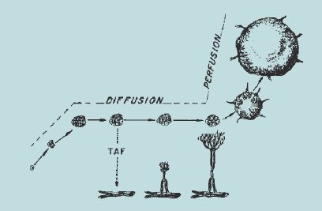
Folkman, 1971

Slide 38
Integrins
Heterodimeric transmembrane proteins
Extracellular ligand receptors
Crucial for stability of microenvironment, cell movement and differentiation
18α and 8β genes
24 αβ combinations at protein level

Slide 39
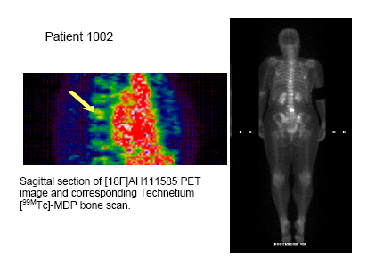
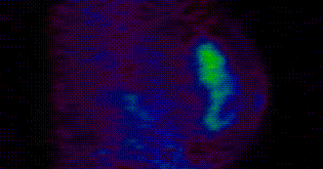
Breast tumour with bone metastases
Primary tumor
Bone metastases
Sagittal view of left breast grade 2 invasive ductal carcinoma imaged with [18F]AH-111585 PET

Slide 40
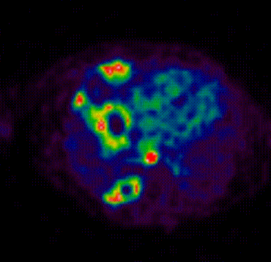
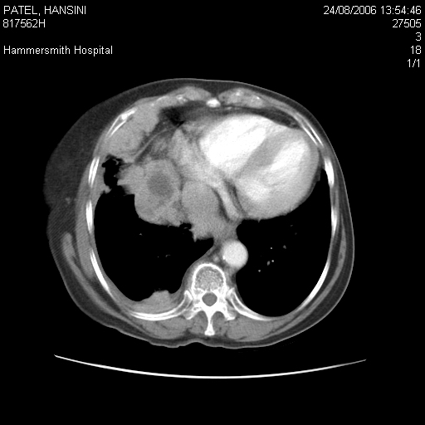
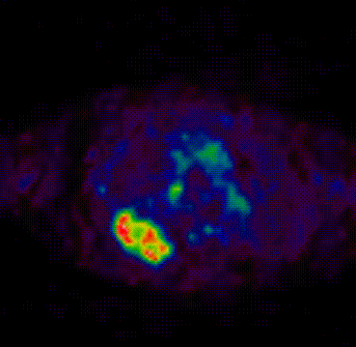
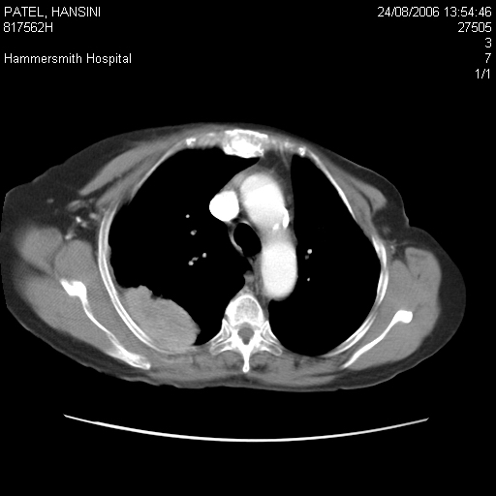
Pleural and lymph node metastases
Necrotic lymph node
Posterior necrotic mass
Right pleural
metastasis

Slide 41
Results
Efficacy:
  Good visualization of tumors in breast, pleura, lymph node, lung
  Hepatic metastases demonstrate low level of tracer uptake compared with surrounding normal liver
Safety:
  No any adverse event and serious adverse event was found in this group

Slide 42
Blood flow
Quantified using [15O]Water
Very short half-life
Independent prognostic feature in LABC (Dunnwald JCO 2008)
Varies with subtype in LABC (Specht CCR, 2010)

Slide 43
PET Water Images in Breast cancer
coronal
transverse

Slide 44
Apoptosis
Annexin V – detects asymmetric phosphatidylserine distribution,nonspecific, poorly distributed
Isatin analogues
Caspase 3/7 selective labelled with [18F]
Preclinical validation in RIF-1 sarcoma and lung cancer
Increases 2 fold in lymphoma xenografts 24 hrs post-treatment

Slide 45
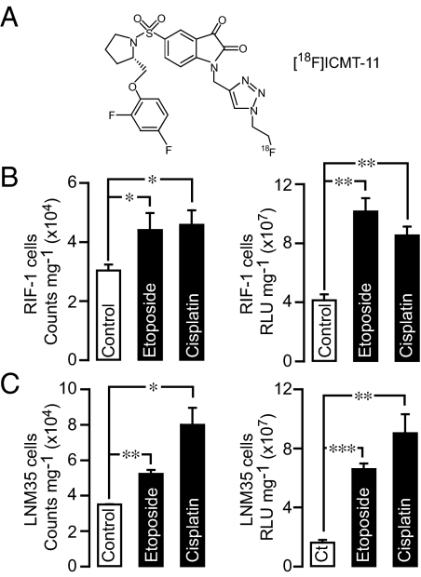
Nguyen PNAS , Sept 2009
ICMT-11 binding caspase 3 activity

Slide 46
Carcinoids
Standard imaging with SPECT
New somatostatin receptor analogues
[68]GA-DOTA-NOC – peptide binds to somatostatin receptors 2,3,5
Increased specificity

Slide 47
PET and Therapeutics

Slide 48
Radiolabelled drugs
Capecitabine
Docetaxel
Trasuzumab

Slide 49
PERCIST criteria WAHL, JNM 2009: 50(5)
Anatomical imaging response may not predict survival benefit – Sorafenib v placebo in HCC: PR 2% v 1% by RECIST, but 3 months difference in PFS
Attempt to standardize response assessment in PET
Suggest using SUV corrected for lean body mass

Slide 50
PERCIST
CMR: - Complete resolution of FDG uptake in measureable target lesion to less than mean liver background activity/blood pool, complete disappearance of all other lesions. No new FDG PET avid lesions
PMR: Reduction in FDG uptake of 30% within target lesion, no increase in non-target lesion

Slide 51
PERCIST contd
Stable metabolic disease: - Not CMR, PMR, or PMD
PMD: 30% increase in FDG SUL, or new FDG avid lesions which are typical of cancer and not due to treatment or infection

Slide 52
The future
Incorporate PET into novel drug development
Molecular imaging “phenotypes”
Combine imaging analysis with bioinformatics
Improve patient outcomes

Slide 53
