Slide 1
6 steps to good writing for your Times article
Dr Graham Easton MB BS MSc MRCGP
Deputy Director of Primary Care Education
Imperial College Medical School

Slide 2
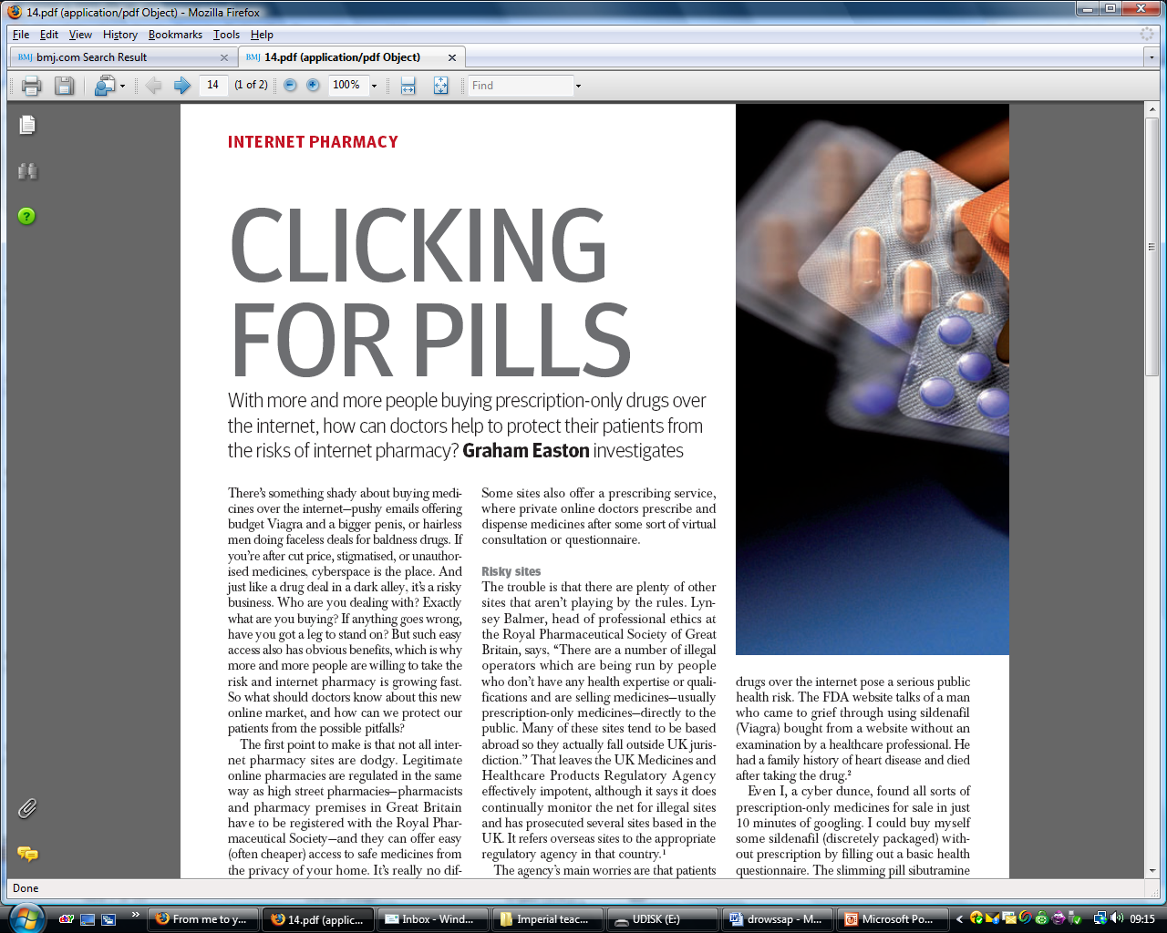
Notes:
2

Slide 3
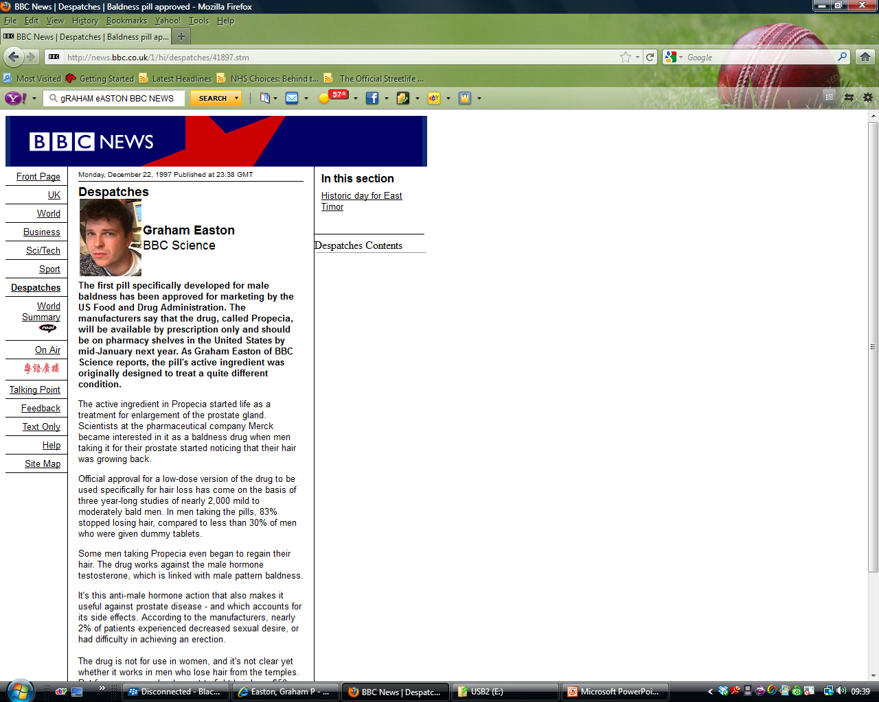

Slide 4
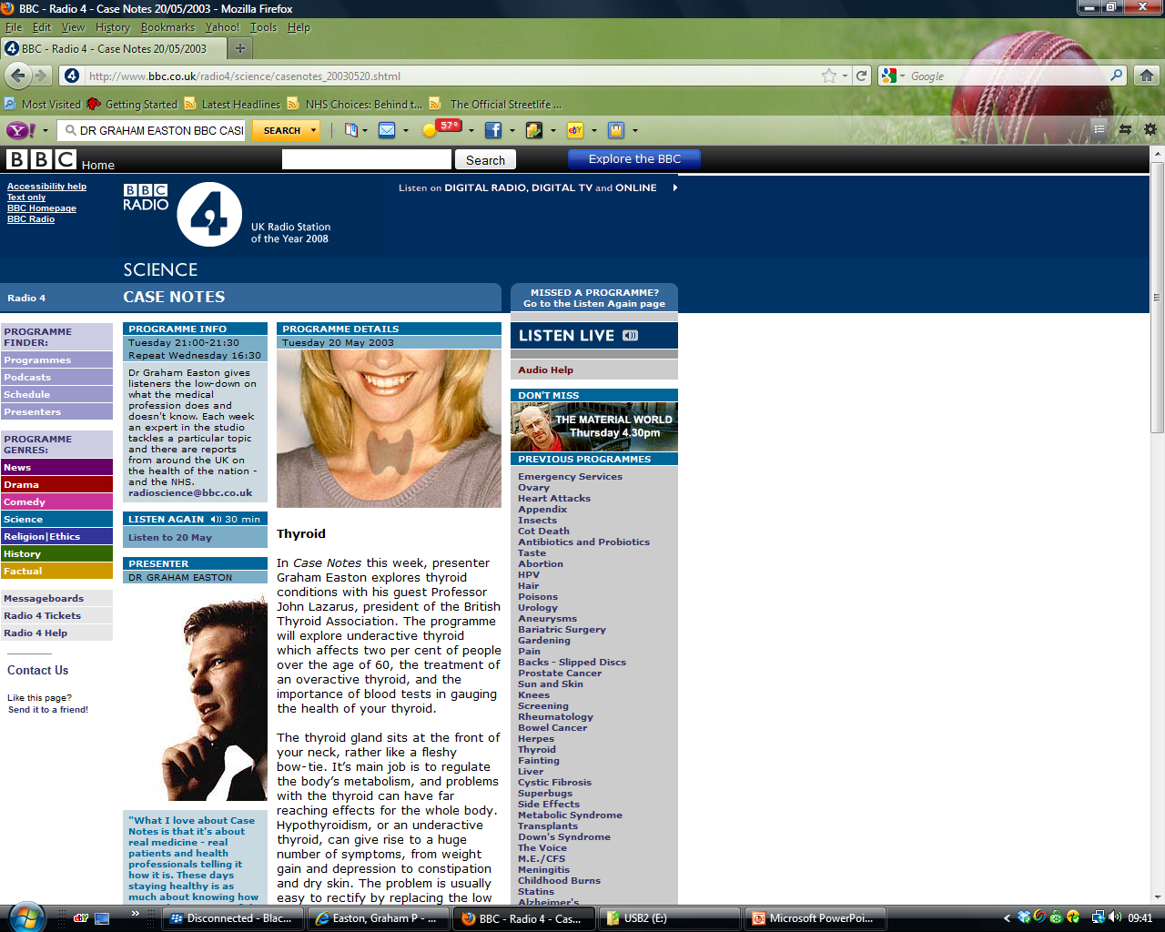

Slide 5
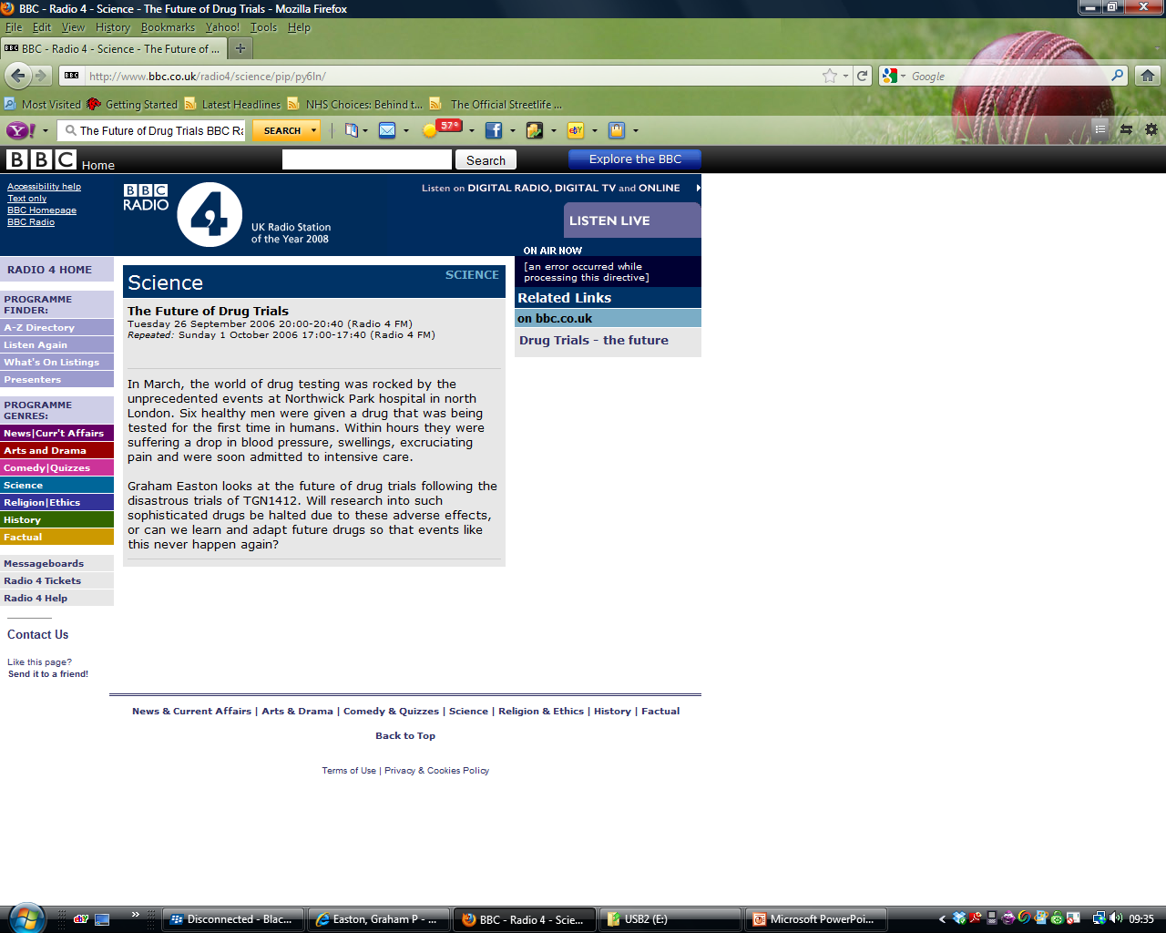

Slide 6
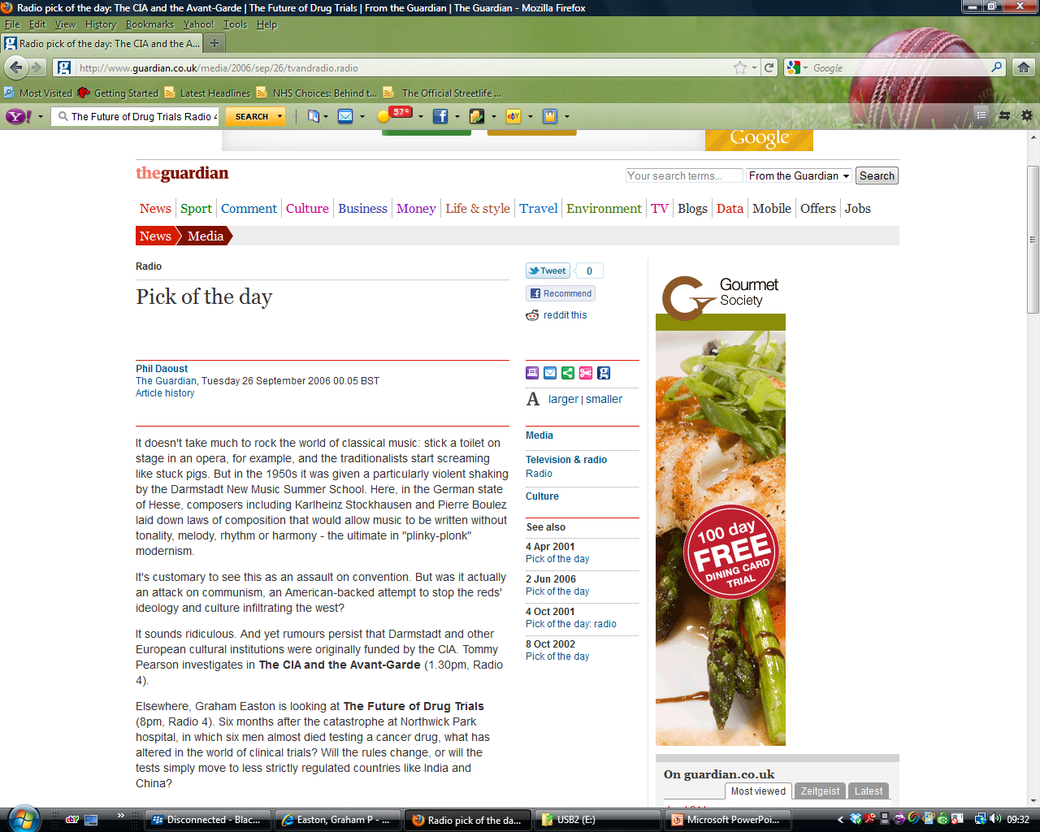

Slide 7
Coming up….
6 steps to writing well
Some quick exercises
Think about your own assignment
Notes:
7

Slide 8
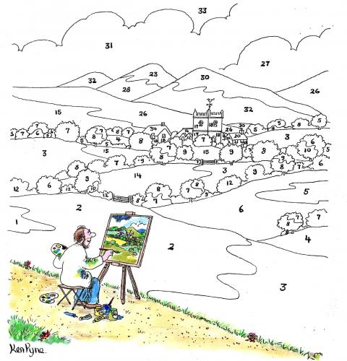
Writing by numbers

Slide 9
6 steps to good writing
1
Who is my reader?
2
What is my main message?
3.
How will I structure my writing?
4
Can I use a short word instead of a long one?
5
Have I used active rather than passive voice?
6
Have I read and re-read for waffle, mistakes and red herrings?

Slide 10
Exercise
Write down your own idea for your next piece of writing...
OR
An account of your summer holiday

Slide 11
1. Who is my reader?
Write for the reader, not you
…imagine who your reader is…speak to him or her. Who is your reader?

Slide 12

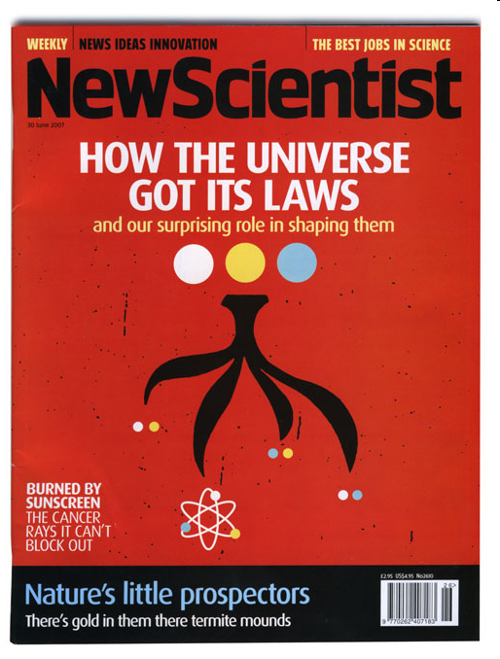
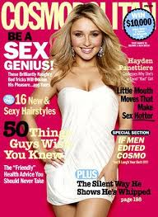



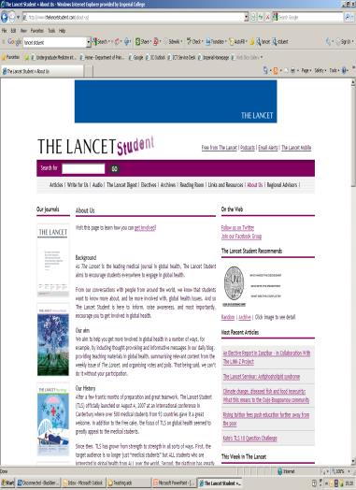

Exercise – style and message?

Slide 13
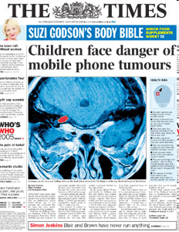

Slide 14
National Readership Survery
A upper middle class
Higher managerial, administrative or professional
B middle class
Intermediate managerial, administrative or professional
C1 lower middle class
Supervisory or clerical and junior managerial, administrative or professional
C2 skilled working class
Skilled manual workers
D working class
Semi and unskilled manual workers
E Those at the lowest levels of subsistence. Casual or
lowest grade workers, pensioners and others who depend on the welfare state for their income

Slide 15
Readership profile and image
The British Business Survey 2005 named The Times as the UK's leading daily newspaper for business people. This independent survey was sponsored by The Financial Times, The Guardian, The Daily Telegraph, The Economist, and The Times.
The latest figures from the national readership survey show The Times to have the highest number of ABC1 25–44 readers
largest numbers of readers in London of any of the "quality" papers.
The certified average circulation figures for November 2005 show that The Times sold 692,581 copies per day.
Tabloid newspapers, such as The Sun and middle-market newspapers such as the Daily Mail, at present outsell both papers with a circulation of around 3,005,308 and 2,082,352 respectively. By March 2010 the paper's circulation had fallen to 502,436 copies daily and the Telegraph's to 686,679, according to ABC figures.

Slide 16
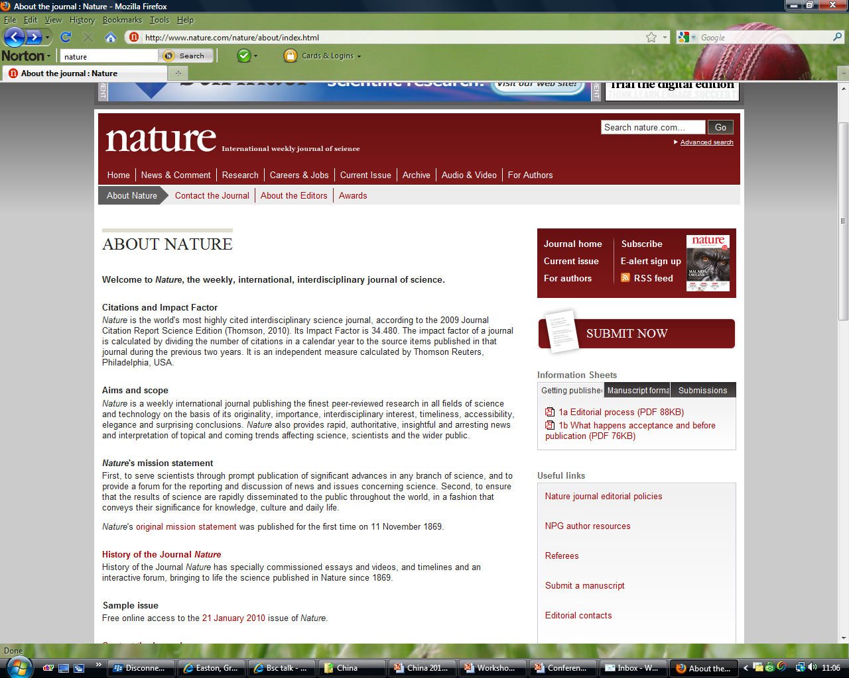

Slide 17
2. What is my main message?
What is my main message?
Can you sum up in one sentence?
Make it relevant for your audience
If stuck, try to explain it to someone from your audience {mum/friend/peer/professor}

Slide 18
Exercise
In pairs...
Explain your message in 1 sentence to your neighbour

Slide 19
3. How will I structure my writing?
Use a clear structure
Show the reader where they are going.
Signpost
Give a clear summary
What structure will you use?

Slide 20
Basic structure of scientific article
Inverted pyramid
Notes:
20

Slide 21
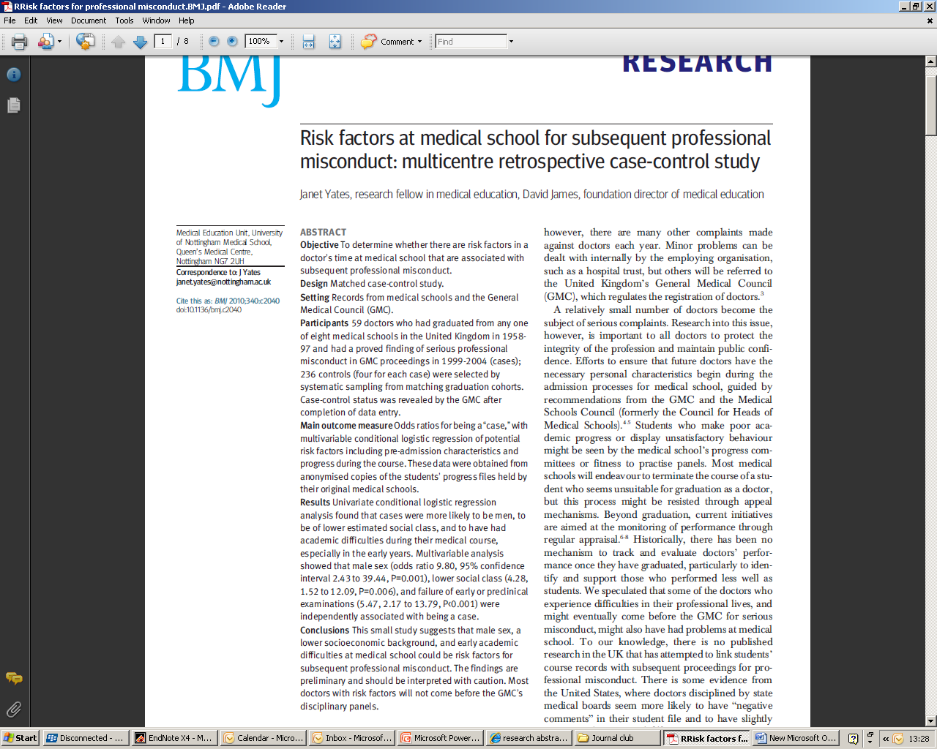

Slide 22
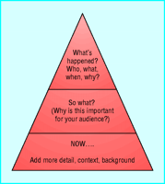
Structure of most news stories
Notes:
22

Slide 23
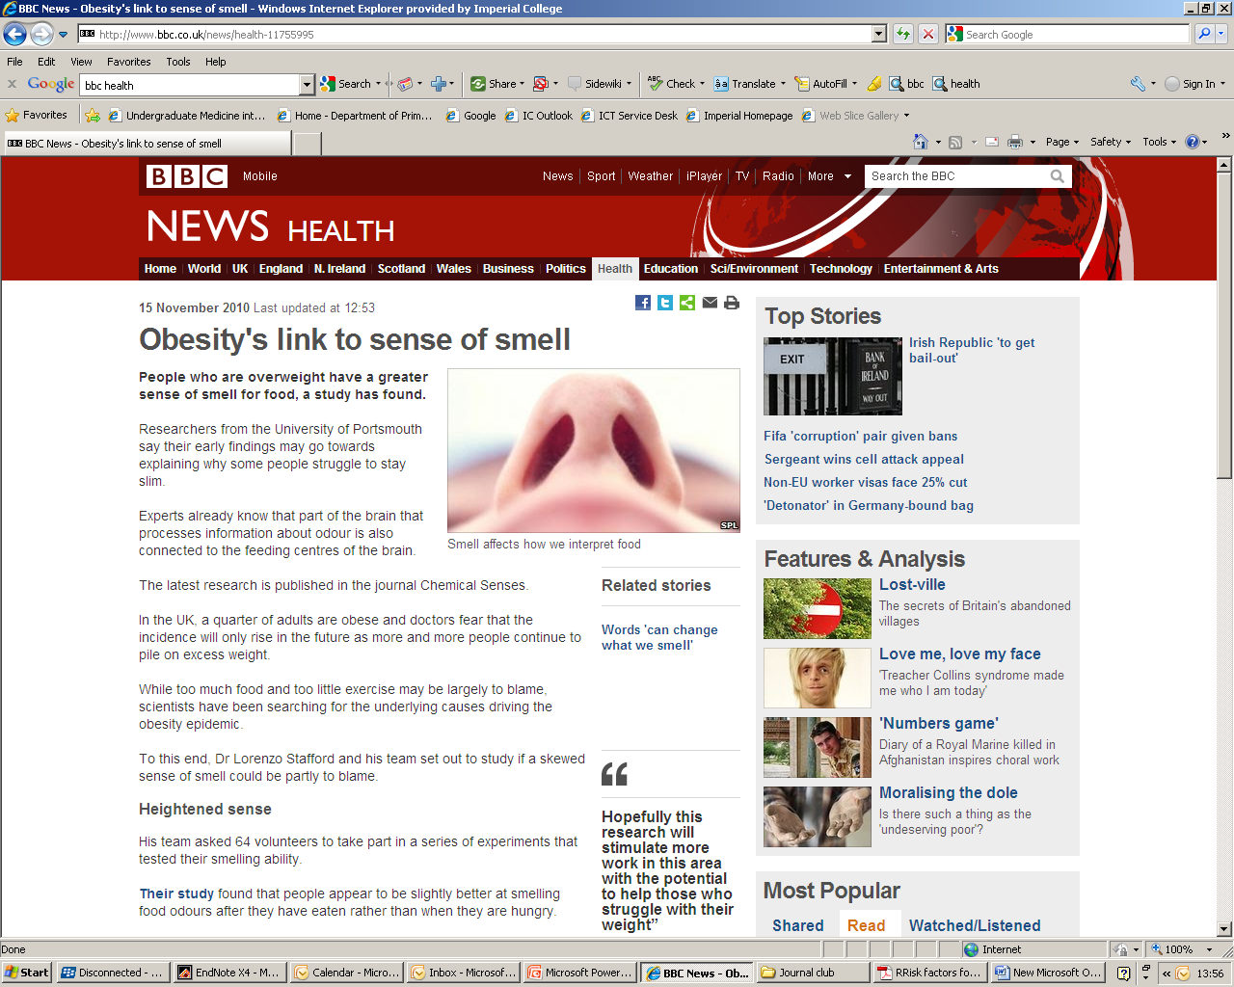

Slide 24
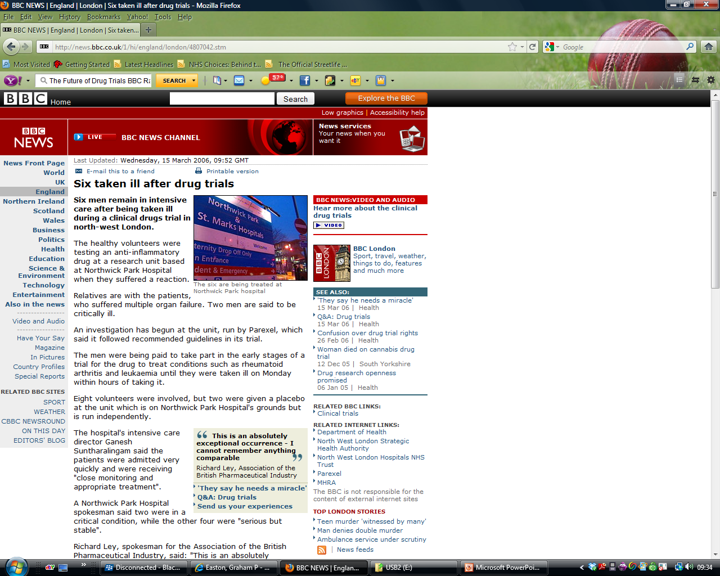

Slide 25
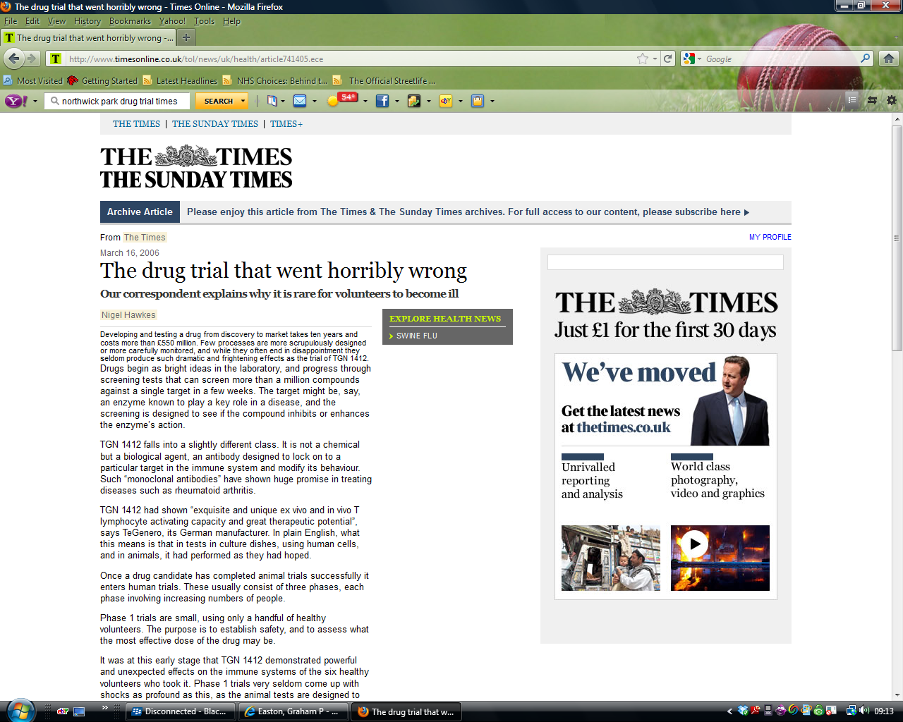

Slide 26
4. Can I use a short word instead of a long one?
Use simple words and short sentences
…Could you use a short word instead?
Why use long words?

Slide 27
The Elements of Style
Strunk & White 1918
“Vigorous writing is concise. A sentence should contain no unnecessary words, a paragraph no unnecessary sentences, for the same reason that a drawing should have no unnecessary lines and a machine no unnecessary parts”.

Slide 28
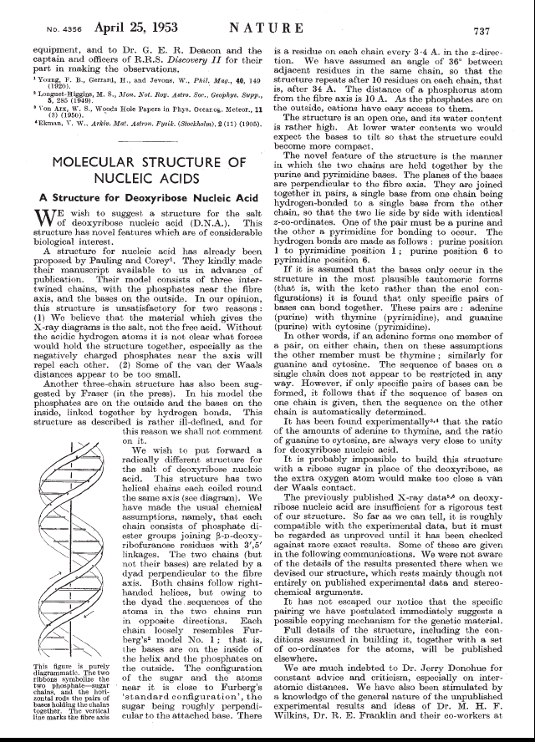
The Structure of DNA
Watson and Crick, Nature, 1953

Slide 29
Exercise
Approximately
Demonstrate
In the course of
Substantial number
Utilise
At this point in time
Reached a conclusion
Revealed

Slide 30
New language
Dyspnoea
Myocardial infarction
Biopsy
Phlebotomy
Gastroenteritis
Idiopathic erythema
Breathlessness
Heart attack
Small sample
Taking blood
The shits
Rash – haven’t a clue
Notes:
30

Slide 31

FOG INDEX
Take a full passage that is around 100 words (do not omit any sentences).
Find the average sentence length (divide the number of words by the number of sentences).
Count words with three or more syllables (complex words), not including proper nouns (for example, Djibouti), familiar jargon or compound words, or common suffixes such as -es, -ed, or -ing as a syllable.
Add the average sentence length and the percentage of complex words
Multiply the result by 0.4
The complete formula is

Slide 32
“The English Language”
Fog Index of 24.4.
  As a result of the military, economic, scientific, political, and cultural influence of the United Kingdom from the 18th century, and of the United States since the mid 20th century, it has become the lingua franca in many parts of the world, and the most prominent language in international business and science. It is used extensively as a second language and as an official language in the European Union and many Commonwealth countries, as well as many international organisations.
Analysis
There are 79 words in two sentences.
The 17 italic words are considered complex.
0.4 ((79/2) + 100(17/79))
0.4 x ( 39.5 + 12.79)
Fog index = 24.4

Slide 33
“The English language”
Fog Index of 7.07
  English has become the standard language around the world. This was the result of many factors. In the 1700s, the British affected English with the army, economy, science, politics and culture. In the mid-1900s, the United States caused change. It is the most used language in world business and science. It is a famous second language and an official language in most of Europe and in Commonwealth countries. It is also the case in groups around the world.
Analysis
There are 79 words in seven sentences.
The 5 italic words are considered complex.
0.4 ((79/7) + 100(5/79))
0.4 x ( 11.28 + 2.5)
Fog index = 7.07

Slide 34
Fog Index examples
BMJ article: 16
Insurance Policy: 20
Practice Leaflets: 8-17

Slide 35
5. Have I used active rather than passive voice?
Use active not passive
…Jim hits John
NOT
…John was hit by Jim
Active is shorter and clearer…

Slide 36
Exercise
My first night on call will always be remembered by me…
The test tubes were shaken and the resulting solution was filtered by the students
It is believed by researchers…

Slide 37
Have I read and re-read for waffle, mistakes and red herrings?
And don't forget..
Spelling and grammar
Libel
Plagiarism (quotes and opinions of others clearly attributed?)

Slide 38
6 steps to good writing
1
Who is my reader?
2
What is my main message?
3.
How will I structure my writing?
4
Can I use a short word instead of a long one?
5
Have I used active rather than passive voice?
6
Have I read and re-read for waffle, mistakes and red herrings?

Slide 39
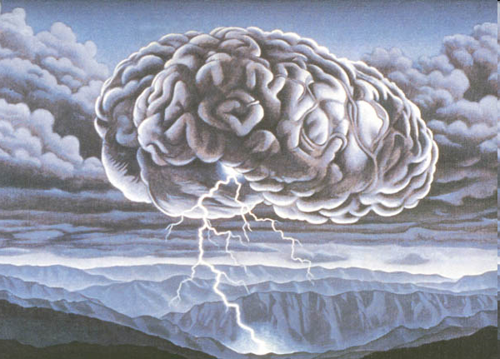
Your piece…brainstorm
Notes:
39

Slide 40
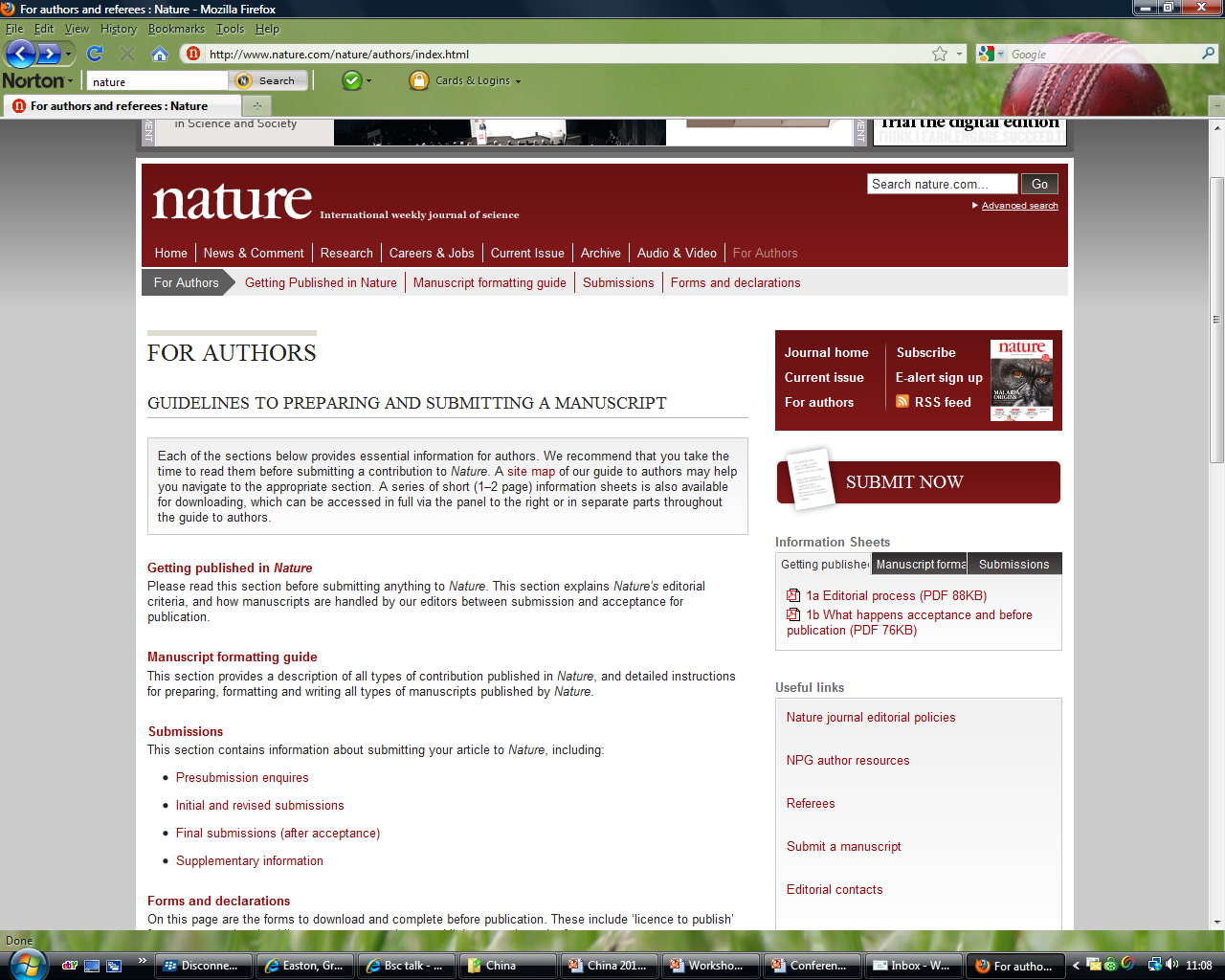

Slide 41
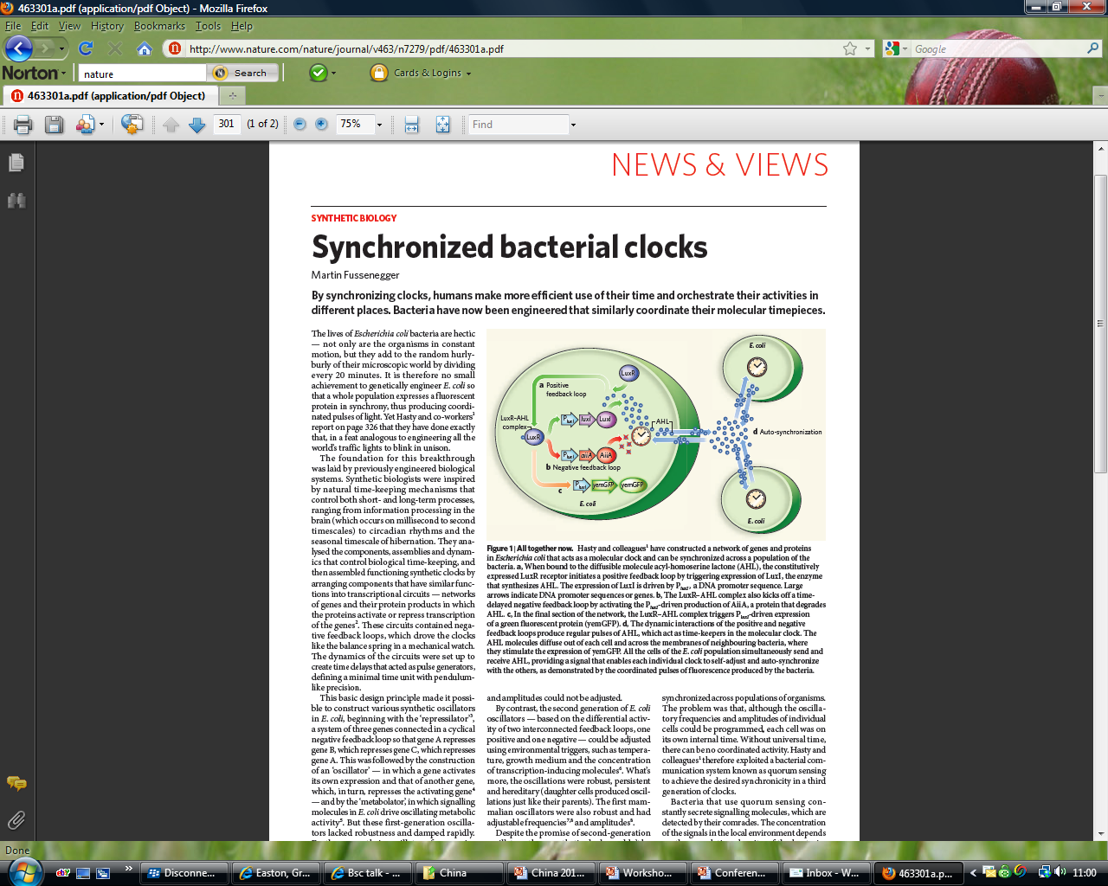

Slide 42
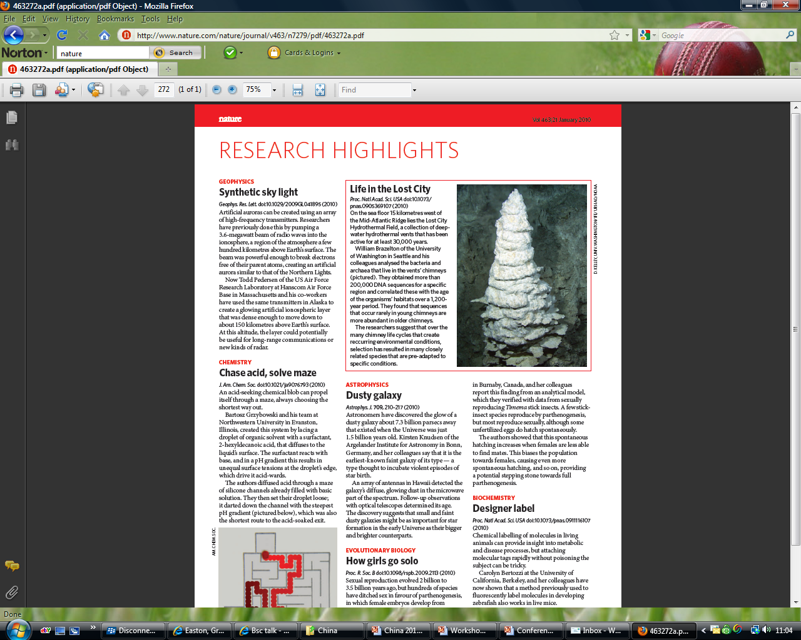

Slide 43
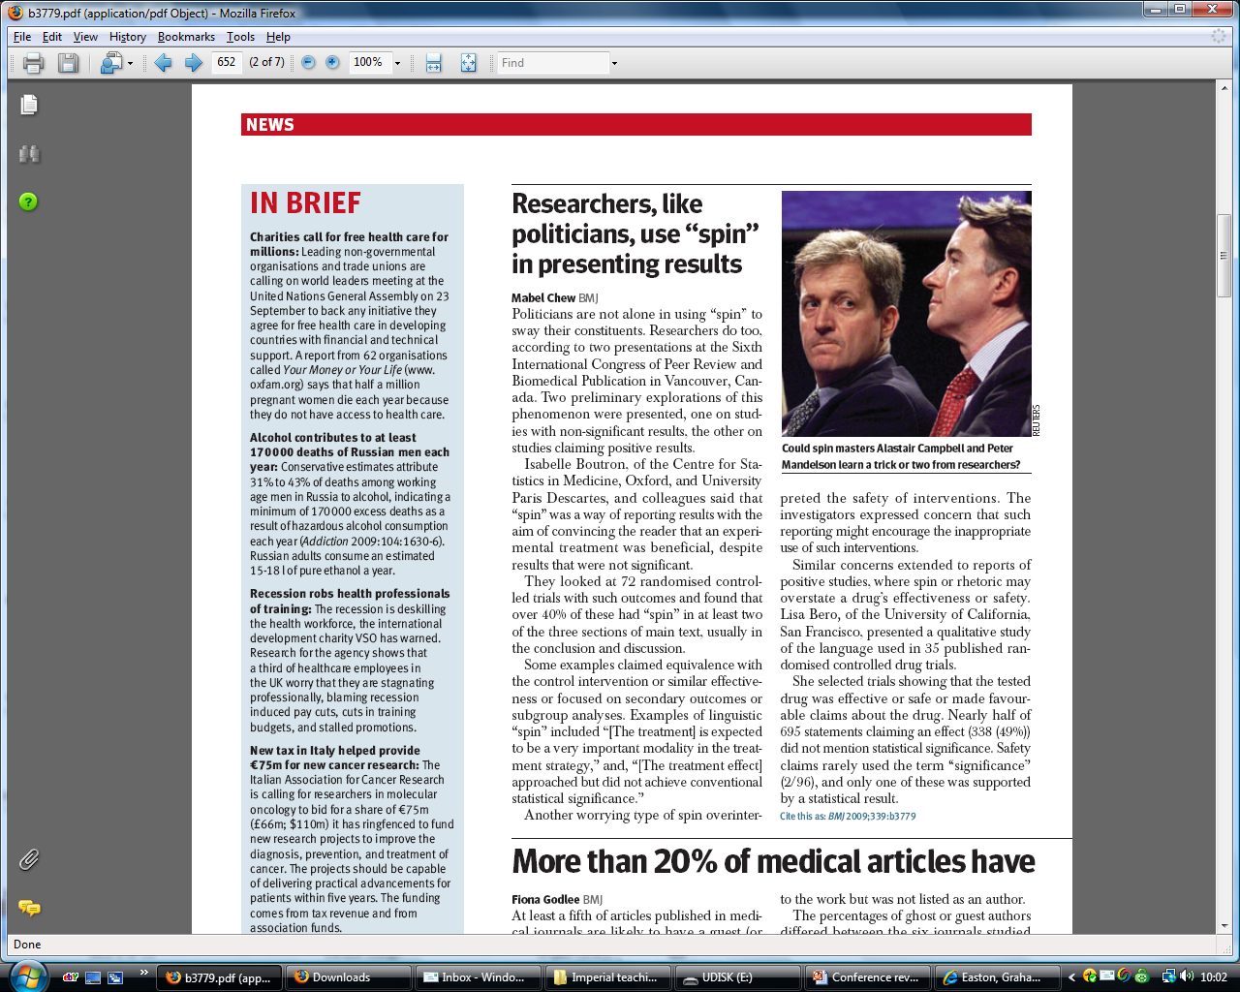
Notes:
43

Slide 44
Dr Graham Easton
g.easton@imperial.ac.uk
Notes:
44

