Slide 1
Women in surgery – Beyond the stereotype and making reality work
Ms Sisse Olsen MBBS MRCS PhD

Slide 2
A guide to keeping all the balls in the air
The Future of Women in Surgery – beyond the stereotype
My story
Family planning
Access to flexible training
Person specification
Why do it?

Slide 3
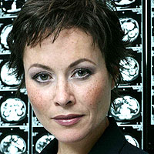
Dispelling the stereotype

Slide 4
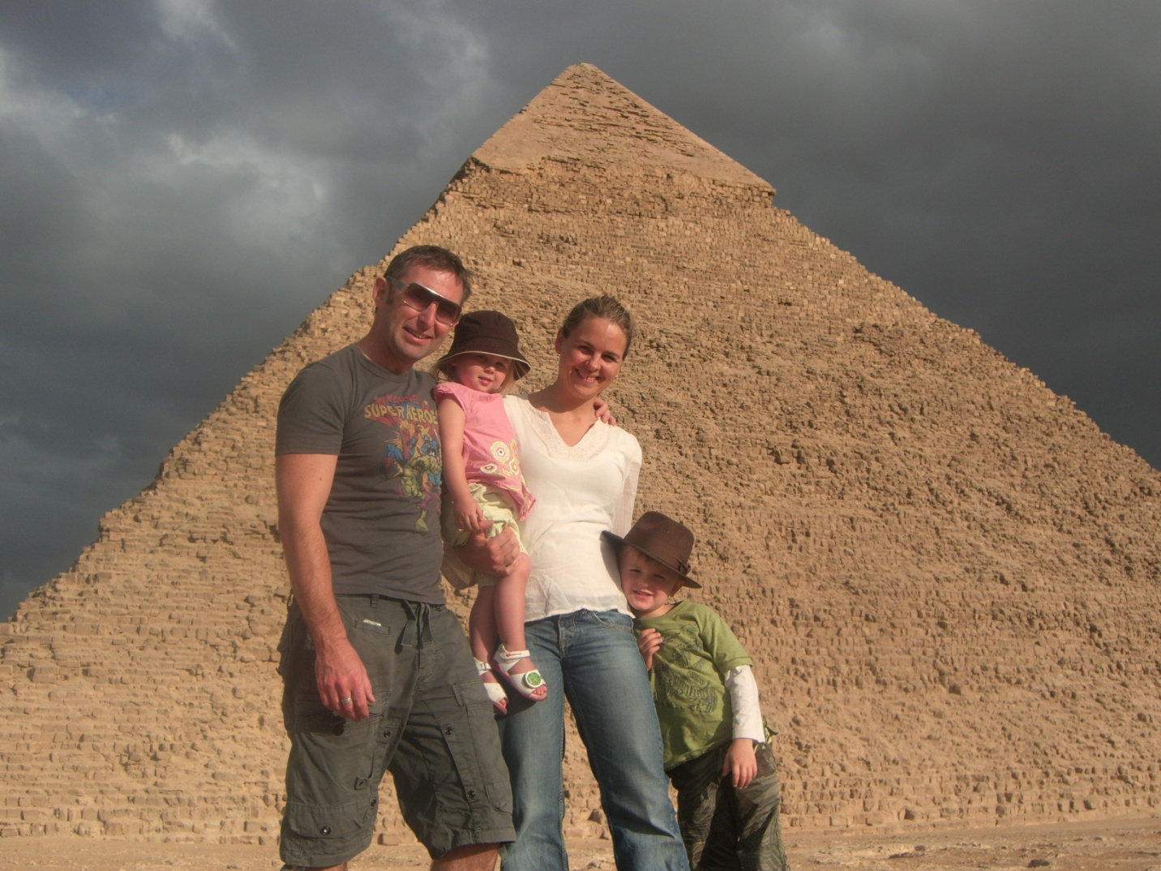
My story

Slide 5
Family planning
Exams – wait until after MRCS
Radiation – Orthopaedics, Urology, Vascular and Breast surgery
Research offers flexibility but requires self discipline
Be aware of maternity pay during research
Early SpR years good time, secure employment with options for flexible training
Whenever it happens it will all work out in the end!!!!!!

Slide 6
Flexible training
Equal access for men and women
Available at any part of training but easier to arrange as ST3 and beyond
As much or little as you want – 1 year to all of ST training
Train at 50%-90% of usual timetable incl. on call
Slot sharing, job sharing, supernumerary or reduced hours in fulltime post
DIY!!!!!!
Benefits: Flexibility, control over placement, better dedicated training opportunities,
Disadvantages: Some prejudice, longer overall training, hard work setting up
Worth it .........YES!!!!!!!!!!

Slide 7
Is surgery right for you ????
Not needed
  Hard-as-nails personality
  No desire to have family or life outside surgery
  Balls bigger than all the male surgeons combined
  Skin thicker than a rhino
Needed
  Self confidence
  Resilience
  Passion for the job
  Flexibility
  Excellent communication skills
  Ability to delegate

Slide 8
Why do it ??
Short answer
  Because I love surgery!!!!
Long answer
  Mentally and emotionally challenging and stimulating
  Combination of technical skill and patient relationship
  “Curing Cancer”
  Ongoing patient relationship in reconstruction and post op surgical oncology
  Multi-disciplinary team working
  Art of reconstruction 2D to 3D, aesthetics
  Ability to use skills to benefit patient safety
  WHO work and travel
  Ever growing opportunities to develop as a professional

Slide 9
Questions
s.olsen@imperial.ac.uk

