Slide 1
Surgery and Radiology: A multi-disciplinary approach to excellence in patient care Introduction to day and surgical component
Mikael Sodergren MRCS
Clinical Lecturer in Surgery

Slide 2
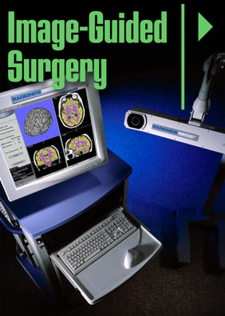
Introduction
Twinned specialty approach
A flavour of 2 very broad diverse specialties
Team working, planning and communicating
Better patient care from close partnership

Slide 3
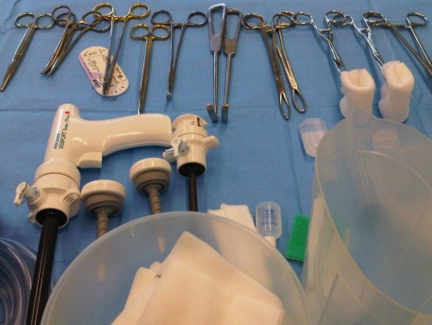
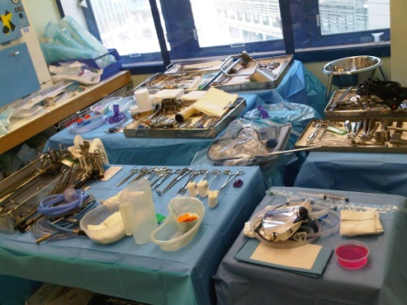
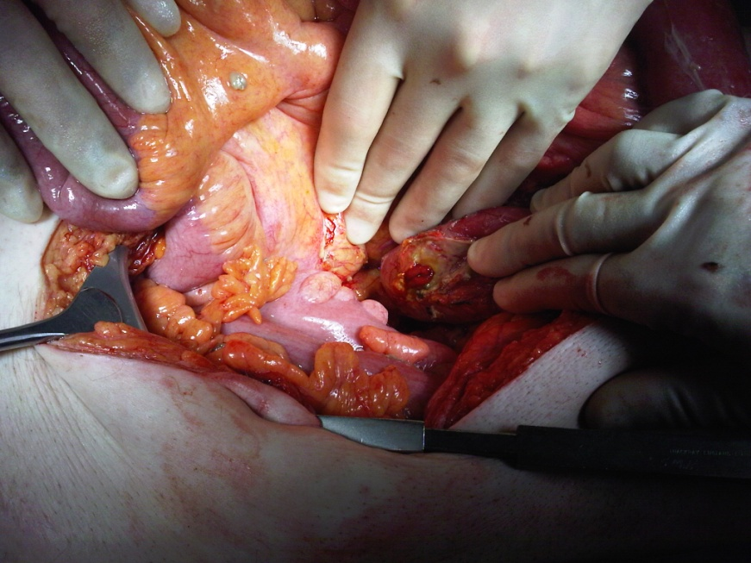
Operating
The “end effector organ” of one pathway of patient care
“Technician”
Surgeon-craftsman vs. surgeon-physician

Slide 4
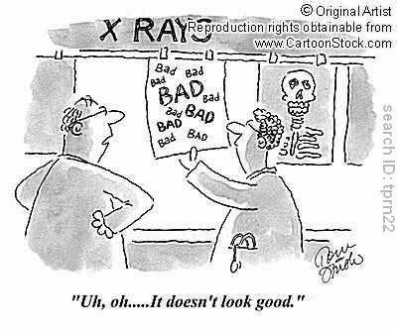
Image of surgeon / surgery
Single minded approach
Arrogant / vain
Callous
Uncaring
Stupid
Fickle
Selfish
Hates other specialties
Works alone
Dysfunctional
Very little knowledge of other specialties
No time for the awake patient

Slide 5
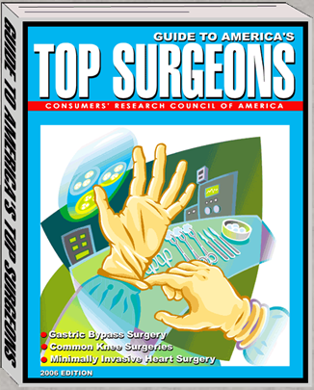
Ideally though.....
Good communicator
Decisive
Broadminded
Multifaceted
Takes time with pt
Works with colleagues
Problem solver
Medically sound
Asks for help
Technically excellent

Slide 6
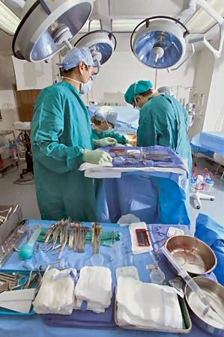
Operating: surgical decision making
When NOT to operate
When TO operate
When to get another opinion
When to ask for help

Slide 7
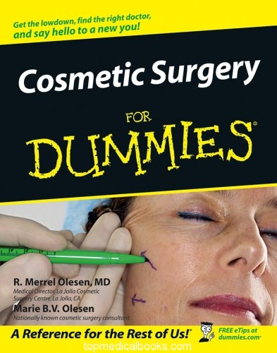
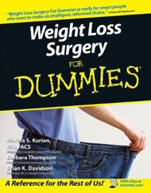
Learning surgery
Know your medicine!
Basic sciences
Surgery
Operating / Technical skill
Complications
Communicating
Resources
Building a portfolio

Slide 8
Team working
Other surgeons, same specialty
Clinical firm
Other surgeons different specialty
Radiologists
Oncologists
Anaesthetists
ICU
Other medical specialties
Students
Ward nurse
Ward manager
Specialist nurse
Dietician
Physiotherapist
OT
Discharge planner
Waiting list
Secretaries
Bed manager
Pharmacist
Surgeon
PATIENT & RELATIVES

Slide 9
Today....
Symptom based approach
Elective vs. acute presentation
Cases – show you imaging + surgery
Team work
Communication
Patient experience
Get a flavour of surgery & radiology
Questions

Slide 10
0930: Introduction to day & introduction to surgical component (MS)
0945: Introduction to radiology component (EK)
0955: Elective general surgery case (MS&EK)
1030: Elective vascular surgery (CR&EK)
1105: Coffee break
1135: Urology case with patient (DC,EM&EK)
1210: Emergency general surgery case (MS&EK)
1245: Lunch break
1345: Emergency vascular surgery (CR&EK)
1420: Career path in radiology (EK)
1440: Career path in surgery (MS)
1500: Coffee break
1515: Women in surgery – beyond the stereotype and making reality work(SO)
1525: Spot diagnosis test (EK)
1545: Summary of day and questions (MS)

Slide 11
Introduction to Radiology Component
Dr E Kashef
Consultant Interventional Radiologist

Slide 12
Elective general surgery case – Ms Unlucky
Mr M Sodergren – Clinical Lecturer in Surgery
Dr E Kashef – Consultant Interventional Radiologist

Slide 13
Turn ON your handset - slide the Power Switch up (I = ON)
Wait 4 seconds till GTCO CalComp disappears. It will start scanning.
Join the class by pressing the letter <C> and
then the green arrow
4. Press the * key and WAIT. It should say “ANS”
course title

Slide 14
Ms Unlucky
45 year old female
Upper abdominal pain intermittently for 1 yr especially after eating Mars bars
Now severe upper abdominal pain 2/7 associated with vomiting
Overweight but otherwise fit and well
O/E
Temp 37.8 HR100 BP110/65
Tender and guarding in epigastrium
No J/ Cl / Ly / An / Cy
CVS, RS, CNS, PNS – NAD

Slide 15
Ms Unlucky
Urine - nad
WCC 20, neutrophila
Hb 14
Plts 230
MCV 80
INR & APTR Normal
LFTs normal apart from bilirubin of 35
CRP 150
Amylase 2150
ECG – sinus tachy 100
CXR erect – no free air
AXR – nil diagnostic
Differential diagnosis and further investigations.....

Slide 16
Most likely diagnosis?
Appendicitis
Biliary colic
Cholecystitis
Perforated duodenal ulcer
Pancreatitis
Gastritis

Slide 17
Next investigation?
CT abdo/pelvis
USS abdomen
MRCP
HIDA scan
ERCP

Slide 18
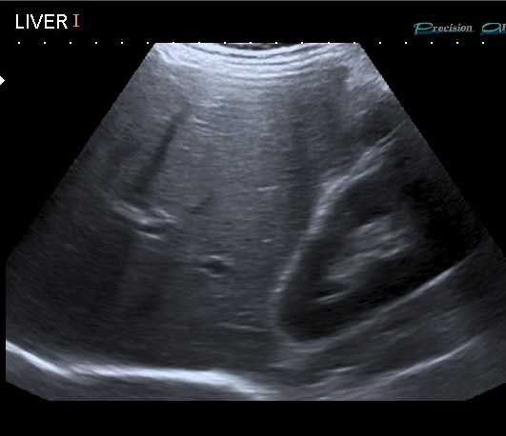
USS
D

Slide 19
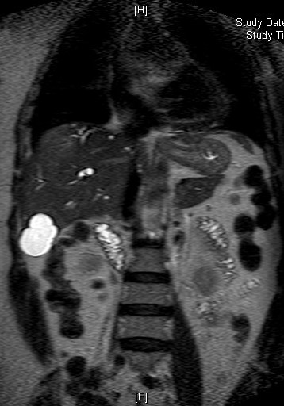
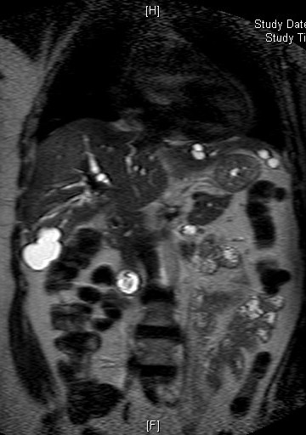
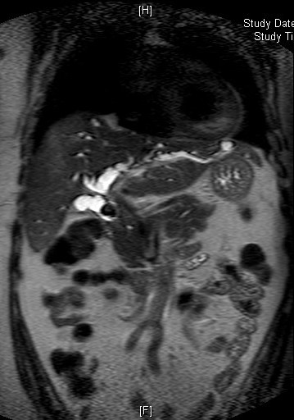
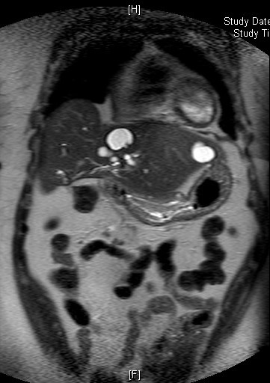
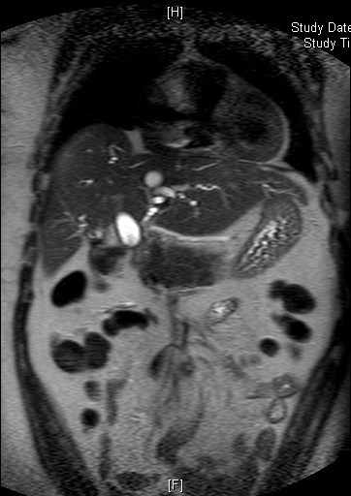
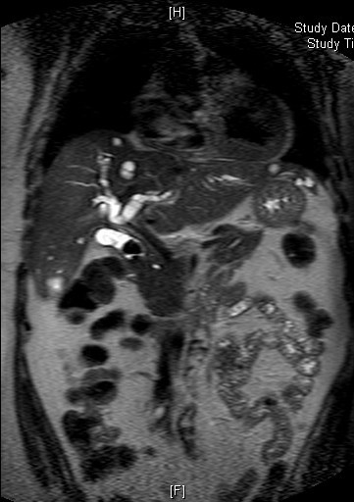
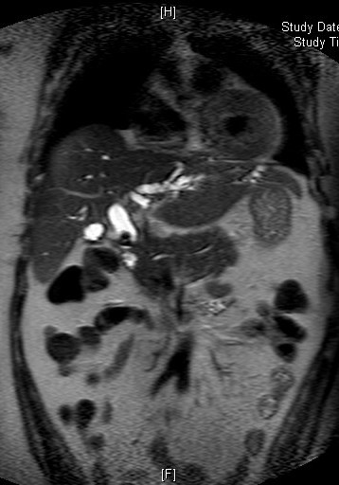
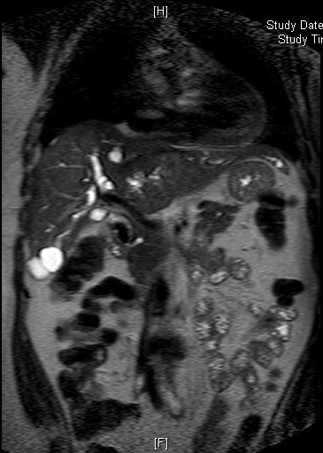
MRCP
D

Slide 20
MRCP
Dilated intrahepatic ducts
Dilated Common Bile Duct with impacted calculi
Caculi in gallbladder
Simple cysts in Liver

Slide 21
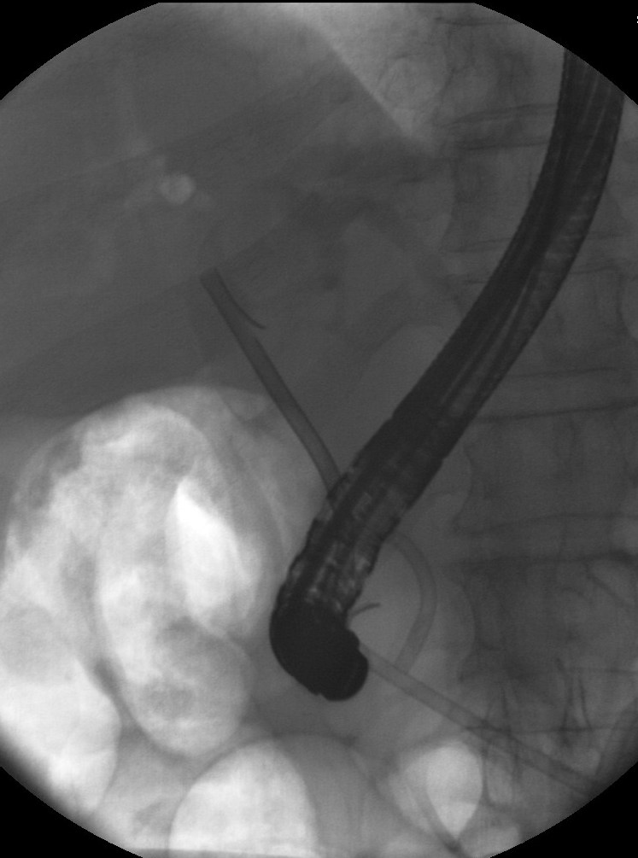
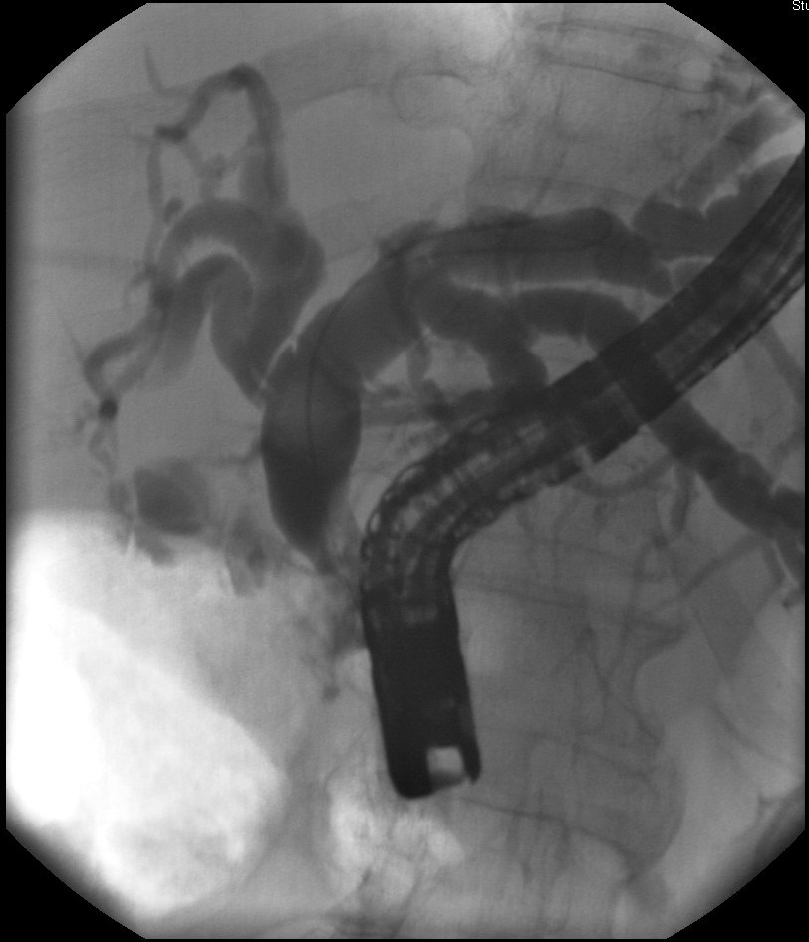
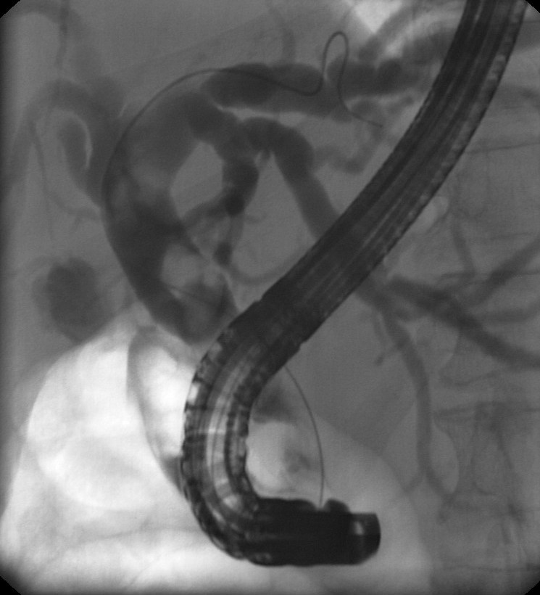
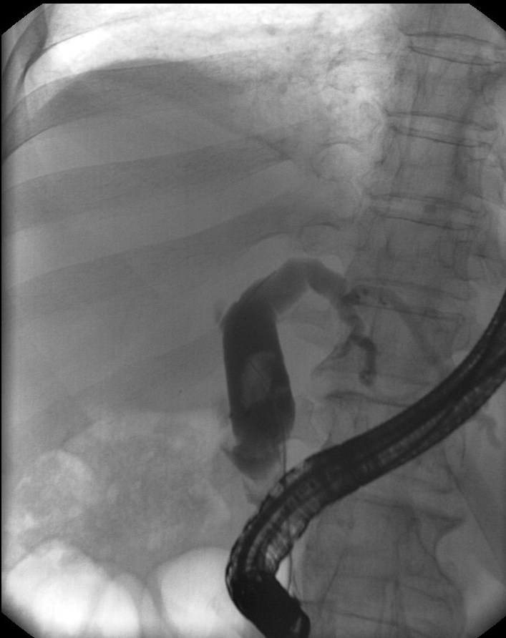
ERCP
D

Slide 22
Ms Unlucky - Day 2 in-patient admission
In pain. On HDU.
Urine output 10mls/hr despite +ve fluid balance of 3L daily
p02 of 8.3 on Fi02 0.35
HR110 BP110/65
Modified Glasgow score of 3 (LDH, WCC, p02)
Next investigation….

Slide 23
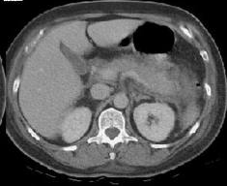
CT
D

Slide 24
Ms Unlucky - Day 7 in-patient admission
Clinically much improved
Good urine output
All vital signs normal
No supplementary oxygen
Painfree
All blood tests normalised
Discharged home with urgent elective lap chole set for 2/52

Slide 25
Ms Unlucky – Readmitted 10/7 following discharge
Severe RUQ pain 3/7
Colicky
Sweats and rigors
O/E
Temp 37.9 HR115 BP100/60
Abdomen soft, tender and guarding RUQ
Murphy’s sign +ve
Bloods
WCC18
Bili 40, ALP350, AST100, Amylase75
CRP95

Slide 26
Most likely diagnosis?
Biliary colic
Cholecystitis
Pancreatitis
Perforated duodenal ulcer
Hepatitis
Gastritis

Slide 27
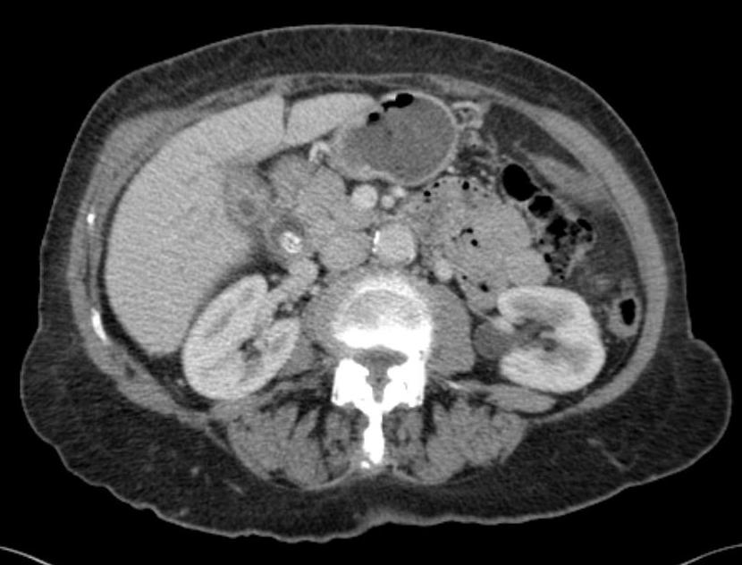
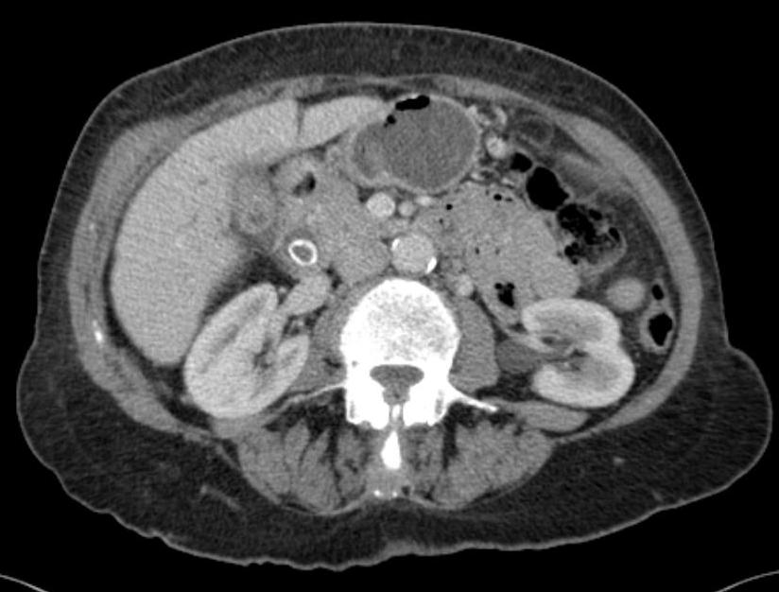
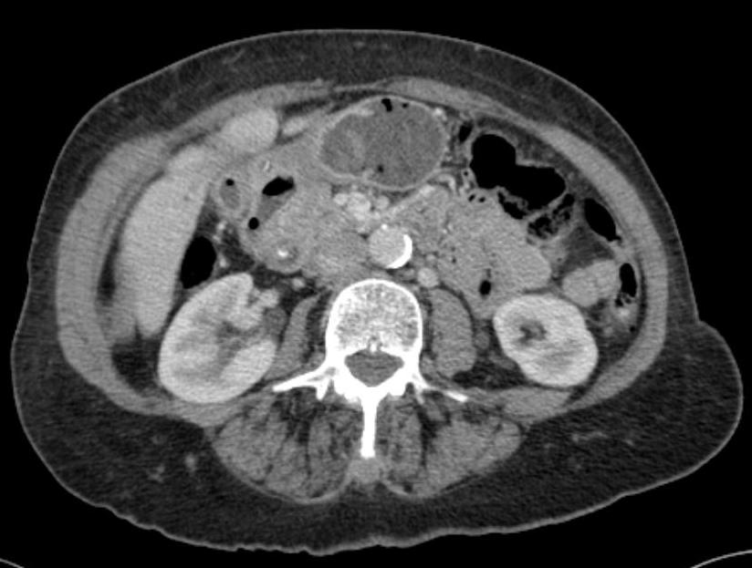
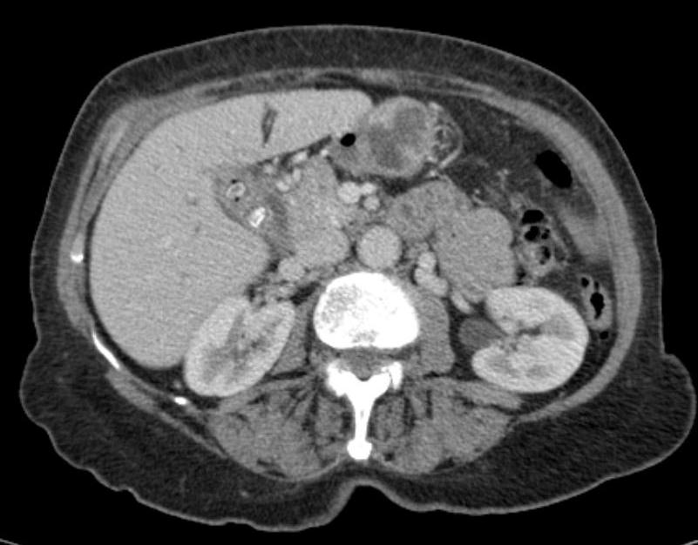
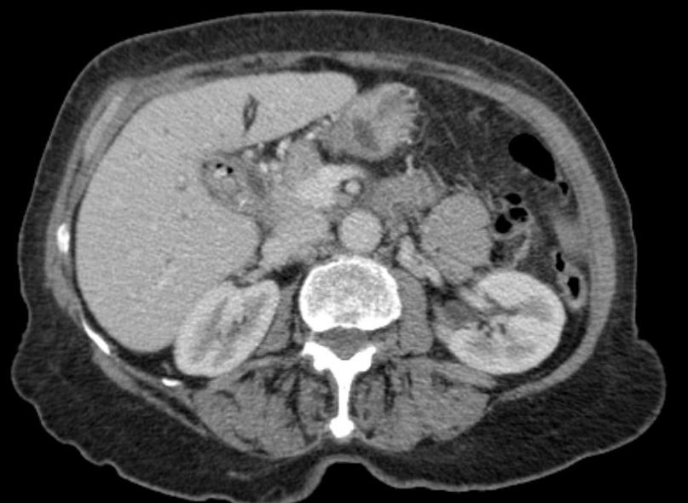
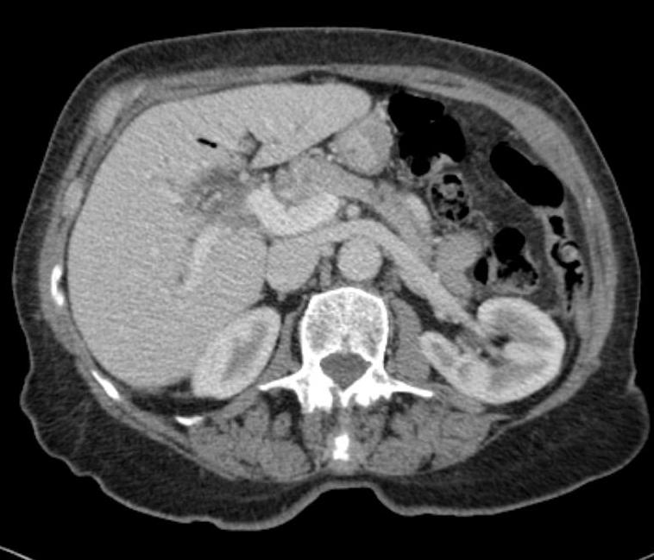
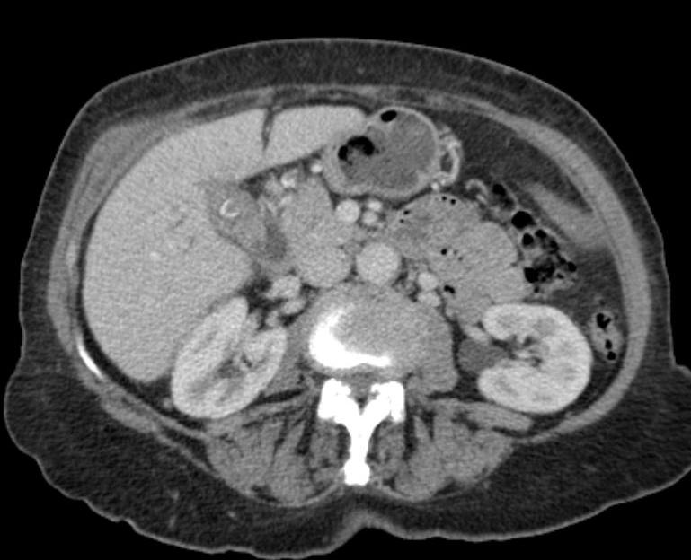
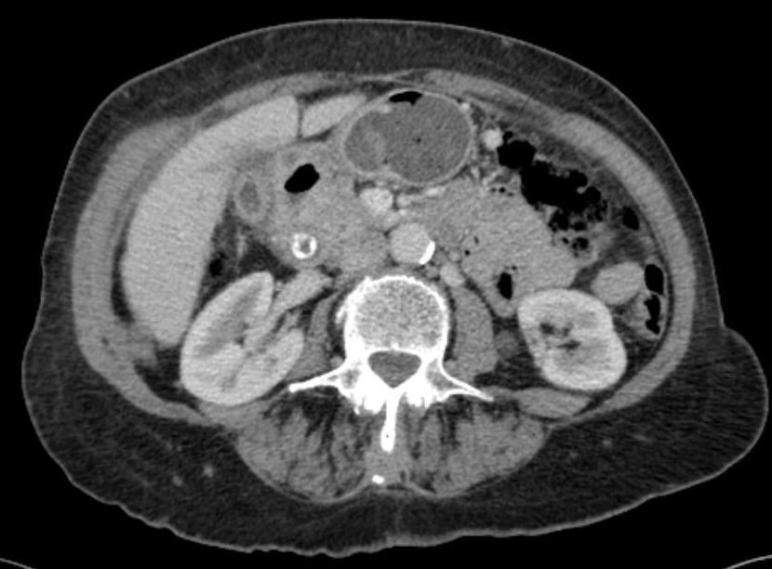
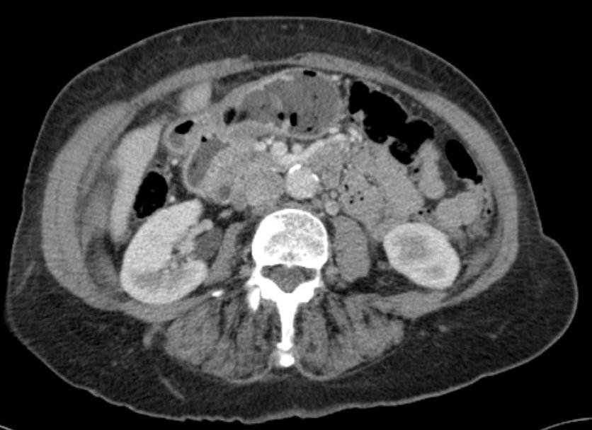
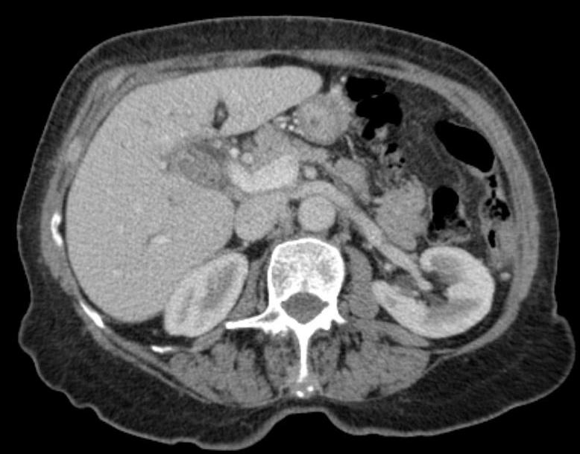
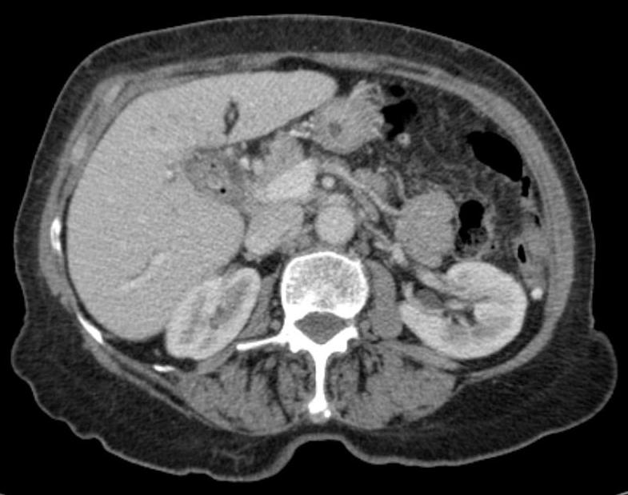
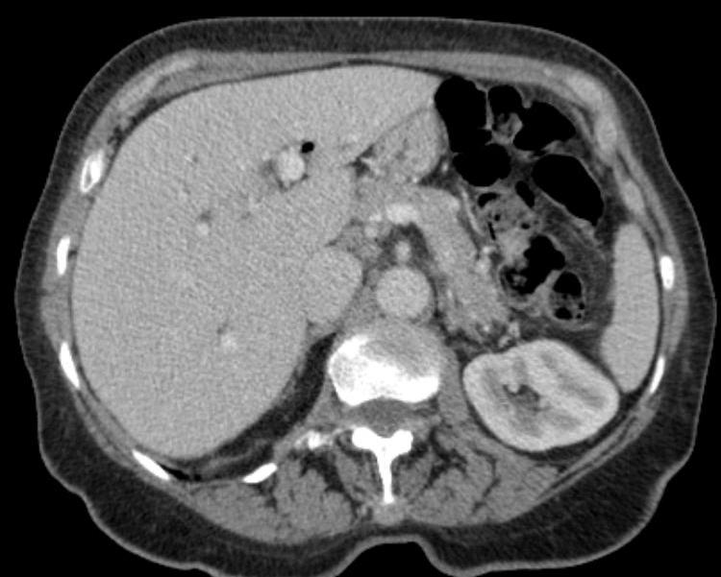
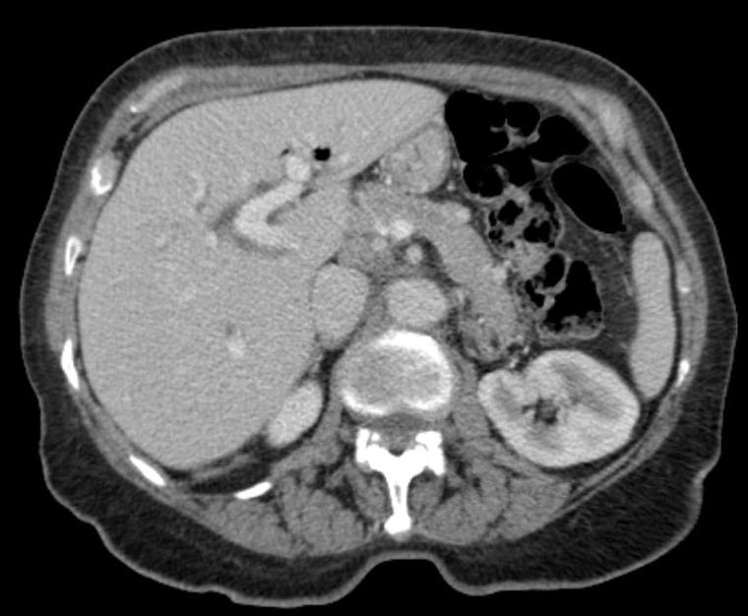
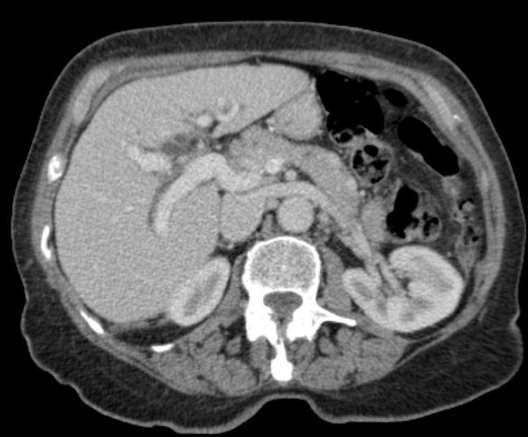
CT
D

Slide 28
CT Findings
Inflamed gallbladder wall
Pericholecystic fluid
Multiple calculi in gallbladder
Dilated intrahepatic and common bile duct
Free air in bile ducts due to previous interventions

Slide 29
Ms Unlucky
Management
Admit – bed – nursing instructions
Paperwork – nursing, drug chart, clerking, property
Analgesia and antipyretics
Blood cultures
Oral intake?? NBM-sips-clear fluids-free fluids-sloppy diet-light diet-normal diet
Antiemetics
iv access and fluids and fluid balance chart
Abx
DVT prophylaxis
Communicate the above to pt (and relatives) and nurses and admitting team
Surgery??

Slide 30
Ms Unlucky – day 4 readmission
Decision not to do acute lap chole because of duration of symptoms
Treated conservatively with fluid resuscitation and IV antibiotics
Pain improving
Inflammatory markers coming down, CRP now 10
No further fevers or tachycardia for 24 hrs
Discharge with lap chole set for 2/52

Slide 31
Ms Unlucky admit for surgery
Lap chole
Try to manage as many cases as DSU
Admit in the morning
? Home evening

Slide 32
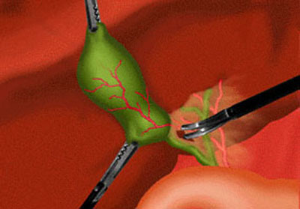
Lap chole

Slide 33
Which are the two structures that need to be identified and divided during laparoscopic cholecystectomy?
Cystic duct and hepatic artery
Cystic duct and cystic artery
Common bile duct and cystic artery
Common bile duct and left hepatic artery

Slide 35
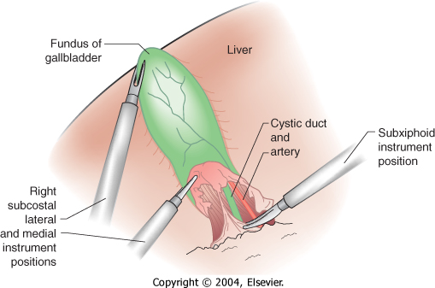

Slide 36
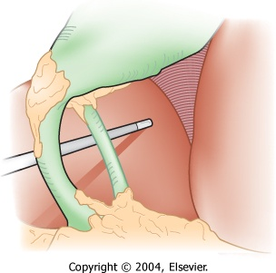
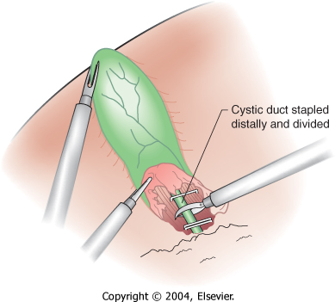
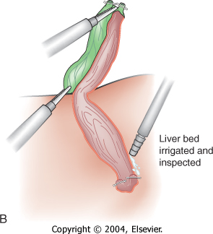
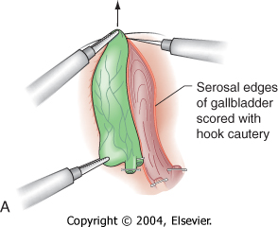

Slide 37
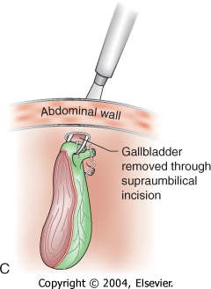
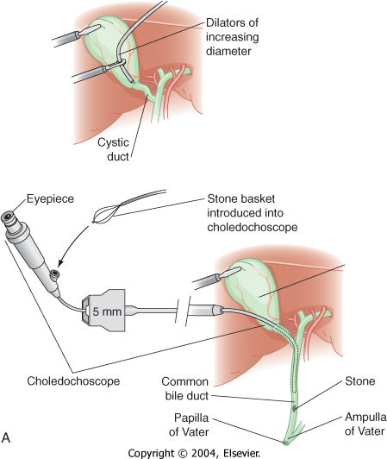
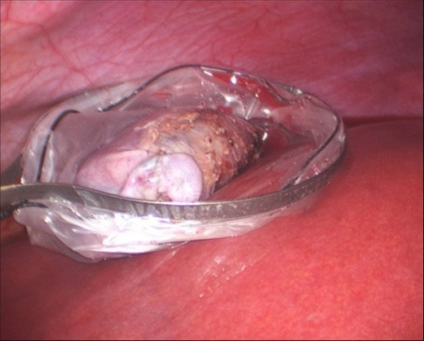

Slide 38
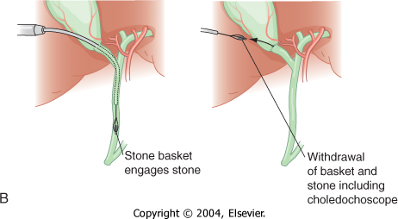

Slide 39
Video of lap chole

Slide 40
Ms Unlucky post-op
Well
No pain
Drain removed by nurse 12 hours later, prior to discharge
? Drain snapped
Phone call Sat am
? Where is drain tip

Slide 41
Post op complication
Patient
“Definitely snapped”
Nurse
“I think its snapped”
Where is the rest of the drain?
In the sluice?
Somebody threw it away!!

Slide 42
Help with confirming diagnosis and position of drain
Plain XR
? In Abdo wall or in abdo cavity?

Slide 43
CT scan
D

Slide 44
Re-operation
Re-laparoscoped sat pm
Drain removed
Pt home Sun am
Extended stay

Slide 45
Complication resulted in....
Patient
Anxiety / distress
Extra radiation
Another anaesthetic
Another operation
Increased length of stay
Increased need for meds / analgesia
Increased risks
Hospital
LOS
Cost
Slots in radiology
Slots in theatre
Critical incident reporting / investigation
Reputation

Slide 46
Ms Unlucky
Biliary colic
Obstructive jaundice
Pancreatitis
Cholecystitis
Laparoscopic cholecystectomy
Iatrogenic foreign body

Slide 47
Questions?

Slide 48
Elective Vascular Surgery
Miss Celia Riga – Clinical Lecturer in Vascular Surgery
Dr Elika Kashef – Consultant Interventional Radiologist

Slide 49
COFFEE BREK

Slide 50
Urology patient case presentation
Mr Erik Mayer – Clinical Lecturer in Urology
Mr Daniel Cohen – Specialist Research Registrar in Urology
Dr Elika Kashef – Consultant Interventional Radiologist

Slide 51
A 30 year old presents to you in clinic with a painless scrotal lump, palpable on the testis. It feels hard.
You decide to perform some imaging – what would you suggest initially?
Ultrasound scan of scrotum
MRI abdomen/pelvis
CT chest/abdomen/pelvis
A plain x ray of the pelvis

Slide 52
The scan comes back highly suspicious of a testicular tumour What’s the next step?
A CT of the Chest/Abdomen/Pelvis
An MRI scan of the Abdomen and Pelvis
Testicular Biopsy
Scrotal Exploration
Orchidectomy

Slide 53
So, the patient has an orchidectomy. What’s next?
A CT scan of the chest/abdomen/pelvis
An MRI scan of the abdomen and pelvis
Chemotherapy
Radiotherapy

Slide 54
Which tumour markers might be raised in testicular cancer?
AFP, B-HCG, LDH
Ca 19-9, Ca 125
CEA, B-HCG
Ca 125, AFP
None of the above

Slide 55
Which of these people are not involved in the care of this patient?
The Urologist
The Radiologist
The Histopathologist
The Oncologist
The GP
They all are

Slide 56
Testicular Cancer
Mr Daniel Cohen – Research SpR in Urology
Mr Erik Mayer – Clincial Lecturer in Urology
Dr Elika Kashef – Consultant Radiologist

Slide 57
Incidence and Mortality
Affects 6 in 100,000 men
Most common solid cancer in men 20-45
Rare below 15 and above 60
1990 new cases pa, 17 deaths (2004 figure)

Slide 58
Epidemiology and Aetiology
Teratomas 20-35y
Seminomas 35-45y
RARE - Yolk sac tumour below 10y
>60y – high chance lymphoma (>50%)
Undescended testes have 3-14x ↑ risk of TC.
Early orchidopexy does not eliminate risk completely.
5-10% contralateral testes will develop TC.
HIV
White:Black 3:1
Intratubular Germ Cell Neoplasia (50%→TC 5 yrs)

Slide 59
WHO classification
90% Germ cell tumours
Seminoma (48%)
Non Seminomatous GCT (42%)
Teratoma
Yolk sac tumour
Choriocarcinoma
Mixed Germ Cell Tumour (10%)
10% other tumours
Lymphoma (5%)
Stromal tumour (3%)
Metastatic, Carcinoid

Slide 60
Testicular Cancer Spread
Local extension
Epididymis
Spermatic Cord
Scrotal wall
Lymphatic spread
Para-aortic nodes
Blood Bourne
Lungs, liver, bones
Inguinal / Pelvic node involvement (but less common than Para-aortic)

Slide 61
Symptoms
Hard, painless lump
5% scrotal pain – intra-tumoural haemorrhage
Metastatic - wt loss, bone pain neck lumps
Differential Diagnosis
Any cause of scrotal lump/pain
Investigations
USS scrotum
Staging CT of chest abdomen pelvis
Tumour markers

Slide 62
Tumour Markers
AFP - raised in 50-70% of NSGCT
- normal <10ng/mL
hCG - raised in 40% teratoma
100% choriocarcinoma
10% seminoma
- normal <5mIU/mL
LDH - elevated in 20% seminomas
Useful in diagnosis and monitoring

Slide 63
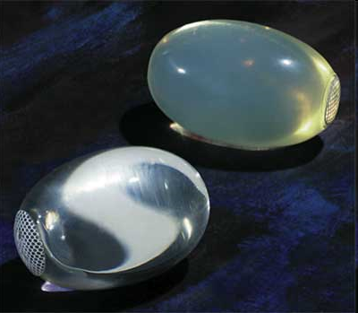
Management 1
Radical inguinal orchidectomy
A testicular prosthesis may be inserted

Slide 64
Management 2
Then, dependant on tumour type…
NSGCT
Non-metastatic
Surveillance/Adjuvant Chemotherapy
Metastatic
Chemotherapy +/- Retroperitoneal LN Dissection (RPLND)
Seminoma/IGCN/Lymphoma
Non-metastatic
Surveillance / Radiotherapy / Chemotherapy
Metastatic
Radiotherapy +/- Chemo if N1-2
Chemo +/- consider RPLND if N3 or M1+

Slide 65
Prognosis
Seminoma
73-86% 5 year survival
NSGCT
48-92% 5 year survival

Slide 66
True or False ???
A cancerous testicle should be removed through a scrotal incision

Slide 67
True or False ???
2. Testicular cancer most commonly presents with blood in the semen

Slide 68
True or False ???
3. Lymphatic drainage of the testes is via the inguinal lymph nodes

Slide 69
True or False ???
4. Self examination is the best way of picking up testicular cancer in the general population

Slide 70
True or False ???
5. Teratomas may contain hair or cartilage

Slide 71
True or False ???
6. Chemotherapy or Radiotherapy is given to all men before surgery

Slide 72
Emergency general surgery case - Mr Unlucky
Mr M Sodergren – Clinical Lecturer in Surgery
Dr E Kashef – Consultant Interventional Radiologist

Slide 73
Mr Unlucky
45 year old male carpenter
1 yr history of intermittent upper abdominal pain
“My stomach is always worse if I am hung over doc”
Presents to A&E with worsening abdo pain for 3 hours and one vomit of gastric contents
PMHx – lower back pain. SHx - smoker
DHx – ibuprofen PRN for past 2 yrs
O/E Afebrile HR75 BP130/75
Abdomen soft, tender in epigastrium
No J/ Cl / Ly / An / Cy
CVS, RS, CNS, PNS – NAD

Slide 74
Mr Unlucky
Urine - nad
WCC 13.4
Hb 15.1
Plts 250
INR & APTR Normal
LFTs normal
CRP 15
Amylase 71
ECG – sinus rhythm
Start formulating a differential diagnosis…

Slide 75
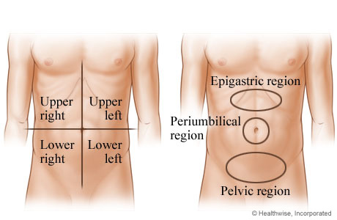
Causes of upper abdo pain?
Surgical
Non surgical
PUD / GORD
Pancreatitis
Biliary pathology
Abdominal wall
Vascular
Small bowel
Large Bowel
Cardiac
Gastro
Muscoloskeletal
Diabetes
Dermatological

Slide 76
Next investigation?
CXR & AXR
USS
CT
MRI
Laparoscopy
Laparotomy

Slide 77
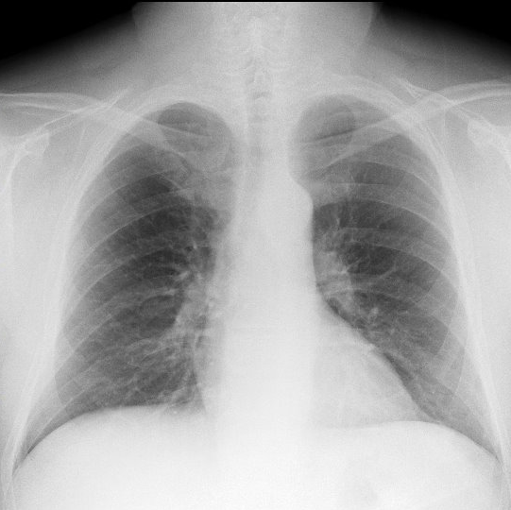
CXR & AXR
D

Slide 78
Mr Unlucky
Patient reports improvement in pain with paracetamol and IVF
Wants to go home to watch the football
Diagnosed with gastritis
Discharged home with no follow-up

Slide 79
Mr Unlucky
Represents 2 days later
Been taking double dose ibuprofen since the pain has not got better
Worsening epigastric pain
Associated with vomiting
Now constant
O/E Looks unwell, sweating
Temp 37.9 HR110 BP 100/60
Abdomen rigid with four quadrant tenderness

Slide 80
Mr Unlucky
Urine - nad
WCC 16.4
Hb 15.1
Plts 250
INR & APTR Normal
LFTs normal
CRP 180
Amylase 105
ECG – sinus tachycardia
AXR & CXR requested

Slide 81
AXR

Slide 82
CXR

Slide 83
Diagnosis?
Gastritis
Pancreatitis
Pneumonia
Small bowel obstruction
Large bowel obstruction
Perforated viscus

Slide 84
AXR
Free intraperotineal air
Rigler’s sign
D

Slide 85
CXR
Free subdiaphragmatic gas
D

Slide 86
Mr Unlucky
Diagnosis – perforated viscus
Responds well to IVF and Abx
HR 85 BP120/75 Afebrile
Abdomen still rigid with maximal tenderness in epigastrium
Likely diagnosis…

Slide 87
Likely perforated organ
Duodenum
Stomach
Sigmoid diverticular disease
Appendix
Small bowel
Colon from colitis

Slide 88
D

Slide 89
CT
Free gas
Falciform ligament
Upper abdomen
Fluid
Thickened D1

Slide 90
Basic operative principles regarding acute peritonitis
identification of the aetiology of the peritonitis
eradication of the peritoneal source of contamination
peritoneal lavage and drainage
Treatment for perforated ulcer ranges from conservative treatment (Taylor's approach) to radical surgery (vagotomy, gastrectomy).
Types of peritonitis
primary peritonitis (bacterial origin, but no visceral perforation): eg, spontaneous, tuberculosis, peritoneal dialysis catheterization
secondary peritonitis (bacterial origin with visceral perforation): eg, perforated ulcer, perforated appendicitis,
tertiary peritonitis (either fungal or without known pathogens)

Slide 91
About duodenal ulcer disease
The site of the perforation is:
most commonly on the anterior or superior surface of the first part of the duodenum or the pylorus (more rarely on the pre-pyloric antrum);
less frequently found in the stomach (lesser curvature, fundus);
rarely found on the posterior surface of the first part of the duodenum or the stomach.
Duodenal perforation is generally 8 to 10 times more frequent than gastric perforation.
Acute ulcers occur in patients with no history of ulceration in 25% to 30% of cases. They have the shape of a small ring, 5 to 10 mm in diameter, with slightly indurated edges at the level of the anterior or superior surface of the duodenal cap.

Slide 92
Operative treatment – laparoscopic

Slide 94
Post-operatively
Stable and normal observations for first 48 hrs
Day 3 post-op
Patient complains of SOB
O₂ sats drop from 99% to 87% on 2L nasal specs
Spike of temperature to 38.5
Sinus tachycardia 100 (no ECG changes)
Bibasal creps on auscultation R>L
pO₂ 8.2 on FiO₂ of 0.35

Slide 95
Differential diagnosis..
Pulmonary oedema
Pneumonia
Pulmonary embolism
Leak/collection

Slide 96
CXR

Slide 97
Diagnosis ?
Pulmonary oedema
Pneumonia
Pulmonary embolism
Leak/collection

Slide 98
CXR
D

Slide 99
Mr Unlucky
Clinically improves with IV antibiotics and is discharged home on post-operative day 6
Represents 2 days later with abdominal pain and vomiting
Febrile 38, HR110 BP100/60 Sats 98% RA
Abdomen soft but tender and guarding in epigastrium
Hb 14.1, WCC 18, CRP 209, LFTs and U&Es normal
ECG sinus tachy
CXR and AXR unremarkable

Slide 100
CT guided drainage of subhepatic collection
D

Slide 101
Mr Unlucky
Gradually improved with drainage and IV antibiotics
Observations normalise
Feels better with no further vomiting
Discharged 5 days post re-admission

Slide 102
Questions?

Slide 103
LUNCH BREAK

Slide 104
Emergency Vascular Surgery
Miss Celia Riga – Clinical Lecturer in Vascular Surgery
Dr Elika Kashef – Consultant Interventional Radiologist

Slide 105
Career Path in Radiology
Dr Elika Kashef
Consultant Interventional Radiologist

Slide 106
Radiology
Diagnostic
CT, US, MRI, Fluoroscopy. Xrays
Interventional
Recognised subspeciality
Vascular
Venous
Non vascular
Biliary
Urological/renal
Other: Abscess etc

Slide 107
Radiology
Medical school
FY1/FY2
Radiology :ST 1-5
5th year
“are of interest”
Subspeciality fellowship
6th year
Fellowship : pre CCT/Post CCT
Extend CCT

Slide 108
Diagnostic Radiology
Chest
HRCT, CTPA, lung/pleural biopsy
Cardiac
Cardiac MRI, Aorta MR, Cardiac CT
Gastrointestinal
Fluoro studies, Small bowel MR , rectal MR
Genitourinary
Tran-rectal US/Biopsy, Prostate MR, MRA renals
MSK- MRI, US, Xray
Paediatric
Xray, CT, MR, Fluoro

Slide 109
Interventional Radiology
Arterial
EVAR/fEVAR/ TEVAR
Ruptures
Elective
Peripheral angiogram/angioplasty/Stent
Acute ischaemic limb→ thrombolysis

Slide 110
Interventional Radiology
Venous
Venogram/Venoplasty
IVC filter insertion, removal
Central Lines
Hickman/Tessio/Groshong
Transjugular biopsy
Arterio/venous malformations

Slide 111
Interventional Radiology
Non vascular
Percutaneous Transhepatic cholangiostomy
Transjugular intrahepatic porto-shunt
Nephrostomy
Ureteric /biliary stent
Drain insertion
Ascitic/ abscess
Oesophageal/ Rectal/Colonic stent

Slide 112
Exams - FRCR
Part 1
Physics/anatomy/techniques
Part 2A
GI
GU/Obs& Gyn
MSK
Chest/CVS/IR
Paeds
Neuro
Par 2B
Vivae
30 min rapid reporting
Long case

Slide 113
More information
http://www.londondeanery.ac.uk/specialty-schools/clinical-radiology
www.rcr.ac.uk
www.BSIR.org
www.cirse.org
Email:
Elika.kashef@imperial.nhs.uk

Slide 114
Career Path in Surgery
Mikael Sodergren MRCS
Clinical Lecturer in Surgery

Slide 115
Job description
“Surgeons are a specialized type of physician who helps heal people through operations.”
Technical skill + broad knowledge base + determination
Surgery is one of the most satisfying careers in medicine offering the opportunity to save and transform lives.
Surgeons are at the forefront of discovering new ways to fight disease and heal injury.
It is a unique career in that surgeons need to on rely on quick brains and skilful hands to succeed.

Slide 116
Is it for me?
+
-
Rewarding career
High level of job security
Comfortable income
Constantly learn new skills
Develop throughout career
Lengthy training
Commitment
(High pressure working environment)
(Competitive )

Slide 117
Career path 1

Slide 118
Career path 2

Slide 119
Surgery School

Slide 120
Portfolio
Expanded and extended CV
Necessary for all career routes in surgery
Organise in binder, with contents page and index tabs
Types of evidence included in your portfolio might include:
logbook of clinical activity
trainers’ reports
audits
written workplace assessments
list of competencies signed by supervising consultant
assessments such as DOPS and mini-CEX (www.iscp.ac.uk)
For example foundation portfolio www.mmc.nhs.uk

Slide 121
What should I do now?
As a medical student there are several things you can do to improve your chances of entering a surgical career and gain a number of transferrable skills in the meantime!
Key to success is a well developed portfolio demonstrating your commitment to surgery
Get involved in medical school surgical society or if there is not one that suits you – set one up!
Elective – gain experience in a surgical setting
Centre of excellence or developing world
Careers afternoon @ RCS – March 2011

Slide 122
Gain experience and improve your portfolio
attend courses
attend conferences, seminars, etc
make presentations at conferences, seminars, etc
join or organise a journal club
join and participate in relevant associations
undertake self-directed learning
teach and/or demonstrate (anatomy demonstration posts are
particularly useful)
research
write letters, articles, reports, etc for publication
audit projects
work in alternative environments, eg electives at medical school
join and participate in your medical school surgical society
choose surgically-focused options at medical school

Slide 123
What kind of surgeon do I want to be?
There are nine recognised specialties within surgery, each of which will provide you with different challenges and rewards throughout your career:
cardiothoracic surgery
general surgery
neurosurgery
oral and maxillofacial surgery
otolaryngology (ENT)
paediatric surgery
plastic surgery
trauma and orthopaedic surgery
urology
academic surgery
What to consider?
the type of work involved,
working conditions (on call, emergency work, clinics, administration, etc),
working options and
how competitive the specialty is

Slide 124
Exams
BSc
MBBS
MRCS
MD / PhD
FRCS
Superspecialisation exams
USMLEs / other system exams

Slide 125
Courses
MRCS
ATLS
CCrISP
BSS
HSS
BLS
ALS
Management courses
Teaching courses

Slide 126
Time course
Qualify 2014
Foundation years
CT 2016
ST 2018
Research 2-3yrs 2021
ST training 3-4 years 2025
Consultant

Slide 127
Academic Surgery
Audit
Research
BSc
MD/PhD
Publications
Presentations
Education
Grants

Slide 128
Most importantly…
If you are genuinely interested in a career in surgery -go for it!
Technical skill + broad knowledge base + determination

Slide 129
Questions?

Slide 130
COFFEE BREAK

Slide 131
Women in surgery – Beyond the stereotype and making reality work
Ms Sisse Olsen MBBS MRCS PhD

Slide 132
A guide to keeping all the balls in the air
The Future of Women in Surgery – beyond the stereotype
My story
Family planning
Access to flexible training
Person specification
Why do it?

Slide 133
Dispelling the stereotype

Slide 134
My story

Slide 135
Family planning
Exams – wait until after MRCS
Radiation – Orthopaedics, Urology, Vascular and Breast surgery
Research offers flexibility but requires self discipline
Be aware of maternity pay during research
Early SpR years good time, secure employment with options for flexible training
Whenever it happens it will all work out in the end!!!!!!

Slide 136
Flexible training
Equal access for men and women
Available at any part of training but easier to arrange as ST3 and beyond
As much or little as you want – 1 year to all of ST training
Train at 50%-90% of usual timetable incl. on call
Slot sharing, job sharing, supernumerary or reduced hours in fulltime post
DIY!!!!!!
Benefits: Flexibility, control over placement, better dedicated training opportunities,
Disadvantages: Some prejudice, longer overall training, hard work setting up
Worth it .........YES!!!!!!!!!!

Slide 137
Is surgery right for you ????
Not needed
Hard-as-nails personality
No desire to have family or life outside surgery
Balls bigger than all the male surgeons combined
Skin thicker than a rhino
Needed
Self confidence
Resilience
Passion for the job
Flexibility
Excellent communication skills
Ability to delegate

Slide 138
Why do it ??
Short answer
Because I love surgery!!!!
Long answer
Mentally and emotionally challenging and stimulating
Combination of technical skill and patient relationship
“Curing Cancer”
Ongoing patient relationship in reconstruction and post op surgical oncology
Multi-disciplinary team working
Art of reconstruction 2D to 3D, aesthetics
Ability to use skills to benefit patient safety
WHO work and travel
Ever growing opportunities to develop as a professional

Slide 139
Questions
s.olsen@imperial.ac.uk

Slide 140
Radiology spot diagnosis

Slide 141
Surgical Simulation Study at St.Mary’s Hospital
Simulation is becoming an increasingly important part of Training both for surgical and medical specialities.
We are looking for students to get simulator training on validated virtual reality models.
You will receive training for several sessions on Laparoscopy AND Colonoscopy until you have achieved competence on the curriculum.
All participants will get credited certificates for your CV/ portfolio. This Certificate will be useful when you apply to Jobs in the future.
Places are now limited.
If you are interested please email or have any questions. I am running sessions next week. Very flexible with times. Sign up early.
Jean Nehme
jean.nehme09@imperial.ac.uk
Or text your name and email to 07762796706

Slide 142
End of Surgery & Radiology Day Questions?

