Slide 1
Clinical PPD and leadership
Elizabeth Muir
e.muir@imperial.ac.uk
Colin Bicknell
colin.bicknell@imperial.ac.uk
Imperial College London

Slide 2
PETER PROVONOST
“[On reflection of US medical students]…I had to confront the sad reality that most of them will graduate ill-prepared to lead the improvements of quality, safety and our health care system needs. They no doubt will know chemistry, biology and physiology, but they may not know about human factors, implementation science or performance measurement – the language of quality improvement”
Imperial College London
Notes:
This is what time magazine said about him:
In science you learn that the simplest answer is often the best. That's a principle sometimes lost in a world of high-tech medicine—but not on Dr. Peter Pronovost. A critical-care researcher at Johns Hopkins University, Pronovost may have saved more lives than any laboratory scientist in the past decade by relying on a wonderfully simple tool: a checklist.
In the U.S., hospital-acquired infections affect 1 in 10 patients, killing 90,000 of them and costing as much as $11 billion each year. Pronovost, 43, began investigating this alarming trend at Johns Hopkins' hospital in 2001 and concluded that arming physicians with a chart reminding them of each step in routine procedures drastically reduces the medical errors that lead to such infections. After he published his results in several prominent journals, the medical community started listening. Michigan hospitals began implementing Pronovost's checklists in ICUs in 2003. Within three months, hospital-acquired infections at typical ICUs in the state dropped from 2.7 per 1,000 patients to zero. More than 1,500 lives were saved in the first 18 months.
Numbers like this get noticed. California and Spain top a long list of places that soon hope to replicate Michigan's results. Pronovost says the checklist protocol could be rolled out nationwide within two years for less than $3 million. With health-care costs mounting, it's nice to know that one solution requires simply returning to basics.
Read more: http://www.time.com/time/specials/2007/article/0,28804,1733748_1733754_1735344,00.html #ixzz2EksD6rS9

Slide 3
INTRODUCTION
Do you see yourself as a leader?
Why this session, why now, why leadership?
How:
Introduction to your Quality improvement project
Background: changes for the profession over recent years
The profession’s response
Your role models
What is quality
Recap and back to your ideas for projects
Imperial College London

Slide 4
Improving Management and Leadership Skills in Undergraduate Medicine Clinical Quality Improvement Assignment
Imperial College London

Slide 5
Clinical Quality Improvement Assignment
PLAN:
Project identification
Evaluation of service
Tutors - help steer your project work and smooth troubled group dynamics.
Poster design
Poster presentations
2nd Medical attachment in third year
Imperial College London

Slide 6
Clinical Quality Improvement Assignment in the Third Year
The poster format should be determined by each site, an electronic poster or a few ppt slides may be best.
The following should be addressed on each poster:
Identification of a deficiency in service quality
Evaluation of the problem
Development of an effective improvement strategy and how this may take place
Imperial College London

Slide 7
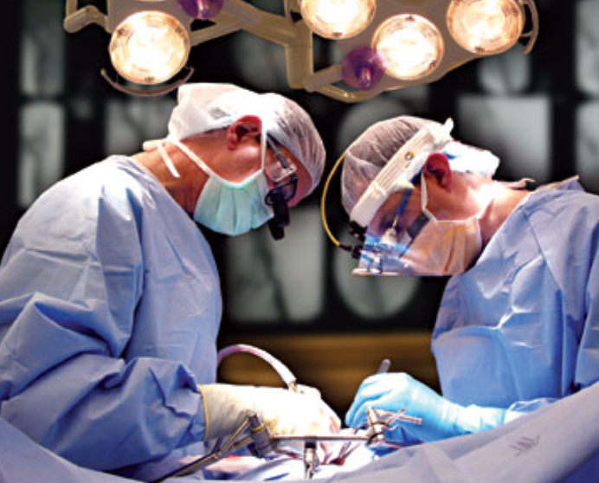
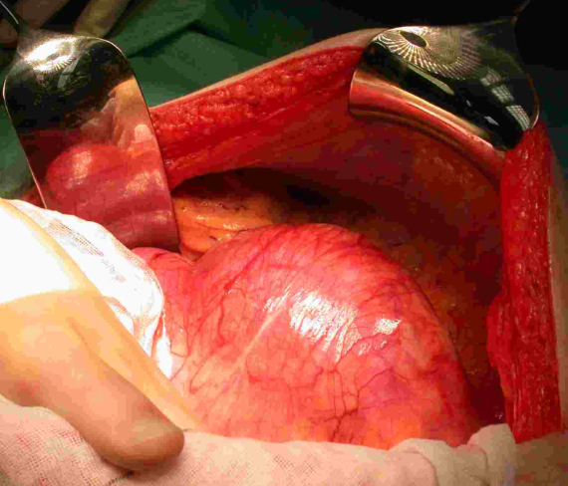
Year 3 Quality Improvement Projects
Undergraduate Leadership Teaching
Imperial College
London

Slide 8
Year 3 Quality Improvement Projects
Undergraduate Leadership Teaching
GP services
OPD
Cardiology
PCT
Service Delivery
MDT co-ordinator
Nursing
HDU
Pathology
Recovery
Radiology
Cleaning
Transport
Transport
Admin
Finance
Pathology
ITU
Admin
Porters
Nursing
Respiratory
PCT
Renal
Radiology
Porters
Nursing
Radiology
Coding
Transport
OPD
Service Delivery
Cleaning
Catering
Pathology
Industry
Transfulsion
Coding
Admin
Bed managers
Anaesthetics
Service Delivery
Transport
GP services
Imperial College
London

Slide 9
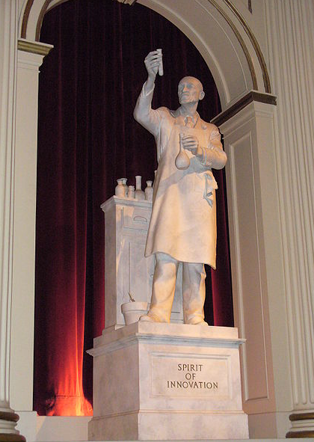
Clinical Quality Improvement Assignment in the Third Year
The posters will be assessed on the strength of a proposal to make a locally relevant, important and feasible impact on service quality.
The improvement strategies must be feasible and cost-effective, a multimillion pound redesign of the ward for example is not practical and unlikely to happen.
Imperial College London

Slide 10
Clinical Quality Improvement Assignment in the Third Year
Examples:
Patient dissatisfaction, not being involved in their care
A patient safety issue, where staff are often searching for sharps bin after taking blood
Microbiology results not being recorded and acted on effectively
Imperial College London

Slide 11
Clinical Quality Improvement Assignment in the Third Year
Who will be sources of advice?
What aspects of quality of care could you study?
Imperial College London

Slide 12
Clinical Quality Improvement Assignment in the Third Year
The work will be performed in the same clinical groups as attachments
There will be a Winners prize session at the Business School in the next year…. Date to be confirmed.
Imperial College London

Slide 14
The good old days of the NHS
Imperial College London

Slide 15
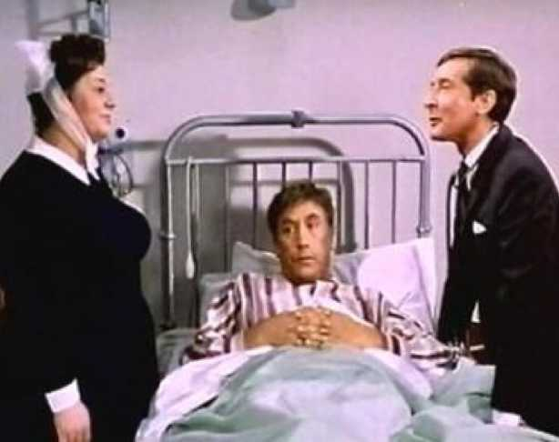
The good old days of the NHS
Imperial College London

Slide 16
What major changes have occurred that have affected the profession in last 20 years?
What you your family and patients tell you?
How do these changes affect you?
Notes:
And why does this affect you!

Slide 18
Poor Quality
Imperial College London
Notes:
Defining bad quality is easy..
A walk through time to see what sparked quality improvement - Link to Yr 2 cases that changed the profession

Slide 19
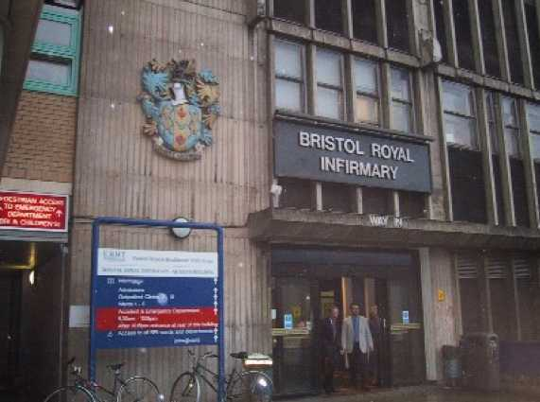
INSTITUTIONAL FAILURE
Imperial College London
Notes:
WHAT happened here?

Slide 20
Bristol Royal Infirmary
….It now appears that at least 90 babies were affected, left dead or damaged as a result of the sub-standard treatment they received at the hospital in the late 1980s and early 1990s….
Imperial College London

Slide 21
Bristol Inquiry
The story of the paediatric cardiac surgical service in Bristol is not an account of bad people. Nor is it an account of people who did not care, nor of people who wilfully harmed patients.
…It is an account of a time when there was no agreed means of assessing the quality of care. There were no standards for evaluating performance. There was confusion throughout the NHS as to who was responsible for monitoring the quality of care….
The aim of these and all our recommendations is to produce an NHS in which patients' needs are at the centre and in which systems are in place to ensure safe care and to maintain and improve the quality of care.
Imperial College London

Slide 22
Bristol Inquiry
A turning point in the history of the NHS
It changed:
"old boy's" culture among doctors
patients being left in the dark about their treatment
a lax approach to clinical safety
secrecy about doctor's performance
lack of external monitoring of NHS performance.
Imperial College London

Slide 23
Bristol Inquiry
Greater openness about clinical performance, allowing patients to access information about the relative performance of hospitals, services or consultant unit.
Individual results for cardiac surgeons
Agencies created for monitoring safety and quality
Imperial College London

Slide 24
LOCAL FAILURE
Notes:
EM- Death from thirst story
22 year old Kane Gorny phoned police because he was so desperate for water at St George's hospital in Tooting. 2009.
History.
Admitted for a routine hip replacement. Bones weakened due to steroid treatment given for brain tumour after radiotherapy in previous year.
Surgeon did not read notes
Post-operatively, not given medication
Became aggressive, asking for more water.
Sedated and put in a side room.
Observations not done
Left to sleep, not given medication.
2 days after operation-dies.
Apply London protocol

Slide 25
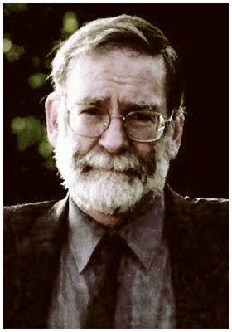
INDIVIDUAL HIGH-PROFILE
CASES
Imperial College London

Slide 26
“I will use my power to help the sick to the best of my ability and judgment; I will abstain from harming or wronging anyone by it. I will not give a fatal draught to anyone if I am asked, nor will I suggest any such thing.”
From the Hippocratic oath
Imperial College London

Slide 27
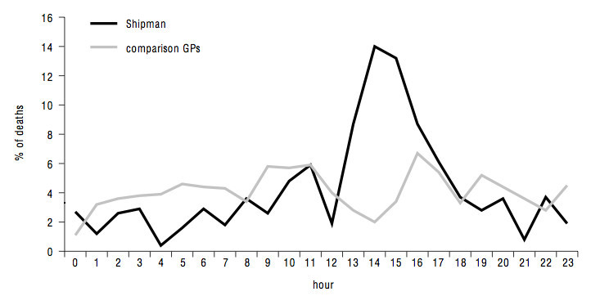
Imperial College London

Slide 28
Harold Shipman
Imperial College London

Slide 29
The Enquiry
Function and strength of the GMC
The role of revalidation
How we deal with sick doctors
The purpose and reliability of death certification
The monitoring of cremation certification
The use of controlled drugs
The problem of isolated doctors
The value of clinical governance
The problems of whistleblowing
The function of the coroners' service.
Imperial College London

Slide 30
PERSONAL – SIGNIFICANT EVENTS ANALYSIS FROM LAST WEEK….

Slide 31
TASK DURING COFFEE
Who are your medical role models and why?
Write down
After break:
Present
We’ll collect in your work

Slide 32
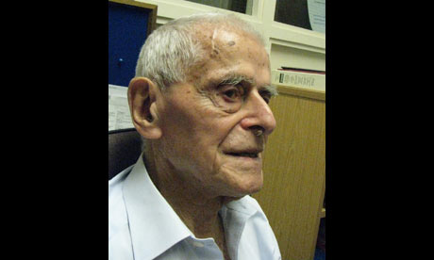
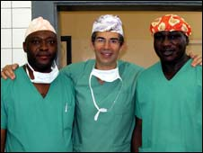
Your role models
Notes:
David Nott Imperial Vascular surgeon, volunteer Medecins sans Frontieres-saves boy’s life by amputating arm- following text instructions from colleague. BBC news
Dame Carol Black, past president RCP- Bristol history graduate turned rheumatologist, work with government, Unemployment is disastrous for long-term health. Photo-Bristol alumni ass.
Jerry Morris –judged to have done his very best work in his 90s
The first physician to show the link between exercise and health – The Guardian

Slide 34
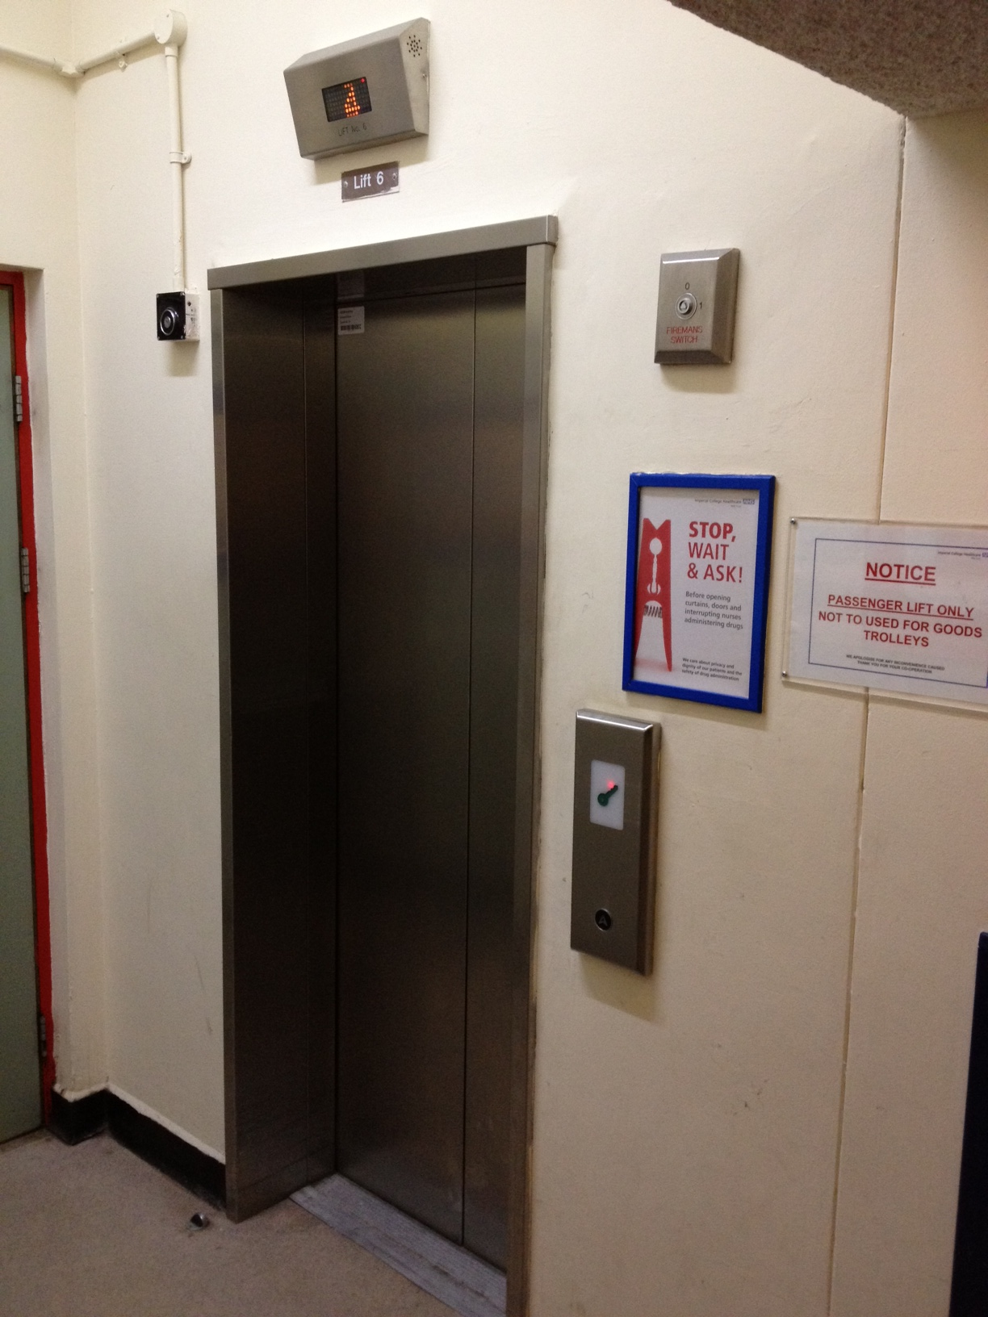

Slide 35
High Quality Care for All
Simple monitoring of what is achieved is not the whole story
“Nationally, the NHS in the 21st century faces different challenges:
rising expectations
demand driven by demographics
the continuing development of our ‘information society’
advances in treatment
the changing nature of disease
changing expectations of the health workplace.”
Imperial College London

Slide 36
Dimensions of Quality
Must be understood from the patients perspective
Includes:
Experience: Quality of caring
Effectiveness: Clinical outcomes and PROMS
Safety: Measurement of avoidable error and adverse outcome
Experience
Effectiveness
Safety
Imperial College London

Slide 37
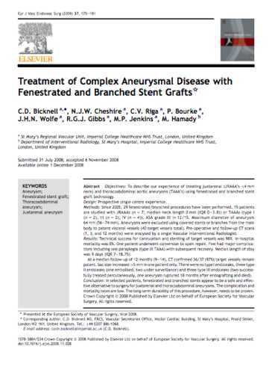
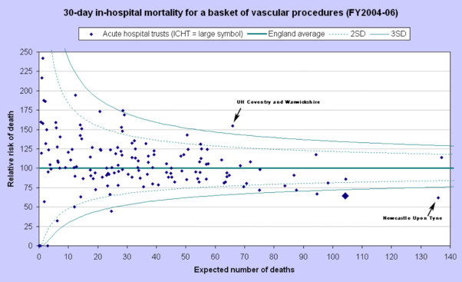
Quality in terms of outcomes only?
Imperial College London

Slide 38
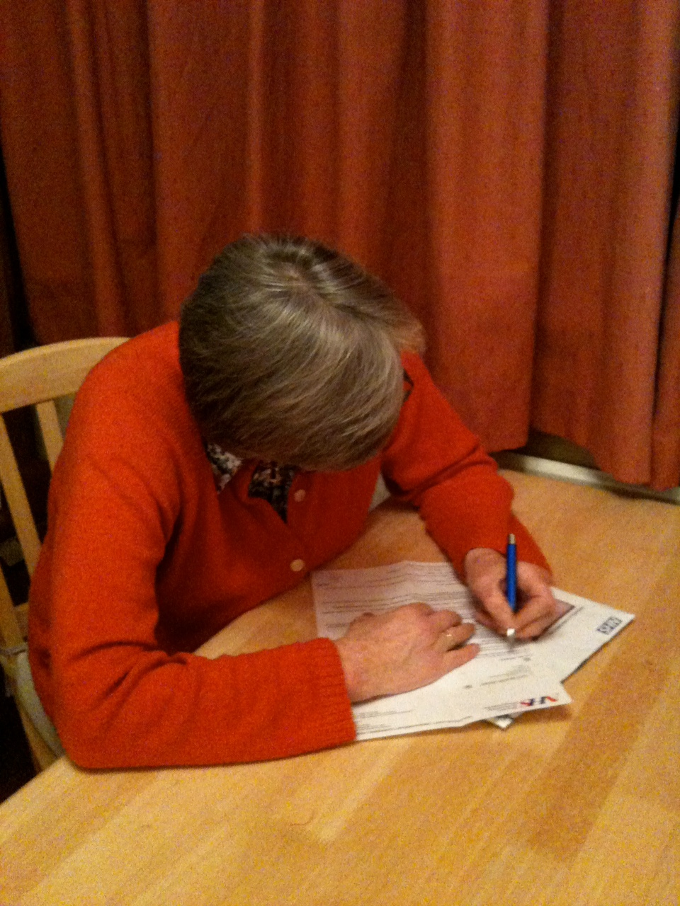
PROMS
Imperial College London

Slide 39
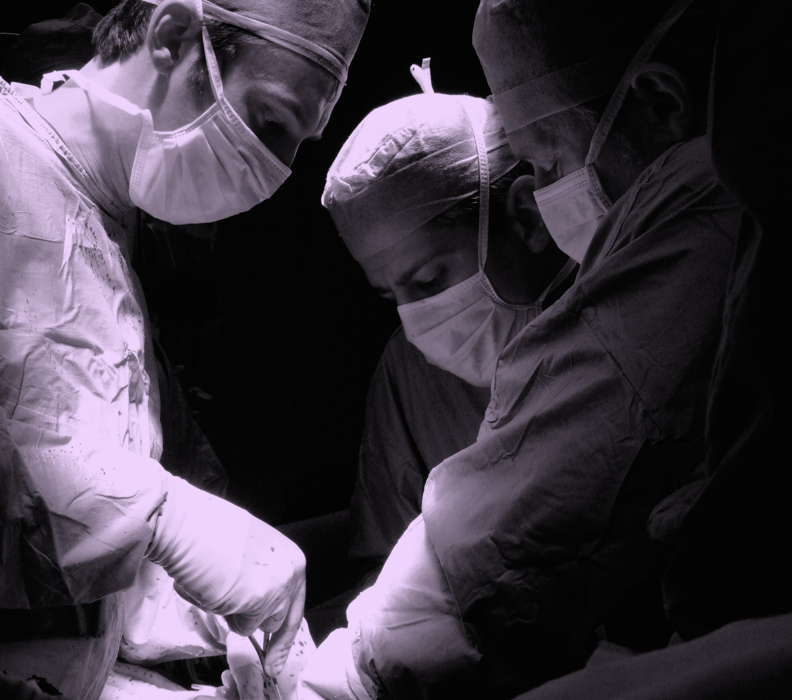
The safe surgery project
Imperial College
London

Slide 40
“Quality at the heart of everything we do”
Bring clarity to quality
Measure quality
Publish quality performance
Recognise and reward quality
Raise standards
Safeguard quality
Stay ahead
Imperial College London

Slide 41
How is quality measured and monitored?
Imperial College London

Slide 42
Quality
National – National Quality Board
Regional – Quality observatories responsible for Regional quality improvement
Institutional – Provide Quality Accounts and CQUIN targets
Individual – Benchmarking and Dashboards
Imperial College London

Slide 43
Institutional - Quality Accounts
Bring clarity to quality
Measure quality
Publish quality performance
Recognise and rewrd quality
Raise standards
Safeguard quality
Stay ahead
Publishing quality performance
“…we will require, in legislation, healthcare providers working for or on behalf of the NHS to publish their ‘Quality Accounts’ from April 2010 – just as they publish financial accounts. These will be reports to the public on the quality of services they provide in every service line…
Imperial College London

Slide 44
Health Regulators
Imperial College London

Slide 45
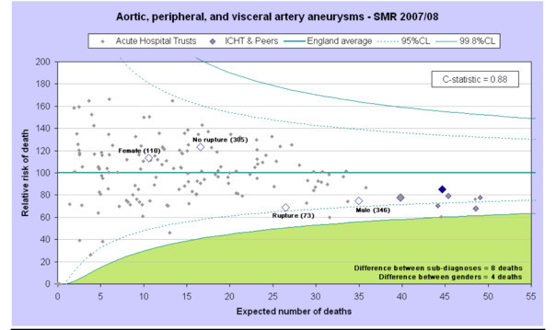
Quality Assessment
Imperial College London

Slide 46
Next Stage Review
Lord Darzi highlighted the growing need for all doctors to fulfill a leadership role in their practice
“Clinicians are expected to offer leadership and where they have appropriate skills take senior management and leadership posts in research, education and service delivery.”
Imperial College London

Slide 47
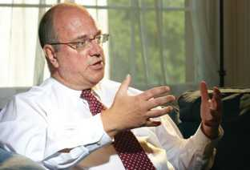
Begin to Lead – drivers...
The NHS is only just beginning to grasp the importance of leadership. We have not systematically identified, nurtured and promoted talent and leadership.
(Leadership for Quality, Jan 2009)
It is unrealistic to expect NHS staff to take on leadership without action to make it integral to training and development. So we will explore ways to ensure that the undergraduate curricula for all medical and nursing students reflect the skills and demands of leadership and working in the NHS. (HQCfA, July 2008)
Tomorrow’s doctors
Medical Leadership Competency Framework

Slide 48
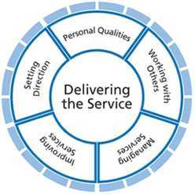
Medical Leadership Competency Framework Framework
Developing personal awareness
Managing yourself
Continuing personal development
Acting with integrity
5 “Domains”
Knowledge
Skills
Behaviours and Attitudes
Identifying contexts for change
Applying knowledge and evidence
Making decisions
Evaluating impact
Developing networks
Building and maintaining relationships
Encouraging contribution
Working within teams
Ensuring patient safety
Critically evaluate
Encourage improvement and innovation
Facilitate improvement
Planning
Managing resources
Managing people
Managing performance

Slide 49
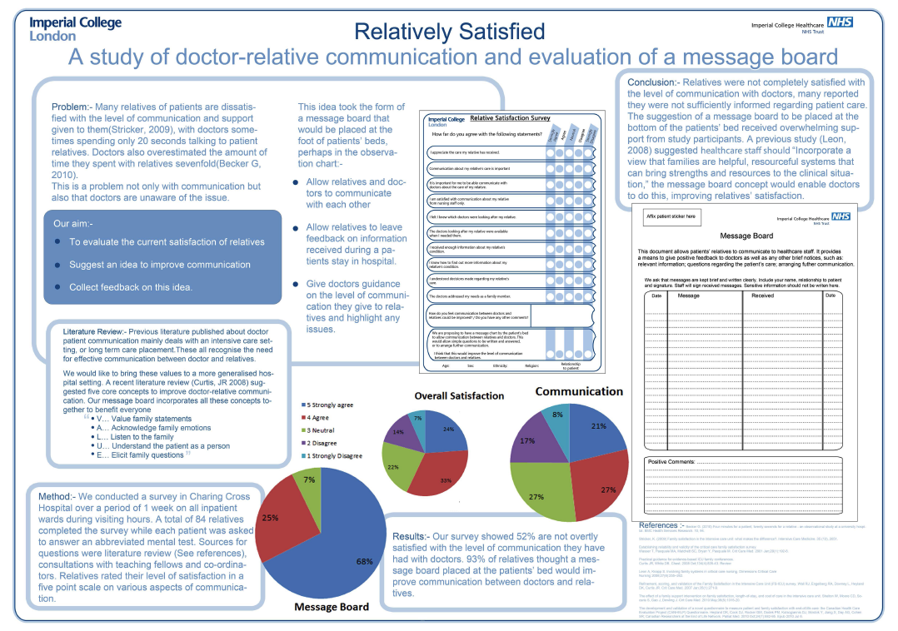
Year 3 Quality Improvement Projects
Imperial College
London

Slide 50
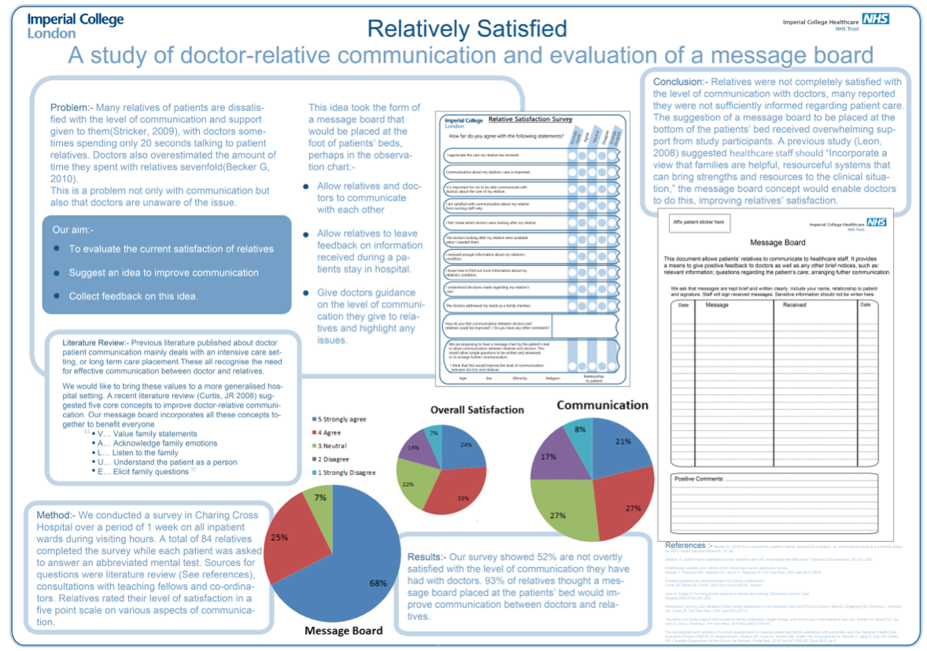
Imperial College
London

Slide 51
Summary
Making a small difference just as important as those that are world famous
Quality improvement project the first stepping stone to looking at medicine in a different way, improving the care of many many patients rather than just one at a time…

Slide 52
What will you take away from today?
What will you do ?
How do want patients and peers to remember you ?
Release the inner leader in yourself......

