Slide 1
Firms
and an
Introduction to Exams

Slide 2
Questions to be addressed
What am I supposed to actually learn this year? Is there a syllabus for the exams?
How can I make the most of firms?
What learning resources should I use?
How can I prepare for the OCSEs?
How can I prepare for the written paper?
What exactly will the FoCP paper involve?

Slide 3
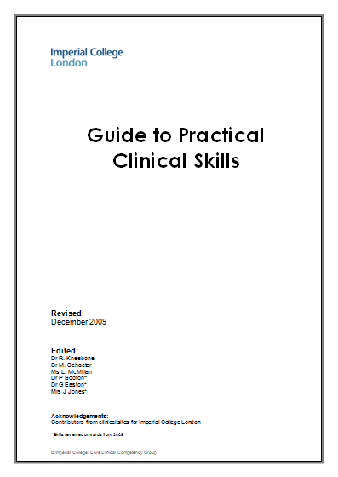
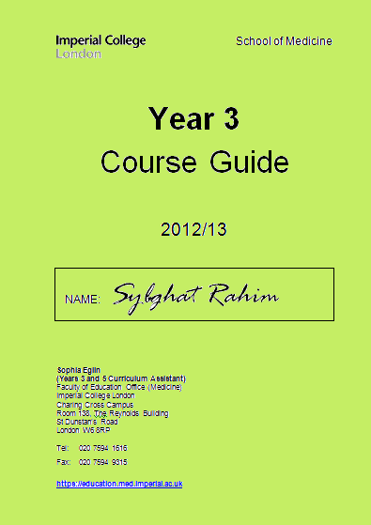
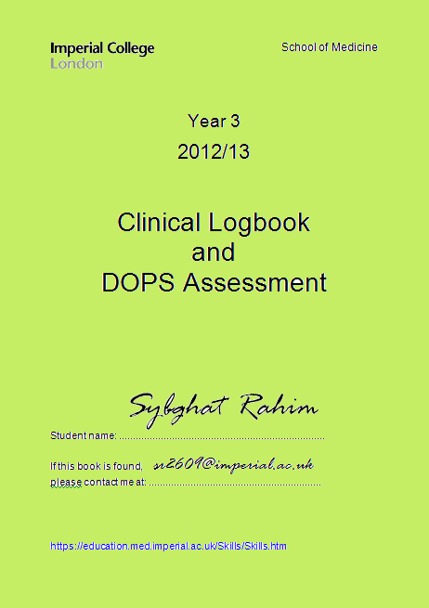
Learning Objectives

Slide 4
Learning Objectives from the Course Guide
Your syllabus for the OCSEs:
History taking:
The basic structure, communication skills
Focussed histories
Examinations:
The major systems and complaints examinations
Don’t forget CMT!
Explaining procedures
Diagnosis, Investigations and Management
This includes interpreting scans and ECGs

Slide 5
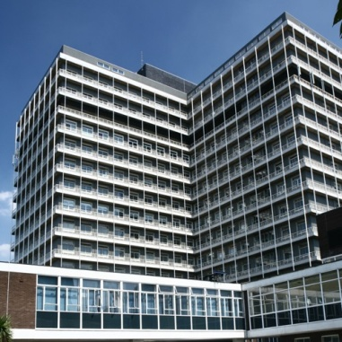
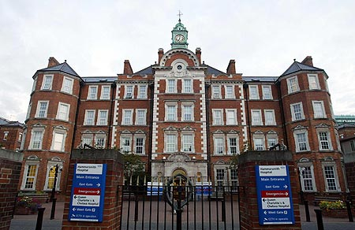
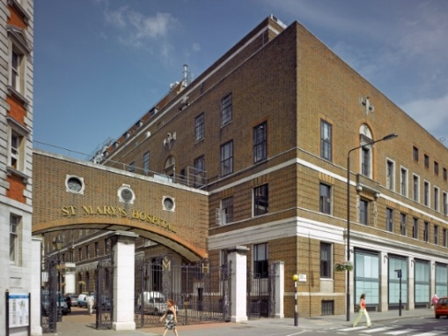
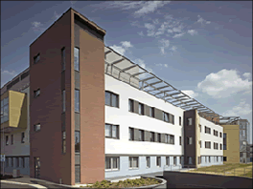
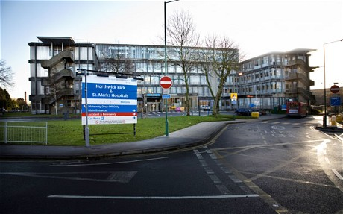
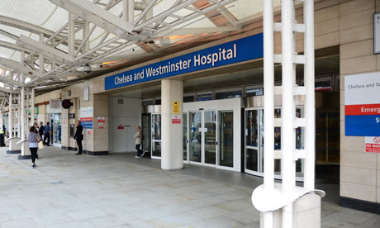
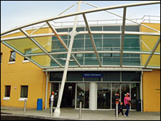
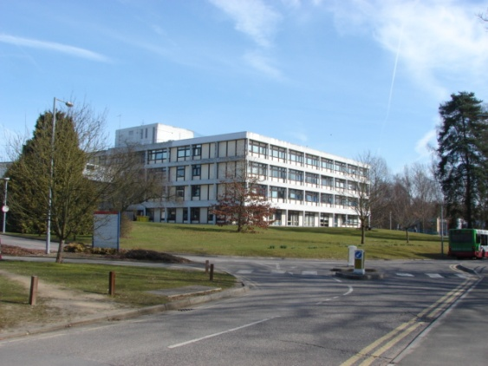
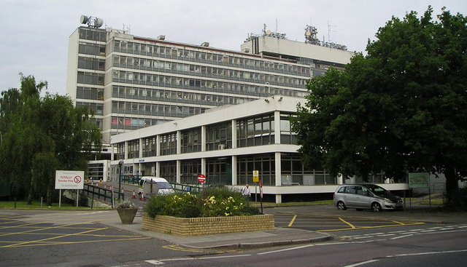
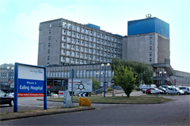
Best place to learn these skills?
GO
ON CALL!

Slide 6
CMT

Slide 7
Learning Objectives from the Course Guide
Your syllabus for the Written Paper:
Lots of conditions – don’t need to know the ins and outs of every single one!
Definition
Risk factors
Presentation
Investigations
Treatment
Page 10
Pages 27 - 32

Slide 8
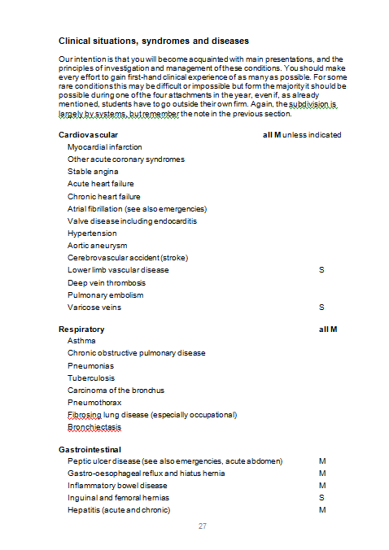
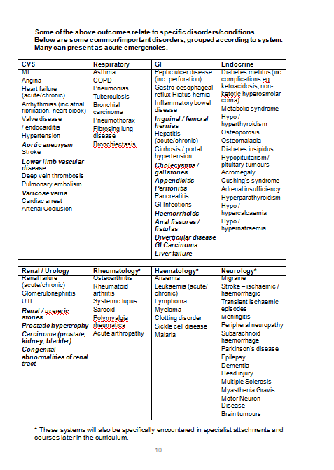

Slide 9
Best place to learn about it all?

Slide 10
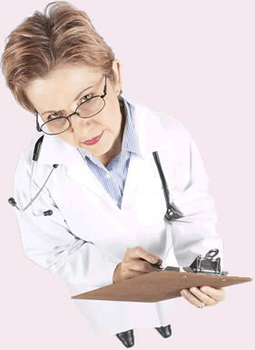
Learning Objectives from the DOPS Book
Your syllabus for the OCSEs:
ECG
Peak flow
Inhaler
Venepuncture
Cannulation
Explain MSU

Slide 11
Learning Objectives from the Clinical Skills Guide
Your syllabus for the OCSEs:
Venepuncture
Cannulation
Injections
ECG
Abdo/Chest X-ray
Suturing
Ophthalmoscope/Otoscope
Breast Exam
DRE
MAKE SURE YOU ATTEND ALL SESSIONS ON FIRMS!

Slide 12
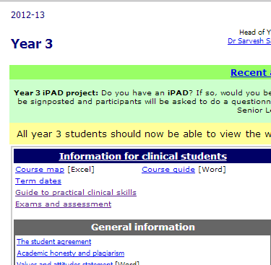
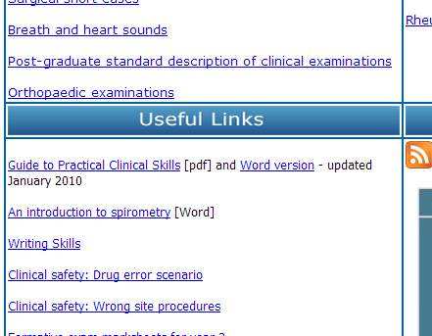

Slide 13
Best place to learn these skills and practice them?

Slide 14
Learning Objectives

Slide 15
Year 3 at ICSM
You are here

Slide 16
A typical wasted day at firms
9:00: Went on ward-round, stood around at the back not doing much, said I had “teaching” and left early.
9.30: Chilled out in the common room for a bit
10.30: Went to the ward, stood around in the corridor looking lost, there’s nothing to do…
11:00: Read the cheese and onion for a bit, got bored.
11.10: Went on facebook in the library
12:00: Lunchtime! Great bants in the canteen.
13:00: Went to the ward to clerk a patient, but it was protected meal time, couldn’t do anything.
13:20: Back to the library, swatted up on some EMQs
14:30: Checked facebook and did half an e-Lecture
15:00: Chilled out in the common room. Great bants.
16:00: I’ve stayed extra long today, so tired, time to go home!

Slide 17
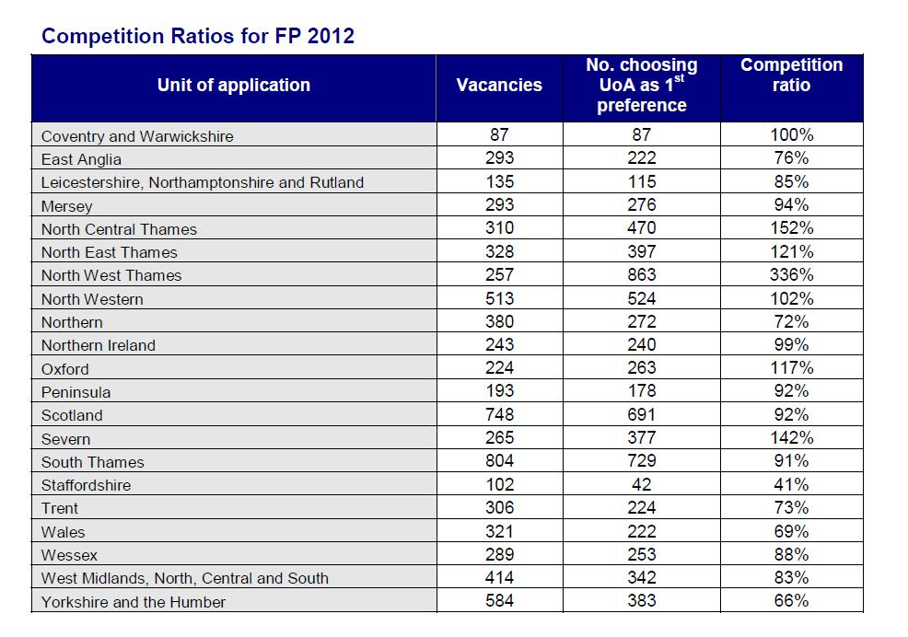
Do you know where you are?

Slide 18
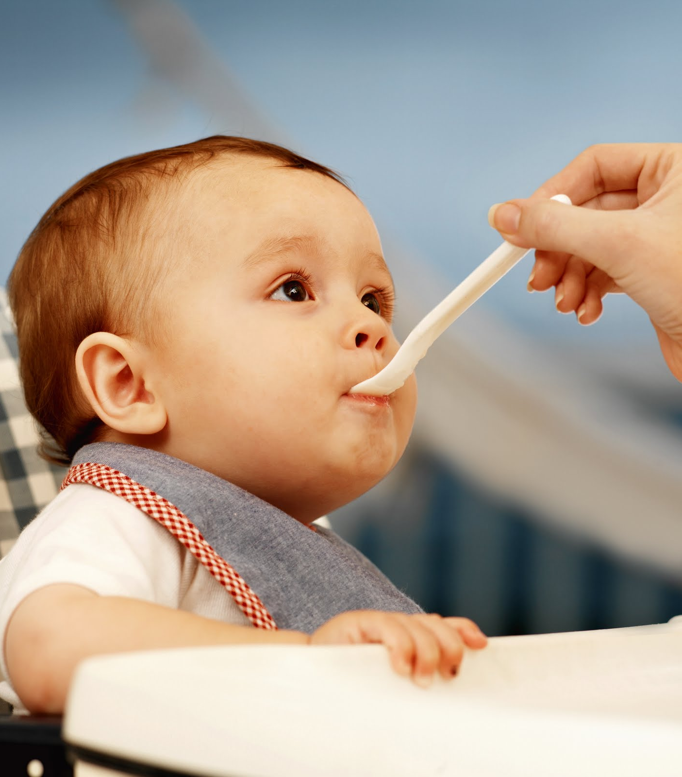
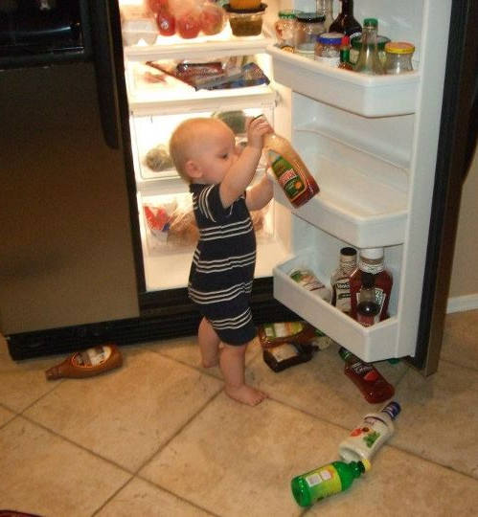
Basic Principles for Firms
Years 1 and 2
Year 3

Slide 19
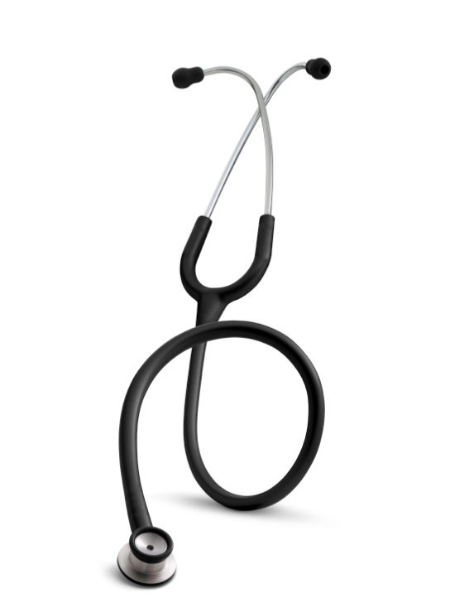
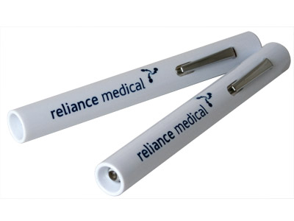
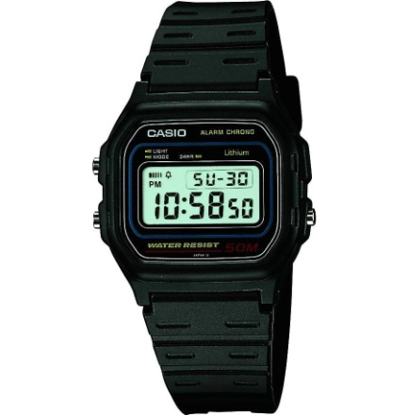
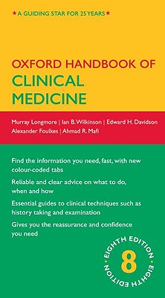
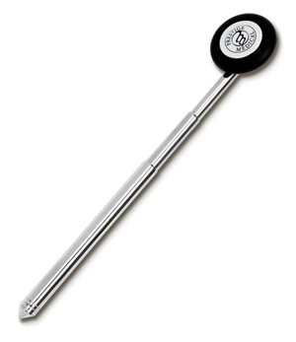
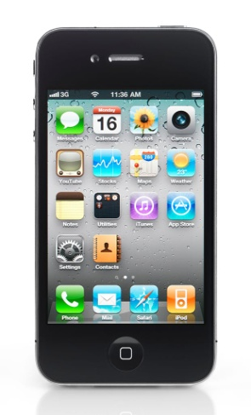
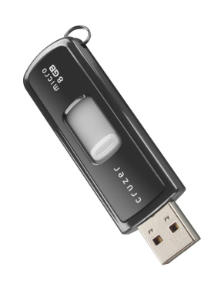
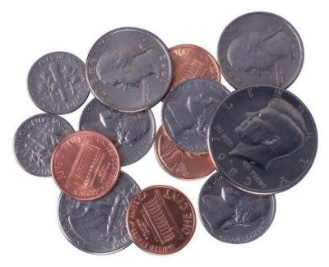
Medical Student Utility Belt

Slide 20
Basic Principles for Firms
You are a member of the team – but the bottom of the food chain, befriend the juniors! Get their numbers, not their bleeps.
You are there to learn – ask questions when its appropriate and convenient.
You know your learning objectives for the year – seek out opportunities and enjoy the freedom of setting your own targets.
You’re all in it together – work with your firm partners, you will not benefit from trying to look better than them. Don’t even think about screwing them over.

Slide 21
Basic Principles for Firms
You are there to be taught – try to attend all scheduled teaching, but the freedom is yours to choose opportunities at the discretion of your firm lead. Take advantage of all the teaching that various doctors and professionals will offer you!
You are learning for life – make notes on everything you come across, specific cases will leave lasting memories and will facilitate further reading.
Your OSCE patients will have signs – it is useless to just practice on your friends. Real patients have a different manner, and they have the signs you need to learn to pick up.

Slide 22
A typical good day at firms
Saw lots on ward round – noted down interesting cases and exemplary patient interactions.
Got to observe a bronchoscopy, was with the patient during briefing and consenting, watched the procedure and learnt the main causes of haemoptysis.
Scrubbed in with the surgeons and assisted, asked lots of questions and was grilled on anatomy and pathology.
Scrubbed in with the anaesthetists, got to put in an LMA, asked lots of questions and was grilled on pharmacology and physiology.
Performed an abdominal examination in front of an FY1, got great feedback so I can improve for next time.

Slide 23
A typical good day at firms
On-call: SAU had so many patients coming in, so they asked me to help clerk them in. I was the first person to see them, took a full history, examined, and gave my differentials. Wrote it all up in the notes (signed med student) and presented to the on-call reg.
Picked up some great patient booklets on endoscopy – they are literally the perfect checklists for explaining procedures!
Had to ask a couple of people if I could help with any jobs on the ward, eventually was asked to do some of the bloods. Got it signed off in the DOPS book.
My FY1 called me to come to Frederick-Salmon ward, there was a patient with Peutz-Jaghers syndrome. Looked at his abdominal x-ray and noted he had the freckles on his lips. I’ll read more about this when I get home.

Slide 24
Know when to do what
When you are free and have time:
Clerk patients: focussed histories and go through entire examinations
When you are with doctors:
Just look at/listen to/examine the signs
Scribble down everything on your pad
Ask questions
Get involved, if you’re always around they will use you as a member of the team
When you are finished for the day:
Have time to relax and unwind
Spend a bit of time reading or practicing questions

Slide 25
You know best
Help each other to make the most of firms
facebook is an excellent resource!
Class of 2016 group
Create a File: Handy tips for firms
What are the learning opportunities?
Who are the good teachers?
Great for site specific feedback

Slide 26
The Firms Mentality
Keen is the new cool
Be proactive about your learning
Find good and bad examples of patient interaction, and use this to tailor your own
Develop a strong framework not just for your OCSEs, but for Years 5 and 6 and your future as a doctor
Be the best you can – for your patients

Slide 27
Learning Resources

Slide 28
Learning Resources
Firms, CMT and Clinical Skills
Real patients, real signs
Presentation, clerking, investigations, diagnosis, management, discharge and follow-up
Health professionals and academics
Find people who are keen to teach, take advantage of the opportunities presented to you!
Medical Students
They have been through it already
OSCE Tutoring, Subject Tutoring

Slide 29
Learning Resources
Blackboard
E-lectures are a fantastic overview
Don’t waste the quizzes: make notes!
Practice questions
Repetition is the key
Making notes is essential
Learn from your mistakes
Great opportunity to ask questions!

Slide 30
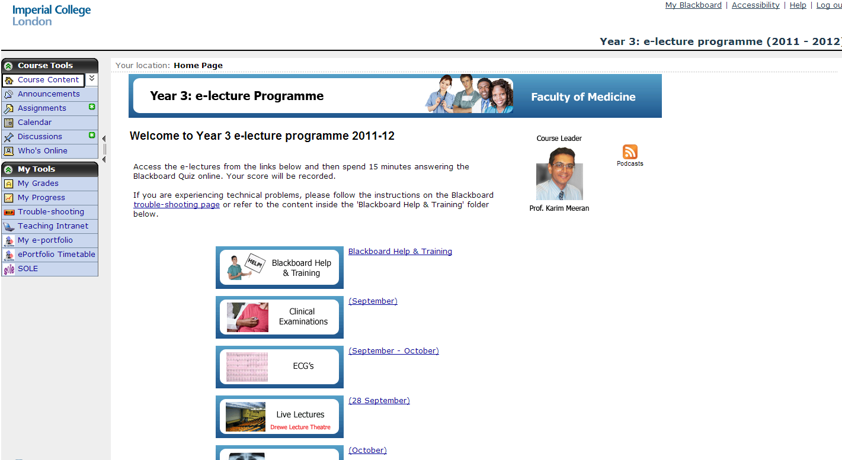
Learning Resources

Slide 31
Learning Resources
ICSMSU Notebank (under construction)
OSCE crib-sheets
Focussed histories booklet
How to present examination reports
Ophthalmoscopy and otoscopy slides
Medical Ethics and Law Notes
EMQs
General Medicine and Surgery Notes
Intranet Clinical Skills Page
The OSCE Station YouTube channel

Slide 32
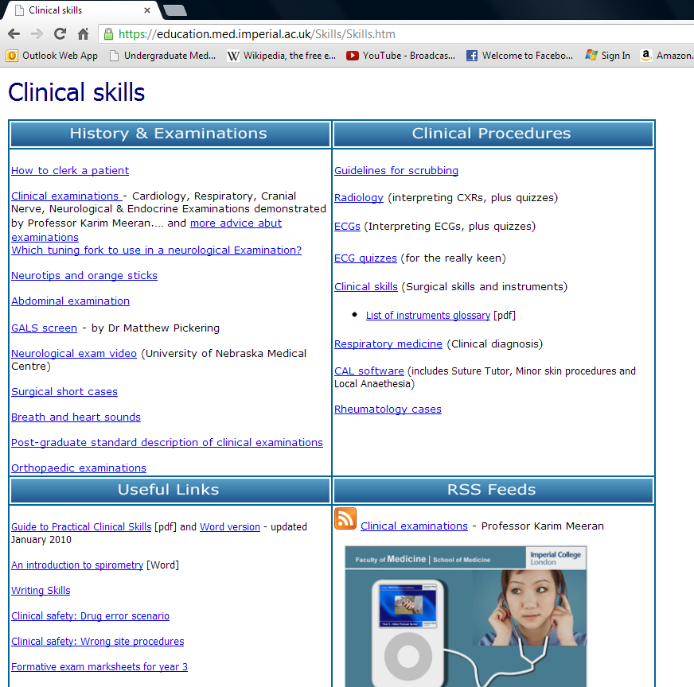
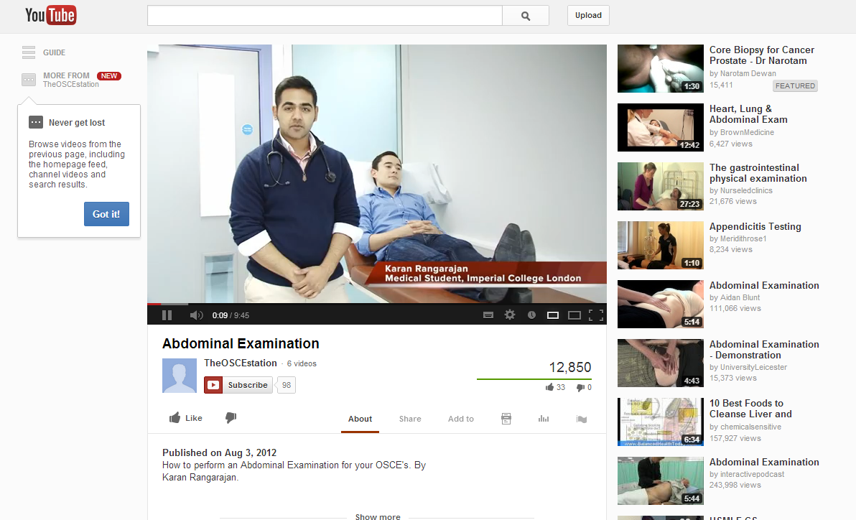

Slide 33
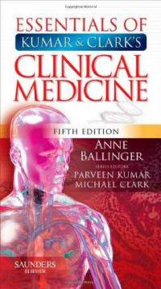
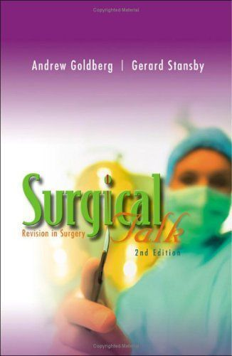
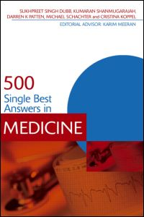
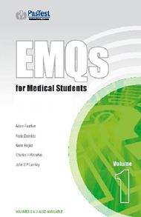
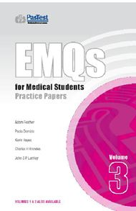
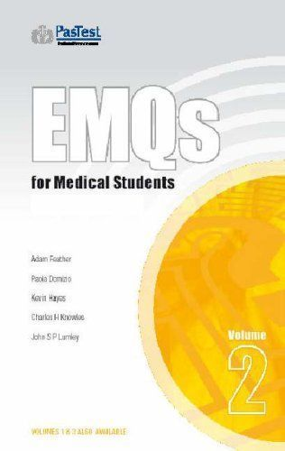
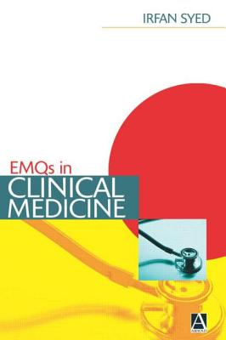
If you fancy some reading…

Slide 34
Preparing for the OSCE
Objective Structured Clinical Examination
Histories, Examinations, Communication Skills, Clinical Skills, Interpretation of Investigations, etc…
Year 3 = a scaffold upon which to build
Everyone can tick the boxes
Top scorers have a style and their own manner with patients
To develop your style, find role models
Finding a role model means attending firms!
Pick up on patient interaction techniques you like
Practice makes perfect!

Slide 35
OSCE Tutoring and Practice
The objective of this is to get slick and to make sure you know each examination inside out.
Partner up and practice with each other.
Implement this on firms and gain practice on real patients with real signs.
Use learning resources like Blackboard, Books (e.g. Macleod’s), Notes and YouTube.

Slide 36
Preparing for the written paper
Rule No. 1: Listen to Professor Meeran
Seeing cases on firms is the most effective!
Hx, Ix, DDx, Tx
Keep on top of your clinical examinations
Start practicing EMQs around February, the same sort of time as the MedEd weekly EMQ sessions

Slide 37
Which EMQs should I practice?
Whatever you choose, don’t waste your time
Don’t just do the questions and mark them
Be organised – make notes!!!
Always read the answer explanations
Blackboard:
For questions you get wrong, copy and paste the answer and explanation into a Word document.
By the end of the year there are so many quizzes and practice EMQ papers! You’ll know them a lot better if you go through your notes.
Repetition is the key.
PasTest and other Books:
Doing as many practice questions as you can will teach you a good exam technique: patterns!
MedEd:
You’ll feel stupid and worthless, but it will pay off – again, make notes!!!
OHCM/Kumar & Clark/Surgical Talk are good books for reading.

Slide 38
What’s involved in the FoCP exam?
Medical Ethics:
Year 2 lectures and tutorials led by Dr Wing May Kong
Year 3 E-Lectures
Law:
Year 3 E-Lectures
Clinical Communication:
Drawing on the past three years of sessions
PPD:
Year 2 sessions and Year 3 online material

Slide 39
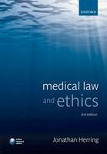
What’s involved in the FoCP exam?
You will be given a case 1 month in advance of the exam, just like in PBL.
It will be drenched with ethical goodies!
PBL GROUPS ASSEMBLE!!! Go through it in groups and split up research topic areas.
There will be suggested reading with the case – read it!
Know your ethical concepts and be able to justify your opinions.
Revision: the lecture content will do!
Lecture slides
ICSMSU Notebank
Recommended reading from lectures

Slide 40
What’s involved in the FoCP exam?
Medical ethics:
Short answer questions based on the ethical case.
Clinical Communication:
Short answer questions related to the ethical case.
PPD:
Short answer questions related to the ethical case.
Law:
Single best answer questions for a variety of situations each question.

Slide 41
Questions addressed today
What am I supposed to actually learn this year? Is there a syllabus for the exams?
How can I make the most of firms?
What learning resources should I use?
How can I prepare for the OCSEs?
How can I prepare for the written paper?
What exactly will the FoCP paper involve?

Slide 42
Any problems?
Year 3 Reps: su-year3-reps-dl@imperial.ac.uk
Adam, Charlotte, Hoon, Sarah and Sharika!

