Slide 1
When to start dialysis
Professor Edwina Brown

Slide 2
Implications of renal failure (1)
Electrolyte misbalance
Hyperkalaemia, hyponatraemia
Acidosis
Fluid retention
Retention of waste products
Small molecules, e.g., urea, creatinine, urate
Phosphate
Middle molecules, e.g., peptides, ß2-microglobulin
Secretory failure
Erythropoietin
1.25 vitamin D

Slide 3
Implications of renal failure (2)
Symptoms
Tiredness, lethargy
Shortness of breath, oedema
Pruritis, nocturia, feeling cold, twitching
Poor appetite, nausea, loss of/nasty taste, weight loss
Anaemia – exacerbates tiredness
Renal bone disease – aches & pains, pruritis

Slide 4
Implications of renal failure (3)
If no renal replacement treatment
Hyperkalaemia – arrythmias, cardiac arrest
Pulmonary oedema
Nausea, vomiting
Malnutrition / cachexia
Fits
Increasing coma
DEATH

Slide 5
Renal Replacement Treatment
Dialysis
Haemodialysis
Predominantly hospital-based, but can be done at home
Peritoneal dialysis
Home treatment
Transplantation
None of these are cures

Slide 6
Aims of Renal Replacement Treaments
Correct electrolyte and acid-base status
Remove waste products
Restore fluid balance
Improve symptoms
Maintain quality of life for patient

Slide 7
Timeline to RRT
Conversation started when eGFR <20 ml/min
Education
Risks of renal failure
Types of RRT
Establish access to chosen RRT
Fistula (HD), PD catheter, transplant assessment
Start dialysis
eGFR <10 ml/min and benefits outweigh risks
eGFR <6ml/min and no reversible features
Life-threatening complications

Slide 8
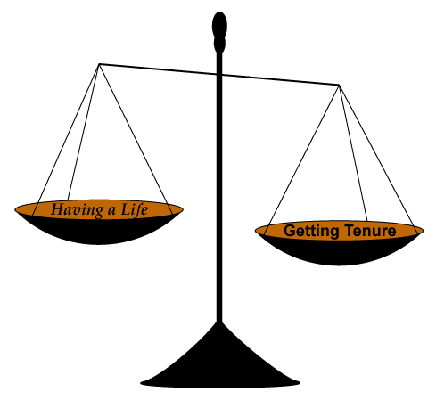
When to start dialysis
BENEFITS
RISKS

Slide 9
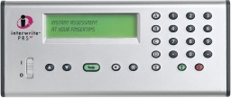
Dialysis should be started now
True or False
TRUE FALSE

Slide 10
When to start dialysis
BENEFITS
RISKS
Improve uraemic symptoms
Tiredness, nausea, pruritis
Correct fluid balance
Less SOB and oedema
Avoid life-threatening events
Severe acidosis
Severe hyperkalaemia
Pulmonary oedema resistant to diuretics
Dialysis-related complications
Infection (HD and PD)
Hypotension, arrhythmias (HD)
Access-related (HD and PD)
Adverse effects on quality of life
Work
Family life
Travel

Slide 11
Dialysis does not treat...
Lack of erythropoietin
Anaemia
Lack of 1.25 vitamin D
Hyperparathyroidism
Renal bone disease
Other diseases – comorbidities
SLE
Diabetes
Vascular disease

Slide 12
HD or PD
HAEMODIALYSIS
PERITONEAL DIALYSIS
Hospital based treatment
3 times a week
4 hours only but time to recover plus transport
Vascular access needed
Catheter or A-V fistula
Quality of life
Done for you and does not invade home
Limits travel, work
Loss of independence
Home based treatment
Daily and continuous
Less haemodynamic stress
Limited by access to peritoneum and ability to do technique
Quality of life
Maintains independence
Easier to travel, work
Avoids swings of HD
Less dietary and fluid restrictions

Slide 13
Transplantation
BENEFITS
RISKS
Better renal replacement
Improvement in metabolic disorders
Anaemia
Renal bone disease
Costs less in long-term
Prolonged survival
Quality of life
Avoids disadvantages of HD/PD
Much easier to travel, work, maintain independence
Older and sicker patients not eligible
Immunosuppression
Increased infection
Increased malignancy
Not a cure
Surgical complications
Hospital visits – particularly frequent at start
Often worse off if/when transplant fails

Slide 14
Clicker
Which type of renal replacement treatment should Mrs J start on?
1. Haemodialysis
2. Peritoneal Dialysis
3. Modality of her choice

