Slide 1
Chronic disease pathway: role of active and supportive treatment
Professor Edwina Brown

Slide 2
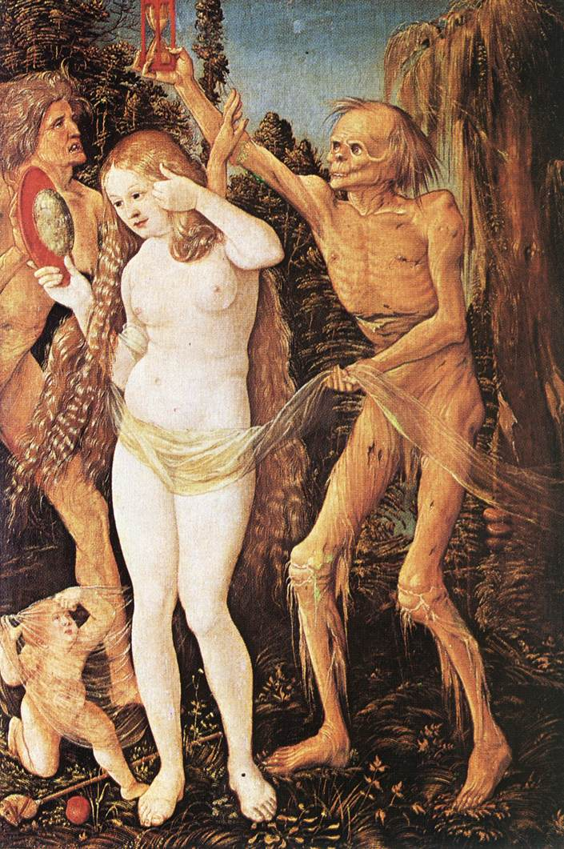
Hans Baldung: “Three Ages of Women and Death” (circa 1484-1545). Kunsthistorisches Museum, Vienna

Slide 3
MONTHS TO LIVE Weighing Medical Costs of End-of-Life Care NY Times 23.12.09 http://www.nytimes.com/interactive/2009/12/22/business/23UCLA-AUDIOSS/index.html
The Ronald Reagan U.C.L.A. Medical Center, one of the nation’s most highly regarded academic hospitals, has earned a reputation as a place where doctors will go to virtually any length and expense to try to save a patient’s life.
“If you come into this hospital, we’re not going to let you die,”
said Dr. David T. Feinberg, UCLA hospital system’s chief executive.

Slide 4
This all-out fight for life denies us a happy death
Most of us say we hope to die peacefully, at home, with our minds intact and our family around us. Few of us will manage it, because our emphasis on life at all costs is leading the vast majority of us into a bleak future
The quality of our existence may be terrible, but medical ethics and social norms won’t let us die
..told that mother is dying only for jubilant medical staff to tell her that antibiotics have saved her mother’s life
Jenni Russell, Sunday Times 19th Sep 2010

Slide 5
Modern medicine is good at staving off death with aggressive interventions – and bad at knowing when to focus, instead, on improving the days that terminal patients have left
PHOTOGRAPH: PHILLIP TOLEDANO, “BIRTHDAY BALLOON,” FROM “DAYS WITH MY FATHER” (2008)
New Yorker, 2nd August 2010

Slide 6
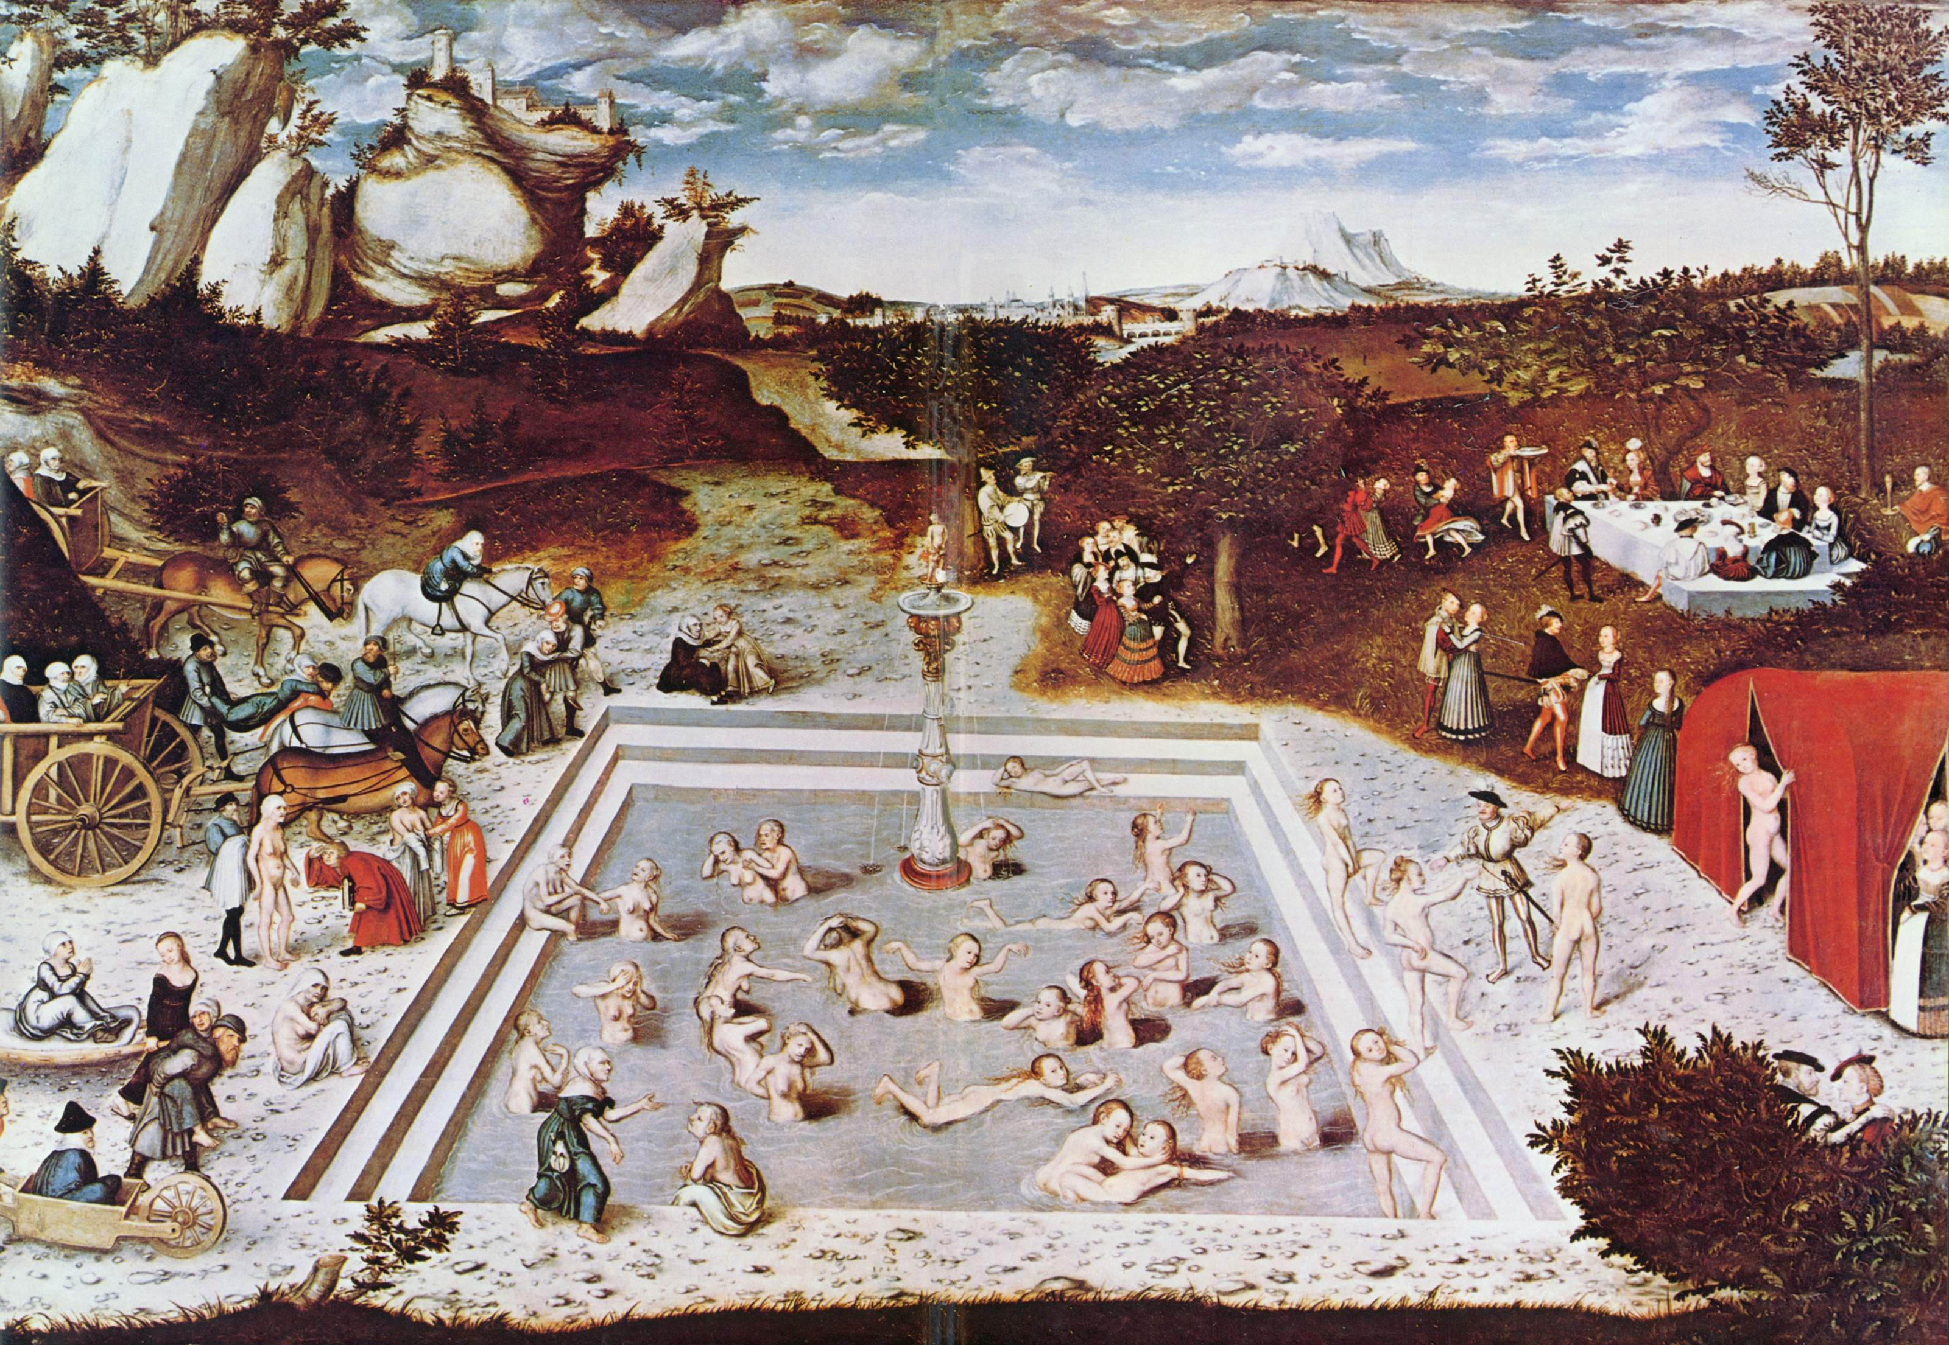
Cranach: Fountain of Youth
Notes:
6

Slide 7
Supportive Care: UK definition
Care that helps patient and family to cope with condition and its treatment
from prediagnosis
through diagnosis and treatment
to cure, continuing illness or death
into bereavement
Helps patient maximise benefits of treatment and to live as well as possible with effects of disease
As important as diagnosis and treatment
National Council for Palliative Care 2006

Slide 8
Where does it fit in? Old paradigm
Aggressive treatment Palliative
care

Slide 9
Where does it fit in? Current paradigm
e
Aggressive treatment Bereave
ment
Palliative
care

Slide 10
Management of all frail older patients with chronic disease is palliative care
“Palliative care is care which enables people with progressive, and/or life threatening conditions or who are approaching the end of life to live according to their wishes and preferences wherever possible”
Tom Hughes-Hallet, CEO of Marie Curie Cancer Care
Palliative Funding Review, Interim Report 3rd Dec 2010

Slide 11
Achieving aims of supportive care
Communication with patient and family
Patient and family expectations and wishes
Symptoms and pain control
Realistic prognosis
Awareness of patient being near end of life
Advance care planning
Appropriate active interventions, e.g., antibiotics, dialysis, ventilation – and discussing withdrawal where appropriate – or not starting

Slide 12
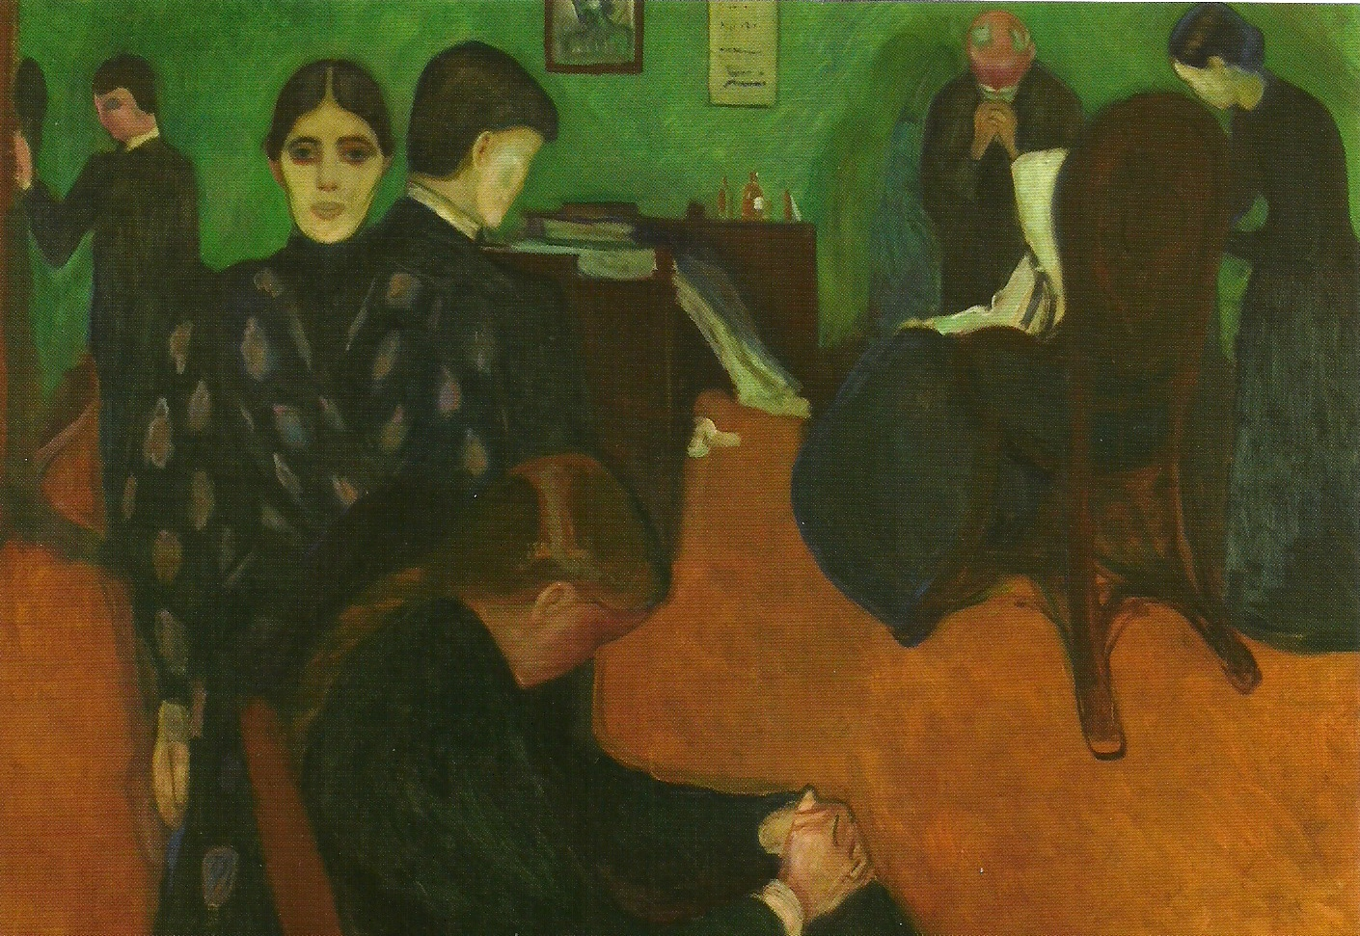
Edward Munch: Death in the Sickroom, 1893

