Slide 1
A career in medical oncology
Dr Shairoz Merchant
SpR in Medical Oncology and Clinical Research Fellow

Slide 2
Medical Oncology
Diagnosis
Assessment
Treatment and management
Chemotherapy
Biological therapy
Immunological therapy
(Not radiotherapy – clinical oncology)
Palliative care skills

Slide 3
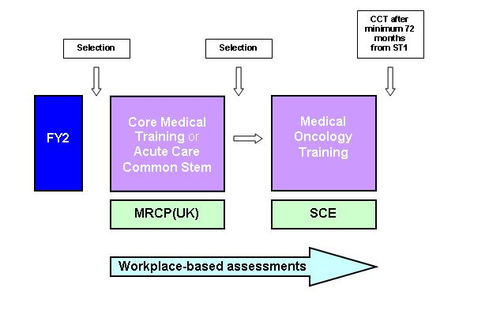
The training pathway
From: JRCPTB

Slide 4
My background
SHO jobs in Oncology and Haematology
Respiratory Medicine MDTs sparked an interest in Oncology cases
Currently ST4 at Imperial NHS Trust
Currently undertaking my PhD in PET imaging at Imperial College.

Slide 5
Clinical & Academic Medicine
Clinical aspects
Range of cancer treatments
Working in tertiary referral centres
Good communication skills
Team work
Continuity of care
Academic aspects
MD or PhD
Clinical research: Design and recruitment to clinical trials

Slide 6
