Slide 1
GUM / Sexual health
Dr Lamsi Dosekun
Consultant physician HIV/Sexual Health
Jefferiss Wing
St. Mary’s Hospital, ICHT

Slide 2
Overview
STI Epidemiology
  Trends in sexual health
  Populations and sexual health
STI Services
Taking a sexual history
Clinical scenarios
Careers in sexual health

Slide 3
A Few Questions For You
Notes:
Hands up if you smoke?
Hands up if you’ve ever drunk so much that you were sick?
Hands up if you’ve ever taken a recreational drug?
Hands up if you’ve ever had sex without a condom with a new or casual sexual partner?
Hands up if you’ve been to a GUM clinic as a patient?
Hands up if you’ve had an STI?

Slide 4
STI Epidemiology
Notes:
4

Slide 5



What Do We Know About Sexual Behaviour In The UK?
Kinsey reports in 1948 and 1953
1st large-scale investigation of sexual behaviour
Explored many social taboos such as masturbation, pre-marital sex, homosexual experiences
Scientifically controversial
Notes:
750,000 copies sold worldwide; translated into 13 languages
Multiple methodological criticisms:
Sampling process condemned by prominent statisticians
Self-selected volunteers
Prison population and male prostitutes [25% and 5% respectively]
Included paedophiles/child molesters
Unrepresentative of general population
7 point scale of sexuality including asexual
5

Slide 6

The National Survey of Sexual Attitudes and Lifestyles
NATSAL 1990
@19,000 randomly selected subjects aged 16 - 59
Designed to better understand sexual behaviour in order to plan interventions to reduce spread of HIV
Published 1994
Repeated 2000 and 2010
Notes:
1st UK wide study of sexual behaviour
Commissioned initially by DH and veto’ed by Maggie Thatcher
Wellcome Trust funded at last minute, published as penguin paperback
Stratified probability sample surveys of the general population
18,876 men and women aged 16-59 years were interviewed
Focused on patterns of HIV risk behaviour, partnership formation and sexual practices
Results widely used to model the extent of the HIV epidemic and to plan sexual health services and preventive interventions
6

Slide 7
Changes Between NATSAL 1 and 2
Earlier age first sexual intercourse
  1st heterosexual sex <16 in 30% males, 26% females
  Stabilised in mid-90s
  Fewer having UPSI at 1st sex than in NATSAL 1 [but still 50% in under 16s]
Increased number of lifetime partners – male > female at all age groups
Decline in marriage, growth cohabitation - assoc with higher rates of partner change
Concurrent relationships – 15% men and 9% of women
Increased risky behaviours
  non-use or inconsistent use of condoms with new partners - doubled in women from 7.1% to 13.6%
  Paying for sex increased in men from 2.1% to 4.3%
  Increased rates of casual UPAI in MSM since 1996 - ?AIDs fatigue or optimism
2010 survey taking place now
Notes:
7
A second Natsal survey was conducted in 1999-2001 ('Natsal 2000') using computer assisted interviewing techniques
Prevalence of many reported behaviours had increased since NATSAL 1990
Men consistently reported more lifetime partners than women at all age groups
Mean no of partners in last 5 years for hetero men was 3.8 cw 2.4 for women
Mean no of new partners in last year 2.04 for single men aged 25 – 35 cw 0.05 for married women aged 35 – 44
15% of men and 9% of women reported recent concurrent relationships
2.6% of men and women were in homosexual partnerships
4.3% of men had paid for sex
Probability survey
11,161 people aged 16-44 years were interviewed as a 'core' sample, and an additional 949 people of Black African, Black Caribbean, Indian, and Pakistani ethnicity interviewed as part of an ethnic minority boost sample
20% reported 1st sex before age 16
50% of sex before 16 was without a condom
The third Natsal survey (‘Natsal 2010’) will be interviewing until 2012 and approximately 17,000 people aged 16-74 years will be interviewed. The Natsal surveys have proved to be major reference sources for research into sexual behaviour, and have been used for a number of purposes, including:
- Informing future estimates and projections of HIV prevalence and AIDS incidence;
- Measuring changes in behaviour over time;
- Planning appropriate sexual health services and health promotion strategies;
- Improving our understanding of STI epidemiology;

Slide 8
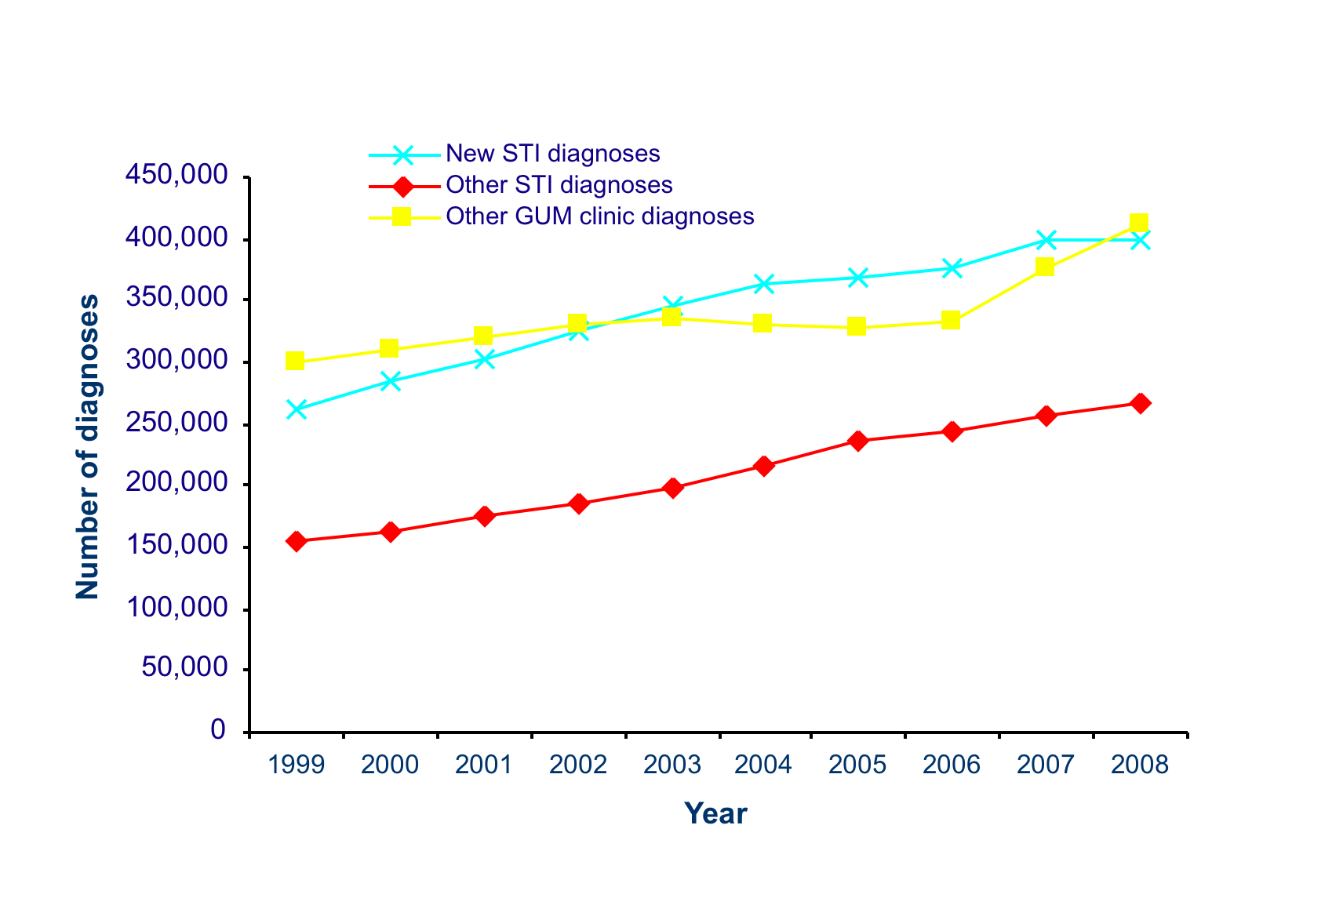
Trends in diagnoses made in GUM clinics in the UK: 1999 – 2008
Routine GUM clinic returns
Notes:
2million visits to GUM clinics in 2008

Slide 9
How Common Are STIs?
 |  | % change
 | 2008 | 2007-2008 | 1999-2008
Infection A | 123,018 | 1% | 116%
Infection B | 92,525 | 3% | 29%
Infection C | 28,957 | 10% | 65%
Infection D | 16,629 | - 11% | 1%
Infection E | 2,524 | - 4% | 1,032%

Slide 10
Diagnoses of selected STIs, GUM clinics, United Kingdom
 |  | % change
 | 2008 | 2007-2008 | 1999-2008
Chlamydia | 123,018 | 1% | 116%
Genital warts | 92,525 | 3% | 29%
Genital herpes | 28,957 | 10% | 65%
Gonorrhoea | 16,629 | - 11% | 1%
Syphilis | 2,524 | - 4% | 1,032%
Notes:
10
So how common are STIs?
2 million GUM clinic attendances per annum
¾ millions STIs were diagnosed in GUM clinics and through the NCSP in 2009
In the last 10 years there has been a substantial increase in diagnoses of many STIs.
It is likely that increased transmission through unsafe sexual behaviour, especially among men who have sex with men (MSM), has contributed to the overall rise in STI diagnoses.
Also more sensitive molecular diagnostic tests [NAAT tests for CT and HSV for e.g.] and increased testing for certain STIs e.g. NCSP [30% coverage of 16 – 24 year olds in 2009]
Previous decline in GC in recent years but 6% increase in 2009

Slide 11
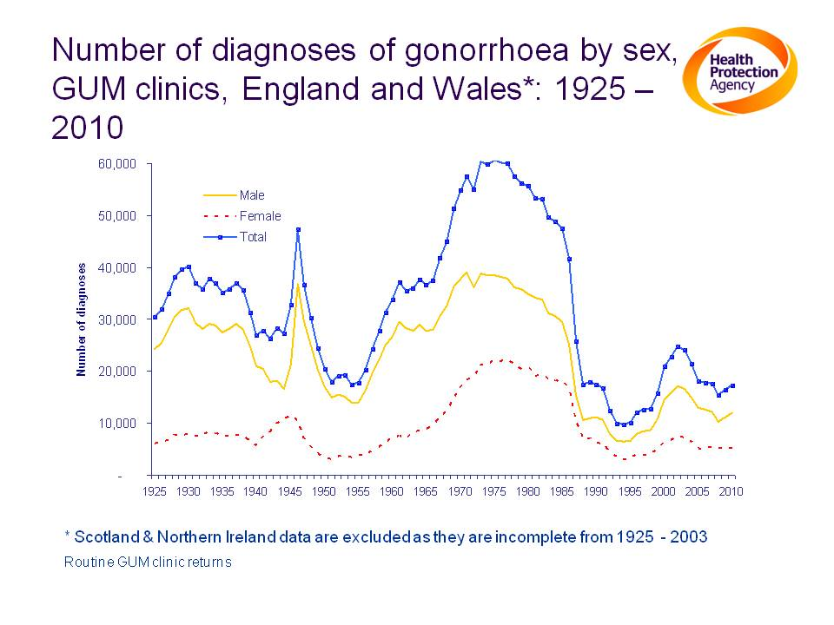
Notes:
Number of diagnoses of gonorrhoea by sex, GUM clinics, England & Wales*: 1925 – 2010
Diagnoses of gonorrhoea rose steadily during the 1960s and 70s and remained at high levels until 1985, thereafter decreasing sharply to their lowest levels since recording began. Diagnoses of gonorrhoea began to rise in the mid-1990s until 2002, since when they have steadily fallen. The decline in the incidence of uncomplicated gonorrhoea between 1985 and 1988 may reflect changes in sexual behaviour brought about in response to the HIV epidemic. The subsequent rise observed from 1994 to 2002 suggested increasing unsafe sexual behaviour during this period.

Slide 12
Risk Groups and Risk Factors for STIs
  Young people [16 – 24]
  BME
  MSM [esp HIV +ve]
  Living in a city
  Deprivation
  2 or more partners in 12 months
  Concurrent relationships
  Non-use of condoms
  Alcohol and/or drug misuse
  Mental health disorders
Many of the above factors are interrelated
Notes:
And who gets STIs?
61% of London PCTs are in the top quartile for STI diagnosis rates
12

Slide 13
Percentage Of All Diagnoses Of STIs And HIV That
Occurred In Young Adults (16-24), UK: 2008
Notes:
Now to illustrate some of these risk factors for STIs starting with young people who are the group most at risk of acquiring an STI
Take home messages about young people and STIs
Represent 12% of the population but have almost 50% of the entire populations STI burden
In 2009 young people had 65% of CT, 50% of GC, 55% of warts and 43% of herpes
Young women and certain ethnic minorities most at risk
Young people are also the group most likely to be re-infected with an STI
In England, at least 11% of 16 to 19 year old women and 12% of 16 to 19 year old men presenting with an acute STI at a GUM clinic will become re-infected with an STI within a year
Black and mixed race young people represented 21% of all GC diagnoses
In women, rates of CT and GC peak at age 19; herpes at 20
In men rates of GC, CT and HSV peak at 20, 21 and 23 respectively
Underlying factors include increased access to testing but mostly due to increased sexual activity, partner change and sex without condoms
25% of young people in NATSAL in 2000 reported sex under 16 and 50% of 1st sex was without a condom

Slide 14
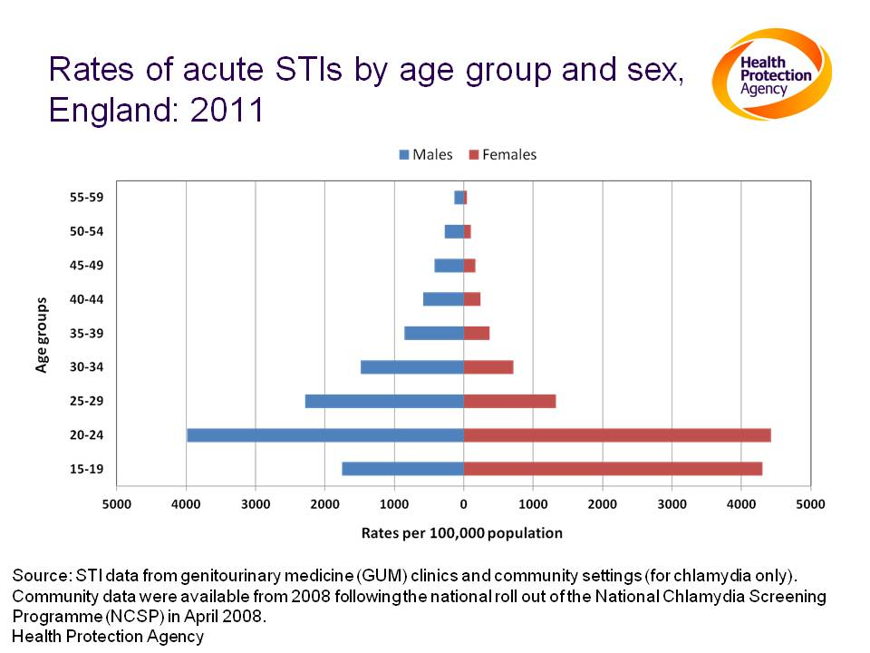
Notes:
Notes:
STIs included. Chlamydia, gonorrhoea, syphilis, genital herpes (first episode), genital warts (first episode), non specific urethritis, chancroid, LGV, donovanosis, molluscum, trichomoniasis, scabies, pubic lice. Includes data on chlamydia from community-based settings.
Young adults aged under 25 years experience the highest rates of STIs.

Slide 15
Proportions Of New HIV, Gonorrhoea, Syphilis And Chlamydia Diagnoses Among Heterosexuals Of Different Ethnic Groups, UK*, 2007.
*HIV diagnoses in the UK; gonorrhoea and syphilis diagnoses in England and Wales; chlamydia diagnoses in England.
Notes:
Black caribbeans and black africans are disproportionately affected by STIs
If we look first at the representation of these 2 ethnic minorities in the UK population on the far right we can see how disproportionately black caribbeans are affected by GC [less than 5% of the population of E and W but 26% of all heterosexual GC] and black africans are by HIV [1% of population but 70% of new heterosexual diagnoses]
15

Slide 16
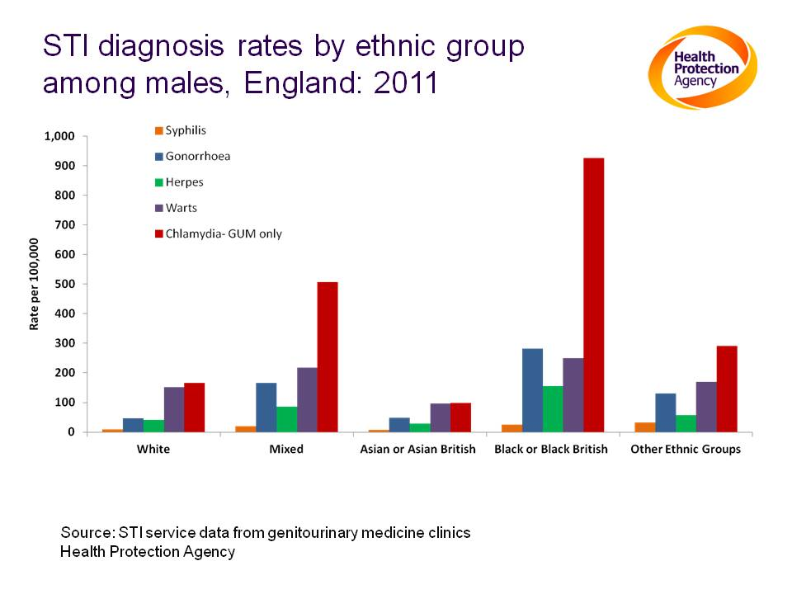
Notes:
STI diagnosis rates by ethnic group among males, England: 2011
The rates of diagnoses of syphilis, gonorrhoea, genital herpes, genital warts, and chlamydia were highest among men of ‘Black or Black British’ ethnicity (25/100,000, 281/100,000 , 156/100,000, 249/100,000, respectively) and lowest among those of ‘Asian or Asian British’ ethnicity.

Slide 17
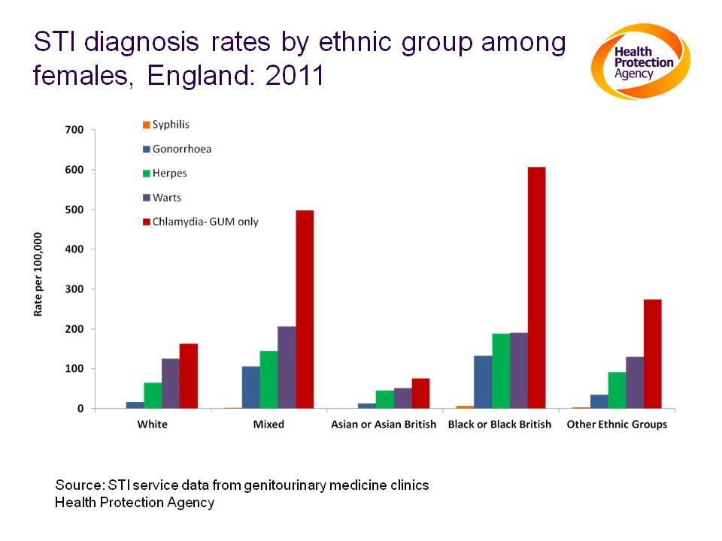
Notes:
STI diagnosis rates by ethnic group among females, England: 2011
Patterns of STI diagnosis rates are similar across ethnic groups, with rates of chlamydia being the highest for each ethnic group, followed by genital warts and rates of syphilis being the lowest. As in males, the rates of diagnoses of syphilis, gonorrhoea, genital herpes, genital warts and chlamydia were highest among females of ‘Black or Black British’ ethnicity (6.7/100,000, 132/100,000, 188/100,000 ,190/100,000 , 607/100,000 , respectively) and lowest among those of ‘Asian or Asian British’ ethnicity.

Slide 18
Diagnoses of selected STIs among MSM, UK
Notes:
On a population basis [415,000 MSM aged 15 -44 in UK] MSM are disproportionately affected by STIs – most STIs continue to rise year on year
In 2009, for cases in men where sexual orientation was recorded, about 66% of syphilis and 36% of gonorrhoea diagnoses in England were among
MSM
4% of MSM aged 50 having a screen at a GUM clinic have infectious syphilis – peak incidence in MSM
Older white MSM are particularly at risk, especially HIV positive MSM as illustrated on the next slide
18

Slide 19
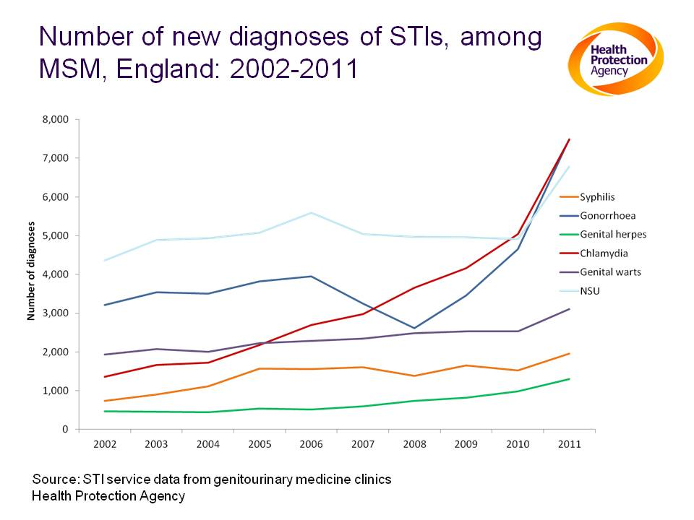
Notes:
Notes:
The number of diagnoses of STIs reported in MSM continues to rise. Gonorrhoea diagnoses increased by 61% in the past year (4,651 to 7,487 diagnoses), chlamydia diagnoses by 48% (5,045 to 7483), genital herpes diagnoses by 32% (979 to 1,301) syphilis diagnoses by 28% (1,523 to 1,955) and genital warts diagnoses by 23% (2,528 to 3,102)
A number of different factors are likely to have contributed to the sharp rise in diagnoses among MSM. More screening of extra-genital (rectal and pharyngeal) sites in MSM using highly sensitive Nucleic Acid Amplification Tests (NAATs) in response to new gonorrhoea testing guidance and the Lymphogranuloma venereum (LGV) epidemic

Slide 20
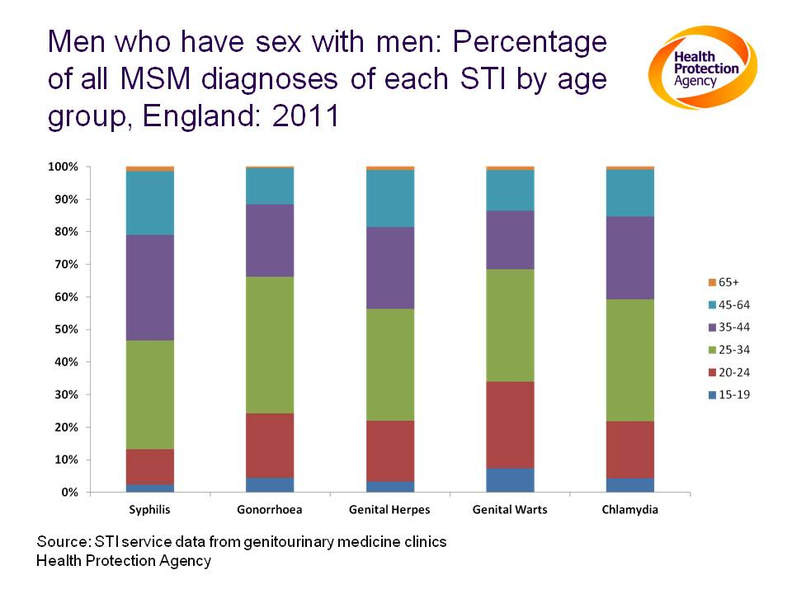
Notes:
Notes:
A significant proportion of STI diagnoses among MSM continues to be in the younger age groups with 34% of genital warts diagnoses, 24% of gonorrhoea, 22% of genital herpes and chlamydia and 13% of syphilis cases in those men aged 15-24.

Slide 21
HIV Co-infection Of New Cases Of Syphilis, Gonorrhoea And LGV Reported Through Enhanced Surveillance, Among MSM By Age Group, England & Wales
Notes:
2007 DATA
A high proportion of MSM with an acute STI in 2007 were also infected with HIV – 78% of those with LGV, 40% of those with syphilis, and 32% of those with GC
97% of MSM diagnosed with Hep C were HIV positive
During the latter half of 2009 and early 2010, diagnoses of LGV rose substantially, particularly in older, HIV-infected MSM
21

Slide 22
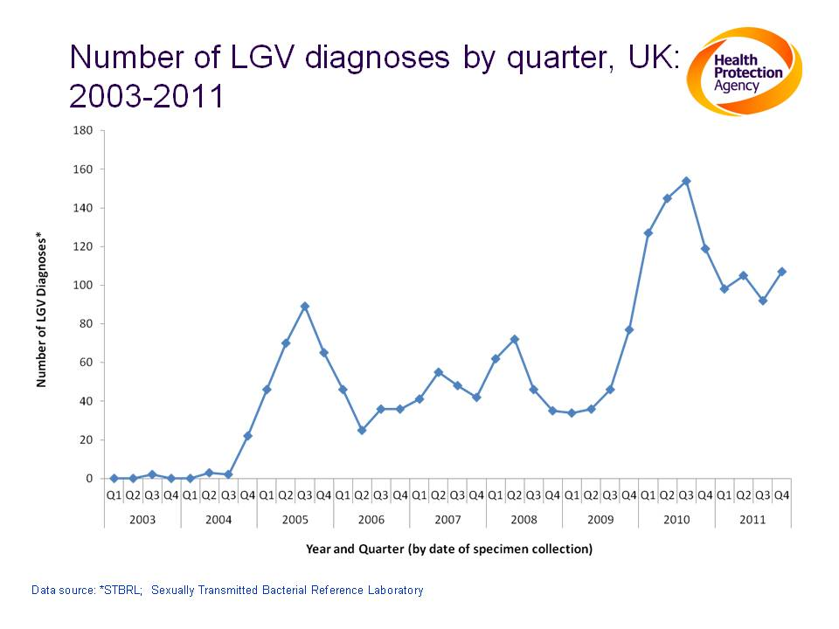
Notes:
Notes:
1,983 (>99%) diagnoses in MSM, 5 cases in heterosexual men, 2 in heterosexual women
Data from the Enhanced Surveillance of LGV (2004 to 2010) showed that the median age is 37 years (range 19-67) and that 88% of cases are of white ethnicity.

Slide 23
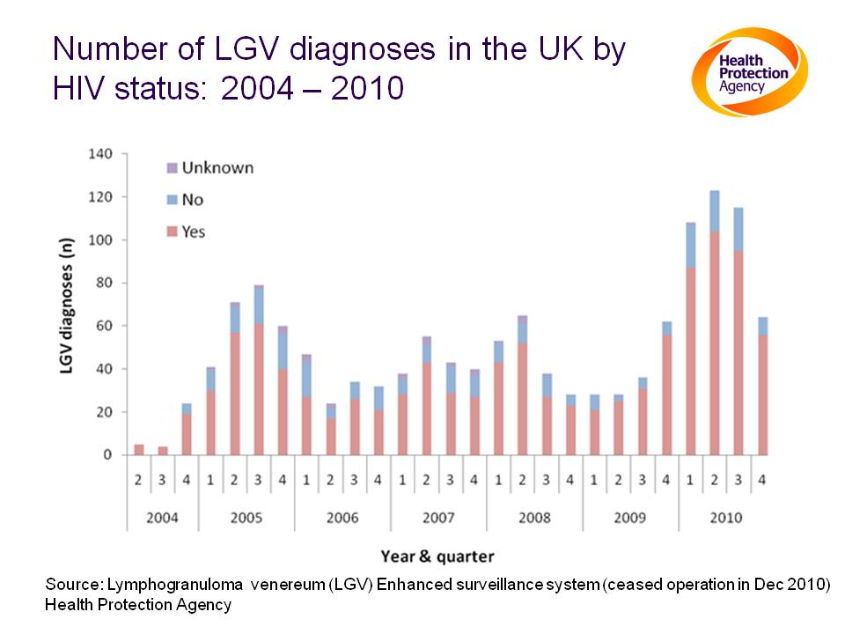
Notes:
Notes:
LGV enhanced surveillance ceased in December 2010
78% of LGV cases are co-infected with HIV, 4% of whom are diagnosed with HIV within 3 months of LGV diagnosis

Slide 24
Don’t Forget The Oldies......
HPA STI and HIV Surveillance data
  2008 - STI rates doubled in over 45s
  2010 - HIV diagnoses in over 50s doubled in last decade; estimated 50% acquired infection after 50
Sexually Transmitted Infections June 2010 - Dutch public health researchers “Older and swinging; need to identify hidden and emerging risk groups at STI clinics”
  Median age swingers 43
  CT prevalence 10%; GC prevalence 4%
  Older swingers [45+] accounted for 55% diagnosed STIs cw 31% for MSM
Sexual Health Week 2010 theme “Middle-age Spread”
Notes:
Heterosexuals over a certain age not traditionally viewed as at increased risk of STIs, but....................
SAGA didn’t ask about swinging in their survey but could be a whole new marketing strategy for saga coach trips – pick a freedom pass out of the bowl rather than the volvo keys perhaps….
Definition of a swinger…..heterosexual couples who are practising mate swapping, group sex, visit sex clubs for couples
24

Slide 25



Notes:
25

Slide 26
STI Service Objectives
Control of communicable diseases which have potentially serious effects upon
    Physical well-being
    Psychological well-being
STI control is essential to reduce HIV acquisition and transmission
Notes:
26

Slide 27
Linked Sexual Health Pathologies
Mental Health
Anogenital Cancers
Unintended pregnancies
STIs
HIV
Neonatal Infections
Subfertility
Notes:
27

Slide 28
Establishment of “VD” Clinics
    Public Health (VD) Regulations 1916
    Voluntary attendance, no doctors referral needed
    Confidentiality assured
    Free tests and treatment
1916 : Specialist clinics set up around the country : 113 by 1917
Notes:
28

Slide 29
Confidentiality
  The 1916 Regulation has been updated over the years:
  NHS (Venereal Diseases) Regulations 1974
  → Officers of all Health Authorities
  NHS Trusts and Primary Care Trusts
(Sexually Transmitted Diseases) Directions 2000
→ members or employees of NHS Trusts
Notes:
Keep separate paper and electronic records
The National Health Service (Venereal Diseases) Regulations 1974 (S.I.1974/29) imposed on health authorities an obligation to secure that information about sexually transmitted diseases obtained by their officers should be treated as confidential. In 1991 Directions were made imposing the same obligations on trustees and employees of a National Health Service trust. These are now revoked in relation to England. These new Directions, which apply only to England, impose the same obligations of confidentiality on the members and employees of both NHS trusts and Primary Care Trusts.
29

Slide 30
What’s In a Name?
VD [Venereal Diseases] clinic
Special Clinics
GUM [Genitourinary Medicine] Clinics
Sexual Health Clinics
Integrated Sexual Health Services

Slide 31
Sexual Health Clinics Today
National network of clinics
  Most major cities, towns
  Consultant-led service
Providers:
  Acute Trust
    Integration with HIV/AIDS inpatient services – may change
    Linked to other acute services e.g. ID medicine, urology, dermatology, gynae
    Increasing provision of contraception services – will be core
  Community Care Trust
    Often GP, family planning (CASH) settings
    Co-location / integration with other sexual health services
  Private/third sector - as many in London as NHS services
Notes:
31

Slide 32
Range of GUM Services
Core services
Surveillance
Screening
Diagnosis & treatment
Prevention of STI/HIV
Partner notification
Sexual health promotion
Teaching and training
Research
Outreach services
Vulval/genital dermatology
Adolescent health care
Sexual assault services
Contraception including LARC
Screening for CIN/AIN
MSM clinics
Psychosexual services
Notes:
32

Slide 33
Core Principles of STI Management
  Diagnostic tests [where possible POCT] before treatment
  Screen for other STIs
  Simple effective treatment regimens[>95% cure rate for bacteria]; where possible DOT
  Follow-up after treatment
  Partner notification and epidemiological treatment
  Non-judgemental patient information, risk reduction support
Notes:
33

Slide 34
Taking A Sexual History

Slide 35
Why take a sexual history?
Notes:
35

Slide 36
Why take a sexual history?
    to assess clinical condition
    to assess risk for STIs (including HIV)
    plan tests
    enable partner notification
    identify need for vaccination
    aid the provision of health promotion
    Discuss, provide contraception
    research

Slide 37
What's different about a sexual history?
Notes:
37

Slide 38
What's different about a sexual history?
    Emotional issues
    Emotive issues
    Embarrassment
    Involves other people
    Attendance as a contact
    Moral/legal issues

Slide 39
What concerns might a patient attending STI clinic have?
Notes:
39

Slide 40
What concerns might a patient attending STI clinic have?
Confidentiality
The unknown
Being examined
Shock / embarrassment
Anger (waiting times, partner)
Privacy once within the clinic
Taking time off work
  Difficulty talking about sex
  Fear of stigmatisation & of disapproval
  Risk of spreading an infection (partner or baby)
  Have I got disease? / Is it curable? / What are the long-term effects?

Slide 41
Taking a Sexual History – Key Info
Symptoms [in self; in partner/s]
When last had sex
Who with [M or F; regular or casual; where from]
Type of sex [vaginal; oral; anal]
Condom use [for each of above]
When last had sex with a different partner [risks of concurrent relationships; inconsistent condom use with different partners; partner notification issues]
Previous STIs/treatment
HIV risk factors [if MSM having UPAI do they know status of partner/s?]
Notes:
41

Slide 42
Who needs a sexual history?
A – 75 year old man with dementia
B – A 24 year old man who has fractured his wrist playing football
C – A 19 year old lady with acute arthritis of her wrist and shoulder
D – A 23 year old man with a urethral discharge

Slide 43
Clinical Scenarios
Notes:
43

Slide 44
All in a days work……
  New HIV diagnosis
  Acute and chronic STIs
  Dermatological presentations
  Gynaecological and urological presentations
  Relationship issues
  Sexuality issues
  Commercial sex workers
  Sexual assault/ rape
  Child protection
  People from all backgrounds

Slide 45
How Might STIs In Men Present?

Slide 46
How Might STIs In Men Present?
Urethral discharge[+/-rectal discharge]
Dysuria
Scrotal pain/swelling
Ulceration; painful/painless
Rash/sores
“Lumps/growths”
Anorectal symptoms
Systemic symptoms

Slide 47
Case 1
17 year old man concerned about lumps on his penis
What do you want to ask him?

Slide 48
History
Noticed a few months ago
Unsure if they have changed
Not painful or symptomatic in any way
Never had any sexual contact

Slide 49
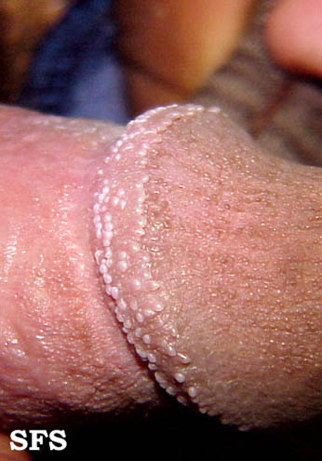

Slide 50
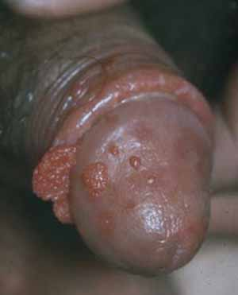

Slide 51
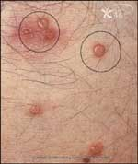

Slide 52
How Might STIs In Women Present?

Slide 53
How Might STIs In Women Present?
Vaginal discharge [+/- urethral, rectal]
Ulceration; painful/painless
Itching/soreness
Rashes
“Lumps/growths”
Abnormal bleeding; IMB, PCB
Abdominal pain [and/or lower back pain]
Dyspareunia [pain during sex]
Dysuria
Anorectal symptoms
Systemic symptoms

Slide 54
Case 2
21 year old women
C/o vaginal discharge
Treated for similar symptoms a few weeks ago with clotrimazole pessary
What do you want to ask her?

Slide 55
Questions re discharge
Colour, consistency, amount, variability
Smell
Itch
Associated symptoms – abnormal bleeding, pain, urinary symptoms, rash, bumps

Slide 56
Normal vaginal discharge

Slide 57
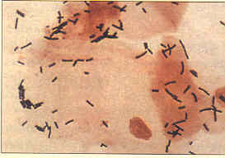

Slide 58
Normal Vaginal Discharge
Varies+++
  Within an individual
  Throughout the menstrual cycle
  In colour
  In amount
Normal vaginal discharge can seem abnormal!

Slide 59
Complaint of Vaginal Discharge
Step 1
Take History (esp. sexual). Determine Risk
Step 2
Do Exam, Pass speculum
Step 3
Clean and Inspect Cervix
Step 4
Observe nature of Vaginal Discharge- Tests
Step 5
Give Prevention Messages
Notes:
There are 5 essential steps in the vaginal discharge algorithm:
Step 1: We have just seen how the Risk Score is determined.
Step 2 speaks for itself.
Progress after steps 3 to 4 depends on clinical findings.
Step 5: The prevention messages have already been outlined under STI Care Management, and will be summarised later.

Slide 60
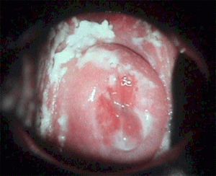

Slide 61
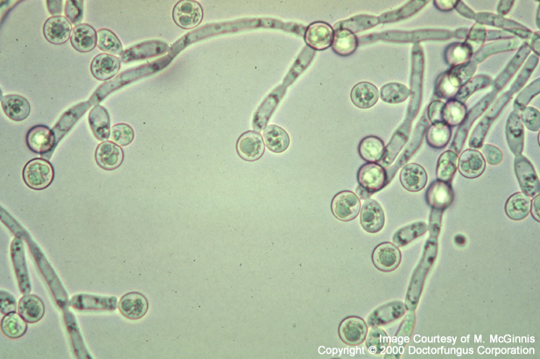

Slide 62
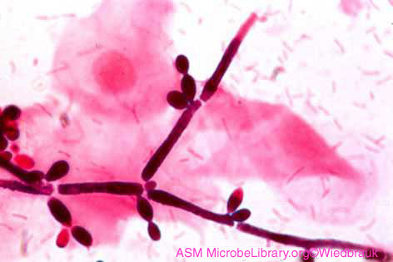

Slide 63
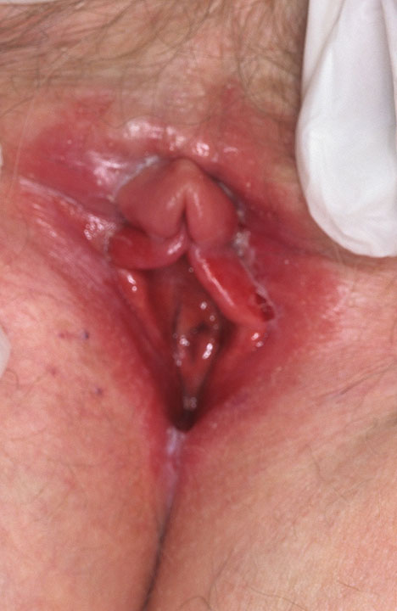

Slide 65
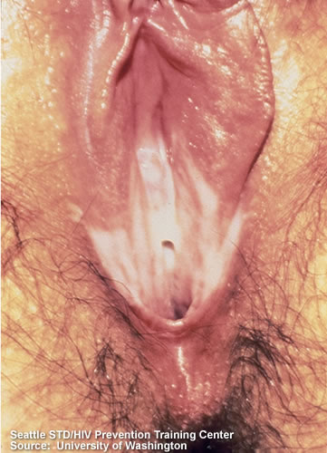
Notes:
Grey, homogenous vaginal discharge

Slide 66
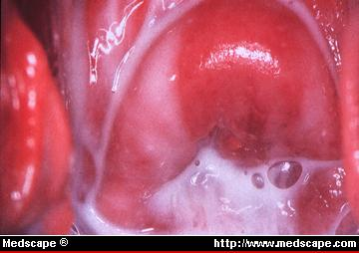

Slide 67
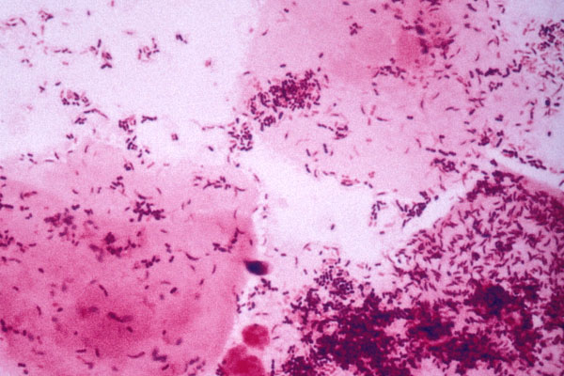
Notes:
Mixed bacteria/no lacto and clue cells (Grade 3)

Slide 69
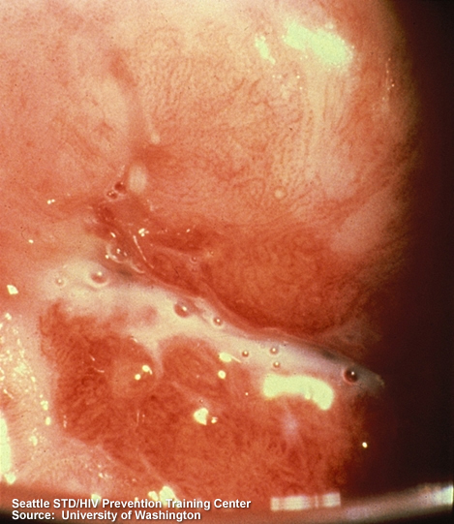

Slide 70


Slide 71
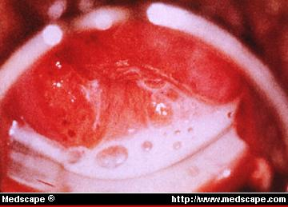

Slide 72
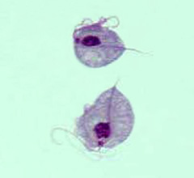

Slide 74
SEXUALLY TRANSMITTED INFECTIONS
DISCHARGE
Gonorrhoea
Chlamydial infection
Trichomoniasis
NSU/NSC
Candidal infection
Bacterial vaginosis
ULCERATION
Syphilis
Herpes simplex
LGV
Chancroid
Donovanosis
Primary HIV
RASHES, LUMPS/GROWTHS
Genital warts
Molluscum contagiosum
Scabies
Pubic lice
HIV
DIARRHOEA/GI SYMPTOMS
LGV
Syphilis
Shigella [Salmonella]
Amoebiasis
Giardia
Worms

Slide 75
SEXUALLY TRANSMITTED INFECTIONS
Bacterial
Gonorrhoea
Chlamydia
LGV
Syphilis
NSU/NSC
Donovanosis
Chancroid
Viral
Herpes simplex [1/2]
Hepatitis A/B/C
HIV
Genital warts
MC
Protozoa/other
Trichomonas
Giardia
Scabies
Pubic lice

Slide 76
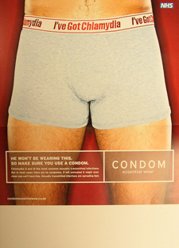
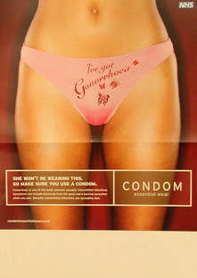

STI Prevention And Control
Education/health promotion
Condoms [M/F]; other barriers
Vaccination – HBV, HPV
Partner numbers
Rapid access to diagnostic testing and treatment
Partner notification
  Difficult in some groups with high partner numbers
Microbicides

Slide 77
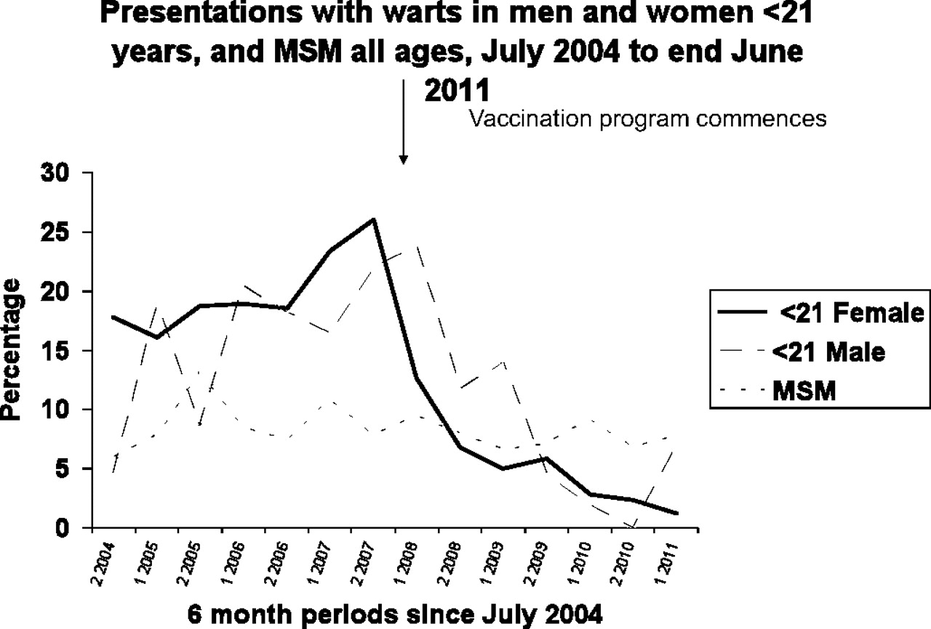

Slide 78
GUM/HIV?
Interest in sexual health
Interest in public health
High throughput
High satisfaction
Long term patients
Travel/ international work
Research opportunities; formal academic training
Don’t assume 9 – 5
Private work
High prestige
Major practical procedures

Slide 79
Personal Qualities For GUM/ HIV
Ability to be at ease with patients and cope with chaotic, anxious patients
Good interpersonal skills
  essential as it is often necessary to deal with highly emotionally charged situations
An interest in other people and relationships
Probably not suited to people interested in high-tech care

Slide 80
Speciality Training
F1 and FT2
ST1 ST2 Acute Medicine
CCST Consultant
ST3-6 GUM MRCP DipGUM DipHIV DFFP
Notes:
Public health now part of curriculum

