Slide 1
Clinical quality improvement
Claire Woolcock
Consultant Pyschiatrist
Colin Bicknell
Senior Lecturer and Hon Consultant Surgeon
Deputy Vertical Theme Head Ethics, Professionalism, Leadership and Management
colin.bicknell@imperial.ac.uk
Imperial College London

Slide 2
INTRODUCTION
The NHS Alternative Health Care Models Quality and learning from our mistakes Quality measurement and monitoring Driving quality improvement
Imperial College London

Slide 3
The good old days of the NHS
Imperial College London

Slide 4
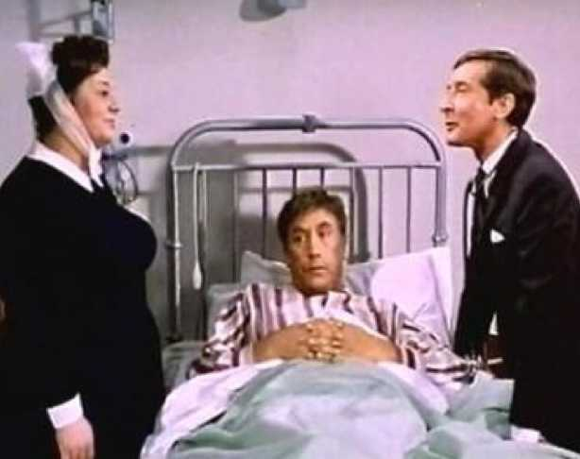
The good old days of the NHS
Imperial College London

Slide 5
Sir Cyril Chantler
’Medicine used to be simple, ineffective and relatively safe. It is now complex, effective and potentially dangerous’.
Imperial College London

Slide 6
QUESTIONS
Harold Higgins needs an oesophagectomy for an early gastrooesophageal carcinoma and wants to exercise his right to patient choice. In choosing where he has this operation which of the following would not be of any use?
www.Ratemydoctor.com
Institutions quality account
Picker report
Care Quality Commission report
National quality standards authority (NQSA) information
Imperial College London

Slide 7
QUESTIONS
The Care Quality Commission are coming to visit your hospital where you work as an FY1. Which of the following is the CQC not responsible for:
Reviewing hospital standards
Rating efficiency of care
Overseeing merging of services
Rating patient satisfaction
Rating safety of care provided
Imperial College London

Slide 8
QUESTIONS
Veronica Bulger is one of your patients undergoing varicose vein repair and asks you, the FY1 why she has to fill out the questionnaires beforehand. What is the best response to this query?
It is important to assess whether the GPs are getting value for money
It is important to prove patients are happy to convince GPs to pay for varicose veins.
Don’t bother, just throw it away…no one looks at it anyway
Varicose vein surgery is one of four key procedures where patient related outcome measures are assessed as a marker of quality
So we can relate patient satisfaction to the duplex results and show what works for patients of the future.
Imperial College London

Slide 9
Imperial College London

Slide 10
Delivery of Quality Care at a National Level The NHS and other examples of delivery from around the world.
Imperial College London

Slide 11
The NHS
‘On 5 July we start together, the new National Health Service. It has not had an altogether trouble-free gestation. There have been understandable anxieties, inevitable in so great and novel an undertaking. But the sooner we start, the sooner we can try…to secure the improvements we all want. My job is to give you all the facilities, resources and help I can, and then to leave you alone as professional men and women to use your skills and judgement without hindrance. Let us try to develop that partnership from now on.' - Aneurin Bevan, The Lancet, 1948
Imperial College London

Slide 12
The Aims of the NHS
That it meet the needs of everyone
That it be free at the point of delivery
That it be based on clinical need, not ability to pay
Imperial College London

Slide 13
The people that affect everything you do in Healthcare
Parliament
Department of Health
PCTs
SHAs
Providers and Commissioners
Imperial College London

Slide 14
How the money goes round
Imperial College London

Slide 15
The White Paper (again)
Putting Patients First
Making it Happen
Vision
Improving Healthcare Outcomes
Autonomy & Accountability
Improving Efficiency
Imperial College London

Slide 16
Other healthcare systems
US- 35-60% private insurance; 30% government funded; 15-30% uninsured
16% of GDP
46th in life expectancy
Less than half of Americans with mental illness receive treatment
Sweden – organised at National, Regional and Local
9% of GDP
Tax payments pay for 97% of cost; pt pays for nominal examination fee
Imperial College London

Slide 17
Imperial College London

Slide 18
Quality Care at an Institutional Level High profile quality failures
Imperial College London

Slide 19
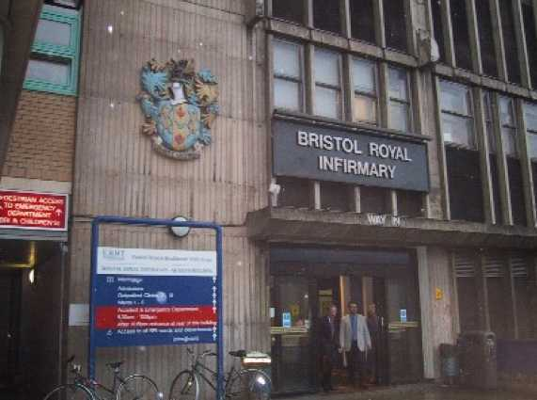
Bristol Royal Infirmary
Imperial College London

Slide 20
Bristol Royal Infirmary
….It now appears that at least 90 babies were affected, left dead or damaged as a result of the sub-standard treatment they received at the hospital in the late 1980s and early 1990s….
Imperial College London

Slide 21
Bristol Inquiry
To inquire into the management of the care of children receiving complex cardiac surgical services at the Bristol Royal Infirmary between 1984 and 1995 and relevant related issues; to make findings as to the adequacy of the services provided; to establish what action was taken both within and outside the hospital to deal with concerns raised about the surgery and to identify any failure to take appropriate action promptly; to reach conclusions from these events and to make recommendations which could help to secure high-quality care across the NHS.
Imperial College London

Slide 22
Bristol Inquiry
To inquire into the management of the care of children receiving complex cardiac surgical services at the Bristol Royal Infirmary between 1984 and 1995 and relevant related issues; to make findings as to the adequacy of the services provided; to establish what action was taken both within and outside the hospital to deal with concerns raised about the surgery and to identify any failure to take appropriate action promptly; to reach conclusions from these events and to make recommendations which could help to secure high-quality care across the NHS.
Evidence from 577 witnesses, including 238 parents, was received in writing. The Inquiry also received 900,000 pages of documents, including the medical records of over 1,800 children. Oral evidence of selected witnesses was taken over 96 days.
Imperial College London

Slide 23
Bristol Inquiry
To inquire into the management of the care of children receiving complex cardiac surgical services at the Bristol Royal Infirmary between 1984 and 1995 and relevant related issues; to make findings as to the adequacy of the services provided; to establish what action was taken both within and outside the hospital to deal with concerns raised about the surgery and to identify any failure to take appropriate action promptly; to reach conclusions from these events and to make recommendations which could help to secure high-quality care across the NHS.
Evidence from 577 witnesses, including 238 parents, was received in writing. The Inquiry also received 900,000 pages of documents, including the medical records of over 1,800 children. Oral evidence of selected witnesses was taken over 96 days.
The story of the paediatric cardiac surgical service in Bristol is not an account of bad people. Nor is it an account of people who did not care, nor of people who willfully harmed patients….
Imperial College London

Slide 24
Bristol Inquiry
To inquire into the management of the care of children receiving complex cardiac surgical services at the Bristol Royal Infirmary between 1984 and 1995 and relevant related issues; to make findings as to the adequacy of the services provided; to establish what action was taken both within and outside the hospital to deal with concerns raised about the surgery and to identify any failure to take appropriate action promptly; to reach conclusions from these events and to make recommendations which could help to secure high-quality care across the NHS.
Evidence from 577 witnesses, including 238 parents, was received in writing. The Inquiry also received 900,000 pages of documents, including the medical records of over 1,800 children. Oral evidence of selected witnesses was taken over 96 days.
The story of the paediatric cardiac surgical service in Bristol is not an account of bad people. Nor is it an account of people who did not care, nor of people who wilfully harmed patients.
…It is an account of a time when there was no agreed means of assessing the quality of care. There were no standards for evaluating performance. There was confusion throughout the NHS as to who was responsible for monitoring the quality of care….
Imperial College London

Slide 25
Bristol Inquiry
To inquire into the management of the care of children receiving complex cardiac surgical services at the Bristol Royal Infirmary between 1984 and 1995 and relevant related issues; to make findings as to the adequacy of the services provided; to establish what action was taken both within and outside the hospital to deal with concerns raised about the surgery and to identify any failure to take appropriate action promptly; to reach conclusions from these events and to make recommendations which could help to secure high-quality care across the NHS.
Evidence from 577 witnesses, including 238 parents, was received in writing. The Inquiry also received 900,000 pages of documents, including the medical records of over 1,800 children. Oral evidence of selected witnesses was taken over 96 days.
The story of the paediatric cardiac surgical service in Bristol is not an account of bad people. Nor is it an account of people who did not care, nor of people who wilfully harmed patients.
…It is an account of a time when there was no agreed means of assessing the quality of care. There were no standards for evaluating performance. There was confusion throughout the NHS as to who was responsible for monitoring the quality of care….
The aim of these and all our recommendations is to produce an NHS in which patients' needs are at the centre and in which systems are in place to ensure safe care and to maintain and improve the quality of care.
Imperial College London

Slide 26
So….
What would you have changed?
What actions would you have taken?
Name Five…
Imperial College London

Slide 27
Bristol Inquiry
A turning point in the history of the NHS
It changed:
"old boy's" culture among doctors
patients being left in the dark about their treatment
a lax approach to clinical safety
secrecy about doctor's performance
lack of external monitoring of NHS performance.
Imperial College London

Slide 28
Bristol Inquiry
Greater openness about clinical performance, allowing patients to access information about the relative performance of hospitals, services or consultant unit.
Individual results for cardiac surgeons
Agencies created for monitoring safety and quality
Imperial College London

Slide 29
Bristol Inquiry
Greater openness about clinical performance, allowing patients to access information about the relative performance of hospitals, services or consultant unit.
Individual results for cardiac surgeons
Agencies created for monitoring safety and quality
Is this a good thing?
Imperial College London

Slide 30
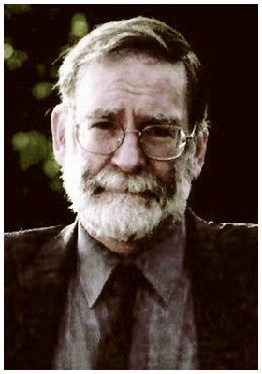
Imperial College London

Slide 31
“I will use my power to help the sick to the best of my ability and judgment; I will abstain from harming or wronging anyone by it. I will not give a fatal draught to anyone if I am asked, nor will I suggest any such thing.”
From the Hippocratic oath
Imperial College London

Slide 32
Harold Shipman
Imperial College London

Slide 33
Excess Death
Imperial College London

Slide 34
AUDIT
Imperial College London

Slide 35
The Enquiry
Function and strength of the GMC
The role of revalidation
How we deal with sick doctors
The purpose and reliability of death certification
The monitoring of cremation certification
The use of controlled drugs
The problem of isolated doctors
The value of clinical governance
The problems of whistleblowing
The function of the coroners' service.
Imperial College London

Slide 36
Imperial College London

Slide 37
High Quality Care for All
Simple monitoring of what is achieved is not the whole story
“Nationally, the NHS in the 21st century faces different challenges:
rising expectations
demand driven by demographics
the continuing development of our ‘information society’
advances in treatment
the changing nature of disease
changing expectations of the health workplace.”
Imperial College London

Slide 38
“Quality at the heart of everything we do”
Bring clarity to quality
Measure quality
Publish quality performance
Recognise and reward quality
Raise standards
Safeguard quality
Stay ahead
Imperial College London

Slide 39
What is quality?
Imperial College London

Slide 40
Poor Quality
Imperial College London

Slide 41
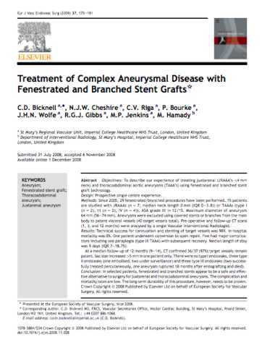
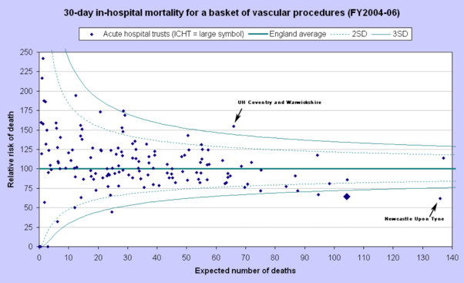
Quality in terms of outcomes only?
Imperial College London

Slide 42
Dimensions of Quality
Must be understood from the patients perspective
Includes:
Experience: Quality of caring
Effectiveness: Clinical outcomes and PROMS
Safety: Measurement of avoidable error and adverse outcome
Experience
Effectiveness
Safety
Imperial College London

Slide 43
PROMS
What are PROMS?
What is the best measure of successful lower limb revascularisation?
Imperial College London

Slide 44
How is quality measured and monitored?
Imperial College London

Slide 45
Quality
National – National Quality Board
Regional – Quality observatories responsible for Regional quality improvement
Institutional – Provide Quality Accounts and CQUIN targets
Individual – Benchmarking and Dashboards
Imperial College London

Slide 46
Institutional - Quality Accounts
Bring clarity to quality
Measure quality
Publish quality performance
Recognise and rewrd quality
Raise standards
Safeguard quality
Stay ahead
Publishing quality performance
“…we will require, in legislation, healthcare providers working for or on behalf of the NHS to publish their ‘Quality Accounts’ from April 2010 – just as they publish financial accounts. These will be reports to the public on the quality of services they provide in every service line…
Imperial College London

Slide 47
Health Regulators
Imperial College London

Slide 48
Formerly the Healthcare Commission
Independent healthcare watchdog
All health and adult social care in England.
Registers, licenses and monitor healthcare standards
Reviews Hospital Standards each year in an “annual health check”
Rates quality of care as well as efficiency
Patient safety
Patient experience
Imperial College London

Slide 49
Health Regulators
NICE is an independent organisation responsible for providing national guidance on promoting good health and preventing and treating ill health.
NPSA is an arms length body that contributes to improved, safe patient care by informing, supporting and influencing organisations and people working in the health sector. Eg National reporting and learning service
The Medical Research Council (MRC) is a publicly funded organisation dedicated to improving human health. It supports research

Slide 50
Health Regulators
The HPA is an independent UK organisation that was set up by the government in 2003 to protect the public from threats to their health from infectious diseases and environmental hazards.
The MHRA is responsible for the regulation of medicines and medical devices and equipment used in healthcare and the investigation of harmful incidents.
The Human Tissue Authority (HTA) is a watchdog that licenses organisations that store and use human tissue for purposes such as research, patient treatment, post-mortem examination, teaching, and public exhibitions.

Slide 51
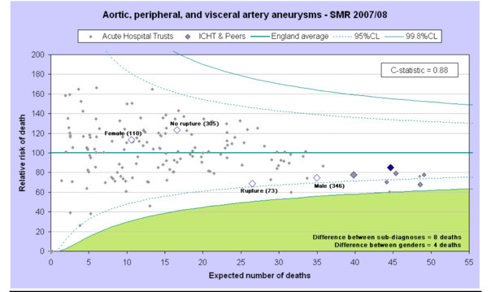
Quality Assessment
Imperial College London

Slide 52
Imperial College London

Slide 53
Quality improvement at a Team level How does this happen?
Imperial College London

Slide 54
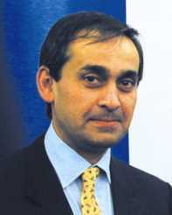
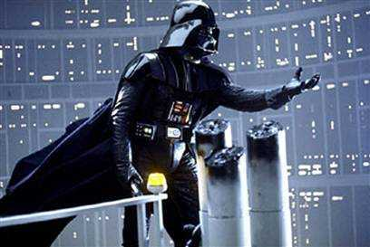
Who is responsible for leading quality improvement?
Imperial College London

Slide 55
Next Stage Review
Lord Darzi highlighted the growing need for all doctors to fulfill a leadership role in their practice
“Clinicians are expected to offer leadership and where they have appropriate skills take senior management and leadership posts in research, education and service delivery.”
Imperial College London

Slide 56
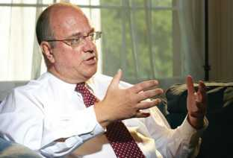
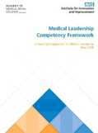
Begin to Lead – drivers...
The NHS is only just beginning to grasp the importance of leadership. We have not systematically identified, nurtured and promoted talent and leadership.
(Leadership for Quality, Jan 2009)
It is unrealistic to expect NHS staff to take on leadership without action to make it integral to training and development. So we will explore ways to ensure that the undergraduate curricula for all medical and nursing students reflect the skills and demands of leadership and working in the NHS. (HQCfA, July 2008)
Tomorrow’s doctors
Medical Leadership Competency Framework

Slide 57
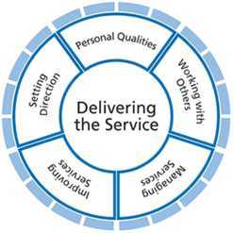
Medical Leadership Competency Framework Framework
Developing personal awareness
Managing yourself
Continuing personal development
Acting with integrity
5 “Domains”
Knowledge
Skills
Behaviours and Attitudes
Identifying contexts for change
Applying knowledge and evidence
Making decisions
Evaluating impact
Developing networks
Building and maintaining relationships
Encouraging contribution
Working within teams
Ensuring patient safety
Critically evaluate
Encourage improvement and innovation
Facilitate improvement
Planning
Managing resources
Managing people
Managing performance

Slide 58
Management and Leadership: GMC
Management and Leadership themes one of the essential learning requirements of medical students.
Tomorrow’s Doctors 2009 states:
The graduate will be able to learn and work effectively within a multi-professional team:
Understand and respect the roles and expertise of health and social care professionals, including doctors, in the context of working and learning as a team, as well as in policy and practice development.
Work with colleagues in ways that best serve the interests of patients, passing on information and handing over care.
Demonstrate ability to play various team roles including leadership.
Deal effectively with uncertainty and change.
Imperial College London

Slide 59
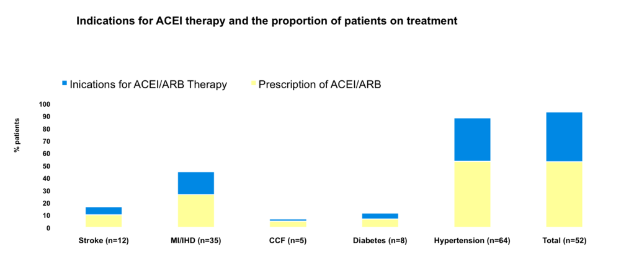
ACE Inhibition in Aneurysm patients
Quality Improvement
Imperial College
London
Imperial College London
Notes:
56.7%

Slide 60
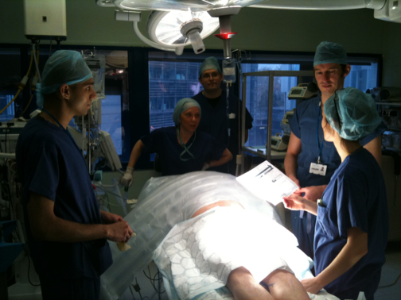
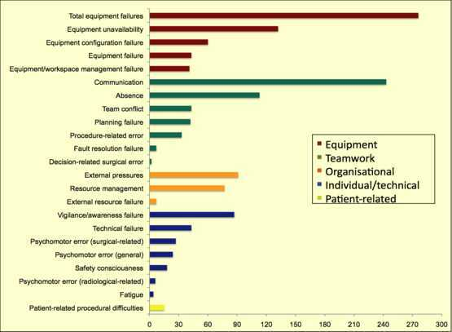
Measuring Safety and Efficiency
Quality Improvement
250 hours of operating time studied by direct observation and blinded error analysis
Imperial College
London
Imperial College London

Slide 61
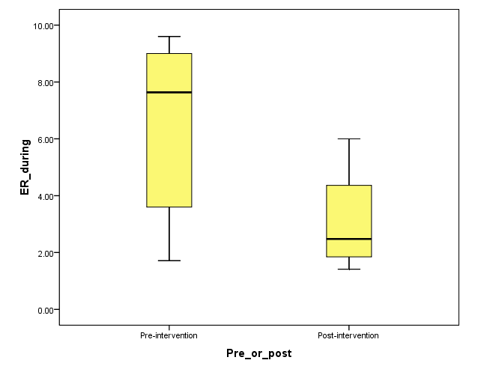
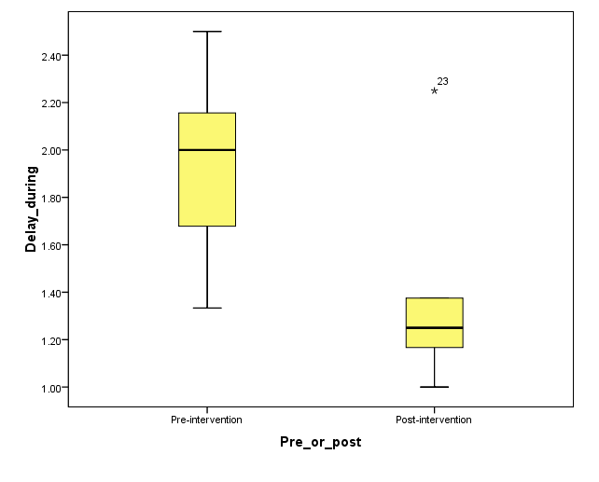
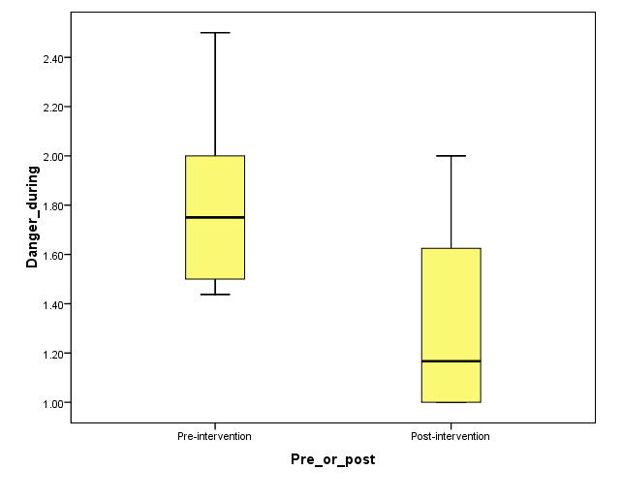
QUALITY IMPROVEMENT
Errors/hour
Procedure disruption
Error significance
Imperial Mental Team Rehearsal Study:
Combined procedures
PRE
POST
PRE
POST
PRE
POST
Imperial College
London
Imperial College London
Notes:
*In a sub-analysis of endovascular cases, very broadly if you look at where these failures occur in the intraoperative timeline, the majority were identified in the endovascular stage of the procedure – that is, the stenting phase involving the interventional radiology team.
*Some may argue that this pattern was seen because the stenting phase is the lengthiest part of the procedure. However, it is important to mention that some endovascular cases also involved a hybrid repair phase that continued for several hours either before or after the stenting phase.

Slide 62
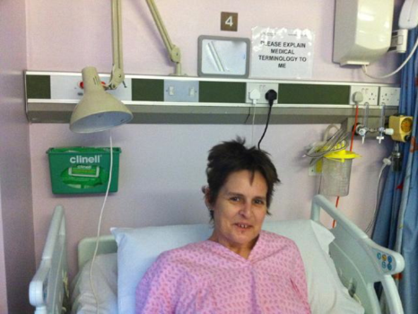
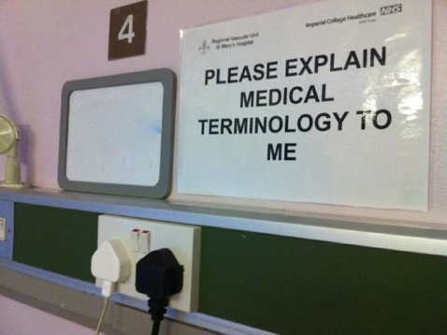
Quality Improvement
Influencing behavior
Imperial College
London
Imperial College London

Slide 63
Imperial College London

Slide 64
Improving Management and Leadership Skills in Undergraduate Medicine Clinical Quality Improvement Assignment
Imperial College London

Slide 65
Clinical Quality Improvement Assignment in the Third Year
PLAN:
Project identification
Evaluation of service
Tutors - help steer your project work and smooth troubled group dynamics.
Poster design
Poster presentations
2nd Medical attachment in third year
Imperial College London

Slide 66
Clinical Quality Improvement Assignment in the Third Year
The poster format should be on a series of A4 sheets that can be joined together to describe your work. The following should be addressed on each poster:
Identification of a deficiency in service quality
Evaluation of the problem
Development of an effective improvement strategy and how this may take place
Reasons for choosing this method as opposed to other methods
Imperial College London

Slide 67
Clinical Quality Improvement Assignment in the Third Year
The posters will be assessed on the strength of a proposal to make a locally relevant, important and feasible impact on service quality.
The improvement strategies must be feasible and cost-effective, a multimillion pound redesign of the ward for example is not practical and unlikely to happen.
Imperial College London

Slide 68
Clinical Quality Improvement Assignment in the Third Year
Who will be sources of advice?
What aspects of quality of care could you study?
Imperial College London

Slide 69
Clinical Quality Improvement Assignment in the Third Year
Examples:
Patient dissatisfaction, not being involved in their care
A patient safety issue, where staff are often searching for sharps bin after taking blood
Microbiology results not being recorded and acted on effectively
Imperial College London

Slide 70
Clinical Quality Improvement Assignment in the Third Year
Choose one of the scenarios:
How will you evaluate the problem
What ideas do you have to develop an effective improvement strategy
Imperial College London

Slide 71
Clinical Quality Improvement Assignment in the Third Year
The work will be performed in the same clinical groups as attachments
Keep the 21st March free for the Winners prize session at the Business School.
Imperial College London

