Slide 1
The expanded case study + significant events and the ePortfolio
Dr Adrian Raby
Vertical Theme Lead in Patient Centred Education
a.raby@imperial.ac.uk

Slide 2
Clinical assessment
CLINICAL SCIENCE

Slide 3
Clinical assessment
Thrombolysis, BP, lipids, etc
Management plan
Bloods, CT/ MRI, ECG, echo
Investigations
Reduced power, hyperreflexia
Examination
Slurred speech, fall, blackout
History
CLINICAL SCIENCE

Slide 4
Clinical assessment
What has happened?
Why?
Why me?
Why now?
What can be done?
How will I manage?
Thrombolysis, BP, lipids, etc
PATIENT
Management plan
ideas
Bloods, CT/ MRI, ECG, echo
Investigations
concerns
Reduced power, hyperreflexia
expectations
Examination
effects
Slurred speech, fall, blackout
History
CLINICAL SCIENCE

Slide 5
Clinical assessment
Self care, shopping, cooking, support
PATIENT
Management plan
ideas
social
Depression? Anxiety?
Investigations
concerns
Psychological
expectations
Weakness, speech, mobility
Examination
effects
physical
History
CLINICAL SCIENCE

Slide 6
Clinical assessment
MULTIPROFESSIONAL TEAM
PATIENT
Physiotherapist
Occupational Therapist
Speech and language therapist
Community pharmacist
Social worker
District nurses
GP
Management plan
ideas
social
Investigations
concerns
Psychological
expectations
Examination
effects
physical
History
CLINICAL SCIENCE

Slide 7
Clinical assessment
ETHICAL LEGAL and
PROFESSIOANL OBLIGATIONS
MULTIPROFESSIONAL TEAM
Mental capacity
Autonomy
Consent to treatment
Advance decisions
DNAR decisions
Legal framework (Mental Capacity Act)
End of life care
PATIENT
Management plan
ideas
social
Investigations
concerns
Psychological
expectations
Examination
effects
physical
History
CLINICAL SCIENCE

Slide 8
Multiprofessional team
MULTIPROFESSIONAL TEAM
Physiotherapist
Occupational Therapist
Speech and language therapist
Community pharmacist
Social worker
District nurses
GP

Slide 9
Expanded case study
Work individually
2000-2500 words
Identify a suitable patient (week 1)
Find out which professionals are involved
Clinical assessment
Follow patient through admission

Slide 10
Expanded case study
a multidisciplinary meeting
a session with a physiotherapist
a session with an occupational therapist
a nurse who is involved in the rehabilitation of the patient
the nursing handover of the patient
a discussion with the pharmacist
a session with a speech and language therapist
a session with a dietician
participation in a goal planning session
a home visit with a therapist and document reflections on the visit
a family meeting or case conference a Ward MDT meeting

Slide 11
Expanded case study
Marking
History, including patient’s perspective
Examination
Management plan including addressing any troublesome symptoms
Transfer of care
Roles of professionals
Pathophysiology, rationale for treatment plan
Reflections

Slide 12
eModules
eLecture programme on Blackboard
2 modules
Module 1 –Multiprofessional team working
19th -26th October
Module 2 – Symptom assessment and management. Transfer of care

Slide 13
Clinical assessment
ETHICAL LEGAL and
PROFESSIOANL OBLIGATIONS
Mental capacity
Autonomy
Consent to treatment
Advance decisions
DNAR decisions
Legal framework (Mental Capacity Act)
End of life care

Slide 14
Ethics and law SEAs

Slide 15
Ethics and Law SEAs
Individually
2 during each 10 week clinical attachment
Any issue that has made you think
decision making with patients,
disclosure of information to patients and others
professional behaviour
the application of professional and legal frameworks (such as the Mental Capacity Act),
decision making towards the end of life,
eligibility for treatment,
responsible use of health care resources,
medical error and
issues in medical research

Slide 16
SEA
What happened?
What ethical or legal issues were raised by this significant event?
What was done well?
What could have been done differently?
What further (personal) learning needs did you identify and how will you address them?

Slide 17
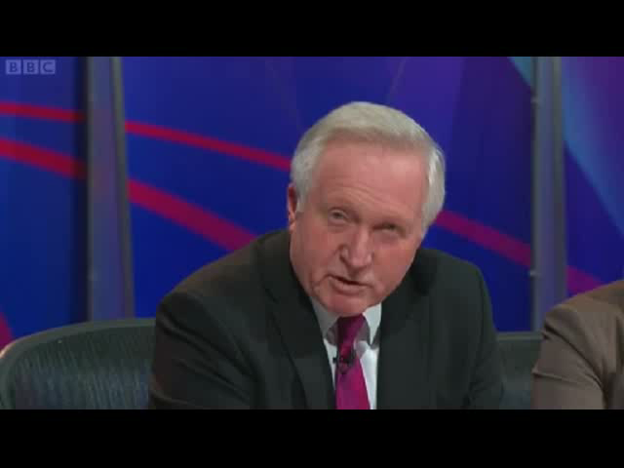
Everyday ethics in clinical medicine

Slide 18
Mr A
50 year old male
Suffering from terminal prostate cancer with metastases
Had received chemoradiotherapy for cancer, but non-responsive
Hugely distended abdomen as a result of obstruction of rectum by prostate cancer
In pain from distension
Patient likely to die soon as a result of distant metastasis

Slide 19
Question
At what point is it no longer appropriate to treat terminal patients palliatively with complex surgeries rather than allowing a natural death?

Slide 20
QuestionTime
The presentation should last no longer than 5 minutes and does not need to be in a PowerPoint format. The case should end with a question that will then be put to a panel of experts.
During the session a number of cases will be selected for students to present to the year.
There will be a prize for cases that are chosen for inclusion in the session.

