Slide 1

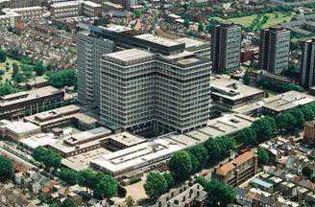
Background to Clinical Specialities
Cardiac and Respiratory study day
29.11.11
Dr Irem Patel
Consultant Chest Physician
Integrated Care
ICHT

Slide 2
1.30-1.35 Introduction
1.35-2.00 Getting the most out of the plain chest radiograph:
Dr Mary Roddie Consultant Radiologist
2.00-2.30 An approach to the breathless patient
2.30-2.45 Respiratory Examination
2.45-3.00 Self management- what does it mean?
3.0- 3.20 Tea break
3.20-3.50 Living – and dying – with a long term respiratory condition
3.50-4.00 Respiratory quiz

Slide 3
1.30-1.35 Introduction
1.35-2.00 Getting the most out of the plain chest radiograph:
Dr Mary Roddie Consultant Radiologist
2.00-2.30 An approach to the breathless patient
2.30-2.45 Respiratory Examination
2.45-3.00 Self management- what does it mean?
3.0- 3.20 Tea break
3.20-3.50 Living – and dying – with a long term respiratory condition
3.50-4.00 Respiratory quiz

Slide 4
Learning objectives for the afternoon
The Student should be able to:
•To differentiate the different causes of breathlessness
Be confident regarding the diverse causation of some common physical findings
•To have an understanding of the principles of interpreting chest radiographs
•To understand the long term nature of many cardio/respiratory illnesses
To appreciate how that affects the patients’ views about their condition and health care
To understand the importance of supporting patients to self care
•Understand the importance of appropriate end of life discussions and decision making in heart/lung disease

Slide 5
What respiratory diseases do you know?

Slide 6
Airways diseases | Small lung disorders (also known as “restrictive disorders”)
Localised obstruction | Due to disease within the lungs
Sleep apnoea Laryngeal carcinoma Thyroid enlargement Vocal cord dysfunction Relapsing Polychondritis Tumours Post tracheostomy stenosis Foreign bodies Bronchopulmonary dysplasia | Sarcoidosis Asbestosis Extrinsic Allergic Alveolitis Fibrosing Alveolitis Eosinophilic pneumonia
Generalised obstruction | Due to disease outside the lung
Asthma C.O.P.D. Bronchiectasis Cystic Fibrosis Obliterative Bronchiolitis | Pleural effusions Pneumothorax Scoliosis Respiratory muscle weakness Obesity
Infections | Pulmonary vascular disorders
Tuberculosis Infective bronchitis Pneumonia Empyema | Pulmonary emboli Pulmonary hypertension

Slide 7
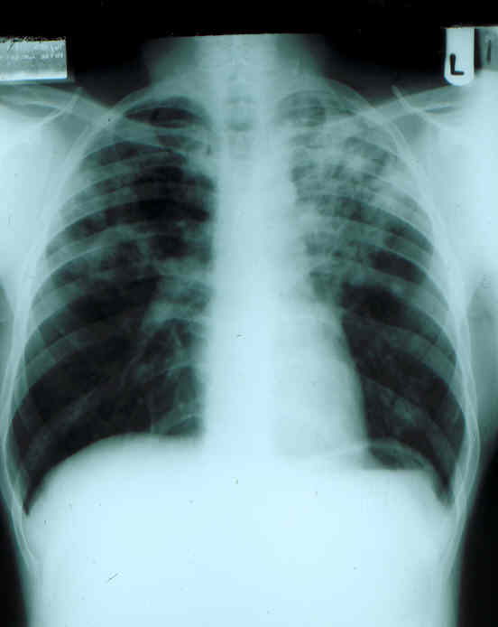
Airways diseases | Small lung disorders (also known as “restrictive disorders”)
Localised obstruction | Due to disease within the lungs
Sleep apnoea Laryngeal carcinoma Thyroid enlargement Vocal cord dysfunction Relapsing Polychondritis Tumours Post tracheostomy stenosis Foreign bodies Bronchopulmonary dysplasia | Sarcoidosis Asbestosis Extrinsic Allergic Alveolitis Fibrosing Alveolitis Eosinophilic pneumonia
Generalised obstruction | Due to disease outside the lung
Asthma C.O.P.D. Bronchiectasis Cystic Fibrosis Obliterative Bronchiolitis | Pleural effusions Pneumothorax Scoliosis Respiratory muscle weakness Obesity
Infections | Pulmonary vascular disorders
Tuberculosis Infective bronchitis Pneumonia Empyema | Pulmonary emboli Pulmonary hypertension
Rates of TB rising again especially in London

Slide 8
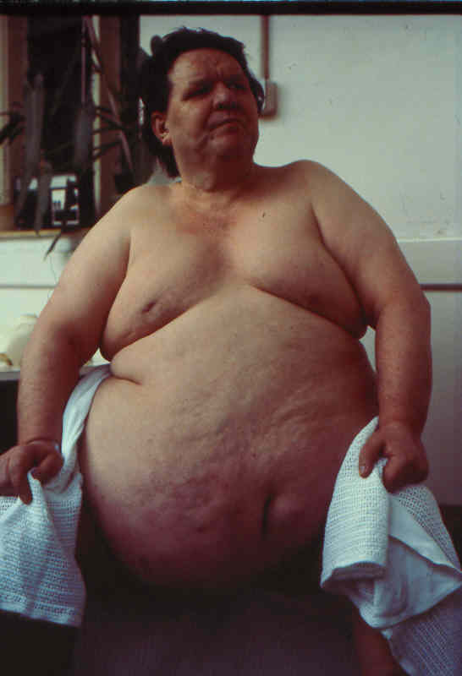
Airways diseases | Small lung disorders (also known as “restrictive disorders”)
Localised obstruction | Due to disease within the lungs
Sleep apnoea Laryngeal carcinoma Thyroid enlargement Vocal cord dysfunction Relapsing Polychondritis Tumours Post tracheostomy stenosis Foreign bodies Bronchopulmonary dysplasia | Sarcoidosis Asbestosis Extrinsic Allergic Alveolitis Fibrosing Alveolitis Eosinophilic pneumonia
Generalised obstruction | Due to disease outside the lung
Asthma C.O.P.D. Bronchiectasis Cystic Fibrosis Obliterative Bronchiolitis | Pleural effusions Pneumothorax Scoliosis Respiratory muscle weakness Obesity
Increasing prevalence of obesity causes both increased respiratory workload, but also respiratory dysfunction
Infections | Pulmonary vascular disorders
Tuberculosis Infective bronchitis Pneumonia Empyema | Pulmonary emboli Pulmonary hypertension

Slide 9
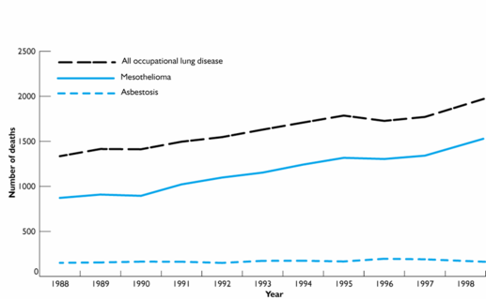
Airways diseases | Small lung disorders (also known as “restrictive disorders”)
Localised obstruction | Due to disease within the lungs
Sleep apnoea Laryngeal carcinoma Thyroid enlargement Vocal cord dysfunction Relapsing Polychondritis Tumours Post tracheostomy stenosis Foreign bodies Bronchopulmonary dysplasia | Sarcoidosis Asbestosis Extrinsic Allergic Alveolitis Fibrosing Alveolitis Eosinophilic pneumonia
Generalised obstruction | Due to disease outside the lung
Asthma C.O.P.D. Bronchiectasis Cystic Fibrosis Obliterative Bronchiolitis | Mesothelioma Pneumothorax Scoliosis Respiratory muscle weakness Obesity
Deaths due to asbestos related lung disease increasing significantly
Infections | Pulmonary vascular disorders
Tuberculosis Infective bronchitis Pneumonia Empyema | Pulmonary emboli Pulmonary hypertension

Slide 10
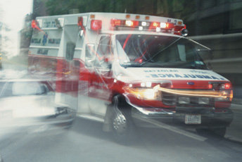
Airways diseases | Small lung disorders (also known as “restrictive disorders”)
Localised obstruction | Due to disease within the lungs
Sleep apnoea Laryngeal carcinoma Thyroid enlargement Vocal cord dysfunction Relapsing Polychondritis Tumours Post tracheostomy stenosis Foreign bodies Bronchopulmonary dysplasia | Sarcoidosis Asbestosis Extrinsic Allergic Alveolitis Fibrosing Alveolitis Eosinophilic pneumonia
Generalised obstruction | Due to disease outside the lung
Asthma C.O.P.D. Bronchiectasis Cystic Fibrosis Obliterative Bronchiolitis | Pleural effusions Pneumothorax Scoliosis Respiratory muscle weakness Obesity
Leads to a six times normal
risk of having a road traffic crash
Infections | Pulmonary vascular disorders
Tuberculosis Infective bronchitis Pneumonia Empyema | Pulmonary emboli Pulmonary hypertension

Slide 11
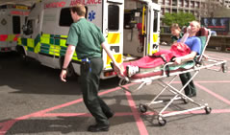
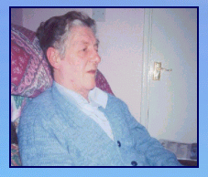
Airways diseases | Small lung disorders (also known as “restrictive disorders”)
Localised obstruction | Due to disease within the lungs
Sleep apnoea Laryngeal carcinoma Thyroid enlargement Vocal cord dysfunction Relapsing Polychondritis Tumours Post tracheostomy stenosis Foreign bodies Bronchopulmonary dysplasia | Sarcoidosis Asbestosis Extrinsic Allergic Alveolitis Fibrosing Alveolitis Eosinophilic pneumonia
Generalised obstruction | Due to disease outside the lung
Asthma C.O.P.D. Bronchiectasis Cystic Fibrosis Obliterative Bronchiolitis | Pleural effusions Pneumothorax Scoliosis Respiratory muscle weakness Obesity
One in eight of all medical admissions is due to COPD
Infections | Pulmonary vascular disorders
Tuberculosis Infective bronchitis Pneumonia Empyema | Pulmonary emboli Pulmonary hypertension

Slide 12
COPD is projected to be the third biggest GLOBAL killer by 2020
1990
2020
Ischaemic heart disease
CVD disease
Lower respiratory infection
Diarrhoeal disease
Perinatal disorders
COPD
Tuberculosis
Measles
Road traffic accident
Lung cancer
3rd
6th
Stomach cancer
HIV
Suicide
Murray & Lopez 1997
Notes:
02/12/2011 15:29
12
Notes:
As part of the Global Burden of Disease Study, Murray and Lopez¹ projected future mortality rates based on the most common causes of death in 1990. The top 10 most important causes of death are presented in this slide. The majority of these leading causes of deaths are projected to remain stable or decline.
Notably, COPD is expected to rise from the sixth biggest killer in 1990 to the third in 2020. Of the top 10 leading causes of death in 1990, only deaths caused by COPD, lung cancer and road traffic accidents are projected to rise.
Reference
Murray CJ, Lopez AD. Alternative projections of mortality and disability by cause 1990–2020: Global Burden of Disease Study. Lancet 1997;349:1498–504.

Slide 13
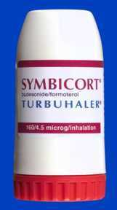
Airways diseases | Small lung disorders (also known as “restrictive disorders”)
Localised obstruction | Due to disease within the lungs
Sleep apnoea Laryngeal carcinoma Thyroid enlargement Vocal cord dysfunction Relapsing Polychondritis Tumours Post tracheostomy stenosis Foreign bodies Bronchopulmonary dysplasia | Sarcoidosis Asbestosis Extrinsic Allergic Alveolitis Fibrosing Alveolitis Eosinophilic pneumonia
Generalised obstruction | Due to disease outside the lung
Asthma C.O.P.D. Bronchiectasis Cystic Fibrosis Obliterative Bronchiolitis | Pleural effusions Pneumothorax Scoliosis Respiratory muscle weakness Obesity
5.2 million people in the UK have asthma
Infections | Pulmonary vascular disorders
Tuberculosis Infective bronchitis Pneumonia Empyema | Pulmonary emboli Pulmonary hypertension

Slide 14
Many diseases, many people affected by them…..

Slide 15
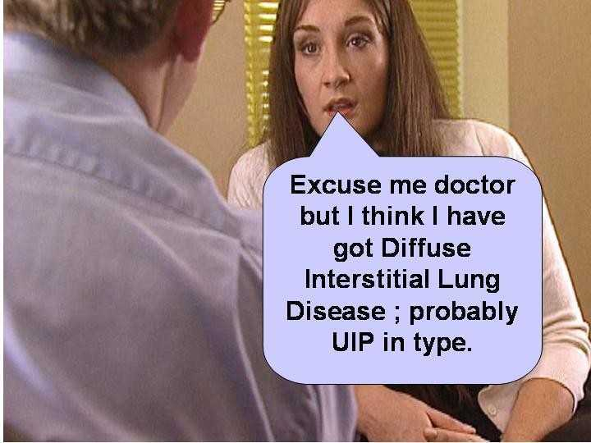

Slide 16
Many diseases, many people affected by them
What symptoms might reflect lung disease?
  Breathlessness
  Cough
  Sputum production
  Haemoptysis
  Chest discomfort
  Wheeze or musical breathing
  Stridor
  Hoarseness
  Snoring history /Daytime sleepiness
  (Weight loss. Anorexia, Fever)

Slide 17
Breathlessness may be due to:
Heart Disease
Pulmonary Thrombo-embolic Disease
Lung Disease
Systemic diseases (Anaemia, obesity, hyperthyroidism)
Respiratory Muscle weakness
Psychological factors

Slide 18
Assessing the breathless patient:
Enquire regarding:
•Onset of breathlessness (eg acute, gradual)
•Circumstances of breathlessness
on exertion or at rest?
at night?, on lying flat?
associated symptoms?
•Degree of breathlessness

Slide 19
Breathlessness:
Differential diagnosis according to onset
•Within Minutes:
Think: Pulmonary embolus, Pneumothorax,
myocardial infarction, cardiac rhythm disturbance, dissecting aneurysm, acute asthma
•Over hours or days:
Think: pneumonia, pleural effusion, LVF
(LV dysfunction, valve dysfunction, septal rupture
post MI), asthma, blood loss, lobar collapse,
respiratory muscle weakness (Guillain Barre)

Slide 20
Over weeks:
Think: Infiltration (malignancy, sarcoidosis, fibrosing alveolitis, extrinsic allergic alveolitis, eosinophilic pneumonia), respiratory muscle weakness (motor neurone disease), main airway obstruction, anaemia, valvular dysfunction (SBE)
•Over months:
Think same as for weeks plus obesity, muscular dystrophy, asbestos related conditions
•Over years:
Think: COPD, Chest wall deformity, heart valve dysfunction, obesity

Slide 21
Next:
In some way quantify the size of the problem

Slide 22
New York Heart Association (NYHA) Classification Scale
Early-Stage Heart Failure
•NYHA Class I No symptoms at any level of exertion and no limitation in ordinary physical activity.
•NYHA Class II Mild symptoms and slight limitation during regular activity. Comfortable at rest
Advanced-Stage Heart Failure
•NYHA Class III Noticeable limitation due to symptoms, even during minimal activity. Comfortable only at rest.
•NYHA Class IV Severe limitations. Experience symptoms even while at rest (sitting in a recliner or watching TV).

Slide 23
Medical Research Council Scale for quantifying breathlessness
1.Not troubled by breathlessness except on strenuous exercise
2.Short of breath when hurrying or walking up a slight hill
3.Walks slower than contemporaries on the level because of breathlessness, or has to stop for breath when walking at own pace
4.Stops for breath after about 100 m or after a few minutes on the level
5.Too breathless to leave the house, or breathless when dressing or undressing

Slide 24
DIAGNOSIS AND MANANGEMENT OF RESPIRATORY DISEASE
Cough
Breathlessness?
Check the patient is not taking an ACE Inhibitor. If yes stop, if not determine length of history of cough
Heart disease?
Lung disease?
Pulmonary embolus/ infarction?
A systemic disorder?
Diaphragm weakness?
Psychogenic dyspnoea?
Irregular pulse?
Clinical signs of left ventricular hypertrophy or failure?
Personal or family history of ischaemic heart disease? ECG abnormal?
Anaemia – check haemoglobin
Obesity – check BMI
Overactive thyroid – check T4
Note that this is usually a diagnosis of exclusion
Cough has lasted less than 12 weeks - if no sinister features (and not a Smoker or ex-smoker) may be post viral
Cough has lasted more than 12 weeks
Is a major risk factor present?
Recent immobility
Recent lower limb trauma/ surgery
Clinical DVT
Previous or FH of VTE
Pregnancy or puerperium
Major medical illness
Is the breathlessness worse on lying flat or in water? Does the vital capacity fall on lying compared with sitting or standing?
Send for
Chest Xray
If in doubt refer
to a respiratory physician
Treat or refer
Chest x-ray shows cardiac enlargement?
Refer to a respiratory physician
Chest x-ray abnormal; refer to respiratory physician
Chest X-ray is normal
Refer urgently for investigation
Treat or refer to cardiologist
Pulmonary embolus/ infarction?
Airways disease?
Infection?
Small lung disease?
Is this an airway disorder? Is there a cough, wheeze, breathlessness or obstructive spirometry or reduced peak flow? If so is it a localised or a generalised obstruction?
Is there a fever, a cough productive of purulent sputum or focal signs on examination of the chest?
Is this a small lung disorder,
and if so is it due to an abnormality
Within the lung:
Sarcoidosis
Asbestosis
Extrinsic allergic alveolitis
Fibrosing alveolitis
Or
Outside the lung:
Pleural effusions
Scoliosis
Respiratory muscle weakness
Obesity
Abnormal spirometry or personal or family history of other atopic disease? - consider asthma or COPD
Localised obstruction?
? Stridor
?monophonic wheeze
?unilateral wheezing
Generalised obstruction?
?Polyphonic wheezing
? Bilateral wheezing
Nasal stuffiness or catarrh or other suggestion of post nasal drip disease - consider trial of intranasal steroids
Symptoms of gastro-oesophageal reflux or overweight – consider trial of proton pump inhibitor in highish dosage for 2/12
Treat &/or refer for a chest x-ray and or a respiratory opinion
Localised obstruction:
Laryngeal carcinoma?
Retrosternal thyroid?
Relapsing polychondritis?
A bronchial or tracheal tumour?
Post tracheostomy stenosis?
Inhaled foreign body?
Bronchopulmonary dysplasia?
Generalised obstruction:
Asthma?
Chronic obstructive pulmonary disease?
Bronchiectasis?
Cystic fibrosis?
Obliterative bronchiolitis?
Advise smoking cessation or trial of anti-asthma therapy as appropriate
Treat or refer to a respiratory physician
No response → refer respiratory physician
Refer to a respiratory physician
Refer to an ENT or respiratory physician
© MRP NJR Imperial College London

Slide 25
Key Learning Point 1:What do we expect from an Imperial Undergraduate by the time of Finals
•Evidence that they can distinguish between the various causes of breathlessness and construct a differential diagnosis
•Know which aspects of the history are helpful in achieving this (onset, associated symptoms etc)
•Quantify breathlessness

Slide 26
1.30-1.35 Introduction
1.35-2.00 Getting the most out of the plain chest radiograph:
Dr Mary Roddie Consultant Radiologist
2.00-2.30 An approach to the breathless patient
2.30-2.45 Respiratory Examination
2.45-3.00 Self management- what does it mean?
3.0- 3.20 Tea break
3.20-3.50 Living – and dying – with a long term respiratory condition
3.50-4.00 Respiratory quiz

Slide 27
Auscultation of the chest:
•Normal Breath Sounds: vesicular
•Abnormal Breath Sounds
(eg Bronchial Breathing)
•Added sounds:
–Wheezes
–Crackles
–Pleural rub

Slide 28
Crackles (Crepitations)
•Short interrupted breath sounds
•May be in inspiration (usually) or expiration
•Occur early, mid, late or pan inspiration
•May be fine or coarse
•Distribution may be basal, unilateral or bilateral
•May be due to acute disease or long term disease

Slide 29
Crackles (Crepitations)
•In the acute situation, think
–Cardiac disease (pulmonary oedema), or
–Infection
•In the less acute situation (eg Finals!) think
–Bronchiectasis(unilateral or bilateral, usually coarse, ask about sputum production)
–Interstitial lung disease (usually fine, late or pan inspiratory, basal, often bilateral, commoner in fibrosing alveolitis and asbestosis than in sarcoidosis)

Slide 30
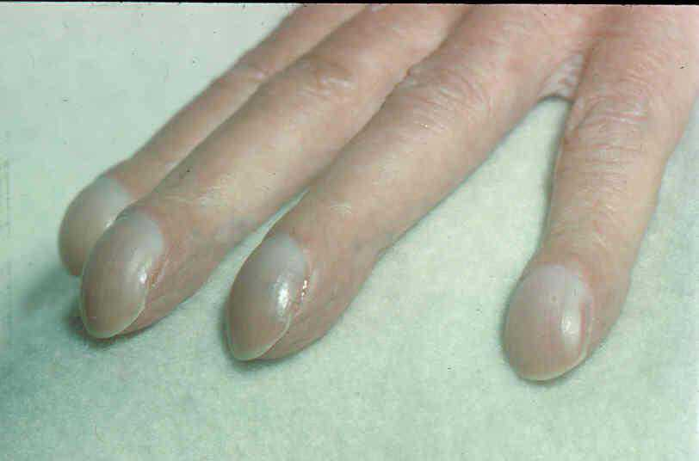

Slide 31

Finger Clubbing
Congenital
(Any doctor ever commented upon the appearances before?)
Acquired
•Cardiac
Cyanotic Congenital Heart Disease
SBE
•Pulmonary
Lung Cancer
Interstitial lung disease (eg Asbestosis, Fibrosing alveolitis)
Suppurative lung disease such as Bronchiectasis
(including Cystic Fibrosis)
•Inflammatory Bowel Disease

Slide 32
Key Learning Point 2:What do we expect from an Imperial Undergraduate by the time of Finals
•Evidence that they understand the significance and possible causes for common respiratory signs and clinical findings

Slide 33
1.30-1.35 Introduction
1.35-2.00 Getting the most out of the plain chest radiograph:
Dr Mary Roddie Consultant Radiologist
2.00-2.30 An approach to the breathless patient
2.30-2.45 Respiratory Examination
2.45-3.00 Self management- what does it mean?
3.0- 3.20 Tea break
3.20-3.50 Living – and dying – with a long term respiratory condition
3.50-4.00 Respiratory quiz

Slide 35
The burden of respiratory ill health has changed
Communicable diseases
Non communicable diseases

Slide 36
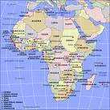
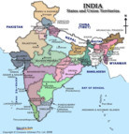
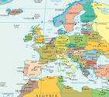
The burden of respiratory ill health is changing; but at different rates in different countries
Time
Communicable Diseases
Non Communicable Diseases
Country A

Slide 37
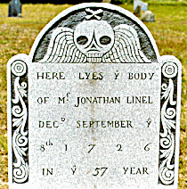
Deaths from different causes
Respiratory disease kills one in five people in the UK

Slide 38
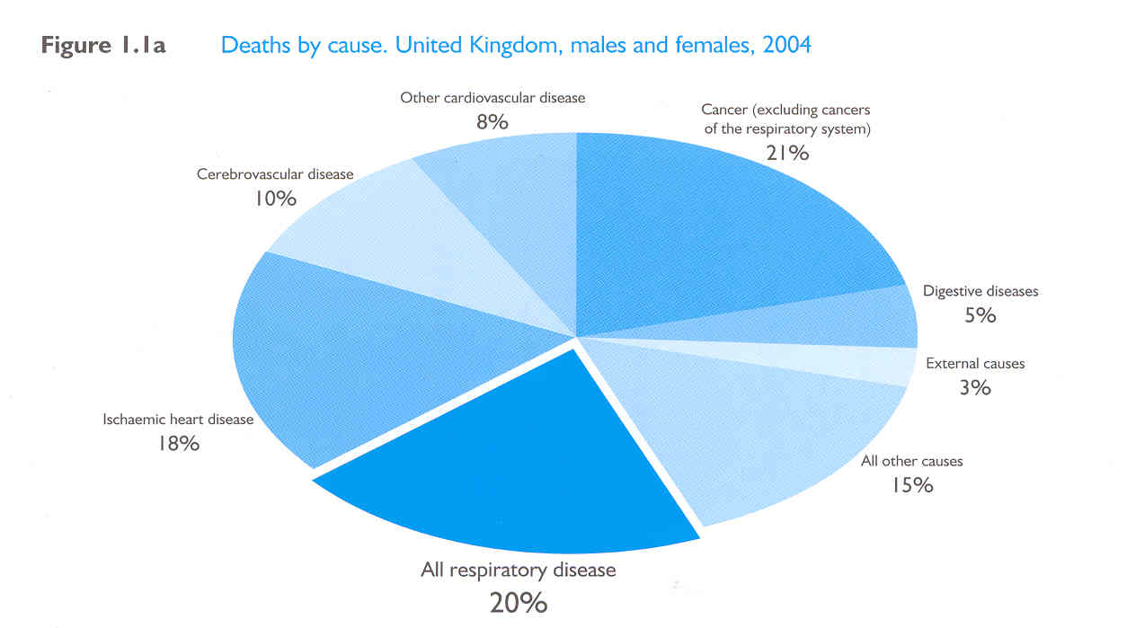
Deaths by cause, 2004, UK

Slide 39
Changes in the pattern and type of diseases may need different services
A series of acute illnesses (eg diarrhoeal illnesses, ARI,)
A long term disorder (eg depression, COPD, Asthma, Hypertension, Sleep apnoea syndromes, Diffuse Parenchymal Lung Disease, Diabetes)

Slide 40
Changes in the pattern and type of diseases may need different services
A series of acute illnesses (eg diarrhoeal illnesses, ARI,)
A long term disorder (eg depression, COPD, Asthma, Hypertension, Sleep apnoea syndromes, Diffuse Parenchymal Lung Disease, Diabetes)
More attention upon:
Enhancing compliance
Long term support
Teaching self care
Convenient follow up

Slide 41


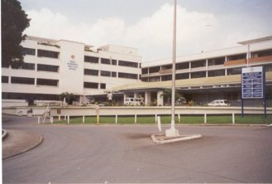
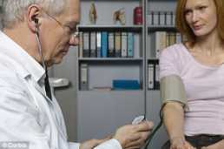
Traditional Model of Health care
Tertiary Care
Secondary Care
Primary Care
The Patient

Slide 42

Evolving Model of Healthcare
Tertiary
Care
Acute medicine
specialists
Respiratory
Physicians
GPs with a special clinical interest
Nurses, MCPs, and HCAs
The patient

Slide 43
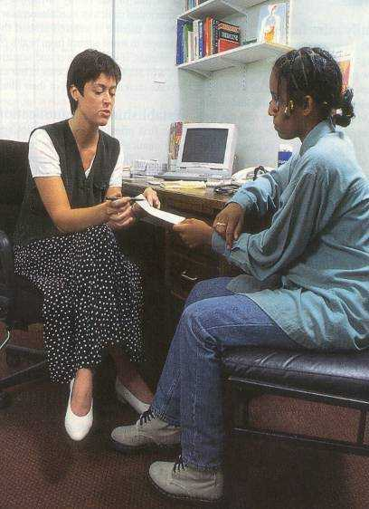
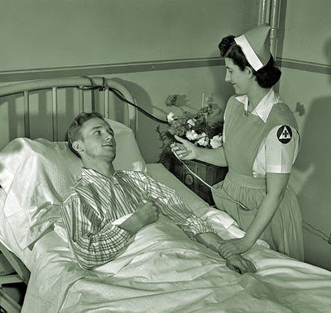
Evolving Model of Healthcare

Slide 44
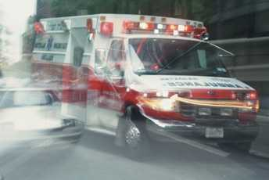


The perception

Slide 45
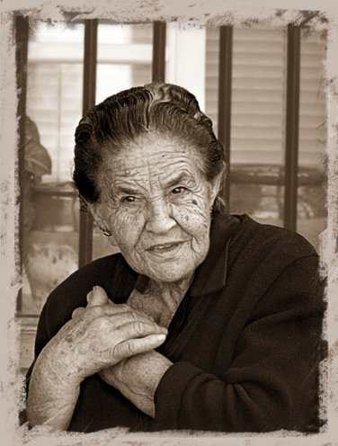
The reality

Slide 46
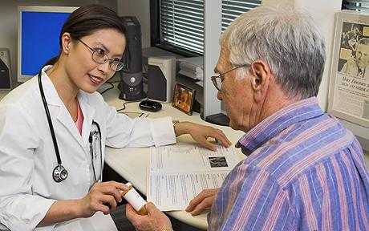

For the other
364 days,
23 hours and
30 minutes ……..

Slide 47
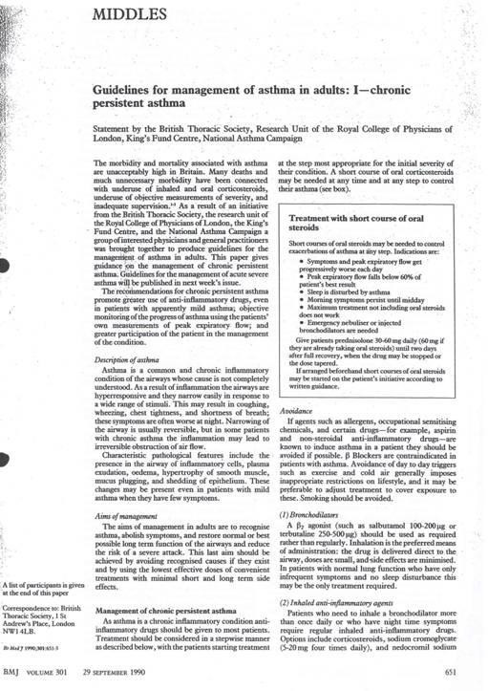
“ As far as possible patients should be trained to manage their own treatment rather than be required to consult their doctor before making changes”
BMJ 1990

Slide 48
Suggested content for an educational programme/discussion
Information given should be tailored to individual patient’s social, emotional and disease status, and age, but should cover:
•Nature of the disease
•Nature of the treatment
•Areas where patient most wants treatment to have effect
•How to use the treatment
•Development of self-monitoring/self-assessment skills
•Negotiation of the personal action plan in light of identified patient goals
•Recognition and management of acute exacerbations
•Appropriate trigger avoidance

Slide 49
Suggested content for an educational programme/discussion
Information given should be tailored to individual patient’s social, emotional and disease status, and age, but should cover:
•Nature of the disease
•Nature of the treatment
•Areas where patient most wants treatment to have effect
•How to use the treatment
•Development of self-monitoring/self-assessment skills
•Negotiation of the personal action plan in light of identified patient goals
•Recognition and management of acute exacerbations
•Appropriate trigger avoidance

Slide 50
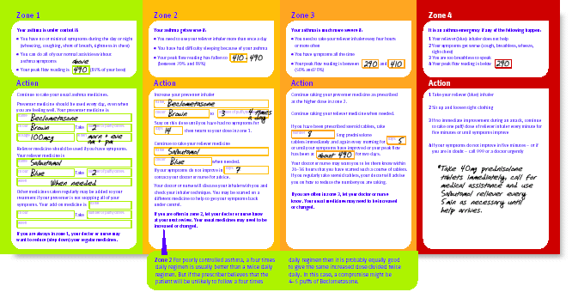
Written asthma action plans

Slide 51
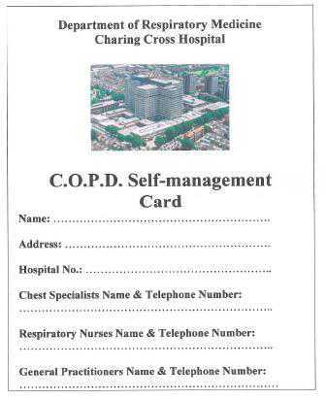

Slide 52
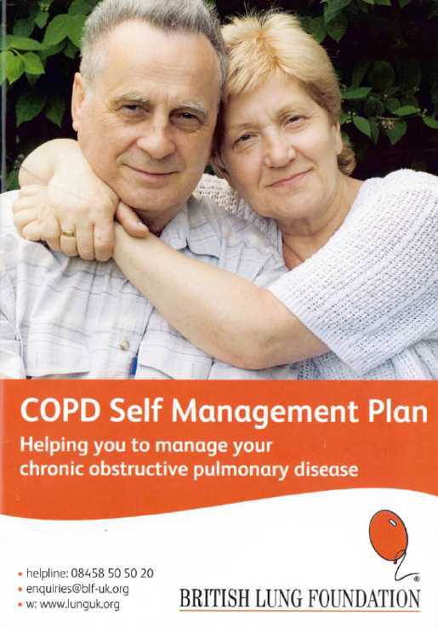

Slide 53
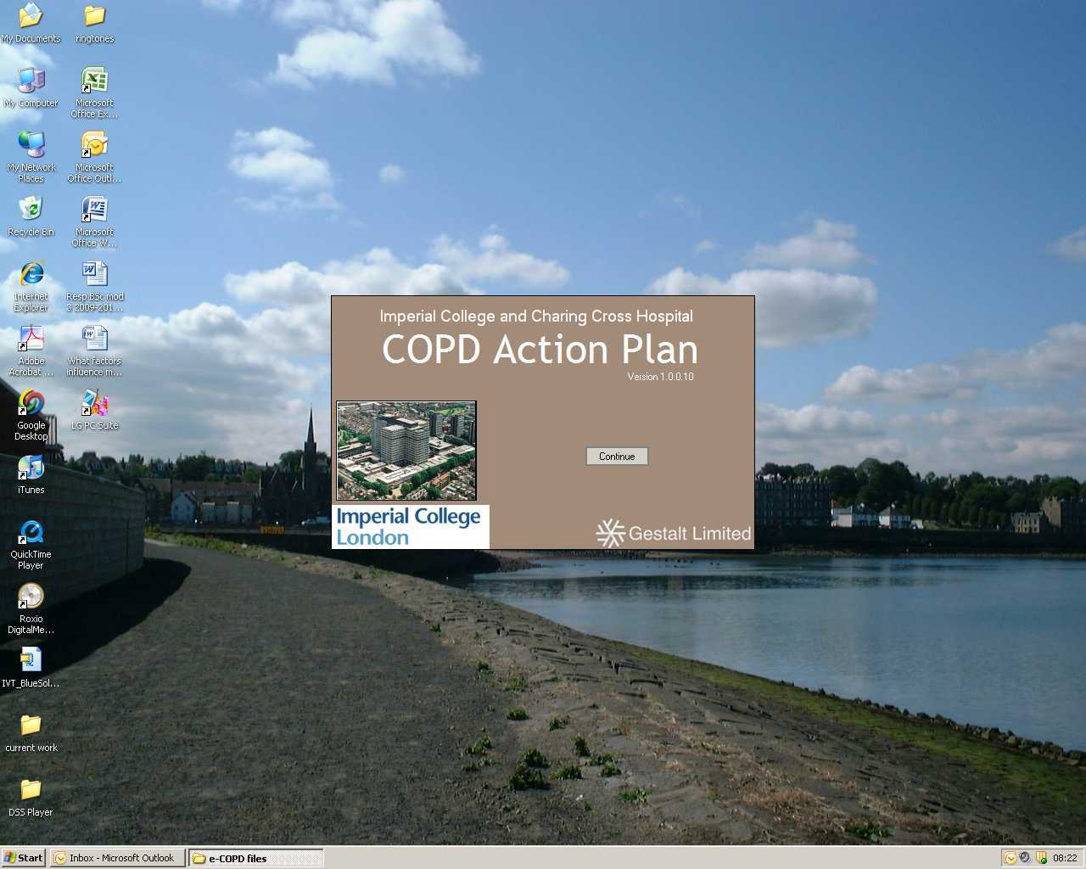

Slide 54
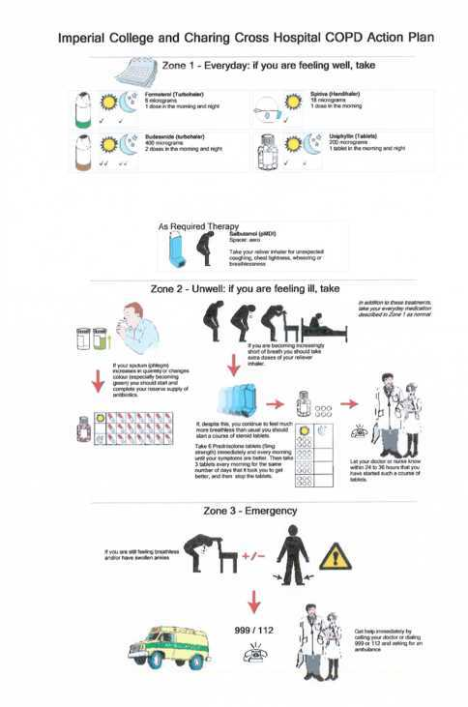
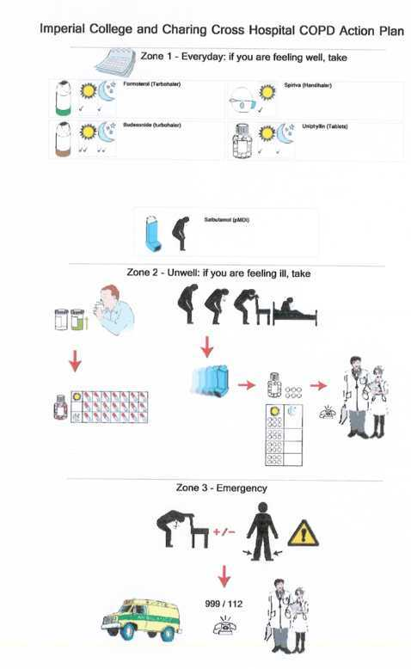
Notes:
Self-management support facilitates patient recognition of an exacerbation and prompts use of antibiotics and steroids as appropriate [20]. In a number of studies, this has translated into reduced hospital admissions, length of stay, emergency room visits, and primary care consultations [21, 22]. Systematic reviews to date have concluded, “it is likely that self-management education [in COPD] is associated with a reduction in hospital admissions” [23], but that larger randomised controlled trials with long-term follow up are still required for a definitive assessment of its impact [24].

Slide 55
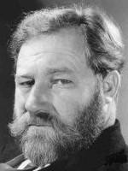


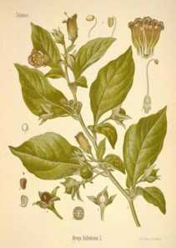
The Doctors role We need to move on from the writing of prescriptions alone to accept responsibility for these wider issues

Slide 56
Key Learning Point 3 :What do we expect from an Imperial Undergraduate by the time of Finals
•An understanding that much of medicine (and surgery) is concerned with the care of those with long term conditions, who are often elderly
•Recognition that these conditions necessitate long term support of the patient as they self manage their own condition
•Evidence that graduates know how to give patients appropriate advice about self management and when to seek urgent medical advice (and an understanding that these approaches necessitate a multi disciplinary approach)

Slide 57
1.30-1.35 Introduction
1.35-2.00 Getting the most out of the plain chest radiograph:
Dr Mary Roddie Consultant Radiologist
2.00-2.30 An approach to the breathless patient
2.30-2.45 Respiratory Examination
2.45-3.00 Self management- what does it mean?
3.0- 3.20 Tea break
3.20-3.50 Living – and dying – with a long term respiratory condition
3.50-4.00 Respiratory quiz

Slide 58
1.30-1.35 Introduction
1.35-2.00 Getting the most out of the plain chest radiograph:
Dr Mary Roddie Consultant Radiologist
2.00-2.30 An approach to the breathless patient
2.30-2.45 Respiratory Examination
2.45-3.00 Self management- what does it mean?
3.0- 3.20 Tea break
3.20-3.50 Living – and dying – with a long term respiratory condition
3.50-4.00 Respiratory quiz

Slide 59
Mrs A.O.
78 years old
October/November 2011
5/7 SOBOE, productive cough, wheeze, swollen ankles
Exercise tolerance 50m 10 m
Antibiotics started at home; no better
Admitted to hospital
Treated with antibiotics, nebulised bronchodilators and steroids
Discharged after 48 hrs
Readmitted after 24 hrs: CRP 110, WCC 17
CXR: lobar consolidation
Arterial blood gas: pH 7.31 pCO₂ 9.4 pO₂ 8.9 kPa on 2 litres oxygen
HDU admission for non-invasive ventilatory support

Slide 60
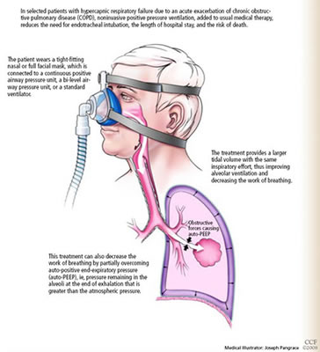
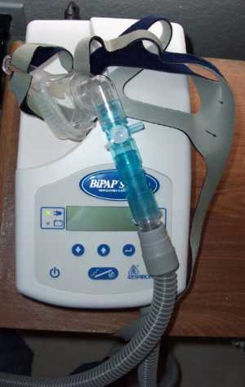
Non-invasive ventilation
Notes:
Hypercapnic RF due AECOPD – reduces need for mechanical ventilation, LOS and risk of death.
Larger TV for same insp effort, improves alveolar ventilation and reduces work of breathing
Partially overcomes auto-PEEP

Slide 61
Mrs A.O.
Background:
Severe COPD – FEV₁ 0.9 litres, 27% predicted, current smoker
IHD
Hypertension
Hypercholesterolaemia
Type 2 DM
Hypothyroidism
Osteoporosis
Depression - HAD score
Low body mass index - weight (kg) = 17 (NR 18.5-24.9)
        height ² (m)

Slide 62
Mrs A.O.
Medication:
Seretide accuhaler Gliclazide
Tiotropium inhaler Metformin
Aminophylline
Carbocisteine
Aspirin Alendronate
Perindopril Calcichew
Rosuvastatin
Levothyroxine Omeprazole
Citalopram

Slide 63
Mrs A.O.
Admissions to hospital:
2009 February AECOPD
        August choecystectomy w/cc
2010 July AECOPD
        Type II respiratory failure requiring
        non invasive ventilation
2011 June AECOPD
        Type II respiratory failure requiring
        non invasive ventilation
        NSTEMI
        July Hospital acquired pneumonia
        October AECOPD
        November Hospital acquired pneumonia
        Type II respiratory failure requiring
        non invasive ventilation

Slide 64
Important features
Elderly
Multiple comorbidities
Polypharmacy
Increasingly frequent need for unscheduled healthcare
Adverse prognostic indicators

Slide 65
RCP/BTS COPD audit 2008: mortality after COPD hospital admission
Mortality 14% at 90 days
33% readmitted within 90 days following discharge
49% die within 2 years of hospitalisation; 1 year if episode of NIV
41% no documented plan in event of NIV failure
11% had DNR order signed within 24 hrs

Slide 66
Adverse prognostic indicators in COPD
FEV1 <30% predicted
Frequent exacerbations
>3 acute admissions in 12 months
MRC dyspnoea score 4/5
Long term oxygen therapy
Requirement for non invasive ventilation
Cor pulmonale
Low BMI
Notes:
4th leading cause of death
3rd leading killer by 2020
Approximately 23,500 people in UK die of COPD each year
Surprise question
Supportive care to avoid crisis admission
Supportive care register in primary care

Slide 67
Timing of discussion with patients
Patient’s experience with mechanical ventilation
Never admitted 6%
First admission with exacerbation 62%
After mechanical ventilation 30%
McNeely Can Med Assoc 1997; 156: 177-183

Slide 68
Time before death individuals know they are likely to die
Edmonds Pall Med 2001; 15: 287
Notes:
Compared to lung cancer many patients with COPD do not know they are dying, and cannot take part in decision making

Slide 69
Why don’t end of life discussions happen?
Clinician
Uncertainty about trajectory of disease
Uncertainty about where/when/how/who
Communication
Patient
Unmet educational needs
Depression

Slide 70
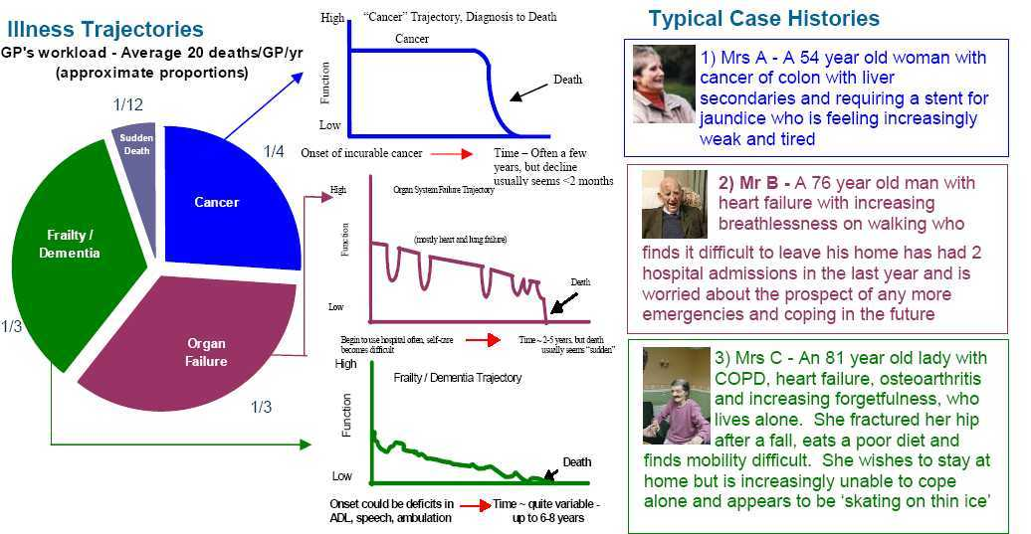

Slide 71
Depression and Anxiety
p <0.01
HAD scale
Gore et al, Thorax 2000; 55: 1000
Notes:
COPD higher scores than advanced cancer

Slide 72
Depression and Treatment Preferences
Percent
Refusing
Treatment
Stapleton, Chest 2005; 127: 328
Notes:
Depression affects decision making

Slide 73
End of life issues for COPD patients
Diagnosis and disease process
Treatment
Prognosis
What dying might be like – symptom management
Advance care planning – message in a bottle
Curtis et al, Chest 2002; 122: 356-362

Slide 74
Number and causes of death in England 2004
Disease group | Number of deaths | % of overall deaths
Circulatory disease | 190,603 | 37.2
Respiratory disease | 69,213 | 13.5
Cancer | 138,062 | 27
Neurological | 14,606 | 2.8
Renal failure | 3,062 | 1.2
Other | 96,905 | 18.9
Total | 512,541 | 100
50.7%
Notes:
Resp and circulatory disease together dwarf cancer deaths
60% prefer to die at home but the majority of non cancer deaths occur in hospital

Slide 75
Key Learning points
Whatever the specialty, we are looking after a population of increasingly elderly patients with multiple problems
Most patients in the developed world die as a result of a chronic disease
In many cases there are prognostic indicators to guide appropriate end of life discussions
Good end of life care enhances quality of life, optimises functioning and helps with decision making

Slide 76
1.30-1.35 Introduction
1.35-2.00 Getting the most out of the plain chest radiograph:
Dr Mary Roddie Consultant Radiologist
2.00-2.30 An approach to the breathless patient
2.30-2.45 Respiratory Examination
2.45-3.00 Self management- what does it mean?
3.0- 3.20 Tea break
3.20-3.50 Living – and dying – with a long term respiratory condition
3.50-4.00 Respiratory quiz

Slide 77
Question 1
Notes:
New virus emerged in 2002
Coronavirus – same family as common cold
Envelope single stranded RNA – looks like a crown on EM, surface proteins
Droplet spread
No treatment

Slide 78
Question 2
Notes:
Small cell – 4%
Very common in non small cell- 35%, but only 30% of cancers overall

Slide 79
Question 3
Notes:
Horners syndroms
Ptosis
Meiosis
Anhydrosis
Interruption of the sympathetic chain due to ipsilateral Pancoast tumour

Slide 80
Question 4
Notes:
OSA

Slide 81
Question 5
Notes:
No 4

Slide 82
Question 6
Notes:
SVC obstruction, for DxT

Slide 83
Question 7
Notes:
No 4; V/Q mismatch

Slide 84
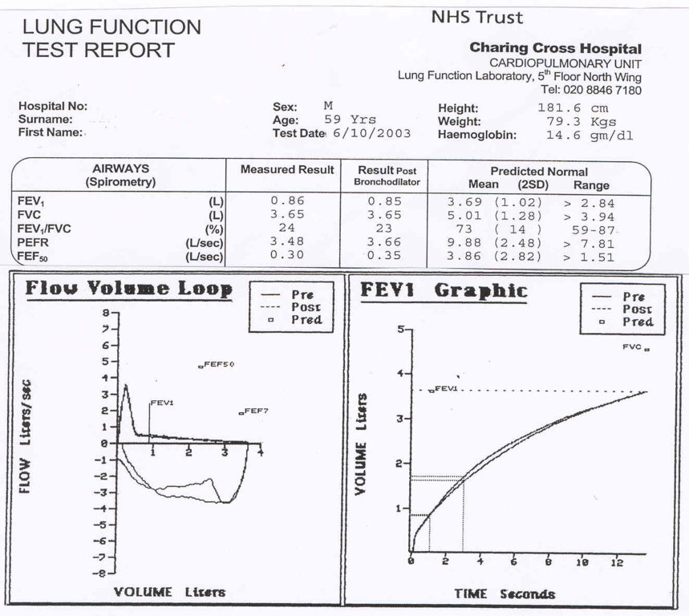
Question 8
What type of ventilatory defect is seen here?

Slide 85
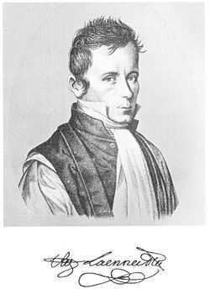
Question 9
Who is this man?
Name two of his contributions to (respiratory)
medicine

Slide 86
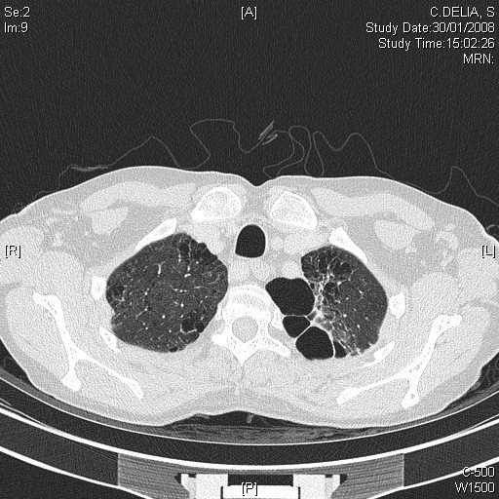
Question 10
What disease process in shown by these two images?

