Slide 1

Clinical sepsis and host defence
Dr Stephen Brett
Consultant in Intensive Care Medicine
Hammersmith Hospital

Slide 2
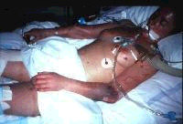
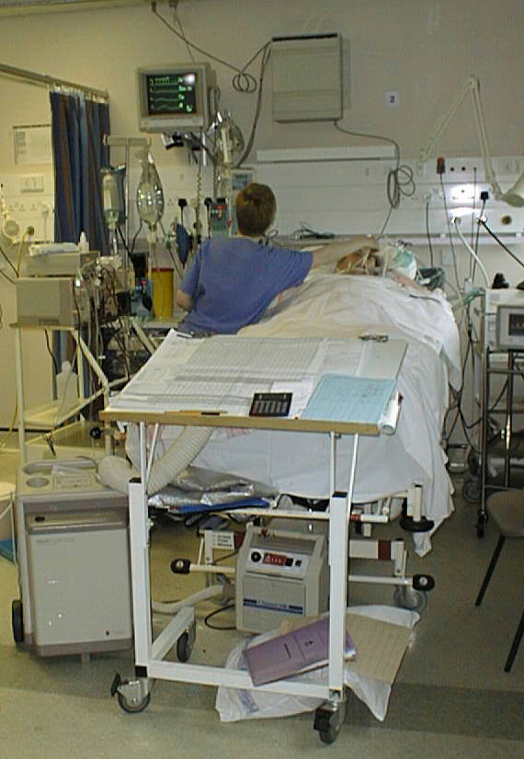
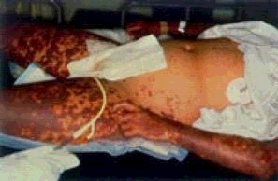

Slide 3
The disease continuum: SIRS
Severe
sepsis
Infection
SIRS
Sepsis
Death
A non-specific clinical response including
>2 of the following:
As well as infection, SIRS can also be caused by trauma, burns, pancreatitis and other insults
Temperature >38ºC or <36ºC
Heart rate >90 beats/min
Respiratory rate >20/min
White blood cell count >12,000/mm³ or <4,000/mm³ or >10% immature neutrophils
SIRS: systemic inflammatory response syndrome
Notes:
The American College of Chest Physicians and the Society of Critical Care Medicine (ACCP/SCCM), at a Consensus Conference, developed clear clinical definitions for the disease continuum.
SIRS (systemic inflammatory response syndrome) is defined as the presence of two or more objective signs of systemic inflammation.¹¹
To standardise definitions, a Consensus Conference was held in the early 1990s by the ACCP/SCCM.
These groups developed three terms for the progression of clinical symptoms: sepsis, severe sepsis and septic shock.^{2,11}
The conference also defined an initial SIRS, which requires evaluation of abnormalities of temperature, heart rate, respiratory rate and white blood cell count.^{2,11}

Slide 4
The disease continuum: sepsis
Severe
sepsis
Infection
SIRS
Sepsis
Death
SIRS with a presumed or confirmed infectious process
SIRS: systemic inflammatory response syndrome
Notes:
The American College of Chest Physicians and the Society of Critical Care Medicine (ACCP/SCCM) defines sepsis as the presence of systemic inflammatory response syndrome (SIRS) with the addition of a confirmed or presumed (i.e. presence of commonly recognised signs of infection without an identifiable pathogen being isolated) microbiological infection.¹¹
Approximately 60% of sepsis cases are associated with a microbiologically confirmed infection.¹⁵
When the underlying site of infection can be identified, the most common infection sites are the lung, abdomen or urinary tract.^{5,16,17} For example, one study found that in 46% of patients the infection site was the lung, 15% the abdomino-pelvic region and 10% the urinary tract.¹⁶

Slide 5
The disease continuum: severe sepsis
Severe
sepsis
Infection
SIRS
Sepsis
Death
Sepsis with signs of at least one acute organ dysfunction
Renal
Respiratory
Hepatic
Haematological
Central nervous system
Unexplained metabolic acidosis
Cardiovascular
Septic shock Severe sepsis with hypotension refractory to adequate volume resuscitation
SIRS: systemic inflammatory response syndrome
Notes:
Severe sepsis is defined as sepsis with signs of at least one acute organ dysfunction.¹¹
Septic shock is sepsis-induced refractory hypotension that persists despite adequate fluid resuscitation, along with the presence of hypoperfusion abnormalities or organ dysfunction.¹¹
In septic shock, hypotension is defined as a systolic blood pressure of <90mmHg or a reduction of >40mmHg from baseline in the absence of other causes of hypotension.¹¹
It is important to realise that these stages do not necessarily imply an increasing severity of infection, but rather an increasingly severe systemic response to infection.³

Slide 6

Case Mix Programme Database 2005
Harrison et al. Crit Care 2006
343,862 admissions
170 adult, general critical care units
December 1995 to January 2005
http://ccforum.com/contents/10/2/R42

Slide 7
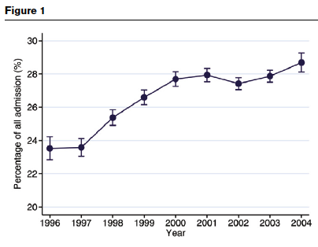
Severe sepsis during first 24 h

Slide 8
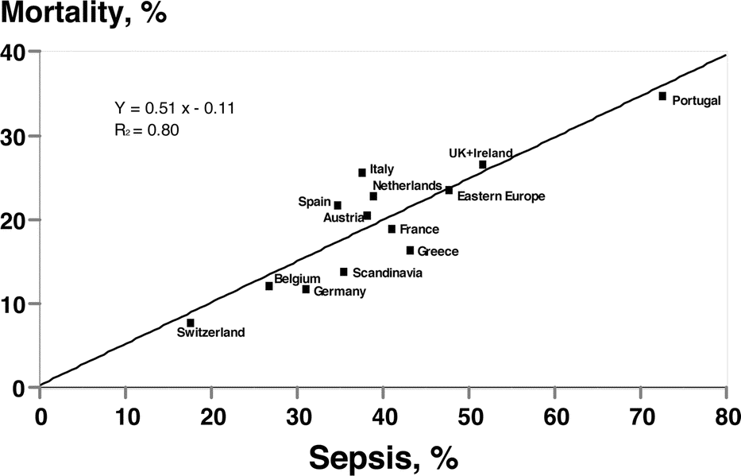
Sepsis in European Intensive Care Units:
Results of the SOAP study
Vincent et al. Crit Care Med 2006;34:344

Slide 9
The cost burden of severe sepsis
Cost burden of severe sepsis
UK €0.42–0.49 billion Approx. £0.25–0.29 billion
EU €5.8–7.6 billion Approx. £4.1–5.4 billion
USA $16.7 billion Approx. £11.3 billion
It is estimated that the 10–14% of European ICU patients who develop severe sepsis account for 24–32% of total ICU costs
*Based on conversion rate of €0.6 to £ sterling, †based on conversion rate of $1.5 to £ sterling
Notes:
Severe sepsis and its sequelae are a significant drain on global healthcare budgets around the world.²⁰
The 10–14% of European ICU patients who develop severe sepsis are associated with approximately 24–32% of the total costs in these ICUs.²⁰
Severe sepsis causes both direct¹ and indirect^{20,21} costs, including lost income and long-term morbidity, as well as medical treatment and continuing care.^{20,21}
Patients with severe sepsis consume significant healthcare resources.²⁰ Direct costs include physician, nurse and other staff costs, ICU beds and equipment, diagnostic equipment, medical and surgical supplies, supportive care equipment and drug therapy.¹ Indirect patient costs include non ICU, non-healthcare costs and morbidity associated with the disease.²⁰
The economic burden shown here for the UK and EU represents ICU healthcare costs only and does not include more intangible burdens to the patient or family.²⁰

Slide 10
“Organs”
Brain
Lungs
Heart and circulation
Kidneys
Liver
Gut
Skin
Bone marrow and immune response

Slide 11
“Organs”
The vascular endothelium

Slide 12
Pathogens involved in sepsis
An overview
Gram negative
Gram positive
Fungal infection
20%
Mixed bacterial
45%
19%
Other mixed
3%
10%
3%
Unconfirmed
Only 60% of severe sepsis/septic shock cases are associated with confirmed infection
Disease progression is similar regardless of causative organism
Notes:
The most common microbial causes of sepsis are pure Gram-negative or Gram- positive pathogens (36% and 35% of cases, respectively).¹⁵
Mixed bacterial infections account for 19% of cases, pure fungal 5%, with mixed bacterial/ fungal/viral infections comprising the remaining 5%.¹⁵
Almost every type of micro-organism has the potential to initiate an episode of sepsis. However, only 60% of cases may be associated with a microbiologically confirmed infectious pathogen.¹⁵
The clinical progression of sepsis is similar, regardless of the infectious agent.^{6,15,23}
Although Gram-negative bacteria have traditionally been the most common bacteria associated with septic shock,^{25,26} the relative proportion of cases associated with
Gram-positive infection has escalated.^{6,23,24}

Slide 13
Bacterial pathogens in sepsis
A final common pathway?
Gram-negative
Gram-positive
e.g. Neisseria meningitidis
Escherichia coli
e.g. Staphylococcus aureus
Streptococcus pneumoniae
Enterococcus faecalis
Endotoxin and other toxins
Cell wall components
Extracellular products
Host immune response
Host immune response
INFLAMMATION
SEPSIS
Notes:
Gram-negative and Gram-positive bacteria initiate the disease process by different mechanisms.⁶ However, there is an overlap in some inflammatory pathways.
The CD14 receptor, present on many human cell types, plays a key role in initiating cellular activation by bacterial envelope components from both Gram-negative and Gram-positive bacteria.⁶
Despite subtle differences in the host response to Gram-positive and Gram-negative pathogens, disease severity and mortality in sepsis is similar.^{6,23,24}
Despite the apparent differences between Gram-negative and Gram-positive bacteria, the systemic inflammatory responses for both types of pathogen are, in a qualitative sense, similar.^{6,23}
This is important because the identity of the causative organism is often unknown at the onset of sepsis and treatment targeting the host inflammatory response needs to be rapid and beneficial, regardless of the causative organism.^{6,27}

Slide 14
Gram-negative sepsis: pathogenetic mechanisms
A large number of Gram-negative virulence
factors have been identified
An endotoxin from the bacterial cell wall – lipopolysaccharide (LPS) – is a key factor associated with Gram-negative bacterial toxicity
LPS is an active component comprising:
  lipid A
  core region
  O-antigen polysaccharide
Notes:
Despite the existence of many virulent factors associated with Gram-negative bacteria, current evidence indicates that endotoxin is the principal component responsible for initiating the process of sepsis.⁶
Lipopolysaccharide (LPS) is the active component of this endotoxin and the factor most commonly associated with toxicity.²⁸
LPS comprises three distinct structural regions: (a) lipid A – the toxic moiety, (b) the core region – a series of saccharide residues (c) O-antigen polysaccharide.^{6,28}
Many of the immunological effects of LPS are mediated by their activation of macrophages and subsequent release of immunological products.²⁸
Endotoxin (lipopolysaccharide [LPS]), a major constituent of Gram-negative bacterial cell walls, is a complex macromolecule and one of the most important microbial products implicated in sepsis.²⁹ Following infection, LPS binds to serum LPS-binding protein, which increases the clearance of LPS and facilitates its interaction with a cell surface receptor (CD14) expressed by leucocytes (e.g. monocytes, macrophages and neutrophils). Thereafter, LPS activates both the classical and alternative complement pathways.³⁰

Slide 15
Bacterial Endotoxin
highly conserved
O-Specific Chain
Core
Lipid A

Slide 16
Lipid A
Administration of isolated endotoxin reproduces effects on the host that are comparable to Gram negative bacterial challenge.
The effects are mediated by the Lipid A component
Direct:
  triggers complement, coagulation and fibrinolytic and kinin pathways
Indirect:
  initiator of cytokine cascade in inflammatory response

Slide 17
Shock & MOD after administration of Salmonella Endotoxin
IV admin of 1 mg (~ 15,000 ng/kg) Salmonella minn endotoxin
all cultures negative
“Endotoxin alone is sufficient to trigger the endogenous inflammatory response that leads to septic shock in humans.” *
* Taveira da Silva, NEJM, 1993

Slide 18
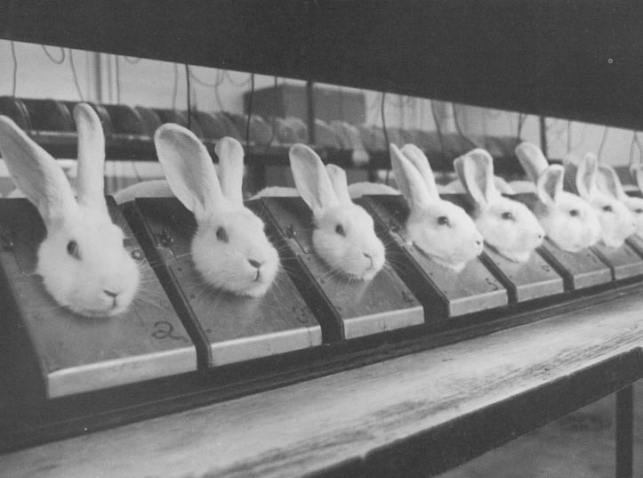
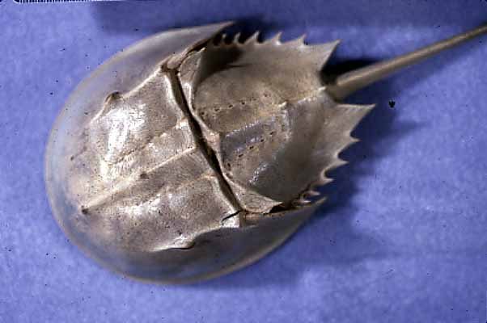
The Evolution of Endotoxin Assays

Slide 19
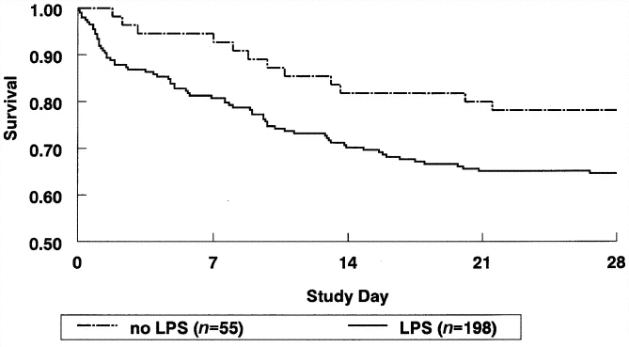
Relationship between plasma levels of LPS and LPS-binding protein in patients with severe sepsis and septic shock
Opal et al. JID 1999; 180: 1584

Slide 20
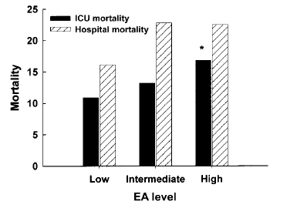
Diagnostic and prognostic implications of endotoxemia in critical illness: Results of the MEDIC study
Marshall et al. JID 2004; 190: 527

Slide 21
Infection
Insult
Adaptive response
Recovery
Severe illness or death
Maladaptive response
Recovery
Severe illness or death

Slide 22
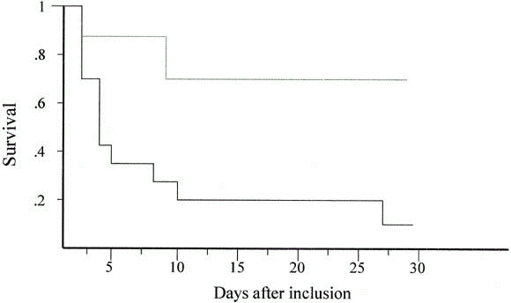
Circulating endotoxin and antiendotoxin antibodies during severe sepsis and septic shock
Maury et al. J Crit Care 2003; 18: 115

Slide 23
Gram-positive sepsis: pathogenetic mechanisms
Cell wall components
  Lipoteichoic acid
  Peptidoglycan
Extracellular products
  A–B toxins (diphtheria)
  Pore-forming toxins (α-toxin of Staphylococcus aureus)
  Hydrolysing enzymes (proteases, hyaluronidases etc)
  Superantigens (TSST, SPEA etc)
Notes:
Gram-positive bacteria harbour a range of toxins, employing a diverse range of toxic mechanisms.^{6,30}
Some similarities have been discovered in the immune responses to some Gram- negative and Gram-positive bacterial toxins.³¹
Lipoteichoic acid from Gram-positive bacteria demonstrates CD14-dependent (receptor present on many human cell types) cellular activation, thus also stimulating leucocytes by a similar mechanism to Gram-negative bacteria.³¹ Furthermore, Gram-positive bacteria posess an array of other factors that contribute to evasion of the host immune response, such as antiphagocytic capsules, intrinsic resistance to bacteriolysis and invasive properties.⁶ Some studies in animal models have indicated that the cytokine profile triggered by exotoxins may be different to that initiated in response to endotoxins, though the few studies performed in sepsis patients have been inconclusive.⁶

Slide 24
Nosocomial infections
Nosocomial infection and drug-resistant pathogens
  multi-resistant Staphylococcus aureus
  vancomycin-resistant enterococci
  multi-drug resistant Gram-negative bacteria
  Clostridium dificile
At any one time, 9% (mean prevalence) of
in-patients have infection, acquired following admission
Microbial resistance increases the threat to patients with nosocomial infection
Notes:
Nosocomial infection is a significant cause of sepsis.^{18,36,37}
Patients admitted to ICUs suffer higher rates of nosocomial infections compared with patients on general hospital wards.¹⁸ Causative pathogens vary between institutions, or even between wards, because of differences in patient population and the prevailing hospital flora.³⁶ Nosocomial infection is a significant cause of sepsis and there is evidence that this is increasing.¹⁸ In a historical cohort study by Pittet et al. in 1994,³⁸ the crude mortality of nosocomial bloodstream infection in the surgical ICU was 50% and associated (not due to an underlying condition) mortality was 35%.
Hospital-acquired pathogens may be multi-resistant and include multi-resistant Staphylococcus aureus (MRSA), Klebsiella spp. and Pseudomonas spp.^{32,37} Such pathogens may be endemic in some hospitals³² and thus pose a threat to patients contracting nosocomial infection.³⁵

Slide 25
Other pathogens in sepsis
Candida spp. are the most common fungal pathogens associated with sepsis
Candidaemia is associated with a high
mortality of 50%
Viruses (e.g. RSV, influenza virus) or parasites (e.g. malaria) may be associated with sepsis
RSV: respiratory syncytial virus
Notes:
Sepsis caused by systemic Candida infection is associated with a high mortality rate of up to 50% in the USA.³⁹
Candida spp. (e.g. C. albicans, C. glabrata, C. tropicalis, C. parapsilosis) are the most common fungal pathogens associated with sepsis. These organisms are difficult to diagnose and the mortality rate is high.³⁹ Studies have shown that Candidaemia is associated with high mortality. However, larger studies are needed in this area to confirm this finding.⁴⁰

Slide 26
Host response to infection
Progression to sepsis and severe sepsis
Pathogen
Infection
Host response
Endothelial dysfunction
Inflammation
Other
factors
Coagulation/
fibrinolysis
Loss of homeostasis
Organ dysfunction
Death
Notes:
Bacterial infection evokes a host response by triggering the immune system.
Normally, the endothelium plays a key role in maintaining homeostasis.^{41,42}
Systemic microvascular endothelial damage compromises the active, moderating role of the endothelium.⁴¹
In the sepsis patient, endothelial dysfunction is central to the imbalance between inflammation, coagulation and fibrinolysis.⁴¹
Other pathophysiological mechanisms, including nitric oxide and mitochondrial dysfunction, may also be involved in disease progression.⁴³
Loss of homeostasis in sepsis patients may result in organ dysfunction.^{41,44}

Slide 27
Pathogenesis of sepsis
An overview
Anti-inflammatory
mediators
e.g. IL-10, IL-1ra receptor antagonists
Pathogen
Infection
Host
responses
Pro-inflammatory
mediators
e.g. Tumour necrosis factor, IL-1, IL-6, IL-8,
nitric oxide
Leucocyte activation
Mitochondrial dysfunction
Inflammation
Microvascular flow redistribution
Endothelial dysfunction
Tissue factor expression
Organ dysfunction
Tissue injury
Microvascular coagulation/
thrombosis
Inhibition of fibrinolysis
Activation of coagulation
Death
Notes:
Sepsis involves a complex host response in an attempt to maintain homeostasis.^{41,46}
This illustration provides a simplification of some of the mechanisms involved in sepsis. In reality, a complex series of physiological events occur simultaneously.^{41,46}
Clinical manifestations of sepsis may involve a single organ or may progress to multiple organ dysfunction syndrome (MODS).¹¹
MODS is considered to be the final result of severe, persistent and generalised inflammation.⁴⁵

Slide 28
Inflammatory response to microbial toxins
Pathogen
Infection
Anti-inflammatory
mediators
IL-4, IL-10, IL-11, IL-13,
IL-1r
Monocyte/
macrophage
Pro-inflammatory
cytokines
Tumour necrosis factor, IL-1, IL-6, IL-8
Neutrophil activation,
aggregation,
degranulation;
release of oxygen free radicals and proteases
Platelet
activation –
aggregation
T-cell
IL-2,
Interferon-γ,
GM-CSF
Endothelial damage
IL: interleukin, GM-CSF: granulocyte macrophage colony-stimulating factor
Notes:
Stimulation of the host immune response by toxins causes an inflammatory response that can lead to endothelial damage.⁴¹
Pro-inflammatory cytokines, such as tumour necrosis factor (TNF), interleukin-1 (IL-1) and
IL-6, are released in response to infection with the aim of destroying damaged tissue and promoting wound repair. Normally, anti-inflammatory mediators (e.g. IL-10, IL-13) are subsequently released to regulate the inflammatory response and restore homeostasis.⁴⁸
Although inflammation is an essential host response, excessive levels of pro-inflammatory cytokines can lead to systemic endothelial damage, and high levels of anti-inflammatory mediators can result in immune suppression.⁴⁸
In sepsis, the imbalance between pro-inflammatory cytokines and anti-inflammatory mediators results in:
• stimulated coagulation response⁵²
• inhibited anticoagulant response^{44,47}
• inhibited fibrinolytic response.^{44,47,53,54}
These processes lead to endothelial damage and loss of equilibrium between the coagulation and fibrinolytic mechanisms.⁴⁴ As a procoagulant state develops, thromboses may form in the microvasculature, and in severe sepsis, the condition may progress to acute organ dysfunction and eventually death.^{44,47,55}

Slide 29
White blood cell adhesion
Rolling
TNF, IL-1
Receptors
Activation
of integrins
Selectins
Direct signalling
ICAM-1
Chemokines
ICAM: intercellular adhesion molecule, TNF: tumour necrosis factor, IL: interleukin
Notes:
There are three main types of adhesion molecules: the immunoglobulin supergene family, integrins and selectins.⁵⁶
Leucocytes are initially slowed on contact with the endothelium by the interaction of selectins with receptors expressed by leucocytes.⁵⁶
Leucocytes respond to chemokines (cytokines and other chemotactic agents) and surface molecules on the endothelium and extracellular matrix. These agents may activate the cell and induce cell migration.⁵⁶
Activation of the cell upregulates the affinity of integrins, which are involved in adhesion to the endothelium and extracellular matrix.⁵⁶
In sepsis, activation of adhesion molecules appears to be increased, with systemic inflammation and widespread thrombin generation.^{57,58,59}
Three main groups of adhesion molecules are associated with leucocyte–endothelium interactions.⁵⁶
• Immunoglobulin supergenes – include cellular adhesion molecules such as intercellular adhesion molecule-1 (ICAM-1), ICAM-2 and vascular cell adhesion molecule-1 (VCAM-1); all of which are expressed on vascular endothelium.^{41,56}
• Integrins – are found on many cells, including leucocytes. They are involved in a wide
range of processes, such as leucocyte adhesion to endothelium and platelet–neutrophil interactions at inflammatory sites.⁵⁶
• Selectins – comprise E-selectin, P-selectin and L-selectin. They are expressed on endothelium, platelets and leucocytes, respectively.^{41,56,58} E-selectin promotes leucocyte adhesion to endothelium and P-selectin expression facilitates leucocyte-platelet interactions that aid leucocyte aggregation.^{41,56,58}
Pro-inflammatory cytokines (including tumour necrosis factor, interleukin-1 and interferon-gamma) and thrombin are important in the up-regulation of adhesion molecules.^{41,57,58} Therefore, in sepsis where there is excessive inflammation and thrombin production, there can also be increased expression of adhesion molecules, which leads to further inflammation, vascular endothelial injury and selectin expression.⁵⁹

Slide 30
The role of the endothelium
Interaction with leucocytes
Release of cytokines and inflammatory mediators
Release of mediators of vasodilatation and vasoconstriction
Functional effects on the coagulation system
Tissue injury
Formation of fibrin clot
Notes:
The endothelium plays a key role in maintaining homeostasis.^{41,42}
Damaged endothelium exacerbates the inflammatory response.^{41,42}
The endothelium is a dynamic participant in cellular and organ function. Through the expression of surface proteins and soluble mediators, the endothelium plays an important role in maintaining the physiological equilibrium between coagulation and fibrinolysis. Derangements in these normal functions contribute to systemic inflammation.^{41,42}
During the inflammatory response, endothelial cell activation causes overall vasodilation, allowing leucocytes to access infection sites.⁴¹ Normally, the endothelium would downregulate this initial pro-inflammatory response by expressing anti-inflammatory and anticoagulant mediators.⁴²
In sepsis, this regulatory function of the endothelium fails, leading to excessive vasodilation, hypoperfusion, generalised tissue damage and inappropriate cytokine response. The damaged endothelium loses its homeostatic balance and becomes procoagulant, precipitating coagulopathy and microthrombus formation.⁴¹

Slide 31
Mortality by organ dysfunctions
83%
23%

Slide 32
Genetic factors in severe sepsis
Inflammatory response
Inflammatory tendency
Differing outcomes
Death
Severe
sepsis
Mediator over-
expression
Sepsis
Systemic inflammation
Elevated
Mediator
normal
expression
Localised inflammation
Normal
Recovery of homeostasis
Notes:
Individuals respond differently to inflammatory stimuli.
Inflammatory cytokine production may be genetically determined. For example, the tendency for overproduction of tumour necrosis factor (TNF) is a hereditary trait.¹⁰²
Increased TNF production has been linked to an increased risk of organ dysfunction and poor prognosis in severe sepsis.¹⁰²
Responses such as the production of cytokines, that play a key role in the development of sepsis and other inflammatory diseases, may be genetically determined through gene polymorphisms.^{102,104}

Slide 33
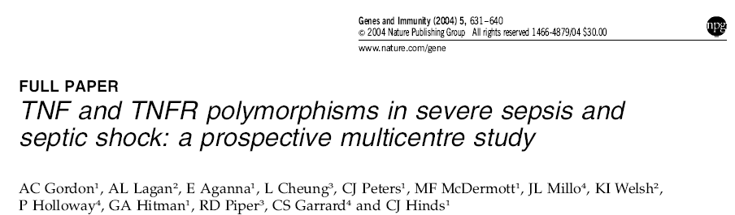
Survived
Died

Slide 34
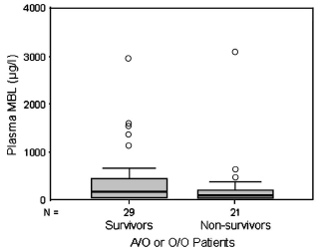

Slide 35
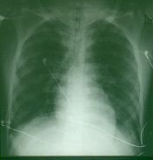
CXR

Slide 36
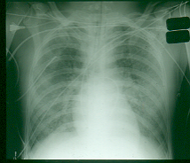

Slide 37
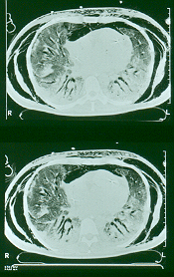
CT Scan

Slide 38
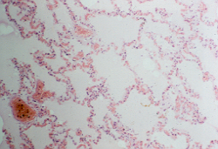
Histology

Slide 39
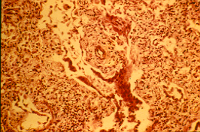

Slide 40
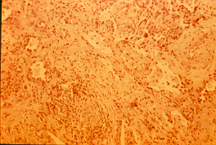

Slide 41
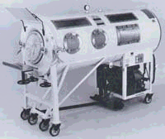
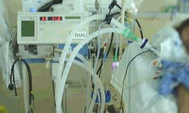

Slide 42
Cardiovascular failure
Hypovolaemia
  Disease, leak, reduced vascular tone
Hypotension
  Hypovolaemia, reduced vascular tone, myocardial depression
Shock
  Failure in oxygen supply and utilisation

Slide 43
Cardiovascular support
Maintenance of circulating volume
  Fluid
Restoration of blood pressure
  Vasoactive drugs
    Adrenaline/Noradrenaline
    Dobutamine
    Vasopressin

Slide 44
Renal failure
Hypovolaemia
Hypotension
Intrinsic vasoconstriction
Acute tubular necrosis

Slide 45
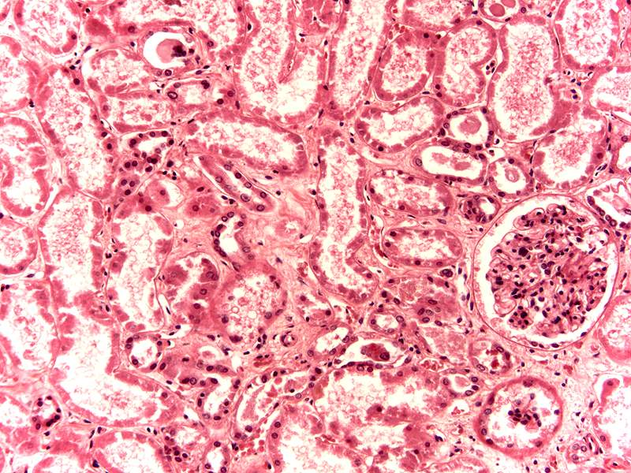

Slide 46
Renal support
Volume resuscitation
Blood pressure restoration
Diuretics
Renal replacement therapy
  Dialysis

Slide 47
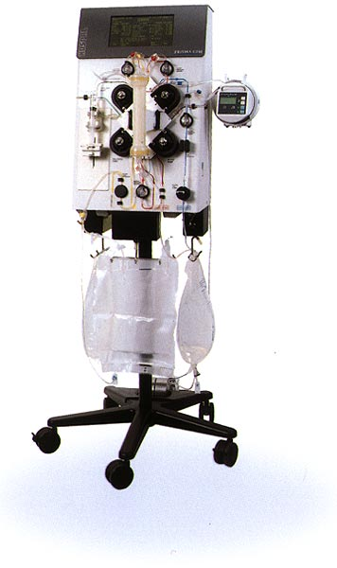
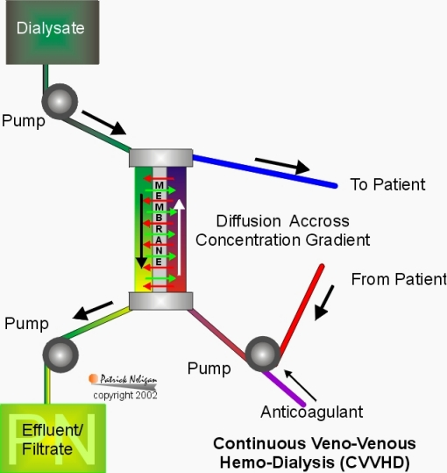

Slide 48
Key events- endotoxaemia
Inflammatory gene induction
  iNOS, TNF, interleukins etc.
  Increased metabolic rate
  fever, tachypnoea/tachycardia
Macrophage/ monocyte activation
  Margination and extravasation
Endothelial activation
  Tissue oedema
  Hypovolaemia
  Coagulation events

Slide 49
Mortality: 48.3% 1996 v 44.7% in 2004

Slide 50
Overall mortality for severe sepsis
Mortality (95% CI) | No sepsis | Severe sepsis
ICU | 16.9% (16.8 to 17.1%) | 31.8% (31.5 to 32.1%)
Hospital | 26.5% (26.3 to 26.7%) | 45.6% (45.3 to 45.9%)

Slide 51
Extrapolating to all adult general critical care units in England, Wales & NI we estimate around 31,000 patients had severe sepsis during their first 24 hours in ICU in 2004
Of these, 14,000 died during the hospital stay

Slide 52
History of supportive care and previous investigational therapies
Goal
Therapy
Block prostaglandins
Ibuprofen
Inhibit or block triggers of immune response
Anti-endotoxin
monoclonal antibody
(HA-1A, E-5)
IL-1 receptor antagonist,
anti-TNF monoclonal antibody
Notes:
Investigational therapies that target only specific inflammatory mediators, e.g. anti- endotoxin therapies, have not been effective in all sepsis patients.⁹
Despite improvements in surgical procedures and advances in antimicrobial agents, the overall success of current approaches has been limited.^{5,9,48,100,129}
The future of severe sepsis management lies in targeting and interrupting the sepsis cascade.^{2,9,63}
Efforts to identify a specific agent that can modulate the underlying disease process in sepsis have met with little success.^{2,9} Agents targeted to host cell activation (e.g. anti-endotoxin monoclonal antibody), a number of mediators of the inflammatory response (e.g. soluble tumour necrosis factor (TNF) receptor, anti-TNF monoclonal antibody, and IL-1 receptor antagonist), and prostaglandin inhibitors (e.g. ibuprofen) have not been shown to reduce mortality in large clinical trials, despite some early indications of benefit.^{19,131,132}
Antithrombin (AT) levels have been shown to be abnormally low in patients with severe sepsis, and this may correlate with a poor prognosis.¹³³ Administration of AT III for severe sepsis in one phase I trial and one phase III trial failed to show any significant improvements in mortality rates compared with placebo.¹³³

Slide 53
Recent investigational therapies
Goal
Therapy
Moderate inflammation, coagulation, fibrinolysis
Recombinant human activated protein C; protein C concentrate
Recombinant TFPI administration
Inhibit inflammatory
response
Inhibit or block triggers of immune response
Steroids
Anti-TNF therapies
TFPI: tissue factor pathway inhibitor, TNF: tissue necrosis factor
Notes:
Investigations into effective therapies for sepsis are still being carried out, with a number of mechanisms being targeted.
A number of potentially beneficial agents are now emerging.
These include recombinant human activated protein C, low-dose steroids, tissue factor pathway inhibitor (TFPI) and anti-tumour necrosis factor (TNF) monoclonal antibody (Mab).
Replenishment therapy with protein C is also being considered. However, no data, other than open-label case studies, have evaluated the effects of protein C in the treatment of severe sepsis.⁸⁷
A phase III trial of TFPI is currently under way with results awaited. A phase I investigation reported that TFPI administration showed a dose-dependent reduction in thrombin generation.¹³⁴ This suggests that TFPI replenishment may also help regulate coagulation dysfunction.
Steroids have been used for many years but their efficacy remains controversial. Two well-designed, prospective, randomised studies demonstrated their inability to decrease mortality.¹³⁵ However, low-dose steroids have recently been shown to significantly reduce the risk of death in septic shock patients who are non-responders to acetylcholinesterase.¹³⁶
Anti-TNF murine Mab fragments, which are less immunogenic than anti-TNF Mabs previously investigated, have been shown to neutralise human TNF and give a 10% reduction in the relative risk of mortality for severe sepsis patients.¹³⁷

Slide 54


Slide 55
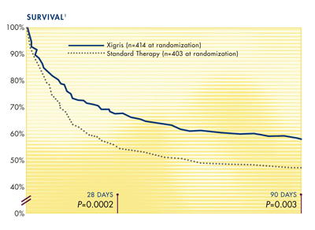

Slide 56
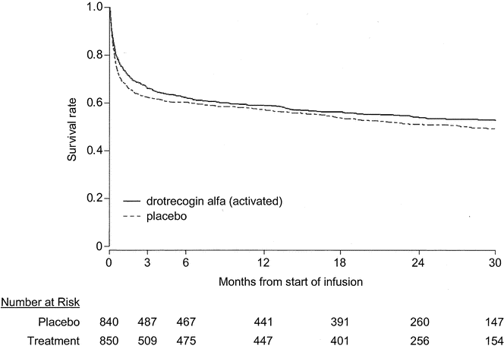
The effect of drotrecogin alpha (activated) on long-term survival after severe sepsis
Angus et al. Crit Care Med 2004; 32:2199

Slide 57
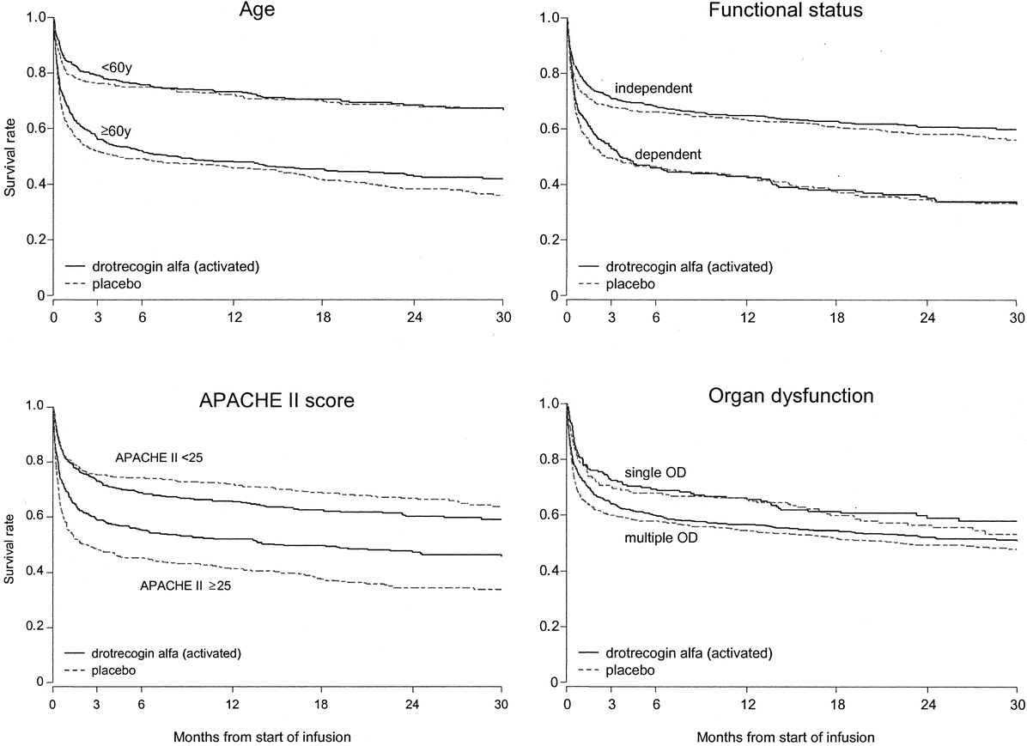
The effect of drotrecogin alpha (activated) on long-term survival after severe sepsis
Angus et al. Crit Care Med 2004; 32:2199

Slide 58
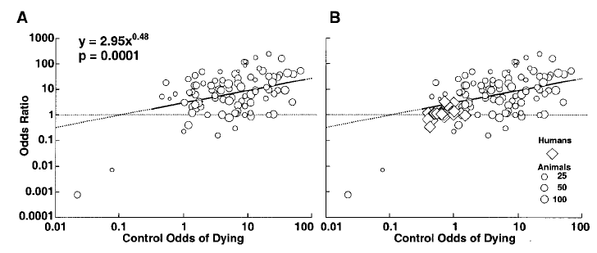
Risk and the Efficacy of Antiinflammatory Agents
Retrospective and Confirmatory Studies of Sepsis
Eichacker P. et al Am J Respir Crit Care Med 2002; 166: 1197

Slide 59


Slide 60
Management 1
Recognition
Resuscitation
Call for help
Provisional Diagnosis
Investigation and sampling
Early antibiotics
Source control

Slide 61
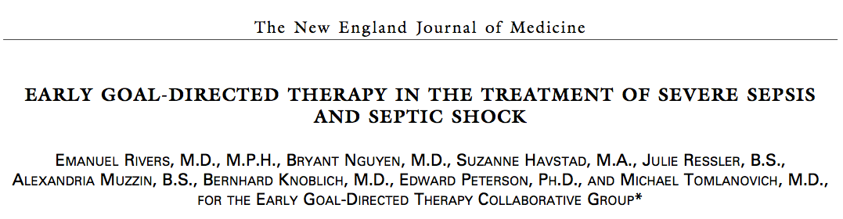
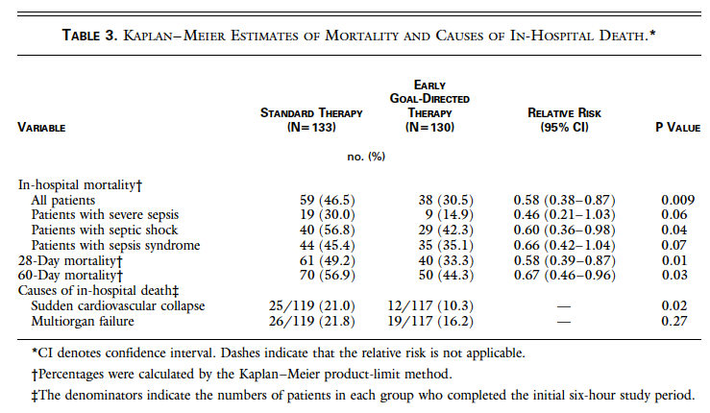

Slide 62
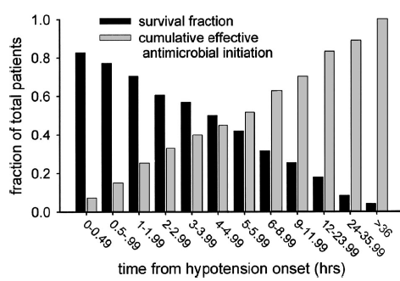
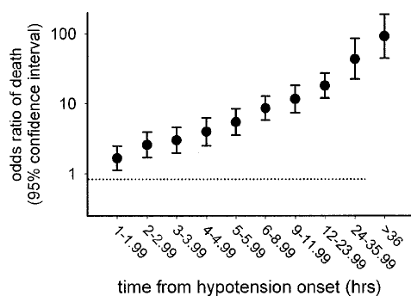
Duration of hypotension before initiation of effective antimicrobial therapy is the critical determinant of survival in human septic shock
Kumar A et al: Crit Care Med 2006; 34:1589

Slide 63
Management 2
Within six hours
Diagnosis
Cultures
Antibiotics
Source control
Targeted resuscitation
  Volume
  Pressure
  Drugs
Subsequent management
Steroids
Tight glucose control
rAPC
Care bundles
  Tidal volumes
  Positioning
  PPIs
  Wake up
  Thromboprophylaxis

Slide 64


Slide 65

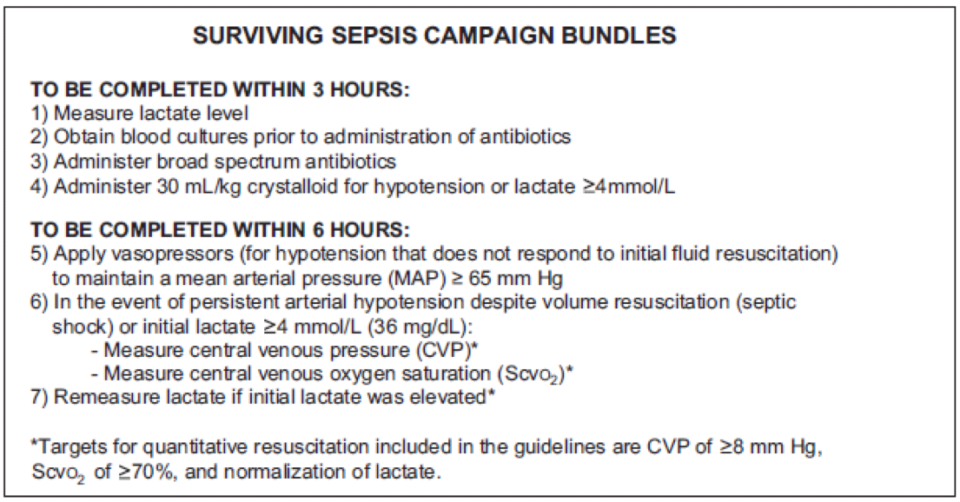

Slide 66
Treatment: general approach
Immediate resuscitation
Oxygen therapy/ ventilatory support
Haemodynamic support
Identify/treat infection
Metabolic assessment
Supportive care
Take microbiology specimens
Immediate broad- spectrum antibiotics
Assess for surgery/drainage
Identify pathogen
Change treatment as necessary
Prevention of pressure sores
DVT prophylaxis
Nutrition
Stress ulcer prophylaxis
Renal replacement therapy
Good practice basics
Consider infection control throughout
DVT: deep vein thrombosis
Notes:
Treatment may be either medical or surgical, or a combination of both.¹²⁹
The initial treatment priority is control of life-threatening abnormalities through assessment of airways, breathing and circulation.
Thereafter, management of sepsis includes treatment of the underlying infection, restoration of tissue perfusion, and patient support.
The purpose of oxygen support is to restore and help maintain adequate tissue oxygenation.
The goals of haemodynamic support are to restore an effective blood pressure to ensure tissue perfusion and to normalise cellular metabolism.
Treating underlying infection through antibiotic therapy and possible surgical debridement is an essential part of sepsis management.^{5,130} The advice of a microbiologist is strongly recommended.
Good practice basics include adherence to aseptic techniques and measures for infection control.

Slide 67
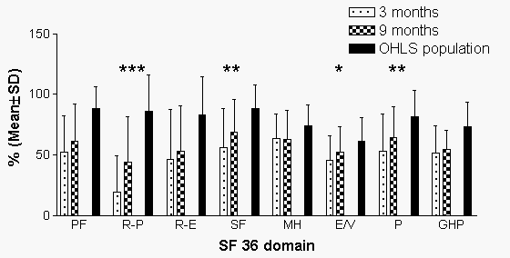
Sukantarat et al. Anaesthesia 2005;60:847

Slide 68
Trials of agents in sepsis,
1996–2001
7.4
10
1
0.1
Benefit
TNF-Mab
Anti-
prostaglandin
Anti-prostaglandin
IL-1ra
Anti-bradykinin
TNF-Mab
rhAPC
PAFra
PAFra
TNF-Mab
IL-1ra
*
TNF-Mab
*
Steroid
Odds ratio
TNF-Mab
sTNFr
TNF-Mab
Anti-bradykinin
IL-1ra
sTNFr
TNF-Mab
Anti-prostaglandin
Harm
0
500
1,000
1,500
2,000
2,500
3,000
Number of patients
Notes:
More than 250 patients are required before any therapeutic activity can be reliably determined.¹⁹
In a meta-analysis of trials of anti-inflammatory treatments in sepsis, the odds ratio – a measure of the probability of surviving – shows a consistently small benefit.¹⁹
A meta-analysis of trials of anti-inflammatory treatments in more than 10,000 patients with severe sepsis or septic shock compared odds-ratios for 21 clinical trials.¹⁹ The graph shows the relative benefit and harm of trial agents for severe sepsis and septic shock compared with placebo. Before any therapeutic activity for an agent can be reliably determined, the number of patients participating in a particular trial must be more than ^{250.19}
Combined results of all 21 sepsis trials in the meta-analysis (excluding trials marked *) showed a small, statistically significant benefit (odds ratio 1:1; 95% confidence interval: 1.02 to 1.20; p=0.02).¹⁹

