Slide 1
Renal physiology summary and data interpretation
Damien Ashby 30.05.13

Slide 2
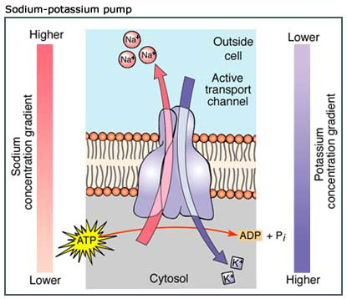
Cl-
Na+
Cl-
K+
K+
Na+
Cl-
K+
K+
Na+
Na+
atp
K+
Na+
HCO3-
-
-
Na+
HCO3-
-
Na+
-
K+
-
-
Intracellular water
28l
K+ 110mmol/l
Na+ 10mmol/l
Interstitial
fluid
10.5l
K+ 4 mmol/l
Na+ 135mmol/l
Intravascular
3.5l

Slide 3
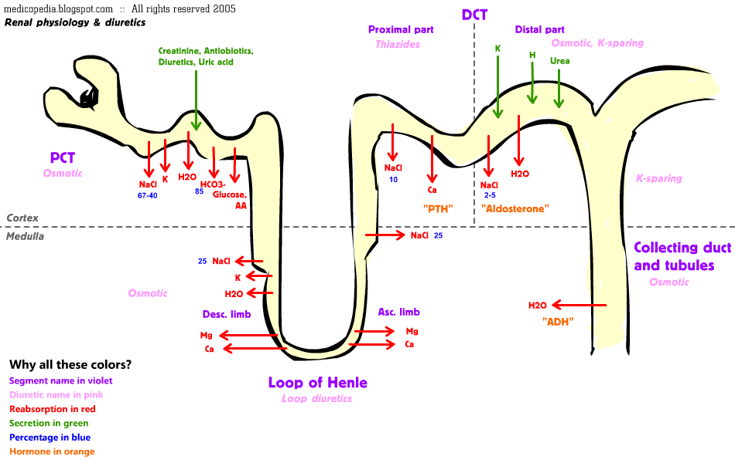
renal handling of Na, H₂O

Slide 4
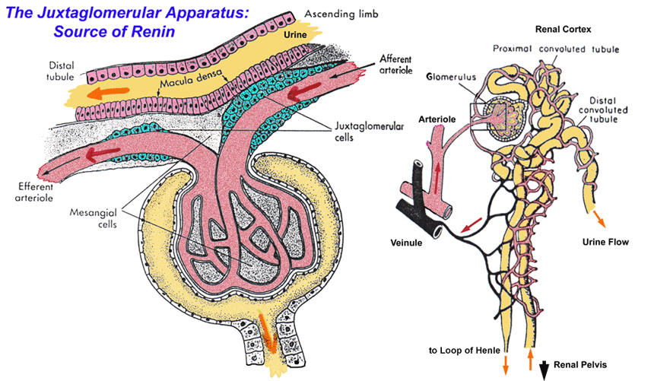
renin-angiotensin
renin release senses renal perfusion
catalyses cleavage of angiotensin I from angiotensinogen
converted to angiotensin II by ACE (lungs, elsewhere)
angiotensin II
vasoconstriction
thirst
aldosterone

Slide 5
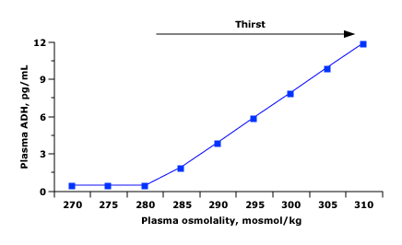
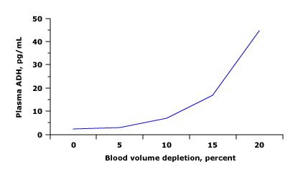
ADH
from hypothalamus / posterior pituitary
mainly senses osmolarity
also blood pressure

Slide 6
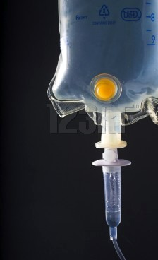
ECF
0.9%
saline
heart failure
low albumin
oedema
effusions
high JVP
renal failure
min-cort excess
+ 2% –
unable to drink
DI
drinking too much
SIADH
- 2% –
low BP
cold
oliguric
fluid losses
osmotic diuresis
min-cort deficiency
diuretics
most (eg GI)
ICF
Na
l
145
l
135
5%
glucose
confusion
thirst
confusion

Slide 7
breathlessness
7.35
pCO2
resp acidosis
7.45
T2 resp failure
6.0 –
tetany
chloride
lactate
ketones
vomiting
diuretics
min-cort excess
4.5 –
T1 resp failure
hyperventilation
pH
resp alkalosis
l
22
-2
l
28
+2
HCO3
BE
met acidosis
met alkalosis

Slide 8
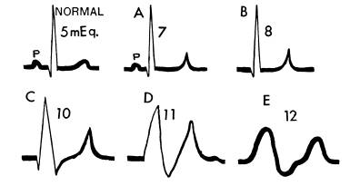
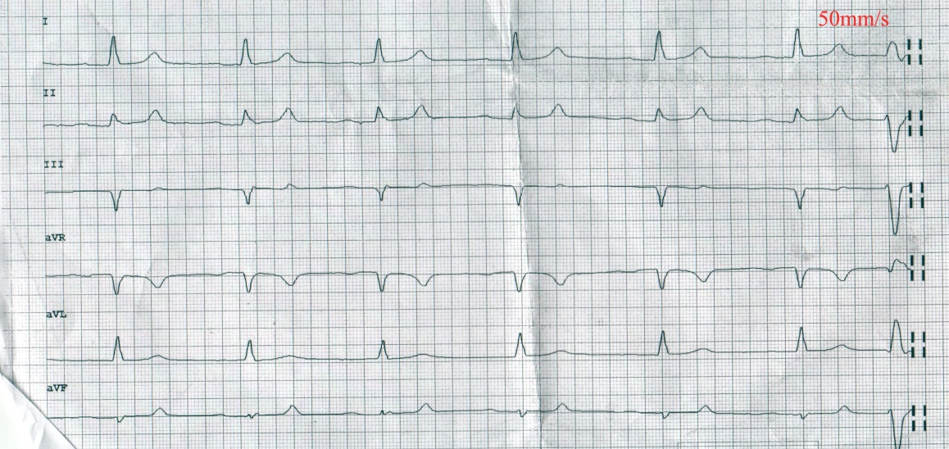
hyperkalaemia
tall T waves
loss of P waves
broad QRS
bradycardia

Slide 9
K
Ca chloride 1
10ml 10%
renal failure
min-cort deficiency
abn ECG
brady
weakness
50% glucose 2
50ml 50%
5.5 –
ketones
lactate
chloride
Na HCO₃ 3
500ml 1.26%
AG
3.5 –
abn ECG
tachy
weakness
GI fluid losses
insulin
diuretics
min-cort excess
renal tubular disorders
l
22
-2
l
28
+2
HCO3
BE

Slide 10
summary
Na in ECF, K in ICF
Na / ECF regulated by renin-angiotensin which responds to renal perfusion
H₂O regulated by ADH which responds to osmolarity (and BP)
K is regulated by aldosterone which responds to renin-ang, as well as K
pH is regulated by balance between resp and renal acid excretion
renin
osmolarity angiotensin K pH pO₂
ADH thirst aldosterone resp
vasoconst
H₂O Na K pCO₂
ICF ECF HCO₃
pH

