Slide 1
Pathology of sepsis 3 case studies

Slide 2
Patient A
57 year old male
4 days headache, fever, sweating
1 day agonising pain in legs, increasing severity
Called ambulance himself
IDDM 11 years; Actrapid 21u/21u

Slide 3
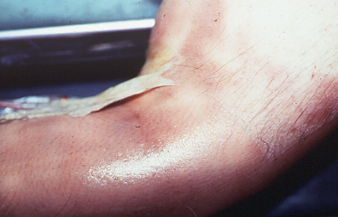
Examination
Mildly confused
Diffuse blanching erythema
T 39.3, sweaty
BP 95/60, RR36, HR 140
Marked tenderness of calf muscles
Chest, heart, abdo: nil remarkable
Urine: blood+++; protein++; glucose +++; ket++

Slide 4
Differential Diagnosis
Auto immune/inflammatory condition eg dermatomyositis
Sepsis but ?source
Management Plan
Blood tests
Blood cultures
I.V. fluids
Antibiotics or immunosuppression ?

Slide 5
‘Progress’
colloid
adrenaline
2l/min O₂
15L/min O₂

Slide 6
Investigations
Na 130, K 5.8, Urea 19.1, Creat 301
Gluc 17.3
Hb 15.0, wcc 4.3, plts 48, ESR 70, CRP 260
CK 5900
pH 7.2, pO2 6.94, pCO2 2.54, Bic 18.6, BE -15
CXR unremarkable
?? Acute dermatomyositis with rhabdomyolysis
?? Sepsis plus Diabetic ketoacidosis

Slide 7
adrenaline
15L/min O2
ICU called
intubated

Slide 8
6 hour reassessment
Mean Arterial Blood Pressure 60mmHg
CVP 18 (reasonably well filled with fluid now)
Catheterised but no urine OP (probable ATN?)
Intubated - to be transferred to ICU; SaO2 99%
Acidosis pH 7.1 -lactate not known

Slide 9
7 h after chart started:-
Unconscious; deeply mottled skin; SBP<60; HR>120;
pH 6.6, BE -25; Na 128, K 9.4, Urea 23.1, Cr 316;
Refractory hypotension, acidosis, hyperkalaemia;
Cardiac arrest -fine VF
Patient died.

Slide 10
Subsequent investigations
Blood : Streptococcus pyogenes
Post mortem: consistent with septicaemia (diffluent spleen, petechiae in intima of aorta, intestinal mucosae) and infective necrotising fasciitis (discoloration of fascia mid-thigh-feet).
Post mortem- all blood cultures positive. Muscle: Streptococcus pyogenes

Slide 11
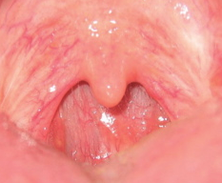
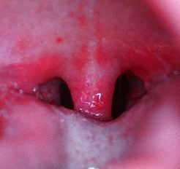
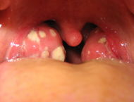
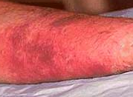
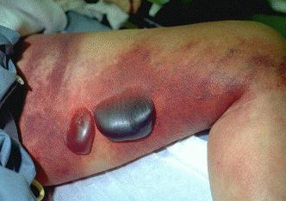
Infections caused by Group A Strep
Throat Carriage
Sore throat
Tonsillitis
Normal throat Sore throat Tonsillitis
2% adults carry GAS
Invasive
Cellulitis
Necrotising fasciitis
Puerperal sepsis
Septicaemia
Pneumonia
Example of necrotising fasciitis ‘Flesh eating disease’ http://www.mdchoice.com/pt/Photo/cpto0032.asp

Slide 12
Invasive group A streptococcal disease
Affects M+F, all ages. Often rapid onset
Associated with all strains of S. pyogenes
Most strains 5+ superantigen genes
Usually bacteraemic (bacteria in blood stream)
Mortality 20-60%
Treatment: supportive (ITU), debridement, antibiotics, antitoxin antibiotics, IVIG

Slide 13
Streptococcal toxic shock (STSS)
Toxic shock= subset of all invasive group A strep infections (10%)
45% mortality rate
Necrotising fasciitis assoc with x7 increased risk
Source: PhD thesis T Lamagni, 2008

Slide 14
Streptococcal toxic shock
Group A strep infection
1. Isolation of group A streptococcus
(A) from sterile site eg blood or
(B) from non-sterile site eg wound, throat
Plus
2. Clinical signs of severity
A. Hypotension AND
B. Two or more of the following
Renal (creatinine x2 ULN)
Coagulopathy
Hepatic dysfunction (ALT,bili, ALP x2 ULN)
ARDS
Erythroderma that may desquamate
Soft tissue necrosis incl necrotising fasciitis, myositis,gangrene
PLUS
FEATURES OF SEPTIC SHOCK
Definite case= 1A + 2AB
Probable= 1B +2AB
The Working Group on Severe Streptococcal Infection. JAMA 1993; 269: 390-391

Slide 15
Patient A
Invasive necrotising fasciitis (S. pyogenes)
Toxic shock syndrome

Slide 16
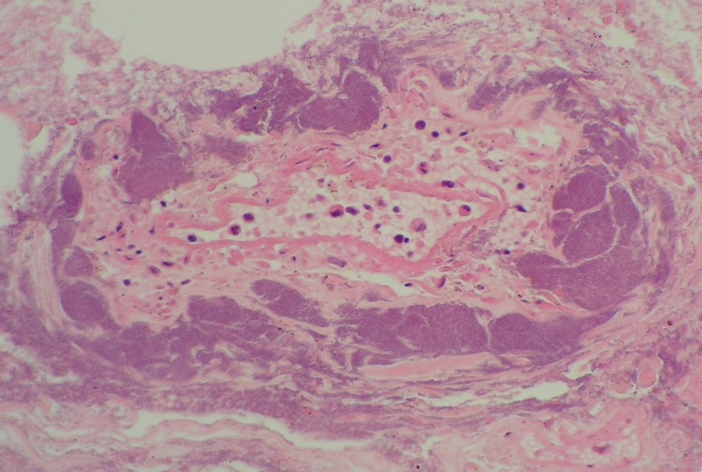
Streptococcal necrotising fasciitis
White cell
Bacteria
Blood vessel
200um

Slide 17
What happened in this patient?
What killed him?
Cardiac arrest
Hyperkalaemia (K >9!)
Acidosis (lactic acidosis)
Hypoperfusion and anaerobic respiration
Hypoxaemia
Hypovolaemia
Renal failure

Slide 18
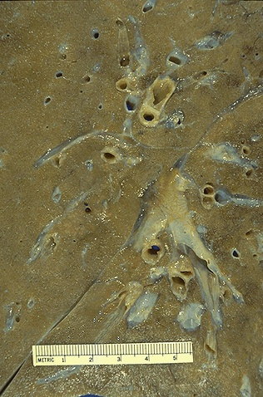
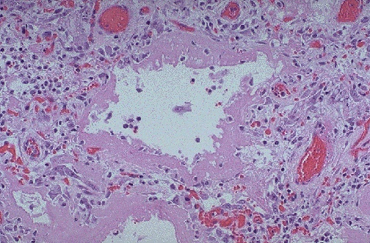
Why hypoxia?
Acute respiratory distress syndrome
Hyaline membranes and fluid in lung

Slide 19
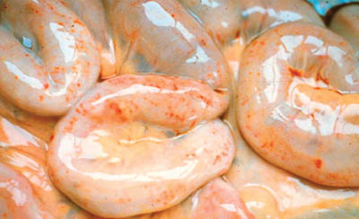
Why hypovolaemic?
Fluid loss into tissues from endothelium- visible severe oedema

Slide 20
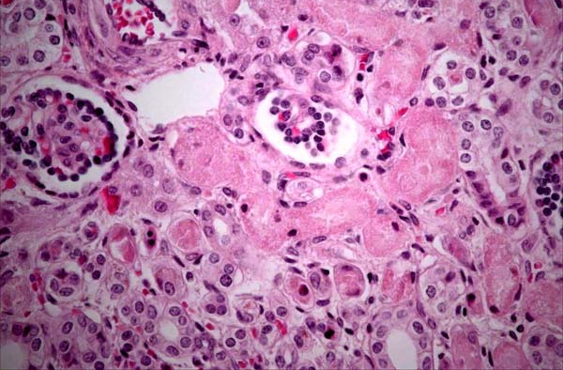
Why renal failure?
Acute tubular necrosis

Slide 21
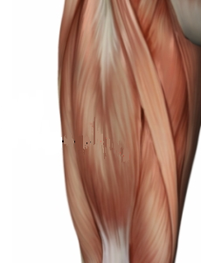
What happened in this patient?
How do streptococci get from throat to tissues?
Chicken pox
Injecting drugs
Eczema
Surgery
Trauma
Skin lesion ~1/4
Skin trauma ~ 1/4
Intact skin. Blunt trauma ~ 1/4
No recalled skin lesion or trauma ~ 1/4
²
?

Slide 22
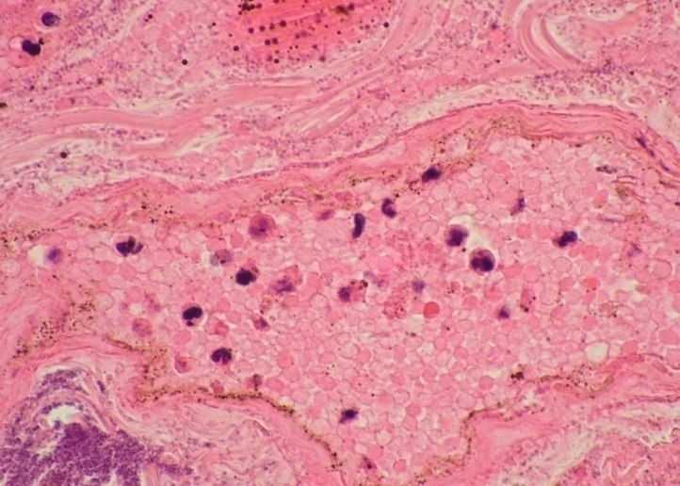
Streptococci in tissues: paucity of host neutrophil response
What happened in this patient?
This patient-
Poor neutrophil migration response despite infection
Vessel
Leukocyte
Bacteria
Comparison:
normal infection site with robust neutrophil migration

Slide 23
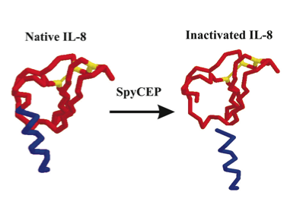
Investigation of poor neutrophil response in fatal strep infections:
S. pyogenes cleaves interleukin-8 using enzyme (SpyCEP)
This strain makes 100x more SpyCEP than some
This strain had a regulator mutation (as do many other invasive lethal strains)
Edwards et al,
J Infect Dis 2005

Slide 24
Case B
27 year old female
4d history of hand pain/swelling and painful leg
Blunt pressure to hand and leg 5 d earlier
CRP>500, sepsis syndrome

Slide 25
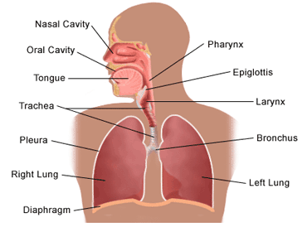
Skin penetration & necrotising fasciitis:
Entry of bacteria through broken skin
Carriage
2% adults
Chicken pox
IDU
Eczema
Traumatic laceration

Slide 26
Blunt trauma & necrotising fasciitis:
Entry of bacteria via bloodstream
Carriage
2% adults
Bacterial factors
Host factors

Slide 27
Case B subsequent events
Fatal stroke due to overwhelming acute phase response (high levels of fibrin, intravascular coagulopathy)
Patient died from the LATE consequences of prolonged, sepsis.
Amputation of fingers
Amputation of leg above knee
Progressive fall in platelets and DIC
Persistent tachycardia despite antibiotics
Persistent acidosis
Day 13 sudden deterioration- fixed dilated pupil

Slide 28
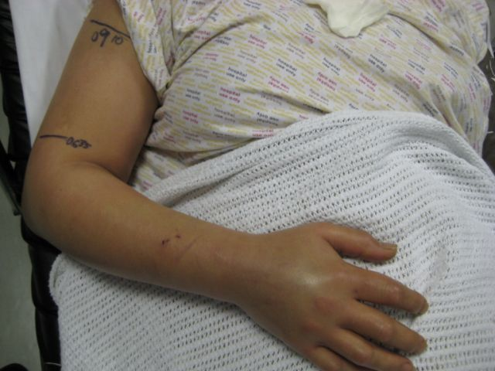
Patient C- a painful arm
Minor injury R forearm
Increasing pain over 24h
Noted to have raised fever, CRP, relative leucopenia
Marked tenderness
Started broad spectrum antibiotics+ Clindamycin
Photographs Simon Eccles

Slide 29
Patient C:
6 hours post op
Worsening lactate
Low BP (MABP 60)
HR increasing >120
Pain in upper arm with dusky discolouration
Final diagnosis Group A strep Necrotising Fasciitis
Extensive debridement upto chest wall & axilla
Gram positive cocci seen in fluid
Patient stabilised post op; given 2g/kg IVIG

Slide 30
Case C; why did she do well?
Key differences
Pathogen- virtually identical to case B
No identified excess virulence factors or mutations
Prompt recognition
Prompt and extensive surgery

Slide 31
Summary
Three patients with group A Streptococcal necrotising fasciitis.
Key differences in pathogen virulence
Key differences in host susceptibility-
Carriage of group A strep
Recent trauma
Diabetes
DELAY in recognition
Extent of surgery (SOURCE control)
Major differences in organ sequelae and survival

