Slide 1
Nutrition and diabetes
Siân Rilstone
Diabetes Specialist Dietitian
Monday 10 June 2013

Slide 2
Plan
Healthy eating for Diabetes
Nutritional management of Type 1 Diabetes
Nutritional management of Type 2 Diabetes
Prevention of type 2 Diabetes
Diabetes and pregnancy

Slide 3
Quiz
What are the symptoms of diabetes?

Slide 4
Symptoms of Diabetes
Excessive thirst (polydipsia)
Polyuria (frequent urination)
Polyphagia (always hungry)
Nocturia (urination at night)
Tiredness / lethargy
Unintentional weight loss
Blurred vision
Recurrent thrush
Poor healing of wounds
Pruritus vulvae in women
Balanitis in men
Numbness in the feet
Superficial infections, boils

Slide 5
Quiz
What are the differences between Type 1 and Type 2 Diabetes?

Slide 6
Characteristics of Type 1 and Type 2 Diabetes
Type 1 Diabetes
  Usually < 30 years
  Usually rapid onset
  Normal or underweight
  Associated with specific human leucocyte antigen (HLA)
  Autoimmune disease
  Viral infection trigger
  Early insulin secretion becomes impaired and later on totally absent
  Ketosis is common
  5-15% of all diagnosed cases
  Complications are not common at diagnosis
  Treatment is insulin
Type 2 Diabetes
  Usually > 40 years
  Usually gradual onset
  80% are overweight
  No HLA association
  Nil autoimmune disease
  No evidence of viral trigger
  Insulin deficiency and/or insulin resistance
  Ketosis is rare
  85-95% of all diagnosed cases
  Complications often present at diagnosis
  Treatment is diet and exercise +/- tablet and/or insulin

Slide 7
Different types of Diabetes
3 Main types:
Type 1
Type 2
Gestational – glucose intolerance first discovered in pregnancy
Other types:
Maturity onset diabetes of the young (MODY)
Latent autoimmune diabetes in adults (LADA)
Drug-induced eg. Glucocorticoids, thiazides
Secondary to endocrinopathies eg. Acromegaly

Slide 8
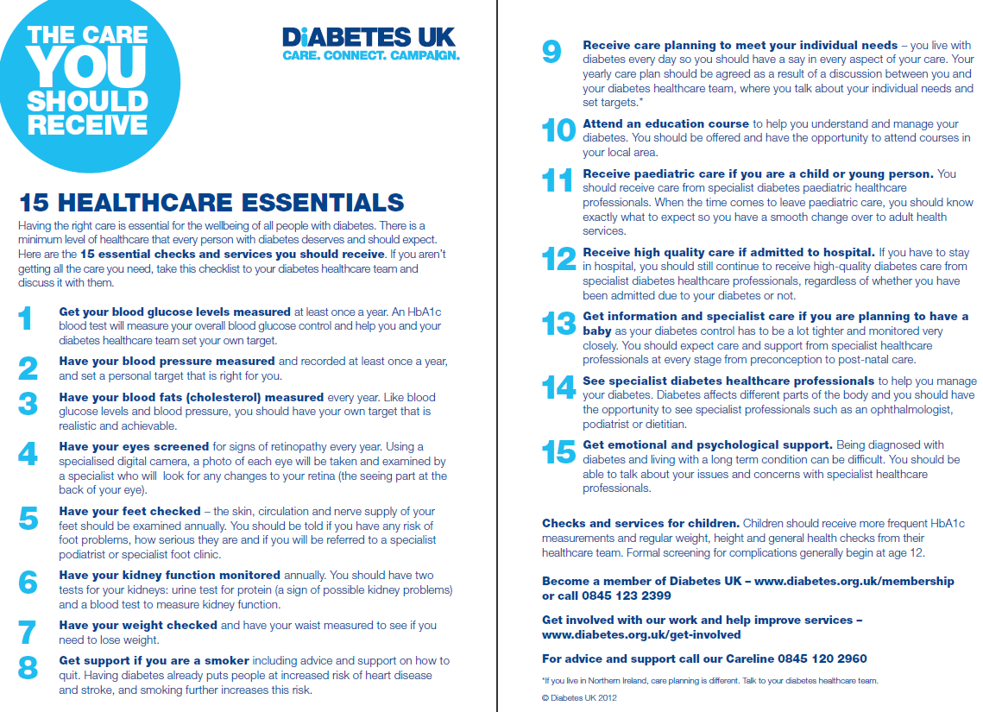

Slide 9
Aims of nutritional management – Type 1 and Type 2 diabetes
Good glycaemic control (HbA1c ≤ 48 mmol/mol and limit hypos)
Minimise risk of long-term microvascular and macrovascular complications
CVD risk reduction: weight, blood pressure and lipid management
Enjoyment of food and good quality of life
Facilitation of health behaviour changes and self management

Slide 10
10 steps to eating well
1. Eat three meals a day
2. Include starchy carbohydrate foods as part of your diet
3. Cut down on the fat you eat, particularly saturated fats
4. Eat more fruit and vegetables
5. Include more beans and lentils
6. Aim for at least two portions of oily fish a week
7. Limit sugar and sugary foods
8. Reduce salt in your diet to 6g or less a day
9. Drink alcohol in moderation only
10. Don't use diabetic foods or drink

Slide 11

Eat three meals per day
Avoid skipping meals and
Space meals over the day.
Helps controls appetite and blood glucose levels, especially if on twice-daily insulin.

Slide 12
Include starchy carbohydrates as part of your diet
Bread, rice, pasta, potatoes, yam, plantain, cereals etc
Aiming for CHO awareness –knowledge of effect of CHO – type and quantity on BG levels
Helps keep blood glucose levels stable
Choose higher fibre varieties e.g. wholegrain cereals
Lower glycaemic index choices recommended e.g. oats, pasta, basmati rice, granary bread, beans and lentils

Slide 13
Cut down on fat, particularly saturated fat
Low fat diet for weight management
  Grill/bake/steam
  Low fat dairy
  Avoid high fat foods e.g pastry, cake, fried foods
Low saturated fat for cholesterol levels
  Choose monounsaturated fat instead (Olive oil, rapeseed/vegetable oil)

Slide 14
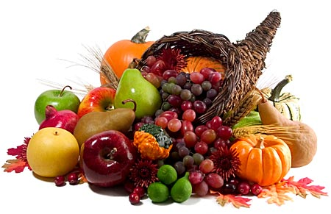
Eat more fruit and vegetables
5 or more a day
Important for vitamins, minerals and other nutrients
Helps protect against disease
Filling, contain fibre, vegetables should form main part of meal

Slide 15
Fruit
A portion of fruit =
1 small banana, medium apple, pear, peach, orange
2 small fruits e.g plums, satsumas
Slice of melon
Cup (10-15) grapes or berries
Handful of dried fruit
Small glass of fruit juice
Important part of a healthy diet
Tastes sweet, but a portion of most fruit doesn’t have a large effect on blood glucose
Some say up to 4 portions per day, spread evenly through day (debatable)
Best if whole fruit is eaten, limit fruit juice to 1 small glass per day
Notes:
15

Slide 16
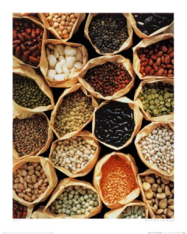
Eat more lentils, beans, pulses
High in soluble fibre
Low GI

Slide 17
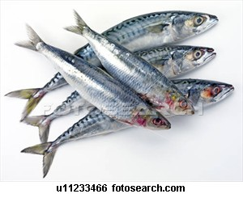
Aim for at least two portions oily fish per week
Salmon, sardines, mackerel, pilchards, herring, trout
Contain omega 3 fats – beneficial to those at risk of cardiovascular disease

Slide 18
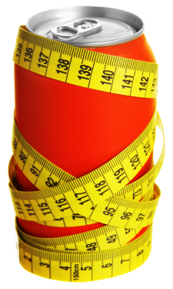
Limit intake of sugary foods and drinks
Diabetic diet does not need to be sugar free!
Modest amounts of sugar can be included as part of meals or snacks
But, sugar has no nutritional value
People who are overweight should limit intake of high sugar foods
Sugary drinks not recommended for general consumption – use diet drinks

Slide 19
Limit intake of sugary foods and drinks
Avoid*/Eat less often | Alternatives
Sugar (brown or white), honey, glucose, jaggery. Sugar added to drinks* | Artificial sweetners e.g. Canderel, Sweetex, Splenda, Supermarket own brands
Thickly spread jam, marmalade, honey, syrup, treacle, lemon curd | Thin spread jam, marmalade or honey. Bovril, marmite.
Ordinary fizzy drinks* e.g. cola, Lucozade, lemonade. Ordinary squash* and Ribena*. | Diet fizzy drinks e.g. Diet Coke, Pepsi Max, Sprite Zero. No added sugar or sugar free squash e.g. Ribena Really Light
Cakes, rich biscuits, sweets, chocolate, puddings, pastries, pies, rich ice-cream | Fresh fruit, plain biscuits e.g. Rich tea, sugar free jelly, custards, plain ice-cream
Tinned fruit in syrup Sugary yoghurts | Tinned fruit in natural juice Diet yoghurt e.g. Mullerlight, Ski light, Shape low fat
Sugar coated breakfast cereals e.g. Frosties, Sugar puffs, Coco pops | High fibre breakfast cereals e.g. oat porridge, Fruit and fibre, All bran.
Notes:
19

Slide 20

Avoid “diabetic” products
Expensive
Often unpalatable
Minimal benefits to blood glucose control
Often high in fat
Can induce osmotic diarrhoea
Notes:
20

Slide 21

Limit alcohol intake
Men no more than 3 units per day
Women no more than 2 units per day
Unit = half pint beer, very small glass (100mls) wine, 25mls spirits
1-2 units daily may have health benefits
High alcohol intakes can lead to high blood pressure, liver problems, weight gain etc.
Risk of hypoglycaemia (liver gluconeogenesis impaired)

Slide 22

Reduce intake of salt
High salt intakes linked to high blood pressure
No more than 6g salt per day – most of us eat 9g or more
Most salt prom processed foods

Slide 23

Take regular exercise
Adults should aim to be active daily.
Over a week, activity should add up to at least 150 minutes (2½ hours) of moderate intensity activity in bouts of 10 minutes or more
  E.g. 30 minutes on at least 5 days a week.
Alternatively, comparable benefits can be achieved through 75 minutes of vigorous intensity activity spread across the week or combinations of moderate and vigorous intensity activity.
Adults should also undertake physical activity to improve muscle strength on at least two days a week
All adults should minimise the amount of time spent being sedentary (sitting) for extended periods
Can improve blood glucose control, lipids, blood pressure and weight management
Can cause hypoglycemia

Slide 24
Structured Education for Type 2 Diabetes
DESMOND (Diabetes Education and Self Management for Ongoing and Newly Diagnosed)
X-PERT (eXpert Patient Education versus Routine Treatment)

Slide 25
Nutritional management
Type 1 Diabetes – focus on carbohydrate counting + healthy eating/CVD risk reduction
Type 2 Diabetes – focus on weight management + healthy eating/ CVD risk reduction + carbohydrate awareness (regular meals, watch CHO portions)

Slide 26
What nutritional management is not
A prescriptive, “special”diet
A judgement of an individual’s eating habits
Based on restriction and blame (e.g. your blood glucose is too high because you are not keeping to your diet/ you are eating the wrong things)

Slide 27


Slide 28
Dietary management of Type 1 Diabetes

Slide 29
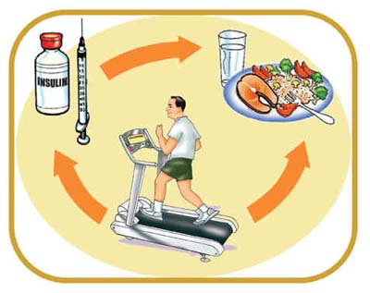
Management of Type 1 diabetes
Insulin
Diet
Exercise

Slide 30


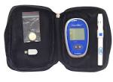
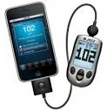
Blood glucose monitoring
Identifies patterns
Tests response to foods & medication
Enables adjustment of medication

Slide 31
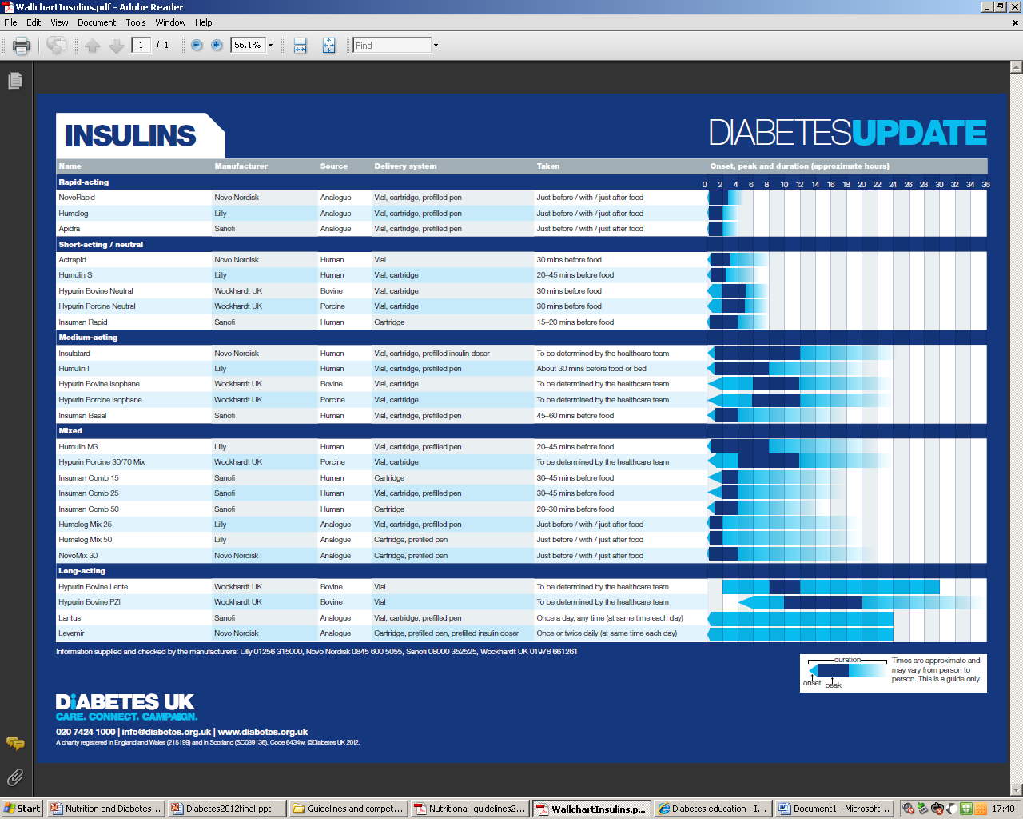

Slide 32
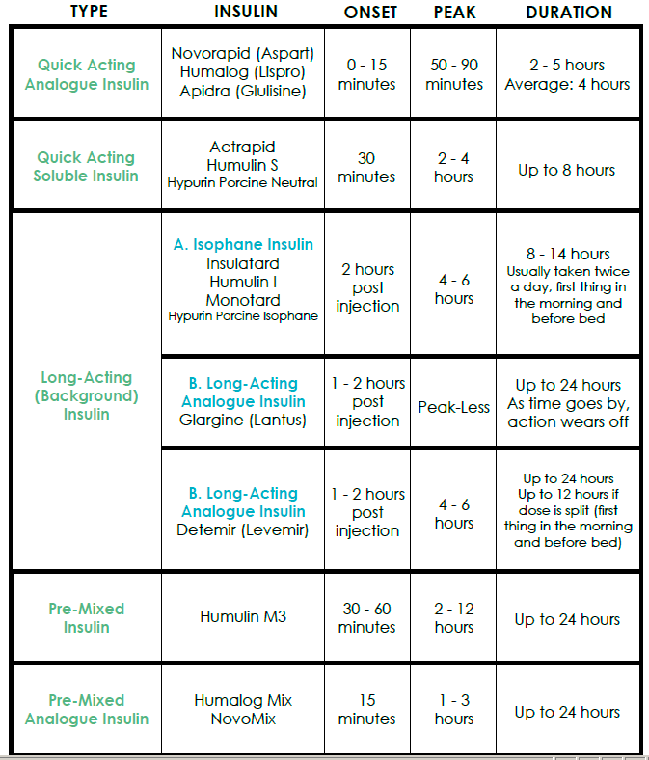

Slide 33
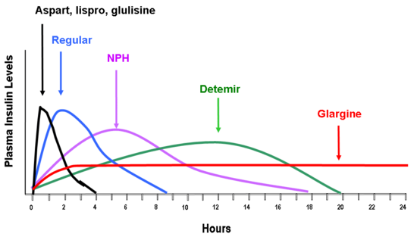
Insulin time action profiles
Each insulin is defined by its onset, peak and duration of action

Slide 34
Type 1 diabetes – commonly used insulin regimens
Twice daily mixed insulin e.g. NovoMix 30
  consistent meal pattern
  consistent carbohydrate intake (meals +/- snacks)
Not very flexible
Basal/bolus i.e. Long-acting background insulin (Glargine or Detemir) + rapid-acting insulin (NovoRapid or Humalog) with food (meals & large snacks).
  Most need 0.5-0.8 units of insulin per kg.
  Roughly half for food and half for basal rate.
  Can adjust insulin to match food timing and quantities
  CHO counting
Regimen of choice
Insulin pump –continuous infusion of rapid-acting insulin with bolus for meals & snacks.
  CHO counting
Most flexible & physiological regimen available

Slide 35
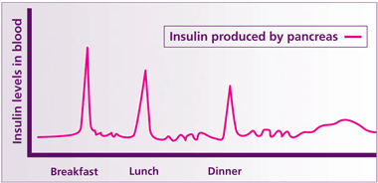
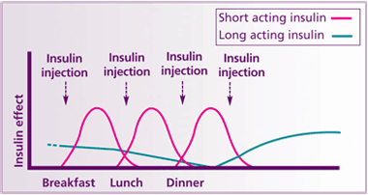
Physiological profile of insulin secretion compared to basal bolus insulin regimen

Slide 36
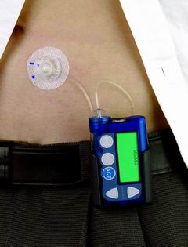
Continuous Subcutaneous insulin infusion (CSII)- insulin pump therapy

Slide 37
Benefits of CSII
Reduces potential hospital admission as a result of Diabetic Ketoacidosis and Hypoglycaemia.
Return to a higher quality of life for patients (greater family cohesion).
Improved Metabolic Control.
Potential reductions in follow-up appointments as HbA1c levels reach an appropriate level.
Better general health and higher treatment satisfaction.
Lower anxiety and depression scores.
Greater freedom in eating and sleeping.
Further reductions in blood glucose swings and insulin dose. Risk of tissue complications is also lowered.
Greater control and accuracy
(NHS Technology adoption centre)

Slide 38
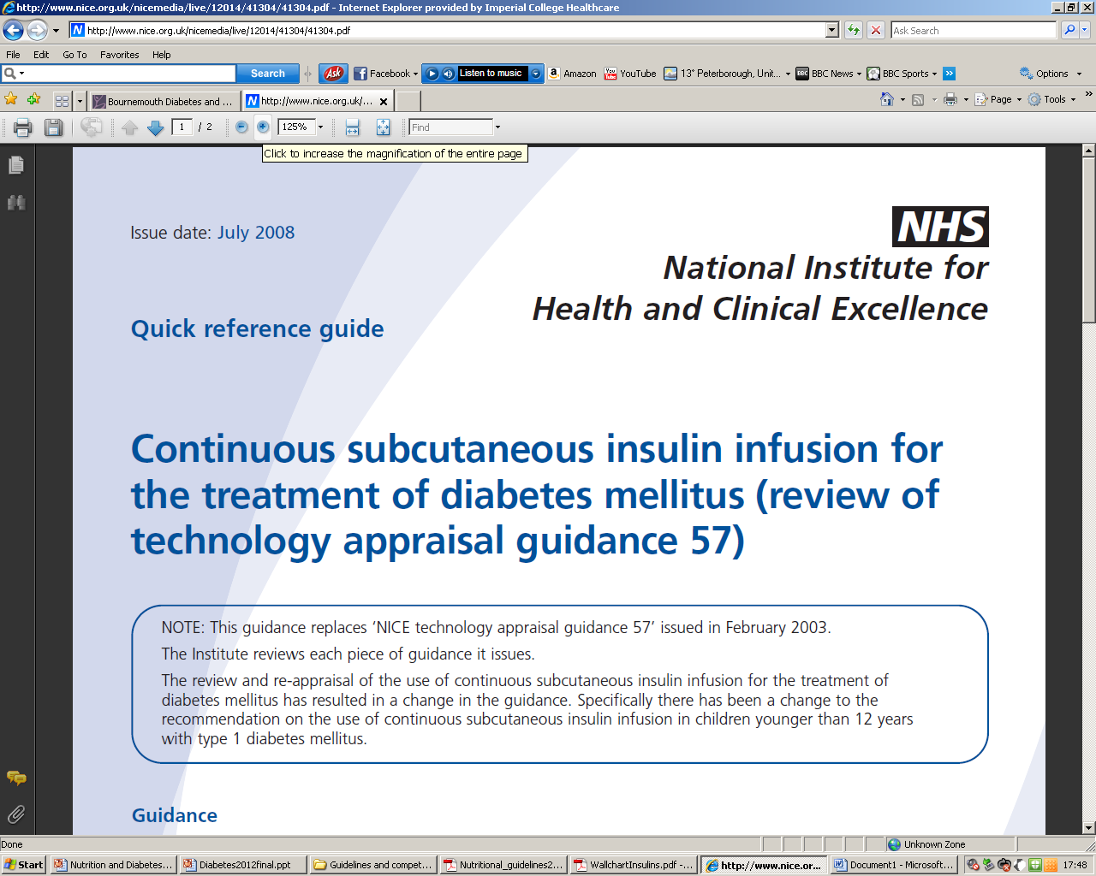

Slide 39
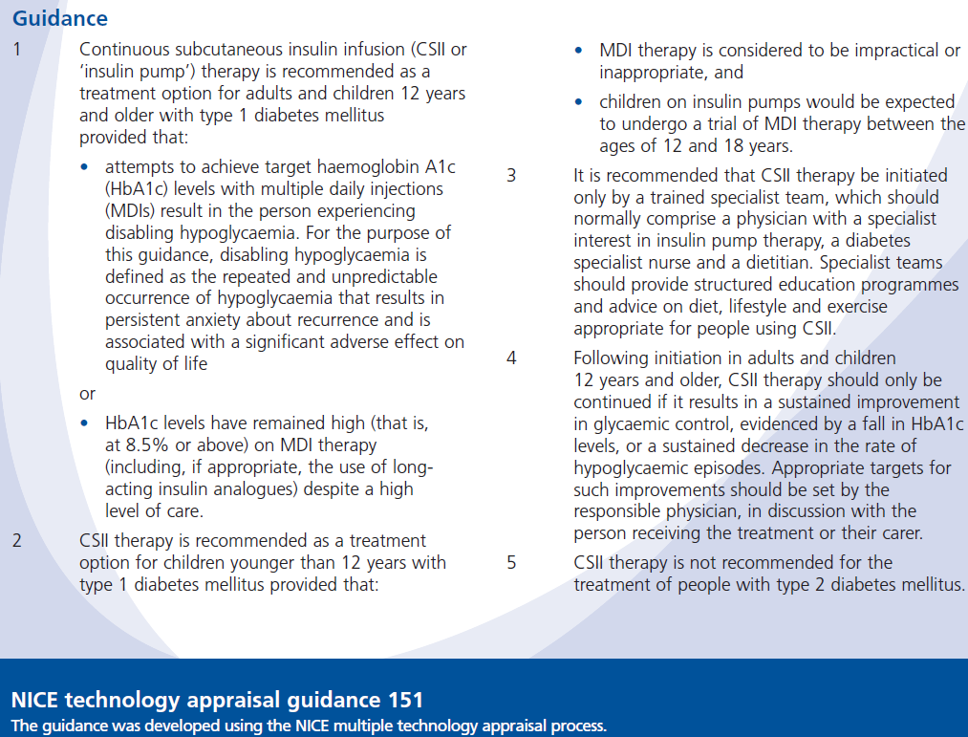

Slide 40
Nutritional considerations Type 1 DM
Aim to co-ordinate lifestyle and insulin therapy with focus on flexibility, good glycaemic control, CVD risk reduction
2 main aspects:
assessing carbohydrate intake and matching it with insulin dose.
  carbohydrate counting required
  Also consider effects of exercise, alcohol, GI and illness on BGLs
encouraging good nutrition (as with Type 2 Diabetes – see later slides)
  healthy eating weight management
  CVD risk reduction

Slide 41
Carbohydrate counting on structured education programmes
DM NSF recommends all patients with Type 1 and Type 2 diabetes are offered structured education
To meet NICE guidelines for structured education. All programmes must: have a structured, written curriculum; have trained educators; be quality assured; be audited
DAFNE – Dose Adjustment for Normal Eating
ICICLE – Imperial College Insulin Carbohydrate Lifestyle Education
BERTIE – Bournemouth Type 1 Intensive education programme

Slide 42

DAFNE
(Dose Adjustment For Normal Eating) www.dafne.uk.com

Slide 43
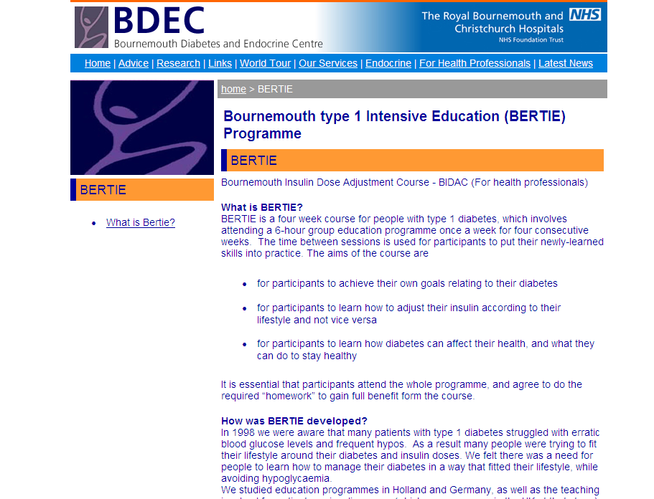

Slide 44
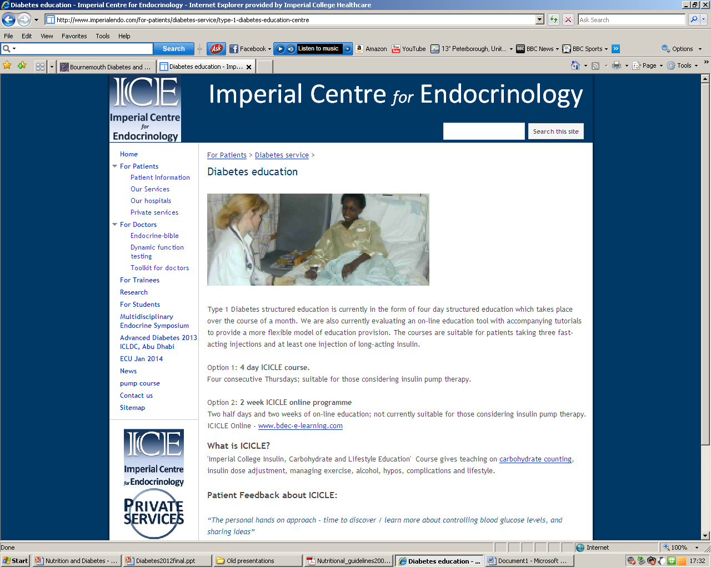

Slide 45
What is Carbohydrate (CHO)?

Slide 46
A quick science lesson…
Glucose
Glucose is a monosaccharide…
Glucose
Galactose
Fructose
…we get it from disaccharides such as sucrose, lactose and maltose (sugars)…
Glucose
…as well as from oligosaccharides and polysaccharides (starch).
Glucose
Glucose
Glucose
Glucose
Disaccharides, oligosaccharides and polysaccharides are broken down into monosaccharides by enzymes, and are absorbed in the small intestine
Glucose
Glucose

Slide 47
Carbohydrate-containing foods
Cereal derived starch products: breakfast cereals, grains, bread, rice, pasta, couscous, flour based products [pastry, biscuits, cakes] thickening agents (cornflour)
Vegetable starch: potato, legumes [lentils, beans, peas], yam, sweet potato
Fructose: fruit, fruit juice
Lactose foods: milk, yoghurt, ice cream, custard
Sucrose (Table Sugar): chocolate & confectionary, ordinary soft-drinks, desserts, cakes, etc

Slide 48
What foods are not counted
Meat, fish, chicken, eggs, nuts
Cheese
Most vegetables (except starchy vegetables)
Diet drinks, sugar free drinks, most artificial sweeteners
Alcohol (but some alcoholic drinks contain unfermented sugars/starches)

Slide 49
Why count carbohydrate in Type 1 Diabetes?
Insulin is required to utilise glucose
Glucose comes from carbohdrate
Insulin and glucose need to be well match to prevent hypoglycaemia or hyperglycaemia
So either:
  match insulin to carbohydrate intake
  or maintain a consistent carbohydrate intake.
Qualitative benefits:
  Improved quality of life, food freedom, general well being
Quantitative benefits:
  Less hypoglycemic episodes, improved glycaemic control/HbA1c.

Slide 50

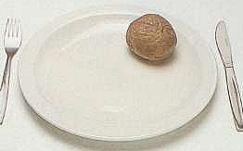
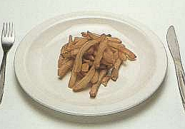
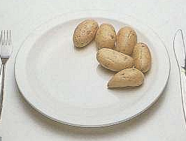
Error in estimating!
Each of the pictures shows 40g of carbohydrate in 4 potato dishes – note how the size of the serving varies according to the different way the potato is prepared.

Slide 51
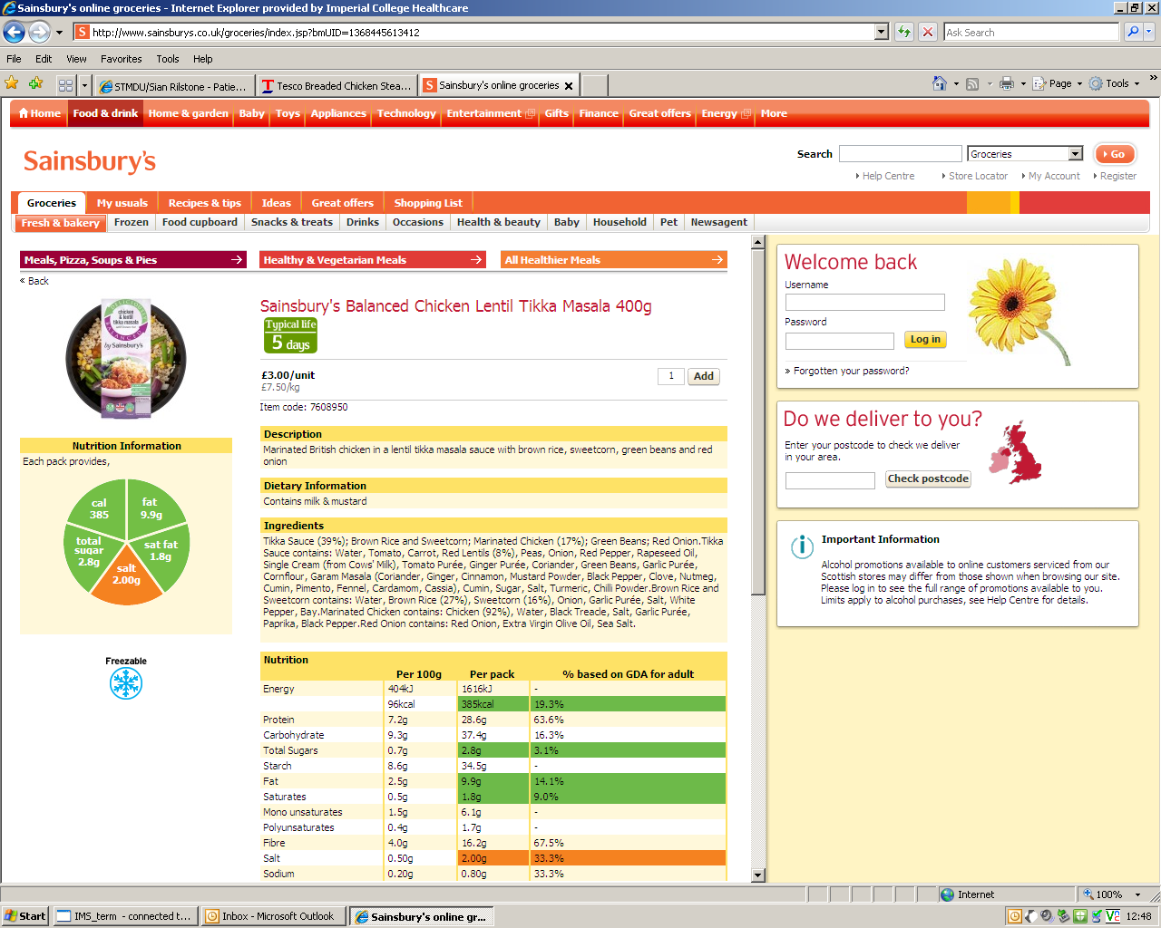
How do you calculate carbohydrate?
Weighing food and using Carbohdrate per 100g to calculate carbs
  E.g. baked potatoes contain 33g carbs per 100g
  A typical baked potato may weigh 150g
Typical servings
  1 tbsp cooked rice = 10g carbs
  ½ cup cooked pasta = 10g carbs
Food labels
.

Slide 52
Pros and cons of counting carbs in Type 1 Diabetes
“Food freedom”
  Vary meal times or skip meals/snacks
  Enjoy eating out
  Enjoy a wider variety of foods
  Avoid fear or guilt
Improved quality of life
Improved glycaemic control
  Predict blood glucose responses
  Achieve appropriate blood glucose
  Less hypoglycaemia
  Improved HbA1c
Blood testing
Reading labels
Weighing foods
Keeping records
Possibly weight gain

Slide 53
Quiz
Name one dairy product that contains carbohydrate
Milk/yogurt/ice cream/custard
What is the name of the sugar it contains?
Lactose

Slide 54
Nutritional management of Type 2 Diabetes

Slide 55
Type 2 Diabetes facts
347 million people worldwide have diabetes
In 2004, an estimated 3.4 million people died from consequences of high fasting blood sugar
More than 80% of diabetes deaths occur in low- and middle-income countries
WHO projects that diabetes will be the 7th leading cause of death in 2030
Healthy diet, regular physical activity, maintaining a normal body weight and avoiding tobacco use can prevent or delay the onset of type 2 diabetes.

Slide 56
Type 2 diabetes
A multi-faceted challenge!
80% people with Type 2 diabetes are overweight/obese
Hypertension and dyslipidaemia are very common
Many people are diagnosed when complications of diabetes are already present

Slide 57
Glycaemic control in type 2 Diabetes
Weight loss is the primary nutritional strategy in overweight or obese patients
Regular, moderate physical activity can reduce HbA1c by 0.45 – 0.65% independent of weight loss.
Total energy intake most important for optimal glycaemic control.
Total amount of carbohydrate consumed is a strong predictor of glycaemic response
Monitoring total carbohydrate intake is a key strategy in achieving glycaemic control.
Low GI diets may reduce HbA1c up to 0.5%

Slide 58
Weight management in Type 2 Diabetes
Weight reduction for the overweight or obese person with Type 2 diabetes is effective in improving glycaemic control and cardiovascular risk factors.
Total energy intake should be less than energy expenditure
Recommendation for people without diabetes are appropriate and can be adopted by people with diabetes
  Dietary, physical activity, surgical, pharmaceutical
Look AHEAD study in US - lifestyle interventions, including a low-fat diet
  reduced bodyweight,
  HbA1c
  Reduced cardiovascular risk factors
  maintained over four years
Look AHEAD Research Group, Wing RR (2010). Long-term effects of a lifestyle intervention on weight and cardiovascular risk factors in individuals with type 2 diabetes mellitus: four-year results of the Look AHEAD trial. Arch Intern Med 170 (17); 1566–75.

Slide 59
Obesity
- treatment options
Prevention
Hypocaloric diet (reduce by 500 kcals./day to lose 0.5kg per week) + exercise
Therapeutic agents
(Orlistat)
Surgery – can “cure” Type 2 diabetes
(gastric by-pass gives best results)
Combination of the above

Slide 60
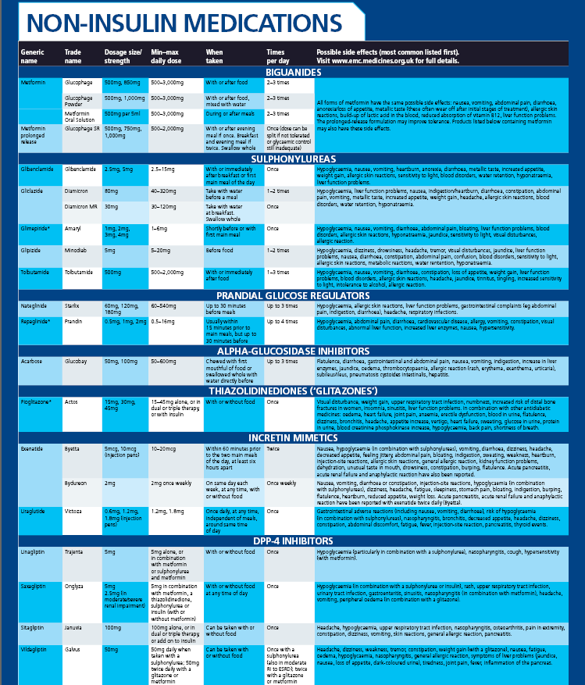

Slide 61
What are the effects of diabetes medications on weight?
1. Biguanides – metformin
2. Sulphonylureas e.g gliclazide
3. Prandial glucose regulators e.g. nateglinide
4. Alpha glucosidase inhibitors - acarbose
5. Thiazolidinediones (glitazones) - pioglitazone
6. Incretin mimetics – Exenetide, Byetta.
7. DPP4-inhibitors e.g. Sitagliptin, saxagliptin
8. Insulin

Slide 62
What are the effects of diabetes medications on weight?
1. Biguanides – metformin - NEUTRAL
2. Sulphonylureas e.g gliclazide - GAIN
3. Prandial glucose regulators e.g. nateglinide - NEUTRAL
4. Alpha glucosidase inhibitors – acarbose - NEUTRAL
5. Thiazolidinediones (glitazones) – pioglitazone - GAIN
6. Incretin mimetics – Exenetide, Byetta - LOSS
7. DPP4-inhibitors e.g. Sitagliptin, saxagliptin - NEUTRAL
8. Insulin - GAIN

Slide 63
Important point
People with diabetes respond more slowly to weight management strategies than those without diabetes (Guare 1995, Paisey et al. 1998, Khan et al. 2000)
Obesity management in diabetes requires long-term investment of time, resources and enthusiasm
Information giving alone unlikely to succeed

Slide 64
How can we prevent Type 2 Diabetes?

Slide 65
Recommendations for the prevention of type 2 Diabetes in high risk groups
Weight loss is the most important predictor of risk reduction for Type 2 diabetes.
  Weight loss of at least 5 to 7 per cent is effective for Type 2 diabetes prevention
Energy restriction, low fat diets and increased physical activity reduce risk
No evidence for the most effective dietary approach for weight loss
Diet alone, increased physical activity alone or a combination of the two is equally effective in reducing risk.

Slide 66
Recommendations for the prevention of type 2 Diabetes in high risk groups (cont’d)
Low intakes of saturated fat and higher intakes of unsaturated fat are protective.
Protective:
  Low glycaemic index/load
  High dietary fibre and wholegrains.
Associated with reduced risk:
  Low fat dairy foods
  Green leafy vegetables
  Coffee
  Moderate intakes of alcohol
Associated with increased risk:
  Red meats
  Processed meat products
  Fried potatoes

Slide 67
Finnish DPS
(Tuomilehto et al 2001)
522 subjects with IGT
5 lifestyle targets for intervention group (reduce weight, total fat & saturated fat intake, increase fibre intake & exercise)
58% risk reduction in developing diabetes
If all 5 targets achieved, 100% risk reduction

Slide 68
DPP
(Knowler et al. 2002)
Similar results to Finnish DPS
Lifestyle changes more effective than medication
7% weight reduction achieved + 150 minutes physical activity per week
Intensive education and support given (& required) to achieve these results

Slide 69
Management of gestational diabetes
Tight BG control reduces maternal and fetal risks
Careful assessment of current eating pattern- aim for even spread of food, CHO portion control, low G.I choices and weight management (if needed)
Encourage physical activity
If extra treatment required, use Metformin and/or insulin
Advice (diet, exercise, weight management) post pregnancy to reduce risk of Type 2 DM in future

Slide 70
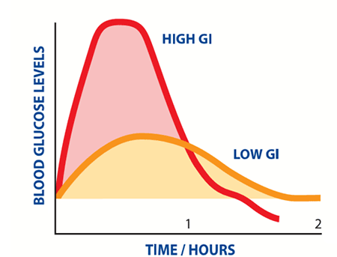
What is glycaemic index?
The glycaemic index (GI) is a ranking of carbohydrates on a scale from 0 to 100 according to the extent to which they raise blood glucose levels after eating
High GI carbohydrates
  rapidly digested and absorbed
  Sharp increase in blood glucose levels
Low-GI carbohydrates
  slowly digested and absorbed
  gradual rise in blood glucose levels
Protein and fat do not have a glycaemic index as they do not break down into glucose

Slide 71
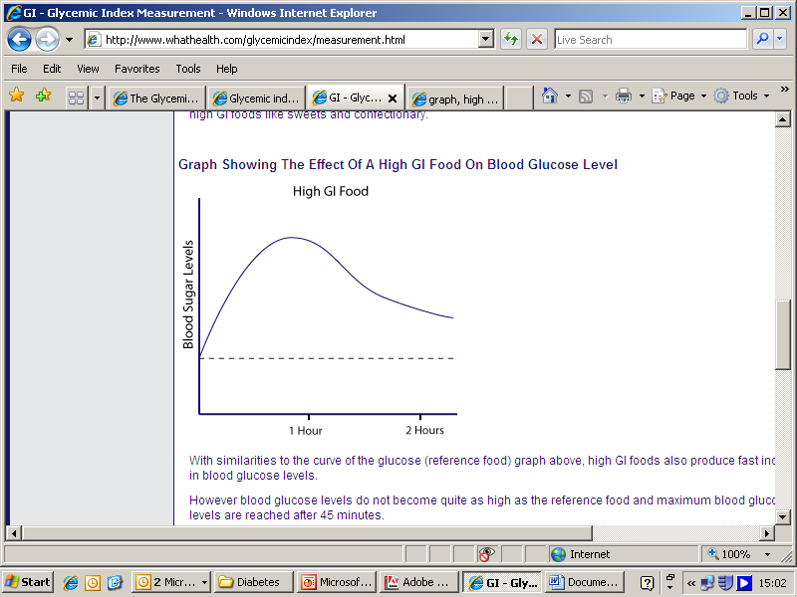
How is glycaemic index determined?
The effect of 50g carbohydrate from the test food is compared to the effect of 50g glucose (reference food, GI=100) in 10 people
10 or more healthy people consume portion of test food containing 50g digestible (available) carbohydrate
Effect on their blood glucose levels are measured over the next two hours
For each person, the area under their two-hour blood glucose response (glucose AUC) for this food is then measured
On another occasion:
Same 10 people consume 50g glucose (the reference food) and their two-hour blood glucose response is measured
A GI value for the test food is then calculated for each person:
  GI value of test food = AUC test food x 100
  AUC reference
The final GI value for the test food is the average GI value for the 10 people

Slide 72

Glycaemic index of foods
White bread, Rice krispies, cornflakes, most potatoes (mashed, baked, boiled), broadbeans, watermelon, short grain rice
New potatoes, digestive biscuits, cous cous, long grain rice, cream crackers, croissants, wholemeal pitta bread, tinned apricots in syrup, pineapple
Pasta, basmati rice, lentils, beans, seeded/granary bread, quinoa, rye crispbread with seeds, oats, apples, milk, most yogurts, fresh/dried apricots, pears, plums, peaches in juice
http://www.glycemicindex.com/

Slide 73
Glycaemic index table
Conflicting information remains
Note meat, fish, chicken, eggs, cheese and most nuts have very little carbohydrate, so are not included in list
* high fat, so limit for this reason
Food | Low glycaemic index | Medium glycaemic index | High glycaemic index
Cereals | All bran, oat porridge, | Shreddies, Fruit and Fibre, Shredded wheat, muesli | Cornflakes, Cocopops, Rice Crispies, Branflakes
Bread, crackers | Granary, rye, pumpernickel | Ryeveta, wholemeal bread, pitta | French bread, white bread, bagel
Potatoes, rice, pasta | Most pasta, noodles | Sweet and New potatoes boiled, Basmati, Wild and Long-grain rice | Mashed potato, jacket potato, Thai and Jasmine rice
Fruit | Most fruit e.g. apples, cherries, grapes, kiwi, orange, peach, pear | Banana, pineapple, melon, mango, papaya, raisins and sultanas

Slide 74
Glycaemic index table
Food | Low glycaemic index | Medium glycaemic index | High glycaemic index
Vegetables | Almost all
Legumes | Lentils, peas, most beans e.g. butter beans, kidney beans, haricot beans, baked beans
Dairy products | Milk, yoghurt – fruit, plain, diet | Ice-cream
Biscuits, cake | Sponge cake*, fruit loaf, banana cake*, | Digestive biscuits*, muesli bar*, flapjack*, rich tea | Morning coffee*, vanilla wafers*, sweet and cream biscuits*, fancy cakes* and puddings*
Confectionery and sodas | Sugar free and diet drinks and squash Chocolate* |  | Coke, Lucozade, lemonade, other non-diet fizzy drinks, normal squash, sweets

Slide 75
The patient with diabetes in hospital
High incidence of malnutrition in hospital
Poor appetite and poor dietary intake common
Importance of meeting nutritional requirements (immune system, wound healing, feeling of well-being)
Healthy eating principles usually not as appropriate while in hospital
Foods that are higher in calories (including fats and sugars) may be required
Important to re-iterate Healthy eating should be resumed on discharge
Education can be provided on discharge
Notes:
75

Slide 76
The patient with diabetes in hospital
Uncontrolled blood glucose levels common in hospital and could be due to
- infection/inflammation/sepsis
- the need to adjust medication
- timing of medication/meals
Diet is not always implicated
Encourage regular meals and snacks
As last meal of day is at 6pm, bed-time snacks should be offered
Identify patients at risk of malnutrition using nutrition screening tool (NST) – follow care plan Nutrition screening Tool
Refer to dietitian if identified as at risk
Supplements may be prescribed - Important to meet nutritional requirements and adjust medication as necessary
Notes:
76

Slide 77
Who would you refer to a dietitian?
All patients newly diagnosed with diabetes
Patients with diabetes starting on insulin
All patients with diabetes in pregnancy
Patients with diabetes who have never seen a dietitian
Patients with a high nutritional screening tool score in hospital
Patients are offered 1-2-1 appointments and group education if appropriate

Slide 78
Case studies - discussion
What dietary advice would be given to a young person newly diagnosed with Type 1 DM?
What dietary advice would be given to an obese, middle-aged man with poor control on Novomix30 b.d

Slide 79
Questions???

