Slide 1
Library update
Kate Perris
1 October 2012

Slide 2
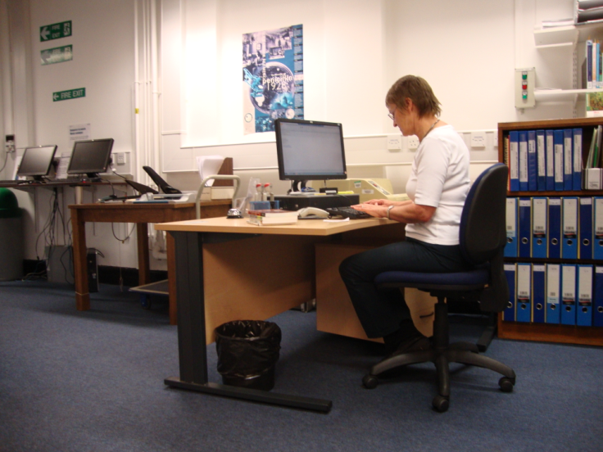
St Mary’s refurbishment
Notes:
Opening hours remain the same:
Monday - Friday 09.00 – 21.00
Saturday 13.30 – 17.00

Slide 3
Access to St Mary’s
Notes:
The temporary library is located at the back of the Medical School Building. From Monday 13 August 2012 current St Mary’s Library members can use their card to access the temporary library via the Revolving Door entrance to the Medical School building, see Entrance B on the map. New St Mary’s Library members or those that have forgotten their card should use Entrance A. On entering the building please follow the signs to the temporary library.

Slide 4
Library search
Notes:
Library search continues to be your main source of information

Slide 5
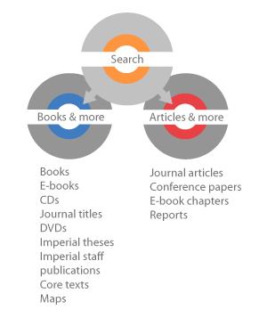
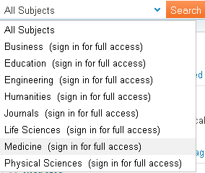
Books & more/Articles & more
Notes:
You may have noticed that there are two tabs, Books and more and Articles and more. Books and more covers books, ebooks and journal titles e.g. BMJ. Articles and more searches journals at the article level (not just the title of the journal), conference papers, ebook chapters. So you will get a lot more results with articles and more if you are looking for more depth in your search. You can search just medicine resources, and sign in to get access to even more full text.

Slide 6
We also provide
Interactive learning tools (including Anatomy.TV)
Notes:
6
In addition to books and ejournals online and in print the library provides access to interactive learning tools such as anatomy.tv and to images through the SpringerImages Life Sciences and Medicine collection.

Slide 7
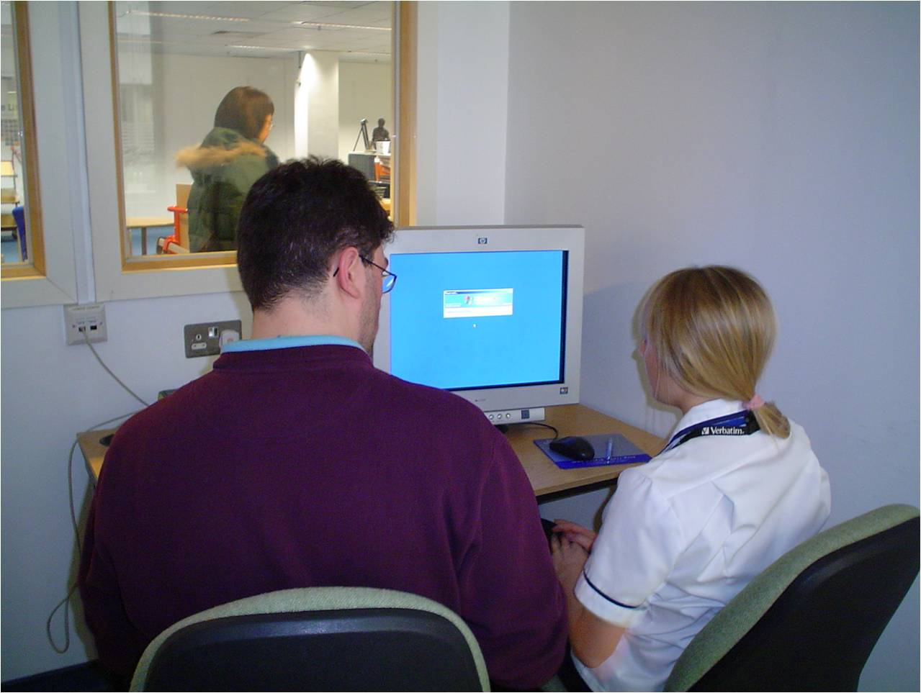
We also provide
Guidance on plagiarism and academic best practice
Training and advice on all aspects of info retrieval
Critical appraisal skills
Reference management expertise
Bespoke training as and when required
Notes:
7
The library can provide a wide variety of training as needed as well as guidance on referencing and reference management software

Slide 8
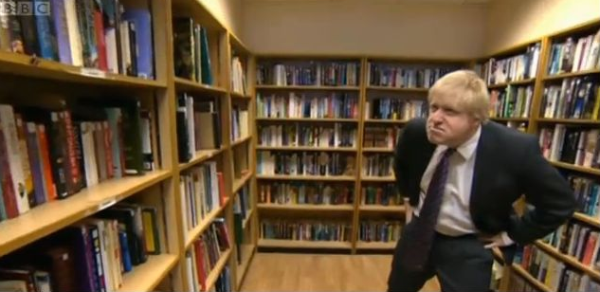
Finding books isn’t this hard...
Notes:
Using the library is easier than Boris makes it look

Slide 9
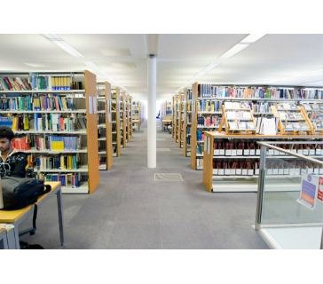
Notes:
In the Central Library most of the medicine books are now found on the 5th floor.

Slide 10
How do I find the book I need?
Notes:
You’re in the library and you’re ready to get the book you need and go read it at home. You already have a library card because you can borrow books with your College ID so you can take it out. To find it on the shelf in the library you can look it up on the catalogue which is on terminals on each floor of the library/each campus library
There are a lot of ways to search for what you are looking for on library search but the easiest way to search for a book is to type in 2 or 3 words from the title

Slide 11
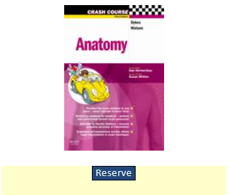
What if there’s no copy on the shelf?
Notes:
If all copies at your location were on loan you could place a hold to reserve a copy when it comes back. When the book becomes available, the library will email you. If the book is at another site we will now transfer a copy from another campus library for you.
We also have a core text copy of all the books on your reading lists so if all the normal lending copies are on loan the core text copy is available from the issue desk for overnight loan.

Slide 12
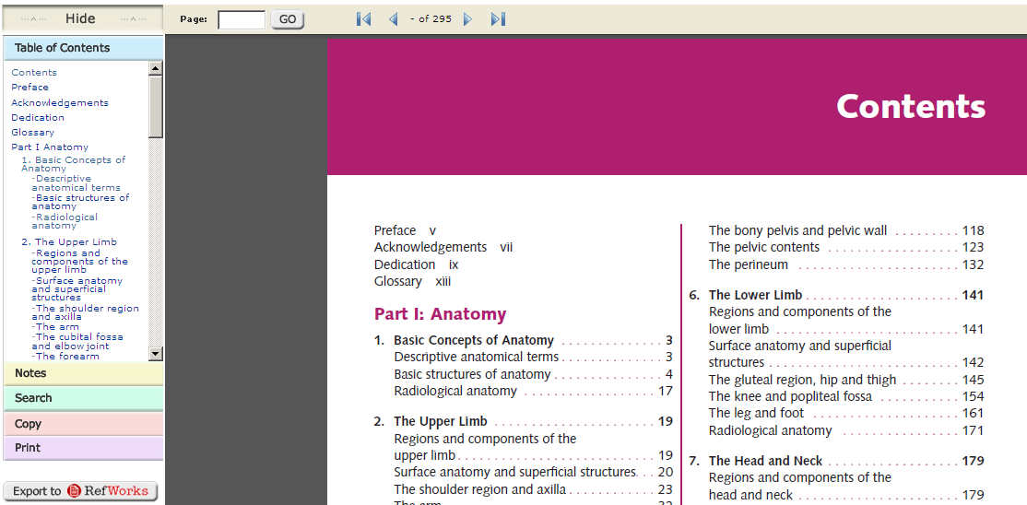
Electronic books
Notes:
Ebooks are another alternative if the book isn’t on the shelf or as an alternative to coming to the library for a print copy. Ebooks are on the catalogue and library search so you can see if there is an eversion available at the same time as checking the print version.

Slide 13
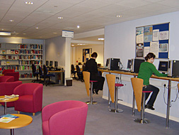
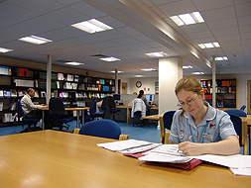
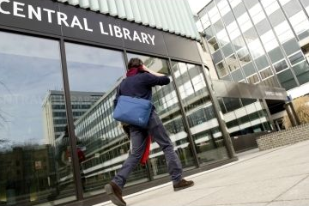
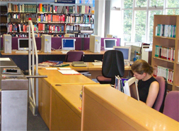
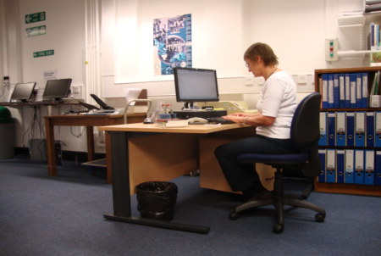
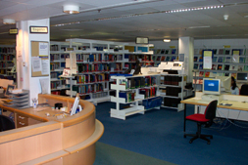
Where is the library?
Royal Brompton Library (NHLI)
Hammersmith Library
Imperial College Libraries
Central Library
St. Mary’s
Hammersmith
Charing Cross
Chelsea & Westminster
Royal Brompton (NHLI)
See the library website for details of locations, facilities
and opening hours
http://www3.imperial.ac.uk/library/aboutthelibrary
Central Library, South Kensington
Charing Cross Library
St Mary’s Library
Chelsea and Westminster Library
Notes:
A few practical questions to start with…
As students at IC
Central library at SK
Maps and directions available on Library homepage & leaflets in library
Opening hours do vary so do check the website, but here it’s 9-9 weekdays, 10-5 on Saturdays

Slide 14
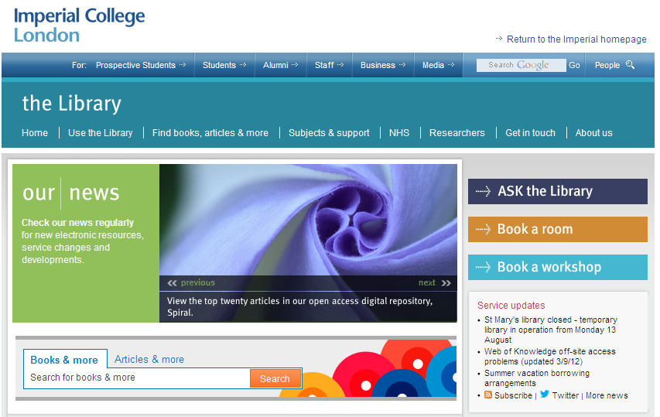
Where to find more information, Pt. 1
Notes:
14
Check the library website for links to all the resources

Slide 15
Where to find more information, Pt. 2
Notes:
15
Use the webform on the library home page for any queries

Slide 16
RefWorks sessions
Notes:
RefWorks sessions will be running for all year 2 students in May
Hands on sessions in Central library covering version 2.0

