Slide 1
Renal physiology When the kidneys are lost
Damien Ashby 30.05.13

Slide 2
renal failure – causes
intrinsic
ATN
ischaemic
toxic
metabolic
nephritis
pre-renal
hypovolaemia
heart failure
diabetes
reflux
hereditary
post-renal
ureteric
bladder outflow

Slide 3
renal failure – features
acute | chronic
oedema
+/-
++
++
-
++
+
+
++
fluid compartment volumes
ECF Na
ICF H₂O
electrolyte balance
K
pH
excretion of metabolic wastes
urea
loads of others
hormones
erythropoietin
vitamin D
hyperkalaemia
vomiting
drowsiness
anaemia
bone weakness

Slide 4
renal failure – recognition
confusion / coma
anorexia / wasting
high potassium
bone disease
anaemia
fluid retention
5 4 3
Notes:
4

Slide 5
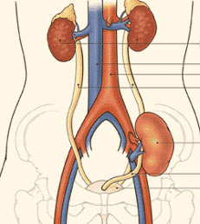
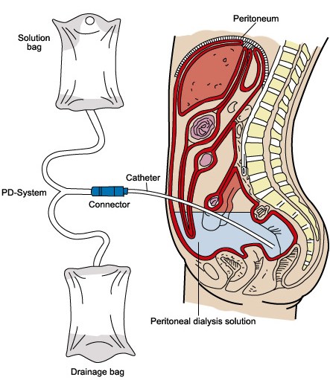
RRT modalities
in hospital
3 x per week
universal
indefinitely
at home
3-4 x per day
capable
5 years
best survival
independent
fit for surgery
10 years

Slide 6
UK Renal Registry 11th Annual Report

Slide 7
UK Renal Registry 11th Annual Report

Slide 8
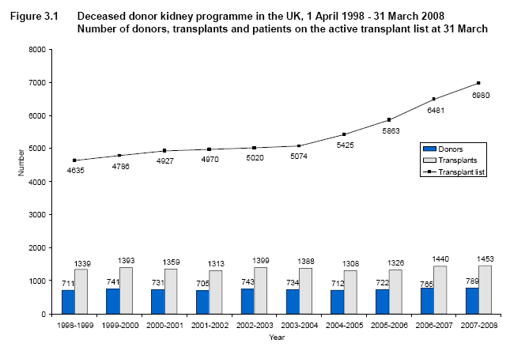
deceased donors

Slide 9
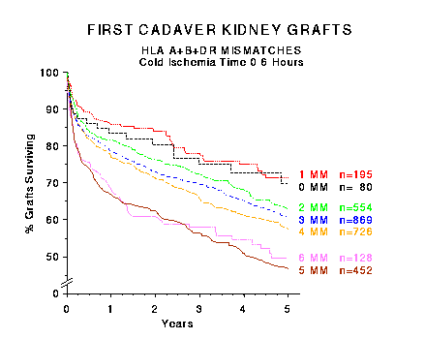
tissue typing

Slide 10
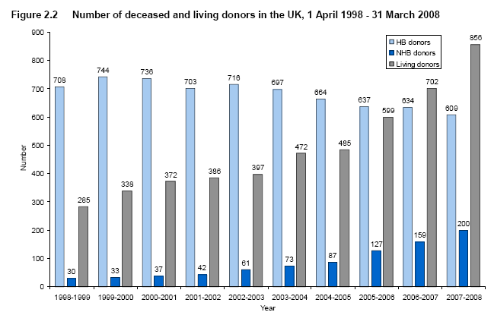
living donors

Slide 11
home HD
1.1
hospital HD
25.2
transplant
46.6
satellite HD
16.9
automated PD
4.2
manual PD
6.0

Slide 12
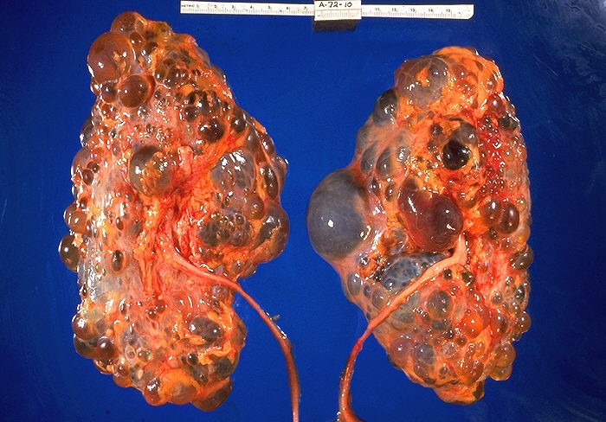
summary
life without kidneys is possible, but…
is a multi-system disease
must be planned
changes lifestyle
affects family members
shortens life expectancy
…avoid if possible

