Slide 1

An Introduction to
Wednesday 3 October 2012
Mr Ashish Hemani – eLearning Project Manager
Mr Akram Ameen – Learning Technologist
Faculty Education Office (Medicine) – October 2012

Slide 2
Outline
Brief History
What’s new?
Accessing Blackboard Learn
Key features
Help and guidance
Wrap up
Questions

Slide 3
Brief History
Process started in 2010
We looked at a number of different options
Blackboard Learn was the best available
All Year 3 courses have been moved over to Blackboard Learn

Slide 4
What’s New?
Cross browser compatible – IE, Firefox, Chrome, Safari
No more Java issues
Faster!
Easier to use, more intuitive
More up to date features and design
Positive feedback all round so far from staff and students
We think you’ll like it too!

Slide 5
Feedback So Far...
“I think the user interface is much better than the old one (not just because of the pretty DNA molecules at the top).”
“A definite improvement. The interface is much more clean and user-friendly.”
“Works well and looks more professional.”

Slide 6
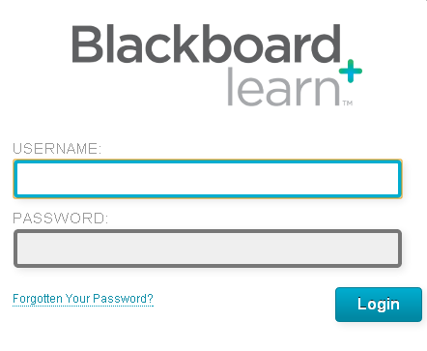
Accessing Blackboard Learn
Go to bb.imperial.ac.uk
Enter your College login details and click Login
Notes:
Or click Forgotten Your Password if you can’t remember your password!

Slide 7
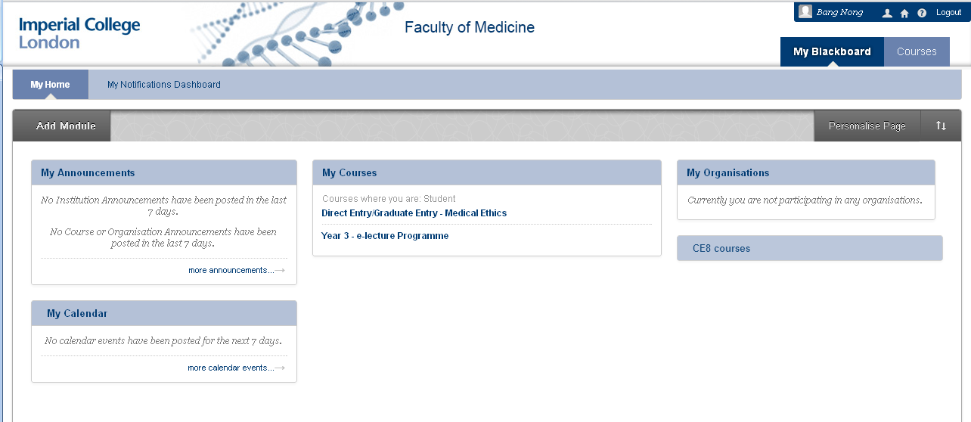
My Home and My Notifications
Notes:
General look and feel
Stay up to date
Personalise your learning space
Show video later

Slide 8
Modules
Notes:
Drag and drop
Change settings
Add or remove
Video

Slide 9

Course Navigation
All your courses for this academic year will be listed under My Courses module
Click a course name

Slide 10
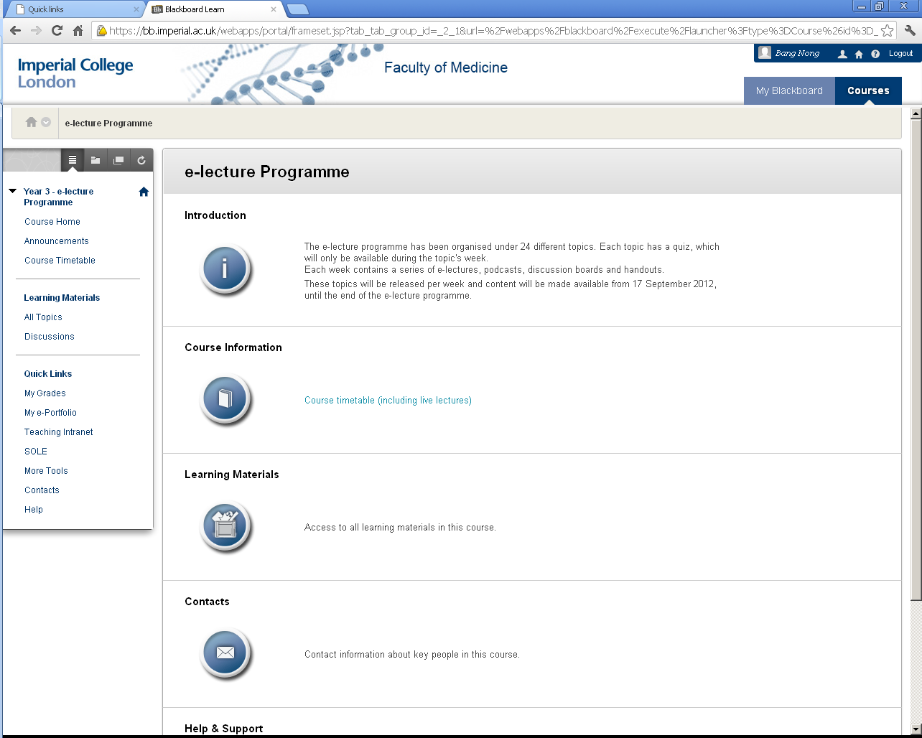
Course Navigation
Notes:
Course menu, course home page – Introduction, Course Information, Learning Materials, Contacts, Help and Support

Slide 11
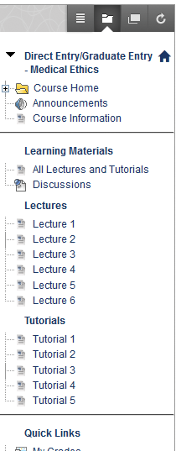
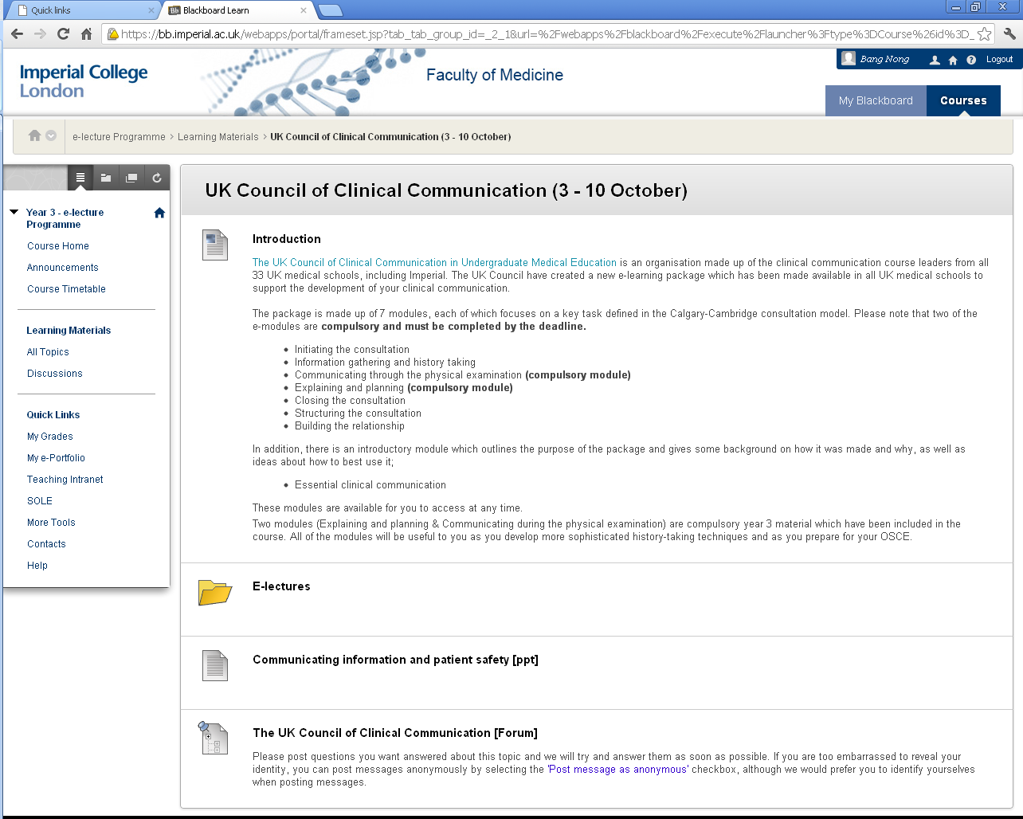
Course Navigation
Notes:
Folder menu, content listed downwards – not like before, where everything is a bunch of links – more visual and direct

Slide 12
Access Previous Year Courses
Beside My Blackboard, click Courses

Slide 13
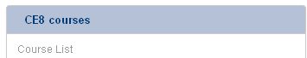
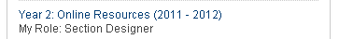
Access Previous Year Courses
Under CE8 courses, all your previous year courses will load
Click to open – simple!

Slide 14
Video Demo

Slide 15
Blackboard Mobile Learn
Access your courses on the go!
Free
Available on:
  Apple iOS
  Google Android
  Blackberry
  HP WebOS
Watch a video...

Slide 16

Blackboard Mobile Learn

Slide 17
Other New Features
Wikis
Blogs
Discussions – send yourself notifications when new messages are posted!
And more... Explore - refer to your guides
Notes:
Some subtle changes, others quite significant.

Slide 18
Help and Guidance
Your printed Quick Reference Guide
Online help and support information from our e-learning website:
imperial.ac.uk/medicine/elearning/blackboard
Email us: webmaster.feo@imperial.ac.uk

Slide 19
Wrap Up
How to access the all new Blackboard Learn – bb.imperial.ac.uk
All 2012-2013 courses available in new system via My Courses module
All previous year courses available via CE8 courses module
Stuck? Refer to the guide, web pages or email us!

Slide 20
Thank you – Any Questions?
Email address:
webmaster.feo@imperial.ac.uk

