Slide 1
Academic honesty
Alison McGregor & Graham Easton

Slide 2
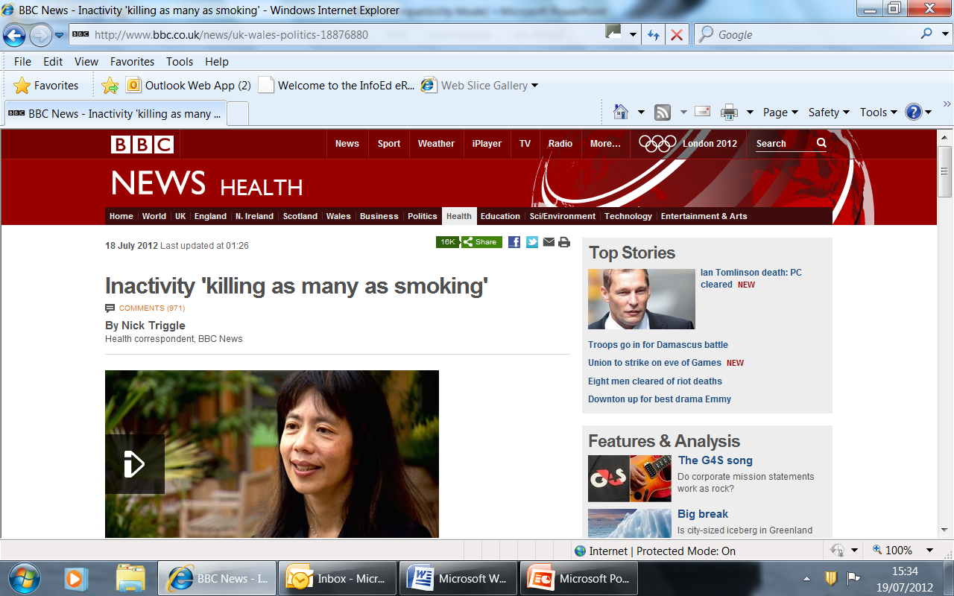

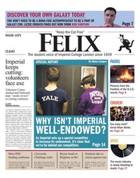

Academic communication

Slide 3
6 steps to good writing
1
Who is my reader?
2
What is my main message?
3.
How will I structure my writing?
4
Can I use a short word instead of a long one?
5
Have I used active rather than passive voice?
6
Have I read and re-read for waffle, mistakes and red herrings?

Slide 4
1. Who is my reader?
Write for the reader, not you
…imagine who your reader is…speak to him or her. Who is your reader?

Slide 5
2. What is my main message?
What is my main message?
Can you sum up in one sentence?
Make it relevant for your audience
If stuck, try to explain it to someone from your audience {mum/friend/peer/professor}

Slide 6
3. How will I structure my writing?
Use a clear structure
Show the reader where they are going.
Signpost
Give a clear summary
What structure will you use?

Slide 7
Basic structure of scientific article: IMRAD
Inverted pyramid
Notes:
7
7

Slide 8
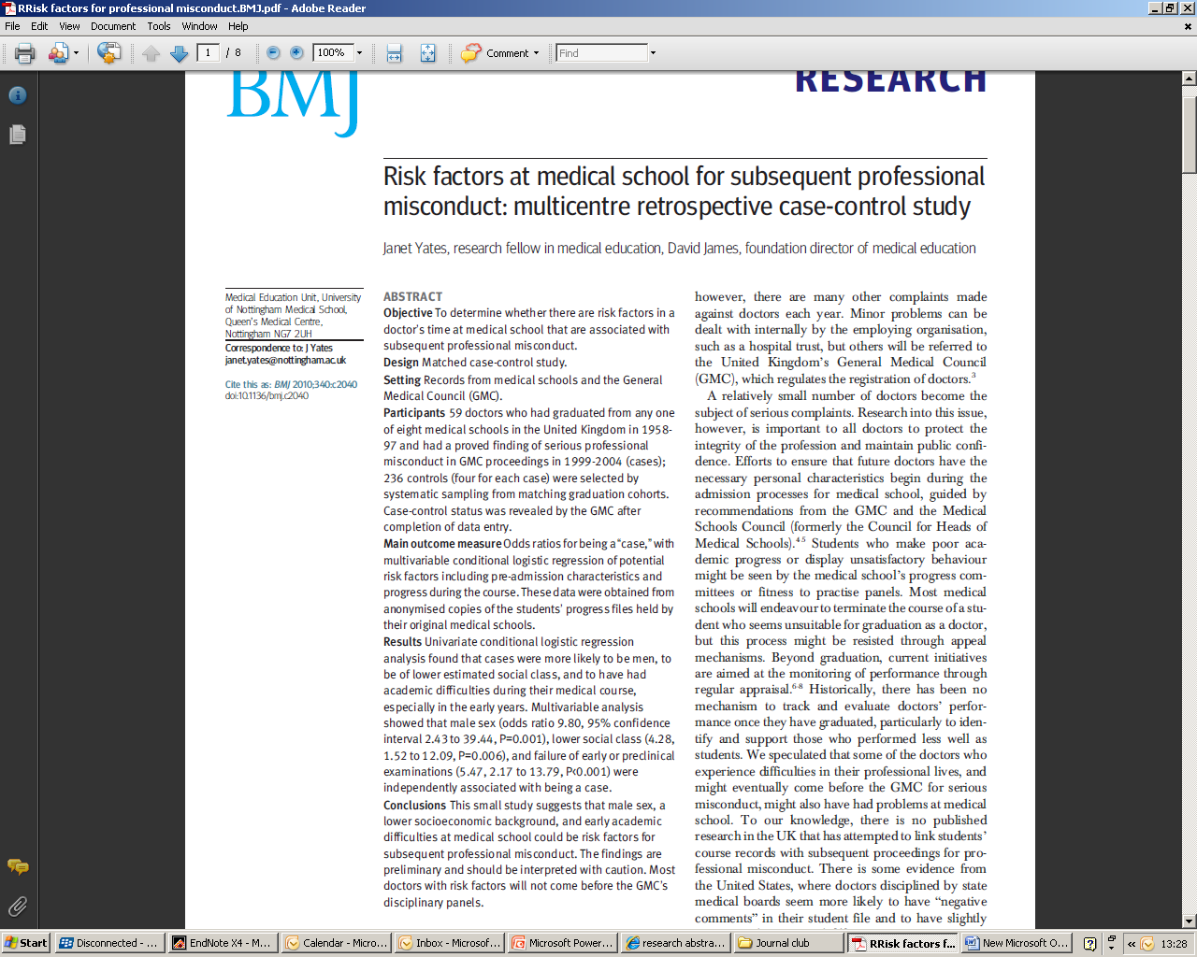

Slide 9
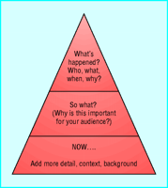
Structure of most news stories
Notes:
9
9

Slide 10
Structures argument clearly
Outlines view/position clearly at beginning
Uses paragraphs to make separate points
Signposts flow of argument to reader
Beginning, middle and end
Don’t forget to conclude or introduce

Slide 11
4. Can I use a short word instead of a long one?
Use simple words and short sentences
…Could you use a short word instead?
Why use long words?

Slide 12
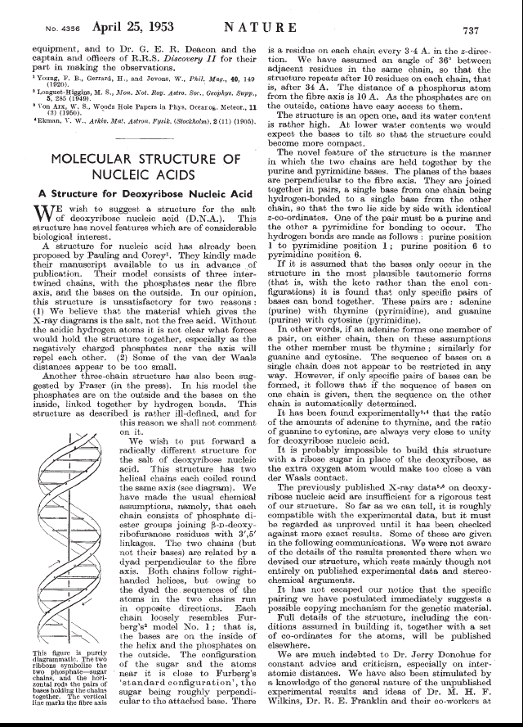
The Structure of DNA
Watson and Crick, Nature, 1953
Notes:
12

Slide 13
5. Have I used active rather than passive voice?
Use active not passive
…Jim hits John
NOT
…John was hit by Jim
Active is shorter and clearer…

Slide 14
Have I read and re-read for waffle, mistakes and red herrings?
And don't forget..
Spelling and grammar
Libel
Plagiarism (quotes and opinions of others clearly attributed?)

Slide 15
Uses references appropriately
Uses appropriate references to support key points
References research/ideas (including the main paper discussed)

Slide 16
6 steps to good writing
1
Who is my reader?
2
What is my main message?
3.
How will I structure my writing?
4
Can I use a short word instead of a long one?
5
Have I used active rather than passive voice?
6
Have I read and re-read for waffle, mistakes and red herrings?

Slide 17
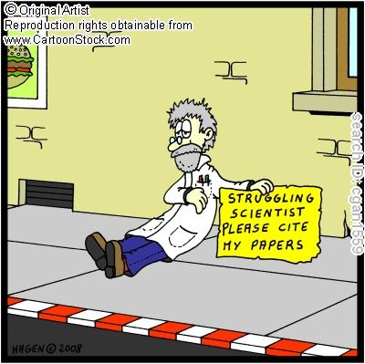
Why is writing important?
Communicating your message
Getting published
Entering debate
Adding to scientific knowledge
Marker of progress and acceptance of work

Slide 18


Academic currency

Slide 19
Plagiarism
"wrongful appropriation"
"close imitation"
"purloining and publication" of another author's "language, thoughts, ideas, or expressions," and the representation of them as one's own original work
Oxford English Dictionary 1999

Slide 20
Good referencing
Avoids plagiarism
Shows you’ve read field
Back up your points and arguments
Demonstrates deeper understanding

Slide 21

Managing your references
End note
Ref works
Reference manager

Slide 22
So how do you know?

Slide 23
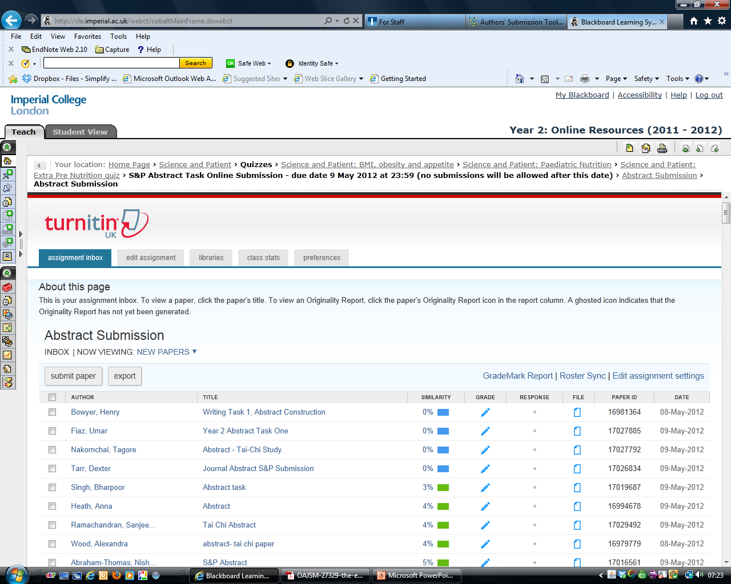

Slide 24
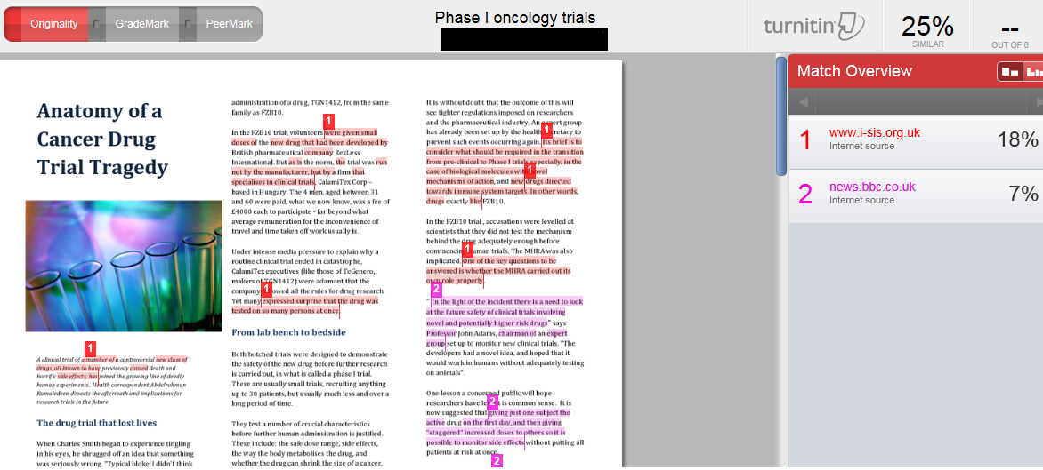
Turnitin report

Slide 25

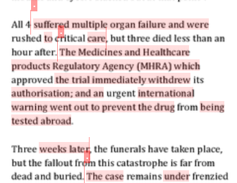
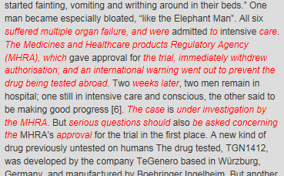
Paraphrasing

Slide 26
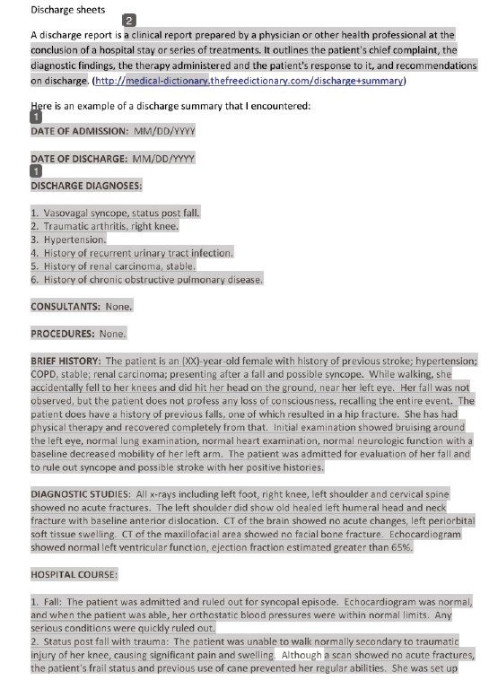
Beware of what you think we won’t find!

Slide 27
Tips
Secret is good writing skills
Good referencing
Allow time to do assignments
Plan essays and structure them before you start writing
Avoid pasting references after you’ve written your text
If you need a direct quote use quotation marks
Be honest, if in doubt reference

Slide 28
Learning more
On line plagiarism courses
Referencing courses
Academic writing lectures and courses
http://www3.imperial.ac.uk/library/subjectsandsupport/workshops

Slide 29
Thank you
g.easton@imperial.ac.uk
a.mcgregor@imperial.ac.uk
Notes:
29

