Slide 1
Health eating
Human nutrition MRES
2013
Gary Frost

Slide 2
Learning objecive
To have an in depth understanding of healthy eating guidelines

Slide 3
What does it mean?
It means many things to many people
  Nutritional security in developing counties
    Important to a third of the worlds population
  Limiting the development of chronic disease in the developed countries

Slide 4
Causes of Death in the Developed and Developing world (percentage)
Causes of Death | Developed Countries | Developing Counties | Total
Circulatory disease | 46 | 24 | 29
Cancers | 21 | 10 | 12
Respiratory Disease | 8 | 5 | 6
Infectious Diseases | 1 | 43 | 33
Perinatel and neonatal causes | 1 | 9 | 7
Other | 23 | 9 | 13
There is a decline in infant and childhood mortality, world population is aging - cardiovascular disease becomes important.

Slide 5
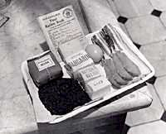
First UK Healthy Eating Programme
Rationing World War 2
Many people where better fed in war
The first recommended dietary allowances where developed
Aimed a nutritional security of the UK population
Dame Elsie Widdowson – Imperial College

Slide 6


Slide 7
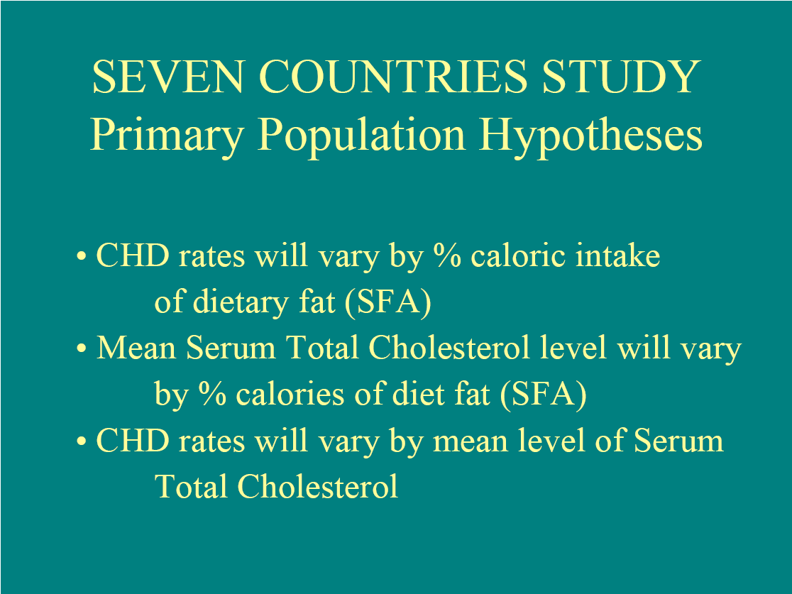

Slide 8
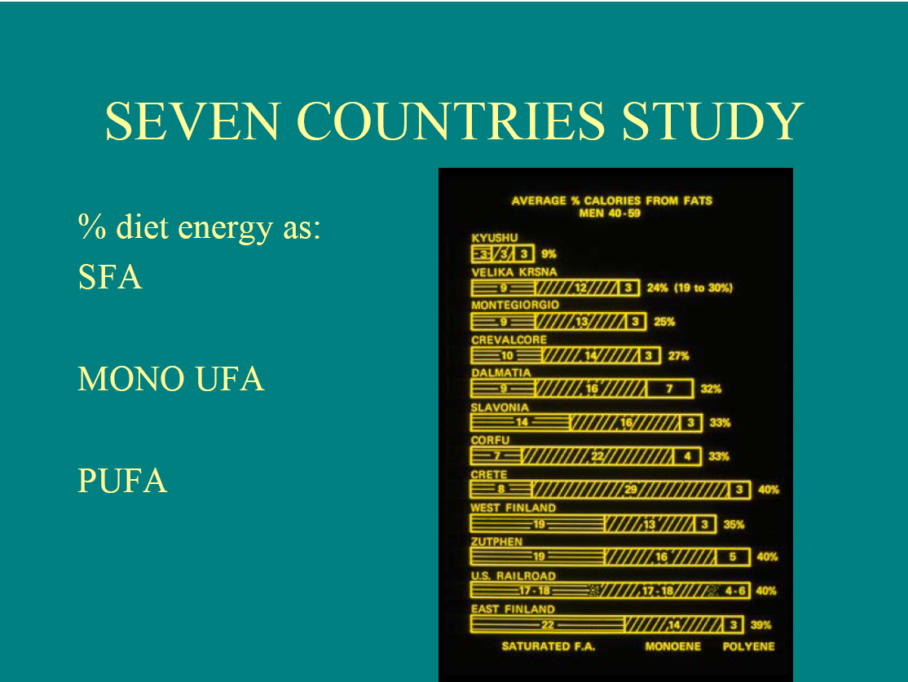

Slide 9
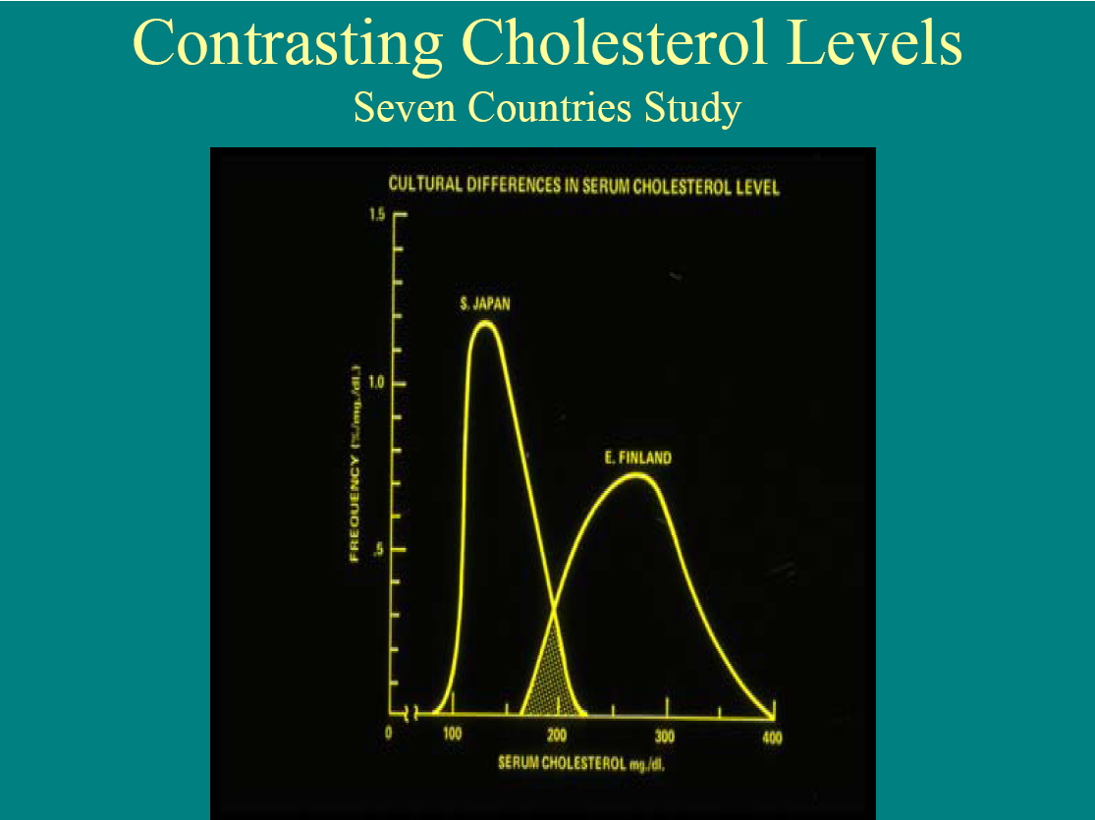

Slide 10


Slide 11
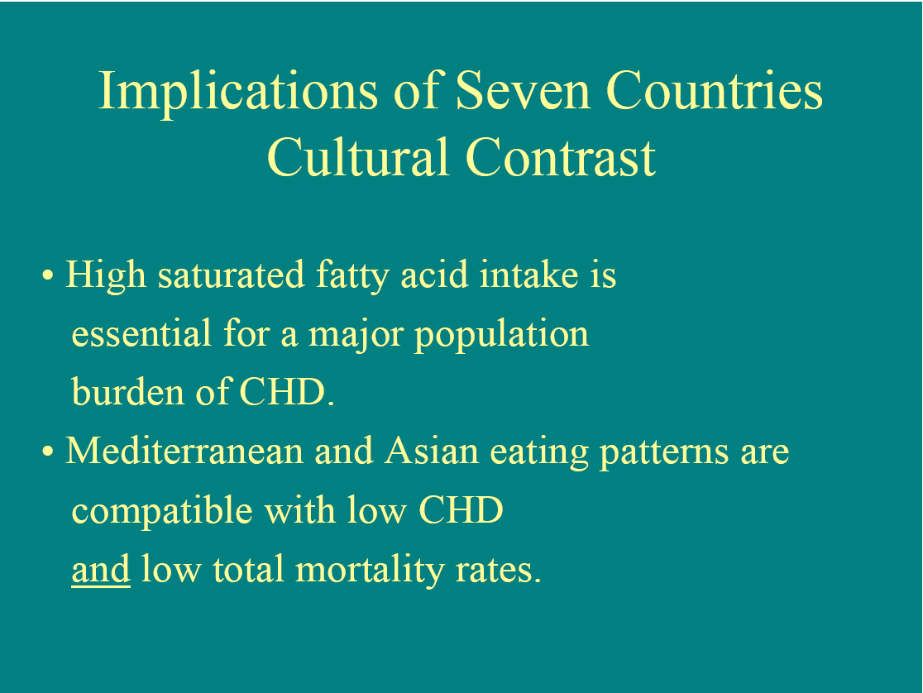

Slide 12

Super size me
Spurlock has specific rules governing his eating habits:
He must fully eat three McDonald's meals per day: breakfast, lunch, and dinner.
He must consume every item on the McDonald's menu at least once over the course of the 30 days (he managed this in nine days).
He must only ingest items that are offered on the McDonald's menu, including bottled water. All outside consumption of food is prohibited.
He must Super Size the meal when offered, but only when offered (i.e., he is not able to Super Size items himself).
He will attempt to walk about as much as a typical U.S citizen, based on a suggested figure of 5,000 standardized distance steps per day
Initial Results
• 185.5 lbs.
• 120/80
• cholesterol 168
End Results
202 lbs.
• 150/90
• cholesterol 225

Slide 13
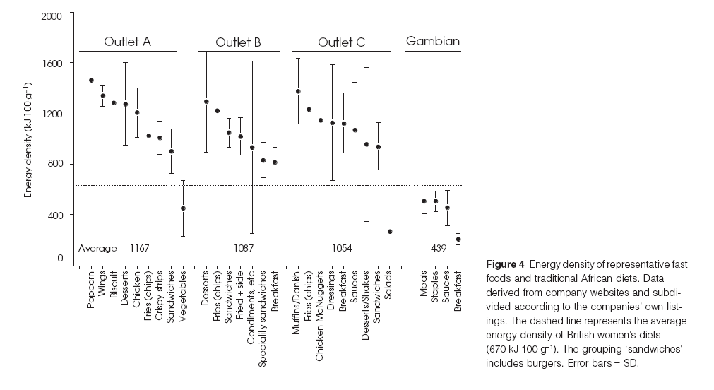
Energy Density

Slide 14
Common theme to disease prevention
O
Type 2
Diabetes
Obesity
Healthy
Eating
Coronary
Artery
Disease
Cancer

Slide 15
Goals and Guidelines
A nutritional goal sets a target:
  Fat intake should be
  35%
A nutritional guidelines tells you how to get there:
  Low fat diary products
  Avoided fried food
The strength of goals and guidelines is they are a consensus
opinion of experts.

Slide 16
What is healthy eating in the UK aimed at?
Long term prevention of disease
Not the short term management of a condition
This makes it very difficult to show the value of healthy eating through RCT – cohort data sets

Slide 17
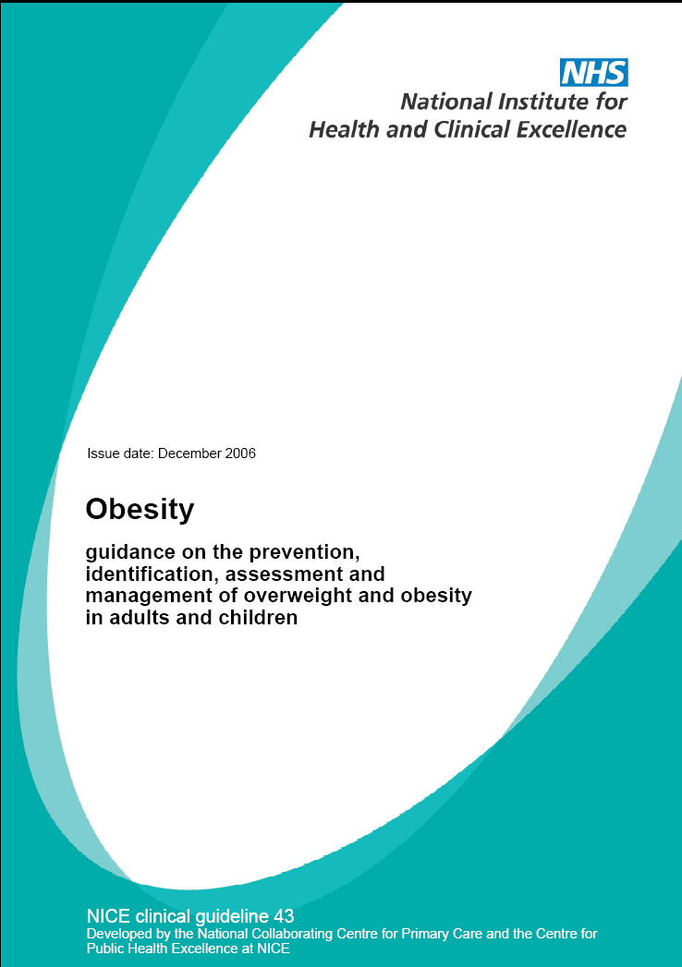
Only useful if the evidence
base is strong!!!!!!

Slide 18
Recommendations
• Base meals on starchy foods such as potatoes, bread, rice and pasta, choosing wholegrain where possible.
• Eat plenty of fibre-rich foods – such as oats, beans, peas, lentils, grains, seeds, fruit and vegetables, as well as wholegrain bread, and brown rice and pasta.
• Eat at least five portions of a variety of fruit and vegetables each day, in place of foods higher in fat and calories.
• Eat a low-fat diet and avoid increasing your fat and/or calorie intake.
• Eat as little as possible of:
- fried foods
- drinks and confectionery high in added sugars
- other food and drinks high in fat and sugar, such as some take-away and fast foods.
• Eat breakfast.
• Watch the portion size of meals and snacks, and how often you are eating.
• For adults, minimise the calories you take in from alcohol.

Slide 19
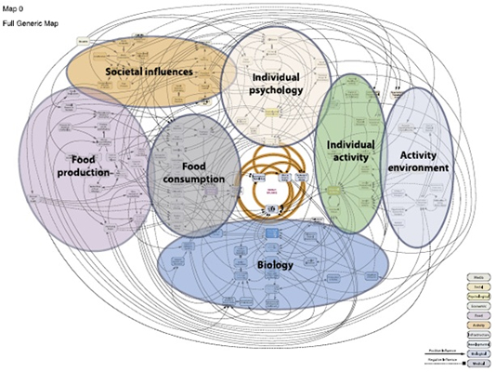

Slide 20

World Cancer Research Fund

Slide 21
Common theme
 | Limits for population average intakes
 | Lower | Upper
Total energy | Prevention of obesity
Total fat | 15 | 30
Saturated fat | 0 | 10
Polyunsaturated fat | 3 | 7
Monounsaturated | 10 | 15
Total carbohydrate | 50 | 75
Complex carbohydrate | 45 | 75
NSP | 16 | 24
Total dietary Fibre | 27 | 40
Free sugar | 0 | 10
Protein | 10 | 15
Salt |  | 6
Friut and veg | 400 | 800

Slide 22
Dietary goals
Based on
  Epidemiological observation
  Mechanistic back up

Slide 23
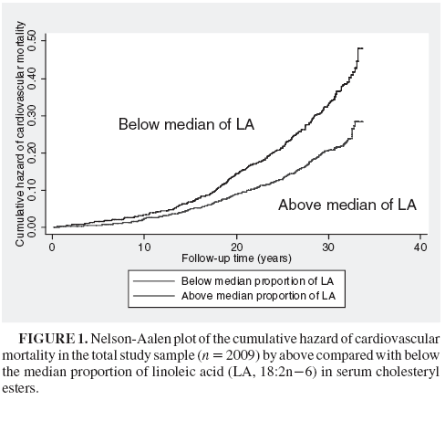
Unsaturated fatty acids

Slide 24
N-6 fatty acid
Not really understood
  Effects on LDL clearance
  Decrease in adhesion molecules

Slide 25
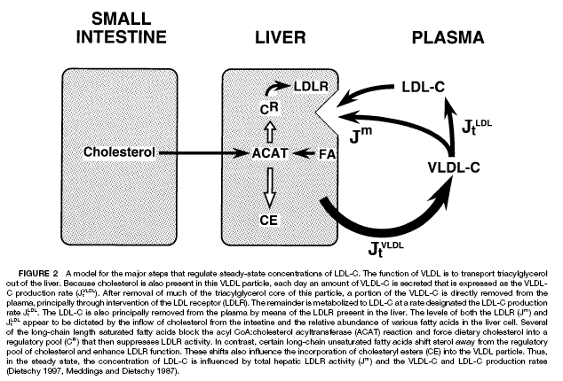
Saturated fat
acyl-CoA:cholesterol acyltransferase (ACAT)
catalyzes the formation of cholesteryl esters from cholesterol
and fatty acyl coenzyme A
Cholesterol
Saturated
Fatty acids
X
Acyl-CoA + Cholesterol ←→ CoA + Cholesteryl ester

Slide 26
Saturated fat
acyl-CoA:cholesterol acyltransferase (ACAT)
catalyzes the formation of cholesteryl esters from cholesterol
and fatty acyl coenzyme A
Cholesterol
Unsaturated
Fatty acids
Acyl-CoA + Cholesterol ←→ CoA + Cholesteryl ester

Slide 27
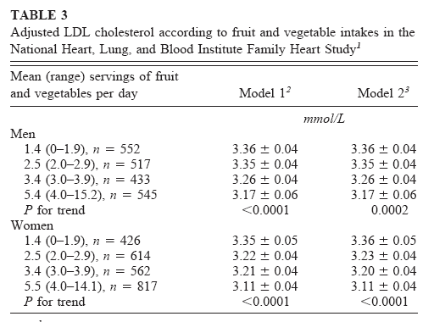
Fruit and Vegetables
There is strong epidemiological evidence
Mechanism has not been found

Slide 28
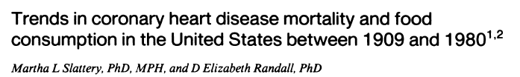
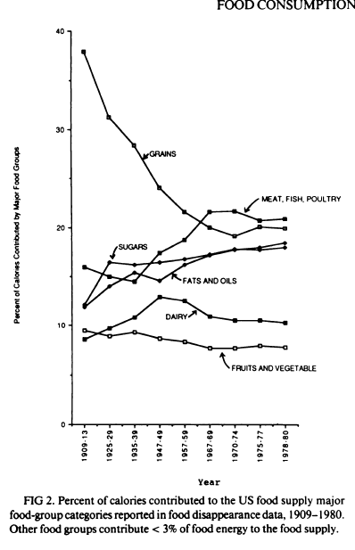
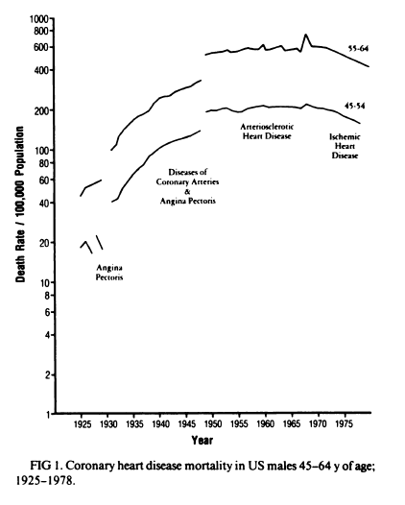

Slide 29
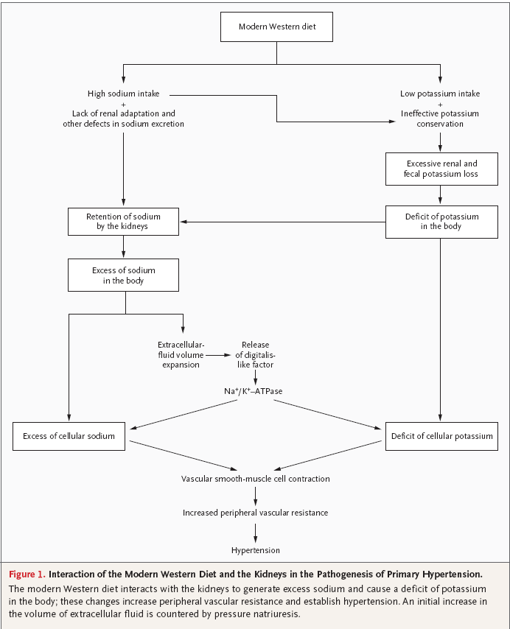
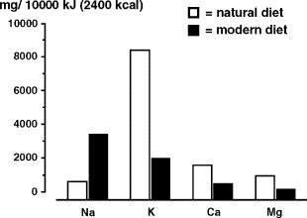
Sodium
Current intake:
6-9g NaCl per day
Target:
<6g

Slide 30
Dietary fibre
Reduced energy density
Soluble fibre lowers total cholesterol
Reduction to plasma triglycerides
Colonic health and reduction of colon cancer

Slide 31
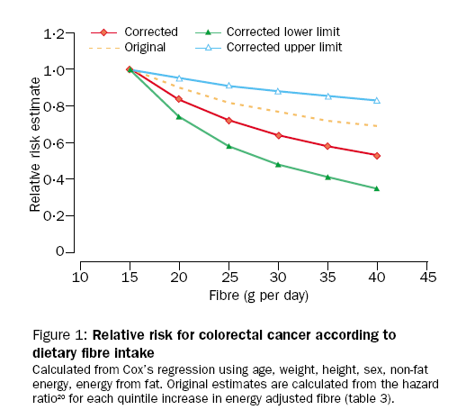
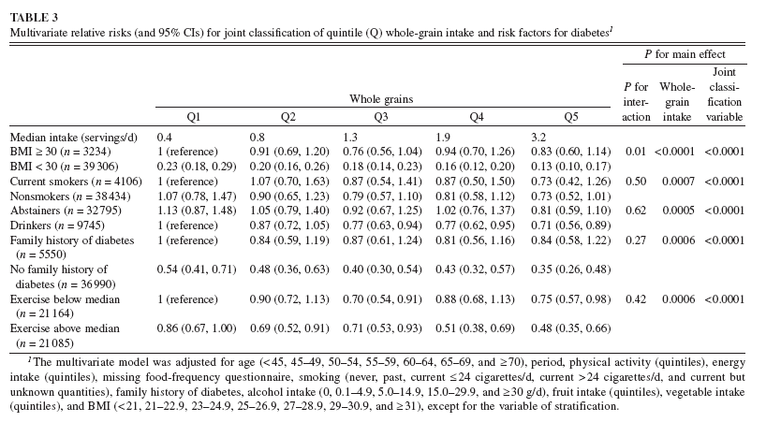
Dietary Fibre

Slide 32
Changing times
NACNE
Total fat <35% (sat < 11, poly 10%, Mono 13)
Trans <2%
Carbohydrate 50%
Fibre 18g/day
Fruit and Veg 5 portions a day
So, try to eat:
– plenty of fruit and vegetables
– plenty of bread, rice, potatoes, pasta and other starchy foods
– choose wholegrain varieties whenever you can
– some milk and dairy foods
– some meat, fish, eggs, beans and other non-dairy sources of protein
– just a small amount of foods and drinks high in fat and/or sugar

Slide 33
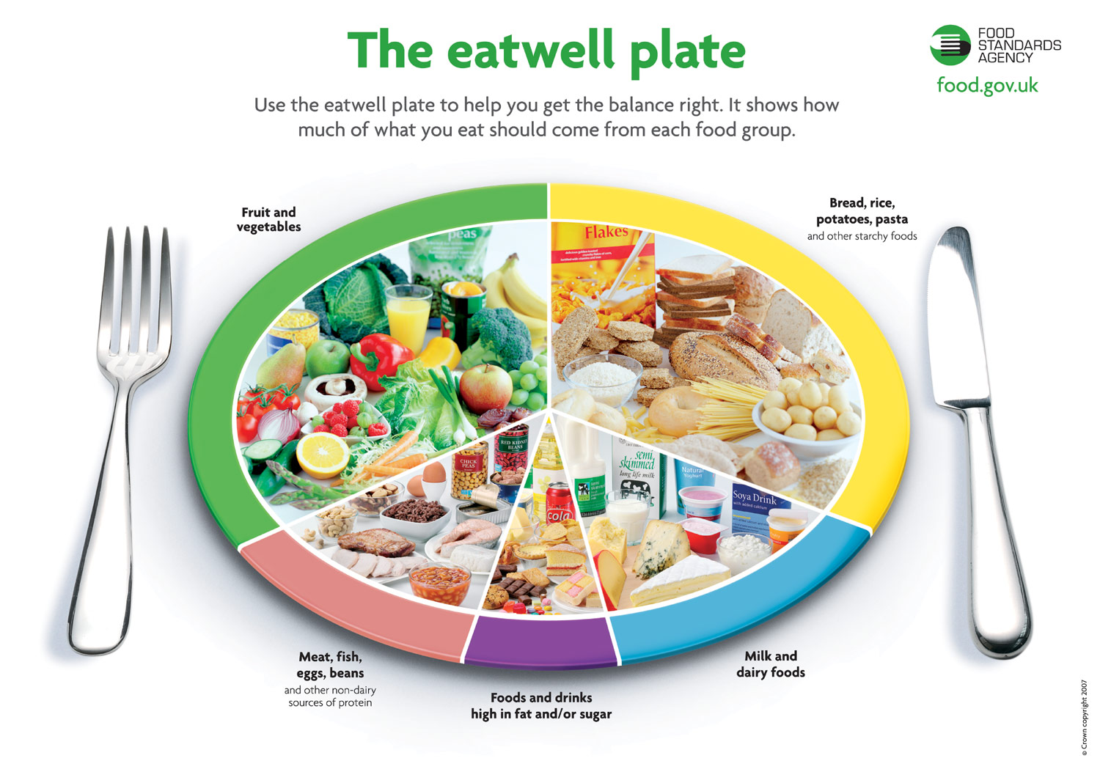

Slide 34
Iron deficiency – common nutritional deficiency
Highest proportions of the UK population with ferritin concentrations below the WHO cut-offs indicating iron deficiency are found in:
  children aged 1½-4½y (25-34%)
  girls aged 11-14y (12%) and 15-18y (24%)
  women aged 19-24y (16%) and35-49y (13%)
  free-living women 75y and over (12-14%).

Slide 35
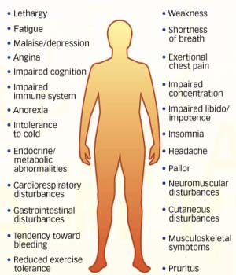
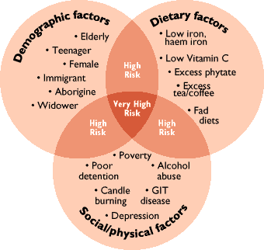

Slide 36
Intake of Iron
In the general population groups with substantial proportions below the LRNI are:
children aged 1½-3½y (12-24%)
girls aged 11-18y (44-48%)
women aged 19-49y (25-40%).
In low income populations, females aged 11-49y have the highest proportions with intakes below the LRNI (39% of girls 11-18y; 50% women, 19-49y).

Slide 37
Calcium
Prevention of osteoporosis
  £1.7 billion pound
Complicated
  Exercise
  Vitamin D
Bone mineral density is at its highest in your 20’s

Slide 38
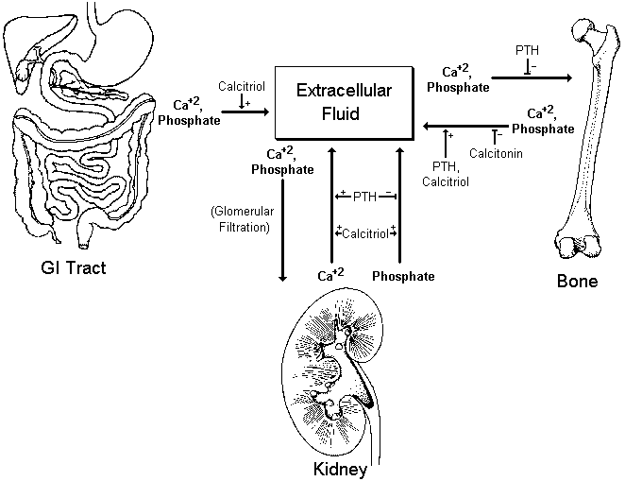
Overview of Calcium-Phosphate Regulation

Slide 39
Vitamin & mineral intakes:
% below LRNI
Age (years) | % British males below LRNI
 | < 4 | 4 - 6 | 7 - 10 | 11 - 14 | 15 - 18 | 19 - 34 | 35 - 64 | 65+
Riboflavin | 0 | 0 | 4 | 6 | 6 | 7 | 1 | 2
Vitamin B₆ | 4 | 4 | 7 | 1 | 1 | 0 | 1 | 1
Vitamin B₁₂ | 0 | 0 | 0 | 0 | 0 | 1 | 0 | 0
Folate | 0 | 0 | 0 | 1 | 0 | 2 | 0 | 0
Vitamin A | 0 | 3 | 3 | 12 | 12 | 16 | 5 | 3
Iron | 3 | 3 | 3 | 3 | 3 | 1 | 1 | 1
Calcium | 2 | 3 | 3 | 12 | 9 | 2 | 2 | 2
Magnesium | 4 | 3 | 2 | 28 | 18 | 9 | 7 | 8
What conclusions can be drawn from this table?
Source: National Diet and Nutrition Survey 2003

Slide 40
Vitamin & mineral intakes:
% below LRNI
Age (years) | % British Females below LRNI
 | < 4 | 4 - 6 | 7 - 10 | 11 - 14 | 15 - 18 | 19 - 34 | 35 - 64 | 65+
Riboflavin | 0 | 0 | 1 | 22 | 21 | 12 | 5 | 9
Vitamin B₆ | 1 | 5 | 0 | 1 | 5 | 7 | 1 | 2
Vitamin B₁₂ | 0 | 0 | 1 | 1 | 2 | 1 | 1 | 1
Folate | 0 | 1 | 2 | 3 | 4 | 3 | 2 | 5
Vitamin A | 8 | 7 | 9 | 20 | 12 | 13 | 5 | 3
Iron | 16 | 4 | 3 | 44 | 48 | 40 | 23 | 5
Calcium | 1 | 2 | 5 | 24 | 19 | 7 | 5 | 9
Magnesium | 0 | 2 | 5 | 51 | 53 | 21 | 9 | 23
What conclusions can be drawn from this table?
Source: National Diet and Nutrition Survey 2003

Slide 41
Can healthy eating messages work

Slide 42
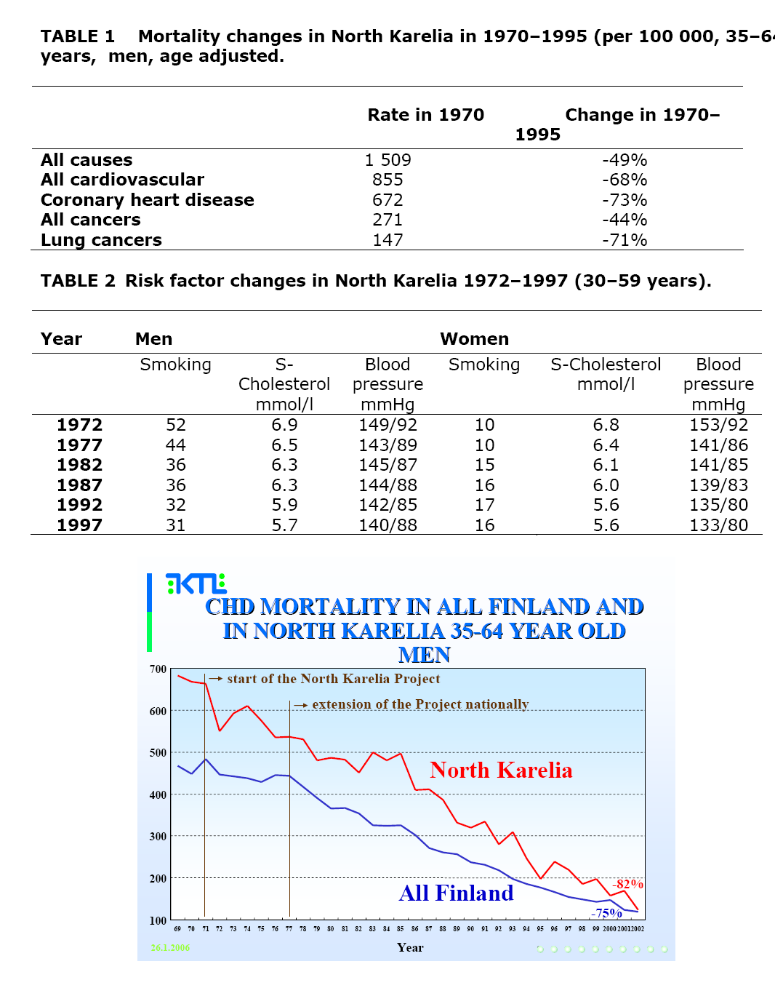
Population bases- North Karella
Comprehensive activities where used, involving health and other services, schools, NGO's, innovative media campaigns, local media, supermarkets, food industry, agriculture etc

Slide 44

Prevalence of treated CHD by sex and deprivation category, 1994/98, England and Wales
Office for National Statistics (2000)
www.heartstats.org

Slide 45
Incidence of Diabetes
Placebo (n=1082)
Metformin (n=1073, p<0.001 vs. Placebo)
Lifestyle (n=1079, p<0.001 vs. Metformin ,
p<0.001 vs. Placebo)
Risk reduction
31% by metformin
58% by lifestyle
The DPP Research Group, NEJM 346:393-403, 2002

Slide 46
Sustained effect
During the total follow-up, the incidence of type 2 diabetes was 4·3 and 7·4 per 100 person-years in the intervention and control group, respectively indicating 43% reduction in relative risk

Slide 47
Simple mix of advice and support
American DDP
> 7% loss of body weight and maintenance of weight loss
Dietary fat goal -- <25% of calories from fat
Calorie intake goal -- 1200-1800 kcal/day
> 150 minutes per week of physical activity
16 session core curriculum (over 24 weeks)
Long-term maintenance program
Supervised by a case manager
Access to lifestyle support staff
Finnish Diabetes Prevention
The main goals of the intervention were: weight reduction of 5% or more; less than 30% of the daily energy intake from fat; less than 10% of the daily energy intake from saturated fat; fibre intake 15 g per 1000 kcal or more; and moderately intense physical activity 30 min per day or more.
The participants in the intervention group were given detailed and individualised counselling to achieve the lifestyle goals. They had seven personal counselling sessions with the study nutritionist during the fi rst year and every 3 months thereafter.

Slide 48
Effectiveness of weight management interventions in UK Primary Care
The Counterweight Programme
Counterweight Project Team
Notes:
Good morning ladies and gentlemen, I would like to thankyou for the opportunity to speak on behalf of the Counterweight team. This is the first in a series of 3 presentations, to be followed by 2 of my colleagues from the team.

Slide 49
Weight Change
All (completers) n = 684,12m
3
High Attenders n = 422
Low Attenders n = 262
2
Expected change*
2.0
1.0
1
0.5
0.2
0
-0.8
0
-1
-1.1
kg
-2.0
-2
-2.2
-2.4
-3.0
-3
-3.5
-4.3
-3.3
-4
-3.8
-5
-4.3
-5.0
-6
Start
3 Months
6 Months
12 Months
24 Months
1:7 patients achieved >5% weight loss at 12m and 24m
*Heitman BL & Garby L (1999) Int J Obes Relat Metab Disord
Notes:
I have added in here predicted weight gain in our obese population. This is an important consideration in running a weight management service, to consider the impact of preventing weight gain.

Slide 50
What will make a difference
Influencing nutritional intake
Agriculture | Education | Science
Employment | Energy | Environment
Finance | Foreign affairs | Health
Health and safety | Home office | Information
Social Security | Trade and industry | Transport
Built environment
Information does not work in it’s own!!!!!!!
This is the bases for the Foresight report and the

Slide 51
Change in UK
Healthy eating messages have been around know for a number of years
Decrease in fat
  Change in quality of fat
Increase fruit and vegetables half a portion a day

Slide 52
Trends on eating habits
Can these be ignored

Slide 53
Knowing what is happening in the population

Slide 54
Summary
Health eating is about reaching nutritional potential
Developed world goals are based on prevention of chronic disease
Obesity is the major public health problem
It is possible to change nutritional behaviour
To make population change needs a change in many aspects of society

