Slide 1
Nutrition for elderly people
Dr Mary Hickson
Department of Nutrition and Dietetics

Slide 2
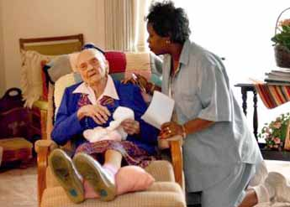
Who are Elderly?

Slide 3
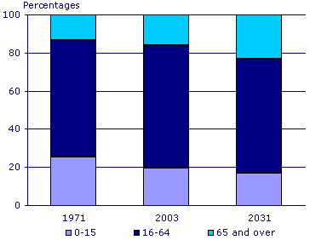
How many old people are there?
http://www.statistics.gov.uk/cci/nugget.asp?id=763
Notes:
13% in 1971 to 16% in 2003 and is projected to rise to 23% in 2031
Average age rose to 38.4 years in 2003
1.9% in 2002 are over 85 years, predicted to be 3.8% by 2031.
5,523 people over 100 years in 1996, estimated to increase to 39,000 in 2036.²
Approximately 7% of elderly population are from different ethnic minority groups.¹

Slide 4
How many are sick?
63% of 65-74 year olds and 72% of people aged over 75 years report a long-standing illness
Almost two thirds of general and acute hospital beds are used by people aged over 65 years
People over 75 years have on average significantly longer hospital stays
^{2002 data}
Notes:
In 2002, 63% of 65-74 year olds and 72% of people aged over 75 years report a long-standing illness. Almost two thirds of general and acute hospital beds are used by people aged over 65 years, and people over 75 years have on average significantly longer hospital stays
40% of NHS & 50% of SS spending was on people over 65 in 1998/99.²¹
700,000 people estimated to have dementia, and risk increases with age - 1 in 20 over 65 yrs, 1 in 5 over 80 years.⁵

Slide 5
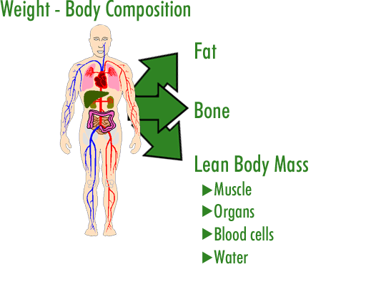

Slide 7
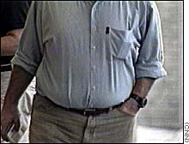
How body composition changes with healthy ageing
FAT MASS
Increases to about 75 years, then decreases^{1,2}.
1.Kyle et al (2001) J Am Geriatr Soc. 49, (12) 1633-1640.
2.Baumgartner et al (1995) J Gerontol A Biol Sci Med Sci 50, (6) M307-M316
May be re-distributed centrally with age.^{1,3}
3.Enzi et al (1986) Am J Clin Nutr 44, (6) 739-746.

Slide 8
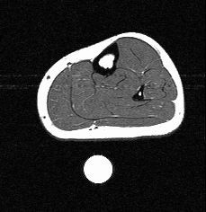
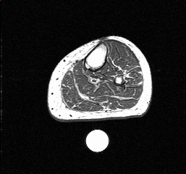
^{Muscle Mass}
Fat free mass starts to decrease in middle age slowly and after about 60 years rate of FFM loss increases.^{1,2}

Slide 9
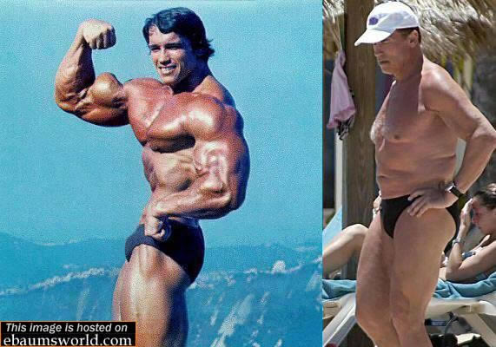

Slide 10
Changes in body composition during starvation and disease
Starvation - loss of lean and fat mass
Disease may also contribute to changes in body composition - increased FFM loss, changes in hydration, FFM loss but stable weight.
In the elderly the size of these losses may be greater as they are in addition to age-related losses.

Slide 11
Difference in %FFM in old and young subjects with different BMI's
X Hebuterne et al. 2001, Curr Opin Clin Nutr Met Care 4, 295-300.

Slide 12
Aetiology of weight loss
Wasting - negative energy balance, due to reduced food intake. Linked to appetite loss.
4. Roubenoff R (1999) J. Nutr. 129, (1S Suppl) 256S-259S

Slide 14
Aetiology of weight loss
Wasting - negative energy balance, due to reduced food intake. Linked to appetite loss.
Cachexia - acute immune response (TNF, cytokines), increased REE, protein catabolism.
4. Roubenoff R (1999) J. Nutr. 129, (1S Suppl) 256S-259S

Slide 15
Cachexia
Disease
Increased TNF
α
, IL-1, IL-6
muscle
↓
Muscle
↓
appetite
Energy
breakdown
repair
Expenditure
↓
Intake
Weight loss
MUSCLE LOSS
Weakness, disability, reduced
function and reduced independence

Slide 16
Aetiology of weight loss
Wasting - negative energy balance, due to reduced food intake. Linked to appetite loss.
Cachexia - acute immune response (TNF, cytokines), increased REE, protein catabolism.
Sarcopenia - exact aetiology unknown. Appears to be part of the ageing process.
4. Roubenoff R (1999) J. Nutr. 129, (1S Suppl) 256S-259S

Slide 17
Factors influencing sarcopenia
↓ CNS Input (loss of motor neurons, altered motor unit activation)
↑ Pro-inflammatory cytokines
↓ GH secretion
↓ Muscle Mass
↓ Muscle Quality
↓ Oestrogen/ androgen
↑ Fat Mass
SARCOPENIA
↓ Metabolic reserve
↑ Inactivity
Weakness
5. Roubenoff R (2000) J Clin Nutr 54, (Suppl 3) S40-S47.
Disability,
Morbidity,
Mortality

Slide 18
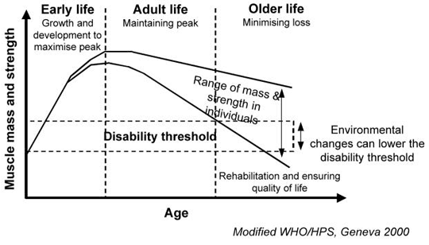
sarcopenia
FFM – decreases by between 2-5% per decade
Mainly skeletal muscle
Also bone and water

Slide 20
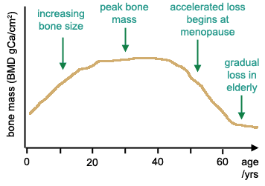
Bone mineral density
Starts at 30yrs – rates of about 0.7-1%/yr up to 50yrs
Increased rates in women post menopause – 2-3%/yr;
Men continue at 0.7-1%/yr .
By 65yrs there is an average loss of 20% bone mineral from 20yrs old.

Slide 21
Body water
Decline in renal function and thirst perception
Reduction of total body water
Decreases in parallel with the reduction of FFM
Reduction of 12% in people over 65 with respect to 19–34 year olds.

Slide 22
Clinical implications
Decreased body energy stores after age 75yrs and increased risk of malnutrition
Central accumulation of fat = risk of stroke, diabetes, hyperlipidaemia, heart disease and hypertension.
Reduced muscle mass results in increasing weakness, affects mobility, respiratory function & independence.
Bone mineral loss = fragile bones and increased risk of fractures.
Increased risk of dehydration

Slide 23
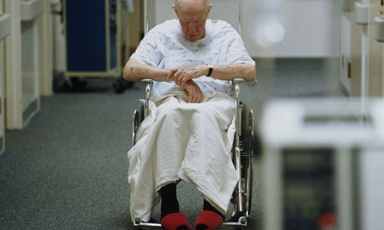
Malnutrition

Slide 24
Nutritional requirements
Energy requirements decrease gradually after 50-60yrs - less active and the basal metabolic rate is reduced.
Protein - Debate continues – current consensus = no difference to younger adults
Vitamins and minerals – no differences
Iron - After the menopause, women’s requirement for iron is reduced to the same level as men.
Since energy needs reduce, but protein, vitamins and minerals requirements remain unchanged, there is a need for higher nutrient density diet.

Slide 25
But with ageing good nutrition becomes harder to achieve
Notes:
So although good nutrition is important to help prevent the consequences of ageing it also may become harder to achieve.
There are many other factors that can affect how people eat in older age group

Slide 26
Think of factors that influence nutrition
Jot down as many factors you can think of that may affect nutrition in older people

Slide 27
Taste and Smell
Appetite and thirst
Teeth and oral health
Medical conditions
Social Factors
Psychological factors
Notes:
Taste and smell deteriorate with age. Noticeable by 60 yrs, deteriorates significantly after 70 yrs. Contributes to appetite loss by decline in pleasantness of food.
Cause not fully understood. Drugs can alter taste and smell. Enhancing food flavour has been shown to increase intake and body weight.
Teeth may be lost, Older people have less of their own teeth. Only 35% of people over 75 yr dentate (any of own teeth).
The more natural teeth present the less chewing problems occur.
Edentate people shown to consume less energy, calcium, iron, vits A, C, E & B complex, fibre and protein. Edentate people have lower BMI’s

Slide 28
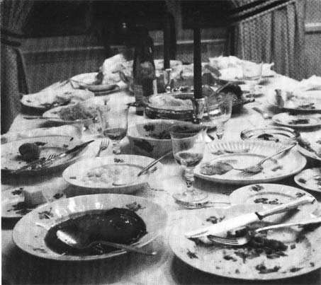
Appetite & Thirst
Decrease with age.
Disease & drugs can also cause appetite loss.
Possible alterations in appetite regulation with ageing.
6. Morley JE (2001): Decreased food intake with aging. J Gerontol. A Biol. Sci. Med Sci. 56 Spec No 2, (2) 81-88

Slide 29
Roberts et al (1994) jama 272(20) 1601-1606
Underfeeding Ad libitum

Slide 30
Roberts et al (1994) JAMA 272(20) 1601-1606

Slide 31
Taste and smell
First taste of puree:
Young 80%
Old 33%
Young 63%
Old 7%
Schiffman SS (1997) JAMA 278, (16) 1357-1362.
Notes:
↓ with age.¹³
Noticeable by 60 yrs, deteriorates significantly after 70 yrs.
Contributes to appetite loss by decline in pleasantness of food.
Cause not fully understood.
Drugs can alter taste and smell.
Enhancing food flavour has been shown to increase intake and body weight.¹⁵

Slide 32
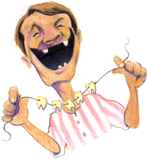
Oral health and dental status
Older people have less of their own teeth. Only 35% of people over 75 yr dentate (any of own teeth).
The more natural teeth present the less chewing problems occur.
Edentate people shown to consume less energy, calcium, iron, vits A, C, E & B complex, fibre and protein.
Edentate people have lower BMI’s
Steele, (1998) NDNS for people aged over 65 years, Oral health survey. HMSO

Slide 33
Medical Conditions
Dysphagia
Gastrointestinal disorders
Infections /trauma /surgery/cancer
Respiratory disease
Physical disability
Drug side effects - nausea, anorexia, malabsorption, diarrhoea, delayed gastric emptying.

Slide 34
Social factors
Isolation - Those living alone had lower energy intakes than those living with others.
Poverty - lower income groups found to have lower energy, protein, fibre and many micro-nutrients intakes.
Ability to shop, cook - can be affected by diseases such as arthritis or other physical disabilities.
Finch S et al (1998) NDNS: people aged 65 years and over. Volume 1. HMSO

Slide 35
Psychological factors
Weight loss and altered eating behaviour recognised characteristic of the dementing process.
Common in late stages but may also appear early. (Priefer & Robbins (1997) Dysphagia 12, (4) 212-221)
Thinnest pt’s are those with the most behavioural problems. (Young & Greenwood (2001) J Gerontol. A Biol. Sci. Med Sci. 56, (11) M700-M706)
Depression thought to be a major cause of reduced food intake and weight loss in the elderly.

Slide 36
Re-nutrition
Research suggests it is more difficult to treat malnutrition in the elderly than in the young.
Hebuterne X, et al (1997) Clinical Nutrition 16, 283-289.

Slide 37
Implications of Malnutrition
Symptoms
See GP
Have some tests
100
See GP
Referred Specialist
More tests
Admission
90
80
Window of opportunity for effective intervention
70
60
Partial starvation of healthy person
Percentage of Normal Body Weight
50
40
30
Dead
Partial starvation of ill person
Total starvation of healthy person
20
10
0
0
10
20
30
40
50
60
70
80
90
100
Days of Starvation

Slide 38
Summary
Ageing is associated with muscle reduction and malnutrition adds to this effect.
Older people are more likely to be malnourished.
Re-nutrition is much harder in older people.

Slide 39
The Elderly in Hospital
The main challenges:
Identification of nutritional problems
Monitoring
Tackling malnutrition
Notes:
Mary has talked about the nutritional consequences of ageing. Now going to carry this forward to the population we see in hospital. I work on the Elderly medicine unit at Charing Cross Hospital which covers the acutely ill elderly as well as the more medically stable pts who are undergoing rehab or waiting for placement.
We will look at nutritional health problems and how we can improve the nutritional status of elderly pts in hospital and potentially decrease length of stay and reduce morbidity.
So what are the common health problems related to nutrition that we see in hospital?

Slide 40
NUTRITION AND PATIENTS: A DOCTOR'S RESPONSIBILITY
Nutritional screening of all patients should be an integral part of clinical practice
All doctors should be aware of nutritional problems and how to manage them
'Nutrition and Patients: A doctor's responsibility', Royal College of Physicians, 2002

Slide 41
Identifying nutritional problems
“Too often nutritional status and nutritional management are overlooked in clinical practice to the detriment of patient care.” Professor Peter Kopelman, RCP, 2002.
Two main points to address:
Recent weight loss
Change in appetite or food intake
Also consider medical condition
'Nutrition and Patients: A doctor's responsibility', Royal College of Physicians, 2002

Slide 42
What about BMI?
Measuring weight should always be done but is not always easy
Measuring height is difficult and can be impossible
Surrogate measures:
Arm span, demi-span, knee height, Ulna length.
Poor agreement and wide margin for error with individuals
Hickson M and Frost G. (2003) A comparison of three methods for estimating height in the acutely ill elderly population. Journal of Human Nutrition and Dietetics 16: 13-20.

Slide 43
What BMI is appropriate for older adults?
Evidence suggests the BMI range associated with lowest mortality is shifted up in older adults
23-25kg/m² for people over 75 years
Stevens J. 2000. Impact of age on associations between weight and mortality. Nutrition Reviews, 58 (5) 129-137.

Slide 44
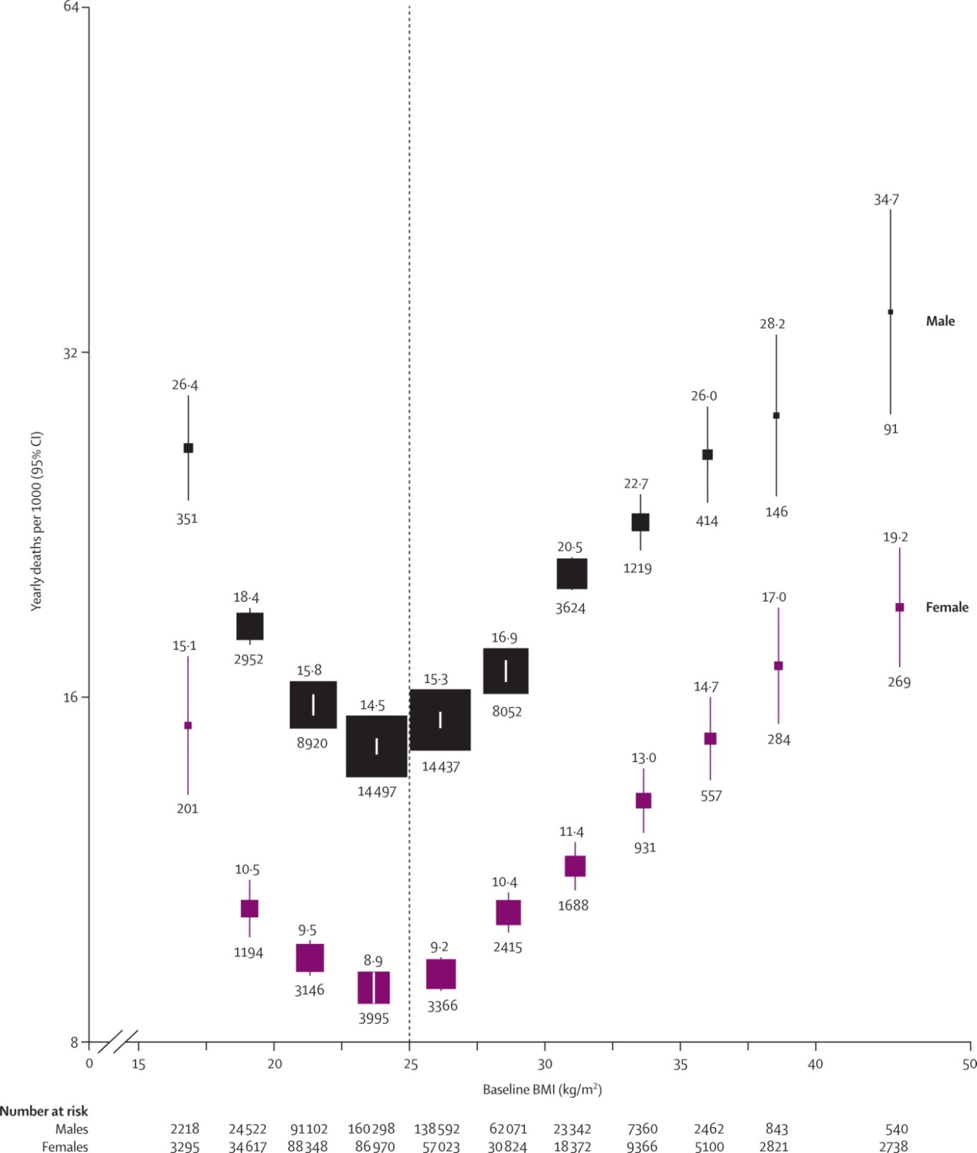
Lancet, 2009; 373: 1083-96
People with a BMI 18.5-22.5 have the same risk of death as people with a BMI 27.5-30.
The increased risk in the lower BMI group was mainly due to respiratory disease.

Slide 45
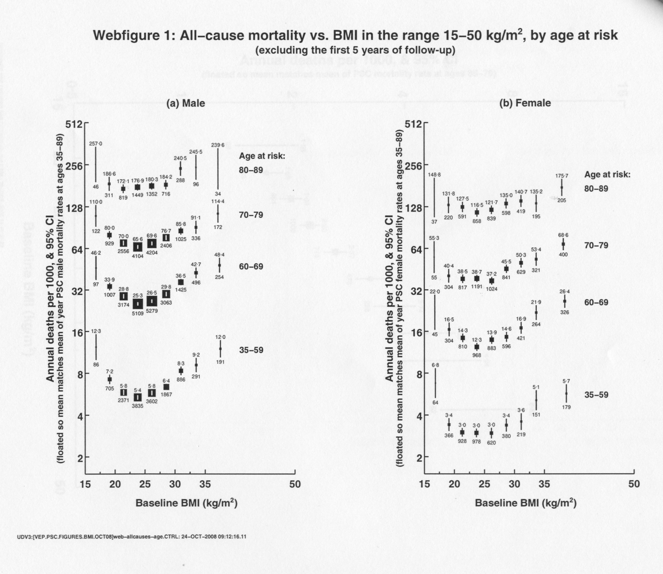

Slide 46
Why?
Fat storage: energy store and hence may protect against wasting – thin people do not have this store
Lean tissue: low BMI = lower lean tissue. Lean tissue is critical for survival mechanisms.

Slide 47
MALNOURISHED OR NOT?

Slide 48
MALNOURISHED OR NOT?

Slide 49
Bit of background info
73 yrs old
Respiratory infection
Weight = 60kg
BMI = 21kg/m²
Lost 6kg recently
Eating poorly
Evidence of muscle wasting

Slide 50
You don’t have to be really thin to be malnourished

Slide 51
Malnutrition
Malnutrition costs £7.3 billion/yr (much more than obesity).
More than 50% cost spent >65yrs and above.
Notes:
Much emphasis has been placed on the issue of obesity but when you look at vulnerable groups such as the elderly, malnutrition is a serious problem.
Just to give you a bigger picture of how malnutrition affects the elderly in hospital.

Slide 52
The scandal of malnourished older people in hospital
14% older people aged>65 years are malnourished in the UK
4/10 older people admitted to hospital are malnourished on arrival
Pts > 80 admitted to hospital are 5x higher malnourished than those <50
Notes:
NICE guidance now recommends all patients are screened for nutritional status on admission to hospital
HOW?
Two key questions:
Recent weight loss
Reduced food intake
More on screening thurs pm

Slide 53
SIGNS OF MALNUTRITION: EYEBALL TEST
Notes:
Lab tests are not helpful
e.g. albumin – reduced due to acute illness – better marker of illness and related to mortality

Slide 54
Monitoring
Weekly weights
Food charts for those at risk
Additional supplements
Referral to the dietitian
Notes:
Studies show that many people go into hospital well nourished but come out malnourished.
Vital to monitor all patients:

Slide 55
Improving intake - older person
Food choice and availability
Food fortification
Eating environment
Protected mealtimes
Red tray system
Feeding assistance

Slide 56
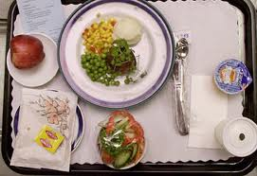
Food in hospital
Notes:
Over the last 10 years major efforts have been put into improving hospital food.
Standards for nutritional content
Hospitals are judged on their food provision
Patients are encouraged to comment
Patient groups keen to publicise deficiencies.

Slide 57
Exciting the appetite in hospital
Fortifying
Small & Often
Alcohol
Notes:
Adding fat, oil and CHO to meals can increase energy intake by 20%
ETOH on drug charts.

Slide 58
Red trays
Notes:
Another initiative to combat malnutrition is the red tray system. By serving food on red trays to those identified as malnourished allows all staff to easily recognise who needs help at mealtimes.

Slide 59
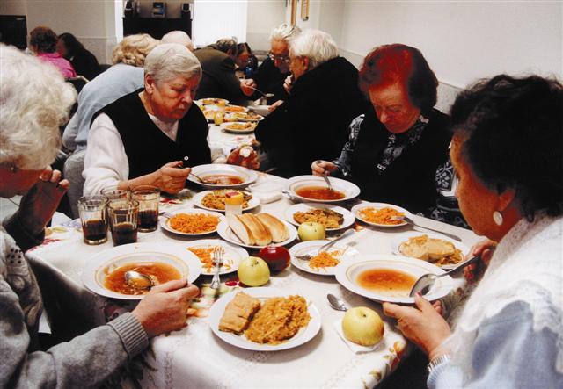
The Eating environment
Notes:
Latest research published by ourselves in Feb 2006 suggests that eating in a dining room rather than bedside significantly increases energy intake. Created dining rooms on all elderly med wards a means of promoting intake, part of rehab experience, sociability.

Slide 60
Using a dining room in an acute elderly medical ward increases energy intake
L. Wright, M. Hickson & G. Frost (2006) Eating together is important:
using a dining room in an acute elderly medical ward increases energy
intake. J Hum Nutr Dietet, 19, pp. 23–26
Notes:
120kcal difference at one meal.
This is significant
Could be 250+kcal /day
1750kcal / week
Approx 2kg weight loss in a month

Slide 61
PROTECTED MEALTIMES
Notes:
All non-urgent activity such as ward and drug rounds and routine tests should not be allowed to happen during mealtimes.
Allows pts to eat their meals without being interrupted by other activity and gives ward staff time needed to help pts eat.

Slide 62
Nutrition Supplements
Notes:
One of the other tools we use is the use of nutritional supplements.
Have been shown to increase energy intake
Tasting session. Red and Green

Slide 63
Timing of supplements
1 hour before meals
Supplements with meals adversely affects intake
Notes:
If all the measures mentioned don’t work or the patient is NBM,

Slide 64
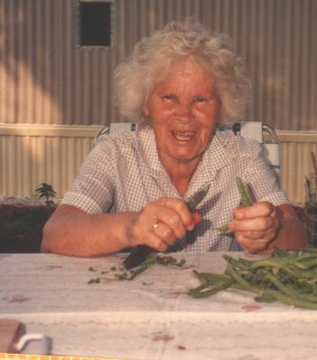
PREVENTION IS THE KEY
Think about nutrition EARLY
Treat any risk factors EARLY

