Slide 1


Drug development and translational medicine
Dr Vincenzo Libri
Head of Clinical Studies
Wellcome Trust McMichael Clinical Research Facility
Department of Medicine
Division of Experimental Medicine
Imperial College, Hammersmith Campus
Du Cane Road, London W12 0HS

Slide 2


  Phases of Drug Development
  Challenges in Drug Development
  Translational Medicine

Slide 3
Drug Development
Pre-IND/IMP
IND/IMP (MHRA-FDA)
Gene
to target
Target to Lead
Lead to Candidate
Safety
& Develop
Phase I
POC
EMA-FDA
Phase II
Phase III
Registration
Phase IV

Slide 4
How Are Drugs Discovered?
Random screening
Rational drug design (combinatorial chemistry, pharmacology, bioinformatics, etc.)
Luck!

Slide 5
The drug development process
  12,000 compounds synthesised
  80 compounds, fully screened
  10 compounds to man
  4 compounds to full clinical trials
  1 compounds to market

Slide 6
The drug development process
  Pre-clinical - 4 years
  Phase I – 2 years
  Phase II – 2 years
  Phase III – 3 year
  Regulatory review – 2 years
  Total 13 years
  > £ 1 billion

Slide 7
Product Development
Pharmacy (formulation, quality, production)
Pharmacology (animal/man)
Safety (animal/man)
Efficacy trials (man)
Pharmacoeconims

Slide 8
Pharmacy
Gram to kilogram to tonne
From test tube to factory production
Stability, dosage, form, packing
Assays

Slide 9
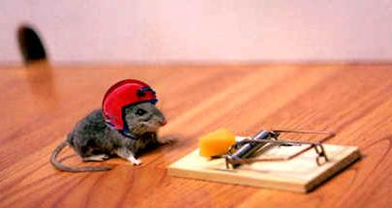
Safety & toxicity in animals
Acute toxicity profile
Chronic toxicity profile
- 14 day toxicity test in one rodent and one non-rodent species before use in man.
3 month study read out at 28 days
longer studies (12 & 24 month)
3 dose levels (below, about, well above human dose)

Slide 10
Phase I
To assess:
  safety, tolerability, and dose range in healthy volunteers
  Pharmacokinetics, pharmacodynamics
  20-100 subjects
  Short term

Slide 11
Phase II
To assess:
  efficacy, safety, optimum dose
  100-500 selected patients
  Short term
  Phase II a (POC)
  Phase II b (full development)

Slide 12
Phase III
To verify:
  effectiveness, safety in longer term
  1000-3000 patients
  Placebo, dose and comparator controlled trials
  Multi-centric

Slide 13
Conventional clinical trial designs
double-blind – randomised - placebo-controlled
parallel arm
crossover
Placebo
Placebo
Placebo
INP 1
INP 2
INP 3
INP
INP
washout

Slide 14
Placebo controlled parallel arm designs
Placebo
NCE
  … placebo controlled trials provide the best evidence to substantiate the claim that a drug safely and effectively treats a disease (FDA)
  … it is unethical to withdraw effective treatments from patients (Declaration of Helsinki)

Slide 15
Marketing Authorisation Application
The regulatory process differs from country to country
(MHRA, EMEA, FDA)
EU Directive in place since 2001
EU Road Map for Clinical Trials
Dossier:
  Chemistry, quality manufacture
  Non-clinical pharmacology
  Toxicology, PK, PD
  Clinical data
  Safety, (adverse events)
  Efficacy
  Publications, labels, etc.

Slide 16
Phase IV
  Pharmacoeconomic
  Quality of life
  Long term safety, efficacy
  Yellow card system (voluntary reporting of AEs)
  Comparator studies
  Special populations
  New formulations
  Marketing

Slide 17
The drug development process
Preclinical
Phase I-II
Phase III
Reg.
£1-2 Bn
Most DD programs ‘fail’ in Phase I-IIa, with an attrition rate of 85-90% due to lack of safety or efficacy
0
4 8 12 years
Notes:
Trials designed to evaluate clinical outcomes are highly expensive and of long duration
Most programs “fail” (lack of efficacy and/or safety) with 85-90% attrition after FTIH
Pipeline are clogged with many molecules that will fail
It is critical to develop laboratory and/or physical tools to be used as an alternative outcome for (or in addition to) clinically meaningful endpoints.
PK/PD modelling are needed to aid PK at site of action and dose selection for human studies.

Slide 18
The Business Need
The pressures associated with productivity and return on investment is a major issue in Pharmas
Unless companies continually bring enough new products to market to replace lost revenues, they are at risk of collapse
To maintain 10% annual growth and justify R & D spend the top tier companies would need to launch at least 4 £500 million drugs every year

Slide 19
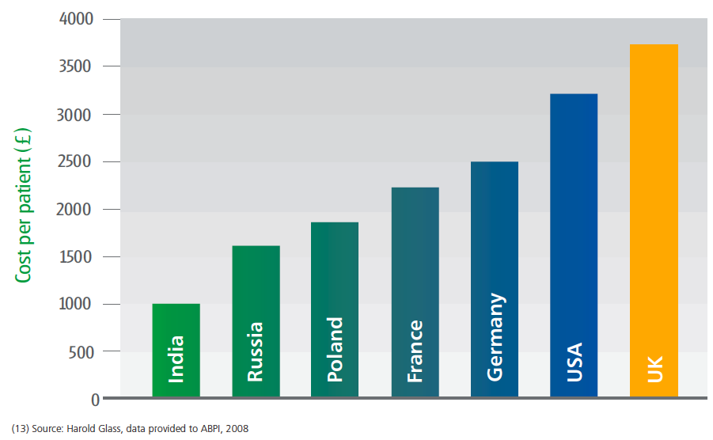
UK is expensive

Slide 20
Shifting the pendulum of clinical research
Percentage of Subjects Randomized by Region for Industry Cohort, 2000 vs. 2007
EU Non-Core
8% > 21%
EU Accession
4% > 8%
EU Core
21% > 12%
United Kingdom
26% > 14%
North
America
41% > 36%
Asia Pacific
2% > 10%
Latin
America
3% > 7%
Middle East &
Africa
2% > 3%
Source : Centre for Medicines Research. © CMR, a Thomson Reuters business

Slide 21
Life Cycle Management
Reduce R&D
Time
Life Cycle
Extension
+
Patent Loss
Profit
0
Launch
_
Traditional
10 20 30 years
Notes:
Trials designed to evaluate clinical outcomes are highly expensive and of long duration
Most programs “fail” (lack of efficacy and/or safety) with 85-90% attrition after FTIH
Pipeline are clogged with many molecules that will fail
It is critical to develop laboratory and/or physical tools to be used as an alternative outcome for (or in addition to) clinically meaningful endpoints.
PK/PD modelling are needed to aid PK at site of action and dose selection for human studies.

Slide 22
Is drug development cost effective?

Slide 23
The drug development process
Preclinical
Phase I-II
Phase III
Reg.
£1-2 Bn
Most DD programs ‘fail’ in Phase I-IIa, with an attrition rate of 85-90% due to lack of safety or efficacy
Translational
Medicine
0
4 8 12 years
Notes:
Trials designed to evaluate clinical outcomes are highly expensive and of long duration
Most programs “fail” (lack of efficacy and/or safety) with 85-90% attrition after FTIH
Pipeline are clogged with many molecules that will fail
It is critical to develop laboratory and/or physical tools to be used as an alternative outcome for (or in addition to) clinically meaningful endpoints.
PK/PD modelling are needed to aid PK at site of action and dose selection for human studies.

Slide 24
Translational Medicine
Set up common strategy plans for investigating animal and human pharmacology
Pharmacological activity in humans that is similar in type and magnitude to that observed in non-clinical efficacy models.
Pharmacological activity that, if clinical trials are negative,
would disprove the target hypothesis for moving to further development.
Novel targets may require novel markers/models

Slide 25
Confidence Tree
Surrogate marker
CNS
PD marker
‘Ideal’
Human
PK/PD
Model
PET
BioDist/RO
CNS Pen
Confidence in POC interpretation
CNS
PD marker
Animal
PK/PD
Model
PET
BioDist/RO
CNS Pen
0
Translational Evidence

Slide 26

The Voltaire Challenge
Doctors put drugs of which they know little
into bodies of which they know less
for diseases of which they know nothing at all
1694-1778

Slide 27
Make Go / No Go Decisions Earlier
Abundance
of Drug
Discovery
Pre-Clinical Development
Proof of Concept
Confirmation,
Dose Finding
Commercialization
Phase II-II
Launch
POC
CS
FTIM
Optimal plans to POC
Notes:
Improve diagnosis
Reduce the sample size, duration, and cost of clinical trials
Allow treatment to be assessed in situations where the use of primary outcomes would be excessively invasive, unethical, long, and/or expensive

Slide 28
Interpretability of Results
Phase I
Evidence of:
Correct dose-selection ?
Receptor Occupancy?
Target Pharmacology?
PK/PD relationships?
Phase II
Phase III
X
?
-
+
+/-
√
?
Notes:
1. Does the compound get to the site of action?
2. What concentrations are associated with pharmacological activity?
3. Are such concentrations achievable?
4. Does the compound cause its intended pharmacological / functional effects?
5. How long should exposure be maintained to obtain the desired response?
6. Does the compound show clinically relevant effects in the target population?
7. Does the compound exhibit a therapeutic window for the proposed indication?
8. How reproducible are the responses from patient-to-patient?
9. Can the compound be safely administered with other medications?
10. Do the properties of the drug allow for suitable formulation?

Slide 29
Marker
  A laboratory, instrumental or a physical sign used as a substitute for a clinically meaningful endpoint
  Changes induced by a therapy on a marker endpoint are expected to reflect changes in a clinically meaningful endpoint

Slide 30
Marker Definitions
Biomarker:
  Measure of normal biologic or pathogenic processes or response to treatment
Diagnostic marker:
  Measure which determines the presence or absence of a specific disease.
Prognostic marker:
  Measure which indicates the likely progression of a specific disease, independent of treatment.
Surrogate marker
  Measure used as a true substitute of the clinically meaningful endpoint
Notes:
To prove useful, a marker should be:
Easily and non invasively (or moderately invasively) detectable in living subjects
Reproducible over a short period of time with small test-retest variability
Altered at the early disease stage
Positively correlated to the disease severity (longitudinal studies are required)
Correlated to the causal pathway of the disease process (disease-based surrogate marker) or recognise the mechanism of action of a potential therapy (mechanism-based marker, or biomarker), i.e. Surrogate marker of disease or marker of pharmacology?
The relation between marker endpoint and intervention should have a biologically plausible explanation
Marker as a true predictor of the clinical endpoint

Slide 31
Proof-of-Mechanism studies
Surrogate Markers correlate to the causal pathway of the
Pharmacodynamic markers (biomarkers) recognise the mechanism of action of the potential new therapy
The relation between marker endpoint and intervention should always have biologically plausible explanations

Slide 32
Possible failure of marker endpoints
The marker is not the causal pathway of the disease process
Marker
End Point
True Clinical
Outcome
Disease
Time

Slide 33
Possible failure of marker endpoints
Of the disease pathways affecting the true clinical outcome, the intervention might only affect the pathway mediated through the marker endpoint
Intervention
Marker
End Point
True Clinical
Outcome
Disease
Time

Slide 34
Possible failure of marker endpoints
The intervention may affect the clinical outcome through several causal pathways that are not mediated through the marker
Intervention
True Clinical
Outcome
Disease
Marker
End Point
Time

Slide 35
Possible failure of marker endpoints
The intervention might affect the true clinical outcome by unintended, unanticipated, and unrecognised mechanisms of action that operate independently of the disease process
Intervention
True Clinical
Outcome
Disease
Marker
End Point
Time

Slide 36
Recognise the real problem
  Markers may not be valid, reliable, or reproducible
  False positives and false negatives often occur
  Effects on marker endpoints may not predict the true clinical effects of intervention
  Marker endpoints and predicted therapeutic doses are often developed in animal models of diseases, but extrapolation of these findings to human diseases may be invalid

Slide 37
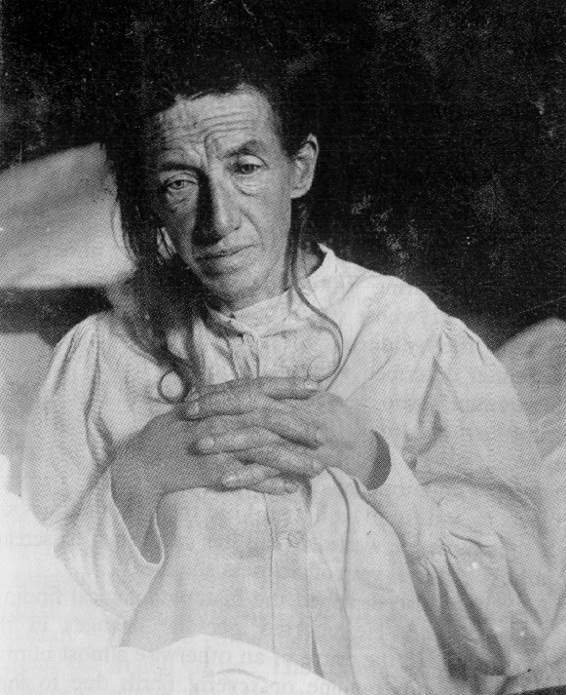
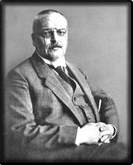
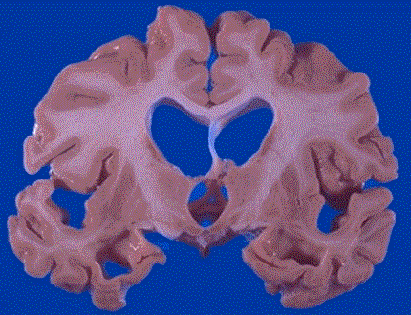
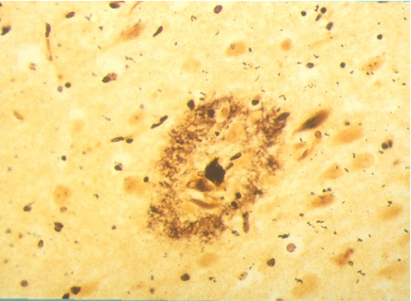
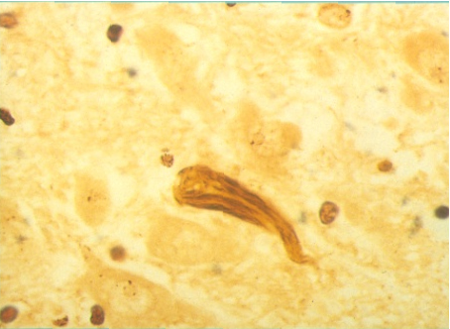
…
Alzheimer’s Disease:
progressive accumulation of neurofibrillary tangles & neuritic amyloid plaques, neuronal loss and brain atrophy
Auguste D. (1906)
Dr Alois Alzheimer
post mortem diagnosis

Slide 38

Choosing the right study design in AD trials
Clinical AD
pre-clinical AD
Amyloid accumulation
0 5 10 15 20 years

Slide 39
Interpretability of Results
DISEASE MODIFICATION REGENERATION
FUNCTION
UNTREATED
SYMPTOMATIC ACTION
TIME
Prior to large clinical trials
Correct dose-selection
Receptor Occupancy
Target Pharmacology
PK/PD relationships

Slide 40
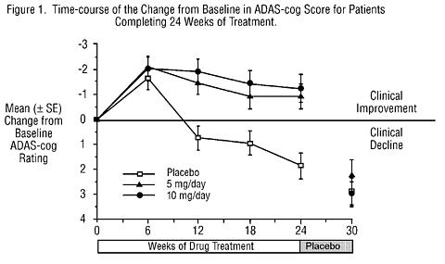
ADAS-cog changes with Aricept

Slide 42
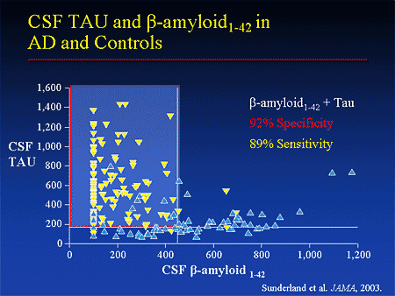
Fluid-phase markers

Slide 43
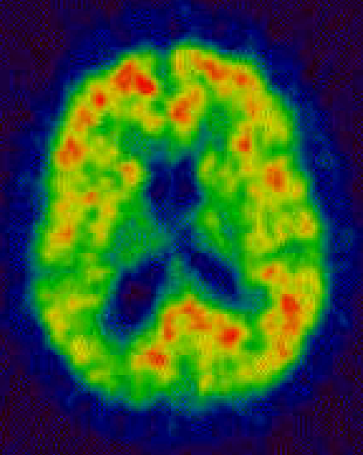
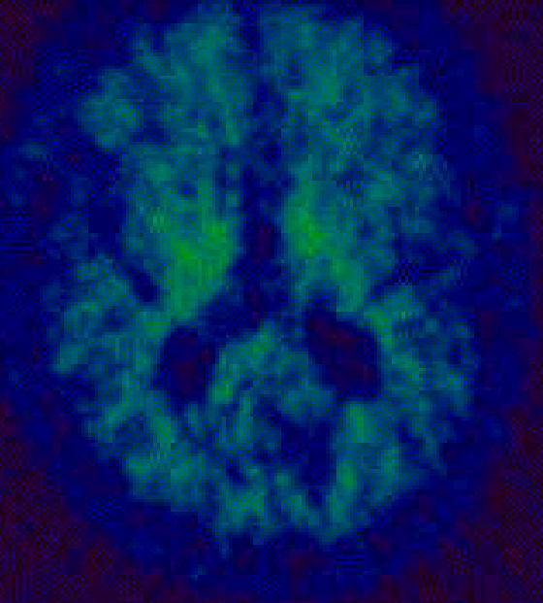
[¹¹C]PIB
Trait or state marker?
Alzheimer
Normal
Do amyloid PET tracers correlate with disease progression?
Can they be used for testing pharmacology?

Slide 44
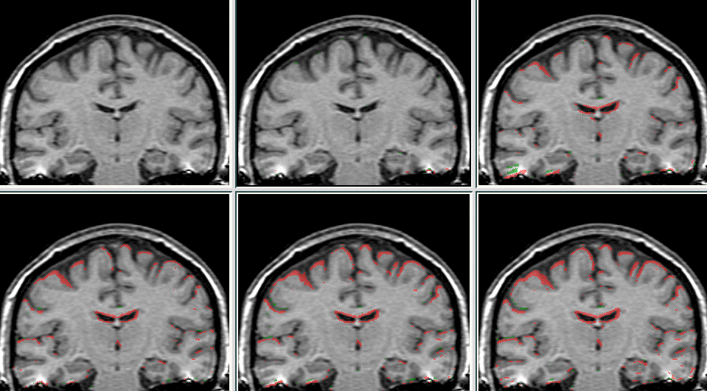
Can MRI detect brain changes?
1993
1994
1995
1996
Apr’97
Nov’97

Slide 45
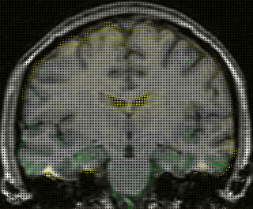
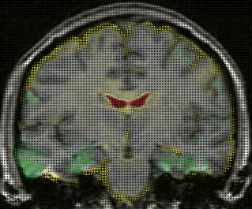
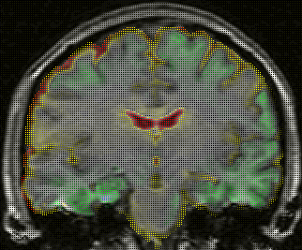
90
88
Normal
Control
Range
86
Symptom onset
84
82
80
BRAIN VOLUME AS A PERCENTAGE OF TIV
78
Fulfils clinical criteria for AD
76
74
72
70
0
500
1000
1500
2000
2500
TIME SINCE BASELINE SCAN (DAYS)
Scahill et al PNAS 2001

Slide 46
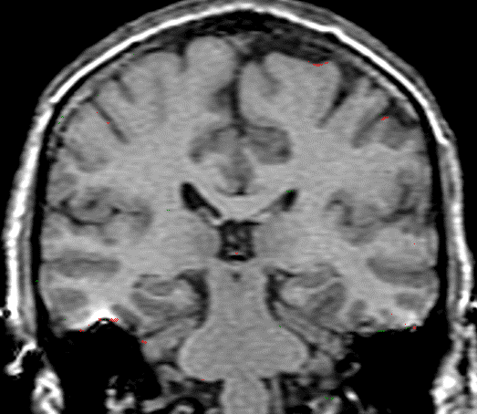
Control: Scan 1-Scan 2
1 year interval
Rate of volume loss (% year)
0.2% ± 0.3
2.8% ± 1
Controls
AD
Controls
0
Brain Volume
(% change)
-5
AD
-10
Alzheimers: Scan 1-Scan 2
1 year interval
-15
0
2
4
6
time (years)
(Red = issue loss)
(Nick Fox, IoN – London)

Slide 47

Transition from normal aging to Alzheimer’s
Normal aging
Mild cognitive impairment
Cognitive Function
Probable AD
0
-5
-10
-15
0
2
4
6
Definite AD
Age

Slide 48
Patient Severity
?
30
0
slow decliner
Cognition MMSE
fast decliner
Time (5-10 y)

Slide 49
Parallel vs. Adaptive Designs
Screen Placebo Randomized, Double-Blind Treatment Follow
Run-in Up
Dose 3
Dose 2
*
Dose 1
*
Placebo
*
Interim analyses – consider dose escalation
-2 -4 0 2 4 8 12 16 24 26
Weeks

Slide 50
Aprepitant Blocks Brain NK₁ Receptors
Mean (± SD) Plasma Trough Concentrations of the Aprepitant 3-Day Regimen
Baseline
100
90
80
70
60
50
Brain NK₁ Receptor Occupancy (%)
After after aprepitant
40
30
20
10
0
0
1
10
100
1000
10000
Tracer Binding
Aprepitant Plasma Trough Concentration (ng/mL)
Low High

Slide 51
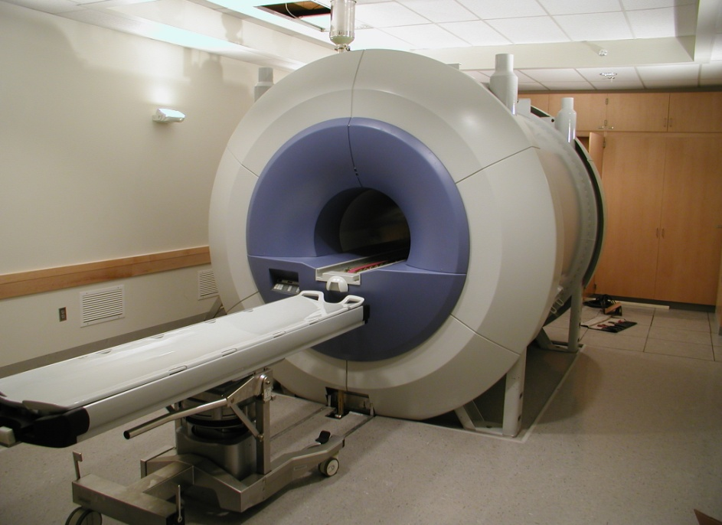
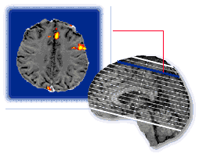
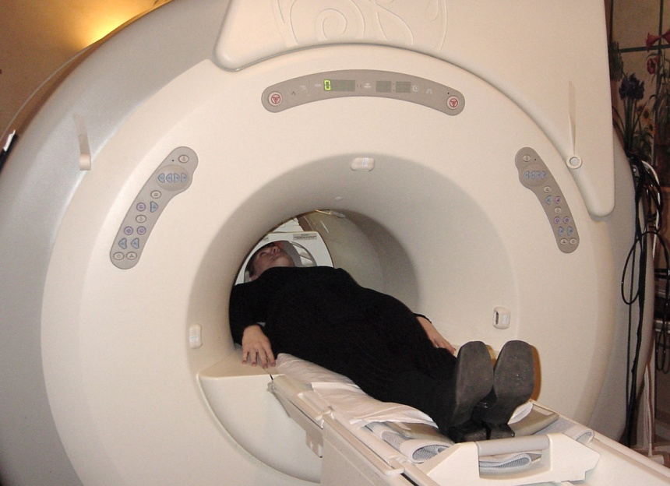
Funtional MRI

Slide 52
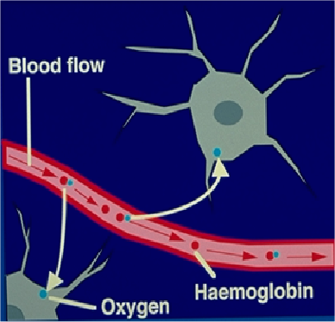
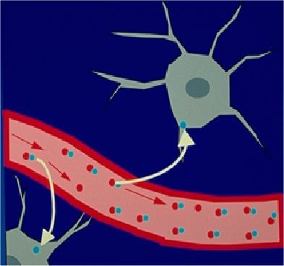
BOLD (Blood Oxygenation Level Dependent) f-MRI
Resting state
Active state
  Reflection of increase in cerebral blood flow (signal increase) during the performance of an activation paradigm (visual stimulation, motor activity, cognitive test)
  Net result of the ratio between Hb (diamagnetic) and deoxy-Hb (paramagnetic)

Slide 53
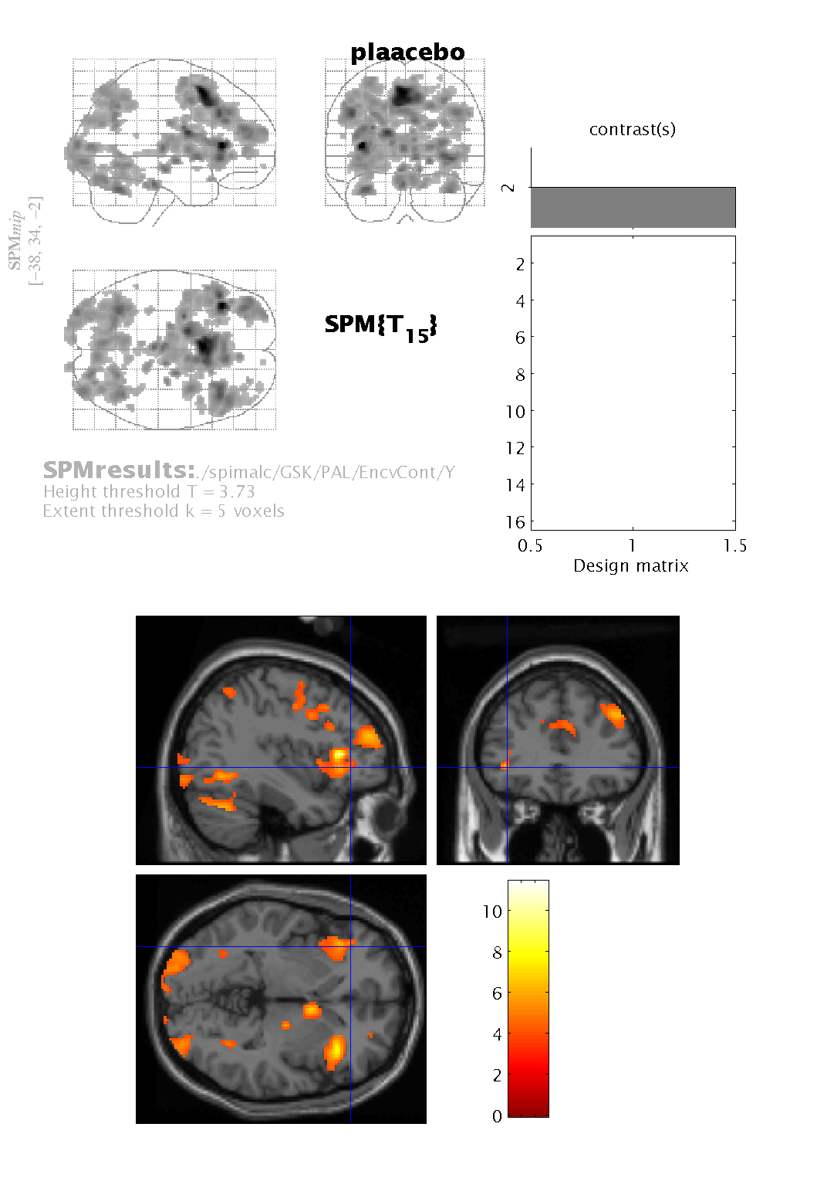
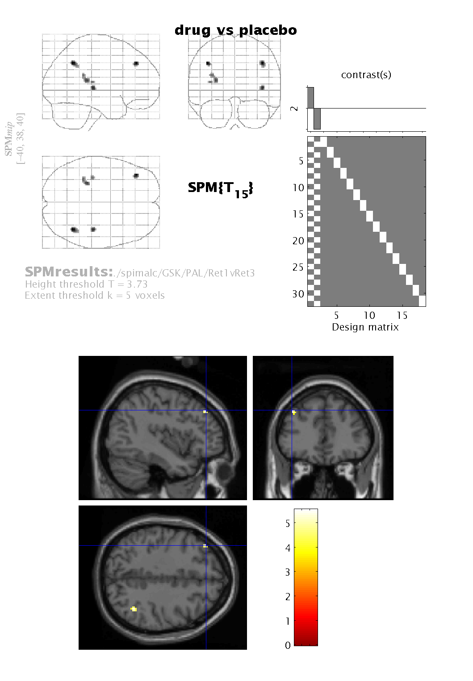
Scopolamine effects on learning network
(Similar results after sleep deprivation)
placebo
scopolamine (0.4 mg s.c)

Slide 54
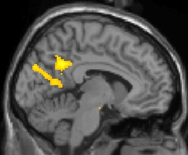
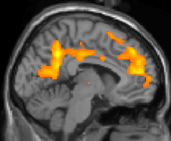
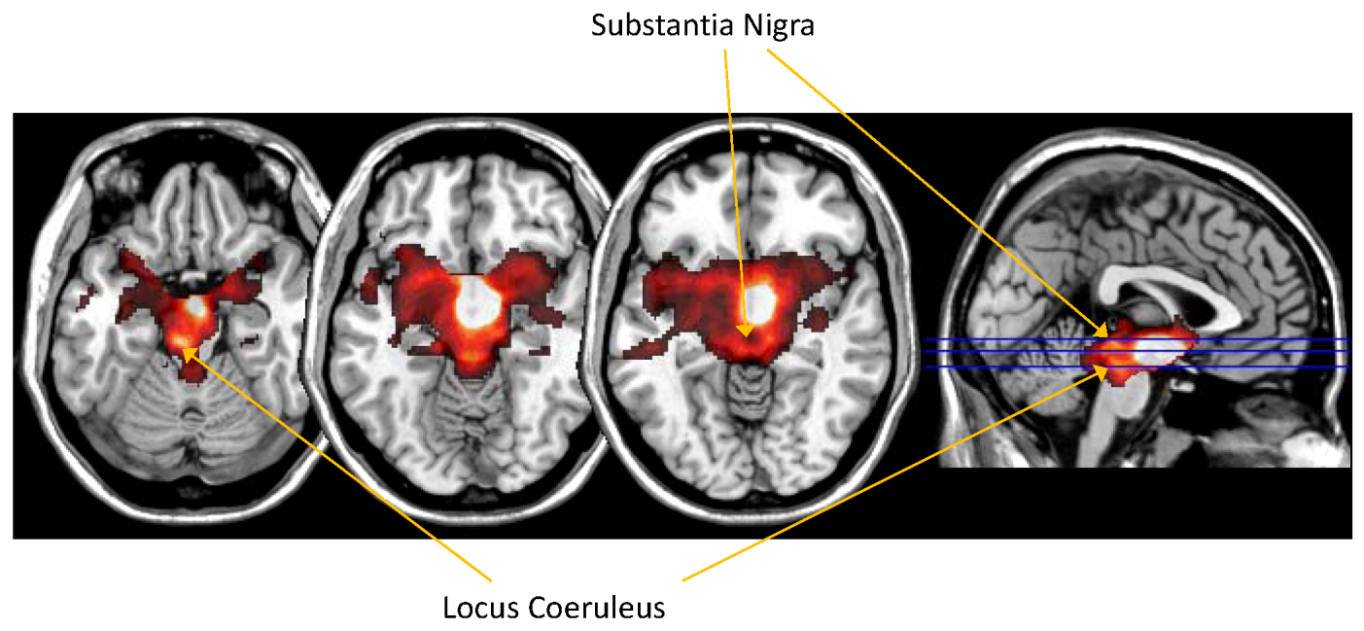
Sustained attention fMRI results in HVs
placebo
Drug

Slide 55
Animal MR Imaging System

Slide 56
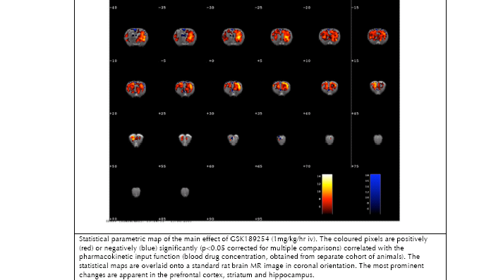
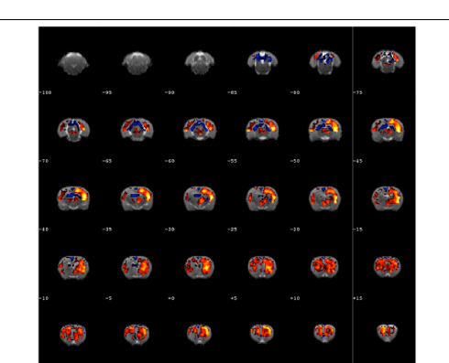
Rat pharmaco fMRI
+ve correlation with
exposure
-ve correlation with
exposure
Hippocampus
Thalamus
Striatum
Prefrontal cortex

Slide 57
What Markers? A question based approach
Disease
initiating
event
Markers
of disease
progression
Surrogate Markers
of efficacy
Healthy
Patient
Prospective Markers
in ‘at risk’ or susceptible
individuals
Diagnostic and
prognostic
markers
PD Markers
Marker Features
Specificity
Sensitivity
Positive and negative predictive value
Discriminant validity
Sensitivity to change
Sensitivity to treatment difference Accuracy
Likelihood ratio of a positive and negative results

Slide 58
Summary
  Predicted therapeutic doses are often developed in animal models of diseases, but extrapolation of these findings to human diseases may be invalid
  Pharmacodynamic markers in Phase I clinical trials are important steps toward validation of target pharmacology
  Pharmacological activity at selected doses improves decision making abilities and dose-selection for subsequent studies
  Presence of effect on PD markers but subsequent lack of efficacy in POC trial disproves the target hypothesis for moving to further development

Slide 59
MREs in Clinical Research
Translational Medicine
(TM)
Clinical Research Research Design & Management (CRDM)
Cellular Pathology
(CP)
Human Nutrition
(HN)
Open to MBBS, BSc, Nurses and Allied Health Professionals who wish to pursue a career in clinical research

Slide 60
MRes inTranslational Medicine
Designed for MBBS and BSc graduates
Provide training in the design and execution of clinical trials, experimental medicine and drug development
Topics covered:
  Study designs and management
  Research governance (GCP - Ethical and Regulatory approvals)
  Principles drug discovery
  Bench to Bedside
  Pharmacokinetics and Pharmacodynamics
  Biomarkers and surrogate endpoints
  Emerging technologies in medical research
  First-time-in-human studies
  Early phase clinical trials in patients
  Selection of patient populations and Informed Consent
  Medical statistics
Enhance opportunities to pursue careers as Academic Clinical Fellows and/or follow up with a Clinical PhD programme

Slide 61

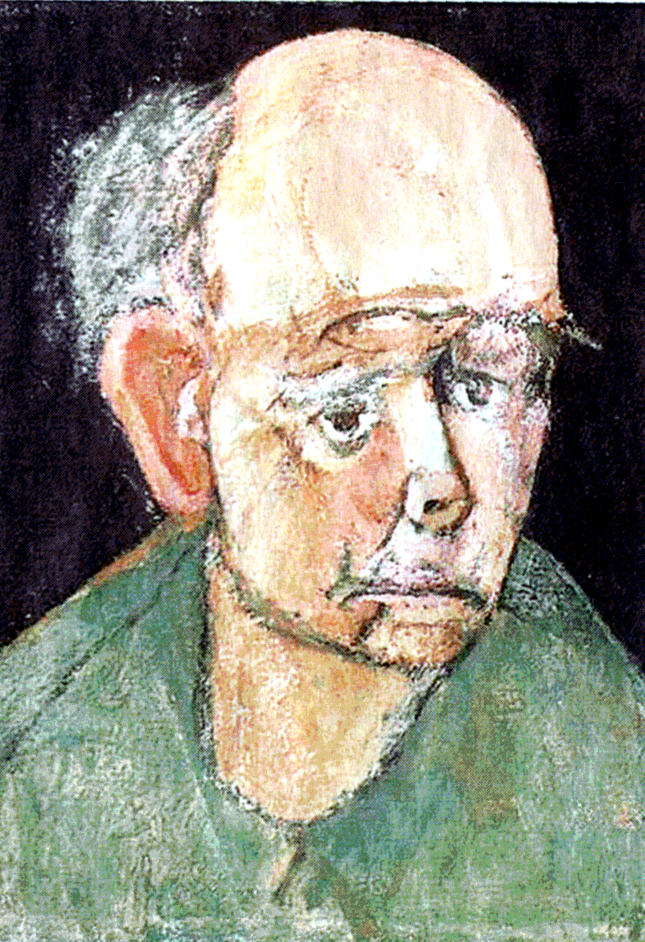
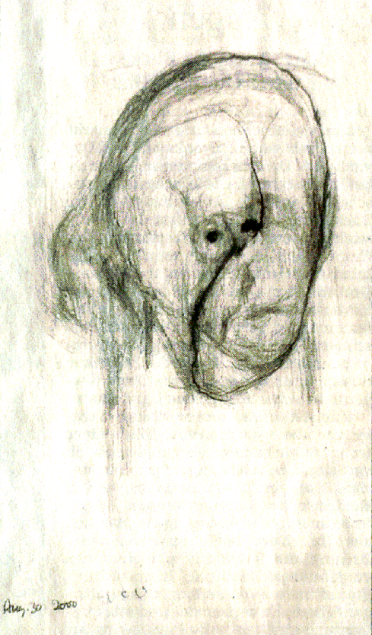
Progressive decline in cognitive functions
1996
1997
2000
William Utermohlen – self portraits

