Slide 1
Acute coronary syndromes
Dr Gareth Barnes
ST Clinical Pharmacology
June 2013

Slide 2
Acute Coronary Syndromes
Aims
Clinical features, diagnosis
ECG features
Evidence based drug therapy

Slide 3
ESC definition
Detection of a rise and/or fall of cardiac biomarker values [preferably cardiac troponin (cTn)] with at least one value above the 99th percentile upper reference limit (URL) and with at least one of the following:
Symptoms of ischaemia.
New or presumed new significant ST-segment–T wave (ST–T) changes or new left bundle branch block (LBBB).
Development of pathological Q waves in the ECG.
Imaging evidence of new loss of viable myocardium or new regional wall motion abnormality.

Slide 4
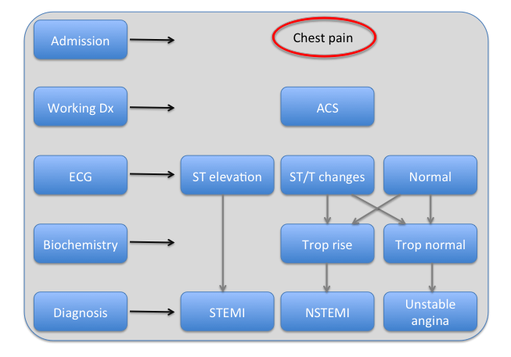
ESC definition
Positive troponin in context of symptoms or ECG changes, myocaridial ischaemia

Slide 5
Clinical features
Central pain, heavy, radiates to left arm and neck
Shortness of breath
Autonomic – sweating, nausea, tachycardia
Usually history of exertion chest pain
Need to consider risk factors

Slide 6
Chest pain –many causes
Cardiac
Aortic disection
Myocarditis
Pericarditis
Cardiomyopathy
Valvular disease
Pulmonary
Pulmonary embolism
Pneumonia Pleuritis
Pneumothorax
Gastro-intestinal
Oesophageal rupture
Oesophageal spasm
Oesophagitis
Peptic ulcer
Pancreatitis
Cholecystitis
Vascular
Stroke disease
Aortic aneurysm
Others
Rib fracture
Cervical discopathy
Costochondritis
Muscle injury/
Herpes zoster
Infiltration

Slide 7
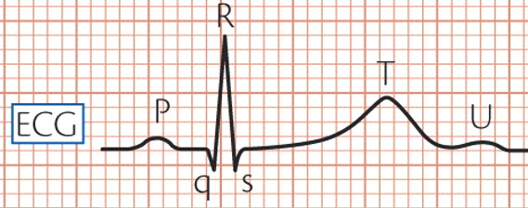
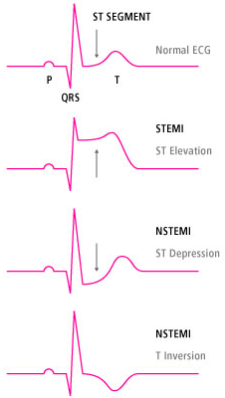
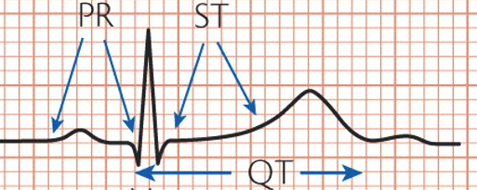
ECG

Slide 8
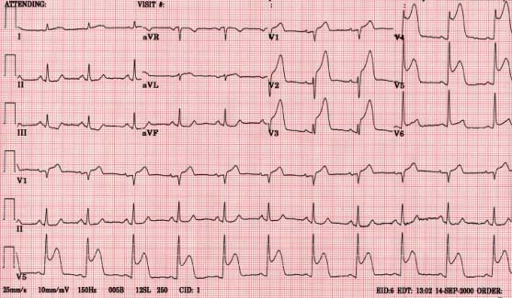
ECG is this normal?

Slide 9
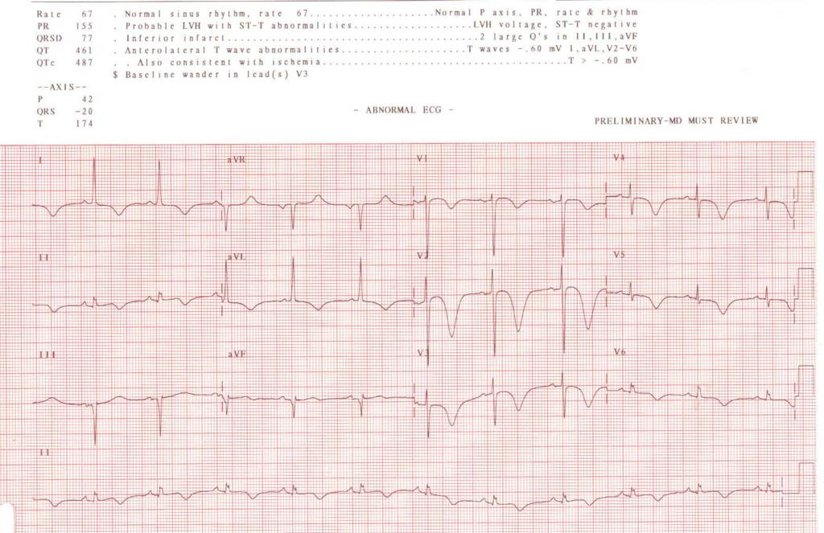
ECG is this normal?

Slide 10
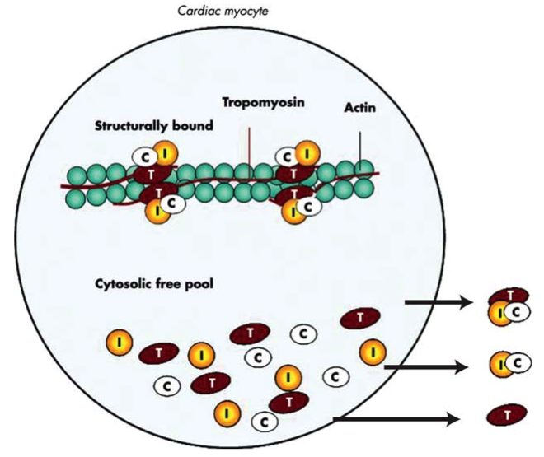
Circulating biomarker in ACS

Slide 11
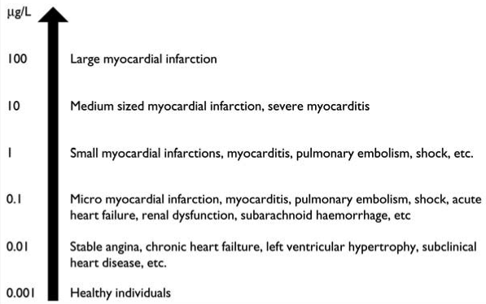
Rises in troponin, myocardial necrosis
Chronic or acute renal dysfunction |  | Cardiac contusion, ablation, pacing, cardioversion, or endomyocardial biopsy
Severe congestive heart failure – acute and chronic |  | Hypothyroidism
Hypertensive crisis |  | Apical ballooning syndrome (Tako-Tsubo cardiomyopathy)
Tachy- or bradyarrhythmias |  | Infiltrative diseases, e.g. amyloidosis, haemochromatosis, sarcoidosis, sclerodermia
Pulmonary embolism, severe pulmonary hypertension |  | Drug toxicity, e.g. adriamycin, 5-fluorouracil, herceptin, snake venoms
Inflammatory diseases, e.g. myocarditis |  | Burns, if affecting >30% of body surface area
Acute neurological disease, including stroke, or subarachnoid haemorrhage |  | Rhabdomyolysis
Aortic dissection, aortic valve disease or hypertrophic cardiomyopathy |  | Critically ill patients, especially with respiratory failure, or sepsis

Slide 12
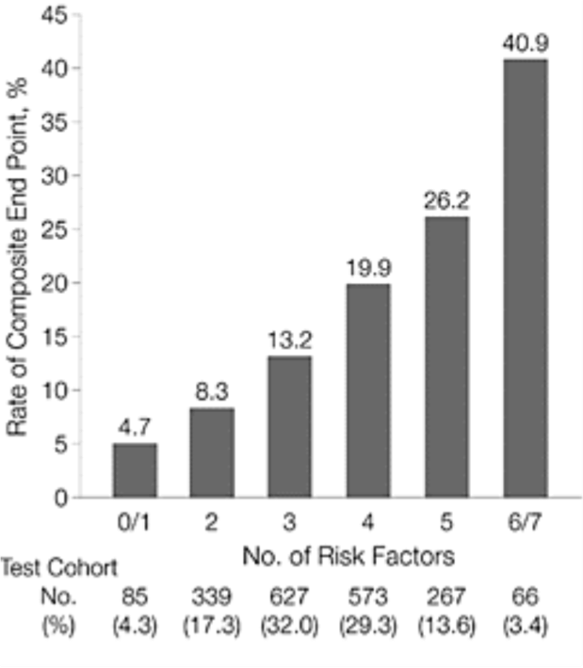
Risk stratification
RISK – who is the most
risky for future events
Multiple factors –
biomarkers, ranging from blood tests to imaging.
TIMI score

Slide 13
Treatment of ACS
Immediate Cath lab
& medical
Medical ±
Cath lab

Slide 14
Treatment of ACS
General measures
Risk assess; some people will be very well, some critically unwell
There can be complications
Try and restore this mismatch of oxygen supply and demand

Slide 15
Management
STEMI (ECG Dx) →cath lab
Coronary angiography, angioplasty and stent insertion at the time of MI
“Primary PCI” – directly to cath lab
You need to know it exists and when to do it
Medical therapies too

Slide 16
Overview of therapy
Oxygen supply
Coronary blood flow
Mechanical
(PCI)
Nitrates
Thrombosis
Oxygen consumption
Heart rate
Contractility
Ca blockers
β blockers
Analgesia

Slide 17
Medical therapy; platelets
Platelet bind at site of vascular injury
Adhesion mainly due to 1b/V/IX glycoprotein complex
Mediators released from platelets;
these serve to amplify and sustain initial response – mediators ADP, thromboxane A2, thrombin, adrenaline
Endothelium functioning tissue – releases NO, anti-thrombotic molecules

Slide 18
Platelets - activation
Agonists bind to receptors
Activates intracellular signaling cascades
End result is IIb/IIIa binding to fibrinogen and binding of other platelets.

Slide 19
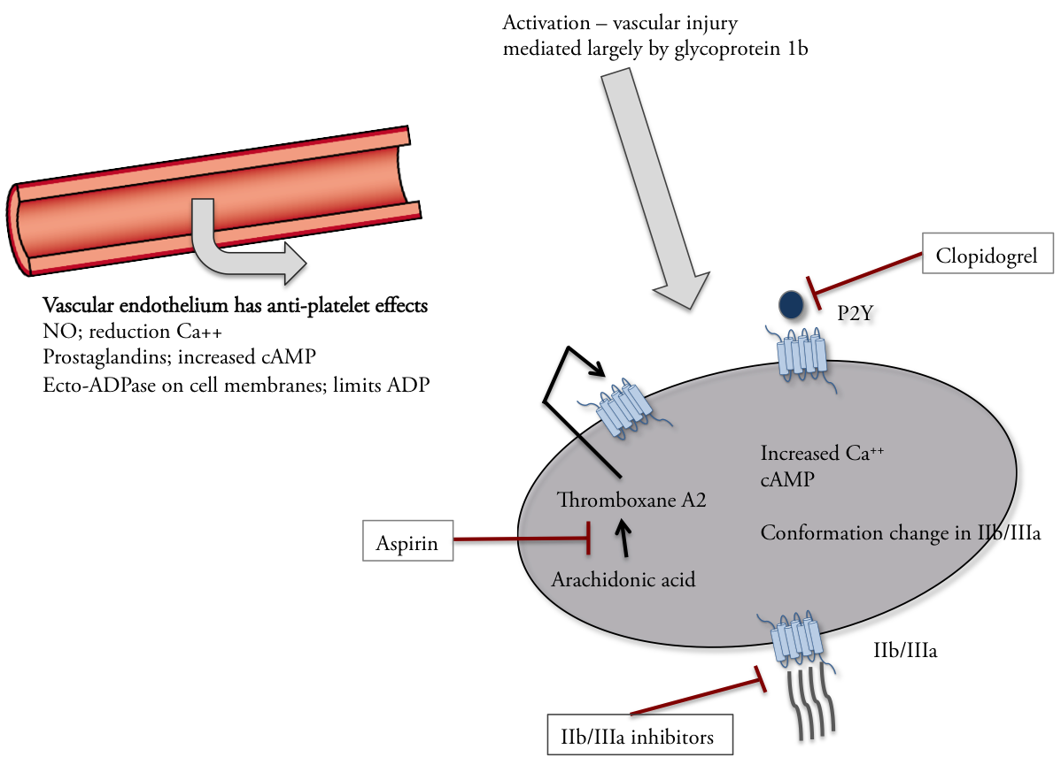
Platelet activation, drug action
P2Y ₁₂ inhibitors
Clopidogrel irreversible
Prodrug -> esterases, CYP450 metabolism
COX 1 inhibitors that blocks formation of thromboxane A₂

Slide 20
Evidence of anti-platelets
Data for aspirin
Considerations of additional anti-platelets
Improvement and future therapies

Slide 21
Aspirin, early trials 80’s
Study | n | Drugs | Setting | Primary | Timescale | Outcome
Veterans Administration Study | 1266 | Aspirin vs placebo | Acute | Death MI | 12 weeks | 10.1 vs 5.0%
Canadian Multicentre Trial | 555 | Apirin, sulfinpyrazone, placebo or both | Acute | Death MI | 2 years | 17 vs 8.6%
Montreal | 479 | Aspirin, heparin, both, neither | Acute | Death MI | 6 days | 6.3 vs2.6%
RISC | 945 | Aspirin, heparin, both, placebo | Acute | Death MI | 7 days | 13.4 vs 4.3
 |  |  |  |  | 30 days | 17.1 vs 6.5
These are absolute benefits and are huge gains

Slide 22
Clinical trials of other anti-platelets
If a new agent was available after aspirin, how would you test it?
Would you withhold aspirin?

Slide 23
Dual anti-platelets trials
Ferreiro JL, Angiolillo DJ. New Directions in Antiplatelet Therapy. Circulation: Cardiovascular Interventions. 2012 Jun 19;5(3):433–45.

Slide 24
Future antiplatelet directs
Clopidogrel requires activation – is ingested as a pro-drug.
CYP variation – this leads to differing response in individuals.
There are low responders (2C19 loss of function mutation) and they have less active Rx
Drives investigation into new agents

Slide 25
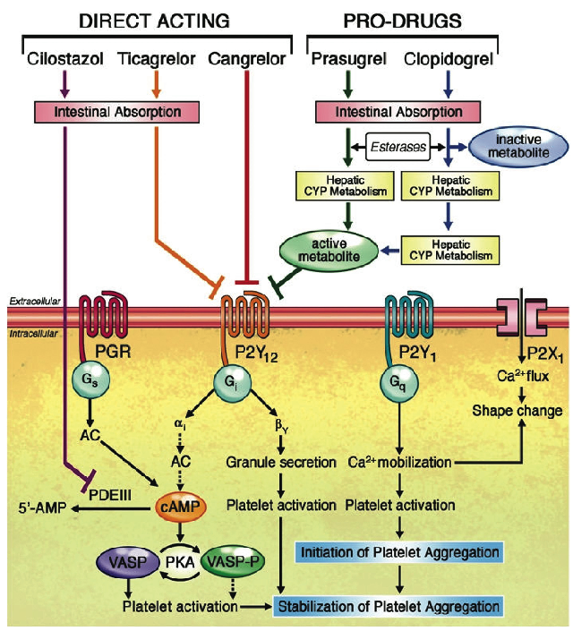
Improvement and future therapies
IV – therapies, these are in hospital only
BD regimes, but what if patients forget
If only small benefits are seen, these trials are large,
time consuming, very costly
Ferreiro JL, Angiolillo DJ. New Directions in Antiplatelet Therapy. Circulation: Cardiovascular Interventions. 2012 Jun 19;5(3):433–45.

Slide 26
Anti-coagulation
Low molecular weight heparin
This is superior to unfractionated heparin
Recent advances have improved safety (what could main problem be?)

Slide 27
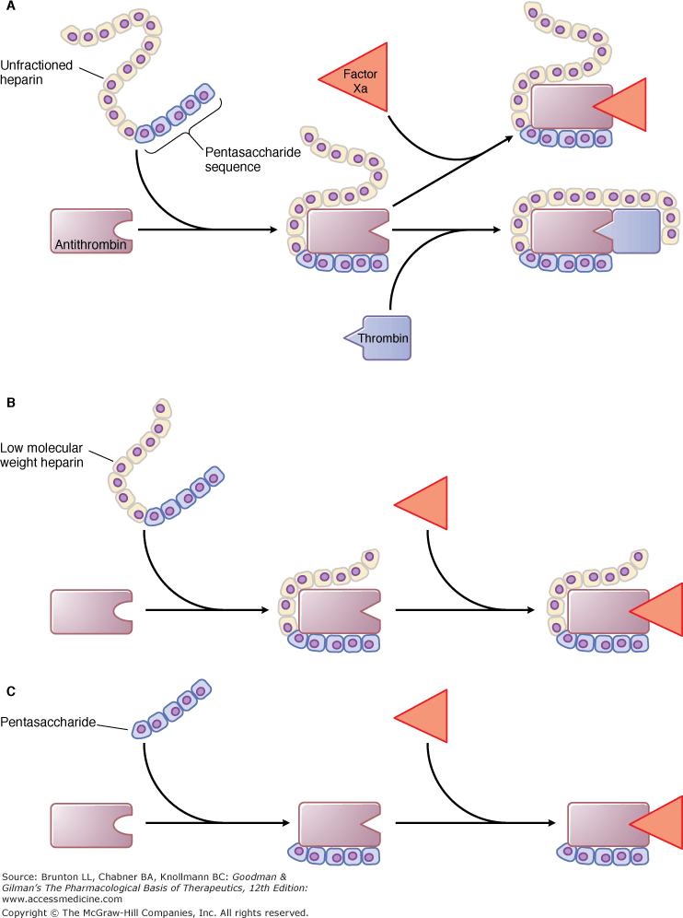
LMWH Mechanism of action
TF/VIIa
Initiation
X
IX
IXa
VIIIa
Va
Xa
Propagation
Anti-thrombin – LMWHeparin
LMWHep
Xa
II
II
IIa
Thrombin
Anti-thrombin
Fibrinogen
Fibrin
Thrombin

Slide 28
Evidence for LMW Heparin
Study | n | Drugs | Setting | Primary | Timescale | Outcome
FRISC | 1506 | LMWH vs placebo | ACS | Death MI | 6 day | 1.8 vs 4.8
ESSENCE | 3180 | LMWH vs unfractionated | ACS | Death MI recurrent angina | 14 day | 16.6 vs 23.3
TIMI-11B | 3190 | LMWH vs unfractionated | ACS | Death MI recurrent angina | 14 days | 14.2 vs 16.6
OASIS 5 | 20078 | Enoxaparin vs fondaprinux | ACS | Non-inferior MI, angina death Bleeding | 9 day | 2.2 vs 4.1
There is progression from no anti-coagulation, to more potent, and then trials aimed to improve safety

Slide 29
Mechanical therapy
Aim to restore perfusion as promptly as possible for STEMI
Is prognostic benefit in NSTEMI, when that perfect time is is unclear
Previously “thrombolysis” you will be unlikely to see this

Slide 30
Anti-ischaemic therapies
Nitrates make people feel better.
Will reduce pain and may remove entirely
No prognostic benefit
Cause hypotension

Slide 31
Anti-ischaemic therapies
β-blockers
There are data to support use - reduce recurrent MI, death and pain
Reduce myocardial oxygen consumption
However they depress cardiac function

Slide 32
Complications of MI
Death is the worst….what would be the next worst?
Left ventricular failure
Haemodynamically what would this look like?
What effect would this have on organ perfusion?
How could you assess this?

Slide 33
Complications of MI
Sufficiently large infarction results in poor LV & heart failure
This carries poor prognosis
Large symptom burden
Medical therapies - hard, many of the drugs used reduce BP so limits what you can do

Slide 34
Complications
Cardiac thrombosis
Arrhythmias – ventricular and atrial
Angina
Papillary rupture, acute mitral regurgitation
Pericarditis
Effusion

Slide 35
Questions

Slide 36
ACS take home
Characteristic pain, although not always
ECG and troponin is essential
Types of ACS may have different initial treatment
Pharmacotherapies
Complications

