Slide 1
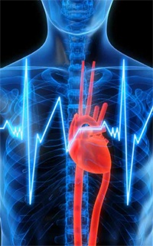
Clinical cardiology
Dr Aamir Ali
Cardiology SpR
CMR Research Fellow
CMR Unit Royal Brompton Hospital, London
NHLI, Imperial College, London

Slide 2
Objectives
Characterise different types of chest pain and their causes
Common first line investigations
Atrial fibrillation
Cardiomyopathies: diagnosis and treatment options

Slide 3
Chest
Pain
Acute coronary syndrome
Myocarditis
pericarditis
Aortic
Dissection
Pneumo-
thorax
Pulmonary embolism
Reflux
Musculo-
skeletal

Slide 4
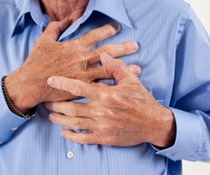
Basic Approach
ABC...
Detailed history and examination
Character of pain:
onset, duration, radiation, positional
Exacerbating / relieving factors, associated symptoms
PMHx, including risk factors for coronary artery disease (CAD)
Drug history, social history – including recreational drug use
Clinical examination:
Baseline observations: HR, BP, Sats, Temp

Slide 5
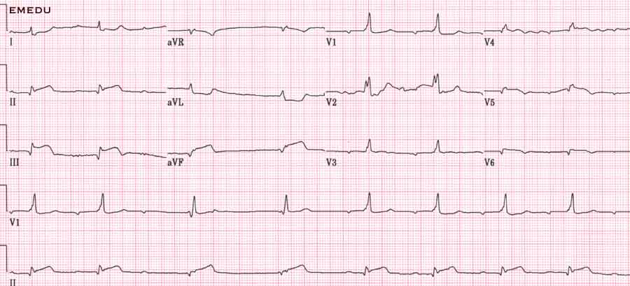
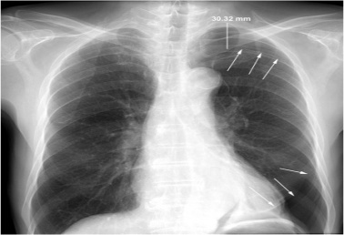
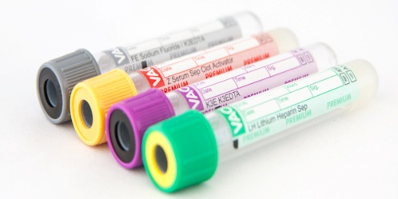
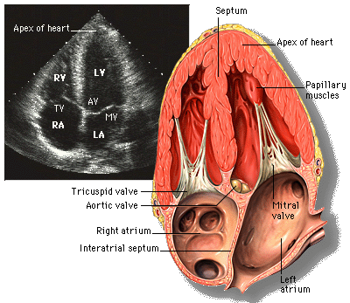
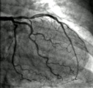
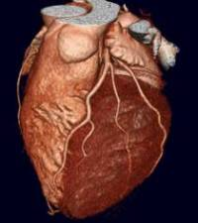
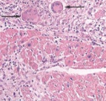
Basic Approach: Investigations
ST Elevation/depression
Arrhythmia
FBC, urea and electrolytes
12 hour Troponin
Coronary angiogram
Pneumothorax
Pneumonia
Cardiomegally, pulmonary oedema
Widened mediastinum (aortic dissection)
D-Dimer (suspected pulmonary embolism)
BNP (heart failure)
CT coronary angiogram
Endomyocardial biopsy
Echo, cardiovascular MRI

Slide 6
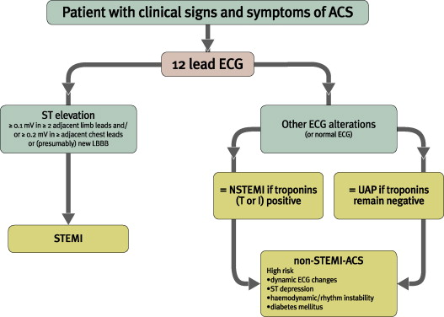
Acute Coronary Syndromes

Slide 7
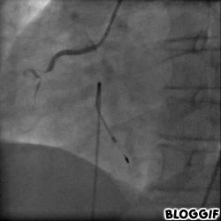
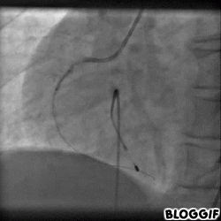
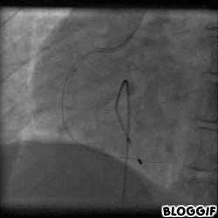
Inferior MI

Slide 8
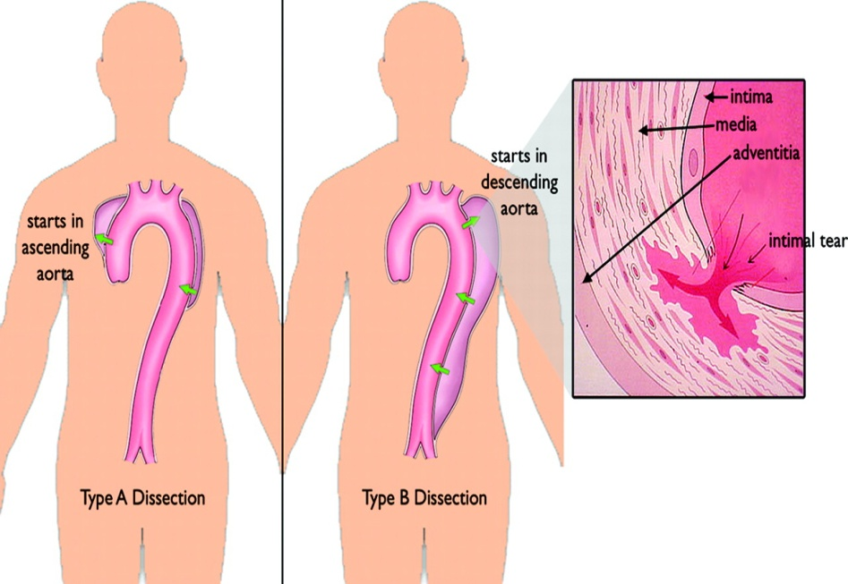
Aortic Dissection
Risk factors: hypertension, connective tissue disease, trauma, bicuspid aortic valve, Marfan Syndrome
Incidence 3-4/100 000
Sudden onset tearing chest pain,
radiation to the back
High morbidity and mortality.
Diagnosis: CT aortogram, transthoracic and transoesophageal echo
Cardiovascular MRI for chronic dissection
Management:
Resuscitation, BP control
Surgery

Slide 9
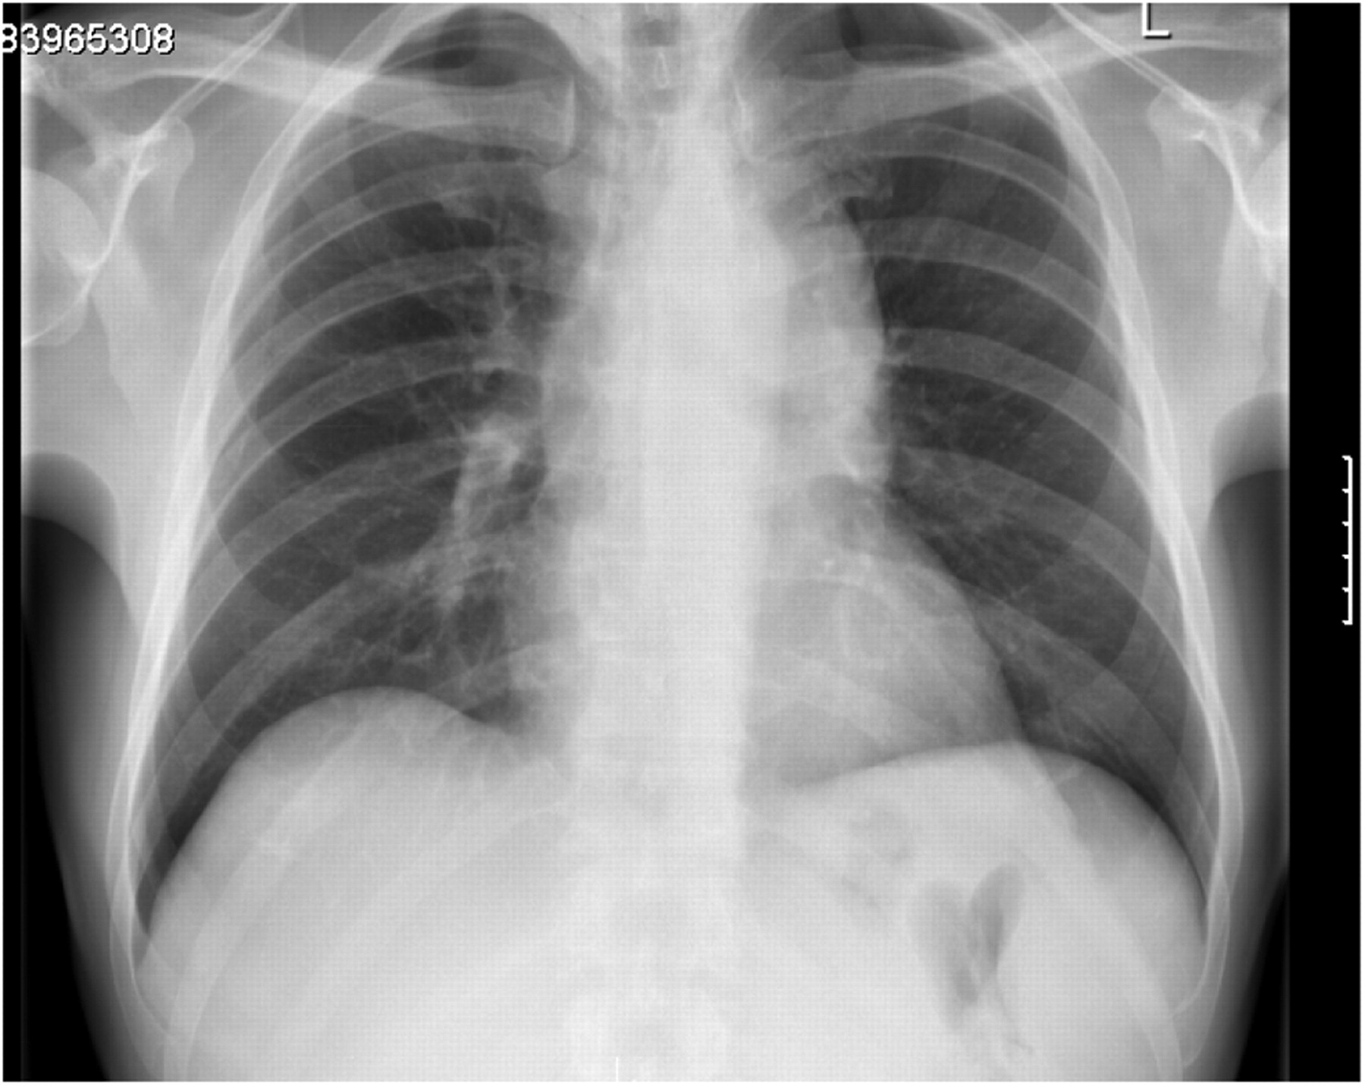
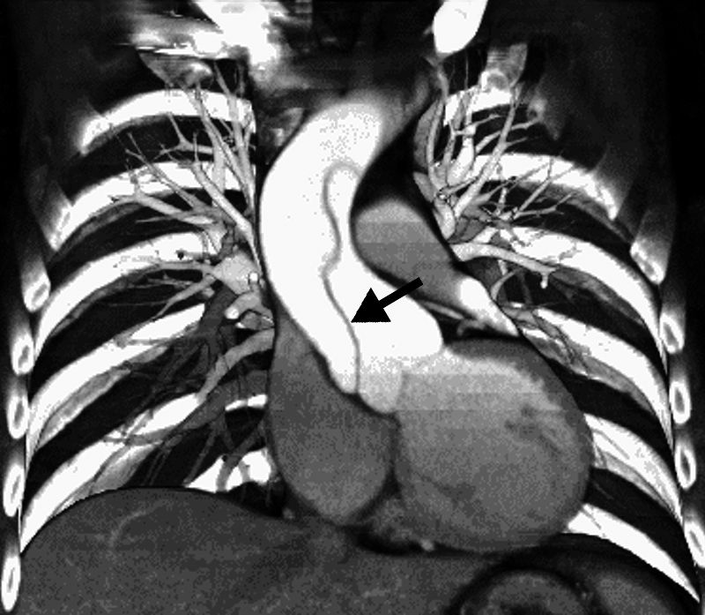
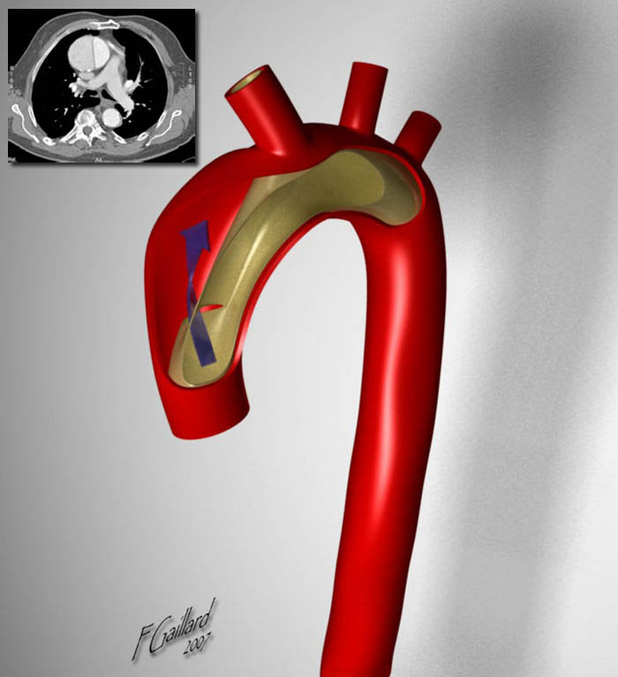
Aortic Dissection

Slide 10
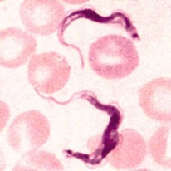
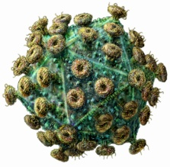
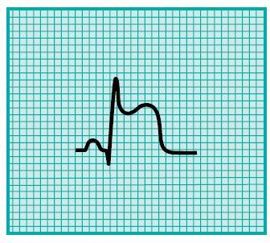
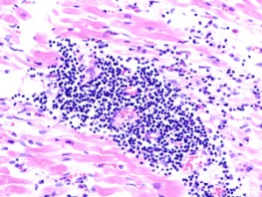
Myocardits and Pericarditis
Causes:
Investigations:
Signs and symptoms:
Management:
Idiopathic
Viral, bacterial, spirochaetes
Drugs: chemotherapy, phenytoin, penicillin
Chest pain, positional element
Preceeding flu-like symptoms
Palpitations
Saddle shaped ST segments on ECG
Troponin, Bloods for viral serology
Angiogram, myocardial biopsy, Echo, CMRI
Supportive
Non steroidal anti-inflammatories
Heart failure management

Slide 11
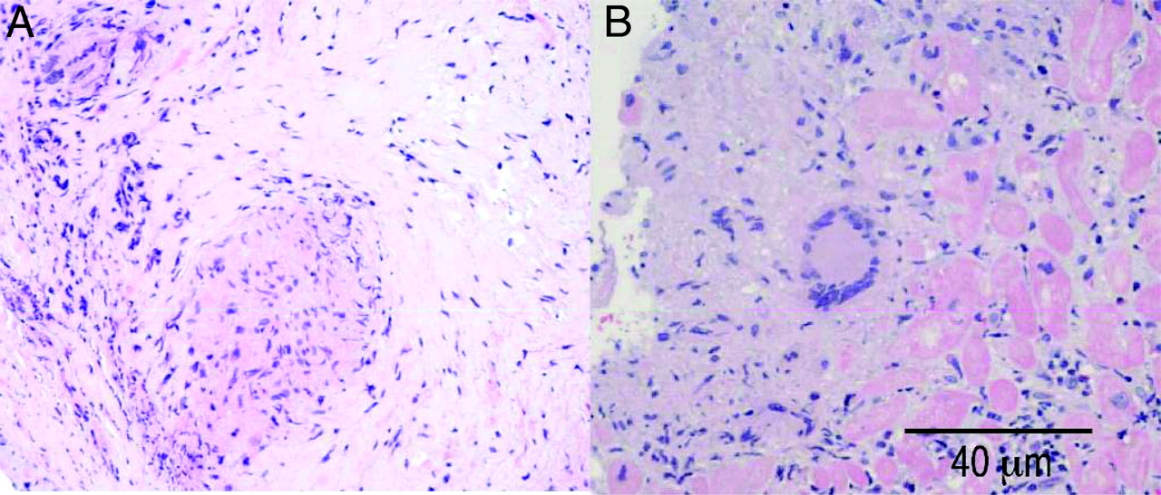
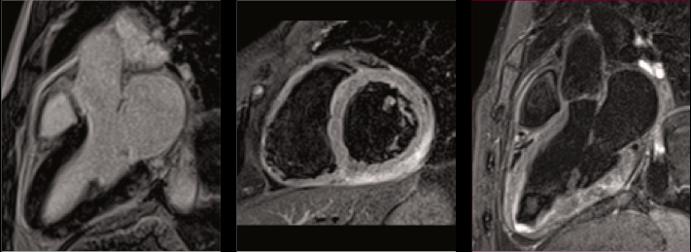
Myocardits and Pericarditis
Notes:
Representative histological findings in endomyocardial biopsy samples (hematoxylin-eosin, original magnification ×40). A, Granulomas and giant cells consistent with cardiac sarcoidosis. B, Multinucleated giant cells with fibrosis, inflammatory cells, and necrotic cardiomyocytes consistent with giant cell myocarditis.

Slide 12
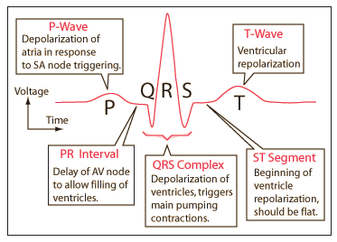
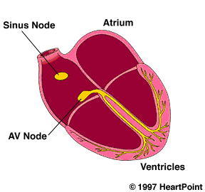
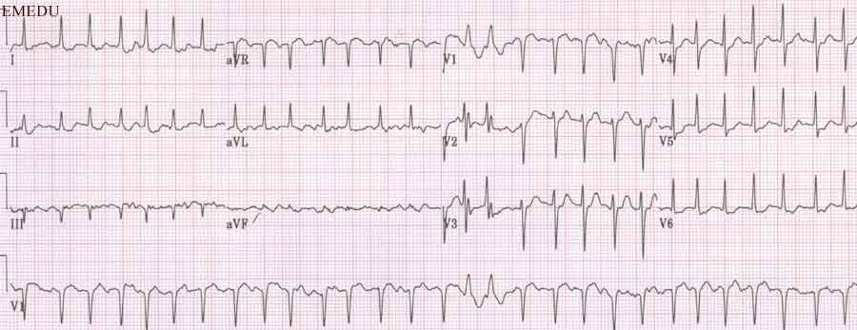
Atrial Fibrillation
Irregularly irregular rhythm
Absent p-waves

Slide 13
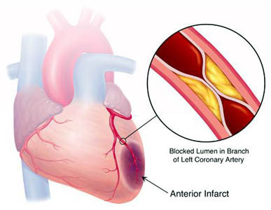
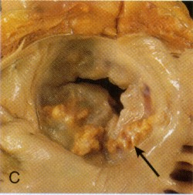
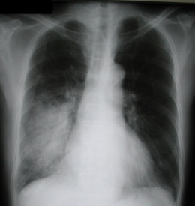
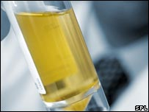
Atrial Fibrillation: Common Causes
Ischaemic heart disease
Electrolyte disturbance (K, Ca)
Alcohol
Hypertensive heart disease
Valvular heart disease
Endocrine: hyperthyroidism, hyperparathyroidism
Infection:
pneumonia
UTI
Caffeine
Notes:
The opportunity to stratify patients at risk of adverse remodelling and outcomes at a much earlier stage
Offer more extensive risk stratification
Detection of perfusion abnormalities may provide a basis to assess more novel forms of therapy, particularly based on regenerative strategies such as stem cell delivery

Slide 14
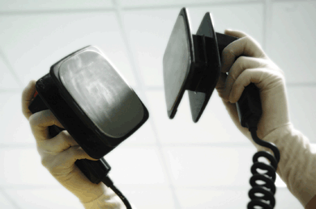
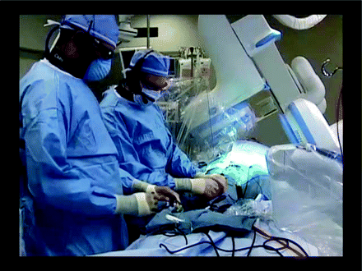
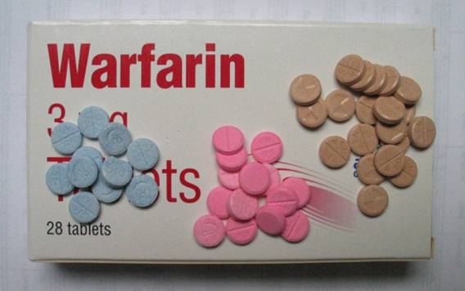
Atrial Fibrillation: Management
Baseline Investigations
Rhythm Control:
Rate control:
ANTICOAGULATION
IV / oral flecainde, amiodarone
DC cardioversion (may be TOE guided)
Beta-blockers
Digoxin
Bloods FBC, UEs, CRP, thyroid function
ECG: irregularly irregular, absent p-waves
Imaging: echo +/- (CT) angiogram
AF Ablation, PPM if sinus pauses > 2 secs
Amiodarone

Slide 15
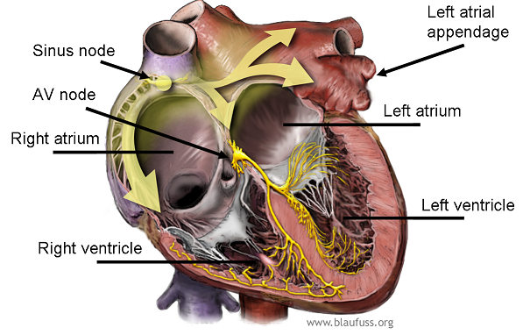
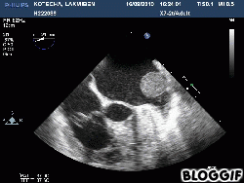
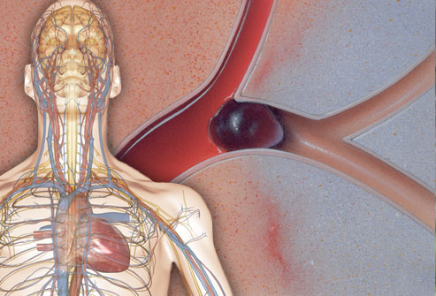
Atrial Fibrillation

Slide 16
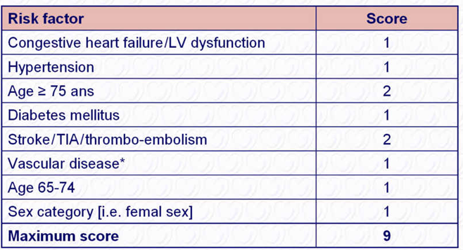
CHA₂DS₂-VASc Scoring System
*Prior myocardial infarction, peripheral artery disease, aortic plaque.
EHJ. 2010; (31), 2369-2429

Slide 17
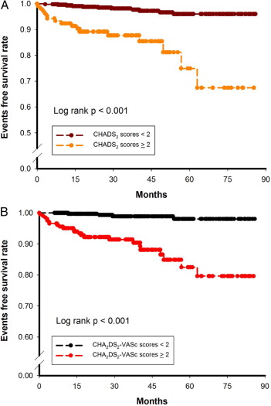
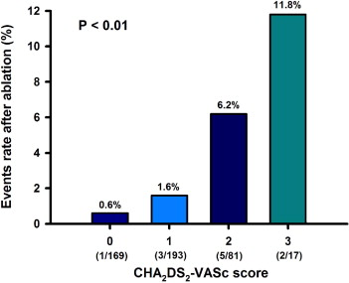
CHA₂DS₂-VASc and Outcomes
EHJ. 2010; (31), 2369-2429

Slide 18
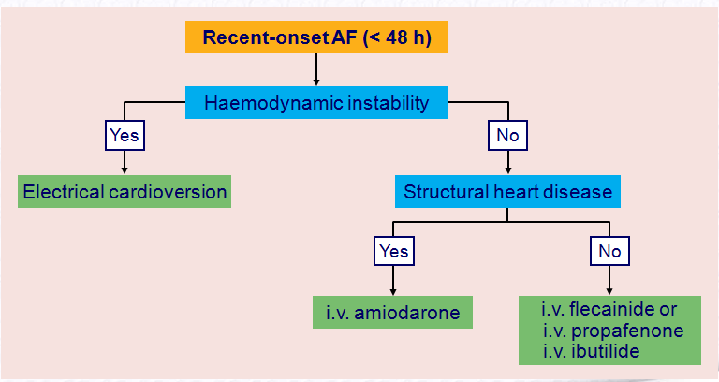
Recent Onset Atrial Fibrillation
EHJ. 2010; (31), 2369-2429

Slide 19
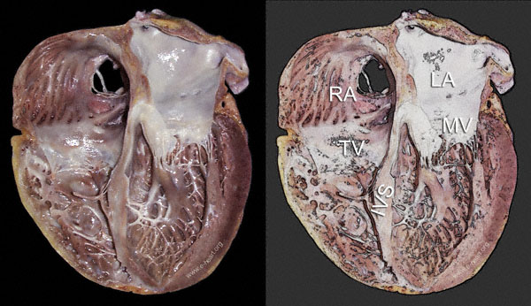
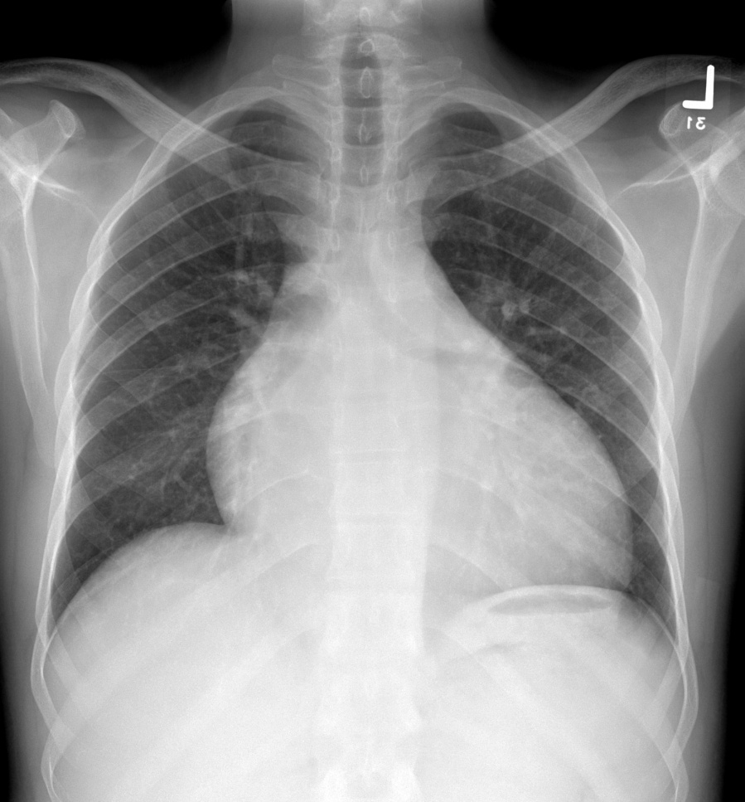
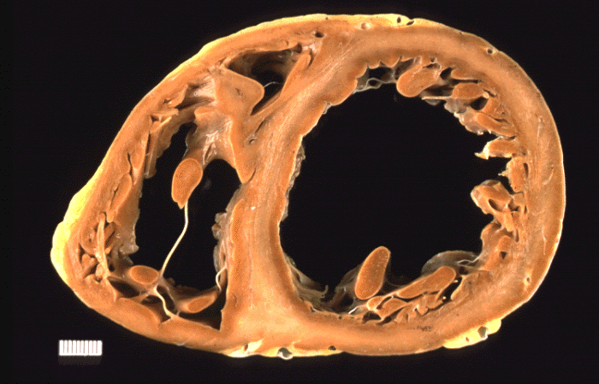
Non-Ischemic Dilated Cardiomyopathy

Slide 20
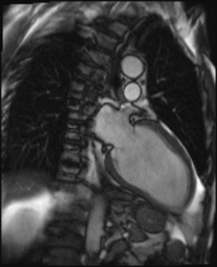
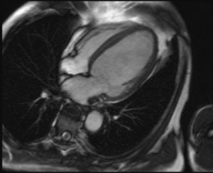
Dilated Cardiomyopathy

Slide 21
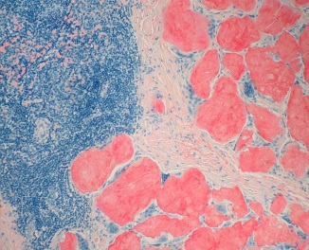
DCM: Causes
Genetic:
Secondary (2):
Acquired:
Inflammatory: sarcoidosis
Autoimmune: systemic lupus
Infection, myocarditis: EBV, Coxsackie, Parvo-, HIV
Stress induced cardiomyopathy (Takotsubo)
Peri- or post-partum cardiomyopathy
Endocrine: hypothyroidism
Nutritional: Beriberi
Drugs: cytotoxic, HIV, recreational: cocaine
Desmin
Lamin
Titin
Infiltrative: amyloidosis
Radiation

Slide 22
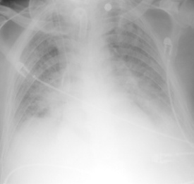
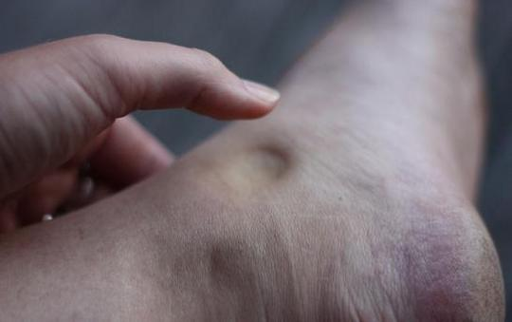
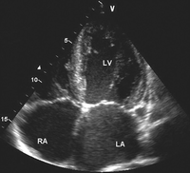
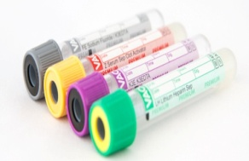
DCM: Management
Signs and Symptoms
Investigations
Investigations
Management:
Coronary angiogram
Echocardiography, Cardiovascular MRI
Breathlessness, chest pain, ankle swelling
Bi-basal crackles, raised JVP, pitting oedema
Fourth heart sound, gallop rhythm
Bloods: FBC, Urea, Electrolytes, iron, vit B, BNP
Viral screen, autoimmune screen
Endomyocardial biopsy
Drugs: ACE inhibitor, beta-blockers, spironlactone
Diuretics
Bi-ventricular pacemaker (CRT-P), heart transplant

Slide 23
Summary
Broad differential diagnosis for chest pain
History and examination
Recreational drug history
Baseline investigations
Management of: ACS, myocarditis
Atrial fibrillation:
causes, management
CHA₂DS₂VASc score and stroke prevention
Dilated cardiomyopathy: causes, management and investigations

Slide 24
Questions?
Aamir Ali
Email: a.ali@rbht.nhs.uk

