Slide 1
Laboratory diagnostic methods
A case study approach to the use of the labs:
chemical pathology, virology, bacteriology, cellular pathology and antibody detection
Professor Karim Meeran,
Dr Mark Atkins, Dr Hugo Donaldson,
Dr Keith Gould and Professor Robert Goldin

Slide 2
Laboratory Diagnostic Methods
Aim: To be able to understand the suitability and timely use of pathology tests in appropriate laboratories and realise the value of such tests to the patient

Slide 3
Case Study
Billy is 26 years old. He has not felt 100% since his holiday in Thailand 4 months ago and has vague aches and pains, loss of appetite, weight loss and has noticed that he has “glands” up in his neck.
On return from Thailand he had a fever, rash, small red patches, some were lumpy, this has subsided.
He also had diarrhoea.

Slide 4
What tests is the GP to do?
Likely causes of fever, rash lymphadenopathy?
Viral illness
e.g. Glandular fever
Diarrhoea
Virus, bacteria, parasites
Tests
FBC, ESR, CRP
LFTs
U&Es
Blood Glucose
Ix of viral illness
Stool culture - Bacteriology

Slide 5
Chemical Pathology Lab
Prof Karim Meeran

Slide 6
What tests is the GP to do?
Likely causes of fever, rash lymphadenopathy?
Viral illness
e.g.Glandular fever
Diarrhoea
Virus, bacteria, parasites
Tests
FBC, ESR, CRP
LFTs
U&Es
Blood Glucose
Ix of viral illness
Stool culture - Bacteriology

Slide 7
What tests is the GP to do?
Tests
LFTs: Liver function tests
U&Es: Urea and electrolytes
Blood Glucose

Slide 8
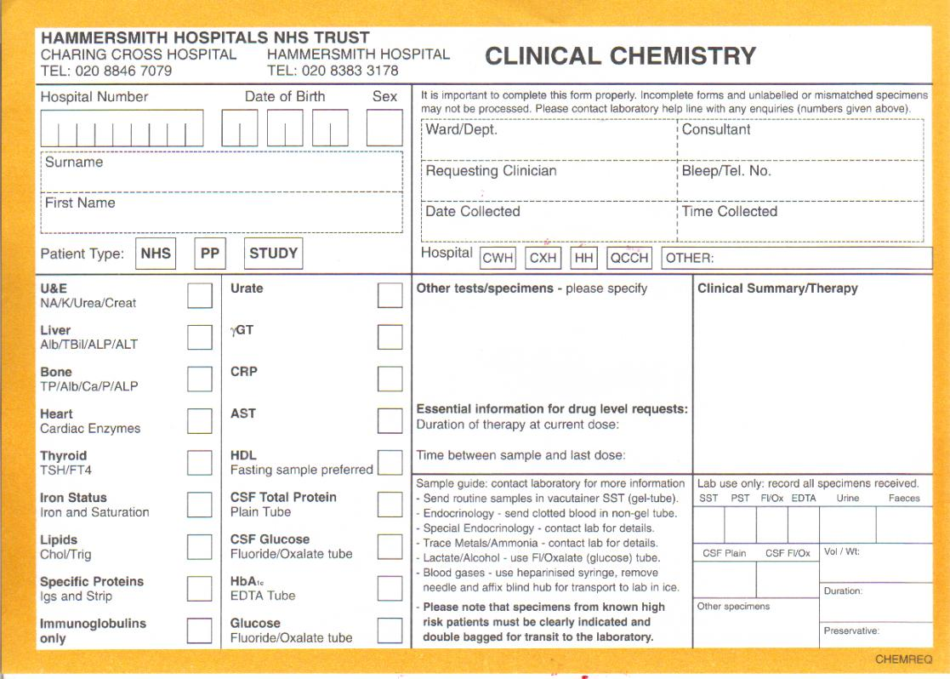

Slide 10
Why does the GP want to know these results?
Because he wants to make a diagnosis and, from the history and examination, thinks that these might either give him
a clue, or the diagnosis

Slide 11
Who will take the blood?
GP
Practice Nurse
Junior doctor
Medical student visiting the practice?

Slide 12
If you are collecting the blood
Which tube should you use?
If you get it wrong, the sample will have to be thrown away
Make SURE you get the correct patient

Slide 13
If you are collecting the blood
LABEL the tube with the patient’s details
If it is urgent, ensure the sample gets to the lab in time
Watch the Year 1 video on How to take blood: Mike Ferenczi (Vacutainer)

Slide 14
Different tubes
have different anticoagulants :
Red top - have none
Yellow top - have gel to speed up clot
Purple top - have potassium EDTA
Grey top - have fluoride oxalate
(poison)

Slide 15
Sample collection
U&E : serum in yellow/red top
Glucose: plasma in grey top
HBA1c: plasma in purple top
TFT: serum in yellow/red top
Liver function tests: in yellow/red top

Slide 16
Serum or plasma?
What is the difference?

Slide 17
No anticoagulant
U&E : serum in yellow/red top
Blood clots, using up all clotting factors
Clot can be removed, leaving serum

Slide 18
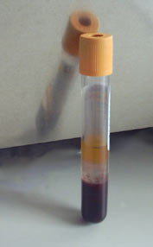

Slide 19
Any anticoagulant
EDTA or heparin
Clotting factors unused
Blood can be separated into red cells and plasma

Slide 20
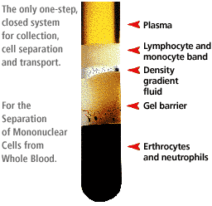

Slide 21
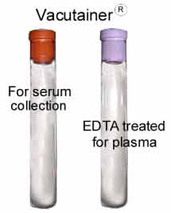

Slide 22
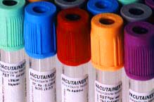

Slide 23
Measuring glucose*
Red cells consume glucose (anaerobic glycolysis), so the longer this is left out, the lower the glucose may read
Fluoride Oxalate (poison) prevents the red cells from using glucose
(write this down*)

Slide 24
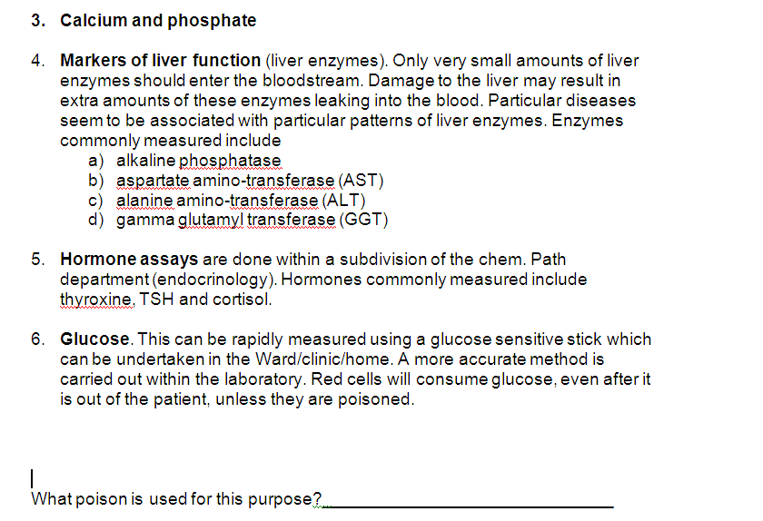
Fluoride oxalate poisons the red cells and so glucose levels stabilise: otherwise the red cells will consume the glucose

Slide 25
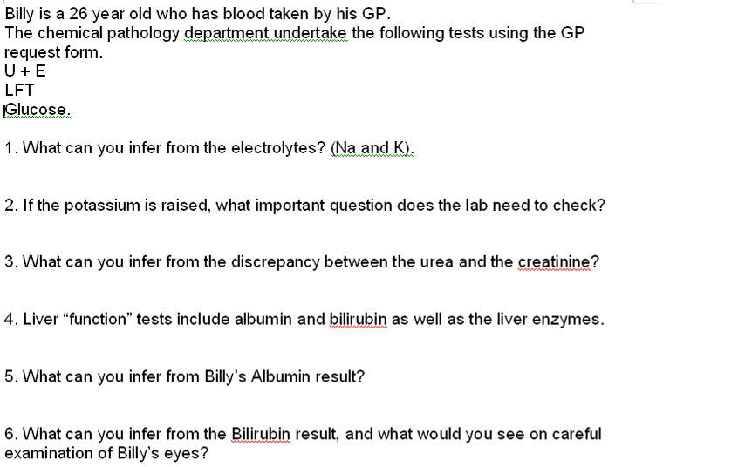

Slide 27
Chemical pathologists…
Are in charge of the Chem Path laboratories
Also do research into better methods of getting results
Also do metabolic medicine clinics
Do some tests…

Slide 28
What happens to the sample?
Chemistry is carried out on the serum or plasma
Thus, the red cells need to be separated off by centrifugation
Then, measure the concentration of…

Slide 29
When do you need to contact a chemical pathologist ?
When you want the sample to be rapidly centrifuged out of hours
When you want to measure labile hormones such as insulin
When you urgently need CSF glucose and protein to be measured

Slide 30
Results
Are available on computer
If urgent are phoned to the requesting clinician
How is the “reference range” determined?
Interpretation of the results…

Slide 31
Results
Electrolytes:
Na: 125 mM (NR 135 – 145)
K: 6.0 mM (NR 3.5 – 5.0)
U: 12.4 mM (NR 2.0 – 6.0)
Cr: 100 micromol/l (NR 70 – 120)

Slide 32
Results (Q1 and Q2)*
What about electrolytes:
Na: 125 mM (NR 135 – 145)
K: 6.0 (NR 3.5 – 5.0)
Adrenal failure* (Q1)
LOW
HIGH
Think of the endocrine causes…
(beware haemolysis*) (Q2)

Slide 33
Renal function
Na: sodium
K: potassium
Urea 12.4 (3.5 – 6)
Creatinine 100 (70 – 120)
In renal failure, the concentration of urea* and creatinine* rise

Slide 34
Renal function
RAISED
NORMAL
Urea 12.4 (3.5 – 6)
Creatinine 100 (70 – 120)
In renal failure, the concentration of urea* and creatinine* rise.
Discrepancy?

Slide 35
Renal function
Creatinine is a marker of glomerular filtration rate. If it is normal, then the GFR is normal. Very little is absorbed or secreted by the tubules.
Urea levels rise when a patient is dehydrated but GFR stays the same to the end.

Slide 36
Liver enzymes
Are present in the liver
A tiny amount normally leaks into the blood
In liver disease, more of these enzymes leak into the blood
With experience you can tell what liver disease a patient has from the pattern of the leak…

Slide 38
Liver function and enzymes
In addition to “Liver”, one would need to measure AST and GGT in a patient with jaundice
“Liver” includes
Albumin: synthesised in the liver
Bilirubin
Alkaline Phosphatase
ALT (alanine amino-transferase)

Slide 39
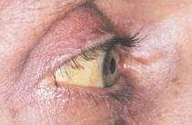
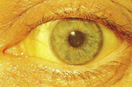
Billy’s results
Na (sodium) 125mmol/l (135 – 145)
K (potassium) 6.0 mmol/l (3.5 – 5.0) (not haemolysed)
Urea 12.4 mmol/l (2.0 – 6.0)
Cr (creatinine) 100 micromol/l (70 – 120)
Albumin 22 g/dl (35 – 50)*
Bilirubin 50 (0 – 17 micromol/l)*
Alkaline Phosphatase 170 IU/l (0-130)*
ALT (alanine amino-transferase) 250 (0-40)*
AST (aspartate amino-transferase) 250 (0-50)*
Glucose 4.5 mM (3.5 – 5.5)

Slide 40
Making a diagnosis
Ask the patient what is wrong
Take history: 26-year-old who has been to Thailand
Examine the patient
Do some tests…

Slide 41
Making a diagnosis
Once you have taken a history and examined the patient, you should have some idea of what is wrong with the patient: use the knowledge you have acquired during years 1 and 2 so far.

Slide 42
Making a diagnosis
When the consultant asks you the diagnosis, don’t pretend that no one has ever taught you about things you know…

Slide 43
Making a diagnosis
History
Examination
Make a plan:
the plan should include doing some investigations…

Slide 45
Cardiac enzymes
Are present in the heart muscle
During a heart attack, heart muscle is damaged
These enzymes leak into the blood in large amounts
Thus we can tell you if someone has really had a heart attack

Slide 46
Cardiac enzymes
Troponins
Creatine kinase (CK)
Aspartate amino transferase (AST)
Lactate Dehydrogenase (LDH)

Slide 48
During your year 3 firms…
You need to see patients at whatever site you are on
EVERY DAY
Take a history
You will be taught this during your
first firm

Slide 49
When in casualty
You need to try and get involved with the management of patients
Helping the house officers and SHOs fill out blood request forms
Take blood (Vacutainer?)
Understand which tests are required

Slide 50
Interpretation of Billy’s results
Low Na and high K
High urea with normal creatinine
Low albumin
Raised Bilirubin
Raised liver enzymes

Slide 51
Diagnostic Virology
Dr Mark Atkins

Slide 52
Diagnostic Virology Tools
History
Physical examination
Laboratory tests
Make a list of possible causes
Determine which tests to request
“non-specific”
Virological

Slide 53
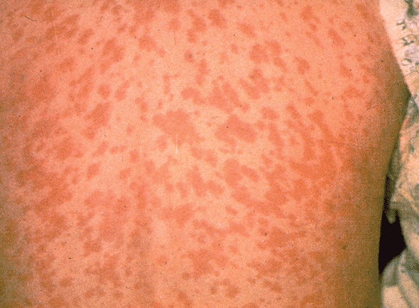

Slide 54
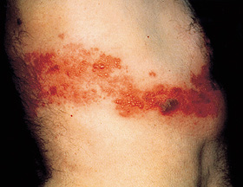

Slide 55
Diagnostic methods
Cell culture
Electron microscopy
Antibody detection
Antigen detection
Genome detection
Antigen sub-typing
Genome typing
Quantification of antigens and genomes (now essential for diagnosis and monitoring of HIV, HBV and HCV)

Slide 56
Typical samples used
Throat swab - for PCR
Stools - for EM, rotavirus EIA & norovirus PCR
CSF - PCR for herpes and enteroviruses
Nasopharyngeal aspirate (NPA) - for respiratory viruses using IF or PCR
Urine - for PCR
Blood (clotted) - for antibody detection
Blood (EDTA) - for PCR

Slide 57
What can we measure?
Detect the infectious virus
(virus isolation)
Detect protein components of the virus
(p24 antigen in HIV, surface antigen in HBV, etc)
Detect genetic components of the virus
(cDNA or RNA) - quantitative or qualitative tests are available
Detect the host response
(e.g. antibody or cell responses)

Slide 58
Serology
HIV antibody
HCV antibody
HBV sAg, eAg e-antibody
Herpes antibodies
(HSV, EBV, CMV, VZV etc)
Hepatitis a IgG and IgM
Rubella, parvovirus B19 (erythrovirus)
Measles, mumps serology

Slide 59
Respiratory infection
Nasopharyngeal aspirate (NPA)
Throat swab
Broncheo-alveolar lavage (BAL)
Blood for PCR if disseminated infection suspected
e.g. adenovirus in immunocompromised patient
Acute and convalescent serology

Slide 60
CNS disease- meningitis/encephalitis
CSF for PCR
Stools and throat swab for enterovirus detection
Serology for West Nile virus infection and other arboviruses.
This is why a travel history is so important

Slide 61
Diarrhoea and vomiting
Stool
Vomit - can be used to detect viruses by electron microscopy, but …
PCR or antigen detection assays for noroviruses best used for stool samples

Slide 62
Cell culture
Still a gold standard
Relatively slow but still useful as a
non-specific method
Main method of herpes simplex and respiratory virus detection
Isolates useful for sensitivity testing
Needed in “forensic” cases
Expensive

Slide 63
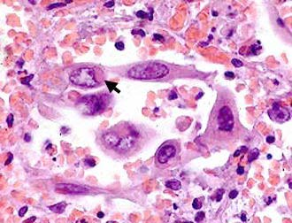
Respiratory Syncytial Virus

Slide 64
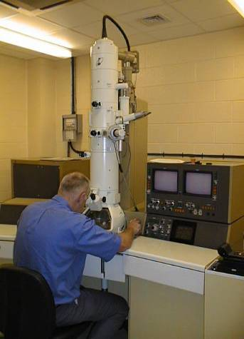
Electron microscopy
Viruses are too small to be seen by light microscopy
They can be visualised using an electron microscope
Useful for identifying structures
Used for stool samples and vesicle fluids

Slide 65
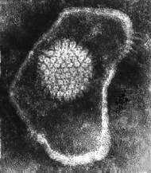

Slide 66
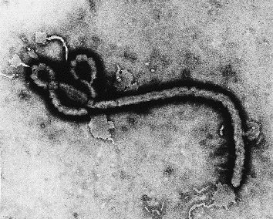
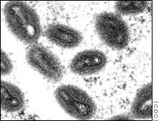

Slide 67
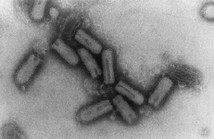

Slide 68
Immunofluorescence
Useful for the direct detection of viral antigens in clinical samples
(e.g. respiratory viruses)
Can be used for typing and culture confirmation
Relatively quick and inexpensive but subjective and very dependent on the skill of the technician and the quality of the sample

Slide 69
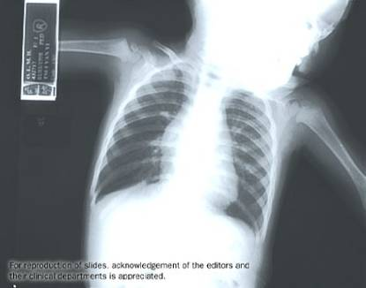
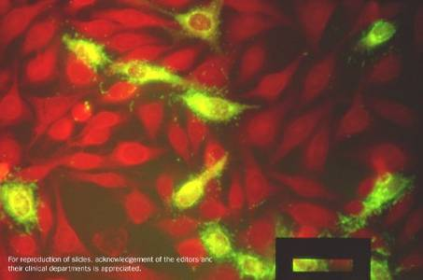
Immunofluorescence

Slide 70
EIA’s for HIV antibody detection
Detection of specific antibody is an indirect method of detecting infection
Non-specific reactions can be a problem
Important to use multiple formats (generally use 3 different assays)
Interpretation of results must take the clinical circumstances into account

Slide 71
HIV antibody tests
In UK we use 3 tests
3 formats
Different manufacturers (different antigens)
Test from clot and separated serum
Ask for repeat tests from all new positives

Slide 72
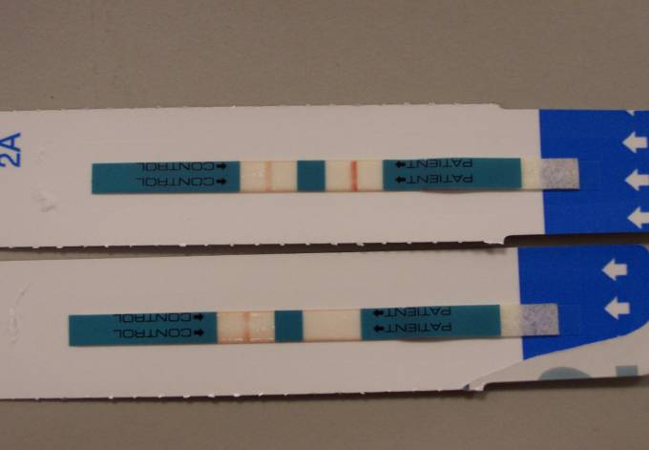
Point-of-care testing for HIV

Slide 73
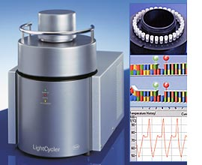
“Real Time” PCR

Slide 74
What tests would you like to do in this case?
Billy is 26 years old. He has not felt 100% since his holiday in Thailand 4 months ago and has vague aches and pains, loss of appetite, weight loss and has noticed that he has “glands” up in his neck.
On return from Thailand he had a fever, rash, small red patches, some were lumpy, this has subsided.
He also had diarrhoea
Low Na and high K
High urea with normal creatinine
Low albumin
Raised Bilirubin
Raised liver enzymes

Slide 75
What tests would you like to do?
EBV serology and monospot

Slide 76
What tests would you like to do?
EBV serology and monospot
CMV serology

Slide 77
What tests would you like to do?
EBV serology and monospot
CMV serology
Toxoplasma serology

Slide 78
What tests would you like to do?
EBV serology and monospot
CMV serology
Toxoplasma serology
HIV tests
Viral hepatitis tests, HAV IgM, HBV, HCV and HEV
Syphilis test

Slide 79
Results
HIV-1 antibody positive
CMV IgG positive, IgM negative
Syphilis EIA negative (IgG)
HBsAg negative
Anti-HCV positive
EBV IgG positive, IgM negative

Slide 80
Bacteriology Lab
Dr Hugo Donaldson

Slide 81
Case Study
Billy is 26 years old. He has not felt 100% since his holiday in Thailand 4 months ago and has vague aches and pains, loss of appetite, weight loss and has noticed that he has “glands” up in his neck.
On return from Thailand he had a fever, rash, small red patches, some were lumpy, this has subsided.
He also had diarrhoea

Slide 82
Microbiological possibilities?
Infectious Diarrhoea
Endocarditis (SBE)
Syphilis
Toxoplasma
Tuberculosis
Brucellosis
Melliodosis

Slide 83
Common Diagnostic Techniques
Culture i) Sterile sites (blood/CSF) ii) Non sterile sites
Serology
Molecular Techniques

Slide 84
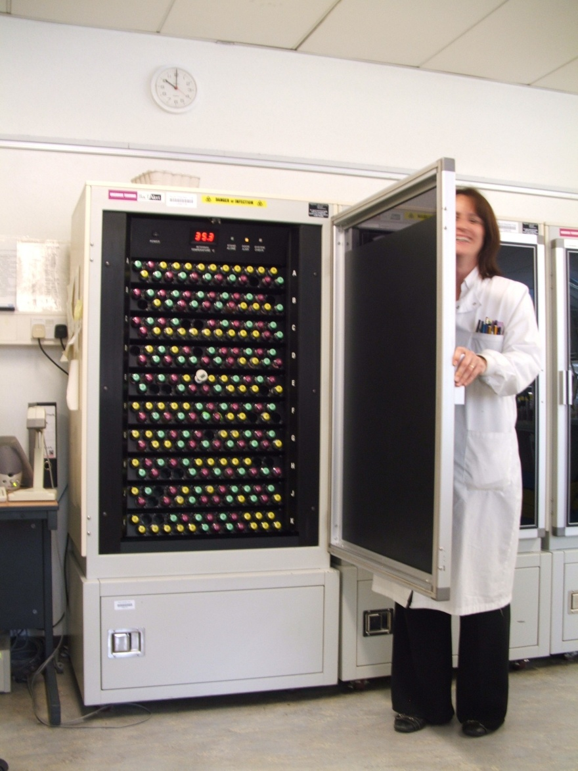
Blood Cultures

Slide 85
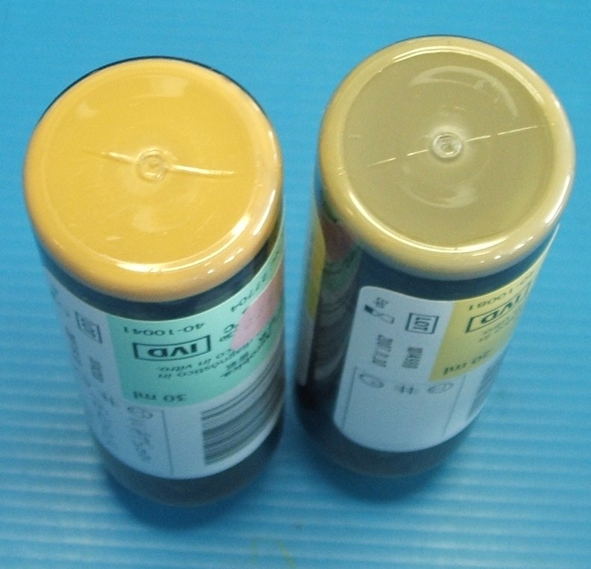
Positive Blood Cultures

Slide 86
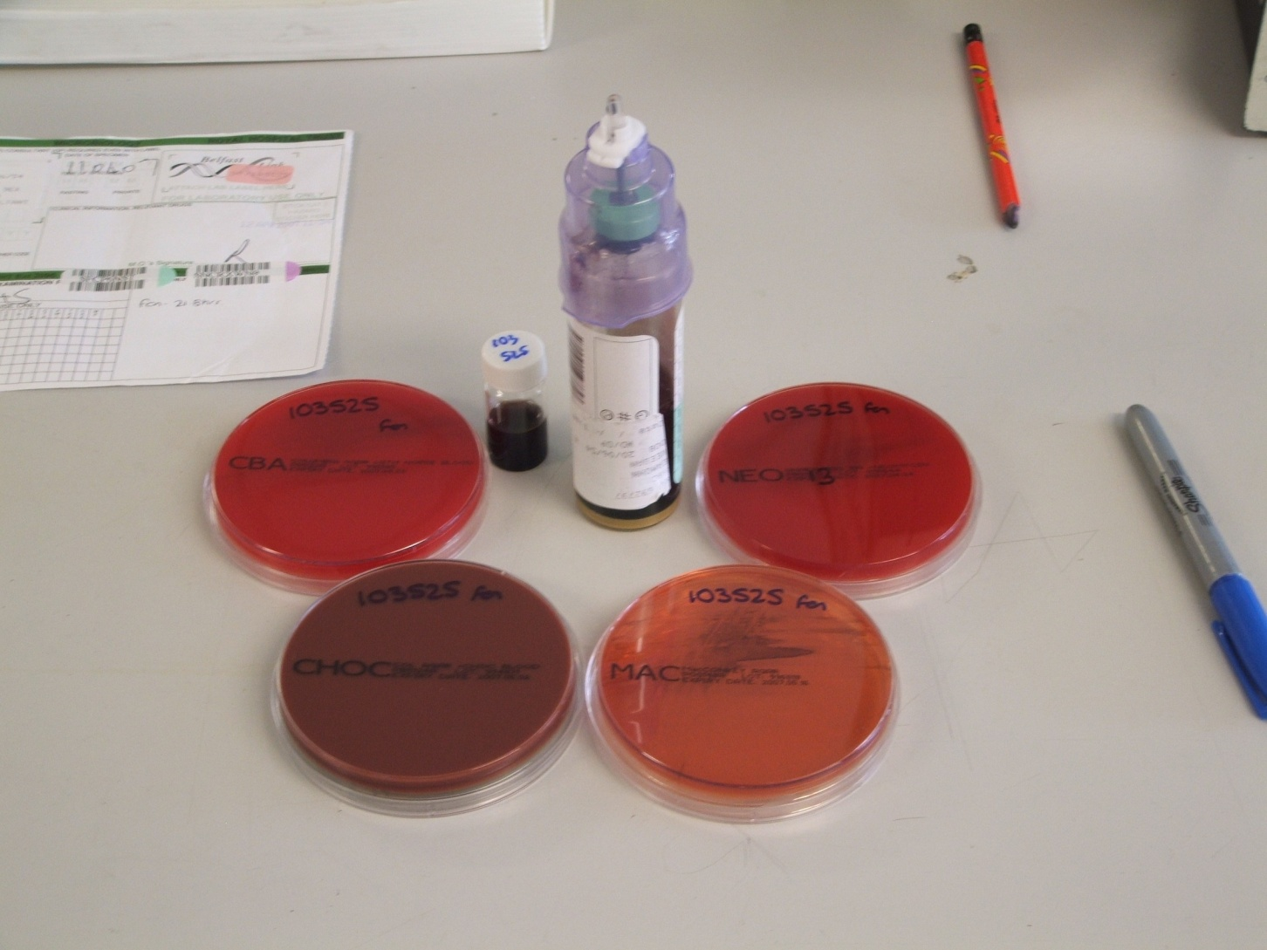
Positive Blood Cultures

Slide 87
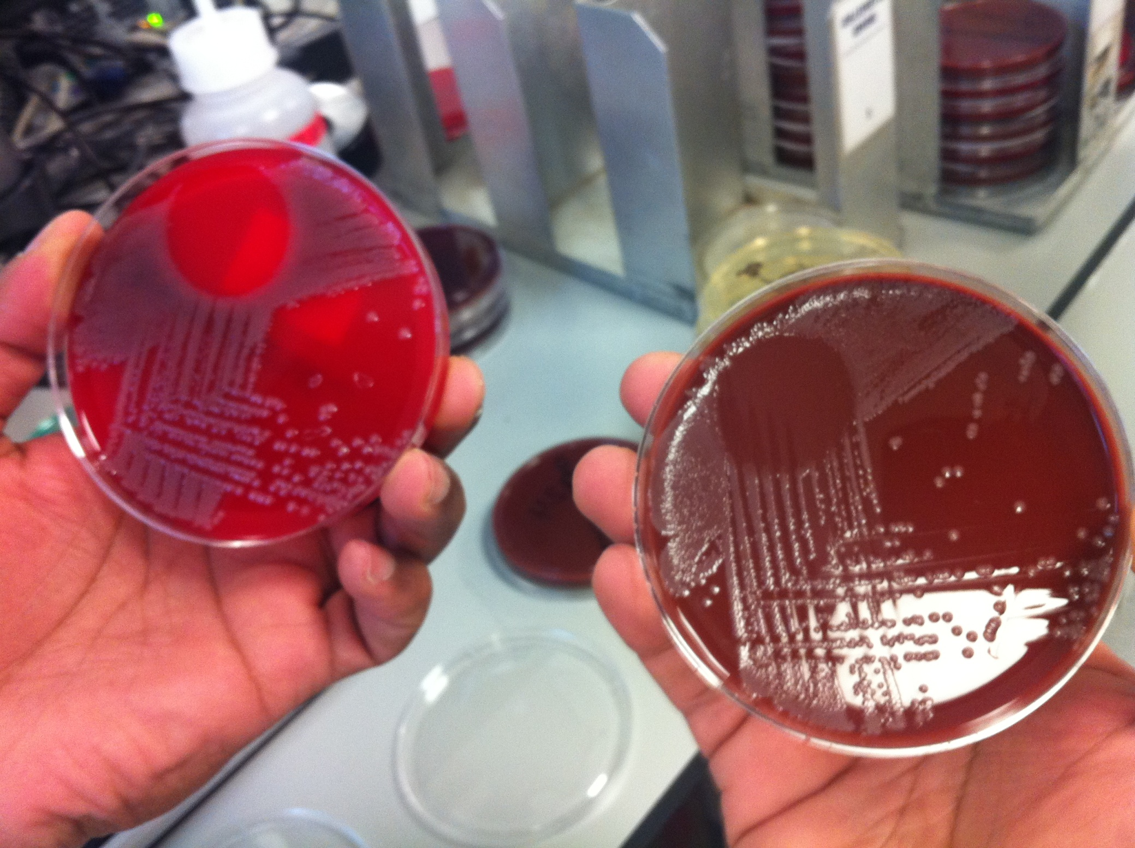

Slide 88
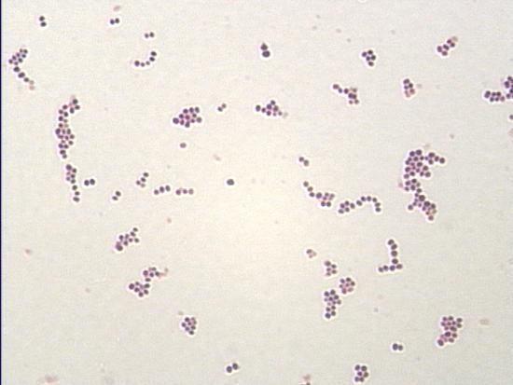
Gram Positive Cocci in clumps

Slide 89
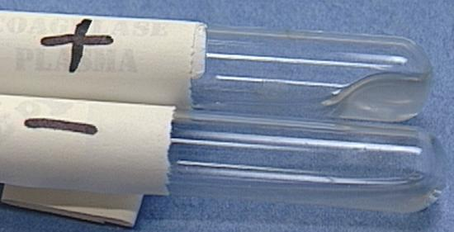
Staphylococci coagulase test

Slide 90
Staphylococci
Staphylococcus aureus (including Methicillin Resistant Staphylococcus aureus, MRSA)
Severe infections eg: skin/soft tissue, endocarditis, osteomyelitis
Coagulase Negative Staphylococci
Skin commensals of low pathogenic potential. Can infect prosthetic material causing line, pacemaker infections and endocarditis

Slide 91
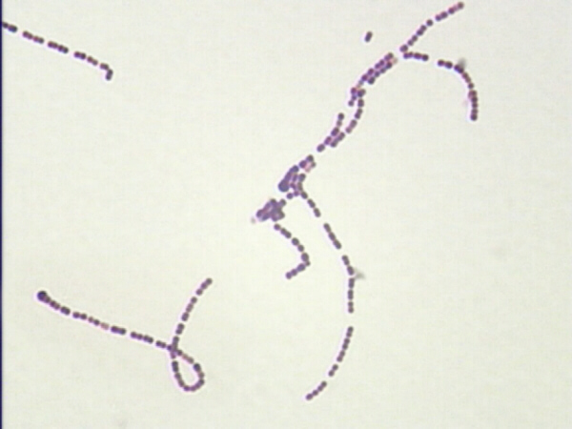
Gram Positive Cocci in chains

Slide 92
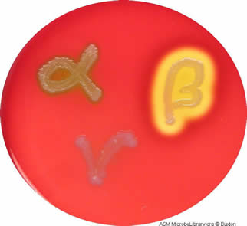
Haemolytic Streptococci

Slide 93
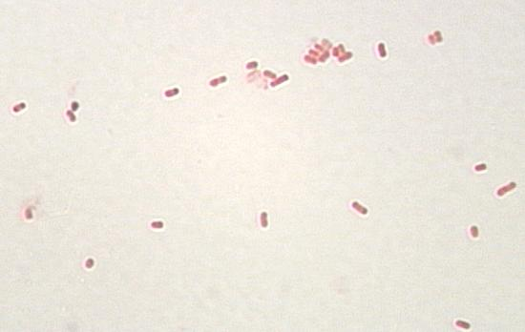
Gram negative Bacilli

Slide 94

Skin is not a sterile site
Rosebury estimates that 50
million individual bacteria
live on the average square
centimeter (5x10⁷/cm²) of
human skin
[5x10⁷/cm² x 20,000 cm²/
person = 10¹¹ bacteria]
He describes the skin surface
of our bodies as akin to a
"teeming population of people
going Christmas shopping."

Slide 95
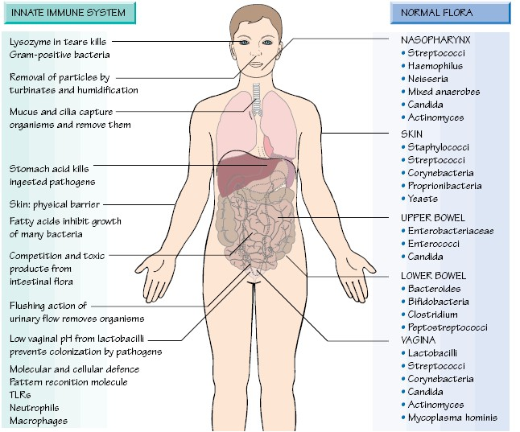

Slide 96
Diarrhoea
Bacteria:
Salmonella (inc S. typhi ), Shigella, Campylobacter,
E coli O157, C difficile, Cholera
Parasites:
Amoeba, Giardia, Cryptosporidium
Viruses

Slide 97
Stool sample - investigations available
Bacteria
Culture on agar plates.
Only Salmonella, Shigella and Campylobacter
looked for routinely.
Different pathogens have different culture
requirements.
Clostridium difficile – toxin detection or PCR for
toxin gene
Parasites
Concentration, special stains

Slide 98
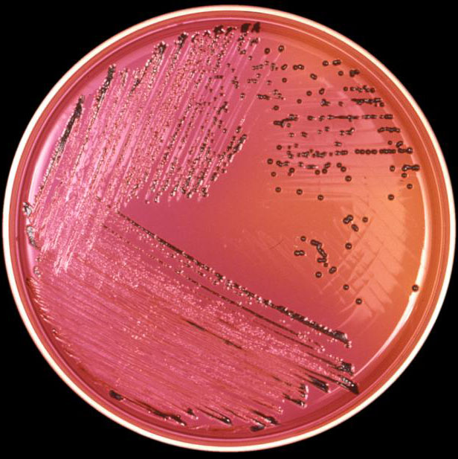
Salmonella on XLD agar

Slide 99
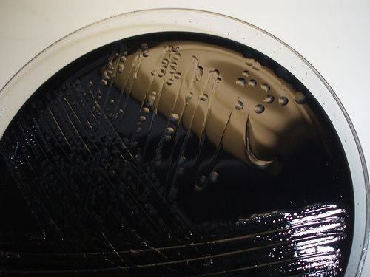
Campylobacter
48 hours

Slide 100
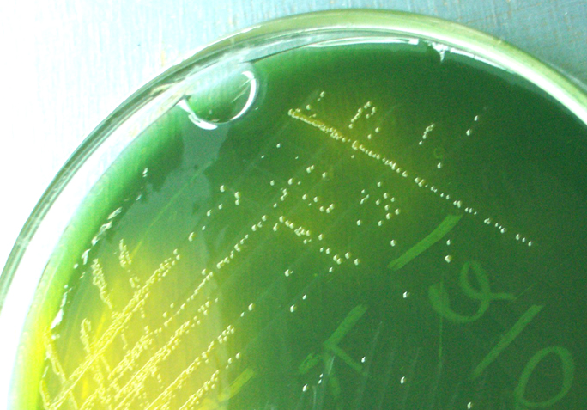
Vibrio cholerae on TCBS agar

Slide 101
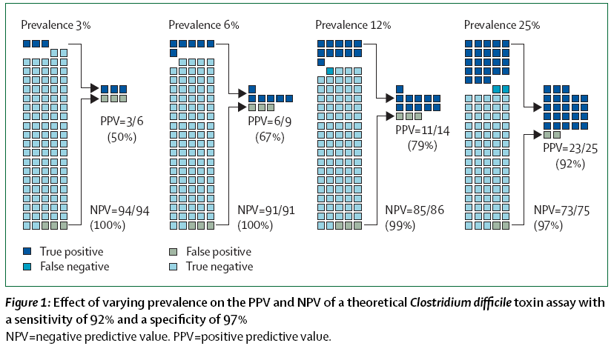
Tim Planche et al. Diagnosis of Clostridium difficile infection by toxin detection kits: a systematic review
Lancet Infect Dis 2008; 8: 777–84

Slide 102
Billy’s diarrhoea
Infectious diarrhoea does not usually persist
for 4 months
Don’t usually get systemic disease (but can
with typhoid, amoebic abscess)
Intestinal helminths don’t cause significant
diarrhoea (but could cause rashes, fever,
eosinophilia)

Slide 103
Other microbiological possibilities
 | Rash | Lymph nodes | Fever | Weight loss | Diarrhoea
SBE | ✓ | ✗ | ✓ | +/- | ✗ | blood culture
Syphilis | ✓ | ✓ | ✓ | ✗ | ✗ | Serum for antibodies
Toxoplasma | ✓ | ✓ | ✓ | ✗ | ✗ | Serum for antibodies
Tuberculosis | ✗ | ✗ | ✓ | ✓ | ✗ | Interferon-γ
Brucellosis | (+/-) | ✓ | ✓ | ✗ | ✗ | Serum for antibodies, blood culture

Slide 104
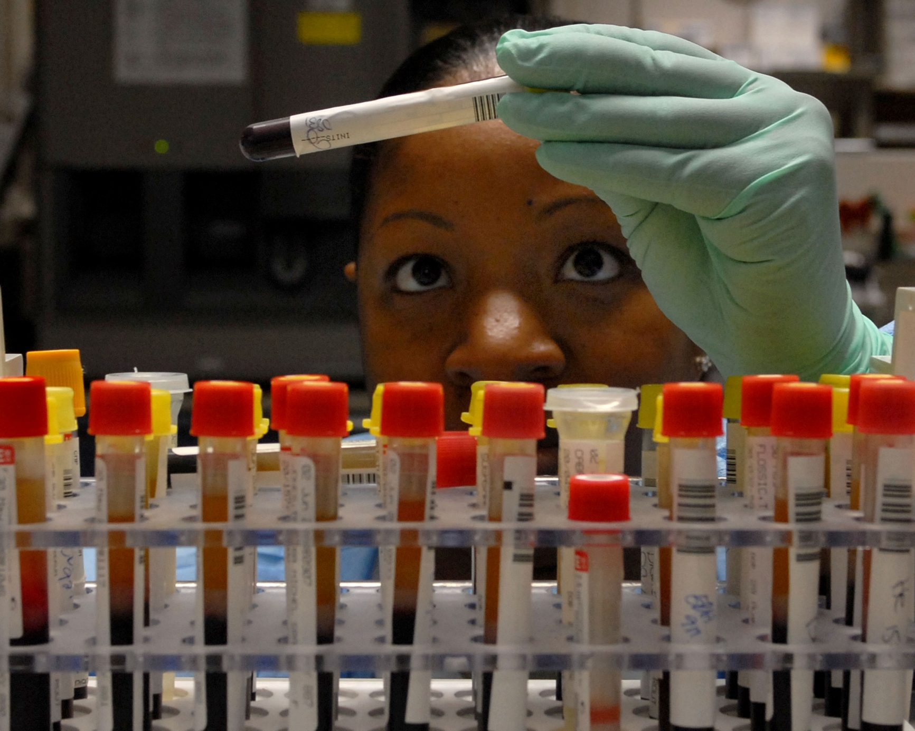

Slide 105
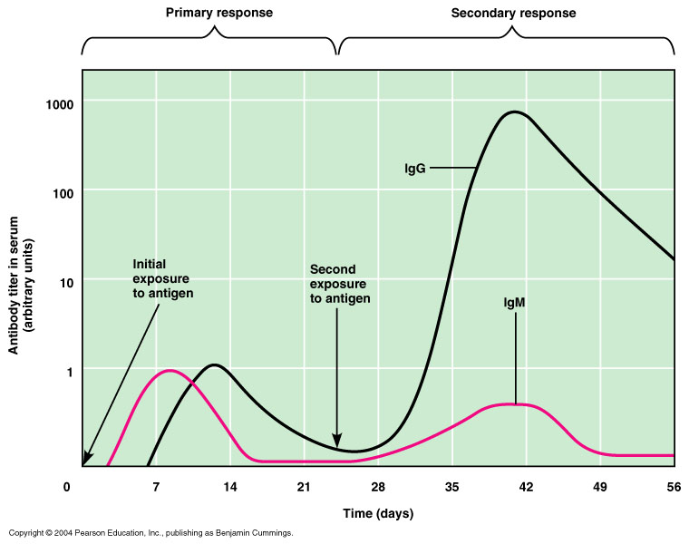
Seroconversion

Slide 106
The New ß-Lactamases. George A. Jacoby, M.D., and Luisa Silvia Munoz-Price, M.D. N Engl J Med 2005;352:380-91.

Slide 107
Billy, microbiologically
………..not an obvious answer
Always include clinical information including travel history on requests.
Contact Infectious Diseases or Microbiology early if you require advice.
Try and send samples for culture prior to starting antibiotics if possible.

Slide 108
Back to Billy
Billy returns to his GP
Results are ^{–ve} for glandular fever
Stool has grown….
He now has some red patches on his lower leg, still has lymphadenopathy and lost more weight…
What tests now?
GP does skin punch biopsy

Slide 109
Histopathology and Cytopathology
Prof Robert Goldin
Diagnosis
Monitor disease and treatment
Margins – staging of cancer

Slide 110
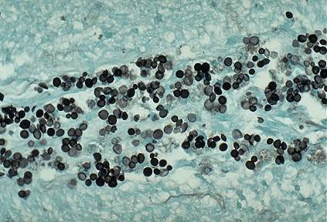
How are sections obtained?
Identify specimen with unique number
Cut up to cassettes
Process to paraffin wax - dehydrate
Cut thin section – rehydrate – stain (H&E)
Stains – Gram, ZN, Silver, Mucin, Immunoperoxidase

Slide 111
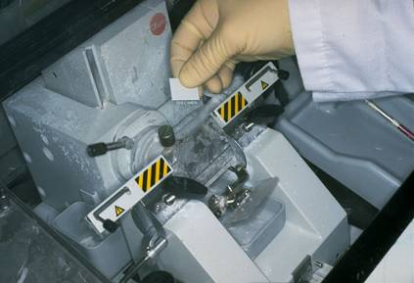
Histopathology - Surgical and Autopsy Pathology
Frozen sections
What is it?
  Parathyroid
  tumour
Is it all out?
  margins
Spread?
  Lymph nodes

Slide 112
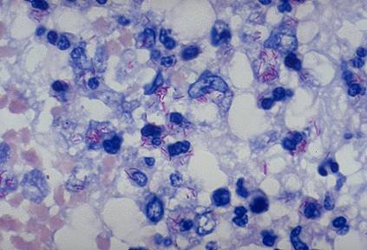
Cytopathology
Diagnosis of lung tumours – non-invasive
Cytopathology can also aid diagnosis in any endoscopy when brushings of the tumour can be taken
Cervical and breast screening
Fluids (urine, ascites contain cells)

Slide 113
How long does a histopathology result take to reach the clinician?
“fix” in formalin, process, sections cut and stained and the histopathologist must write the report
For large specimens - 2-3 days.
Small biopsies can be processed in a day and if a rapid diagnosis is required then rapid processing takes 4-5 hours
Frozen section - An answer can be given by phone within 20 minutes

Slide 114
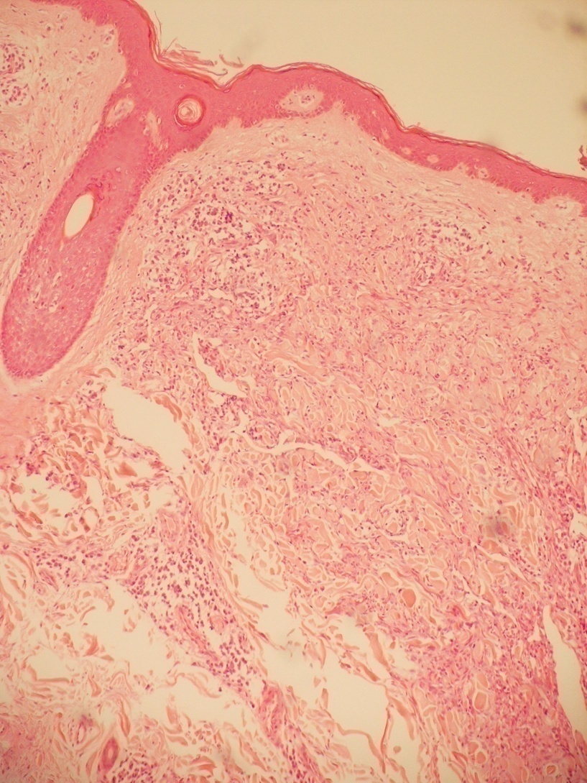
Cellular Pathology Lab
Billy’s skin biopsy shows an HIV AIDS defining disease – Kaposi’s sarcoma

Slide 115
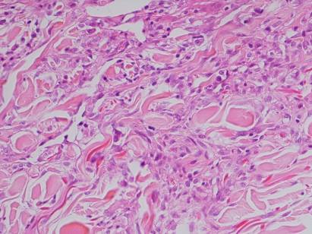
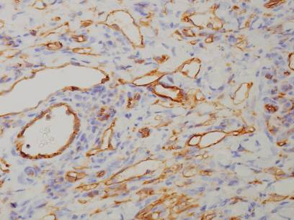
Kaposi's sarcoma
Immunocytochemistry CD31 to show vascular tumour infiltrating collagen bundles

Slide 116
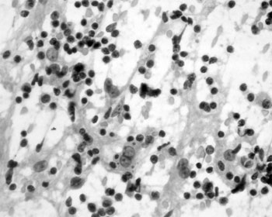
Cellular Pathology Lab
FNA
A fine needle aspiration biopsy of one of the enlarged nodes revealed a mixed cell population
Reactive lymphadenopathy

Slide 117
Billy’s biopsy
Confirms he has HIV / AIDS as KS
Now needs:
Viral load, from Virology
CD4 count, from Haematology
Referral to HIV docs and put on antiretroviral RX
But ….. These do not agree with him and he has to stop
Can we monitor of HIV progression with immunology tests? What about antibodies?

Slide 118
Antibodies as Diagnostic Tools
Dr Keith Gould
Department of Immunology
St Mary’s Campus

Slide 119
Learning objectives:
Explain how antibodies can be generated (experimentally or commercially) for diagnostic purposes
Understand the therapeutic and diagnostics use of manufactured antibodies
Give examples of types of substance that are typically identified diagnostically by means of antibodies
Explain the basic principles of detection methods
Describe the advantages in different situations of the types of detection system: for example, enzyme-linked antibodies, radioactively labelled antibodies, fluorescently-labeled antibodies
Understand how antibodies may be used in clinical practice

Slide 120
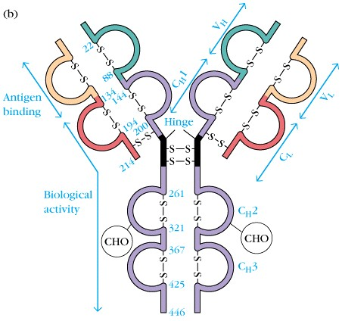
Y

Slide 121
Y
Y
REPORTER
REPORTERS
Enzymes: e.g. peroxidase, alkaline phosphatase
Fluorescent probes: dyes, beads of different sizes
Radioisotopes
Magnetic beads

Slide 122
Antibodies in Diagnostics
The unique specificity of antibodies for their target antigens is the basis of many diagnostic tests
Antibodies can be raised against almost any antigen
  Including immunoglobulins from other species
  =anti-antibodies

Slide 123
Indirect labeling using an anti-antibody
Y
Y

Slide 124
Antibodies
Produced by the patient
  in autoimmune disease
  for defence against infection
    and in Billy’s case, used to diagnose his infection
Manufactured antibodies
  antisera from immunised animals
  monoclonal antibodies
  “genetically engineered” antibodies

Slide 125
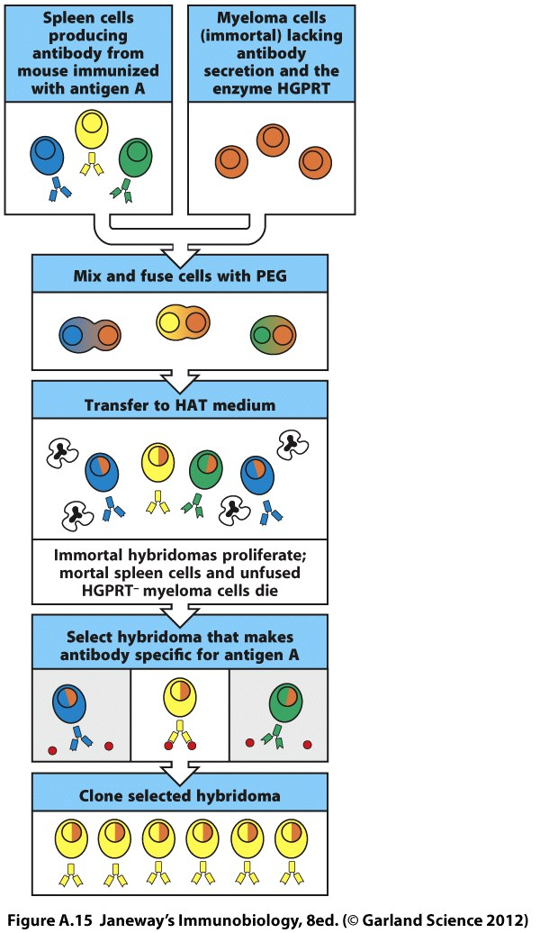
generating
monoclonal
antibodies

Slide 126
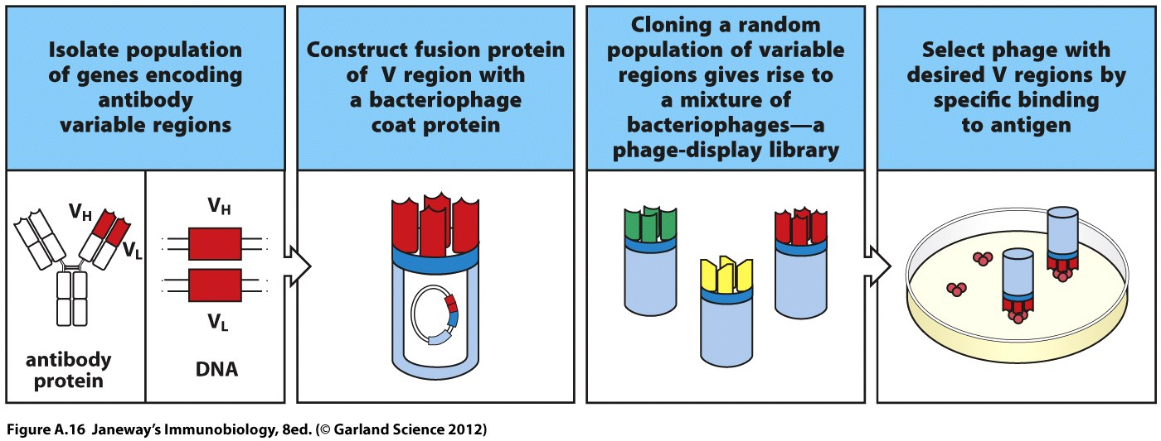
Production of antibodies using
recombinant DNA technology

Slide 127
Uses of Manufactured Antibodies
Therapeutic
Prophylactic protection against microbial infection
Anti-cancer therapy
Removal of T-cells from bone marrow grafts
Block cytokine activity

Slide 128
Therapeutic monoclonal antibodies - nomenclature
Suffix “-omab” mouse monoclonal
  e.g. Muronomab, anti-CD3, transplant immunosuppression (approved 1986)
Suffix “-imab” chimeric or partly humanised
  e.g. Infliximab (Remicade) anti-TNFα, Rituximab anti-CD20
Suffix “-umab” human
  e.g. Palivizumab, anti-RSV (Synagis)

Slide 129
Uses of Manufactured Antibodies
Therapeutic
Prophylactic protection against microbial infection
Anti-cancer therapy
Removal of T-cells from bone marrow grafts
Block cytokine activity
Diagnostic
Tissue typing
Blood group serology
Immunoassays
  hormones
  antibodies
  antigens
Immunodiagnosis
  Infectious diseases
  Autoimmunity
  Allergy
  Malignancy

Slide 130
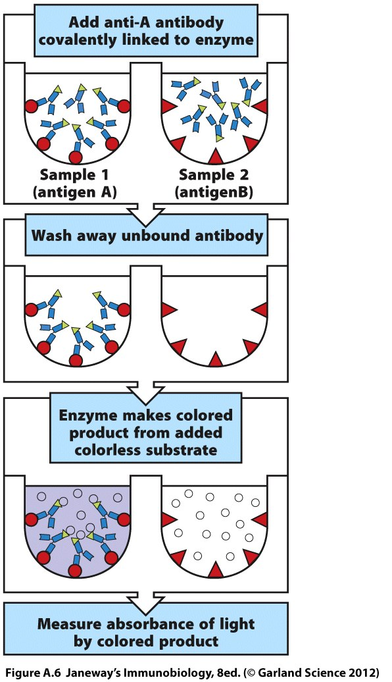
ELISA
Enzyme
Linked
ImmunoSorbent
Assay

Slide 131
Billy
Diagnosis
HIV antibody test
  Serum antibodies against HIV
Role of Immunology Lab ?

Slide 132
Billy
Signs & Symptoms
Vague aches and pains
Loss of appetite
Weight loss
“Glands” up in his neck
Fever, rash, small red patches, some lumpy
Immunological Concerns
Immune complexes
Effect of poor nutrition on bone marrow cells
Immune activation
Acute phase, activation, immune complexes

Slide 133
Billy
Signs and symptoms – Immunological concerns
Immune complexes
  Inflammation
  Serum sickness
  Immune complex glomerulonephritis
  Immune complex deposition at other sites
    Skin
    Joints
    Lungs

Slide 134
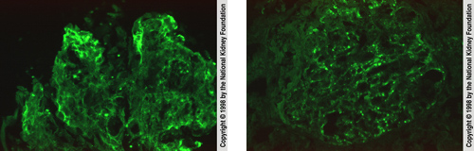
Immune complex glomerulonephritis
IgG immune complexes
Complement C3

Slide 135
Immune Complexes
large
1
2
3
4
5
Immune
Complexes
Glomerular capillary lumen
small
Platelet
thrombus
adherence
Vasoactive
mediators
Endothelial cells
Basement membrane
Epithelial cells
Urinary Space
Separation of
Endo cells
Attachment
Platelet
aggregation
Inflammatory
cell
damage
Pass thro

Slide 136
Immunological concerns Immunodeficiency
Serum Immunoglobulin levels
IgG, IgM, IgA and IgG1, IgG2, IgG3, IgG4
(Serum electrophoresis / ELISA / Nephelometry)
Specific Antibodies (ELISA)
Protein antigens – Tetanus & Haemophilus
Polysaccharides antigens – Pneumococcus
Lymphocyte subsets (Flow Cytometry)
CD3 / CD4 / CD8 / CD19 / NK cells

Slide 137
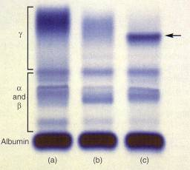

Healthy
Control
Serum Electrophoresis
Monoclonal expansion of B cells
? B cell malignancy
Investigate for myeloma
Active
Immune
Response
Therefore
Not
Immuno
Deficient

Slide 138
Lymphocyte subsets
Flow cytometry
Lymphocyte subpopulations
  CD3+ T cells – pan T cell marker
  CD4+ T cells – T helper/cells
  CD8+ T cells – cytotoxic T cells
  CD19+ B cells
  CD56+ Natural Killer (NK) Cells

Slide 139


Slide 140

Continuous power supplies
Complex IT systems
High cost, highly specialised precision equipment
Standardised sampling
Skilled operators
Advanced, reliable infrastructure

Slide 141


“red”
antibody
“green”
antibody

Slide 142

Natural History of HIV infection

Slide 143
Patient tested for antibodies to HIV
If HIV⁺ perform CD4 count
If HIV⁺ perform viral load
Low CD4 count
High Viral load
Commence ART (1st line therapy)
Every 3 months
Monitor CD4 count and viral load
CD4 count <
Viral load >
ART (2nd line therapy)
Increased Life expectancy

Slide 144

CD4 T cell count defines extent of immune damage and predicts short term outlook in ART naïve HIV-1 patients

Slide 145
Billy
Immunology:
Diagnosis
HIV antibody test positive
  Serum antibodies against HIV
Monitoring
CD4 lymphocyte count 64 cells per ul
HIV viral load 155,000 copies per ml

Slide 147

Billy’s progress
Billy gets pneumonia
RX’d but ……

Slide 148

Autopsy
Progressive wasting and weight loss
Presents in A&E with confusion and bowel obstruction
Dies in A&E
Autopsy

Slide 149
Autopsies
Coroners
Hospital
Terminal event?
Rx?
Complications?
Cancer site?

Slide 150

Diagnostics summary
Chemical Pathology Bilirubin 50
Cellular Pathology Biopsy
Virology
Bacteriology
Haematology
Immunology
Diagnosis
HIV antibody test positive
  Serum antibodies against HIV
Monitoring
CD4 lymphocyte count
HIV viral load

