Slide 1
Viral evasion of the host immune response
Wendy Barclay
w.barclay@imperial.ac.uk

Slide 2
Learning objectives
· Outline, using examples from named viruses, how viruses escape innate immunity by subversion of host innate immune responses
· Describe, with named examples of viruses, how antigenic variation may lead to viral evasion of host immunity
· Describe with named examples how viruses escape host cellular immune responses

Slide 3
Which of these diseases is not caused by a virus?
Smallpox
Chicken pox
cold sores
Poliomyelitis
colds and flu
cervical cancer
encephalitis
Diarrhoea and vomiting
Rabies
Haemorrhagic fevers
Warts
Hepatitis
Leukaemia
pneumonia

Slide 4
Definition of a virus
Viruses are infectious OBLIGATE intracellular PARASITES.
A virus has a genome that comprises DNA or RNA.
Within an appropriate cell, the viral genome is replicated and directs the synthesis, by cellular systems, of more viral components and genomes.
The components effect the transport of replicated viral genomes through the environment to new host cells.

Slide 5
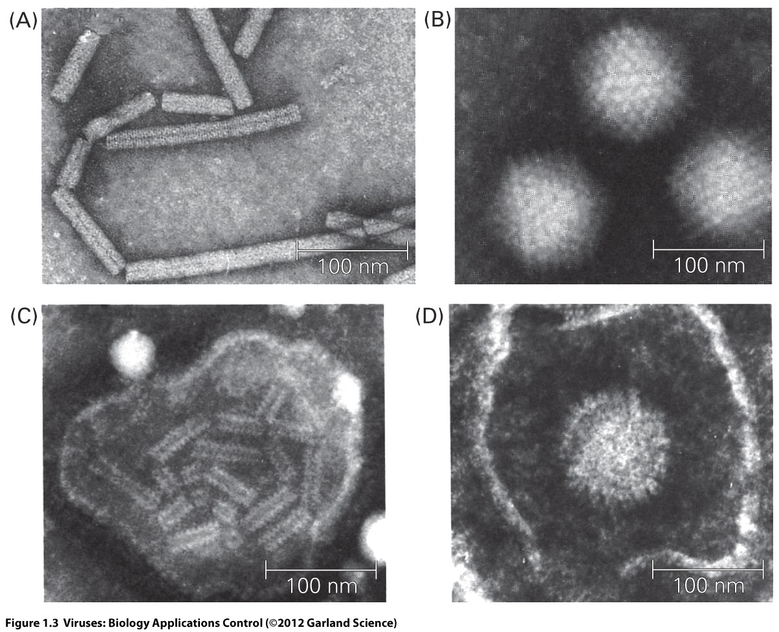
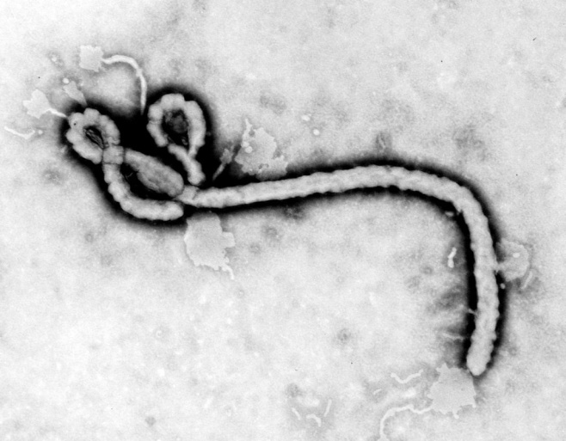
Virus Diversity
Symmetrical protein capsid
Adenovirus
Picornavirus
Calicivirus
Non-enveloped
Non enveloped
Enveloped
Lipid envelope derived from host membrane
Pleiomorphic: measles virus
Typical shape: Ebola virus
Combination of capsid
and envelope
Herpes virus

Slide 6
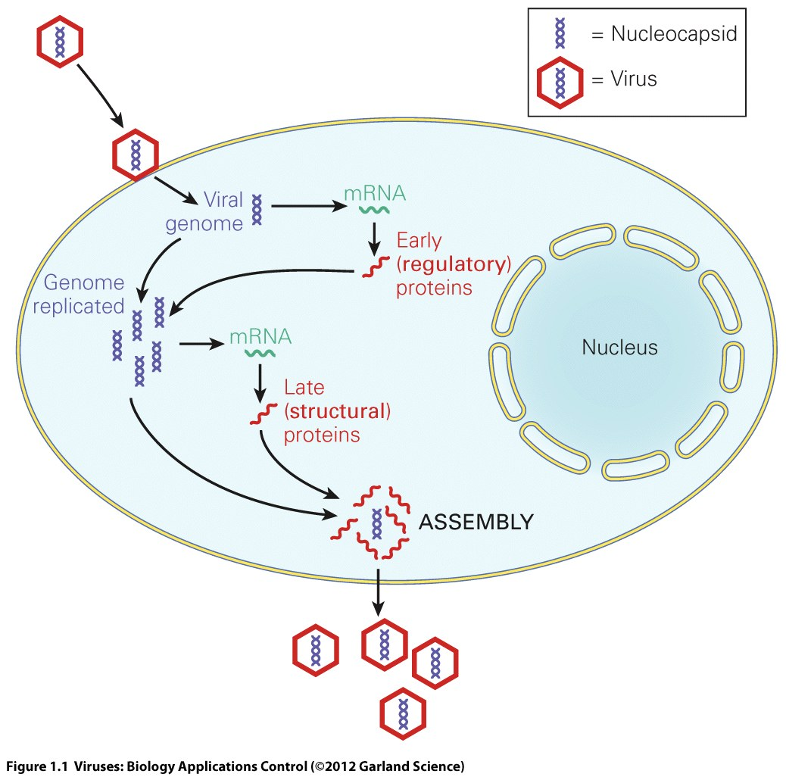
A generic virus replication cycle

Slide 7
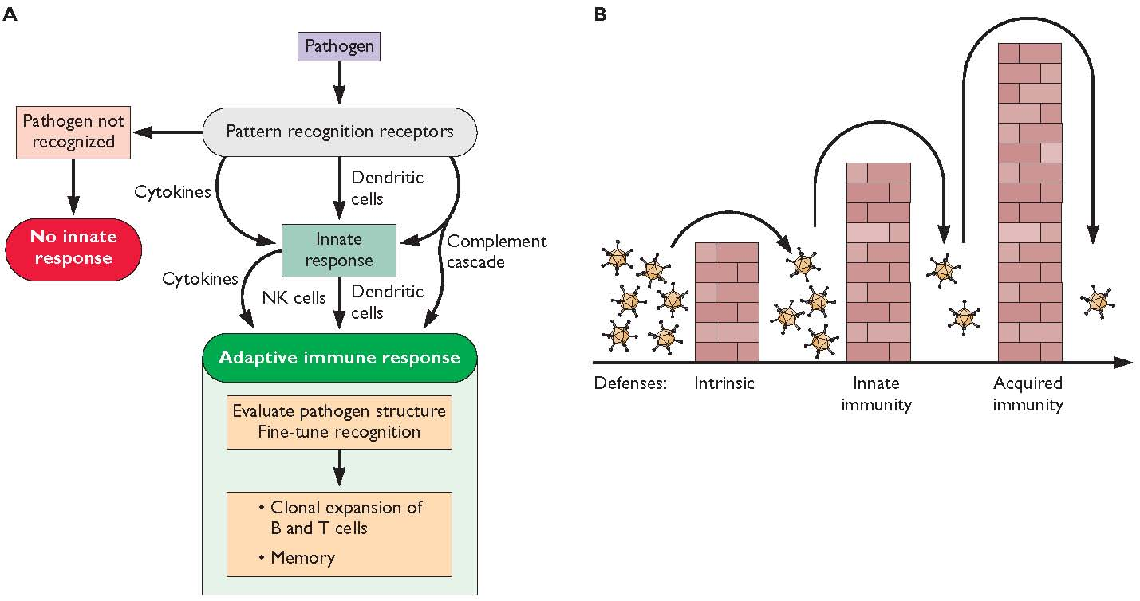
Pathogen sensing by the host

Slide 8
Definitions in innate immunity
Pathogen Associated Molecular Patterns, PAMPs
Pattern Recognition Receptors, PRRs
Often sense foreign RNA
Cytoplasmic RIG-I like receptors RLRs, endosomal Toll like receptors TLRs
Cytoplasmic nucleotide oligomerization domain receptors NLRs

Slide 9
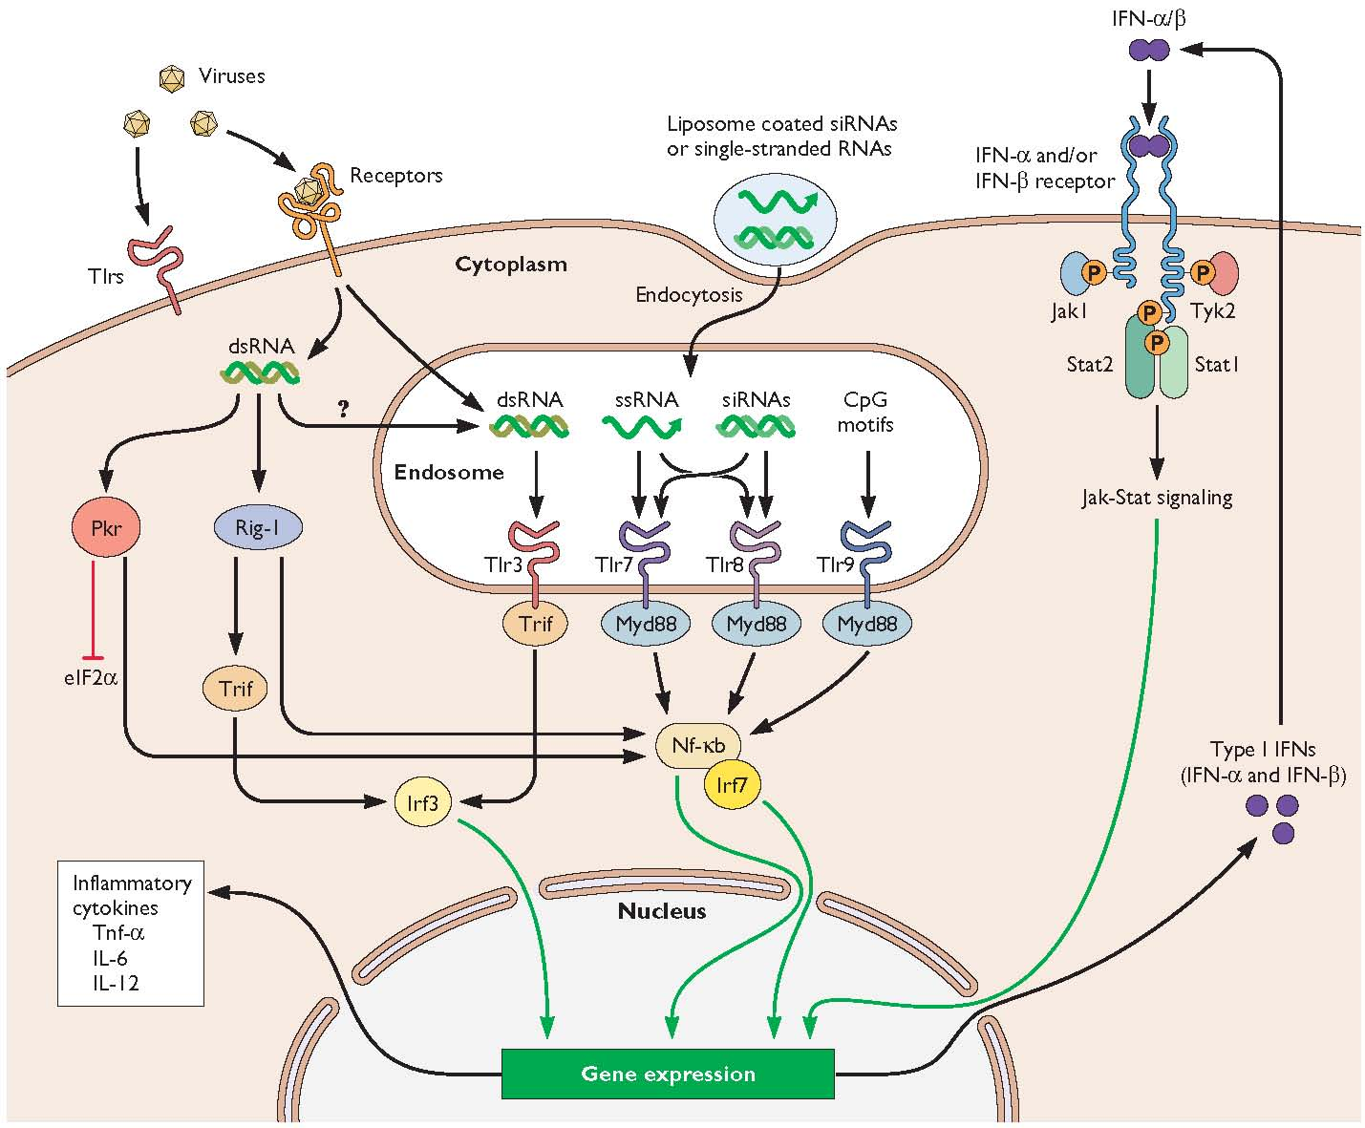
TLRs and cytoplasmic sensors of virus infection

Slide 10
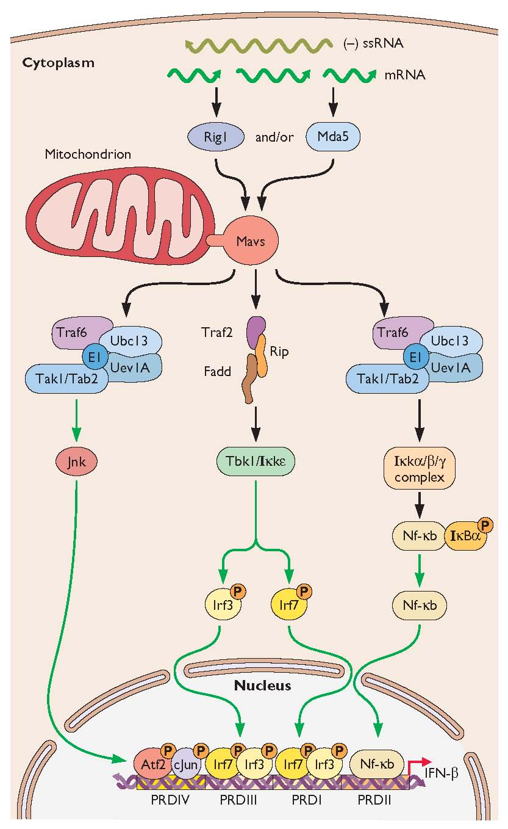
Interferon induction

Slide 11
Interferon
Discovered more than 50 years ago by Isaacs and Lindenmann
A transferable factor produced by exposure of eggs to heat inactivated influenza virus that protected new cells from infection.
Binds to specific receptors and signals activation of de novo transcription of hundreds of Interferon Stimulated Genes, ISGs

Slide 12
IFN is a soluble cytokine
IFN-β
IFN-β
IFN-β
IFN-β
Antiviral signals
IFN-β
IFN-β
promoter
IFN-β
IS genes
Cell 1
Cell 2

Slide 13
Type I, II and III interferons
Type I IFNs are IFN α and IFN β.
Secreted by all cells and IFNAR receptor is present on all tissues.
Plasmacytoid dendritic cells pdcs are specialist IFN secreting cells.
IFN β made first, many variants of IFNα.
Type II IFN is IFNγ.
Signals through a different receptor IFNGR.
Type III IFN is IFNλ.
Signals through receptors IL28R that are only present on epithelial surfaces.

Slide 14
Signalling in response to IFN
IFN-β
IFN-β
Jak1
Tyk2
Jak1
Tyk2
STAT1
P
STAT2
STAT2
P
STAT1
cytoplasm
STAT1
P
nucleus
“ISGF3”
p48
STAT2
P
ISRE
IS gene
ISRE
= Interferon Stimulated Response Element

Slide 15
Interferon stimulated genes
PKR
2’5’OAS
Mx
ISG15, ISG54, ISG56
PML bodies
APOBECs and TRIMs
ADAR
Viperin
miRNAs
Apoptosis
Cell cycle arrest

Slide 16
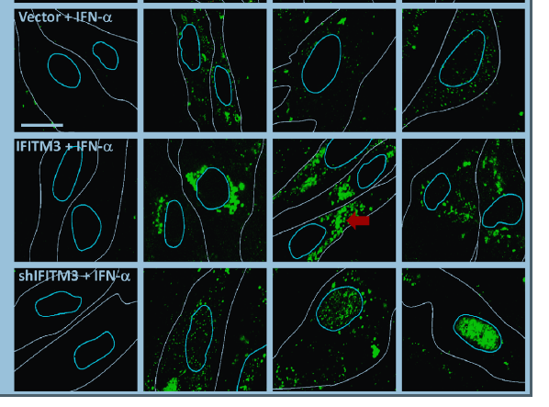
1. IFITM3 inhibits influenza virus entry
Feeley et al. PLOsPath2011

Slide 17
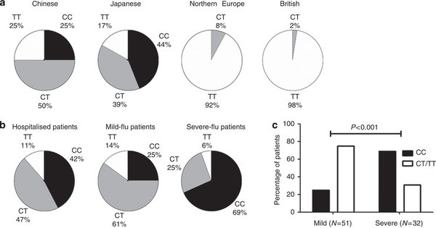
Genetic variation in IFITM3 associated with severe influenza
Dong et al. Nature Commubnications 2013

Slide 18
Antiviral mediators:
2. Mx
GTPase with homology to dynamin
Mx can form multimers which wrap around the nucleocapsids of incoming viruses.

Slide 19
The antiviral mediators:
3. PKR (protein kinase R)
A. Phosphorylates the α subunit of eIF2 and preventing translation
eIF2α
PKR
P
P
eIF2α
PKR
P
IKKβ
B. Activates IKKβ leading to release of NFκB.
NFκB is very important transcription factor for antiviral response!
NF-κB
IκB
NF-κB
IκB

Slide 20
Antiviral mediators:
4. 2’-5’ oligoadenylate synthetase
Induces the formation of an unusual form of ATP
This activates RNase L
RNase L cleaves ssRNA eg. mRNAs and prevents protein synthesis
A very local effect since 2’5’A is highly labile
RNase L
X
Protein

Slide 21
5. APOBEC3G
Aka CEM-15
Apolipoprotein B mRNA-editing enzyme catalytic polypeptide like 3G
Involved in innate immune resistance to retroviruses and hepadnaviruses
Deaminates dC to dU in minus strand viral cDNA during reverse transription
Results in G to A hypermutation

Slide 22
Antiviral state does not last
IFN response may only be maintained for several hours
Subsequently the ability to response to IFN is lost due to negative regulation
SOCS suppressor of cytokine signalling genes turn off the response.

Slide 23
Viral evasion of IFN response
Avoid detection by hiding the PAMP
Interfere globally with host cell gene expression and/or protein synthesis
Block IFN induction cascades by destroying or binding
Inhibit IFN signalling
Block the action of individual IFN induced antiviral enzymes
Activate SOCS
Replication strategy that is insensitive to IFN

Slide 24
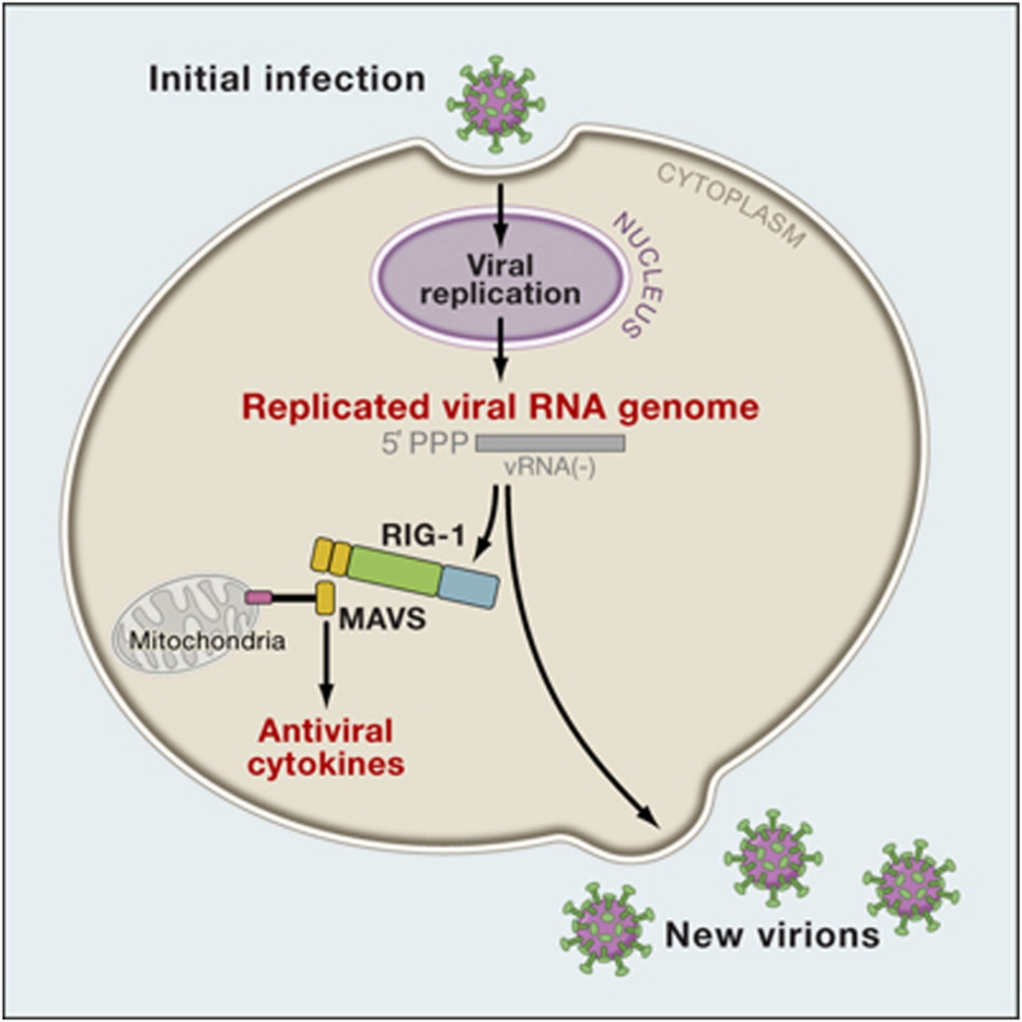
When is the PAMP seen?
Viruses that do not have 5’ monophosphate on their genome can evade RIG-I detection.

Slide 27
Influenza A Virus NS1 protein
Binds dsRNA
Binds RIG-I
NS1
X
PKR
IKKβ
NF-κB
IκB
IRF-3
X
IFN-β
IFN-β gene
nucleus
cytoplasm

Slide 28
Influenza A Virus NS1 protein
IFN-β
IFN-β
2. Stops export of antiviral mRNA
Jak1
Tyk2
Jak1
Tyk2
STAT1
P
STAT2
STAT2
P
STAT1
cytoplasm
STAT1
P
nucleus
p48
STAT2
P
ISRE
IS gene
NS1
AAA
X
AAA
AAA
Antiviral mRNAs
AAA

Slide 29
Consequences of innate immunity: Viral pathology
A combination of damage of infected cells by virus and
damage of infected and bystander cells by the immune response.

Slide 30
Skewing the immune response
Many viruses modulate the immune response, presumably to increase their own replication and transmission.
This can result in inadvertant pathology.

Slide 31
The cytokine storm.
IFN-β
IFN-β
IFN-β
IFN-β
IFN-β
IFN-β
IFN-β
IFN-β
IFN-β
IFN-β
IFN-β
IFN-β
IFN-β
IFN-β
IFN-β
IS genes
IFN-β
IFN-β
IFN-β
IFN-β
IFN-β
Cell 1
Cell 2
IFN-β

Slide 32
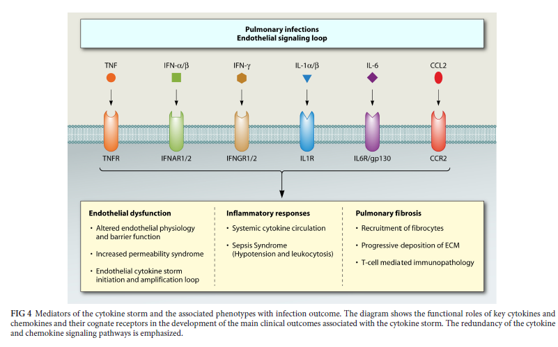
Mediators of the cytokine storm

Slide 33
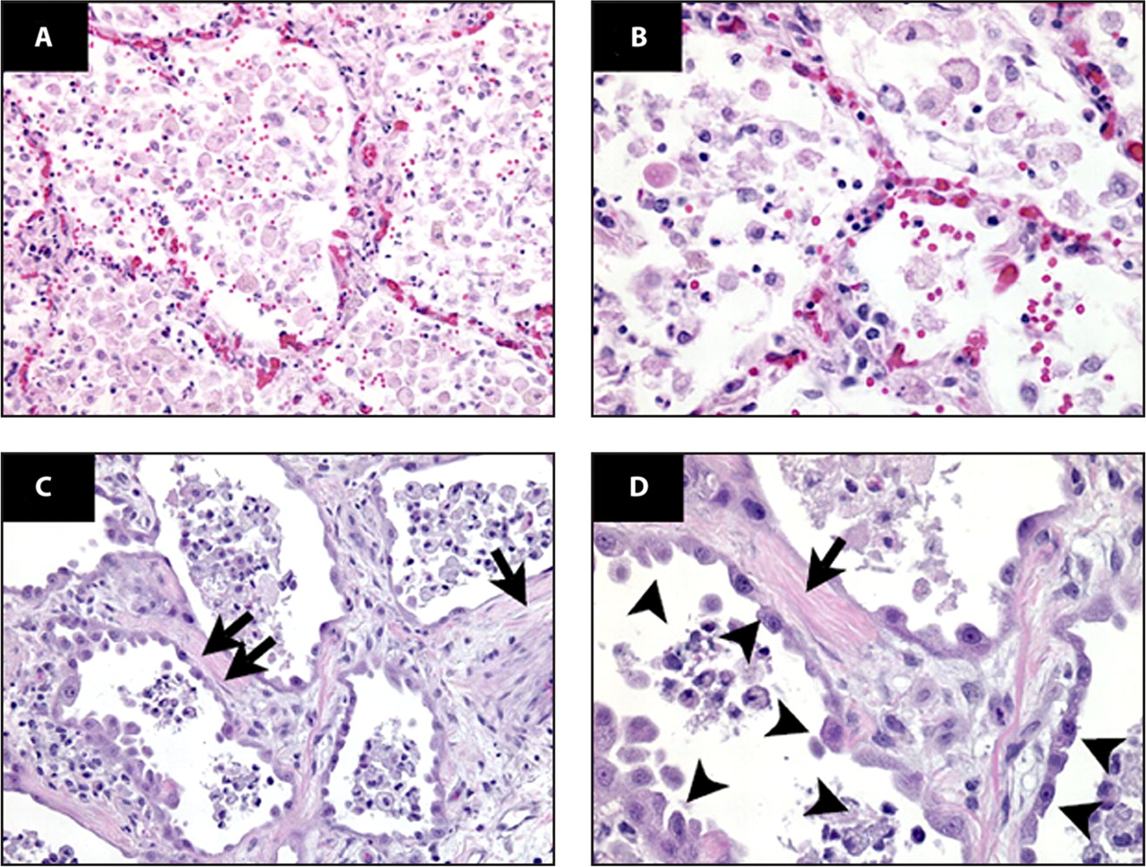
Human ARDS. Photomicrographs from the lungs of 2 different patients with ARDS, stained with hematoxylin and eosin (H&E) are shown.
Tisoncik J R et al. Microbiol. Mol. Biol. Rev. 2012;76:16-32
Notes:
Human ARDS. Photomicrographs from the lungs of 2 different patients with ARDS, stained with hematoxylin and eosin (H&E) are shown. The alveolar spaces are filled with a mixed mononuclear/neutrophilic infiltrate, the alveolar walls are thickened, and the septae are edematous. Note the presence of cellular debris and proteinaceous material in the air spaces (A [magnification, ×200] and B [magnification, ×400]). In later stages (C [magnification, ×200] and D [magnification, ×400]), there is a fibroproliferative response with collagen deposition in the alveolar walls (arrows). Note that the alveolar epithelium has been replaced with cuboidal cells (arrowheads). (Figure and legend reprinted from reference 96 with permission of the publisher.)‏

Slide 34
Immunopathology of H5N1 infection.
Virus replicates, induces high IFN resulting in massive TNFα and other cytokines.
Differences in clinical outcome may reflect vigour of innate immune system, which may vary with age.

Slide 35
Using our understanding of viral control of innate immunity to make vaccines
Viruses deficient in control of IFN are attenuated in IFN competent cells
Cells deficient in IFN response grow more virus.

Slide 36
Antiviral treatments in the clinic
IFN as a treatment (HCV, pegylated IFN often used with ribavirin)
Oncolytic viruses
NDV, mutants of HSV might lyse cells deficient in IFN but not normal cells.

Slide 37
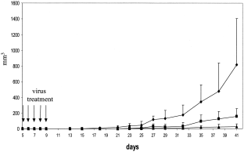
Del-NS1 influenza virus inhibits growth of tumour cells in mice
saline
NS1-99
Del-NS1

Slide 38
Suggested reading
Randall RE, Goodbourn S.
Interferons and viruses: an interplay between induction, signalling, antiviral responses and virus countermeasures. J Gen Virol. 2008 Jan;89(Pt 1):1-47. Review.
Yan N, Chen ZJ.
Intrinsic antiviral immunity
Nat Immunol. 2012 Feb 16;13(3):214-22. doi: 10.1038/ni.2229. Review

Slide 39
Evasion of antibody response
Continued rapid evolution driven by antigenic pressure from host e.g. influenza
Existing as many different genetically stable serotypes e.g. rhinovirus

Slide 40
Evolutionary pressure drives influenza antigenic change
mRNA
mRNA
cRNA
vRNA

Slide 41
Antigenic drift.
Vaccine updated every year to best represent the circulating strains.

Slide 42
Influenza Viruses circulating in humans today
H5N1, H9N2, H6N6
2000 2010 2020
pH1N1
H3N2
B Yamagata
B Victoria

Slide 43
Vaccination Began
Notes:
Main points from this slide, which is based on UK data is that pandemic H1n1 displaced everything else, no other virus circulating even now. Important to track what circulates in S hemisphere this summer

Slide 44
Reassortment leading to antigenic shift
H3N2
H5N1

Slide 45
Influenza Pandemics in the 20th Century.
H5N1, H7N7
1900 1910 1920 1930 1940 1950 1960 1970 1980 1990 2000
H1N1
H2N2
H3N2
Avian circulating
viruses

Slide 46
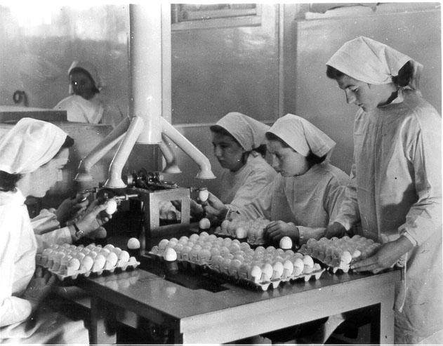
Influenza vaccine

Slide 47
Influenza vaccines in use today
Trivalent or quadrivalent inactivated vaccine
Split or subunit- HA rich
Given to those at risk
Short term strain specific immunity mediated by antibody to HA head
Live attenuated vaccine, also tri or quadrivalent
Cold adapted virus limited to urt
Given to children
Broader more cross reactive immunity including cellular response

Slide 48
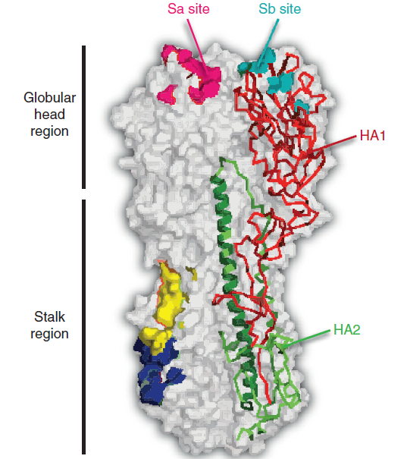
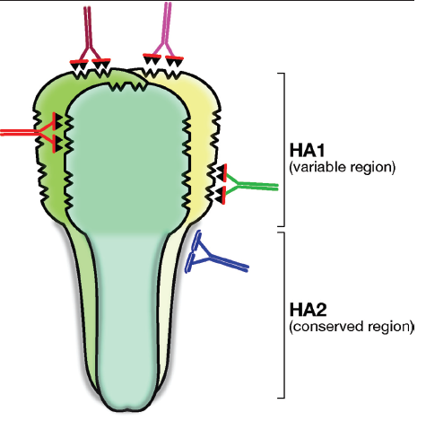
A universal influenza vaccine?

Slide 49
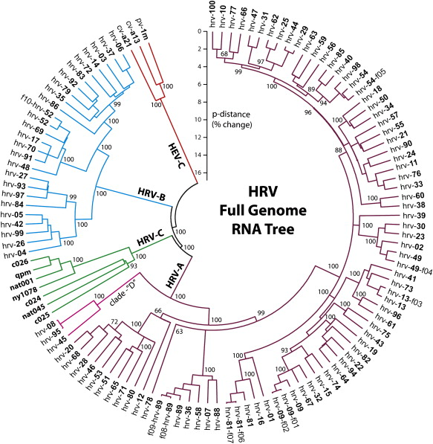
Human rhinovirus antigenic variation
Human rhinoviruses cause the common cold.
They exist as more than 120 antigenically distinct serotypes that co circulate.

Slide 50
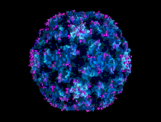
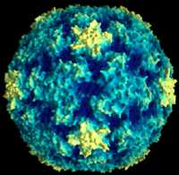
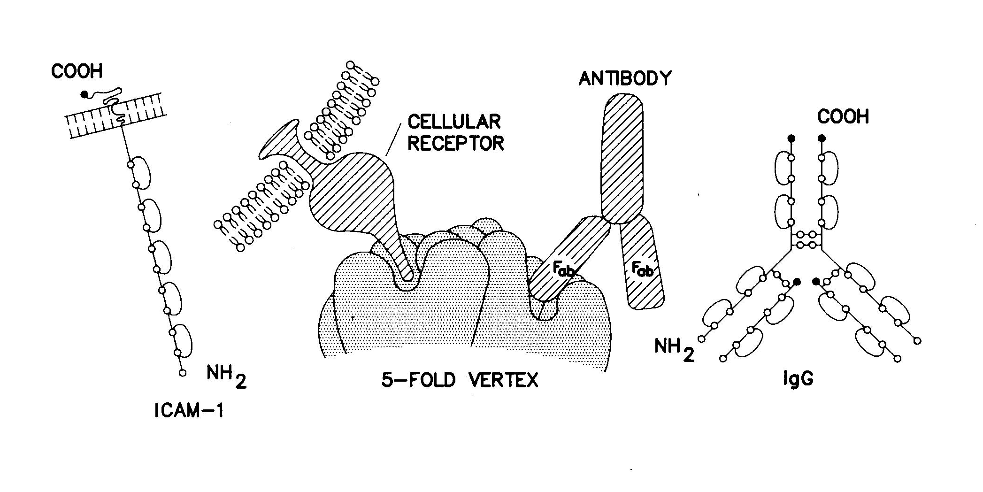
Rhinoviruses – Antigenic variation between serotypes yet they all still use the same ICAM-1 receptor.
5-fold axis
3-fold axis
Canyon

Slide 51
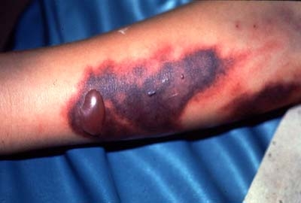
Consequence of antigenic variation of Dengue virus
Dengue haemorrhagic fever. Responsible for 500,00 hospitalizations each year with 5% fatalities.
Leakage of blood plasma from capillaries.
Detected by increase in red cell count and decrease in protein level in blood.
Tendency to severe bruising, and bleeding. Patient deteriorates even after fever drops; shock. Treat with iv fluid replacement.

Slide 52
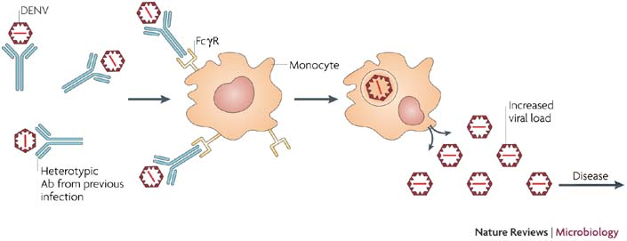
Antibody dependent enhancement of Dengue
Dengue Virus exists as 4 different serotypes.
Antibody generated against a previous infection can bind but not neutralize, and lead to ADE, causing Dengue Haemorrhagic Fever.

Slide 53
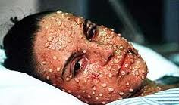
Small pox was eradicated because it does not antigenically vary
Smallpox. Variola virus. Mortality 20-80%. Infection of skin. Viral growth factors induce proliferation of skin resulting in pox.

Slide 54
Viruses and cellular immunity
Viruses are intracellular pathogens and so east target for processing and presentation by MHC.
Cellular immunity is often induced to internal viral proteins that vary less than surface antigens.
Cellular immunity clears viral infection but is short lived.
Viruses that persist must evade cellular immunity

Slide 55
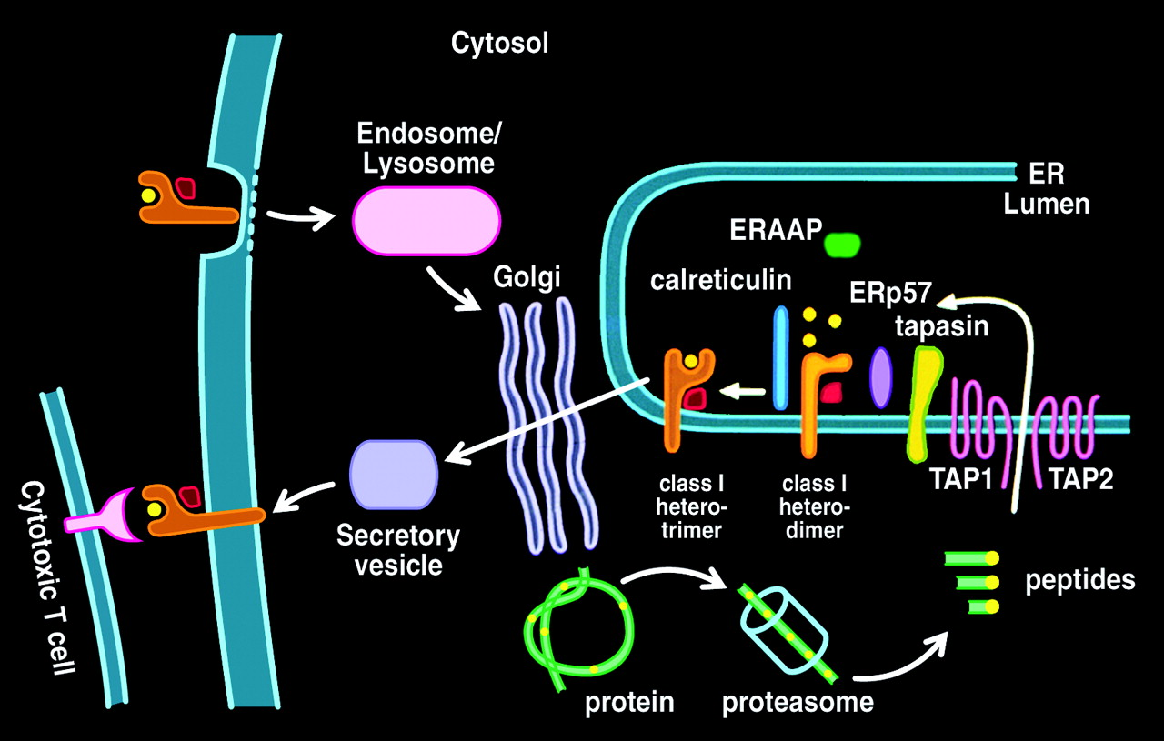
Presentation of viral proteins by MHC class I

Slide 56
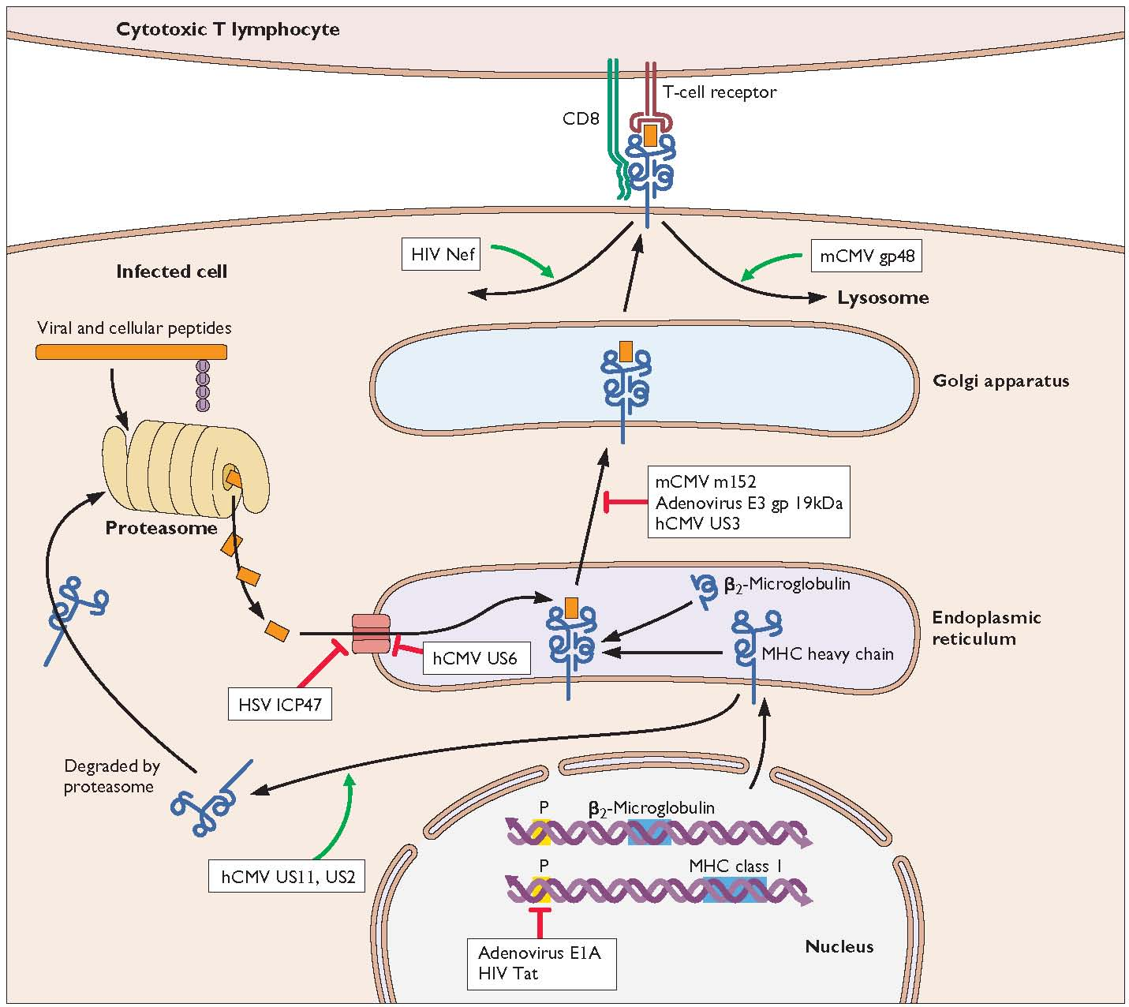
Viral regulation of MHC class I antigen presentation

Slide 57
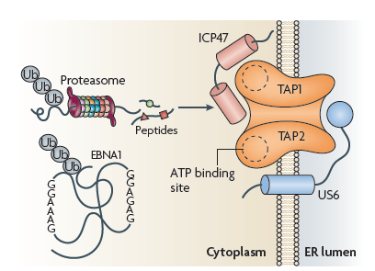
Evasion of antigen loading to TAP
EBV EBNA1 cannot be processed by the proteasome
HSV ICP47 blocks access of the processed peptide to TAP
CMV US6 stops ATP binding to TAP preventing translocation

Slide 58
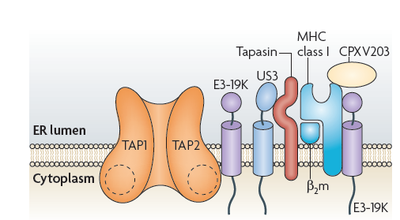
Modulation of tapasin function and prevention of MHC transport
CMV US3 binds tapasin and prevent peptides being loaded to MHC
Adenovirus E3-19K prevents recruitment of TAP to tapasin and also retains MHC in the endoplasmic reticulum

Slide 59
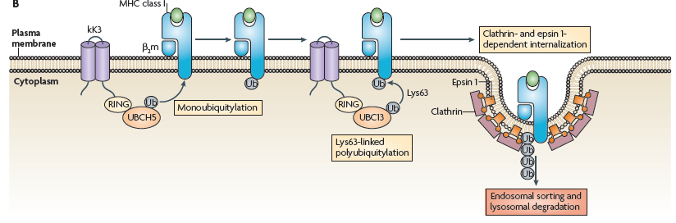
Interfering with MHC presentation at the cell surface
KSHV kK3 protein induces polyubiquitinylation and internalization of MHC.
From the internalized endosome, MHC is passed to lysosomes where it is degraded.

Slide 60
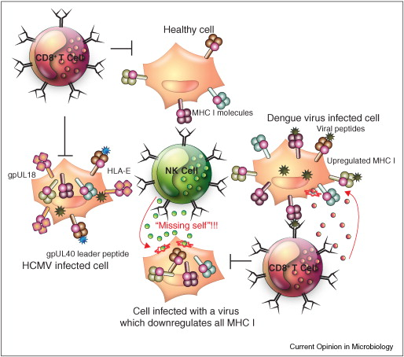
How viruses avoid NK killing by the missing self mechanism
Normal healthy cells display MHC at their surface.
Cells that don’t display MHC are detected by NK cells and killed.
Viruses that disrupt MHC presentation would end up being killed by NK cells.
Viruses encode MHC analogues (CMV gpUL40) or upregulate MHC.

Slide 61
Suggested further reading
Immunity to dengue virus: a tale of original antigenic sin and tropical cytokine storms Rothman Nature reviews in Immunology 2012.
MHC class 1 antigen presentation : learning from viral evasion strategies. Hansen and Bouvier Nature reviews in Immunology 2009.

