Slide 1
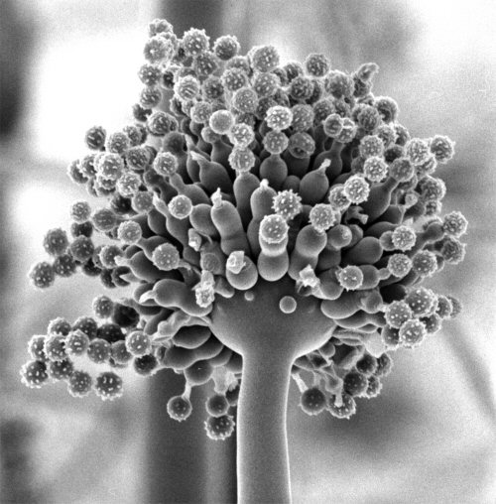
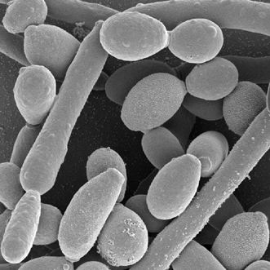
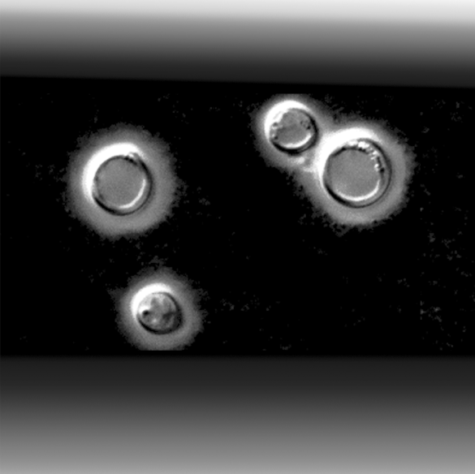
Immunity to fungal infections
Dr Elaine Bignell
Microbiology Section
Department of Infectious Diseases
Faculty of Medicine
e.bignell@imperial.ac.uk

Slide 2
Learning objectives
Following this lecture you should be able to:
Understand how immune status determines risk of fungal infection
Name the major antifungal effector cells
Describe two mechanisms of cell-mediated antifungal defence
Summarise the sequence of events leading to successful clearance
of infectious fungal cells

Slide 3
Structure of the lecture
Introduction: Fungal infections, morphotypes (growth forms) and routes of infection
Aspergillus species
Candida species
Cryptococcus species
2) Immunity to fungal infection (systemic perspective)
Risk factors for fungal infections
A damage-response framework to describe the host-pathogen interaction
Overview of mammalian immunity to fungi
3) Immunity to fungal infections (cellular perspective)
a) Major antifungal effector cells
b) Recognition of infectious fungal cells
c) Clearance of infectious fungal cells
d) Integration of innate and adaptive responses to fungal infection
4) Further reading

Slide 4
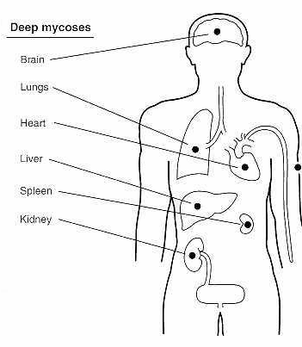
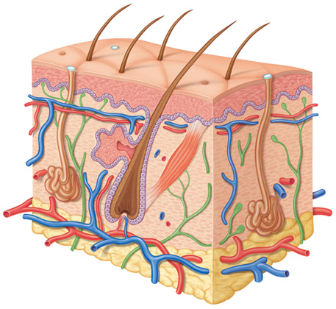
Mycoses
Mycoses are classified by the level of tissue affected
Systemic (deep)
Superficial
Cutaneous
Subcutaneous

Slide 5
Introduction
Fungal infections, morphotypes (growth forms) and routes of infection

Slide 6
Mycoses: The major causative organisms
Primary
Coccidioides immitis
Histoplasma capsulatum
Blastomyces dermatiditis
Paracocidioides brasiliensis
Opportunistic
Cryptococcus
Candida
Aspergillus
Penicillium marneffei
The zygomycetes
Trichosporon beigelii
Fusarium
Able to establish
infection in a
normal host
Well-defined
geographical areas
TRUE
PATHOGENS
Require a
compromised host
in order to establish
infection
Ubiquitous
OPPORTUNISTIC
PATHOGENS

Slide 7
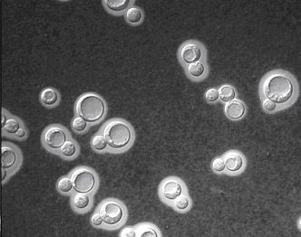
Shape-shifting fungi: Defining fungal morphotypes
Candida albicans
Each distinct growth form of a fungus is called a morphotype
Some fungi exist as multiple morphotypes and can switch between them
The term ‘yeast’ describes single-celled fungal morphotypes such as those exhibited by C. albicans and C. neoformans.
Cryptococcus neoformans

Slide 8
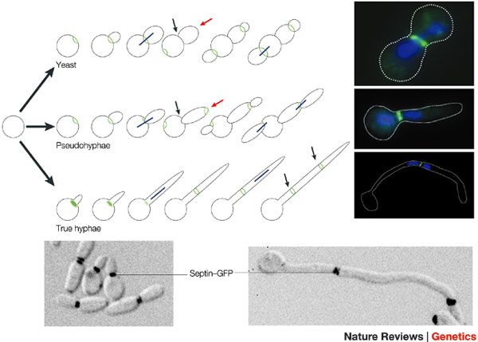
Shape-shifting fungi: Defining fungal morphotypes
Candida albicans is a budding yeast which can differentiate into elongated pseudohyphal and/or hyphal forms in response to environmental signals such as:
pH
nutrient limitation
serum
Pseudohyphal cells lack the dividing partitions known as septa which are found in true hyphae

Slide 9
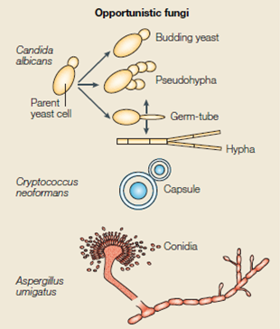
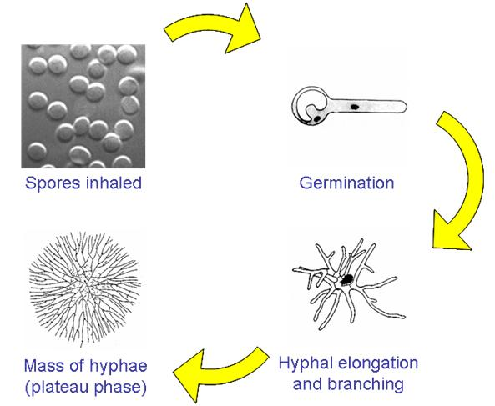
Shape-shifting fungi: Defining fungal morphotypes
Sporulating fungi (those which produce spores) distribute spores via air currents to inhabit new food sources
Cryptococcus neoformans is described as an encapsulated yeast, which has a thick polysaccharide cell wall referred to as the capsule.
Aspergillus species undergo a developmental programme whereby spores are produced in high abundance from aerial hyphae (Aspergillus spores are also called conidia)
A fungal colony composed of multiple branched hyphae is referred to as a mycelium

Slide 10
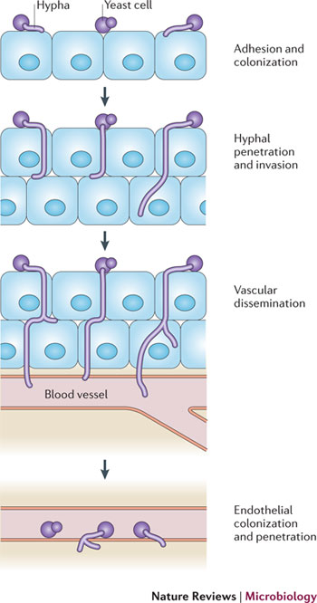
Fungal morphogenesis facilitates infection by:
Promoting tissue invasion
Masking pathogen associated molecular patterns (PAMPs) which are recognised by immune cells
3) Promoting escape from within immune cells following phagocytosis
Schematic view of Candida albicans tissue invasion

Slide 11
Routes of infection [1]
Fungi infect humans via several different routes including:
Attachment and invasion of damaged skin/epithelia
[facilitated by human-human/animal contact] e.g. Candida infections
Inhalation and deposition in the respiratory tract
e.g. Cryptococcus infections, Aspergillus infections
Direct inoculation into deep tissues
[often during surgery/intubation/catheterisation]
e.g. Candida infections, Aspergillus infection.
Disease manifestation depends upon the route of infection and is often
dictated by the nature of the first encounter between host and pathogen.
This may differ by individual.

Slide 12
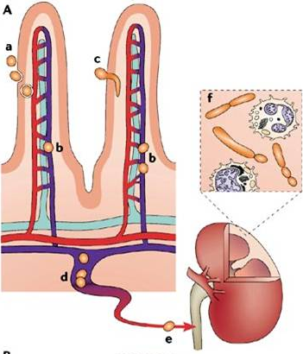
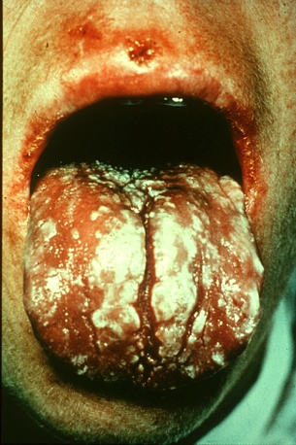
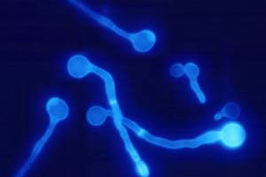
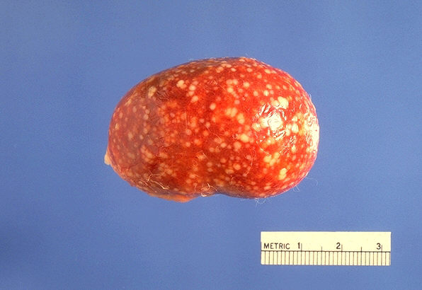
Routes of infection [2]
Candida species :
Opportunistic commensals of the gut, oral and
genitourinary tracts
Risk factors for infection:
Chemotherapy
Surgery
Catheterisation
AIDS
Disseminated canididiasis often originates at a
gastrointestinal site by entering the vasculature
via epithelial microvilli.
Mucosal disease often
follows changes in
resident microflora
Chauhan et al. Nature Reviews Microbiology 4, 435–444 (June 2006) | doi:10.1038/nrmicro1426

Slide 13
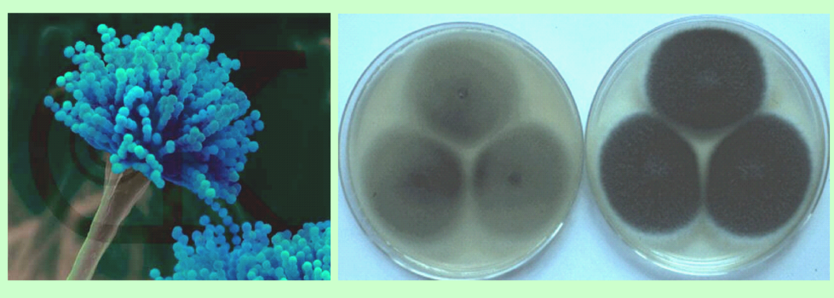
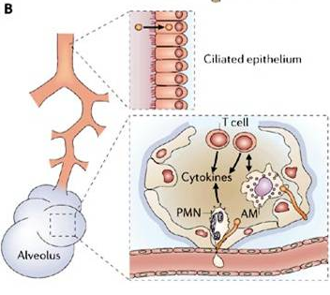
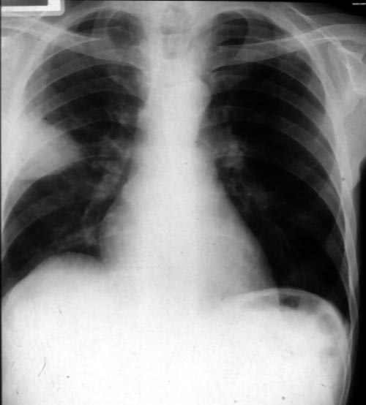
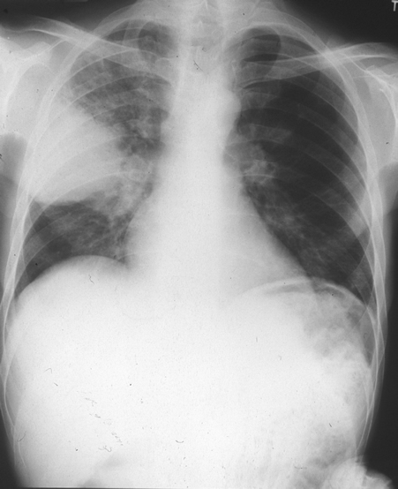
Routes of infection [3]
Aspergillus species:
Major components of the airborne microflora
Hundreds inhaled on a daily basis
Ciliary clearance and pulmonary
polymorphonuclear leukocytes protect
effectively
Chauhan et al. Nature Reviews Microbiology 4, 435–444 (June 2006) | doi:10.1038/nrmicro1426

Slide 14
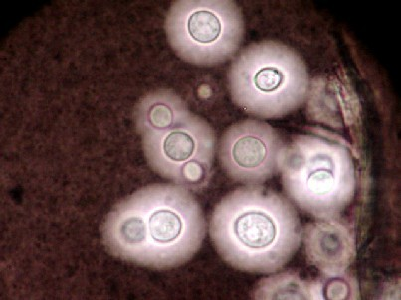
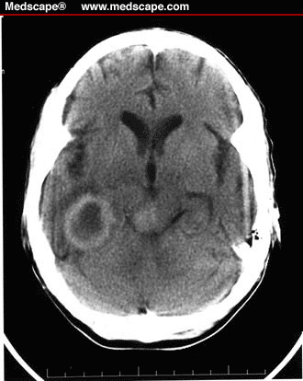
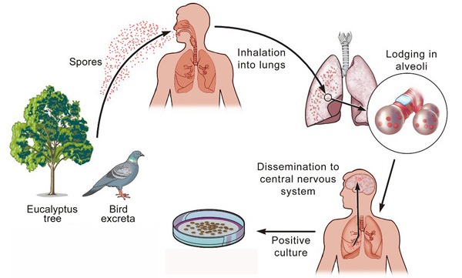
Routes of infection [4]
Crytpococcus species:
Encapsulated yeasts
Reservoirs exist in nature (commonly found in pigeon droppings)
Acquired via inhalation (evidence for early exposure)
Assumed to reside latently becoming pathogenic following subsequent
immune-suppression, particularly AIDS.

Slide 15
2) Immunity to fungal infection (systemic perspective)
Risk factors for fungal infections
b) A damage-response framework to describe the host-pathogen interaction
Overview of mammalian immunity to fungi

Slide 16
The risk for type of fungal infection differs, depending upon
which aspect of immunity is impaired
Fungal pathogen/infection | Host factor
Candida (Mucosal infection) | Impaired cell mediated immunity
Candida (Disseminated infection) | Impaired muscosa, breach of epithelial barrier, neutropenia, chronic granulomatous disorder (CGD)
Aspergillus | Neutropenia, high dose corticosteroids, chronic granulomatous disorder (CGD)
Cryptococcus | Impaired cell mediated immunity, corticosteroids
Defects in host defences that predipose patients to infections with specific fungi

Slide 17
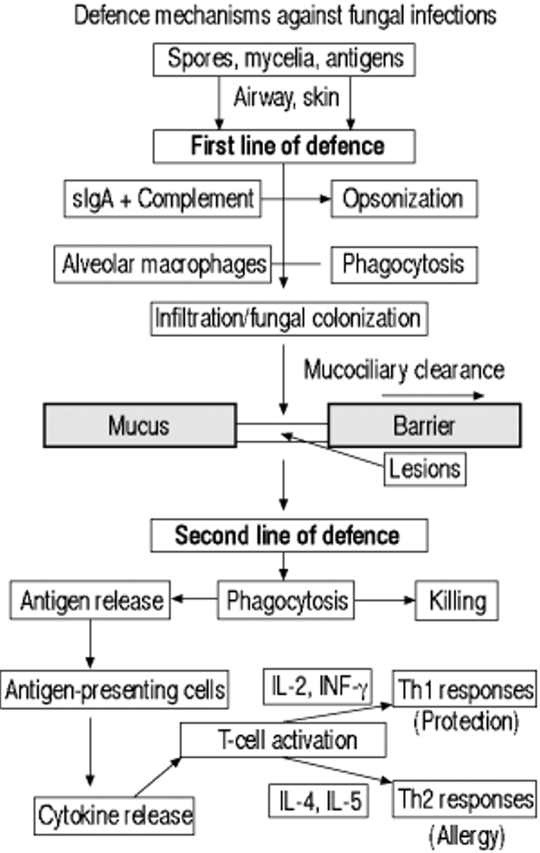
Overview of mammalian immunity to fungi
Antifungal defences are mediated by:
Cells
Cellular receptors
Several humoral factors
Professional phagocytes have an essential role
The first line of defence is physical, on the skin,
or oral, pulmonary or gastrointestinal mucosa.
If first lines of defence are breached, increased
exposure to fungal antigens follows, eliciting a
T-helper 1 type response in normal individuals
and a T-helper 2 type response in atopic
individuals

Slide 18
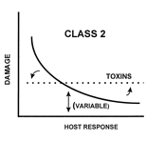
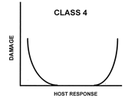
A damage-response continuum to define
fungal pathogenesis
Both the host and the pathogen are responsible for
damage sustained during infection
IMPORTANCE OF TOLERANCE
Pathogens that cause damage either in hosts
with weak immune responses or in the setting of
normal host responses
e.g. Candida albicans and Cryptococcus neoformans
Pathogens that cause damage primarily at the extremes
of both weak and strong immune responses
Invasive disease versus allergy
e.g. Asperillus fumigatus
Casadevall and Pirofski (1999) Host-Pathogen Interactions: Redefining the basic concepts of virulence and pathogenicity Infect. Immun. 67:3703-3713

Slide 19
3) Immunity to fungal infections (cellular perspective)
Major antifungal effector cells
b) Recognition of infectious fungal cells
c) Clearance of infectious fungal cells
d) Integration of innate and adaptive responses to fungal infection

Slide 20
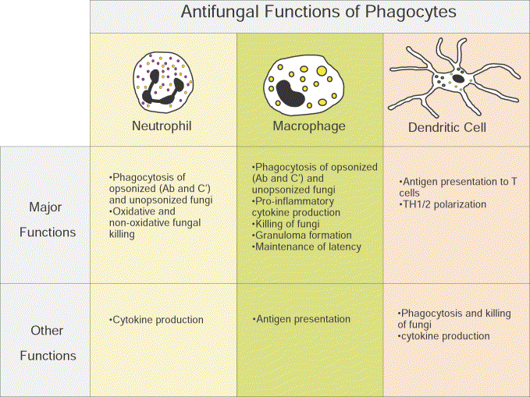
What are the major antifungal effector cells?

Slide 21
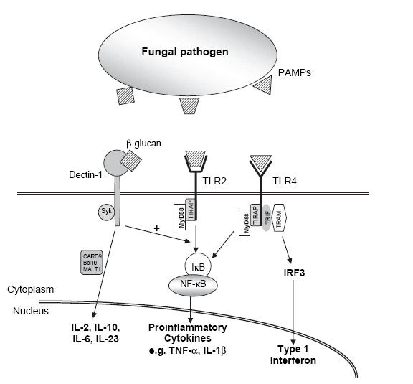
Dichotomous roles of innate immune recognition
and surveillance
Direct role = antimicrobial activity and fungal killing
2) Facilitative role = production of proinflammatory cytokines and chemokines
and antigen presentation

Slide 22
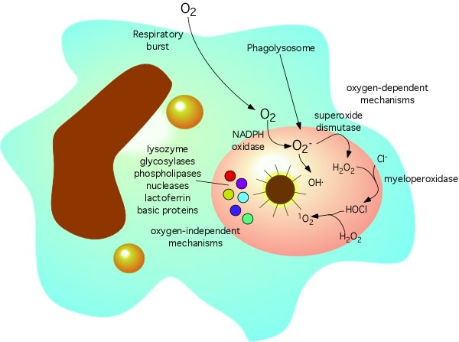
Fungal killing: mechanisms of phagocytic cells
Phagocytic cells kill internalized microbes by both oxidative and non-oxidative mechanisms
The NADPH oxidase enzyme complex is a multi-subunit enzyme complex which mediates the ‘respiratory burst’
During phagocytosis oxygen consumption is increased through the activity of NADPH-oxidase generating superoxide anion O₂₋ and hydrogen peroxide H₂O₂
These oxygen metabolites give rise to yet other reactive oxygen species that are strongly anti-microbial but which may also cause tissue damage and apoptosis, the role of ROS in fungal killing is recognised as essential, but the basis remains controversial.
Inherited mutations of NADPH oxidase enzyme subunits result in Chronic Granulomatous Disorder (CGD). Sufferers are highly susceptible to Aspergillus and Candida infections

Slide 23
Neutrophil-mediated killing
of Aspergillus fumigatus

Slide 24
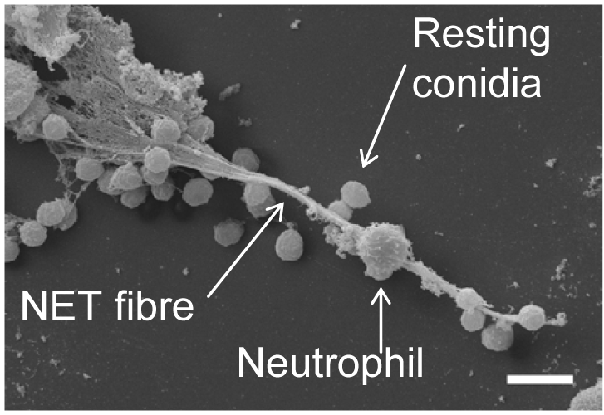
Neutrophil extracellular traps (NETs)
The production of ROI by the host might be important for the control of Aspergillus on a level distinct from direct killing.
NETs are extracellular fibres, derived from chromatin and coated with granule proteins
Produced as a final ac of defence by dying neutrophils
NET production (NETosis) requires a ROI-mediated signalling cascade
Restoration of NADPH oxidase in CGD cells by gene transfer re-establishes NETosis
Bruns et. al. (2010) Production of neutrophil extracellular traps against A. fumigatus
http://www.ncbi.nlm.nih.gov/pmc/articles/PMC2861696/

Slide 25
Extraordinary interaction between
Cryptococcus neoformans and macrophages

Slide 26
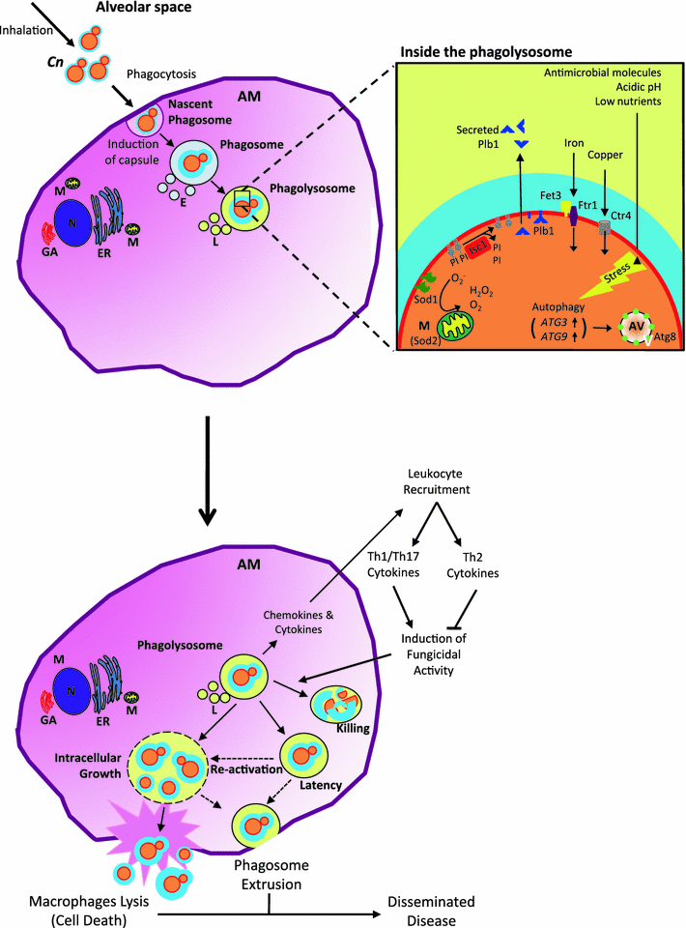
Roles of alveolar macrophages in the
host response to
Cryptococcus neoformans
Alveolar macrophages play an essential role in defence against cryptococcus infections
Internalisation by phagocytosis is an essential step which precedes chemokine and cytokine secretion, recruitment of other immune cells, killing of the pathogen and antigen presentation
A CD4+ Th1 response is essential for clearance of infecting fungal cells and suppression of invasive infection
Three possible outcomes of this interaction:
Clearance by collaborative innate and adaptive responses
Latency
Cn survival, CNS entry and infection
Paradoxical roles of alveolar macrophages in the host response
to C. neoformans J. Infect. Chemother. 2011

Slide 27
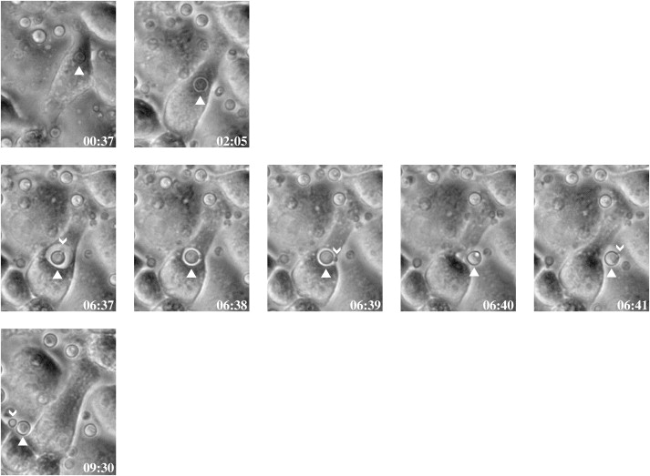
C. neoformans escape from macrophages (unofficially known as vomocytosis)
Curr Biol. 2006 Nov 7;16(21):2156-60.
Expulsion of live pathogenic yeast by macrophages.
Ma H, Croudace JE, Lammas DA, May RC.

Slide 28
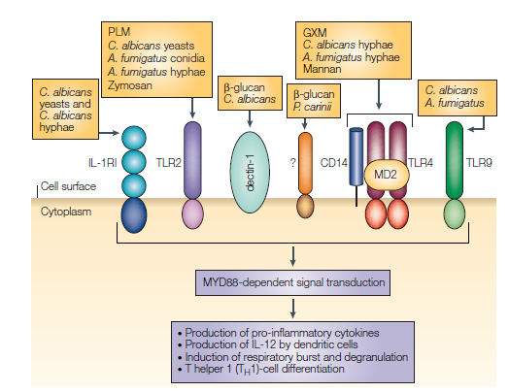
Recognition of fungal pathogens
A number of cell wall components
may act through several distinct
pattern recognition receptors (PRRs).
Some fungal PAMPs are specific to
certain morphotypes.
Certain morphotypes may be able to evade
recognition by host cells.
TLRs are activators of innate and adaptive
immunity to fungi.

Slide 29
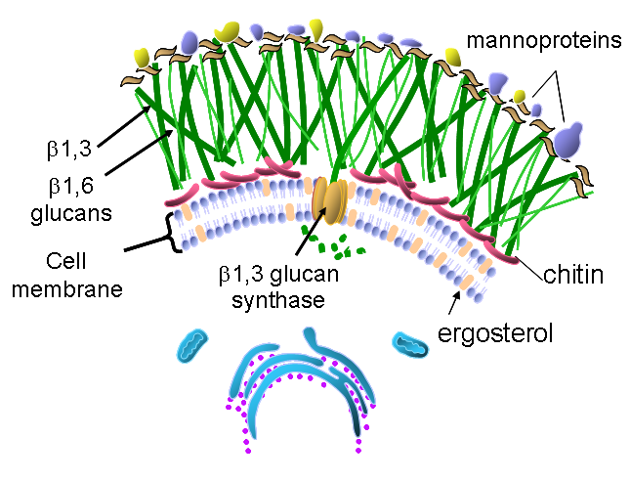
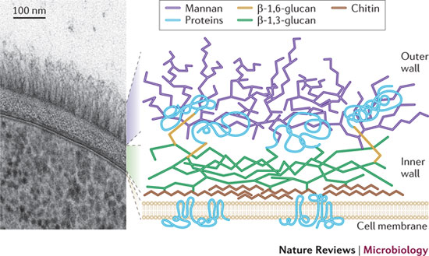
The fungal cell wall
The fungal cell wall is composed predominantly of glucans and chitin which provides physical protection. Many cell wall components are pathogen-associated molecular pattern molecules (PAMPs).
It is a fungal-specific organ and a premier target for antifungal drugs
Cell wall composition is in permanent flux, according to the environment and
morphotype of the organism.
Cell wall composition differs by species and also by morphotype

Slide 30
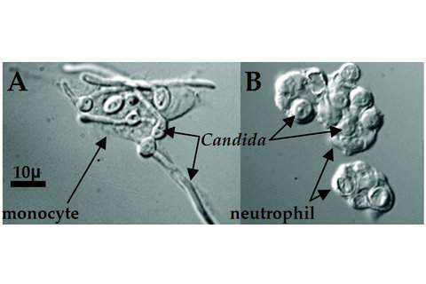
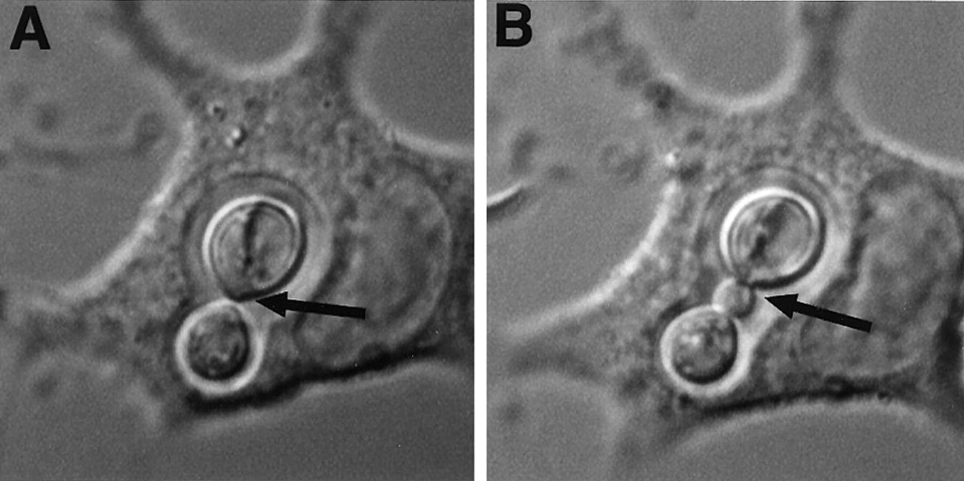
The immune response to fungi varies with respect
to the fungal species and morphotype encountered
Regardless of species and/or site
of infection professional phagocytes
are the major antifungal effector cells
Candida albicans experiences nutrient
starvation inside the macrophage
phagolysososome, prompting germination
and escape
Cryptococcus neoformans can mulitply
inside the macrophage phagolysosome
and subsequently escape.
Candida albicans
Cryptococcus neoformans

Slide 31
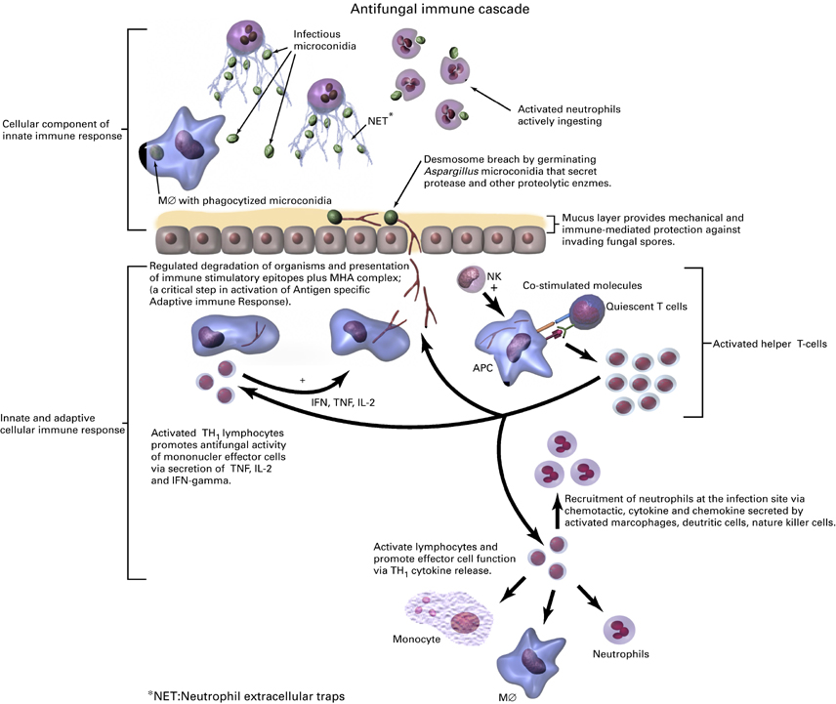
Putting it all together:
Several shared defence mechanisms are operative in response to a range of fungi
Neutrophils, macrophages and dendritic cells are fundamentally important antifungal effector cells
2) Damaged epithelial cells and activated phagocytes secrete cytokines which recruit neutrophils to the site of infection
3) Macrophages, dendritic cells and B cells process microbial antigens, and present them to T cells in an MHC-bound form at their own cellular boundary
4) The nature of the antigen presented, cytokine envronment determine Th1/Th2 polarisation

Slide 32
Further reading (Hyperlinked)
Crameri and Blaser (2002) Allergy and immunity to fungal infections and colonization
Eur. Respir. J. 19:151-157
2) Luigiana Romani (2004) Immunity to fungal infections Nat. Rev. Microbiol. 4:1-23
3) Luigiana Romani (2008) Cell mediated immunity to fungi: a reassessment
Med. Mycol. 46:515-529

