Slide 1
Cancer as a disease: Cellular pathology of cancer
Rob Goldin
r.goldin@imperial.ac.uk

Slide 2
DEFINITIONS AND TERMINOLOGY
Define:
metaplasia, dysplasia, neoplasia, tumour, malignancy, hamartoma
carcinoma, sarcoma, teratoma, lymphoma, leukaemia, metastasis

Slide 3
METAPLASIA
A reversible change in which one adult cell type (epithelial or connective tissue) is replaced by another adult cell type
Adaptive

Slide 4
METAPLASIA

Slide 5
DYSPLASIA
an abnormal pattern of growth in which some of the histological features of malignancy are present
pre-invasive stage with
intact BM

Slide 6
DYSPLASIA
loss of architectural orientation
loss in uniformity of individual cells
variability in size and shape
nuclei: hyperchromatic, enlarged
mitotic figures: abundant, in places where not usually found

Slide 7
DYSPLASIA IS COMMON IN…
CERVIX - HPV infection
BRONCHUS - Smoking
COLON - UC
LARYNX - Smoking
STOMACH -Pernicious anaemia
OESOPHAGUS- Acid reflux

Slide 8
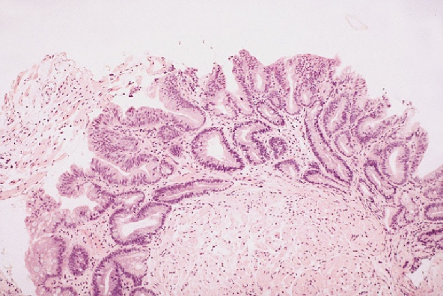
LOW GRADE & HIGH GRADE

Slide 9
NEOPLASIA, TUMOUR, MALIGNANCY
An abnormal, autonomous proliferation of cells unresponsive to normal growth control mechanisms
persists in proliferating even when original stimulus is finished

Slide 10
BENIGN Vs MALIGNANT TUMOURS
DO NOT INVADE DO NOT METASTASISE
ENCAPSULATED
USUALLY WELL DIFFERENTIATED
SLOWLY GROWING
NORMAL MITOSES

Slide 11
Not often fatal unless...
In a dangerous place: meninges, pituitary
Secretes something dangerous: insulinoma

Slide 12
Not often fatal unless...
Gets infected: bladder
Bleeds: benign gastric muscle tumours
Ruptures: ovarian, cyst, liver adenoma
Torts (twisted): ovarian cyst infarcts

Slide 13
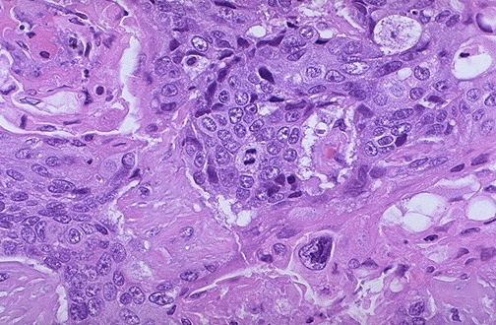
MALIGNANT
INVADE SURROUNDING TISSUES
SPREAD TO DISTANT SITES
NO CAPSULE
WELL TO POORLY DIFFERENTIATED
RAPIDLY GROWING
ABNORMAL MITOSES

Slide 14
METASTASIS
A metastasis is a discontinuous growing colony of tumour cells, at some distance from the primary cancer

Slide 15
METASTASIS
These depend on the lymphatic and vascular drainage of the primary site
Lymph node involvement has a worse prognosis
e.g. Colon:
Dukes A - 90%,
Dukes C - 30%

Slide 16
NOMENCLATURE OF TUMOURS
CARCINOMA
SARCOMA
LEUKAEMIA & LYMPHOMA
TERATOMA
HAMARTOMA
BENIGN EPITHELIAL TUMOURS
CARCINOMA
SARCOMA

Slide 17
CARCINOMA
A malignant tumour derived from epithelium

Slide 18
LEUKAEMIA & LYMPHOMA
Tumours of white blood cells:
Leukaemia a malignant tumour of primitive bone marrow derived cells which circulate in the blood
Lymphoma is a malignant tumour of lymphocytes (usually) in LNs.

Slide 19
TERATOMA
A teratoma is a tumour derived from germ cells, which have the potential to develop into tumours of all three germ cell layers:
ectoderm,
mesoderm,
endoderm

Slide 20
TERATOMA
Common in the gonads, but occur in midline situations
e.g. pituitary, pineal, mediastinum, sacro-coccygeal areas

Slide 21
TERATOMA
Gonadal teratomas in males, all malignant
Gonadal teratomas in females, most are benign

Slide 22
HAMARTOMA
Localised overgrowth of cells and tissues native to the organ.
CELLS are MATURE but ARCHITECTURALLY ABNORMAL
Common in children, and should stop growing when they do,
e.g. Haemangiomas, Bronchial hamartomas, Peutz-Jegher polyps in the gut.

Slide 23
BENIGN EPITHELIAL TUMOURS
Of surface epithelium = PAPILLOMA
e.g. skin, bladder, colon
Of glandular epithelium = ADENOMA
e.g. stomach, thyroid, colon, kidney, pituitary, pancreas

Slide 24
CARCINOMAS
Squamous, adenocarcinoma, transitional cell carcinoma, basal cell carcinoma, and various qualifying names

Slide 25
SARCOMA
A malignant tumour derived from CONNECTIVE TISSUE or mesenchymal cells

Slide 26
SARCOMA
Fat = LipoSARCOMA
Bone = OsteoSARCOMA
Cartilage = ChondroSARCOMA

Slide 27
SARCOMA
Muscle
striated = RhabdomyoSARCOMA,
smooth = LeiomyoSARCOMA
Nerve sheath = Malignant Peripheral Nerve Sheath Tumour

Slide 28
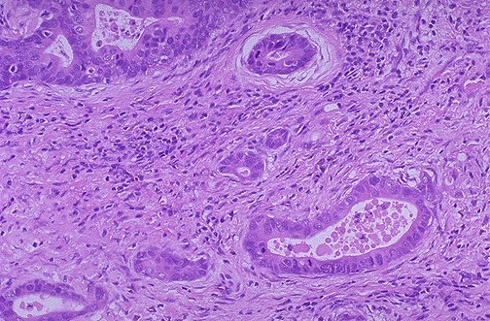
DIFFERENTIATION OF TUMOURS
Criteria for assessing differentiation of a malignant tumour:
evidence of normal function still present - production of keratin, bile, mucin, hormones

Slide 29
DIFFERENTIATION OF TUMOURS
Various grading systems - for Ca breast, prostate, colon
no differentiation, ANAPLASTIC carcinoma

Slide 30
TNM
The grade of a tumour describes its degree of differentiation
The stage of a tumour describes how far it has spread
Tumours of higher grade (i.e. more poorly differentiated) tend to be of higher stage (i.e. spread further)
Overall, stage is more important than grade in determining prognosis
The Tumour, Node, Metastasis (TNM) system can be applied, and individualised, to tumour in all sites

Slide 31
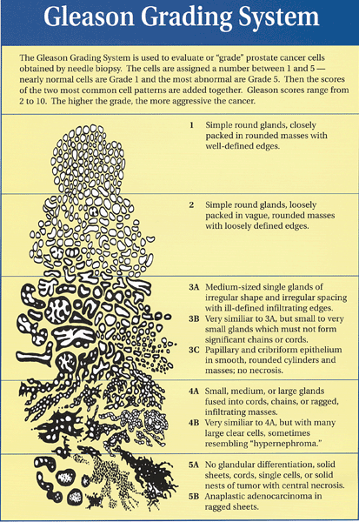
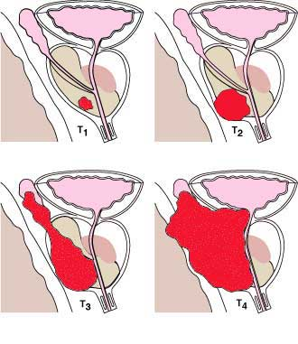
Prostate
Stage
N0, N1

