Slide 1
Cancer 6
Apoptosis
(Programmed cell death, PCD)
Professor Tony Magee
Molecular Medicine
NHLI
t.magee@imperial.ac.uk

Slide 2
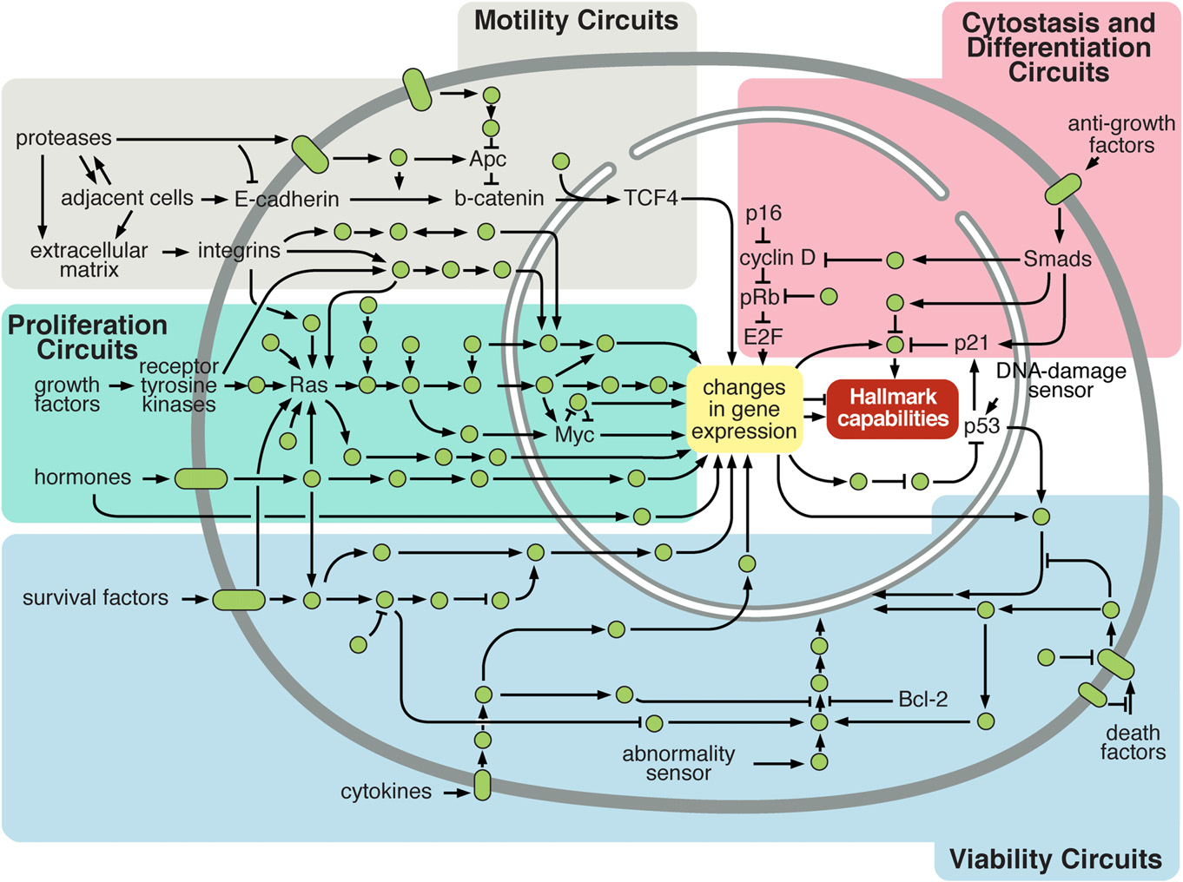
Cell, 2011 Leading Edge Review. Hallmarks of Cancer: The Next Generation
Douglas Hanahan and Robert A. Weinberg
Notes:
Intracellular Signaling Networks Regulate the Operations of the Cancer Cell. An elaborate integrated circuit operates within normal cells and is reprogrammed to regulate hallmark capabilities within cancer cells. Separate subcircuits (differently colored fields) are specialized to orchestrate the various capabilities. This depiction is simplistic, as there is considerable crosstalk between such subcircuits. In addition, because each cancer cell is exposed to a complex mixture of signals from its microenvironment, each of these subcircuits is connected with signals originating from other cells in the tumour microenvironment

Slide 3
Learning objectives:
Explain the difference between necrosis and
apoptosis; describe how they may be distinguished.
Discuss whether necrosis and apoptosis are the
only forms of cell death.
Describe the proteolytic caspase cascades which
execute the apoptotic response.
Discuss how apoptosis may be mediated through
death receptors and/or mitochondria.
Discuss how Bcl-2 family proteins may modulate
apoptosis.

Slide 4
Programmed cell death – why?
1. Harmful cells (e.g. cells with viral infection, DNA damage)
2. Developmentally defective cells (e.g. B lymphocytes expressing antibodies against self antigens)
3. Excess / unnecessary cells:
(embryonic development – e.g. brain to eliminate
excess neurons; liver regeneration; sculpting of digits and organs)
4. Obsolete cells (e.g. mammary epithelium at the end of lactation)
5. Exploitation - Chemotherapeutic killing of cells

Slide 5
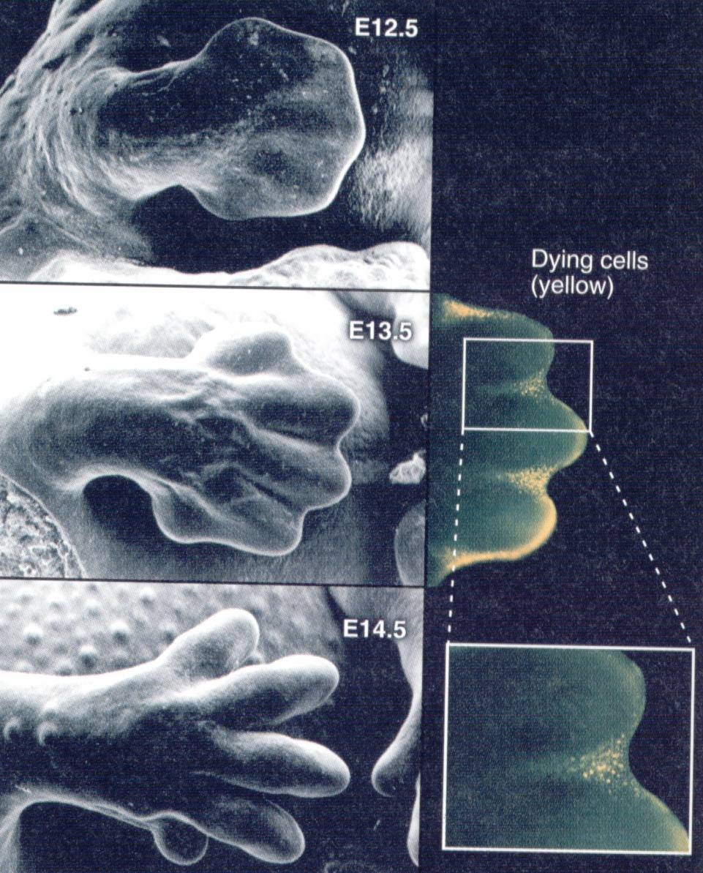
(TUNEL)
Programmed cell
death
in an embryonic
mouse paw

Slide 6
Cell death: necrosis vs. apoptosis
Necrosis - unregulated cell death associated with trauma, cellular disruption and an inflammatory response
Apoptosis (programmed cell death) - regulated cell death; controlled disassembly of cellular contents without disruption; no inflammatory response
2 ways to die?
Apoptosis
Necrosis

Slide 7
Necrosis
Plasma membrane becomes permeable
Cell swelling and rupture of cellular membranes
Release of proteases leading to autodigestion and dissolution of the cell
Localised inflammation

Slide 8
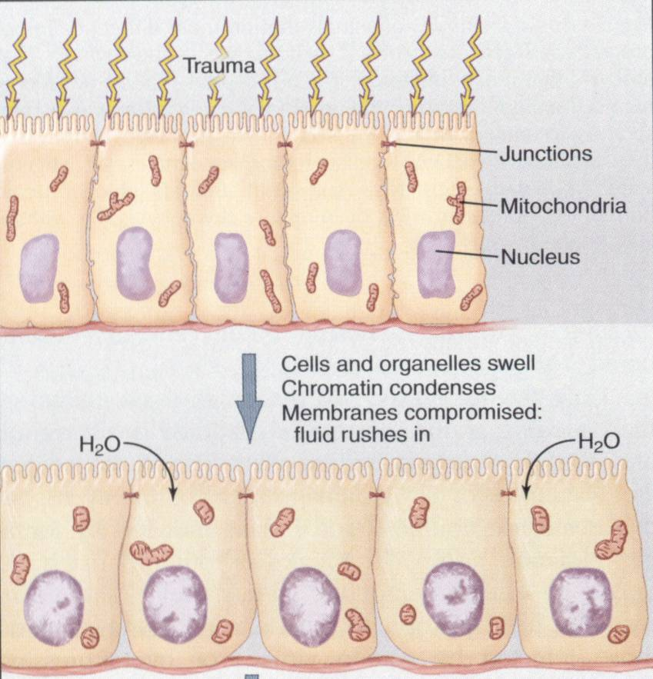
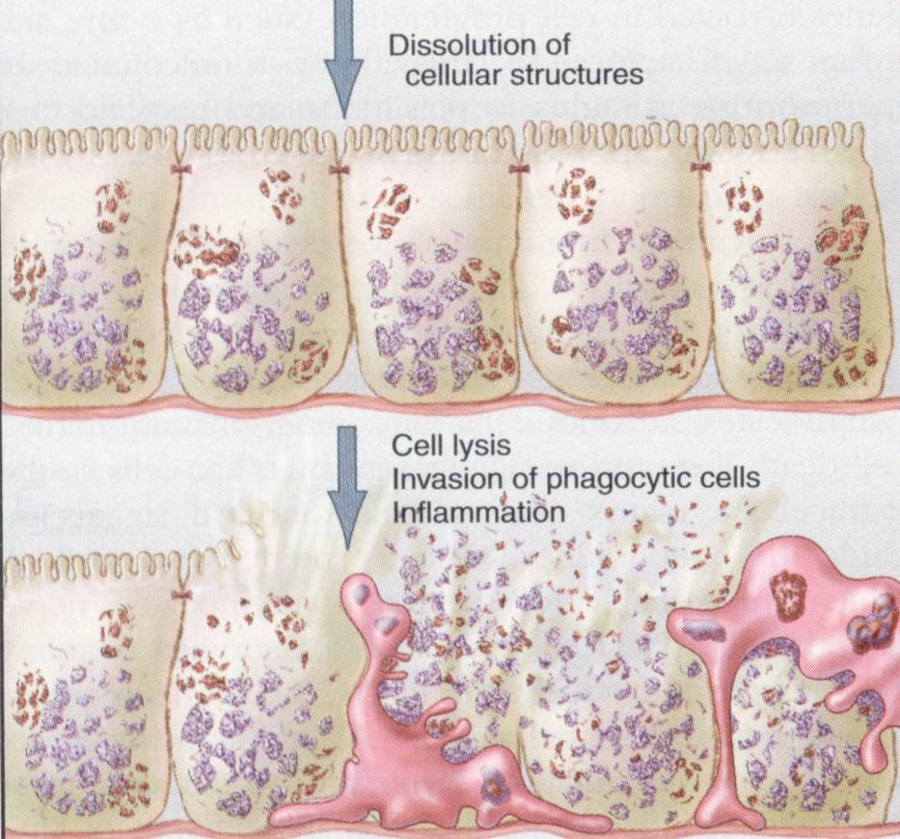
Necrosis

Slide 9
Apoptosis
Latent phase – death pathways are activated, but cells
appear morphologically the same
Execution phase –
Loss of microvilli and intercellular junctions
Cell shrinkage
Loss of plasma membrane asymmetry
(phosphatidylserine lipid appears in outer leaflet)
Chromatin and nuclear condensation
DNA fragmentation
Formation of membrane blebs
Fragmentation into membrane-enclosed apoptotic
bodies
Plasma membrane remains intact

Slide 10
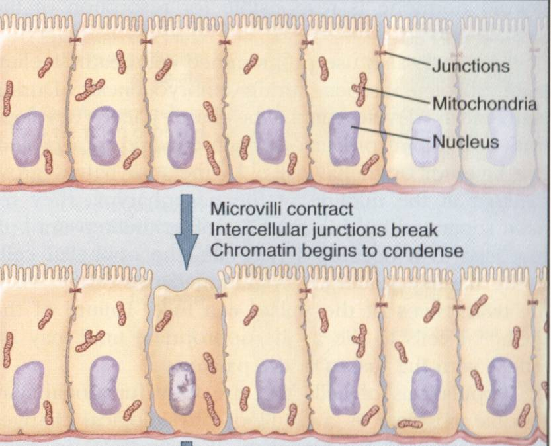
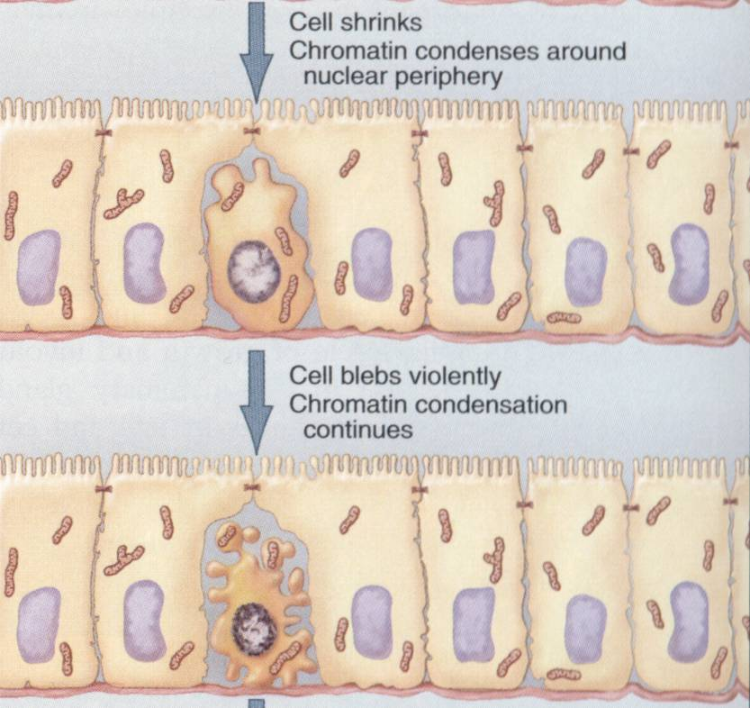
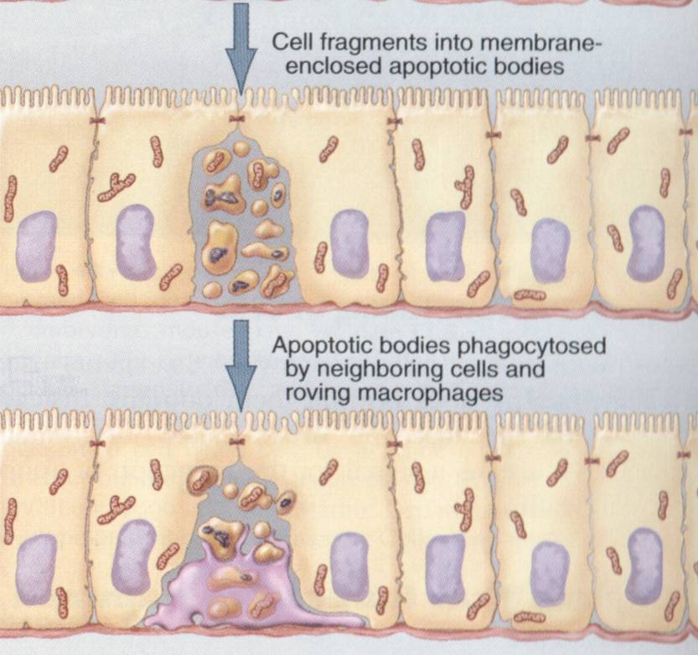
- epithelium closes around

Slide 11
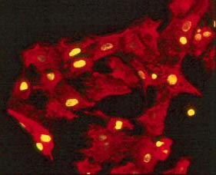
DNA modification in apoptosis
DNA ladders – fragmentation
(agarose gel) “TUNEL” assay
DNA fragmentation leads to more “ends” which are labelled by adding an extra fluorescently tagged base

Slide 12
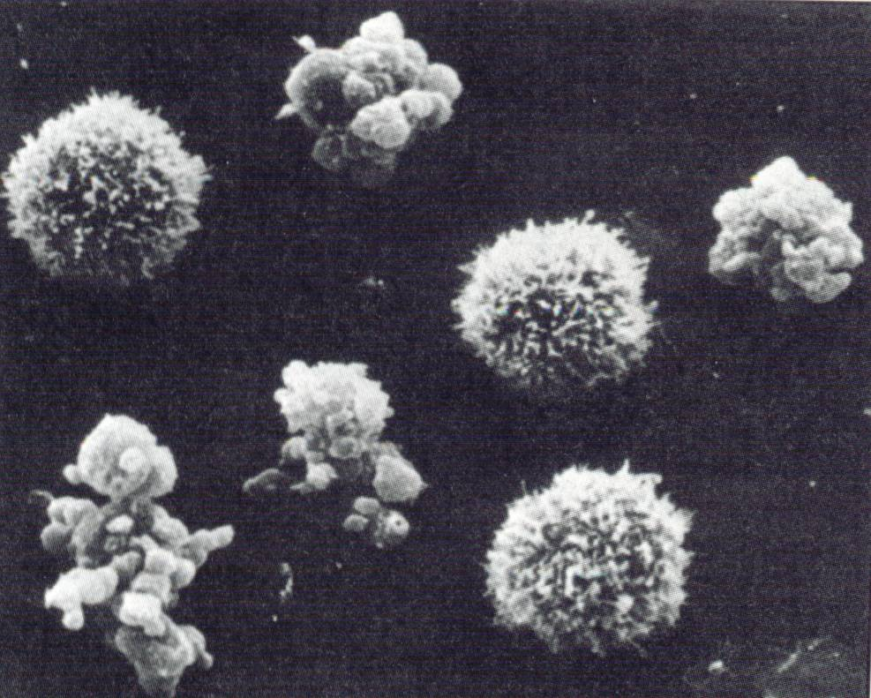
Loss of microvilli, cell shrinkage and cell blebbing
Normal and apoptotic mouse sarcoma cells

Slide 13
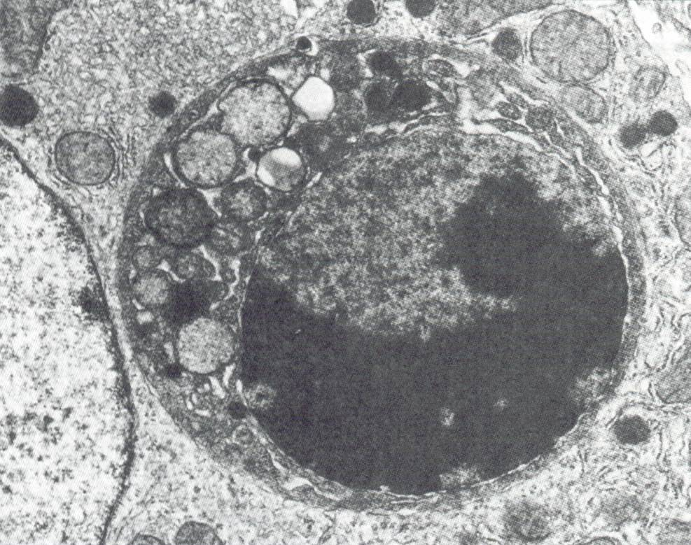
Phagocytosis of apoptotic body by surrounding cells e.g. macrophages

Slide 14
Cell death: Four deaths and a funeral?
(Nature Reviews: Molecular Cell Biology, 2001, 2: 1 - 10)
Necrosis - Unregulated cell death associated with cellular disruption and an inflammatory response
Apoptosis (programmed cell death, PCD) - Regulated cell death; controlled disassembly of cellular contents; no inflammatory response
Apoptosis-like PCD - some, but not all, features of apoptosis. Display of phagocytic recognition molecules before plasma membrane lysis
Necrosis-like PCD - Variable features of apoptosis before cell lysis; “Aborted apoptosis”

Slide 15
Is there a graded response?
Apoptosis
Necrosis
Features of both

Slide 16
Mechanisms of apoptotic cell death
The executioners – Caspases
Initiating the death programme
    Death receptors
    Mitochondria
3. The Bcl-2 family

Slide 17
The executioners - Caspases
Cysteine-dependent aspartate-directed proteases
        Executioners of apoptosis
        Activated by proteolysis
        Cascade of activation

Slide 18
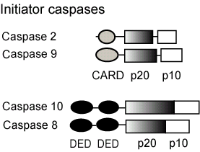
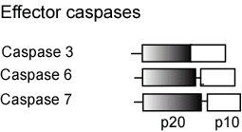
CARD
(CAspase Recruitment Domain)
DED
(Death Effector Domain)
homotypic
protein-protein interactions
(cf. adaptors)

Slide 19
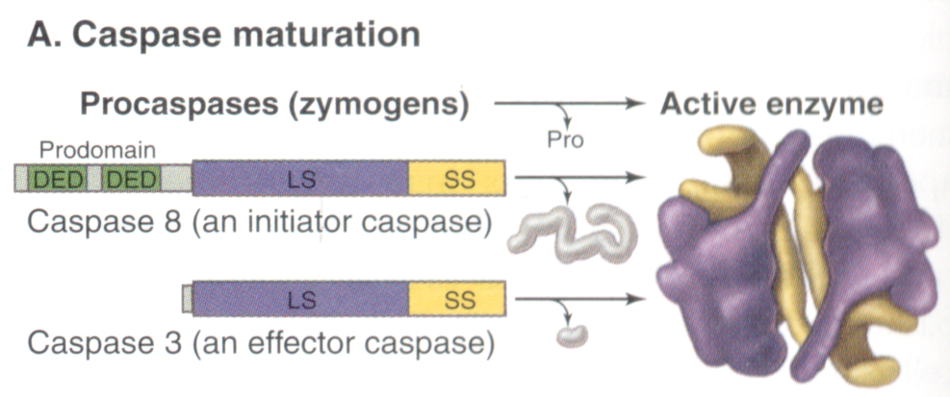
(inactive)
domain
Proteolytic cleavage
Hetero-tetramer

Slide 20
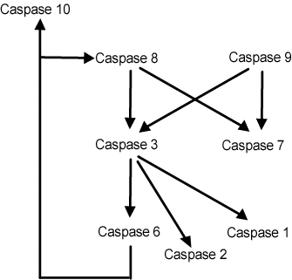
Caspase cascades
        amplification
        divergent responses
        regulation
Initiator caspases – trigger apoptosis by cleaving and activating..
…Effector caspases – carry out the apoptotic programme

Slide 21
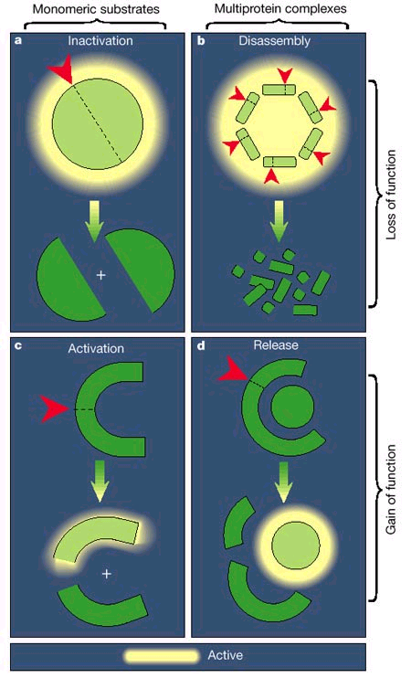
Effector caspases execute the apoptotic programme
Cleave and inactivate proteins or complexes (e.g. nuclear lamins leading to nuclear breakdown)
e.g. nuclear lamins
Activate enzymes
(incl. protein kinases; nucleases, e.g. Caspase-Activated DNase, CAD) by direct cleavage or
cleavage of inhibitory
molecules
e.g. CAD

Slide 22
Mechanisms of Caspase activation
Death by design – Receptor-mediated (extrinsic) pathways
Death by default – Mitochondrial (intrinsic) death pathway

Slide 23
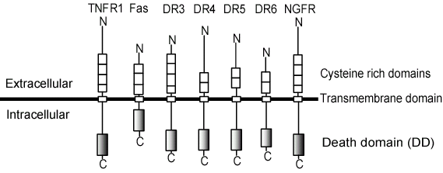
1. Death Receptors
Secreted or transmembrane ligands (trimeric)

Slide 24
Adapter proteins in receptor-mediated apoptosis
Death Domain
(DD)
FADD
DED
DD
Death Effector Domain
(DED)
FLIP
DED
DED

Slide 25
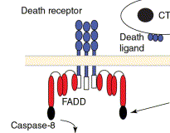
Signalling through Death Receptors, e.g. Fas/Fas-ligand
L
1. Receptor (Fas) trimerisation by ligand (Fas-L on lymphocyte)
(e.g. Fas, upregulated on infected cells)
(Fas-L)
2. Recruitment of adapter protein (FADD) through its DD to DD of Fas
DD
DED
pro
DISC
3. Recruitment and oligomerisation of procaspase 8 through DED to FADD DED –> Death-Inducing Signalling Complex (DISC)

Slide 26
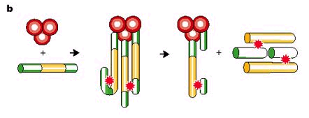
Initiator procaspase 8 oligomerisation results in cleavage and activation
Trimerised receptor tails/FADD
Initiator procaspase
8
Active initiator caspase tetramer released from receptor
cleavage of initiator procaspases
8
Some initiator procaspases have intrinsic low catalytic activity – oligomerisation allows transcleavage
Some procaspases are activated by conformational change on oligomerisation

Slide 27


Death Receptor activation of caspase 8 is inhibited by FLIP
pro
pro
FLIP - caspase homology in DED domain, but no proteolytic activity therefore competes with procaspase

Slide 28
FLIP inhibits procaspase 8 activation
FLIP
Competes for binding to receptor tails/FADD
Incorporates into receptor-procaspase complexes and interferes with transcleavage

Slide 29
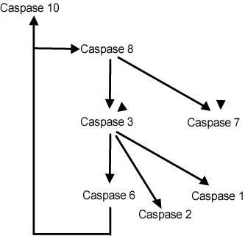
Caspase 8 activates downstream effector caspases
Initiator caspase
Effector caspases – carry out the apoptotic programme

Slide 30
2. Mitochondrial regulation of apoptosis
Cellular stresses e.g. lack of or overstimulation by growth factors, DNA damage (p53)
Loss of mitochondrial
membrane potential (ΔΨ)
Release of cytochrome c
Release of other apoptosis-
inducing factors
Formation of the
apoptosome complex
ΔΨ
Cyt c + other factors
Apoptosome
(Apaf1, caspase 9)

Slide 31

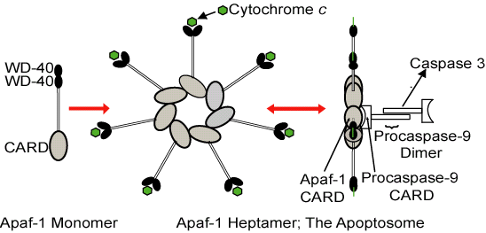
The apoptosome: the wheel of death
Apaf-1 (Apoptotic activating factor-1), Cytochrome c, ATP, procaspase 9
(CAspase Recruitment Domain)
Cyt c
ATP

Slide 32
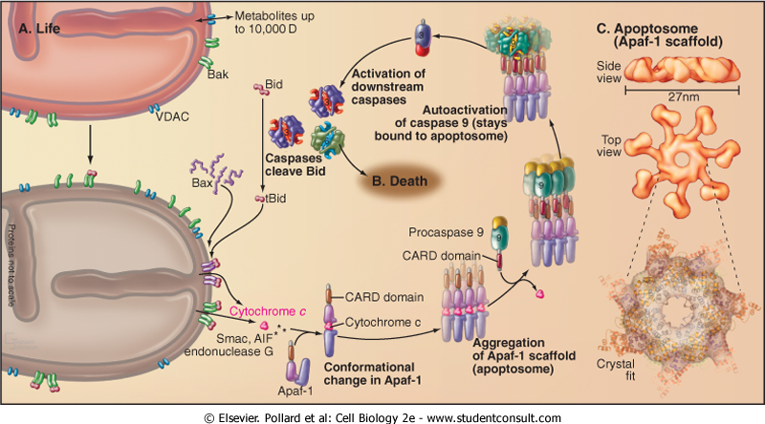
Cyt c
Cyt c bound to WD40 repeats
each Apaf-1 in the heptameric apoptosome can potentially bind a procaspase 9
- oligomerisation brings multiple procaspase 9s close together, resulting in cleavage, activation and release as active caspase 9, which initiates a caspase cascade leading to apoptosis
procaspase 9 binds to
CARD

Slide 33
Principal mechanisms of apoptosis: Bid links receptor and mitochondrial death pathways
FasL, TNF
Caspase 8 cleaves Bid which enhances release of mitochondrial proteins
Cellular stresses
FADD
Bid
ΔΨ
Caspase 8
Cyt c
ATP
Apoptosome
(Apaf1, Caspase 9, ATP)
Caspase 3
cascade
Proteolysis and cell death

Slide 34
Apoptosis requires energy
The apoptosome requires ATP
Energy levels in the cell may determine whether
death is by necrosis or apoptosis
+ ATP
- ATP
Apoptosis
Necrosis

Slide 35
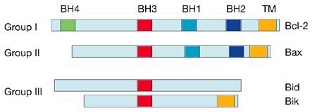
Modulators of apoptosis:
Bcl-2 family proteins
Bad,
Dimerisation motif
TM = transmembrane domain

Slide 36
Bcl-2 family proteins
Anti-apoptotic
Bcl-2
Bcl-xL
(Mitochondrial)
Pro-apoptotic
Bid
Bad
Bax
(move between Cytosol and Mitochondria)

Slide 37
Bcl-2 family proteins
Anti-apoptotic
Bcl-2
Bcl-xL
(Mitochondrial)
Pro-apoptotic
Bid
Bad
Bax
(move between Cytosol and Mitochondria)

Slide 38
Bcl-2 family proteins
Anti-apoptotic
Bcl-2
Bcl-xL
(Mitochondrial)
Pro-apoptotic
Bid
Bad
Bax
(move between Cytosol and Mitochondria)

Slide 39
PI3’-Kinase Signalling Pathway in Cell Cycle and Apoptosis Regulation
Growth factor eg. EGF, insulin
Growth factor receptor eg. EGFR, insulin R
PI3’-K
PTEN
Ras
PDK-1
ERK
PKB/Akt
Growth
Survival
Proliferation
Notes:
39

Slide 40
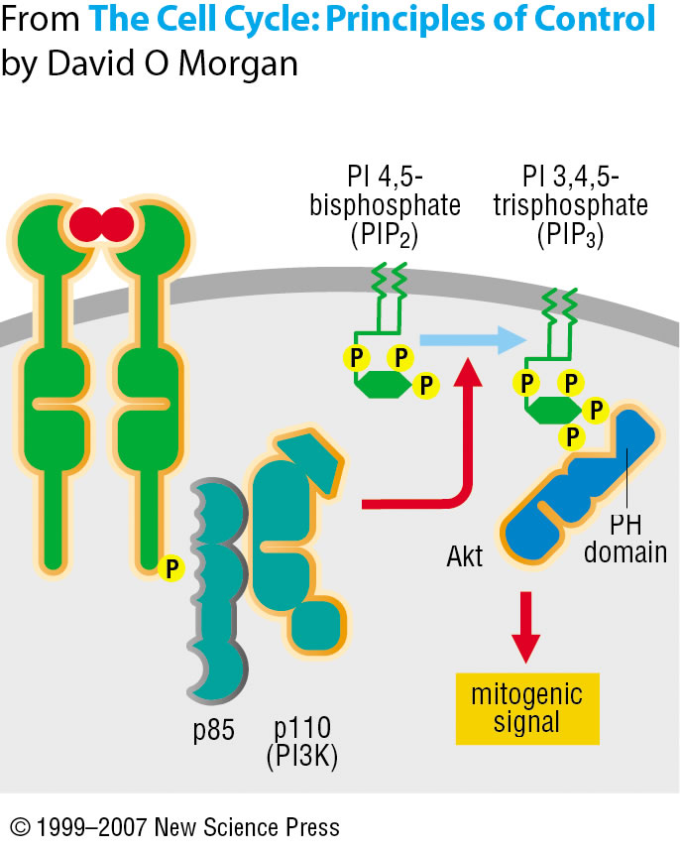
P
Growth Factor Receptor
Phosphatidylinositol 3’-kinase (PI3’-K) – a lipid kinase involved in growth control and cell survival
ATP
PKB/
Akt
Activates protein kinase PKB/Akt which is anti-apoptotic
Tyr
PKB/
and anti-apoptotic
kinase
adapter
PI3’-K

Slide 41
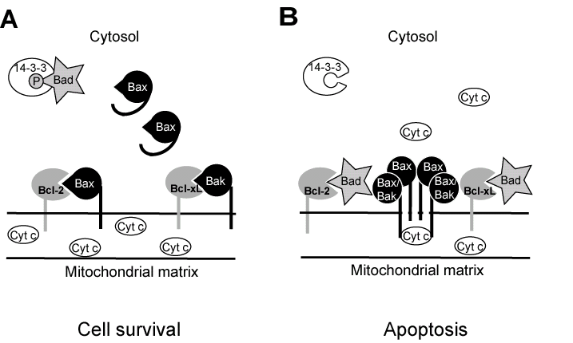
A model for the regulation of apoptosis by Bcl-2 family proteins by BH3 heterodimerisation
PKB/Akt (PI3’-K, GF pathways)
GF absent
P
heterodimers are inactive
phospho-Bad inactive
Bad dephosphorylated and released
displaces Bax/Bak from Bcl-2/-xL ->
Pore ->

Slide 42
PKB/Akt and cell survival
Phosphorylates and inactivates Bad
Phosphorylates and inactivates caspase 9
Inactivates FOXO transcription factors (FOXOs promote expression of apoptosis-promoting genes)
Other, e.g. stimulates protein synthesis

Slide 43
PTEN (lipid phosphatase) counteracts PI3’-K signalling
Phosphatidylinositol 4,5-bisphosphate
P_{i}
PI3’-K
PTEN
Phosphatidylinositol 3,4,5-trisphosphate
Protein kinase B (PKB)/Akt
Cell survival
Protein synthesis

Slide 44
Inhibitor of Apoptosis Proteins (IAPs) regulate PCD
Bind to procaspases and prevent activation
Bind to active caspases and inhibit their activity

Slide 45
Cytoprotective / anti-apoptotic pathways
Bcl-2, Bcl-xL: intrinsic pathway
FLIP, IAPs: extrinsic pathway
growth factor pathways via PI3’-K and PKB/Akt

Slide 46
Proto-oncogenes / tumour suppressors associated with apoptosis
Bcl-2
PKB/Akt
PTEN
Anti-apoptotic – oncogene
Overexpressed in many cancers
Anti-apoptotic - oncogene
Pro-apoptotic – tumour suppressor
Deleted / inactivated in many cancers
BH3 mimics are being developed as promoters of apoptosis of tumour cells

Slide 47
Apoptosis and cancer:
Programmed cell death – uses
Harmful (oncogenic) cells (e.g. cells with viral infection, DNA damage)
Chemotherapeutic killing of tumour cells, e.g. Dexamethasone stimulates DNA cleavage

Slide 48
Apoptosis animations
http://www.promega.com/paguide/animation/selector.htm?coreName=apop01
http://bio-animations.blogspot.com/2008/04/cell-death-necrosis-vs-apoptosis.html

Slide 49
References
Alberts et al., Mol. Biol. of the Cell, 4th edn., Chapter 17
Cell Biology, 2cd edition, Section X. (2008), Pollard, T.D. and Earnshaw, W.C. Saunders Elsevier
Cells, part 5. (2007), Lewin et al. Jones and Bartlett
Leist and Jaattela, 2001, Nature Reviews: Mol. Cell Biol. 2: 1 – 10
Clerk et al., 2003, Pharmacology and Therapeutics 97: 223-261
Riedl and Shi, 2004, Nature Reviews: Mol. Cell Biol. 5: 897-907

