Slide 1
Abnormal white cell counts
Topics to be covered
Investigating an abnormal white cell count
Common causes of an elevated neutrophil, eosinophil or lymphocyte count.
Lymphocytosis how do you distinguish between a reactive or malignant elevation?

Slide 2
Terms you should know
Reduced/raised cell counts
Anaemia/polycthemia
Thrombo (cytopenia/cytosis)
Neutro (penia/philia)
Eosino (penia/philia)
Leuco (penia/cytosis)
Pancytopenia (all lineages reduced)

Slide 3
More terms
Haemopoiesis: production of blood cells in Marrow
Normal haemopoiesis (polyclonal healthy/ reactive)
Normal marrow
Reactive marrow
Malignant haemopoiesis (abnormal/clonal)
Leukaemia (lymphoid,myeloid), myelodysplasia, myeloproliferative

Slide 4
Abnormal WBC
Cell Production
Cell Survival
Reactive
Infection
Inflammation
Malignant
Leukaemia
myeloproliferative
Cell Production
Cell Survival
Impaired BM function
B12 or Folate deficiency
BM failure
Aplastic anaemia
Post chemotherapy
Metastatic cancer
Haematological cancer
Immune breakdown

Slide 5
Two causes of Eosinophilia
Reactive
Primary(malignant)
Eosinophilia
Normal Haemopoiesis
(stimulated by)
Inflammation
Infection
Increased cytokine production
Distant tumour
Haemopoietic or non haemopoietic
AbnormalHaemopoiesis
(autonomous cell growth)
Cancers of haemopoietic cells
Leukaemia
Myeloid or lymphoid
Chronic or acute
Myeloproliferative disorders

Slide 6
WBC production proliferation and differentiation
Immature cells
proliferating and differentiating
from stem cells
Haemopoietic
cancers (leukaemia)
Bone marrow
Peripheral blood
Mature cells
respond to infection
Immature
and mature
cells

Slide 7
Normal Haematopoiesis
Pre T
T-Cell
B-Cell
Pre B
BFU-E
RBCs
Meg-CFC
Megakaryocyte/
platelets
HSC
Granulocytes
GM-CFC
Monocytes

Slide 8
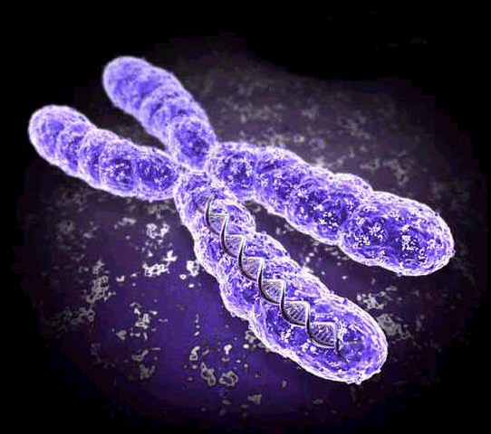
Differentiation & maturation
myeloblast
promyelocyte
myelocyte
BM
metamyelocyte
Peripheral
blood
neutrophil

Slide 9
Controlling Cell numbers
Erythroid
Erythropoietin
Lymphoid
IL2
Myeloid
G-CSF
M-CSF
Cytokines influence differentiation and proliferation
DNA directed differentiation and proliferation
DNA damage >>> cancer (leukaemia/lymphoma/myeloma)

Slide 10
Leucocytes
Myeloblasts
Lymphoblasts
Promyelocytes
Myelocytes
Metamyelocytes
Bone marrow
Peripheral
Blood
immunocytes
T lymphocytes
B lymphocytes
NK cells
phagocytes
granulocytes: neutrophils, eosinophils, basophils
monocytes

Slide 11
Malignant Haematopoiesis (CML)
Pre T
T-Cell
B-Cell
Pre B
BFU-E
RBCs
Meg-CFC
Megakaryocyte/
platelets
HSC
Granulocytes
GM-CFC
Monocytes

Slide 12
How to investigate a raised WCC (1)
History and examination
haemoglobin and platelet count
Automated differential
examine blood film

Slide 13
How to investigate raised WCC (2)
Abnormality White cells only, or all 3 lineages (red cells/platelets/white cells) ?
White cells 1 cell type only, or all lineages? (e.g. neuts/eos/monocytes/lymphocytes)
Mature cells only or mature and immature cells?

Slide 14
elevated WCC
Reactive/
infection
Neutrophils+
myelocytes+
basophils
?Chronic myeloid
leukaemia
All lineages
or only one
neuts, eos, baso
Mature+
immature
mature cells
Immature cells
Blasts +
low Hb
low platelets
? Acute leukaemia
Lymphocytes
Reactive(viral) or primary
(chronic lymphocytic leukaemia)

Slide 15
Normal FBC
Hb 12-16 g/dl
Platelets 150-400 x 10⁹/l
WCC 4-11 x 10⁹/l
Neutrophils 2.5-7.5 x 10⁹/l
lymphocytes 1.5-3.5 x 10⁹/l
monocytes 0.2-0.8 x 10⁹/l
eosinophils 0.04-0.44 x 10⁹/l
basophils 0.01-0.1 x 10⁹/l

Slide 16
Common causes of abnormal White cell counts
Phagocytes
Neutrophils
Eosinophils
Monocytes
Immune cells
Lymphocytes

Slide 17
neutrophils
present in BM, blood and tissues
life span 2-3 days in tissues (hours in PB)
50% circulating neutrophils are marginated (not counted in FBC)
Neutrophilia can develop in:
minutes > demargination
hours > early release from BM
days > increased production (x3 in infection)

Slide 18
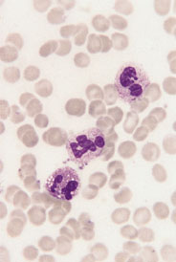
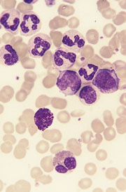
PB in infection
Neutrophilia >7.5x10⁹/l
toxic granulation
vacuoles
PB in leukaemia
Chronic leukaemia
Chronic myeloid leukaemia
Neutrophilia and
Precursor cells (myelocytes)

Slide 19
Neutrophilia (causes)
infection
tissue inflammation (e.g.colitis, pancreatitis)
Physical stress, adrenaline, corticosteroids
underlying neoplasia
Malignant neutrophilia
myeloproliferative disorders
CML

Slide 20
Neutrophilia in infection
Localised and systemic infections
acute bacterial, fungal, certain viral infections
Some infections characteristically do not produce a neutrophilia e.g. brucella, typhoid, many viral infections.

Slide 21
Eosinophilia (causes)
1 Reactive
Parasitic infestation
allergic diseases e.g. asthma, rheumatoid, polyarteritis,pulmonary eosinophilia.
Neoplasms, esp. Hodgkin’s, T-cell NHL
hypereosinophilic syndrome
Malignant Chronic Eosinophilic Leukaemia (PDGFR fusion gene)

Slide 22
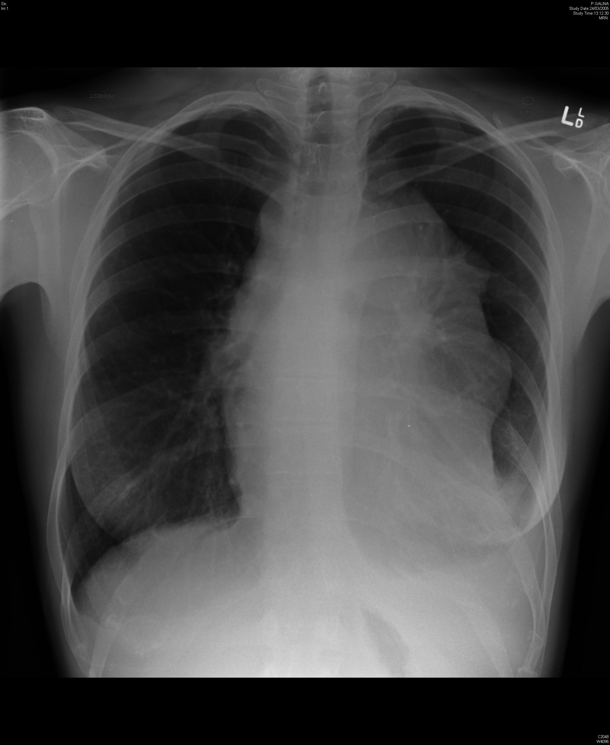
Eosinophilia and malignant disease
Lymphoma
Hodgkin
T cell NHL
Reactive
Interleukin 5
,
Malignant
clonal
HSC
GM CFC Eo

Slide 23
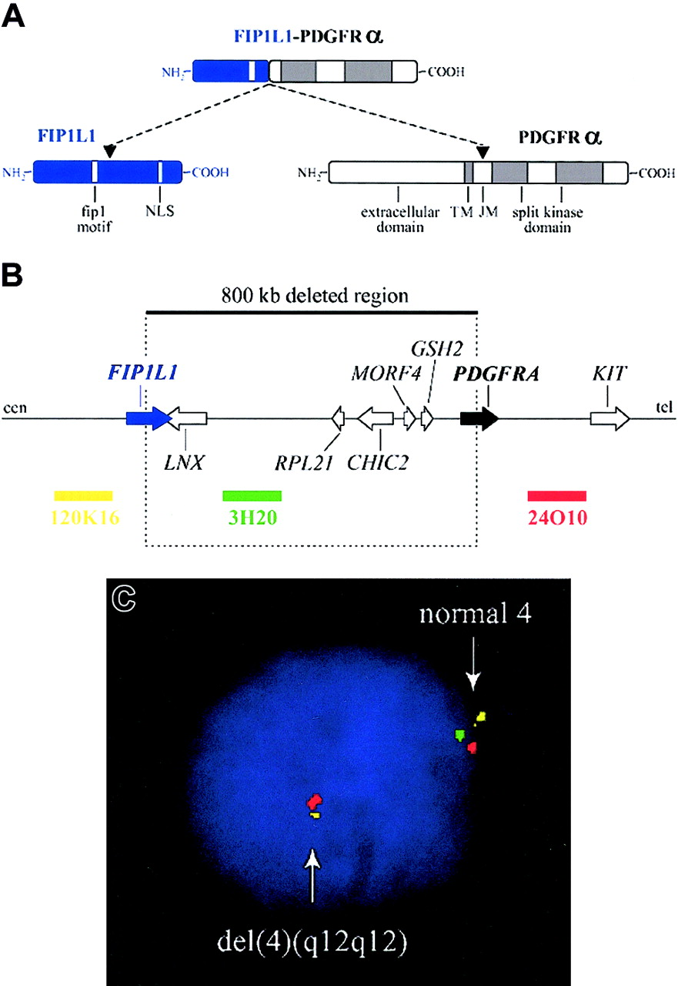
Figure 2. Fusion of FIP1L1 to PDGFRA
Chronic eosinophilic leukaemia
Gotlib, J. et al. Blood 2004;103:2879-2891

Slide 24
monocytosis
Rare but seen in certain chronic infections and primary haematological disorders
TB, brucella, typhoid
Viral; CMV, varicella zoster
sarcoidosis
chronic myelomonocytic leukaemia (MDS)

Slide 25
Reactive elevated phagocyte count

Slide 26
Lymphocytosis
mature or immature cells
If mature is it :
reactive to infection
primary disorder
If immature it is:
primary disorder (leukaemia/lymphoma)

Slide 27
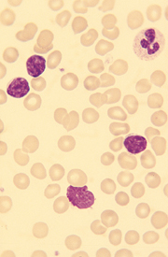
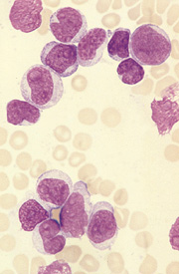
Mature lymphocytes
CLL
autoimmune/inflammatory
disease
Immature lymphoblasts
Acute lymphoblastic leukaemia

Slide 28
Lymphocytosis (mature cells)
Is it primary or reactive ?
Secondary (reactive); polyclonal response to infection, chronic inflammation, or underlying malignancy.
primary; monoclonal lymphoid proliferation e.g. CLL

Slide 29
Reactive lymphocytosis
Infection
EBV, CMV, Toxoplasma
infectious hepatitis, rubella, herpes infections
Autoimmune disorders
neoplasia
sarcoidosis

Slide 30
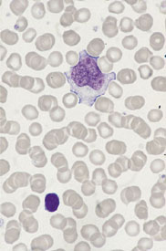
“atypical lymphocyte”
Mononucleosis syndrome

Slide 31
Glandular Fever
EBV infection of B-lymphocytes via CD21 receptor
infected B-cell proliferates and expresses EBV associated antigens
Cytotoxic T-lymphocyte response
acute infection resolved resulting in lifelong sub-clinical infection.

Slide 32
Lymphocytosis
Elderly patients with lymphocytosis
mature lymphocytes (may be smear cells)
differential: reactive to underlying auto immune disorder or chronic lymphocytic leukaemia
how can you distinguish?
Morphology
immunophenotype
gene rearragement

Slide 33
Evaluating lymphocytosis (B cells) Light chain restriction
polyclonal
Kappa &
lambda
Monoclonal
kappa only or
lambda only

Slide 34
Evaluating lymphocytosis (3) gene rearrangement
Imuunoglobulin genes (Ig) and T cell receptor (TCR) genes undergo recombination in antigen stimulated B cells or T cells.
With primary monoclonal proliferation all daughter cells carry identical configuration of Ig, or TCR gene. This can be detected by Southern Blot analysis

Slide 35
conclusion
Look at all aspects of FBC
Look at automated differential
Look at blood film
Now some test cases.

Slide 36
Normal FBC
Hb 12-16 g/dl
Platelets 150-400 x 10⁹/l
WCC 4-11 x 10⁹/l
neutrophils 2.5-7.5 x 10⁹/l
lymphocytes 1.5-3.5 x 10⁹/l
monocytes 0.2-0.8 x 10⁹/l
eosinophils 0.04-0.44 x 10⁹/l
basophils 0.01-0.1 x 10⁹/l

Slide 37
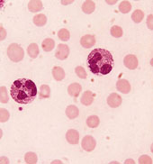
23 year old medical student
previously well. Post elective in Egypt developed malaise.
routine FBC
Hb 13 g/dl
platelets 450 x 10⁹/l
WCC 15 x 10⁹/l
neuts 4 x 10⁹/l
eos 5 x 10⁹/l
lymphs 2 x 10⁹/l
List 2 Likely causes?

Slide 38
Parasitic infestation (schistosomiasis)
Underlying lymphoma (HL or T NHL)
allergic autoimmune disorder (asthma/urticaria)

Slide 39
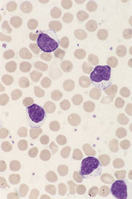
A 65 year old woman
Hb 13 g/dl
platelets 250 x 10⁹/l
WCC 17 x 10⁹/l
neuts 4 x 10⁹/l
eos 0.5 x 10⁹/l
lymphs 12.5 x 10⁹/l
Are these mature or immature?
Could this be leukaemia?
What is your next investigation?

Slide 40
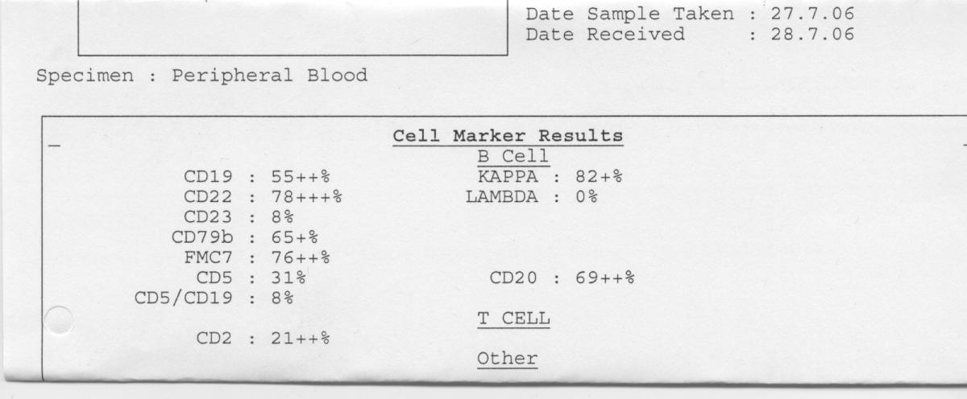
Peripheral blood immunophenotype
Is this a reactive or malignant lymphocytosis
What is the likely diagnosis?

Slide 41
These are mature lymphocytes
Reactive (viral infection,TB)
Primary/monoclonal (CLL)
look for light chain restriction or T cell receptor rearrangement

Slide 42
A 21 year old woman
Hb 8 g/dl
platelets 15 x 10⁹/l
WCC 27 x 10⁹/l
neuts 0.4 x 10⁹/l
eos 0.5 x 10⁹/l
lymphs 1.2 x 10⁹/l
Is this a viral infection
or acute leukaemia?

Slide 43
45 year old man
Hb 13 g/dl
platelets 650 x 10⁹/l
WCC 65 x 10⁹/l
neuts 52 x 10⁹/l
eos 0.4 x 10⁹/l
lymphs 2 x 10⁹/l
Both mature and
immature cells present
is this secondary to
infection?

