Slide 1
Neuroscience and Mental Health Spinal function and dysfunction Dr MB Lowrie

Slide 3
Factors affecting the severity of a spinal lesion
Loss of neural tissue
Vertical level
Transverse plane

Slide 4
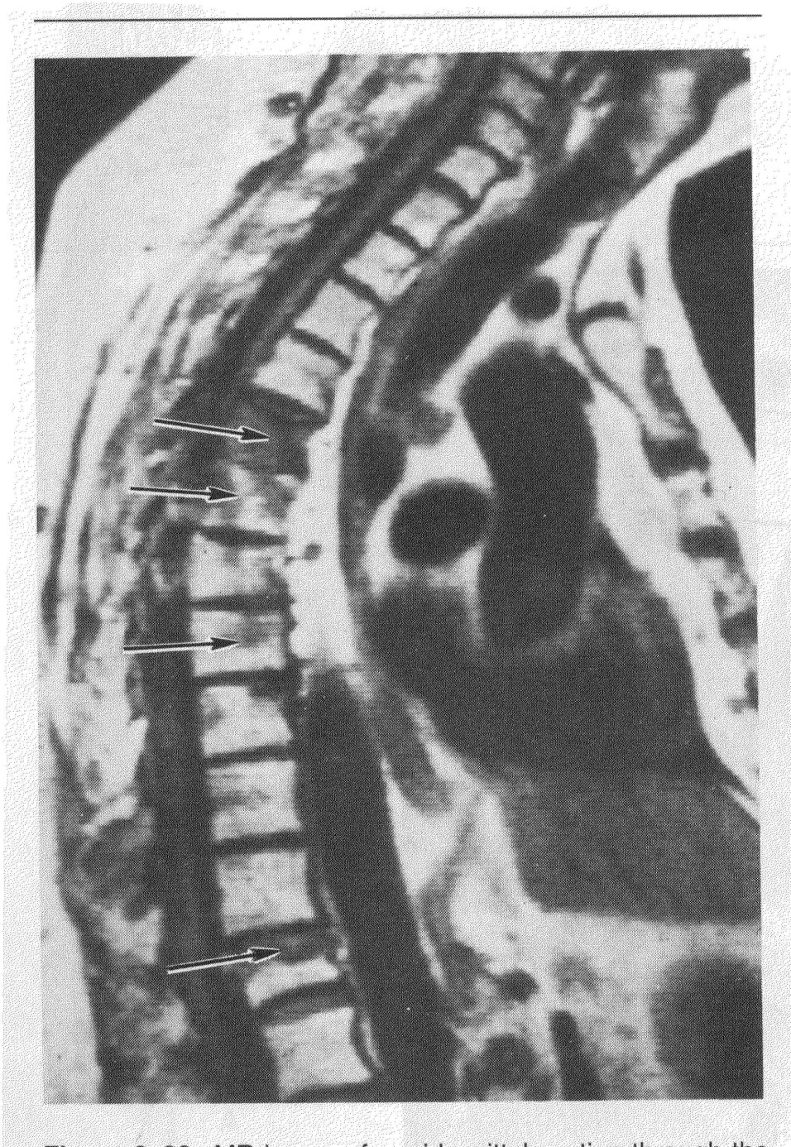
Secondary spinal cord degeneration
MRI showing secondary lymphomas

Slide 5
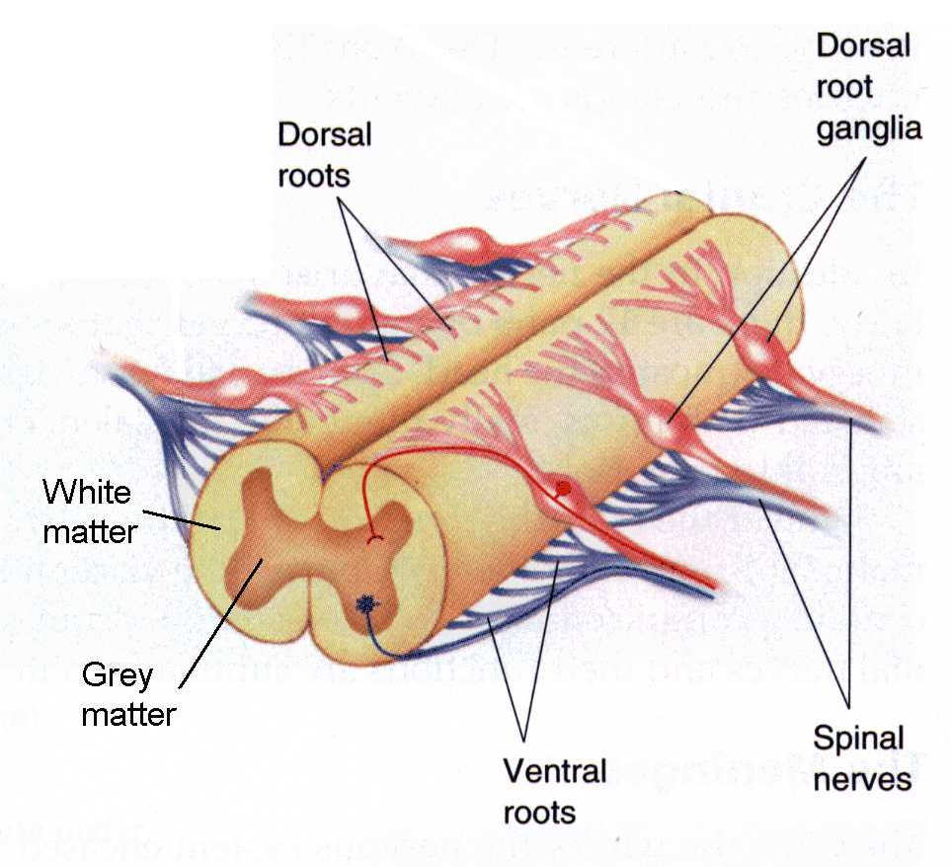
Spinal cord

Slide 6
Factors affecting the severity of a spinal lesion
Loss of neural tissue
Vertical level
Transverse plane

Slide 7
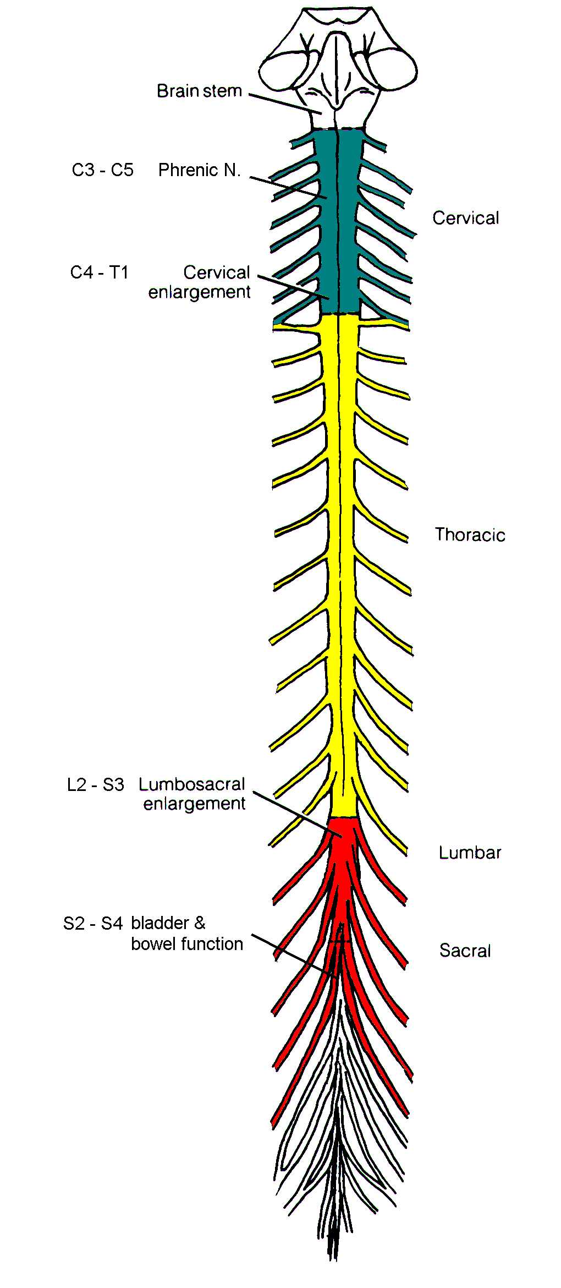

Slide 9
The higher the lesion the greater the disability
Notes:
9

Slide 10
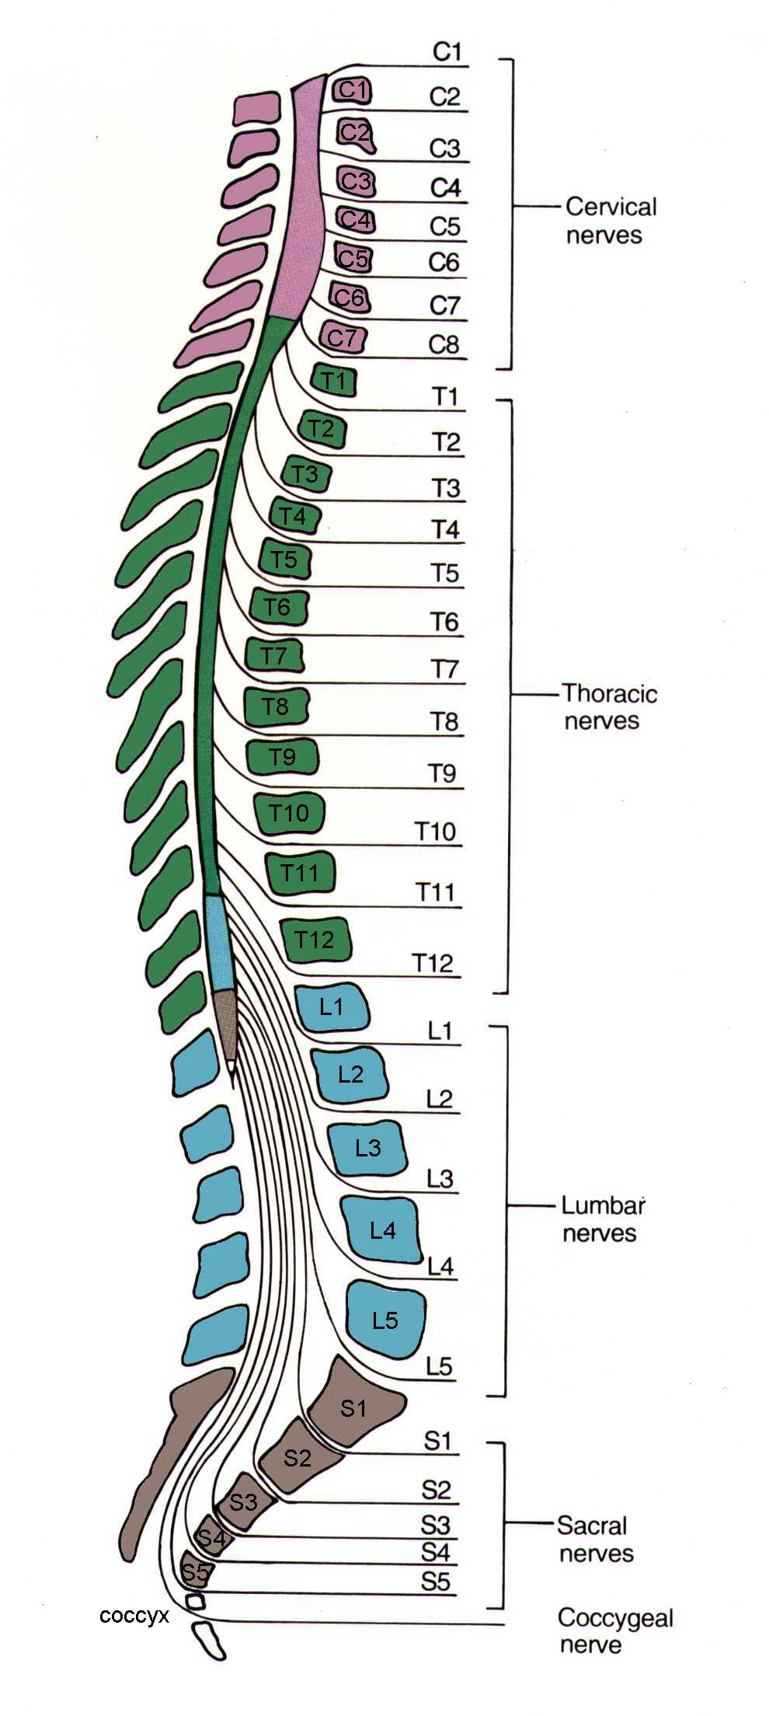
Spinal and vertebral levels
Notes:
10

Slide 11
Spinal and vertebral levels
Lumbar & sacral spinal segments are higher than their corresponding vertebrae
Lumbar cistern may be used to sample CSF
Notes:
11

Slide 12
Meningeal coverings of the spinal cord

Slide 13
Factors affecting the severity of a spinal lesion
Loss of neural tissue
Vertical level
Transverse plane

Slide 14
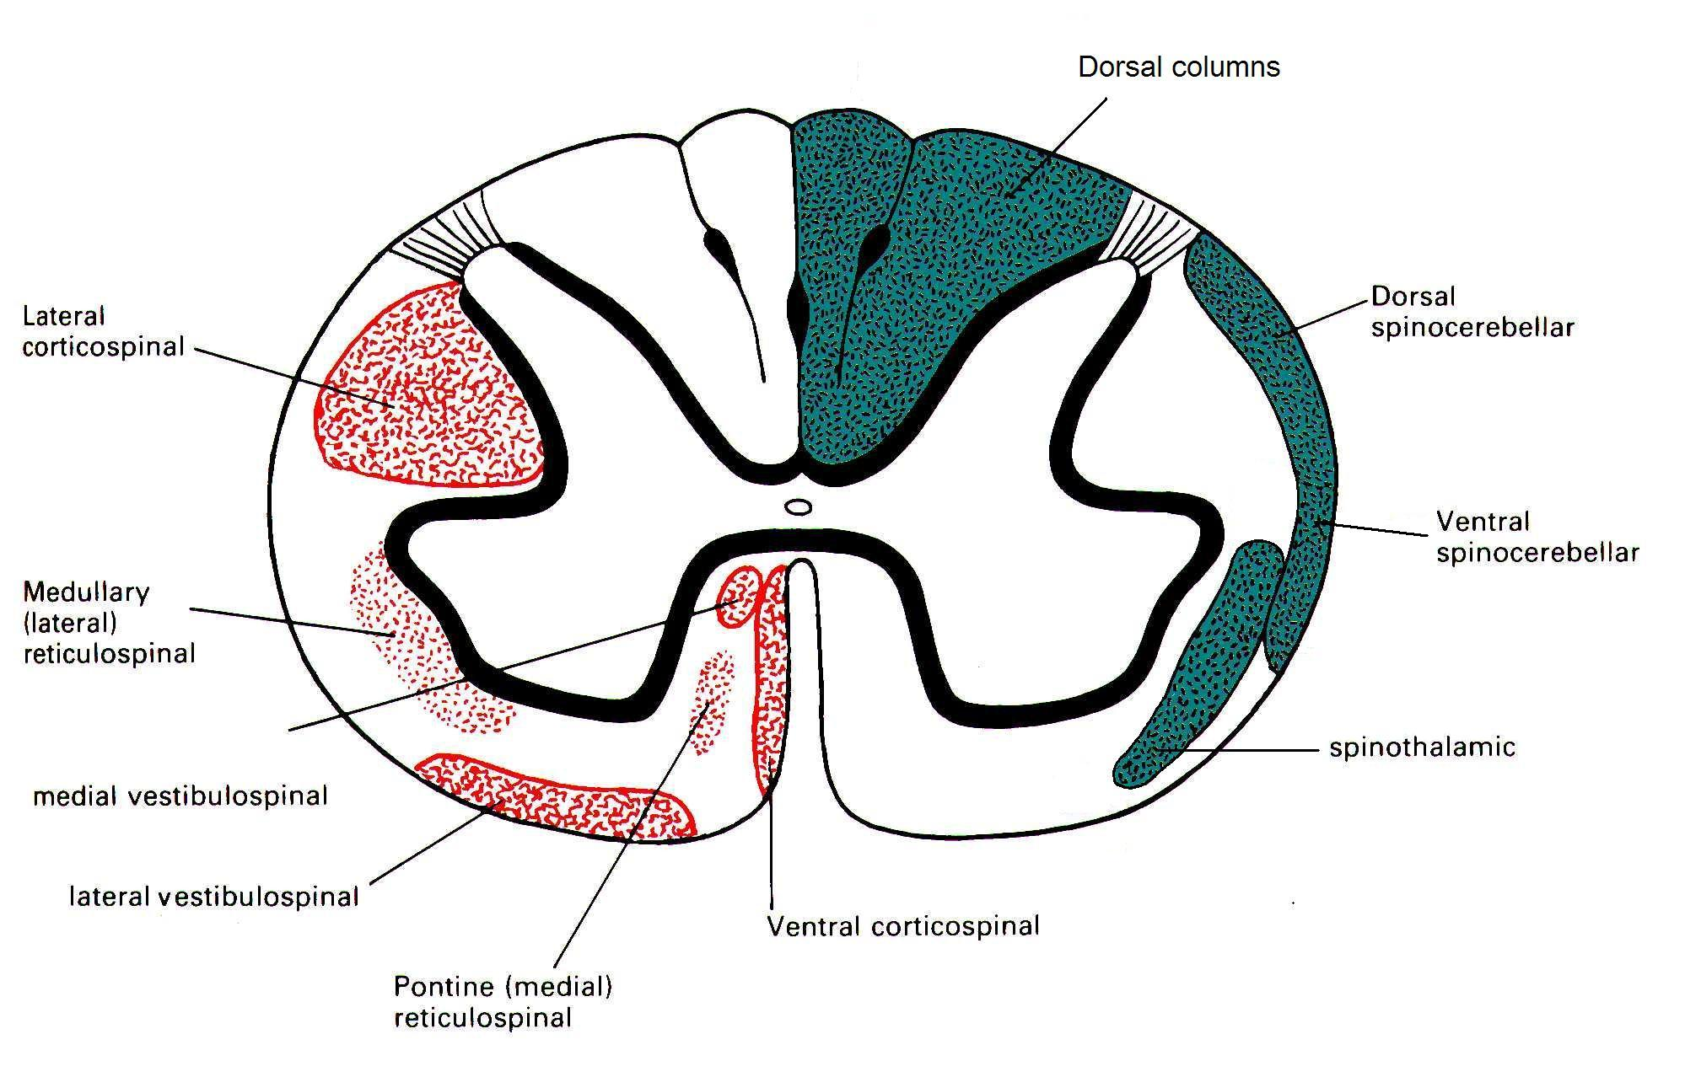
Transverse plane
Descending tracts
Ascending tracts

Slide 15
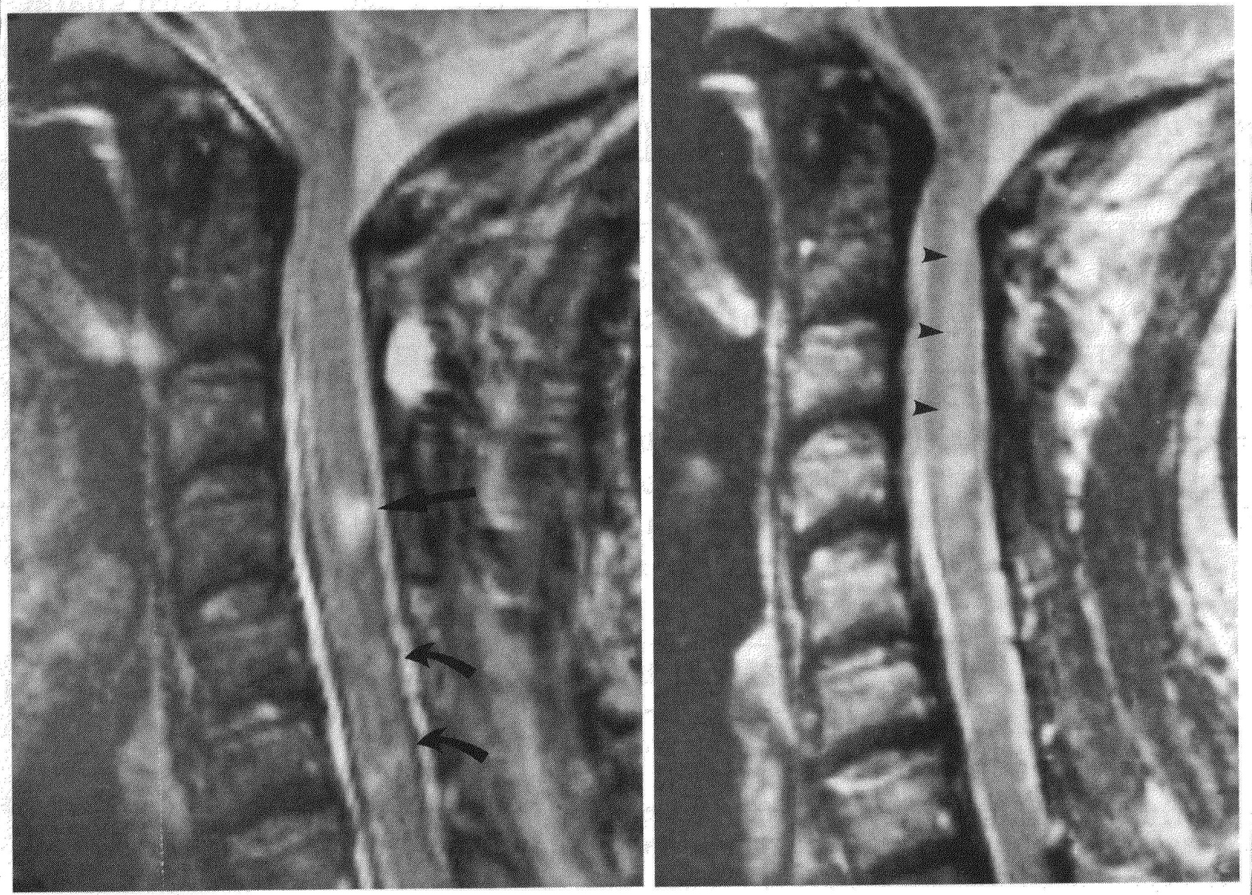
Dorsal columns injury
MRI
6 wks
MRI
16 wks

Slide 16
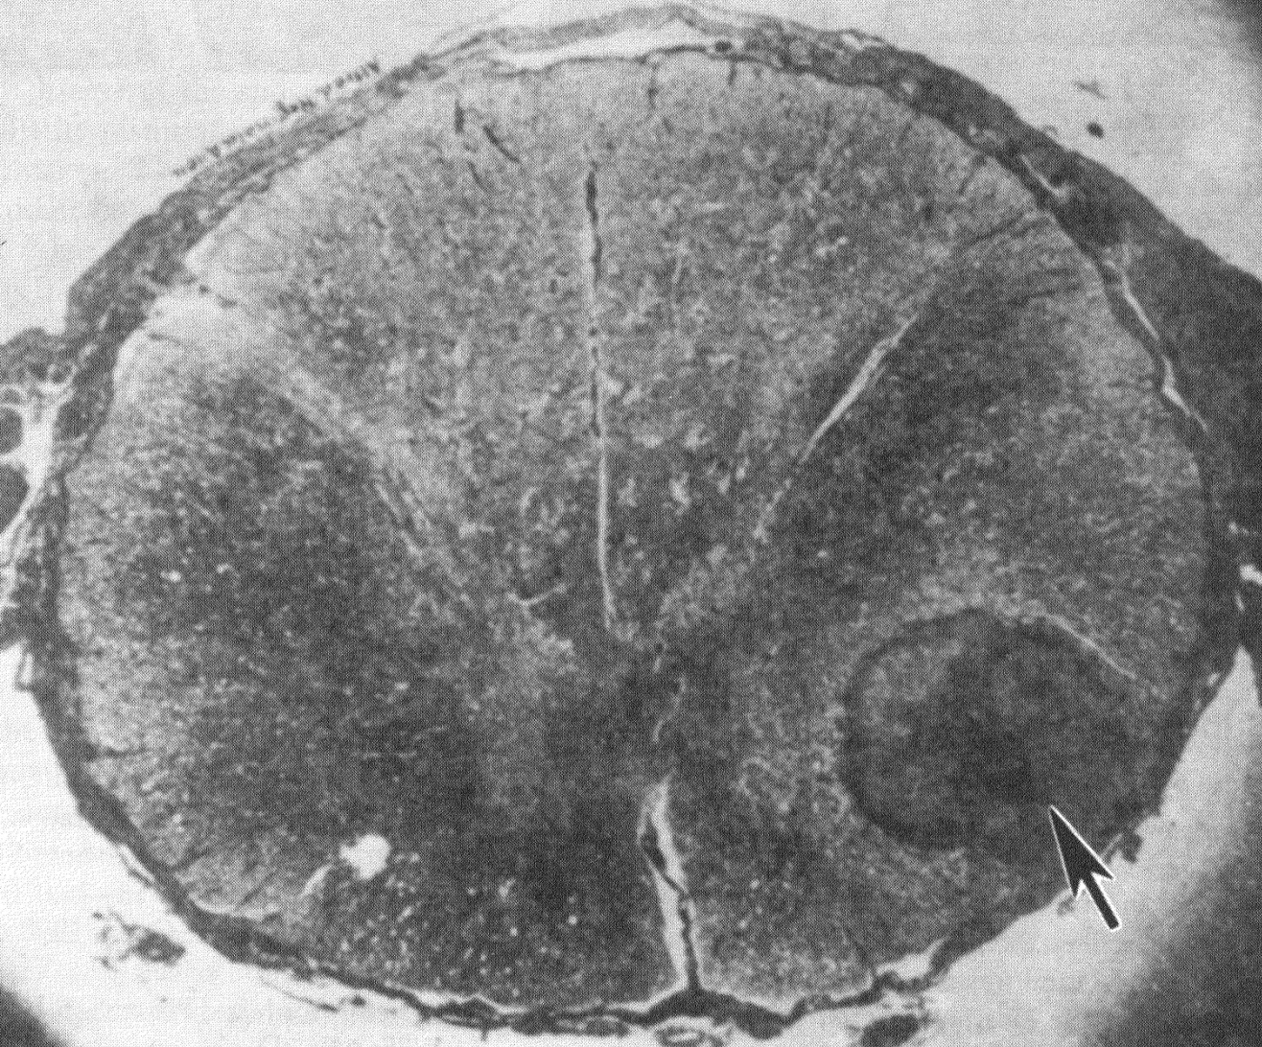
Spinal glioma
transverse pathology section

Slide 17
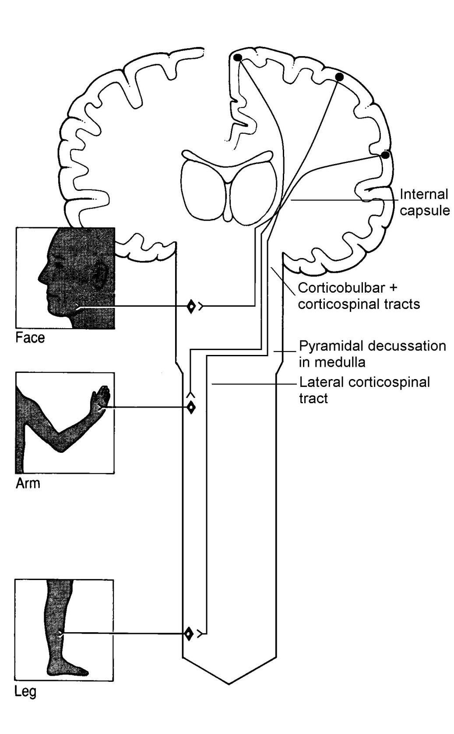
Lateral corticospinal tract
voluntary motor control

Slide 18
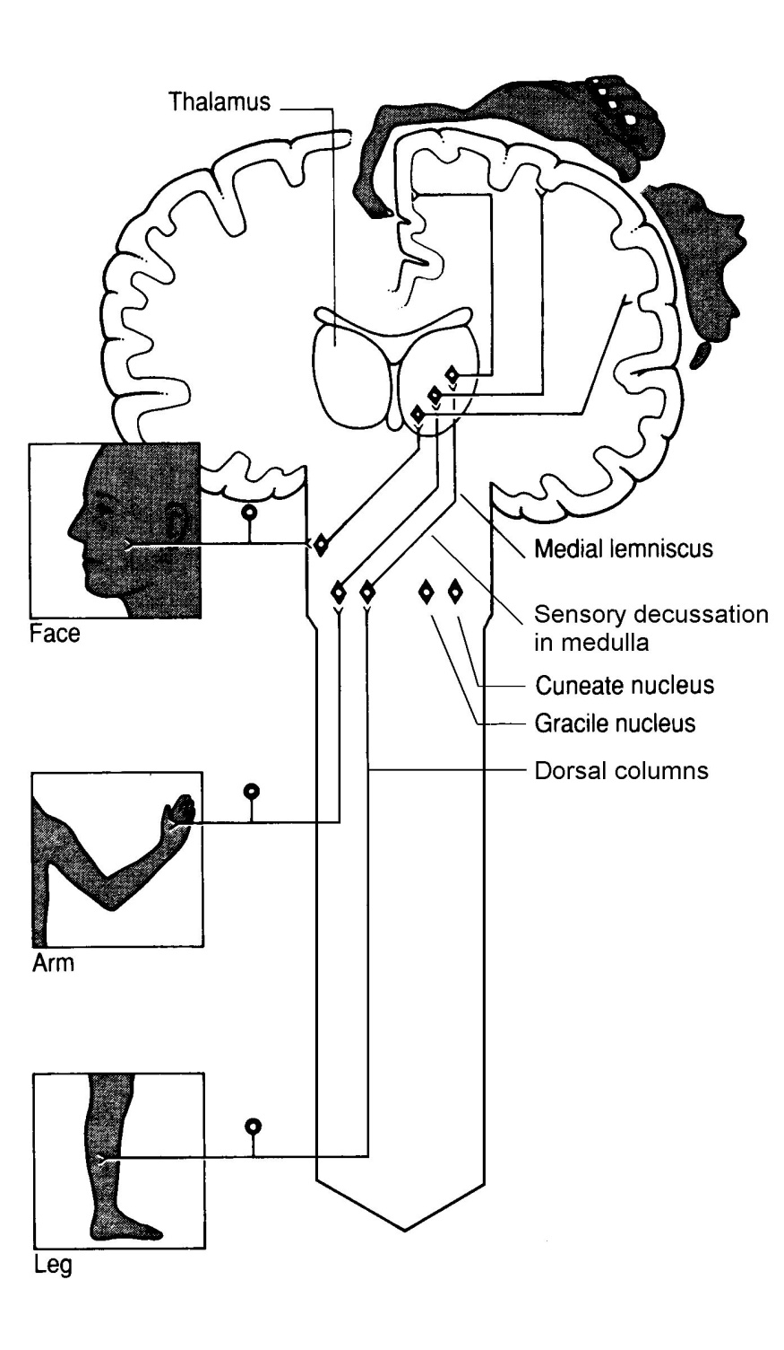
Dorsal columns
fine touch and proprioception

Slide 19
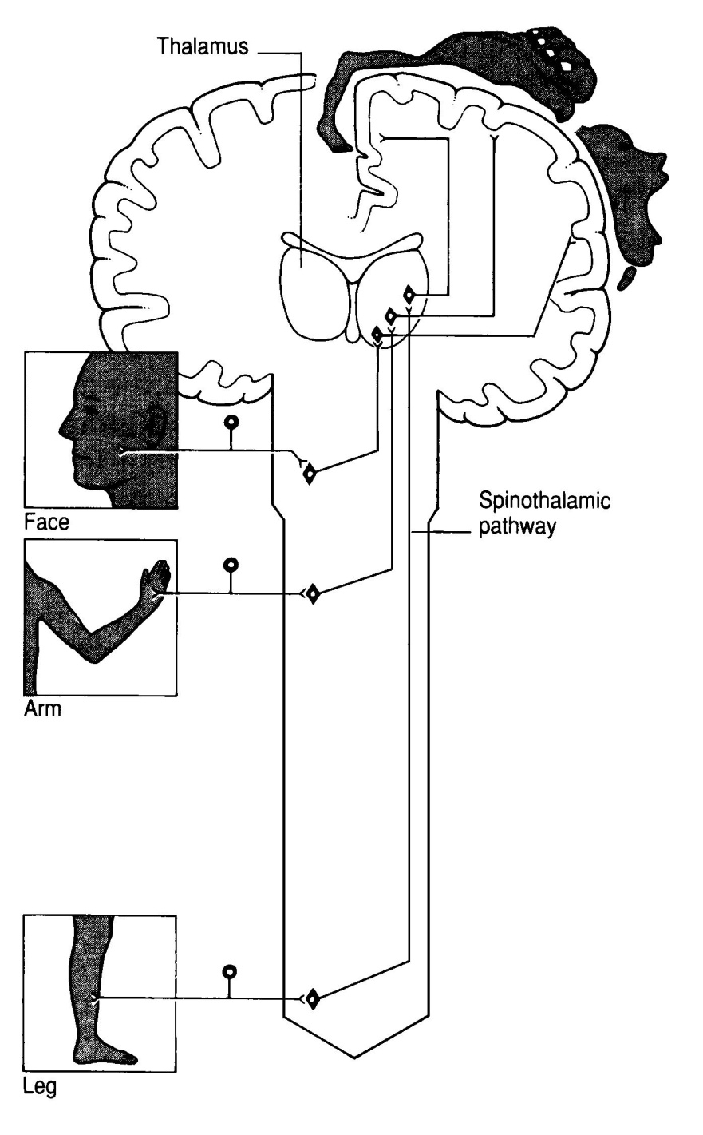
Spinothalamic tract
pain and temperature
Notes:
19

Slide 20
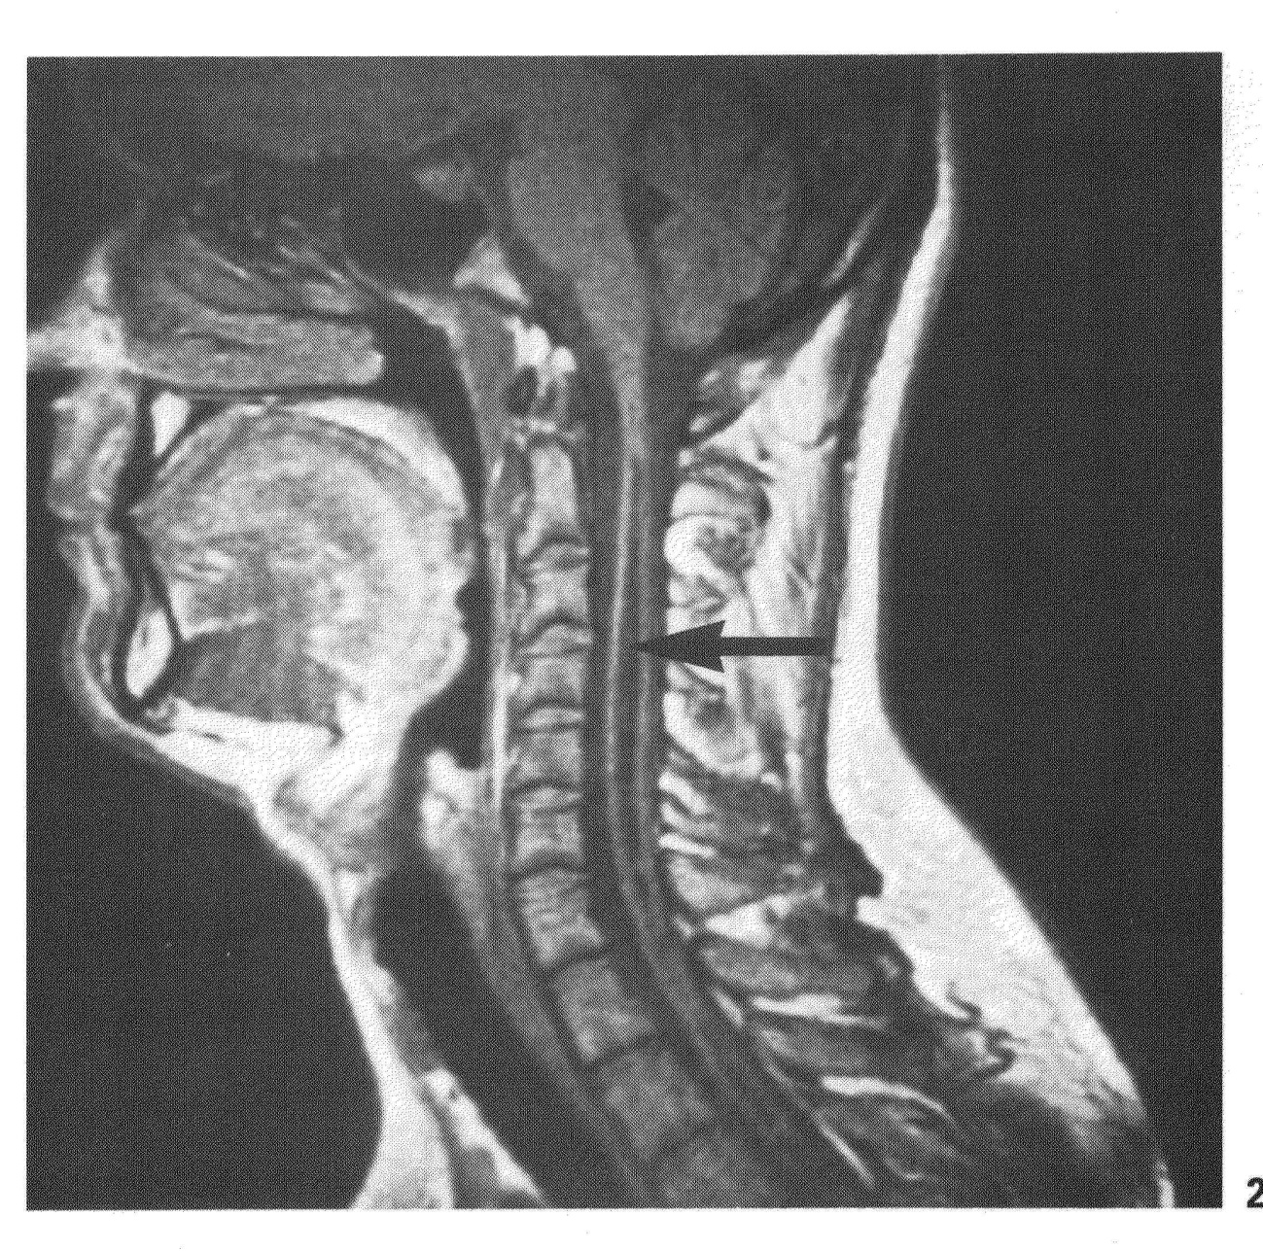
Syringomyelia

