Slide 1
Language and thinking
David Murphy
Consultant Clinical Psychologist
& Hon. Senior Lecturer (Module Leader)
14 January 2013

Slide 2
Learning objectives
Language
Define the structural building blocks of language
Outline the normal course of language development in children
Describe the importance of hemisphere lateralization and the regions of the brain involved in language
Define the main types of aphasia
Thinking
Describe deductive and inductive reasoning
Describe Heuristics
Define the “Availability”’ and “Representativeness” heuristics
Contrast “hot” and “cold” systems of thinking
Describe the concept of “Executive Functioning‟ and the role of the pre-frontal cortex in higher mental functions.
Describe the dysexecutive syndrome

Slide 3
Language
“The jewel in the crown of cognition” Pinker 2000
“The human essence” Chomsky 1972

Slide 4
Structure of language
Phoneme: the smallest unit of speech sound in a language that can signal a difference in meaning
  Humans can produce just over 100 phonemes; English language consists of 44 phonemes, there are only 11 in Rotokas and as many as 112 in !Xóõ (including four tones).
Morphemes: the smallest units of meaning in a language
  Typically consist of one syllable
  Morphemes are combined into words

Slide 5
The structure of language

Slide 6
Surface Structure: the symbols that are used and their order
Three different surface structures can convey the same underlying meaning e.g.
Sam ate the cake
The cake was eaten by Sam
Eaten by Sam the cake was

Slide 7
Deep Structure: the underlying meaning of the combined symbols
A single surface structure can give rise to two different deep structures e.g.
“ The Police must stop drinking after midnight”

Slide 8
Language development
Age | Speech characteristics
1-3 Months | Infant can distinguish speech from non-speech sounds and prefers speech sounds (phonemes). Undifferentiated crying gives way to cooing when happy.
4-6 Months | Babbling sounds begin to occur. These contain sounds from virtually every language. Child vocalizes in response to verbalizations of others.
7-11 Months | Babbling sounds narrow to include only the phonemes heard in the language spoken by others in the environment. Child moves tongue with vocalizations. Child discriminate some words without understanding their meaning and begins to imitate word sounds heard from others.
12 Months | First recognizable words typically spoken as one-word utterances to name familiar people or objects (e.g da-da)
12-18 Months | Child increases knowledge of word meanings and begins to use single words to express whole phrases or requests (e.g. “out” to express desire to get out of the cot); primarily uses nouns.
18-24 Months | Vocabulary expands to between 50-100 words. First rudimentary sentences appear, usually consisting of two words (e.g. “more milk!”) with little or no use of articles (the,a), conjunctions (and) or auxiliary verbs (can, will). This condensed or telegraphic speech is characteristic of first sentences thought-out the world.
2-4 Years | Vocabulary expands rapidly at the rate of several hundred words every 6 months. Two-word sentences give way to linger sentences that, though often grammatically incorrect, exhibit basic language syntax. Child begins to express concepts with words and to use language to describe imaginary objects and ideas. Sentences become more correct syntactically.
4-5 Years | Child has learned the basic grammatical rules for combining nouns, adjectives, articles conjunctions and verbs into meaningful sentences.

Slide 9

Learning approach to language
Da Da!
There’s Daddy!

Slide 10
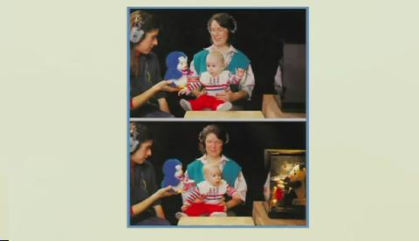
Babies perception of speech sounds

Slide 11
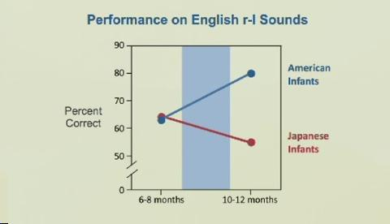
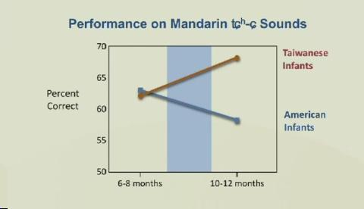

Slide 12

Kuhl et al (2003)

Slide 13
Children raised without exposure to language
‘Genie’ - was deprived of social interaction from birth until discovered aged thirteen She was completely without language, and after seven years of rehabilitation still lacked linguistic competence.
Another case is ‘Isabelle’, who was incarcerated with her deaf-mute mother until the age of 6½ years. She also had no language skills, but, unlike Genie, quickly acquired normal language abilities through systematic specialist training.

Slide 14
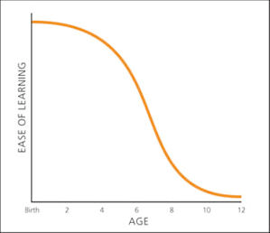
Critical Period in Language Acquisition

Slide 15
Learning Foreign Languages
Percentage
correct on
grammar
test
100
New language learning gets harder with age
90
80
70
60
50
Native
3-7
8-10
11-15
17-39
Age at school

Slide 16
Language Development
Genes design the mechanisms for a language, and experience activates them as it modifies the brain
Environment:
spoken language
heard
provides
input to
Brain:
mechanisms for
understanding and
producing language
Behavior:
mastery of
native
language
design
Genes

Slide 17
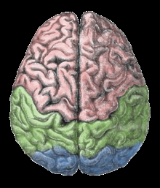
Brain structures underlying language
Hemispheric specialization
for language.
95% of right-handed people
have left-hemisphere dominance for language, 18.8% of left-handed people have right-hemisphere dominance for language function. Additionally, 19.8% of the left-handed have bilateral language functions.

Slide 18
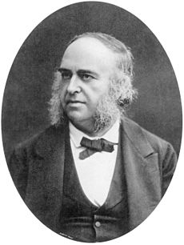
Paul Broca (1824-1880)
Broca was consulted about a 51-year-old patient by the name
of Leborgne with multiple neurological problems, who had
been without any productive speech for many years.
Every time Leborgne attempted to utter a phrase or respond to a question, he could only produce a single repetitive syllable, ‘tan’. Leborgne died of his ailments several days later and, at autopsy, a lesion was found on the surface of the left frontal lobe as Broca had suspected.

Slide 19
Broca’s Aphasia
http://www.youtube.com/watch?v=f2IiMEbMnPM
Characterisitcs - Nonfluent speech, impaired repetition, intact comprehension

Slide 20
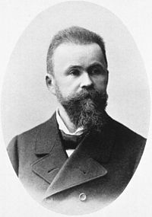
Karl Wernicke (1848-1905)
Wernicke’s Aphasia
Problems in comprehending speech
– input or reception of language
Fluent meaningless speech
Paraphasias – errors in producing specific words
Semantic paraphasias – substituting words similar in meaning (“barn” – “house”)
Phonemic paraphasias – substituting words similar in sound (“house” – “mouse”)
Neologisms – non words (“galump”)
Poor repetition
Impairment in writing

Slide 21
Wernicke’s Aphasia
http://www.youtube.com/watch?v=aVhYN7NTIKU

Slide 22
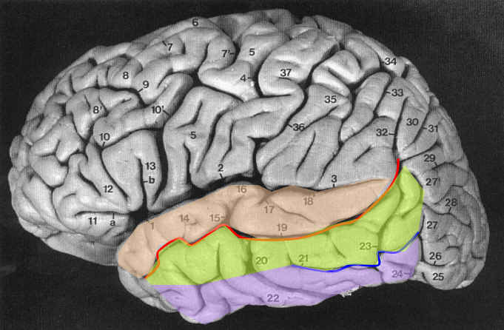
Wernicke’s area
Posterior superior temporal gyrus

Slide 23
Arcuate fasciculus

Slide 24
Wernicke-Geschwind model of language
Sounds are first processed by the auditory cortex, which then passes its input to
Wernicke's area, where the sounds are decoded and comprehended. (A similar process occurs for written words, except that in this case information flows from the visual cortex to the angular gyrus before passing to Wernicke's area.
Then, if a response is necessary, Wernicke's area further translates thought processes into verbal responses, which are transmitted to Broca's area via the left arcuate fasciculus.
In Broca's area are the necessary neurons for articulation and complex muscle co-ordination, so that the appropriate spoken language reply can be voiced.

Slide 25
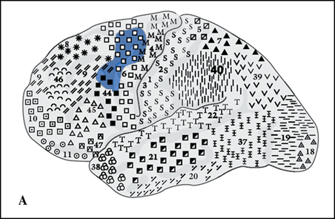
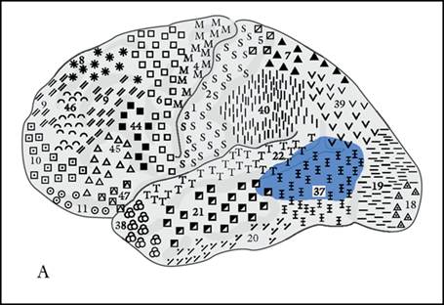
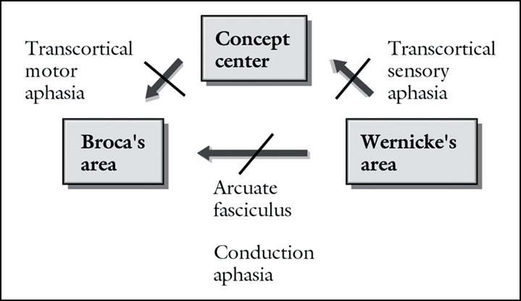
Repetition preserved, speech is fluent but comprehension is impaired
Comprehension and repetition
Both preserved, however, speech
is nonfluent
Comprehension and production intact.
Difficulty in repeating what was just heard

Slide 26
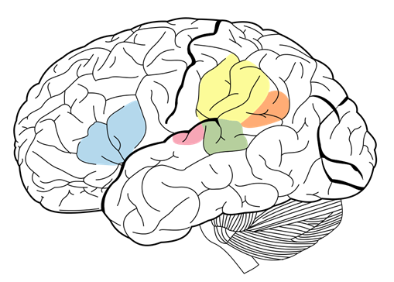
Language cirucuit

Slide 27
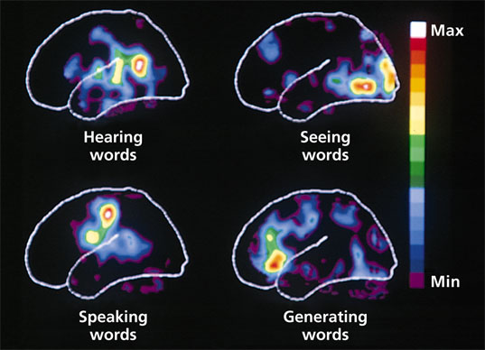
Functional brain imaging of language processing

Slide 28
Summary of Aphasias
Type of Aphasia | Spontaneous speech | Paraphasias | Comprehension | Repetition | Naming
Broca’s | Nonfluent | - | Good | Poor | Poor
Global | Nonfluent | - | Poor | Poor | Poor
Transcortical motor | Nonfluent | - | Good | Good | Poor
Wernicke’s Aphasia | Fluent | + | Poor | Poor | Poor
Transcortical sensory | Fluent | + | Poor | Good | Poor
Conduction | Fluent | + | Good | Poor | Poor
See handbook for simplified version

Slide 29
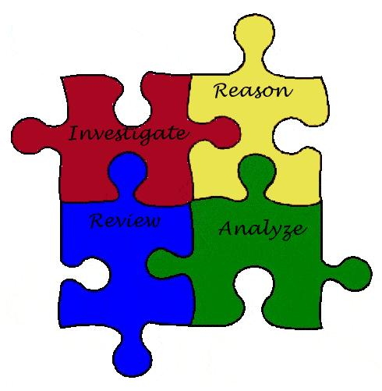
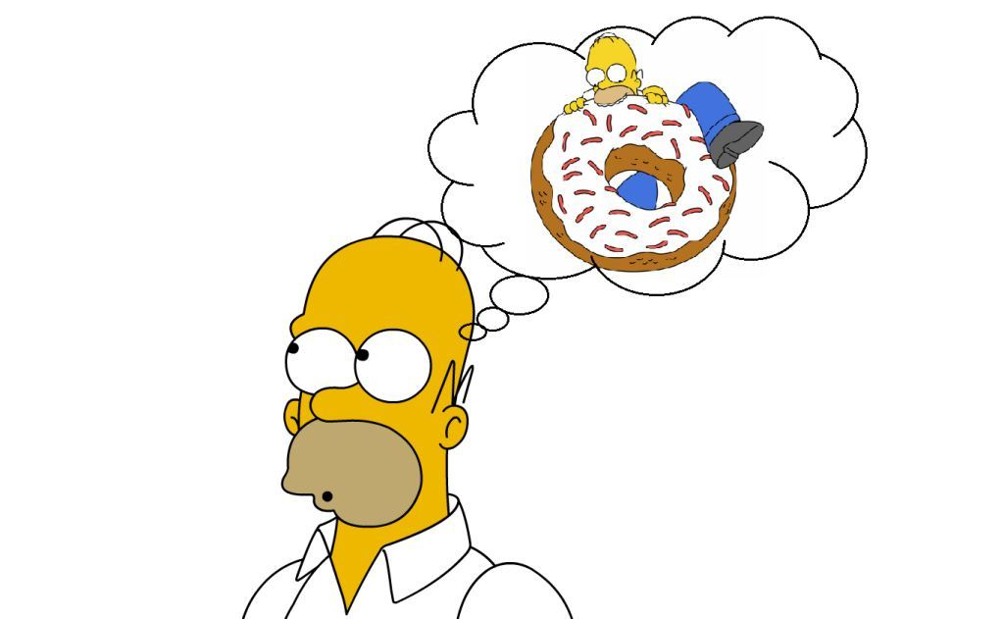
Thinking

Slide 30
Types of reasoning

Slide 31
Deductive and inductive reasoning
Deductive reasoning e.g.
If all mammals are warm-blooded, and
If a sloth is a mammel,
Then a sloth most be warm blooded.

Slide 32
Deductive and inductive reasoning
Inductive reasoning e.g.
Pavlov observed that his dogs began to salivate at the sound of a bell. He therefore, induced that pairing a neutral stimulus with a conditioned stimulus gives rise to a learned association (classical conditioning).

Slide 33
Stumbling blocks in reasoning
Your drawer contains 19 black socks and 13 blue socks.
Without turning on the light, how many socks would you need to pull out to be certain that you have a matching pair?
The answer is 3, the number of each different colour is irrelevant only the number of different colours (i.e. two)

Slide 34
Two systems of thinking
17 x 24

Slide 35
Two systems of thinking
System 1 (Hot)
Answer “2+2=”
Drive a car on an empty road
Detect hostility in a voice
Complete the phrase “Bread and ………”
System 2 (Cold)
Tell someone your phone number
Compare two washing machines for overall value
Complete a tax form

Slide 36
Two systems for thinking
(Metcalfe and Mischel 1999)
Hot system (System 1) | Cold system (System 2)
Emotional | Cognitive
“Go” | “Know”
Simple | Complex
Reflexive | Reflective
Fast | Slow
Develops early | Develops late
Accentuated by stress | Attenuated by stress
Stimulus control | Self control

Slide 37
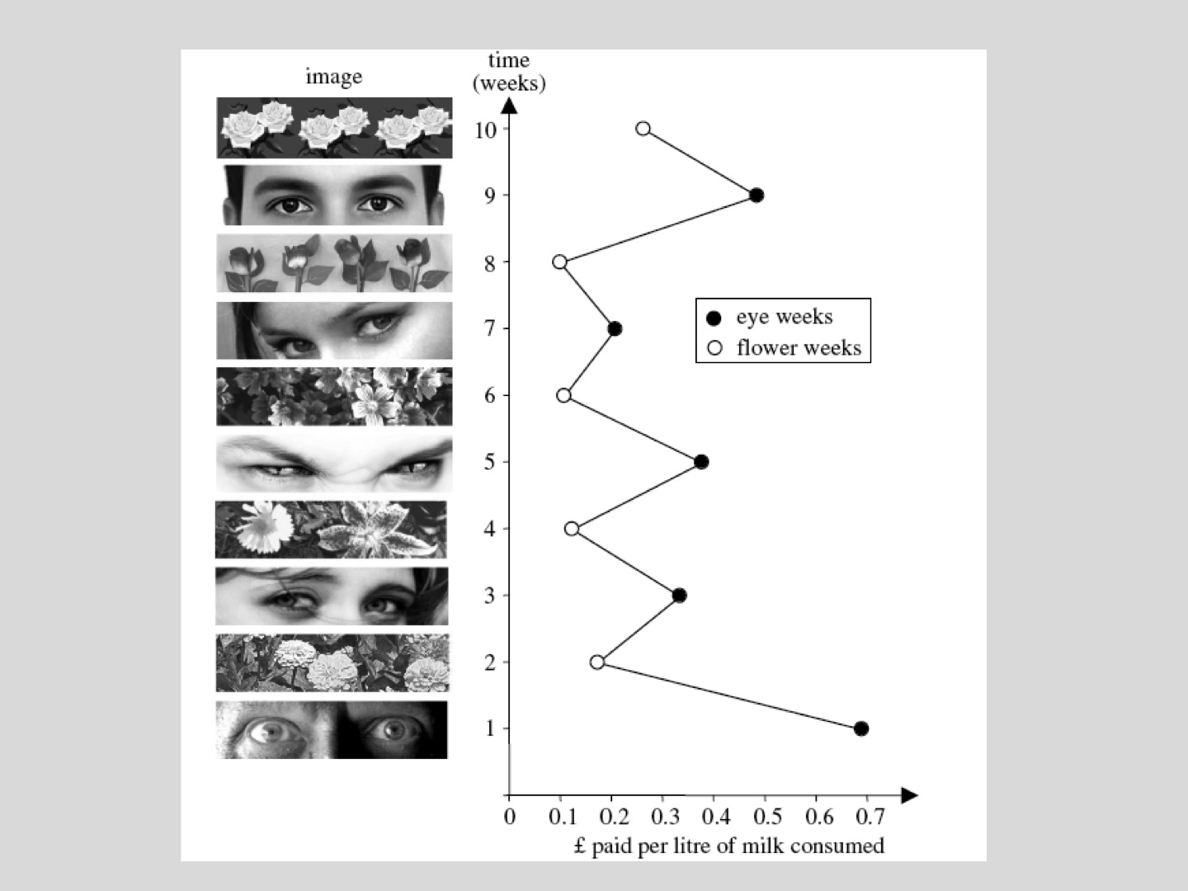

Slide 38
Heuristics
Heuristics are simple “rules of thumb” which are built on experience and are applied to simplify decision making in an ambiguous situation.
Representativeness heuristic
A heuristic used to estimate probability that a stimulus belongs to a particular class based on how ‘typical’ of that class it appears to be (regardless of base rate probability)
Availability Heuristic
A heuristic that leads people to base a judgment on the ease with which something can be brought to mind.

Slide 39
You are invited by a a fellow Imperial College Student to a party at which there are about 30 medical students, 70 students studying other subjects at Imperial. You end up speaking to a guy named James who tells you that he has already had 8 bottles of beer before getting to the party, he says he shouldn’t really be at the party because he has an exam the next day.
Rate the probability that James is a medical student

Slide 40
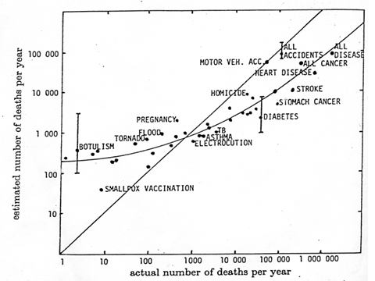
Availability heuristic
Tversky & Kahneman (1974) found that the probability of catastrophic events is frequently overestimated as they are more vivid and easily called to mind.

Slide 41
Executive Functions
Programming, regulation and verification of activity (Luria 1966)
Goal formulation, planning, and carrying out goal-directed plans effectively (Lezak 1983)
Problem-solving behaviour, trying out hypotheses and learning from failed attempts (Shallice 1988)
May be able to work along routine lines, but have difficulties in new situations (Baddeley and Wilson 1988)
The executive system processes novel situations outside the domain of some of our “automatic‟ psychological processes.

Slide 42
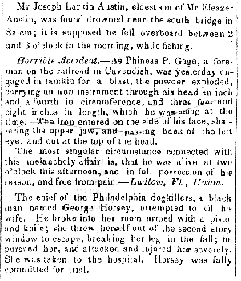
Boston Post
14th Sept 1848

Slide 43
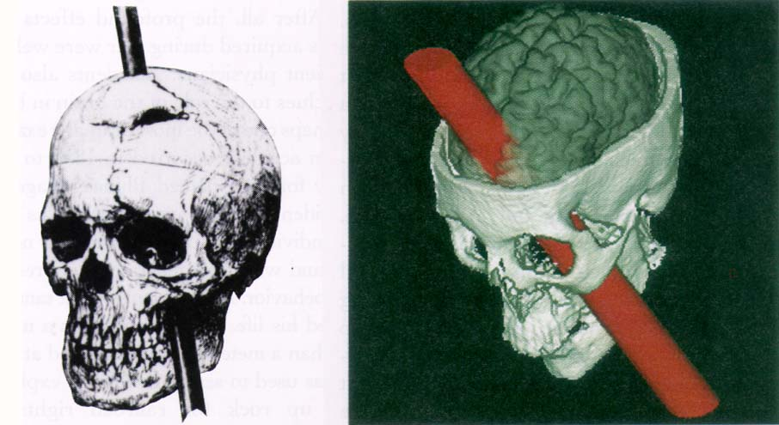

Slide 44
No longer “Gage”

Slide 45
Common characteristics of the dysexecutive syndrome
Impulsivity
Disinhibition
Emotional Bluntness
Attentional problems
Perseveration
Inability to plan
Copes with written and structure but not unstructured tasks
Difficulty grasping complex or abstract ideas

