Slide 1
Neuroscience and Mental Health Year 2

Slide 2
Neuroscience and Mental Health Development of the nervous system Dr MB Lowrie

Slide 3
Why Development?
Helps to understand mature CNS
Some neurological disorders have a developmental origin
Some mechanisms may be useful in treatment

Slide 4
Outline
Early development
Cellular aspects
Development of spinal cord
Development of brain
Development of brainstem
Development of cortex

Slide 5
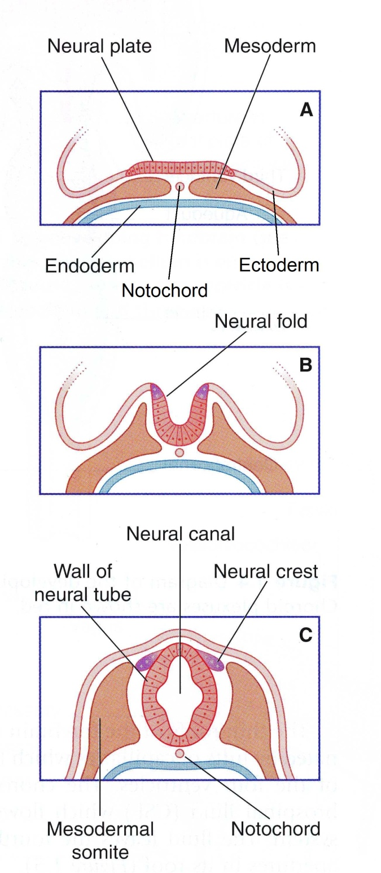
Early development of nervous system
(approx 3 wk)

Slide 6
Wall of neural tube CNS
[ = neuroepithelium]
Neural crest cells PNS

Slide 7
Differentiation of neuroepithelium
Neuroblasts
→ all neurones with cell bodies in the CNS
Glioblasts
→ astrocytes, oligodendrocytes
Ependymal cells
lining ventricles and central canal

Slide 8
Differentiation of neural crest cells
Sensory neurones of dorsal root ganglia and cranial ganglia
Postganglionic autonomic neurones
Schwann cells
Non-neuronal derivatives e.g. melanocytes

Slide 9
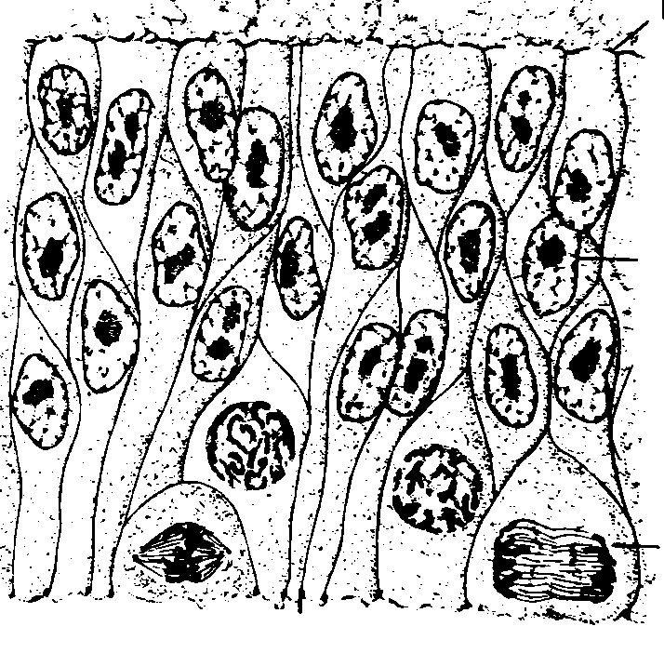
Proliferation of neuroepithelium
Cross-section through wall of neural tube
outside
inside

Slide 10
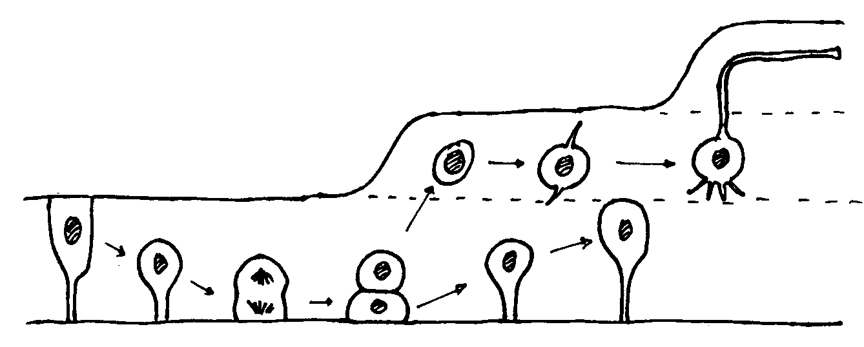
Differentiation of neuroepithelium
Neuroblasts
Outside
Inside

Slide 11
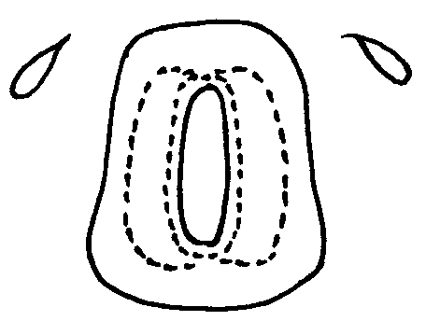
Layers of the neural tube
Roof plate
Neural crest
dorsal
Ependymal layer
(germinal layer)
Grey matter
(mantle layer)
ventral
Floor plate
White matter
(marginal layer)

Slide 12
Signalling molecules control differentiation :
Concentration gradient
Timing
Cell migration & axonal growth guided by attraction or repulsion

Slide 13
Early development
Cellular aspects
Development of spinal cord
Development of brain
Development of brainstem
Development of cortex

Slide 14
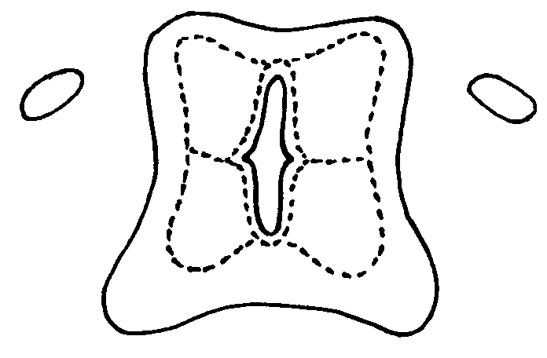
The developing spinal cord
Neurons here are interneurons
(alar plate)
dorsal
Neural crest cells form sensory neurons in dorsal root ganglion
Neurons here are motoneurons and interneurons
(basal plate)
ventral

Slide 15
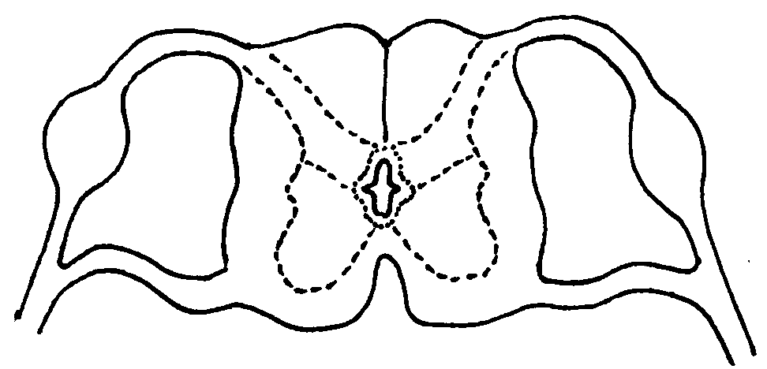
Mature spinal cord
Dorsal horn
Dorsal root
Dorsal root ganglion
White matter
Ventral root
Ventral horn
Central canal
Notes:
15

Slide 16
Early development
Cellular aspects
Development of spinal cord
Development of brain
Development of brainstem
Development of cortex

Slide 17
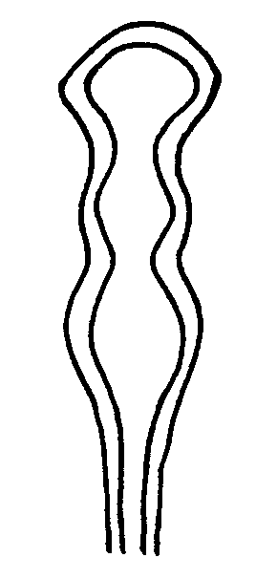
Brain: 3 primary vesicles
Dorsal view of embryo
Future forebrain
(prosencephalon)
Future midbrain
(mesencephalon)
Future hindbrain
(rhombencephalon)
Future spinal cord
(approx 4 wk)

Slide 18
Brain: 5 secondary vesicles
telencephalon
Fore
diencephalon
Mid
pons
Hind
medulla
(approx 5 wk)

Slide 19
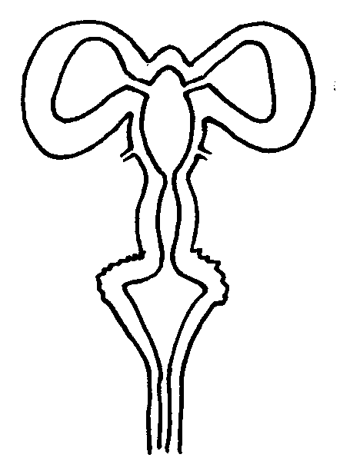
Development of brain regions
Developing
hemisphere
LV
LV
Fore
III
aqueduct
Mid
Developing
cerebellum
IV
Hind
(approx 8 wk)

Slide 20
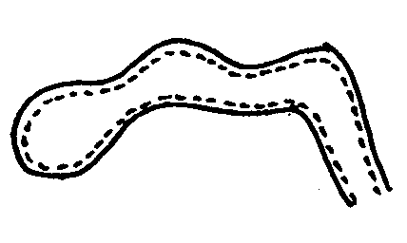
Folding
(4 wk)
Cephalic flexure
Pontine flexure
Cervical flexure

Slide 21
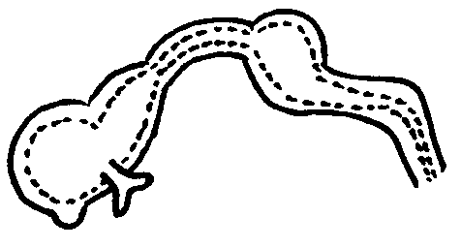
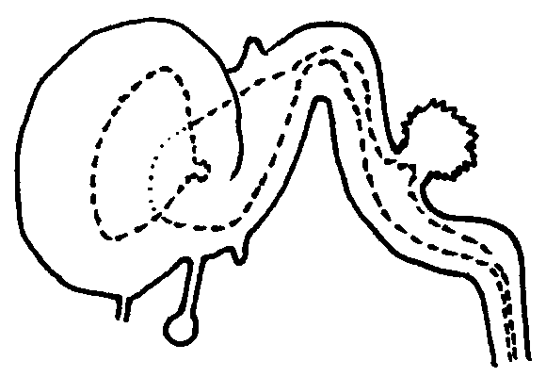
(4 wk)
(5 wk)
(8 wk)

Slide 22
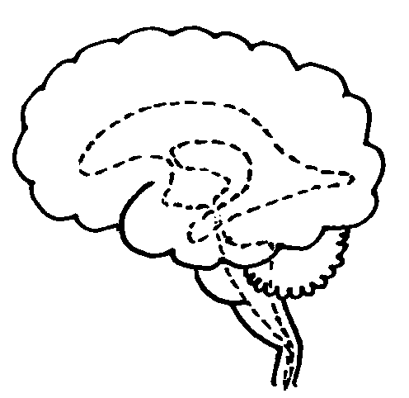
(term)

Slide 23
Early development
Cellular aspects
Development of spinal cord
Development of brain
Development of brainstem
Development of cortex

Slide 24
The developing spinal cord
Neurons here are interneurons
(alar plate)
Roof plate
dorsal
Neural crest cells form sensory neurons in dorsal root ganglion
Neurons here are motoneurons and interneurons
(basal plate)
ventral

Slide 25
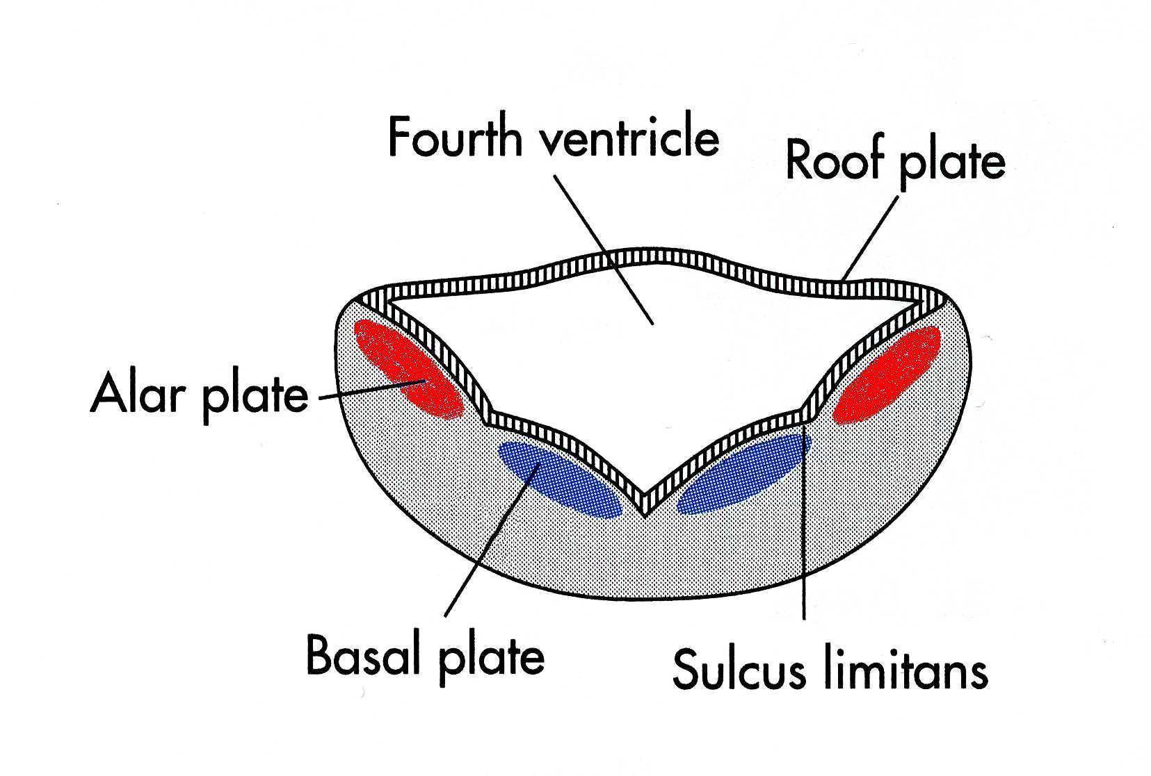
Brainstem
Diagrammatic cross-section

Slide 26
Early development
Cellular aspects
Development of spinal cord
Development of brain
Development of brainstem
Development of cortex

Slide 27
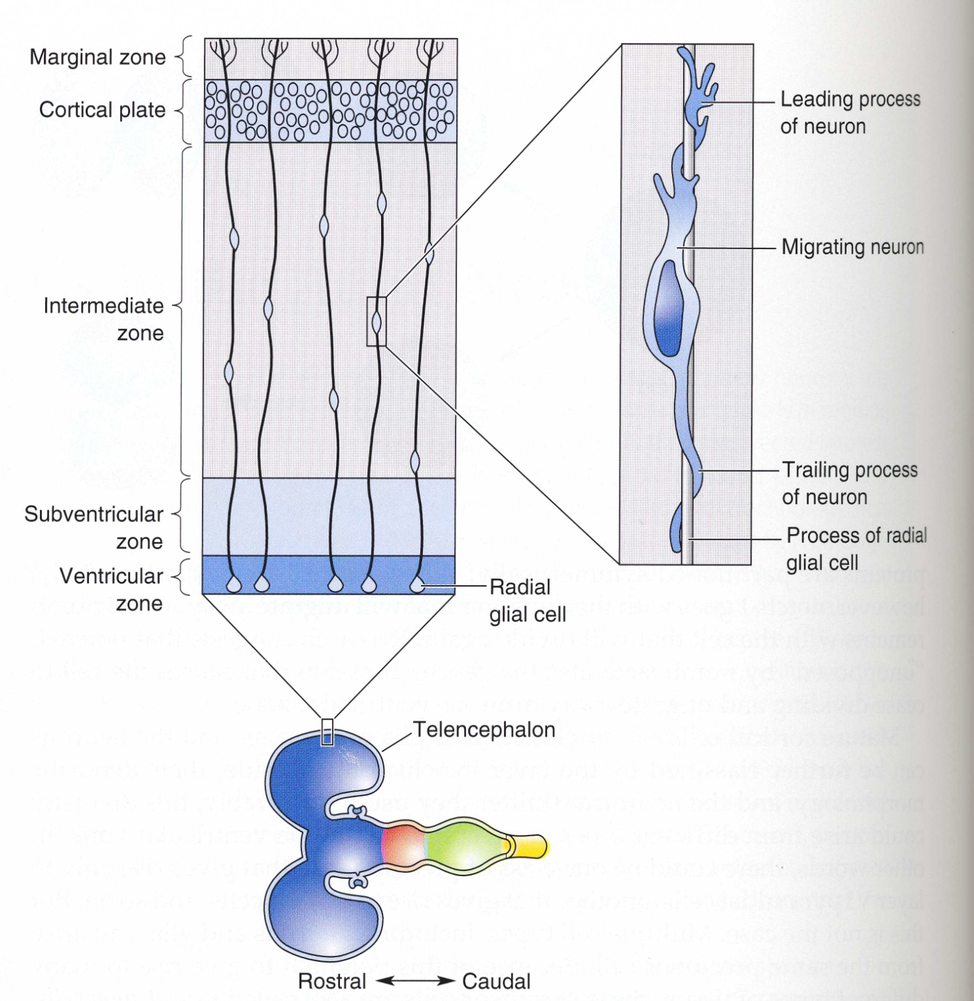
Cerebral cortex formation

Slide 28
Developmental disorders of the NS
Neural development involves several complex, timed processes
May be disrupted by genetic or environmental abnormalities
Occurs early in gestation

Slide 29
Regulation of stem cell differentiation – replace lost neurons?
Guidance mechanisms for axons
– induce CNS regeneration?

